Slide 1
Leading
Lecture 8

Slide 2
Agenda for today
Leadership defined
Early leadership theories
  Trait theories
  Behavioral theories
Contingency theories
  Fiedler model
  Situational leadership
  Path-goal theory
Contemporary views of leadership
Leadership issues
  Managing power
  Developing trust
  Empowering employees

Slide 3
Where are we?

Slide 4
Leaders and Leadership
Leader = someone who can influence others and who has managerial authority
Leadership = what leaders do; the process of influencing a group to achieve goals
Ideally, all managers should be leaders
Although groups may have informal leaders who emerge, those are not the leaders we’re studying
Leadership research has tried to answer: What is an effective leader?

Slide 5
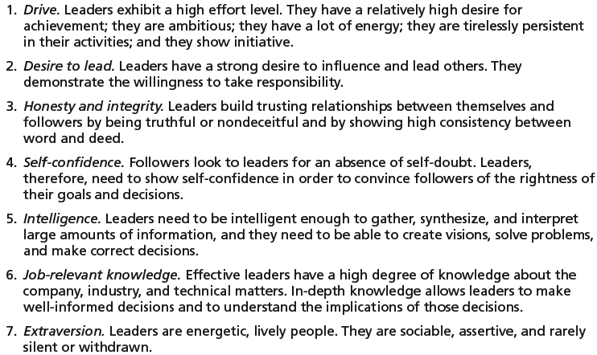
Early Leadership Theories (1/3)
Trait Theories (1920s-30s)
  Research focused on identifying personal characteristics that differentiated leaders from non-leaders was unsuccessful.
Later research on the leadership process identified seven traits associated with successful leadership:

Slide 6
Early Leadership Theories (2/3)
Behavioral Theories
  University of Iowa Studies (Kurt Lewin)
    Identified 3 leadership styles:
      Autocratic style: centralized authority, low participation
      Democratic style: involvement, high participation, feedback
      Laissez faire style: hands-off management
    Research findings: mixed results
      No specific style was consistently better for producing better performance
      Employees were more satisfied under a democratic leader than an autocratic leader.
  Ohio State Studies
    Identified 2 dimensions of leader behavior
      Initiating structure: the role of the leader in defining his or her role and the roles of group members
      Consideration: the leader’s mutual trust and respect for group members’ ideas and feelings.
    Research findings: mixed results
      High-high leaders generally, but not always, achieved high group task performance and satisfaction.
      Evidence indicated that situational factors appeared to strongly influence leadership effectiveness.
  University of Michigan Studies
    Identified 2 dimensions of leader behavior
      Employee oriented: emphasizing personal relationships
      Production oriented: emphasizing task accomplishment
    Research findings:
      Leaders who are employee oriented are strongly associated with high group productivity and high job satisfaction.

Slide 7
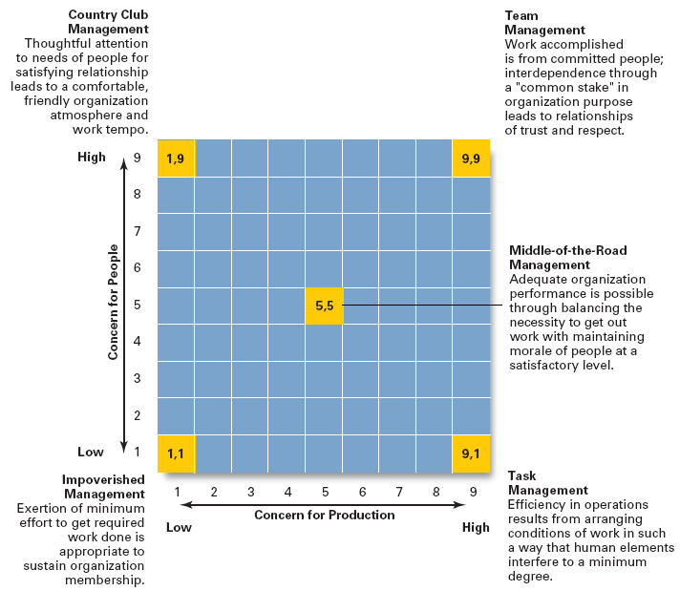
Early Leadership Theories (3/3)
Behavioral Theories
Managerial Grid
  Appraises leadership styles using two dimensions:
    Concern for people
    Concern for production
  Places managerial styles in five categories:
    1,1 Impoverished management
    9,1 Task management
    5,5 Middle-of-the-road management
    1,9 Country club management
    9,9 Team management

Slide 8
Contingency Theories of Leadership (1/4)
The Fiedler Model
  Proposes that effective group performance depends upon the proper match between the leader’s style of interacting with followers and the degree to which the situation allows the leader to control and influence.
  Assumptions:
    A certain leadership style should be most effective in different types of situations.
    Leaders do not readily change leadership styles => Matching the leader to the situation or changing the situation to make it favorable to the leader is required.
  Least-preferred co-worker (LPC) questionnaire
    Determines leadership style by measuring responses to 18 pairs of contrasting adjectives.
      High score: a relationship-oriented leadership style
      Low score: a task-oriented leadership style
  Situational factors in matching leader to the situation:
    Leader-member relations
    Task structure
    Position power

Slide 9
Contingency Theories of Leadership (2/4)
Situational Leadership Theory (SLT) - Hersey and Blanchard’s Model (1/2)
  Follower directed approach: without following, there is no leading…
  Argues that successful leadership is achieved by selecting the right leadership style which is contingent on the level of the followers’ readiness.
    Acceptance: leadership effectiveness depends on whether followers accept or reject a leader.
    Readiness: the extent to which followers have the ability and willingness to accomplish a specific task.
  Posits four stages follower readiness:
    R1: followers are unable and unwilling
    R2: followers are unable but willing
    R3: followers are able but unwilling
    R4: followers are able and willing
  Leaders must relinquish control over and contact with followers as they become more competent.
  Creates four specific leadership styles (incorporating Fiedler’s two leadership dimensions):
    Telling: high task-low relationship leadership
    Selling: high task-high relationship leadership
    Participating: low task-high relationship leadership
    Delegating: low task-low relationship leadership

Slide 10
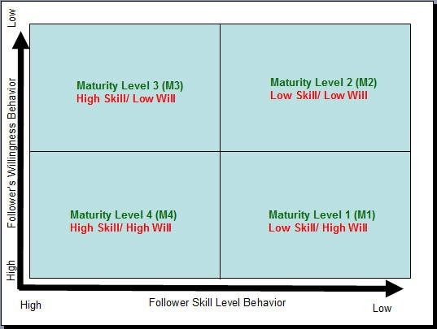
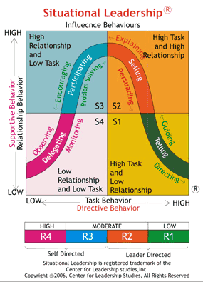
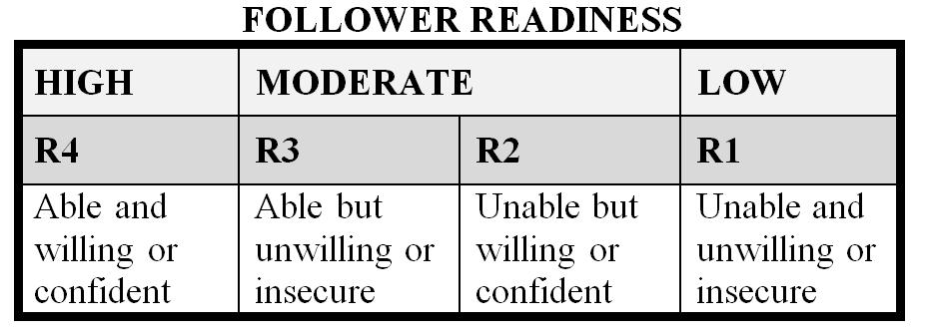
Contingency Theories of Leadership (3/4)
Situational Leadership Theory (SLT) - Hersey and Blanchard’s Model (2/2)

Slide 11
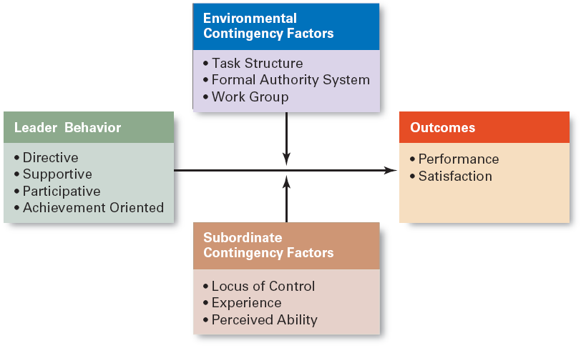
Contingency Theories of Leadership (4/4)
Path-Goal Model
  the leader’s job is to assist his/her followers in attaining their goals and to provide direction or support to ensure their goals are compatible with organizational goals.
  Leaders assume different leadership styles at different times depending on the situation:
    Directive leader
    Supportive leader
    Participative leader
    Achievement oriented leader

Slide 12
Contemporary Views on Leadership (1/2)
Transactional Leadership
Transformational Leadership
  Leaders who guide or motivate their followers in the direction of established goals by clarifying role and task requirements.
  Leaders who inspire followers to transcend their own self-interests for the good of the organization by clarifying role and task requirements.
  Leaders who also are capable of having a profound and extraordinary effect on their followers.

Slide 13
Contemporary Views on Leadership (2/2)
Charismatic Leadership
Visionary Leadership
  An enthusiastic, self-confident leader whose personality and actions influence people to behave in certain ways.
  Characteristics of charismatic leaders:
    Have a vision.
    Are able to articulate the vision.
    Are willing to take risks to achieve the vision.
    Are sensitive to the environment and follower needs.
    Exhibit behaviors that are out of the ordinary.
  A leader who creates and articulates a realistic, credible, and attractive vision of the future that improves upon the present situation.
Visionary leaders have ability to:
  Explain the vision to others.
  Express the vision not just verbally but through behavior.
  Extend or apply the vision to different leadership contexts.

Slide 14
Leadership Issues in the 21st Century (1/3)
Managing Power
  Legitimate power
    The power a leader has as a result of his or her position.
  Coercive power
    The power a leader has to punish or control.
  Reward power
    The power to give positive benefits or rewards.
  Expert power
    The influence a leader can exert as a result of his or her expertise, skills, or knowledge.
  Referent power
    The power of a leader that arise because of a person’s desirable resources or admired personal traits.

Slide 15
Leadership Issues in the 21st Century (2/3)
Developing Credibility and Trust
Credibility (of a Leader)
  The assessment of a leader’s honesty, competence, and ability to inspire by his or her followers.
Trust
  Is the belief of followers and others in the integrity, character, and ability of a leader.
    Dimensions of trust: integrity, competence, consistency, loyalty, and openness.
  Found to be related to increases in job performance, organizational citizenship behaviors, job satisfaction, and organization commitment.

Slide 16
Leadership Issues in the 21st Century (3/3)
Empowering Employees
Empowerment
  Involves increasing the decision-making discretion of workers such that teams can make key operating decisions in develop budgets, scheduling workloads, controlling inventories, and solving quality problems.
  Why empower employees?
    Quicker responses problems and faster decisions.
    Addresses the problem of increased spans of control in relieving managers to work on other problems.

Slide 17
Leadership Can Be Irrelevant!
Substitutes for Leadership
  Follower characteristics
    Experience, training, professional orientation, or the need for independence
  Job characteristics
    Routine, unambiguous, and satisfying jobs
  Organization characteristics
    Explicit formalized goals, rigid rules and procedures, or cohesive work groups

Slide 18
Terms to Know
leader
leadership
behavioral theories
autocratic style
democratic style
laissez-faire style
high-high leader
managerial grid
leader-member relations
task structure
position power
path-goal theory
transactional leaders
Fiedler contingency model
transformational leaders
charismatic leader
visionary leadership
legitimate power
coercive power
reward power
expert power
referent power
credibility
trust
empowerment
situational leadership theory readiness
leader participation model

