Slide 1
Motivating employees
Lecture 9

Slide 2
Agenda for today
Motivation defined
Early theories of motivation
  Maslow‘s hierarchy
  McGregor‘s theory X/Y
  Herzberg‘s 2-factor theory
  McClelland‘s 3 needs theory
Contemporary theories
  Goal setting theory
  Reinforcement theory
  Job design theory
  Equity theory
  Expectancy theory
Integrating theories of motivation
Current issues in motivation

Slide 3
Where are we?

Slide 4
What is motivation?
Motivation
  = willingness to exert high levels of effort to reach (organizatonal) goals, conditioned by the effort‘s ability to satisfy some (individual) need.
  Is the result of an interaction between the person and a situation => it is not a personal trait.
  Is the process by which a person’s efforts are energized, directed, and sustained towards attaining a goal.
    Intensity: a measure of intensity or drive.
    Direction: toward organizational goals
    Persistence: exerting effort to achieve goals.
  Motivation works best when individual needs are compatible with organizational goals.

Slide 5
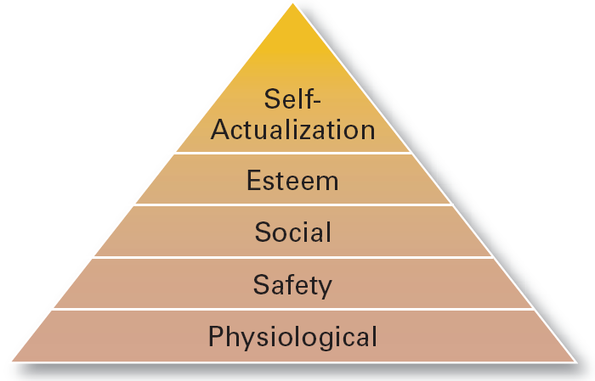
Early Theories of Motivation (1/3)
Maslow’s Hierarchy of Needs Theory
  Needs were categorized as five levels of lower- to higher-order needs.
    Lower-order (external): physiological, safety
    Higher-order (internal): social, esteem, self-actualization
  Individuals must satisfy lower-order needs before they can satisfy higher order needs.
  Satisfied needs will no longer motivate.
  Motivating a person depends on knowing at what level that person is on the hierarchy.

Slide 6
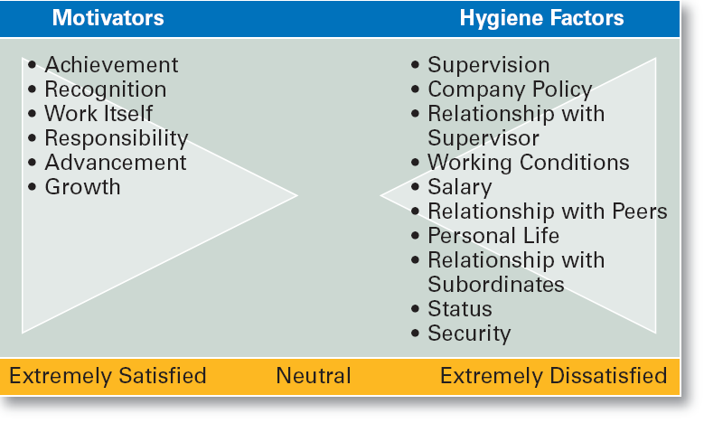
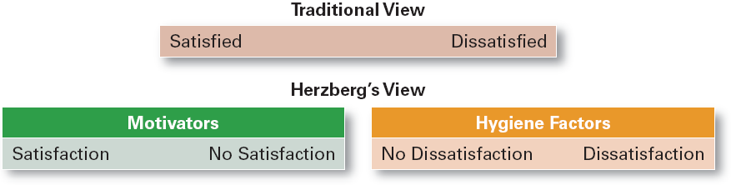
Early Theories of Motivation (2/3)
Herzberg’s Motivation-Hygiene Theory
  Job satisfaction and job dissatisfaction are created by different factors.
    Hygiene factors: extrinsic (environmental) factors that create job dissatisfaction.
    Motivators: intrinsic (psychological) factors that create job satisfaction.
  Attempted to explain why job satisfaction does not result in increased performance.
    The opposite of satisfaction is not dissatisfaction, but rather no satisfaction.

Slide 7
Early Theories of Motivation (3/3)
McGregor’s Theory X and Theory Y
  Theory X
    Assumes that workers have little ambition, dislike work, avoid responsibility, and require close supervision.
  Theory Y
    Assumes that workers can exercise self-direction, desire responsibility, and like to work.
  Assumption:
    Motivation is maximized by participative decision making, interesting jobs, and good group relations.

Slide 8
Contemporary theories (1/6)
Three-Needs Theory (McClelland)
  There are three major acquired needs that are major motives in work.
    Need for achievement (nAch) The drive to excel and succeed
    Need for power (nPow) The need to influence the behavior of others
    Need of affiliation (nAff) The desire for interpersonal relationships

Slide 9
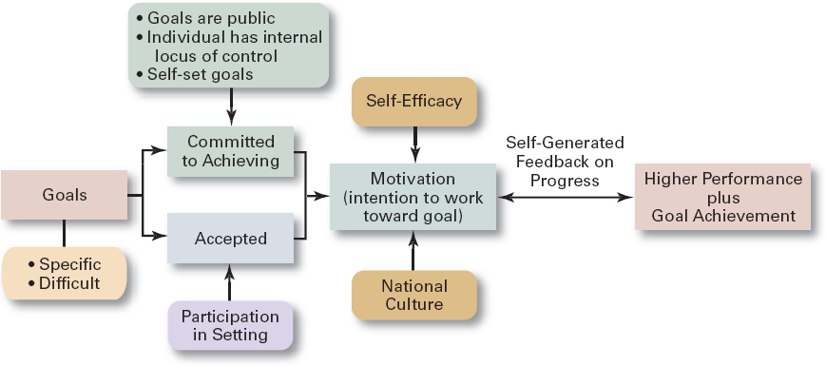
Contemporary theories (2/6)
Goal-Setting Theory
  Proposes that setting goals that are accepted, specific, and challenging yet achievable will result in higher performance than having no or easy goals. Is culture bound to the U.S. and Canada.
Benefits of Participation in Goal-Setting
  Increases the acceptance of goals.
  Fosters commitment to difficult, public goals.
  Provides for self-feedback (internal locus of control) that guides behavior and motivates performance (self-efficacy).

Slide 10
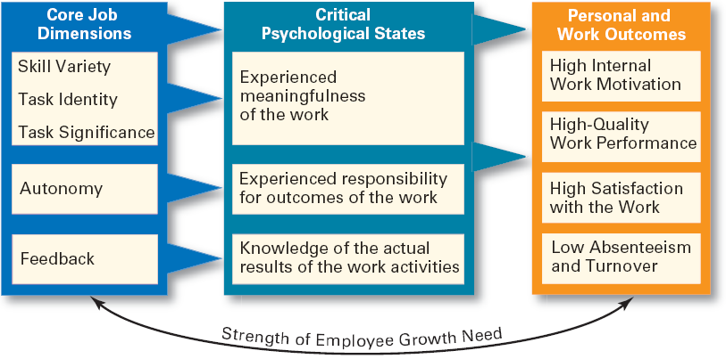
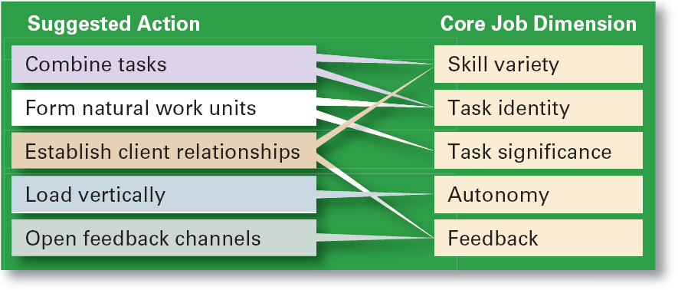
Contemporary theories (3/6)
Job Design Model
  Combine tasks (job enlargement) to create more meaningful work.
  Create natural work units to make employees’ work important and whole.
  Establish external and internal client relationships to provide feedback.
  Expand jobs vertically (job enrichment) by giving employees more autonomy.
  Open feedback channels to let employees know how well they are doing.
  The way into which tasks can be combined to form complete jobs.
  Factors influencing job design:
    Changing organizational environment/structure
    The organization’s technology
    Employees’ skill, abilities, and preferences
  Job enlargement
    Increasing the job’s scope (number and frequency of tasks)
  Job enrichment
    Increasing responsibility and autonomy (depth) in a job.

Slide 11
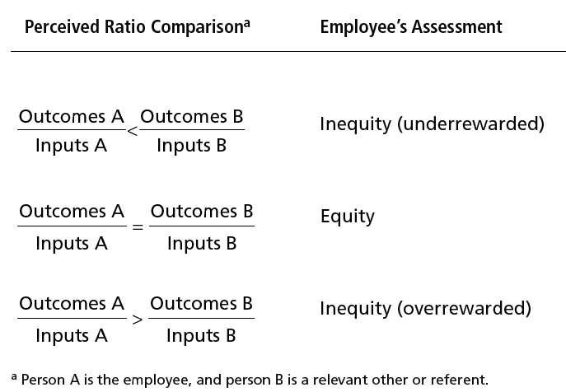
Contemporary theories (4/6)
Equity Theory
  Employees respond to perceived inequities:
    Distort own or others’ ratios.
    Induce others to change their own inputs or outcomes.
    Change own inputs (increase or decrease efforts) or outcomes (seek greater rewards).
    Choose a different comparison (referent) other (person, systems, or self).
    Quit their job.
  Employees are concerned with both the absolute and relative nature of organizational rewards.
  Distributive justice =the perceived fairness of the amount and allocation of rewards among individuals (i.e., who received what).
      Influences an employee’s satisfaction.
  Procedural justice = the perceived fairness of the process use to determine the distribution of rewards (i.e., how who received what).
      Affects an employee’s organizational commitment.
  Proposes that employees perceive what they get from a job situation (outcomes) in relation to what they put in (inputs) and then compare their inputs-outcomes ratio with the inputs-outcomes ratios of relevant others.
    If the ratios are perceived as equal then a state of equity (fairness) exists.
    If the ratios are perceived as unequal, inequity exists and the person feels under- or over-rewarded.
    When inequities occur, employees will attempt to do something to rebalance the ratios (seek justice).

Slide 12
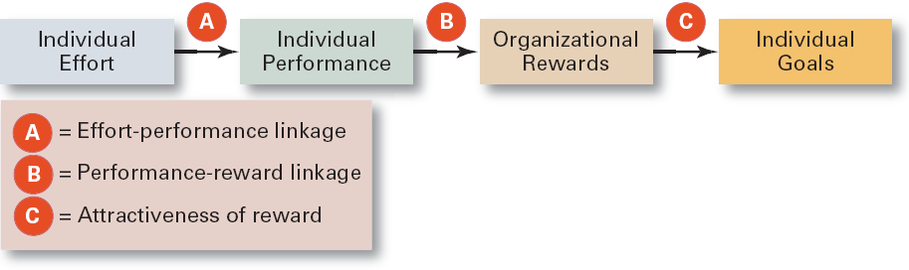
Contemporary theories (5/6)
Expectancy Theory (Vroom)
  States that an individual tends to act in a certain way based on the expectation that the act will be followed by a given outcome and on the attractiveness of that outcome to the individual.
  Key to the theory is understanding and managing employee goals and the linkages among and between effort, performance and rewards.
    Effort: employee abilities and training/development
    Performance: valid appraisal systems
    Rewards (goals): understanding employee needs
Expectancy Relationships
  Expectancy (effort-performance linkage)
    The perceived probability that an individual’s effort will result in a certain level of performance.
  Instrumentality
    The perception that a particular level of performance will result in the attaining a desired outcome (reward).
  Valence
    The attractiveness/importance of the performance reward (outcome) to the individual.

Slide 13
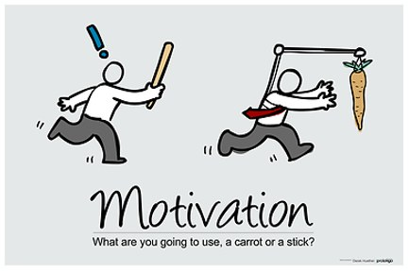
Contemporary theories (6/6)
Reinforcement Theory
  Assumes that a desired behavior is a function of its consequences, is externally caused, and if reinforced, is likely to be repeated.
  Positive reinforcement is preferred for its long-term effects on performance
  Ignoring undesired behavior is better than punishment which may create additional dysfunctional behaviors.

Slide 14
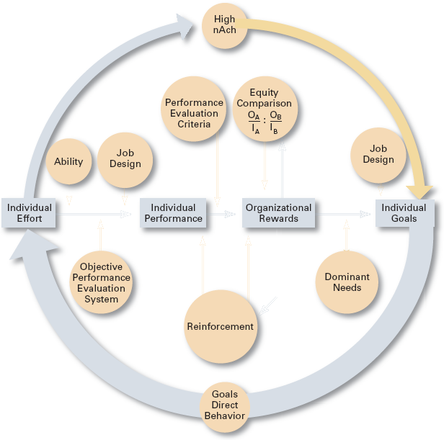
Integrating Contemporary Theories (of Motivation)
Many of the ideas are complementary…
….and the offer some practical advice!
Use goals
Ensure that goals are perceived as attainable
Individualize rewards
Link rewards to performance
Check the system for equity
Use recognition
Show care and concern for employees
Don’t ignore money

Slide 15
Current Issues in Motivation (1/3)
Cross-Cultural Challenges
Motivating through flexibility
  Motivational programs are most applicable in cultures where individualism and quality of life are cultural characteristics
    Uncertainty avoidance of some cultures inverts Maslow’s needs hierarchy.
    The need for achievement (nAch) is lacking in other cultures.
    Collectivist cultures view rewards as “entitlements” to be distributed based on individual needs, not individual performance.
  Cross-Cultural Consistencies
    Interesting work is widely desired, as is growth, achievement, and responsibility.
  Motivating a diverse workforce through flexibility:
    Men desire more autonomy than do women.
    Women desire learning opportunities, flexible work schedules, and good interpersonal relations.
Flexible Work/Job schedules
  Compressed work week
    Longer daily hours, but fewer days
  Flexible work hours (flextime)
    Specific weekly hours with varying arrival, departure, lunch and break times around certain core hours during which all employees must be present.
  Job Sharing
    Two or more people split a full-time job.
  Telecommuting
    Employees work from home using computer links.

Slide 16
Current Issues in Motivation (2/3)
Motivating unique groups of employees
Professionals
  Characteristics of professionals
    Strong and long-term commitment to their field of expertise.
    Loyalty is to their profession, not to the employer.
    Have the need to regularly update their knowledge.
    Don’t define their workweek as 8:00 am to 5:00 pm.
  Motivators for professionals
    Job challenge
    Organizational support of their work
Contingent Workers
  Opportunity to become a permanent employee
  Opportunity for training
  Equity in compensation and benefits
Low-Skilled, Minimum-Wage Employees
  Employee recognition programs
  Provision of sincere praise

Slide 17
Current Issues in Motivation (3/3)
Designing Appropriate Rewards Programs
  Open-book management
    Involving employees in workplace decision by opening up the financial statements of the employer.
  Employee recognition programs
    Giving personal attention and expressing interest, approval, and appreciation for a job well done.
  Pay-for-performance
    Variable compensation plans that reward employees on the basis of their performance: Piece rates, wage incentives, profit-sharing, and lump-sum bonuses
  Stock option programs
    Using financial instruments (in lieu of monetary compensation) that give employees the right to purchase shares of company stock at a set (option) price.
    Options have value if the stock price rises above the option price; they become worthless if the stock price falls below the option price.

Slide 18
Terms to Know
three-needs theory
need for achievement (nAch)
need for power (nPow)
need for affiliation (nAff)
goal-setting theory
self-efficacy
reinforcement theory
reinforcers
job design
job scope
job enlargement
procedural justice
expectancy theory
compressed workweek
motivation
hierarchy of needs theory
physiological needs
safety needs
social needs
esteem needs
self-actualization needs
Theory X
Theory Y
motivation-hygiene theory
hygiene factors
motivators
employee recognition programs
job enrichment
job depth
job characteristics model skill variety
task identity
task significance
autonomy
feedback
equity theory
referents
distributive justice
flexible work hours (flextime)
job sharing

