Slide 1
PROJECT MANAGEMENT
Seminar 2

Slide 2
Agenda
Why a lecture on Project management?
Project – definition
Project management
Process approach to a project
Initiation of a project
Planning of a project
Management and coordination of a project
Closure of a project

Slide 3
Agenda
Why (a lecture on) project management?
Project – definition
Project management
Process approach to a project
Initiation of a project
Planning of a project
Management and coordination of a project
Closure of a project

Slide 4
Why project management?
Changing nature of environment and its impact on management of companies;
Requirements on pretenders to managerial positions.

Slide 5
Ad 1) Changing nature of environment …
rapid development of new products;
frequent and rapid changes of processes;
individualization of products according to customer demand
=> All of these factors require a one-shot managed set of activities.

Slide 6
Ad 2) Requirements on pretenders …

Slide 7
Why project management?
=> increasing importance of project management knowledge and skills for businesses and graduates

Slide 8
Agenda
Why (a lecture on) project management?
Project – definition
Project management
Process approach to a project
Initiation of a project
Planning of a project
Management and coordination of a project
Closure of a project

Slide 9
Project (definition)
A project is a temporary organisation that is created for the purpose of delivering one or more business products according to an agreed business case.’
short-term effort undertaken to create a unique objective (product / service).
  temporariness = start and completion dates are set.
  uniqueness
    goal
    technology
    people (=KSA)
    outer influence and risks
  => specific (one-shot) = every project is realized only once.

Slide 10
Why projects fail
Lack of project justification, no valid business case.
Insufficient attention to quality from the start and through development.
Poorly defined outcomes, confusion over what the project needs to achieve.
Lack of communication amongst stakeholders.
Poorly defined roles and responsibilities amongst project personnel.
Poor cost and time estimating.
Poor planning and resource coordination.
Insufficient measurables and lack of progress control.
Lack of quality control.

Slide 11
Agenda
Why (a lecture on) project management?
Project – definition
Project management
Process approach to a project
Initiation of a project
Planning of a project
Management and coordination of a project
Closure of a project

Slide 12
What is project management
Project Management is the planning, delegating, monitoring and controlling of all aspects of the project, and the motivation of those involved, to achieve the project objectives within the expected performance targets for time, cost, quality, scope, benefits, and risks.
Plan
Delegate
Monitor
Control

Slide 13
Distinctions of PM
What makes PM different from traditional management approaches?
  temporariness;
  uniqueness;
  use of resources allocated based on the project’s needs.

Slide 14
Advantages of PM
rigorous delegation of authority and responsibility;
use of resources allocated based on the project’s needs => flexibility;
creates environment for progress checks (to achieve the project’s goals);
system approach.

Slide 15
Disadvantages / risks of PM
specific demands of customers arise only during realization phase;
need for frequent org. changes;
need for planning and valuation ex-ante (before realization).

Slide 16
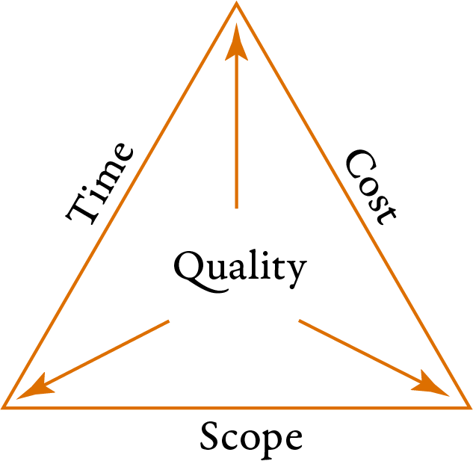
Three bases of PM
Project is a unique sequence of coordinated activities and tasks:
  with a specific goal (final value);
  with a time framework;
  with a framework for drawing on resources.

Slide 17
Problem of interdependence
individual bases are interdependent
specifics of the project define relative importance of every single level (base)
  => need to seek balanced solutions. It is more an optimization problem
  (x maximization of individual categories).

Slide 18
Agenda
Why (a lecture on) project management?
Project – definition
Project management
Process approach to a project
Initiation of a project
Planning of a project
Management and coordination of a project
Closure of a project

Slide 19
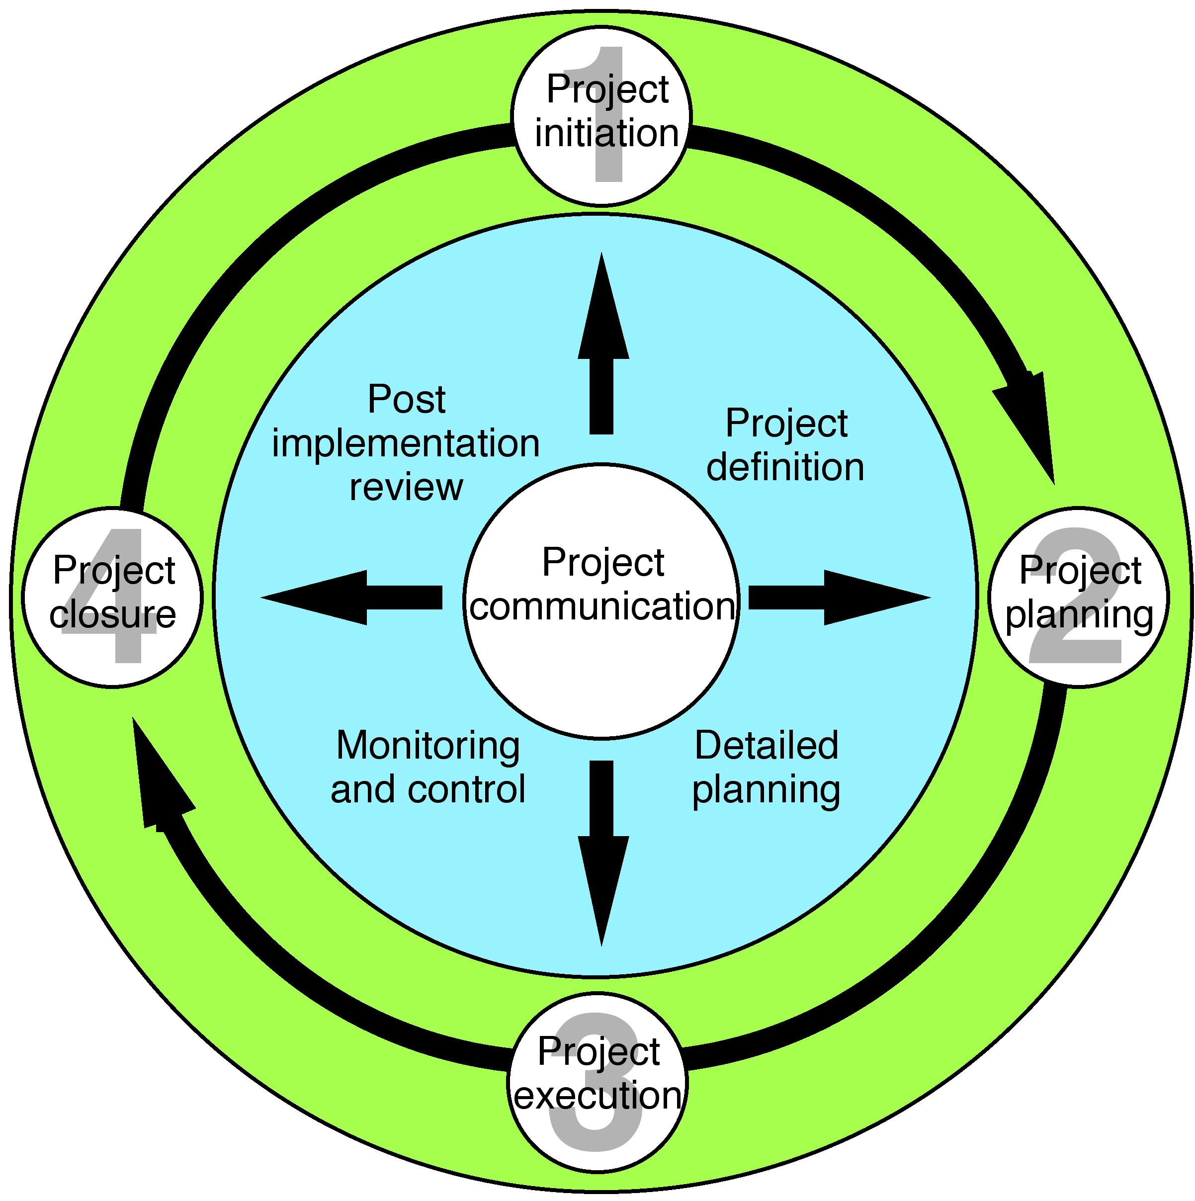
Lifecycle of a project
Sequence of phases
Initiation
Planning
Execution (coordination, monitoring and control)
Closing

Slide 20
Agenda
Why (a lecture on) project management?
Project – definition
Project management
Process approach to a project
Initiation of a project
Planning of a project
Management and coordination of a project
Closure of a project

Slide 21
Goals setting
Project goal = new final value resulting form the project.
S.M.A.R.T.
  Specific
  Measurable
  Assignable
  Realistic
  Time-bound =>critera for evaluation

Slide 22
(Outline) Business Case
Defintion
Composition
Defines the justification for undertaking a project based on estimated costs against the anticipated benefits to be gained and offset by any associated risks.
  Reasons for undertaking the project
  (Business) options = how to reach the goals. => analysis and reasoned recommendation for which one option to choose => project approach
    Do nothing
    Do the minimum
    Do something
  Expected benefits – desired outcomes (qualitative and quantitative) should be expressed in measurable terms.
  Expected dis-benefits – (potential) negative outcomes of project activities
  Timescale
  (Estimated) costs
  (Expected) major risks

Slide 23
Project Brief (= your first deliverable)
Definition
Composition
is used to provide full and firm foundation for the initiation of the project and is created during starting up a project.
Project definition – explains what the project needs to achieve. It covers the background, definition of project objectives, desired outcomes, project scope and exclusions, constraints and assumptions, and project tolerances.
Outline business case (see previous slide)
Project product description – explaining quality expectations and acceptance criteria.
Project management team structure – describing the role of those in the project management team.

Slide 24
Agenda
Why (a lecture on) project management?
Project – definition
Project management
Process approach to a project
Initiation of a project
Planning of a project
Management and coordination of a project
Closure of a project

Slide 25
What to plan for?
time
cost
quality
scope
benefits
risks

Slide 26
Work Breakdown Structure
is a hierarchical structure of tasks ensuring a successful accomplishment of the set project goal
it is important resource for managing all three bases of project management
  allocation of resources (who will do what?)
  time schedule (when?)
  budget (how much is it going to be?)

Slide 27
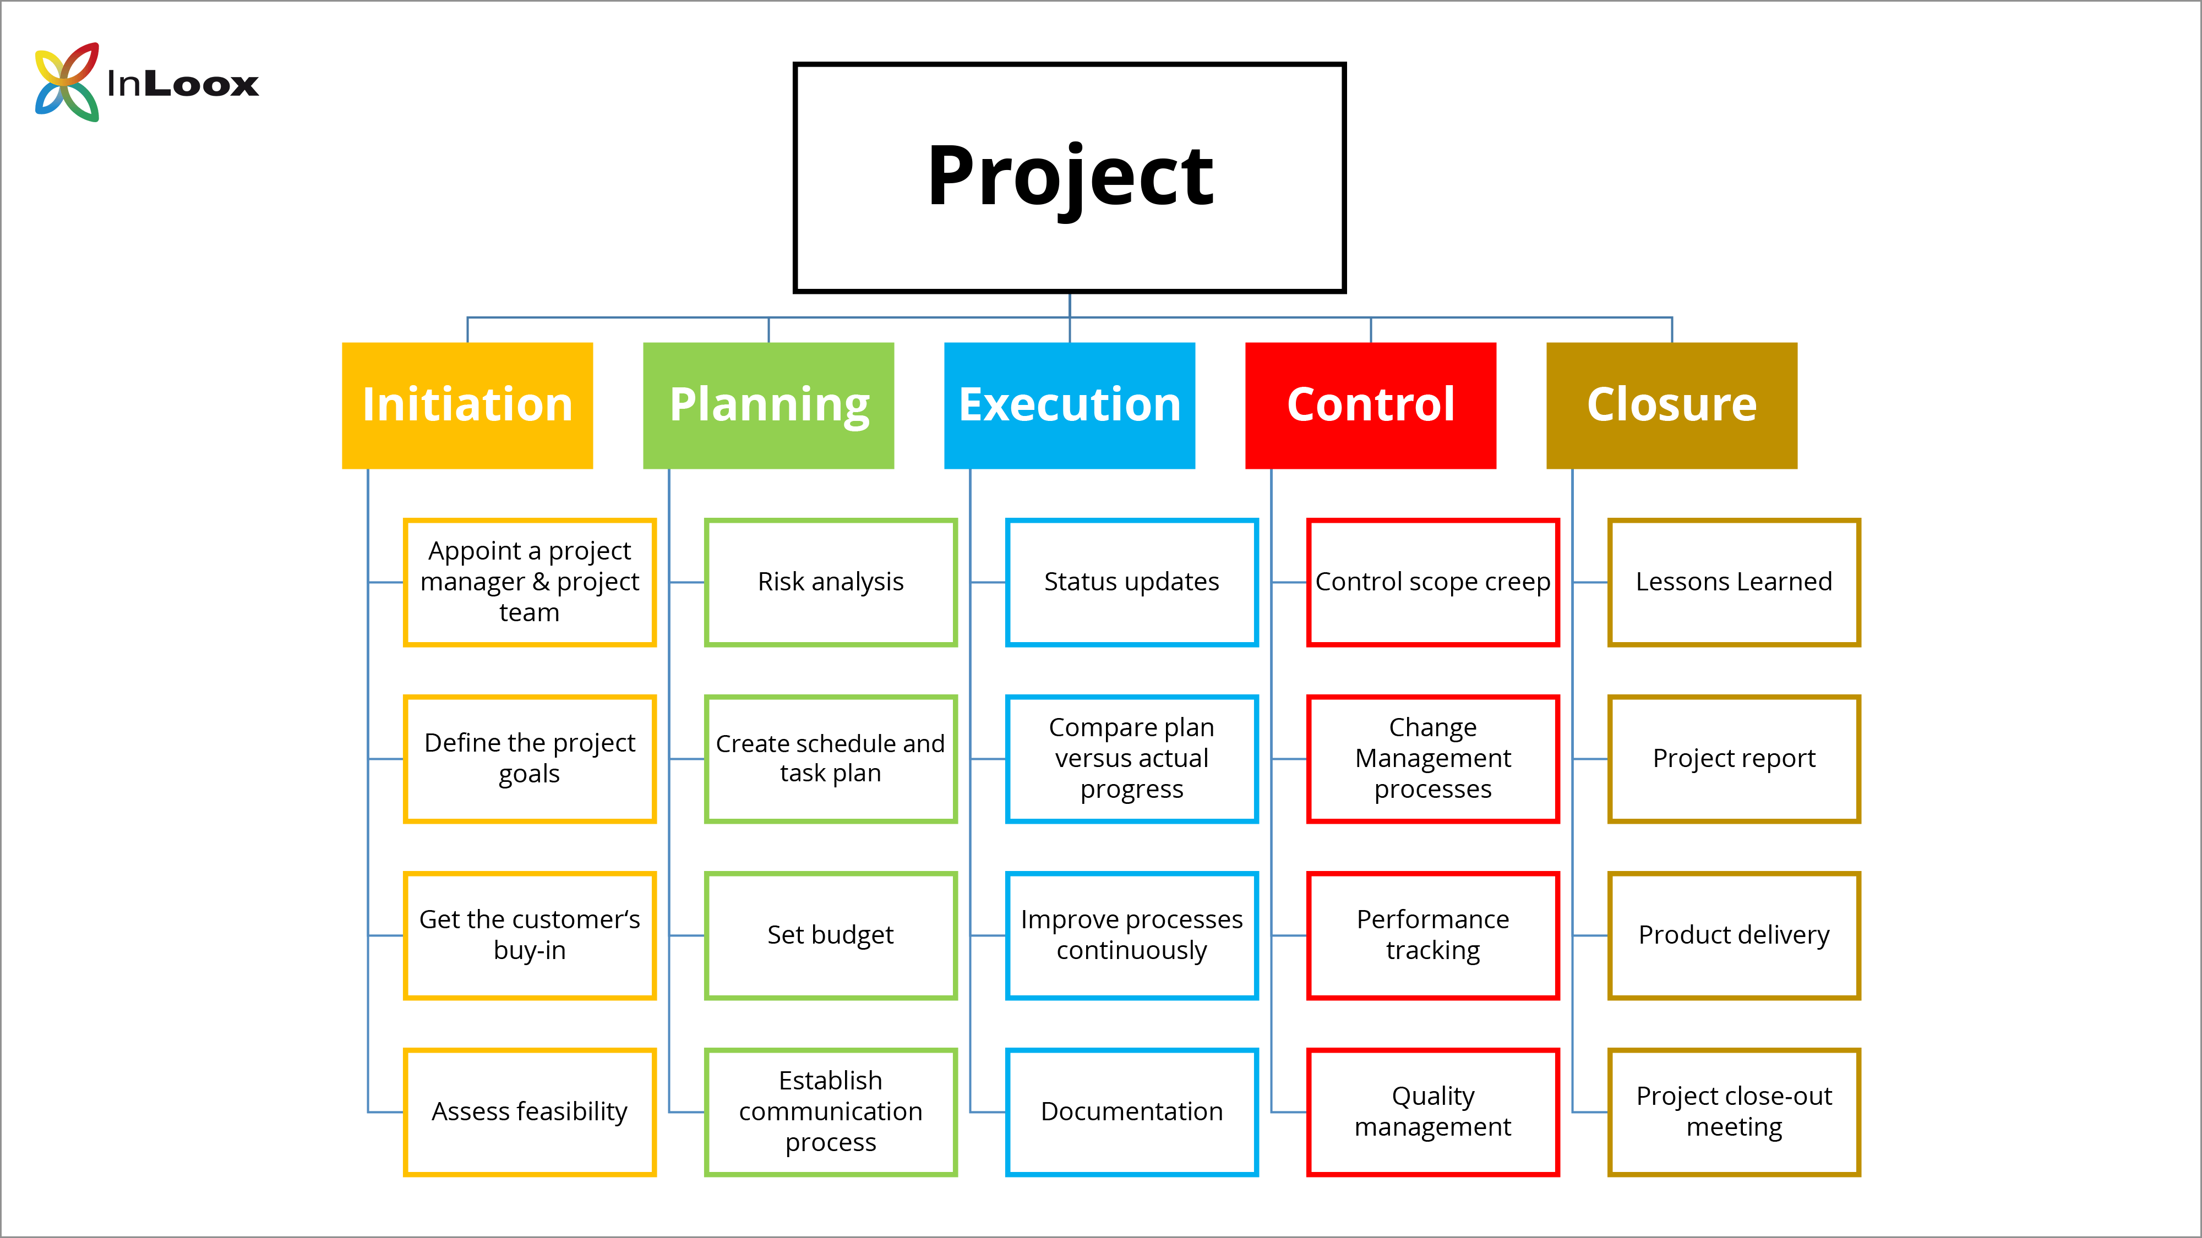
WBS – example 1

Slide 28
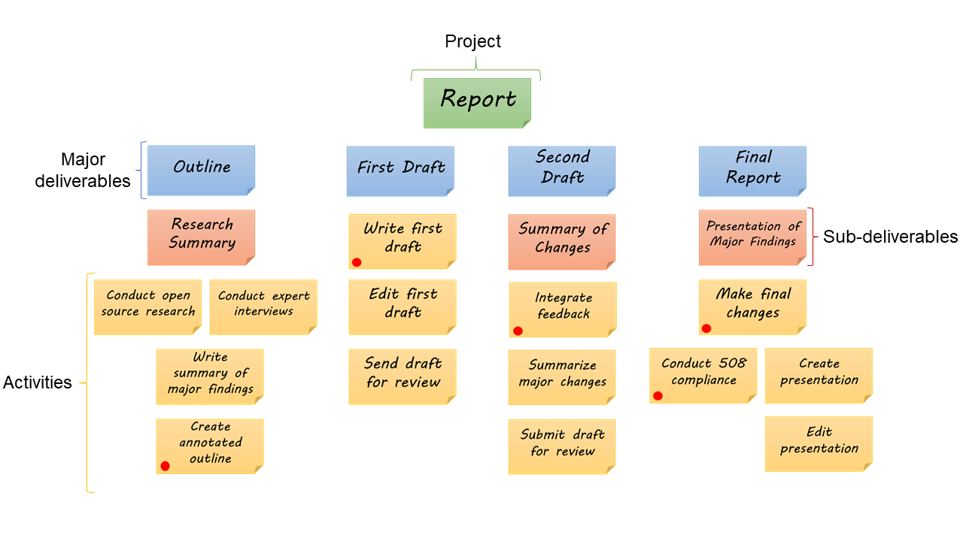
WBS – example 2

Slide 29
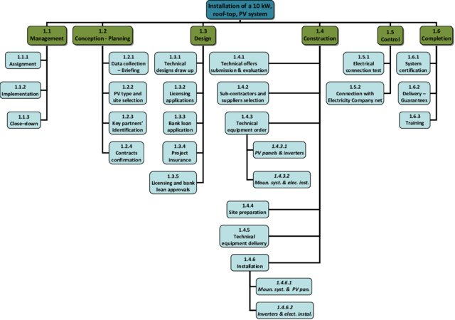
WBS – example 3

Slide 30
Time scheduling
defines sequence and deadlines of activities within a project.
tools:
  line segment charts (Gantt charts)
    + easy-to-create
    + easy-to-follow
    - inability to display the connections between activities
    - inability to show the completion rate as a percentage
  network diagrams
    C.P.M. – based on analysis of a critical path = longest sequence of activities without any float time (reserves).
    P.E.R.T. – duration set according to pessimistic, realistic and optimistic alternatives.
    G.E.R.T – improvement of PERT method
    + present interdependencies
    + allow for seeking alternative solutions
    + define critical path
    - complex
    - not that easy-to-follow

Slide 31
Budgeting
timed plan represented with monetary or working (labor) units:
  general x detailed
  timed according to presumed time of spending the resources
methods

Slide 32
Project Plan (= your final deliverable)
Definition
Structure
provides a statement of how and when objectives are to be achieved, by providing the major products, activities and resources required for the scope of the plan. It identifies the management stages and other major control points.
A plan should cover not just the activities to create products but also the activities to manage product creation.
planning assumptions;
products description;
tolerances – time, cost and scope tolerances;
budgets – time and cost budgets, including provisions for risk and changes;
schedule – incl. a Gannt chart and work breakdown structure;
monitoring and control details

Slide 33
Agenda
Why (a lecture on) project management?
Project – definition
Project management
Process approach to a project
Initiation of a project
Planning of a project
Management and coordination of a project
Closure of a project

Slide 34
Progress tracking
involves measuring actual progress against the performance targets of time, cost, quality, scope, benefits and risk.
Plans need to be fit for progress tracking
Progress tracking is a forward looking excercise
  Estimates „to comlete“
  Estimates „at completion“
Monitor progress.
Compare level of achievement with plan.
Review plans and options against future situations.
Detect problems and identify risks.
Initiate corrective action.
Authorize further work.

Slide 35
Agenda
Why (a lecture on) project management?
Project – definition
Project management
Process approach to a project
Initiation of a project
Planning of a project
Management and coordination of a project
Closure of a project

Slide 36
Project Closure
Verify user acceptance of the project’s products and ensure that the host site is able to support the products when the project is disbanded.
Review the performance of the project against its baselines.
Assess any benefits that have already been realized and update the benefits management approach to include any post-project benefit reviews.
Ensure that provision has been made to address all open issues and risks, with follow-on action recommendations.

