Slide 1
HOW TO BUILD A PRESENTATION
Seminar 10

Slide 2
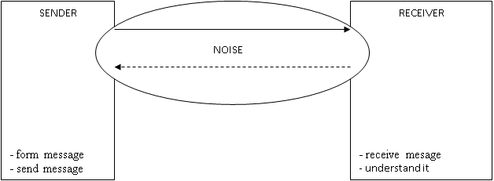
The objectives of communication
the aim is to get the information across in such a way that the receiver will accept it.

Slide 3
Getting the message across
GETTING THE MESSAGE ACROSS
ACTIVE LISTENNING
verbal= oral or written method of transmitting meaning through words;
nonverbal = any part of communication that does not use words.
Empathize
try to understand and be sensitive to the feelings, thoughts, and situation of others.
Repeat
rephrase the key points a couple of times; “tell them what you’re going to tell them → tell them → tell the what you’ve told them”.
Use timing
find a time when the receiver is less likely to be distracted by other matters.
Be descriptive
focus on the problem, rather than be personal (if you have negative information to convey).
4 types of listeners:
non-listener
marginal listener
evaluative listener – hears the words but doesn’t get the meaning;
active listener – hears and understands the message
Listen
listen to the content of the message; try to hear precisely what is being said.
Empathize
try to perceive the speaker’s feelings about what is being said through the way that the message is delivered.
Be interested
as any behavior, active listening requires motivation. Try to take the view that there is always something of value in a conversation and actively look for it.
Provide feedback
by rephrasing the speaker’s ideas; this demonstrates your interest and helps the speaker determine whether you understand the message.

Slide 4
Persuasive communication
Rapport = being attuned to other people verbally or nonverbally so that they are comfortable and have trust and confidence in you.
Pacing = establishing rapport by reflecting what others do, know or assume to be true (saying or doing something similar, matching some part of their ongoing experience).
Leading = getting other people to pace with you (attempting to influence them to consider other possibilities).
Having behavioral adaptability = having enough range in your own behavior to pace with the person or persons with whom you are interacting.

Slide 5
How to build your presentation
Start with the GOAL in mind - what are your objectives?
Identify your audience
Think about the structure
  Sequential argument
  Hierarchical decomposition
  Question orientated
  Pyramid
  „Meaty sandwich“
Create visual aids
Prepare for the (oral) delivery
  Getting your audience‘s attention
  Creating rapport

Slide 6
Possible presentation structure(s)
Sequential argument
Hierarchical decomposition
Question orientated
Pyramid
„Meaty sandwich“

