Slide 1
PUBLIC ECONOMICS economic functions of government
Gabriela Vaceková
gabriela.vacekova@econ.muni.cz

Slide 2
Headlines from your country: What happened around the world last week?

Slide 3
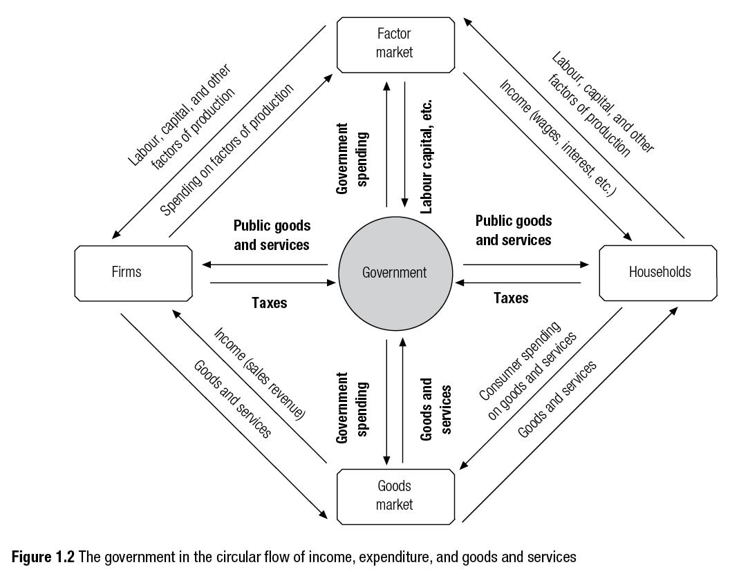
First week: Public Sector and the Economy

Slide 4
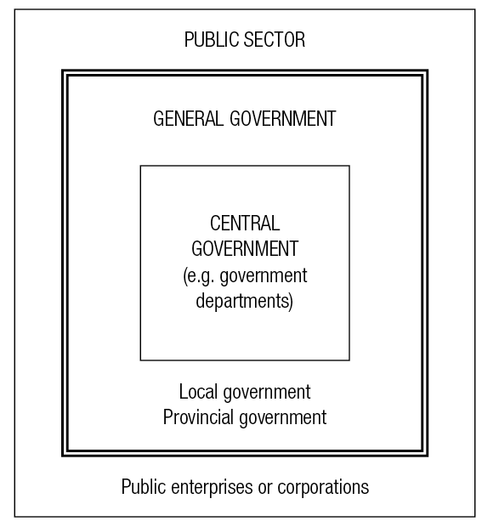
Today: Economic functions of government
Please suggest some economic activities of local, state, and national governments!
…
…
…

Slide 5
Types of government activities
PRODUCTION of goods and services
REGULATION and subsidization of private production
PURCHASE of goods and services
REDISTRIBUTION of income
Payments that transfer money from one to another – but not in return for the provision of goods and services – are called transfer payments

Slide 6
What government can and should do …
Can the Government Ru(i)n the Economy?

Slide 7
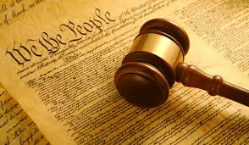
Government COULD do all sorts of things
For example, it could provide everyone with an MP3 player,
or provide everyone with an annual vacation at a theme park.
BUT: What problems might arise if the government expanded
its role along these lines?

Slide 8
Government regulation
Government imposes lots of rules in the economy
- workplace safety regulations, for example.
But some things still go unregulated.
Why not regulate in every problem area?
What would happen if the government decided that all new cars produced in the state must be yellow, since yellow cars are easier for other drivers to see?
What might be problematic about that?

Slide 9
Economic role of government
In order to ensure and support economic freedom as well as political freedom, there is envisioned a limited role for the government in economic affairs.
In a market economy such, most economic decisions are made by individual buyers and sellers, not by the government.

Slide 10
Economic role of government
Still, the government’s role in the economy is not trivial.
It includes, most economists believe, responsibility for six major functions.
The government (1) provides the legal and social framework within which the economy operates, (2) maintains competition in the marketplace, (3) provides public goods and services, (4) redistributes income, (5) corrects for externalities, and (6) takes certain actions to stabilize the economy.

Slide 11
Group activity: Economic functions of government
Explain each of the six economic functions of government.
What would happen if government did not perform this function?
Write examples on the copies of the activity.

Slide 12
Group activity: Classifying government actions
Explain that the 12 newspaper headlines are fictitious but realistic, each one referring to a government activity.
Please classify each headline by writing in the letter of the economic function that fits it best.
Check the answers and discuss the exercise.

Slide 13
Summary
What Are the Economic Functions of Government?

Slide 14
Assessment: Q1
Public goods and services are
A. all goods and services paid for by government.
B. goods and services provided by publicly held companies.
C. goods and services that would not be adequately provided by the market.
D. goods and services that are available to the public.

Slide 15
Assessment: Q2
Establishing and enforcing clearly defined property rights is an example of government
A. providing a social and legal framework.
B. maintaining competition.
C. providing public goods and services.
D. redistributing income.

Slide 16
Assessment: Q3
Smoke from a factory drops ash all over your car. Government’s economic function in this case is to
A. stabilize the economy.
B. maintain competition.
C. provide public goods and services.
D. correct a negative externality.

Slide 17
Thank you for your attention!

