Slide 1
Market Failures & Distributive justice
BPV_APEC Public Economics

Slide 2
Headlines from your country: What happened around the world last week?

Slide 3
Market efficiency
To recap
microeconomics‘ concepts:
The invisible hand of competitive markets
Price mechanism
Pareto efficiency
Individual´s welfare
Perfect competition
„If private markets are efficient, why should there be an economic role for government?“

Slide 4
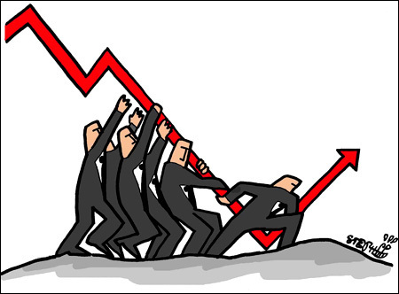
Market failures
Conditions under which markets are not Pareto efficient
Reasons for government interventions
CAUSES OF MARKET FAILURES:
Public goods
Failure of competition
Information asymmetry/failures
Externalities/Spillovers
Incomplete markets or Missing markets
Unemployment, inflation, disequilibrium
Property rights
Distribution of wealth
Public benefit

Slide 5
I. Public goods

Slide 6
Public goods
Goods that:
will not be supplied by market
if supplied, then in insufficient quantity
Example: national defense, navigational aids (light house)
Characteristics:
Non-rival consumption
it’s not desirable to exclude anyone from the benefits (MC of providing to an additional person = 0). Private provision → underconsumption or undersupply
Non-excludability
it’s not feasible to exclude anyone from the benefits of the good (cost of exclusion is too high) → free rider problem
Free-rider problem
Public goods x Publicly provided goods

Slide 7
II. Failure or lack of competition
Perfect competition
numerous sellers
sellers cannot influence prices
homogeneous product
no barriers to enter the market
theoretical concept
Imperfect markets
an economic structure, which does not fulfill the conditions of the perfect competition
Monopoly: Single seller dominates the entire market.
Duopoly: Two sellers share the whole market.
Oligopoly: Few sellers are there who either act in collusion or competition.
Monospony: Many sellers and a single buyer.
Oligospony: Many sellers and few buyers.
Monopolistic Competition: Numerous sellers offering unique products.

Slide 8
Perfect market equilibria

Slide 9
Monopoly
Types of the monopoly
Geographic monopoly
Natural monopoly
Technological monopoly
Government granted monopoly
Monopoly exists on the markets, where:
Exists only one company on the market
There are no substitutes of the goods
There are very high barriers to enter the market
Monopoly solutions
Supporting competition
Regulations
Public ownership
Simply doing nothing

Slide 10
Monopoly example
Rockefeller’s Standard Oil

Slide 11
Monopoly equilibria

Slide 12
Incomplete markets
some of the necessary conditions for market formation exist, but not all of them
firms may enter the market but only satisfy a small proportion of potential demand
total supply fails to meet needs of customers
examples:
Quasi-public goods
Partly-diminishable, and partly-rivalrous
Partly-excludable
Rejectable
Merit goods

Slide 13
Property rights
Many resources that are directly, or indirectly, used in an exchange have no specific or identifiable owner.
common property resources may exist because ownership has never been established. The government has legislated it, or there is no effective regulation in place, or feasible.
ocean fisheries, atmosphere (over consumption), unowned land and sheep
Solution: convert types of property, governmental regulations

Slide 14
Information failure
Imperfect information – situation when one party of the trade doesn´t have all information needed to make proper decision
Content of products, used car markets, medicine, housing market
Solution: government interventions, NGOs initiatives, regulations(labelling content) and certificates (of quality or education).
Moral hazard - if a party that is insulated from risk has more information about its actions than the party paying for the negative consequences of the risk.
Adverse selection - market process in which undesired results occur when the "bad" products or services are more likely to be selected.

Slide 15
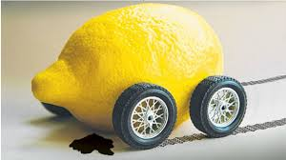
The Market for „Lemons“
market of second-hand cars (video)
There are good used cars („plumps") and defective used cars ("lemons")
Many important mechanical parts and other elements are hidden from view and not easily accessible for inspection, the buyer of a car does not know beforehand whether it is a peach or a lemon
Buyer will be willing to pay for it only the price of a car of known average quality (average price between lemon and peach).
This means that the owners of peaches will be unable to get a high enough price to make selling that car worthwhile.
Therefore, owners of plumps will not place their cars on the used car market. The withdrawal of peaches reduces the average quality of cars on the market, causing buyers to revise downward their expectations for any given car.
George Akerlof: The Market for Lemons: Quality Uncertainty and the Market Mechanism

Slide 16
Unemployment, inflation, disequilibrium
Widely recognized symptoms of market failure
Periodic episodes of high unemployment or high inflation
Periods of recessions and depressions
For most economists -> evidence that something is not working well.
Economic cycles (growth, recession of GDP)
Stabilization policy (solution and even possible cause)

Slide 17
Other reasons for government intervention

Slide 18
Distribution of wealth
not market failure per se
economy is Pareto efficient says nothing about the distribution of income or wealth
competitive markets may give rise to a very unequal distribution, may leave individuals with insufficient resources
solution: government redistribution of wealth
solution as part of problem – inefficiency of redistribution
Distributive justice
considers whether the distribution of goods among the members of society at a given time is subjectively acceptable.
should be based on:
Equity
Equality
Power
Need
Responsibility

Slide 19
Public benefit
Argument for government intervention
Even in Pareto efficient economy individuals may not act in their own best interest, even full informed consumers may make „bad“ decisions.
Examples: smokers, seat belts
Solution: regulations (seat belts), taxes (cigarettes)
Paternalism: government know best interest of individuals better than they do themselves
May be connected with externalities (smokers)

Slide 20
Interrelationships of market failures
Market failures are not mutually exclusive
Information problems – missing markets (inexistent supply)
Property rights- missing markets (market with fishing rights)
Public benefit – externalities (smoking)

