Slide 1
2. TRANSPORT DEMAND ELASTICITY

Slide 2
Readings for Lecture 2
Paulley, N., Balcombe, R., Mackett, R., Titheridge, H., Preston, J., Wardman, M., ... & White, P. (2006). The demand for public transport: The effects of fares, quality of service, income and car ownership. Transport Policy, 13(4), 295-306.

Slide 3
Learning Outcomes
The importance of an understanding of elasticity of demand
Three main types of elasticity of demand
The major determinants of price elasticity

Slide 4
2.1 Elasticities

Slide 5
Main demand factors

Slide 6
Elasticity
Elasticity of demand is the responsiveness of demand to a change in one of its determinants

Slide 7
Price elasticity
Percentage Change in Quantity Demanded
Percentage Change in Price
Price elasticity
of demand
=

Slide 8
Determinants of price elasticity
The number and closeness of alternative modes of travel (substitutes)
Proportion of disposable income spent on the mode of travel
Time dimension

Slide 9
Price elasticity of demand estimates of passenger transport

Slide 10
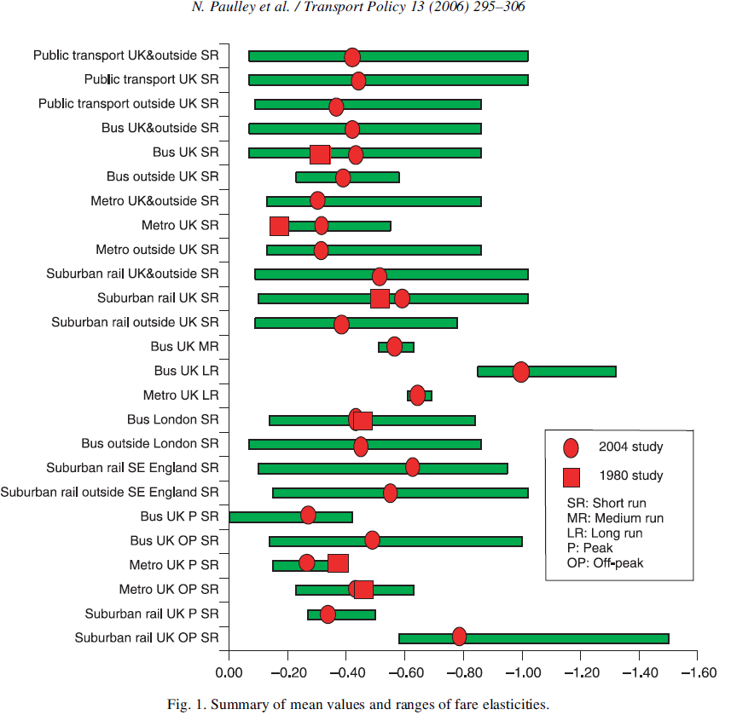
Price elasticities

Slide 11
Cross price elasticity
Cross price elasticity = Percentage change in quantity demanded of service A/Percentage change in price of service B

Slide 12
Cross price elasticities intercity passenger transport demand in Canada, mid range values, Oum and Gillen (1983)

Slide 13
Estimates of cross-elasticities of transport demand

Slide 14
Income elasticity
Income elasticity = Percentage change in quantity demanded/Percentage change in income

Slide 15
South East Britain income rail elasticities (2002)

Slide 16
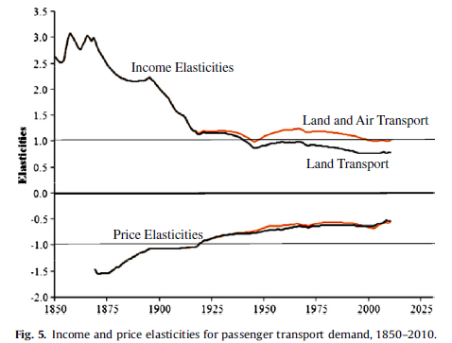
Historical income and price elasticities
Fouquet, R. (2012). Trends in income and price elasticities of transport demand (1850–2010). Energy Policy, 50, 62-71.

Slide 17
2.2 Exercises

Slide 18
Basics
Is the price elasticity of demand for airline industry in short-haul markets more or less than long-haul markets? Why?
What are the factors that influence the elasticity of demand for pilots?
Suppose the income elasticity of demand for good is -4. Is this good a normal good or an inferior good? If it is a normal good, then is it a luxury or a necessity? Why?
With changes in fuel prices what kind of effects should we see in the market for travel?

Slide 19
Elasticity values
Various studies indicate that the price elasticity of demand for automobile usage lies above –0.5 (that is, below 0.5 in absolute value). What does this say about the potential success of policies designed to reduce urban congestion by monetary disincentives?
The price elasticity of demand for Amtrak, the US rail passenger service, among vacation travellers has been estimated as –1.20. Given that Amtrak faces the market demand for rail passenger trips, what effect will a 15% increase in fares have upon market demand? What effect will the fare increase have upon revenues?

Slide 20
Demand estimations
According to demand theory, the market demand curve for transportation is downward-sloping.
You are a transportation economist for rail operator and you are asked to estimate the price elasticity of demand for rail services. Describe in some detail what steps you would follow to obtain the price elasticity of demand.
Suppose that your analysis found that the price elasticity of demand for rail services was –0.78. What impact would a 10% increase in price have upon the quantity of Amtrak services demanded? Do you know whether revenues would rise or fall?

Slide 21
Logit model
Suppose, in a binary logit model, that the “own-” and “cross-” price elasticities of demand for mode “a” are –0.34 and +0.15 respectively. Interpret these numbers.
What is the effect on the demand for mode “a” of a 15% increase in its price? Does this represent a change in demand or a change in quantity demanded?
What is the effect on the demand for a mode “a” when the price of mode “b” increases by 15%? Does this represent a change in demand or a change in quantity demanded?

Slide 22
Advanced exercise (1)
This is a totally artificial exercise; however, it is designed to try to get you to think about own price, cross price and income elasticities. Presented below are some completely hypothetical passenger figures for public transport services in a hypothetical city somewhere near you!

Slide 23
Advanced exercise (2)

Slide 24
Advanced exercise (3)
Using all of these values you should be able to answer the following questions – as a side note, if you have the necessary skills you may find a spreadsheet useful to assist with this exercise.
If there is a 5 per cent rise in income, what would be the new daily modal splits and the new total daily usage?
Using your answer for the new total daily usage from part (a), what is the overall income elasticity to travel?
How does your answer from part (b) compare with the results presented in Case study 3.1 in Chapter 3 and what might be the reason for any such differences? (Hint: you will need to calculate a rough elasticity from the values presented in the case study.)

Slide 25
Advanced exercise (4)
Calculate the effect on modal splits and the new monthly usage of the impact of the following factors (each should be considered on its own) and from your answers highlight which modal fare has the largest impact on the overall demand for travel in this city.
    a 15 per cent increase in the level of rail fares
    a 15 per cent increase in the level of bus fares
    a 15 per cent increase in the level of underground fares
What might be expected to happen to the cross price elasticity of the train across all other modes if the level of rail travel was to significantly increase? Why would this happen?
Roughly speaking, why have we got the answers that we have got for part c and what does this underline with regard to own and cross price elasticities of public transport services?

Slide 26
2.3. The demand for gasoline
based on McCarthy (2001); Chapter 3

Slide 27
Background
94% of all motor vehicle trips in USA were taken in private transportation
80,7 % of total intercity travel was done in passenger cars
45,7 % of all petroleum consumption is by personal cars

Slide 28
Research question
Given the dominance of motor vehicle travel in the USA, are consumers sensitive to changes in its price?
In the 1993 national budget discussions, there was a considerable interest in raising the gasoline tax, both for its effect on deficit reduction and for its potential in reducing urban congestion and pollution.
Holding all else constant, an increase in the federal gasoline tax is expected to reduce the quantity of gasoline consumed. But by how much? Is the demand for gasoline price elastic or price inelastic?

Slide 29
Research question
A related question concerns governmental policy that alters the manner in which gasoline is allocated.
By the mid-1970s, price controls on oil were still in effect.
Because price controls prevent the monetary price of gasoline from rising, what impact did the price controls have on the opportunity cost of gasoline when the 1973-4 oil crisis hit?

Slide 30
The demand for gasoline in California
To answer these questions, the demand for gasoline must be estimated. In a study on monthly gasoline demands and automobile travel in California, Lee (1980) assumed the market demand for gasoline in California, G_{t}, to be:

Slide 31
Hypotheses
By the law of demand β₁is expected to be negative
Each of the gasoline crisis variables reduces the consumption of gasoline, all else hold constant
Estimated effect of gasoline crisis on the opportunity costs of gasoline is positive
Gasoline is a normal good → β₂ > 0
β₃ > 0

Slide 32
Estimation results

Slide 33
Demand curve
Hypothesis 1
Estimated coefficient for β₁ is negative and significant → downward slope of demand curve.
95 % confidence interval for β₁ is (-25,8; -11,3)
Hypothesis 2
Because of the increased time cost, brought on by the gasoline crisis, average daily consumption fell by 1,8 million gallons.

Slide 34
Change in the demand
Hypothesis 3
Given that average daily consumption was approximately 25 million gallons, the results indicate that in march 1974, the gasoline crisis resulted in a 10% reduction in gasoline consumption.
Hypothesis 4
A 1 billion dollar increase in real personal income leads to a 277000 gallon increase in average daily gasoline consumption.
Hypothesis 5
Additional person increases daily demand by a bit more than one and half gallons per day.

Slide 35
Elasticities
The price elasticity of demand is defined as:
Replacing β₁ with 18,552 and RPG and G with their respective sample means, Lee calculated the gasoline price elasticity of demand to be – 0.216 → the demand for gasoline is inelastic.
The data are monthly, covering five year period, the rice elasticity is short run. Long run price elasticity of demand are considerably higher and have been estimated to be around -0.8.
Employing a similar procedure, the income elasticity of the demand for gasoline was calculated to be 0.876 → gasoline is a normal good.

Slide 36
Queuing cost premia
What was the queuing cost associated with the gasoline crisis?
From estimation results, an estimate of queuing prices for each month of the crises can be obtained by dividing the month’s coefficient by β₁.
Table reports these estimates which are positive and consistent with hypothesis 3.
The queuing cost represent a significant portion of the total opportunity cost.

Slide 37
The demand for trips

Slide 38
The demand for gasoline x trips
The impact of price, income and population was same and significant.
However gasoline crisis variables were stronger in demand for gasoline than for trips. Why?
We would expect demand for trips to be less responsive to gasoline price increases than for gasoline because, in the shirt run, there re more substitution opportunities for reducing fuel than for reducing the number of trips.

Slide 39
The 1993 gasoline tax increase
According to the 1993 Deficit Reduction Bill, passed in late 1993, the federal gasoline tax increased by 4.3 cents per gallon. With average per gallon price equal to USD 1.06, this represents an approximate 4% increase in the 1993 real price of gasoline.
The above results found price elasticity of demand for gasoline to be – 0.216 and for trips -0.236.
The federal gasoline tax increase can be expected to have reduced the quantity of gasoline demanded by 0.86% and average daily trips by 0.94%.
At the national level, this translates into a 1.74 million gallon daily reduction in the demand for gasoline and 5.68 fewer automobile trips per day.

Slide 40
Comments
A potential deficiency of the model is the lack of information on relevant alternatives. Economic theory tells us that demand depends on price of substitutes.
Is this important? Possibly, but not necessarily.

Slide 41
2.4 Summary

Slide 42
Summary
Price elasticity = Percentage change in quantity demanded/Percentage change in price
Cross price elasticity = Percentage change in quantity demanded of service A/Percentage change in price of service B
Income elasticity = Percentage change in quantity demanded/Percentage change in income

Slide 43
Readings for Lecture 3
Buehler, R., & Pucher, J. (2012). Demand for public transport in Germany and the USA: an analysis of rider characteristics. Transport Reviews, 32(5), 541-567.

