Slide 1
International Marketing
Ing. Dušan Mladenović Ph.D.
dusan.mladenovic@econ.muni.cz

Slide 2
Roadmap
Lecturers
Aim and Content of the Course
Tasks and Schedules
Literature
Exam and Grading System
Advices
Introduction to the Problematic:
  Key terms
  Motives for firms going international
  Triggers of export initiation
  Export barriers etc.

Slide 3
Lecturers
Ing. Dušan Mladenović Ph.D.
  dusan.mladenovic@econ.muni.cz
  Room 545, 5th Floor
  Individual office hours (online) is possible to arrange via e-mail
Doc. Ing. Alena Klapalova Ph.D.
  alena.klapalova@econ.muni.cz
  Room 533, 5th Floor

Slide 4
Lecturers
Theory Summary – 50-60 minutes
Presentations - 40 minutes
If time available - Case Study or Specific Tasks Will be Solved
Attendance is mandatory

Slide 5
Aims and Content of the Course
Students who complete this course successfully will be able to:
  Understand reasons for adaptations of many marketing approaches in the international environment
  Use special techniques or methods of international and global marketing
  Analyze, select and evaluate various frameworks for firms approaching international markets having in mind the impact of cultural differences on marketing decisions
  Be analytical and critical when it comes to analyzing and interpreting global marketing issues
  Understand the culture and cultural differences in business etc.

Slide 6
Aims and Content of the Course
Following topics will be covered throughout the semesters:
  The Nature of Global Marketing
  Theories of International Trade and Marketing
  The International Environment
  Culture and International Marketing
  International Market Selection and Segmentation
  International Marketing Research
  Market Entry Strategies and Modes
  Product and Service Strategies
  International Pricing
  International Distribution
  International Marketing Communication

Slide 7
Tasks and Schedules
Each student must choose one of the following:
  Seminar work
  Presentation of the country from the marketing standpoint
  Weekly Case Study (optional)
Deadline for registration and enrollment: 16.10.2020 via IS.
Further details available in the Interactive Syllabus

Slide 8
Literature
Mandatory
  Hollensen, S. (2008). Essentials of global marketing. Pearson Education.
  Hollensen, S. (2007). Global marketing: A decision-oriented approach. Pearson education.
Recommended
  Usunier, J. C., Lee, J. A., & Lee, J. (2005). Marketing across cultures. Pearson Education.
  Kotabe, M. M., & Helsen, K. (2020). Global marketing management. John Wiley & Sons.

Slide 9
Exam and Grading System
Consists of 30 questions
Negative points (-0.25) for incorrect answer
Online mode
Minimum: 60%
Dates will be communicated upfront
Grade structure:
  Exam = 30%
  Presentation = 40%
  Case Studies = 15%
  Attendance = 15%

Slide 10
Exam and Grading System
1. | Originality and Creativity Creativity and originality of logic Timeliness and uniqueness of ideas | 15
2. | Organization (Logical presentation of ideas) Objectives/goals are clearly stated. Methods are appropriate for achieving goals Results are clearly presented Thoughts and ideas flow in a logical manner | 10
3. | Presentation (Not applicable in online mode) Exhibits good body posture Maintains good eye contact with audience Good diction; good articulation Time management | n/a
4. | Knowledge of Material Exhibits knowledge of subject matter Answers questions with confidence Visual materials are easy to read. | 15
5. | Overall Presentation (Total) | 40

Slide 11
Advices
Be on-time
Be proactive
Consider Case Studies
Always prepare for lectures (home-reading)
Read Interactive Syllabus
  Check tab: Bonus Materials

Slide 12
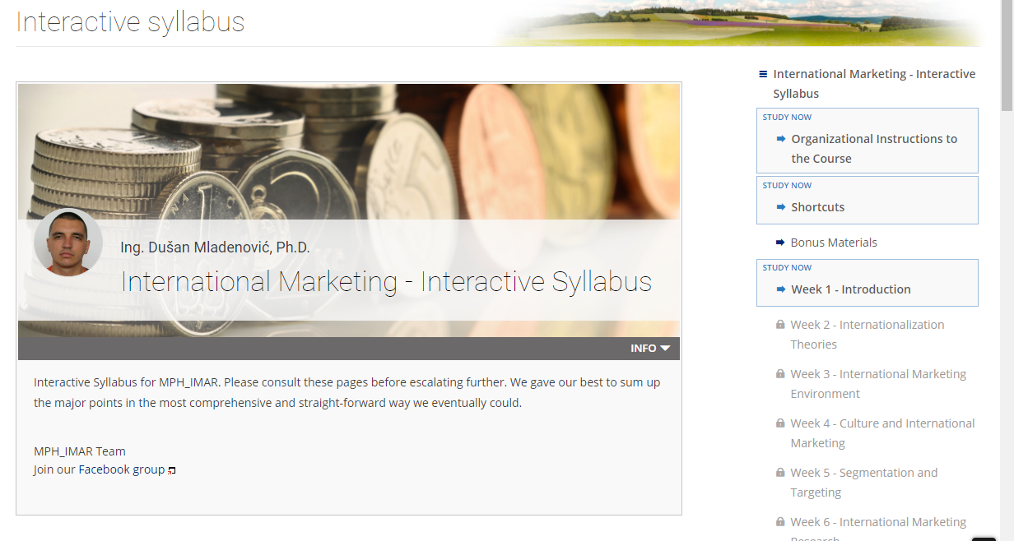
Advices

Slide 13


Slide 14
Introduction
What is marketing?
What are export, international, multinational, and global marketing?
What are reasons for the differences?
Definition and „synonyms“ for international marketing?

Slide 15
Definitions and Synonyms
Marketing is the activity, set of institutions, and processes for creating, communicating, delivering, and exchanging offerings that have value for customers, clients, partners, and society at large.
Unique feature of international marketing is its polycentric orientation with emphasis on product and promotional adaptation in foreign markets.
Polycentric orientation refers to a predisposition of a firm to the existence of significant local cultural differences across markets, necessitating the operation in each country being viewed independently.
Kotabe and Helsen pp.13-18

Slide 16
Definitions and Synonyms
Core marketing concepts
Needs
States of felt deprivation (physical – food, warmth, safety, social – belonging, affection and individual – knowledge, self-expression)
Wants
The form taken by human needs as they are shaped by culture and individual personality or shaped by society and described in terms of objects that will satisfy needs
Demands
Human wants that are backed with buying power
Demand = Want + willingness to buy + ability to buy
Demand may be brand specific (Adidas vs Nike vs Puma)

Slide 17
Definitions and Synonyms
Export marketing begins with unsolicited orders from foreign customers.
The internationalization process is a consequence of incremental adjustments to the changing conditions of the company and its environment, rather than a result of its deliberate strategy.
Export marketers still tend to take an ethnocentric approach to foreign markets as being an extension of their domestic market and export products developed primarily for home country customers with limited adaptation to foreign customers’ needs.

Slide 18
Definitions and Synonyms
International marketing is the process by organizations:
Identify needs and wants of customers in different markets
Provide products, services and ideas competitively to satisfy needs and wants of different customer groups concerning issues different from domestic market
Communicate information about the products and services with the proper adaptation to different customer perception rising from other country effect
Deliver the products and services internationally

Slide 19
Definitions and Synonyms
Multinational marketing is when the company markets its products in many countries around the world.
Management of the company comes to realize the benefit of economies of scale in product development, manufacturing, and marketing by consolidating some of its activities on a regional basis.
This regiocentric approach suggests that product planning may be standardized within a region (e.g., a group of contiguous and similar countries), such as Western Europe, but not across regions.

Slide 20
Definitions and Synonyms
Product development, manufacturing, and marketing are all executed by each subsidiary for its own local market.
Different product lines, product positioning, and pricing may be observed across those subsidiaries. Few economies of scale benefits can be obtained.
Multi-domestic marketing is useful when customer needs are so different across different national markets that no common product or promotional strategy can be developed.

Slide 21
Definitions and Synonyms
Global marketing is defined as the firm’s commitment to coordinate its marketing activities across national boundaries in order to find and satisfy global customer needs better than the competition.
This implies that the firm is able to:
develop a global marketing strategy, based on similarities and differences between markets
exploit the knowledge of the headquarters (home organization) through worldwide diffusion (learning) and adaptations
transfer knowledge and ‘best practices’ from any of its markets and use them in other international markets

Slide 22
Definitions and Synonyms
Global marketing refers to marketing activities by companies that emphasize the following:
  Standardization —standardizing marketing programs across different countries particularly with respect to product offering, promotional mix, price, and channel structure
  Coordination —reducing cost inefficiencies and duplication of efforts among their national and regional subsidiaries
  Global Integration—participating in many major world markets to gain competitive leverage and effective integration of the firm’s competitive campaigns across these markets by being able to subsidize operations in some markets with resources generated in others and responding to competitive attacks in one market by counterattacking in others

Slide 24
Internationalization Philosophies
Ethnocentric (domestic/export marketing)
Polycentric (international marketing)
Regiocentric (multinational marketing
Geocentric (global marketing)

Slide 25
Internationalization Philosophies
Ethnocentric orientation
Home country is superior to others
International markets are secondary, regarded as outlets for surplus production
Sees only similarities in other countries
Assumes products and practices that succeed at home will be successful everywhere
Leads to a standardized or extension approach
Negatives
Loss of demand
No local responsiveness
No anticipation of local needs

Slide 26
Internationalization Philosophies
Polycentric
Each country is unique
Guided by the multi-domestic marketing concept
Each subsidiary develops its own marketing strategies
Fully decentralized, minimal coordination with headquarters
Leads to a localized or adaptation approach that assumes products must be adapted to local market conditions
Negatives
No economies of scale
Duplicated functions
Higher final costs

Slide 27
Internationalization Philosophies
Regiocentric orientation
A region is the relevant geographic unit
Regional offices coordinate marketing activities
Question: Is everything in one region same?
Geocentric orientation
Entire world is a market
Strives for integrated strategies
Strategies aimed at market segments, rather than geographic locations
Maximizes efficiencies worldwide and provides standardized product or service
Retains an association with the headquarters country
Pursues serving world markets from a single country
Leads to a combination of extension and adaptation elements

Slide 28
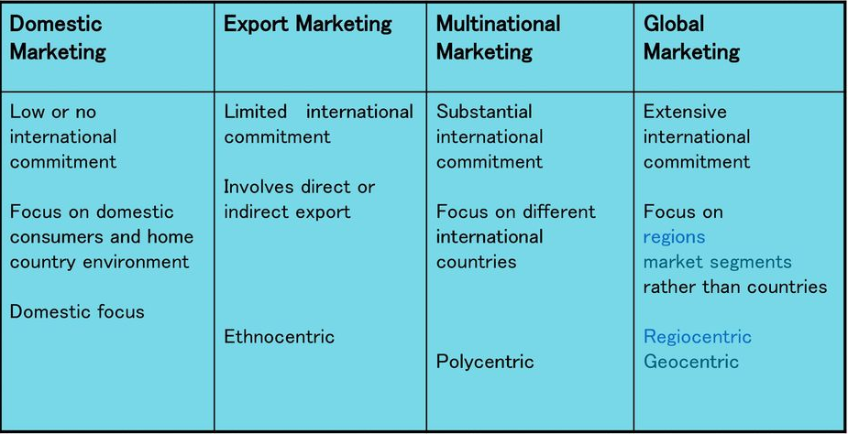
Internationalization Philosophies

Slide 29
Standardization vs. Adaptation
Globalization (standardization)
Developing standardized products marketed worldwide with a standardized marketing mix
Essence of mass marketing
Global localization (adaptation)
Mixing standardization and customization in a way that minimizes costs
Essence of segmentation
“Think globally, act locally”

Slide 30
Internationalization Motives

Slide 31
Export Initiation

Slide 32
Internationalization Barriers
Internal
finances
insufficient knowledge
lack of foreign market connections
lack of export commitment
lack of capital to finance expansion into foreign markets
lack of productive capacity to dedicate to foreign markets
lack of foreign channels of distribution
management emphasis on developing domestic markets
cost escalation due to high export manufacturing, distribution and financing expenditures
External
Market risk
Commercial risk
Political risk

Slide 33
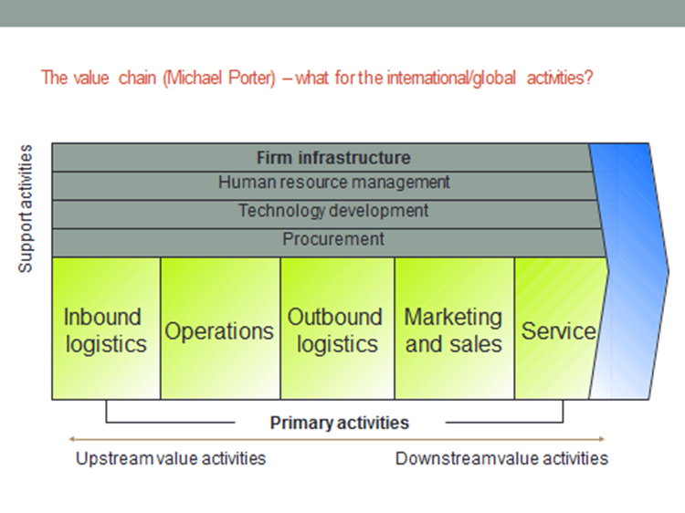
Value Chain in International Marketing

Slide 34
Home-readings for Next Week
Reading for next lecture:
Theories Explaining Firms’ Internationalization Process
Hollensen – Essentials of Global Marketing. Chapter 3
Case Study
Entertainment Rights: Internationalization of ‘Postman Pat’ (p. 67)
More details available in Interactive Syllabus.

Slide 35
Thank you for you attention

