Slide 1
Plánování

Slide 2
Plánování času a zdrojů
JAK, ne CO
definuje v jakých termínech a časových sledech budou práce na projektu probíhat
aktivity založené na WBS nebo logickém rámci
Notes:
zrada je v detailech, zejména ve vynechání prací (buď přílišný detail všeho anebo naopak nepřemýšlení nad tím, co vše práce obsahuje) a podcenění jejich obtížnosti.
Pak trochu v řazení (hlavně lead a lag) a rizicích spojených s kaskádovým "sesypáním" této návaznosti.
A nejvíce v odhadech času a tom, jak z někoho třetího/externího dostat realistický odhad času (a raději tři, než jeden) a navázat ten čas na jeho implicitní přepodklady (složitosti, podmínek, BIAS chyby atd.) a současně chápat implicitně vložené rezervy. Určitě naučit dělat plánovací poker (včetně diskuze těch, kteří dali minimum a maximum)

Slide 3
Plánování času a zdrojů
Hlavní nástroje:
Ganttův diagram
    + přehlednost
    + jednoduchost konstrukce
    - neukazují přehledně závislosti mezi úkoly (činnostmi)
    - změna v délce jedné činnosti se většinou (automaticky) nepromítne do zbývající části
    CPM – critical path method – kritická cesta
    + souhrnně prezentuje souvislosti
    + umožňuje hledat alternativy
    + definuje kritickou cestu
    - složitost
    - nepřehlednost
The time is the only thing that cannot be bought☺

Slide 4
Odhadování
Plánovací poker
Window method ☺
Top-down, Bottom-up
Groupe estimation technique (Delphi, Crawford´s slip etc.)
Expert guess (SME)
Comparative or analogous estimation
PERT – uses Three-point estimating
Planning poker
Notes:
Expert guess – number of experts named, their estimates evaluated in a pre-defined way (top-down)
Simulation (Monte Carlo)
PERT – programme evaluation and review technique

Slide 5
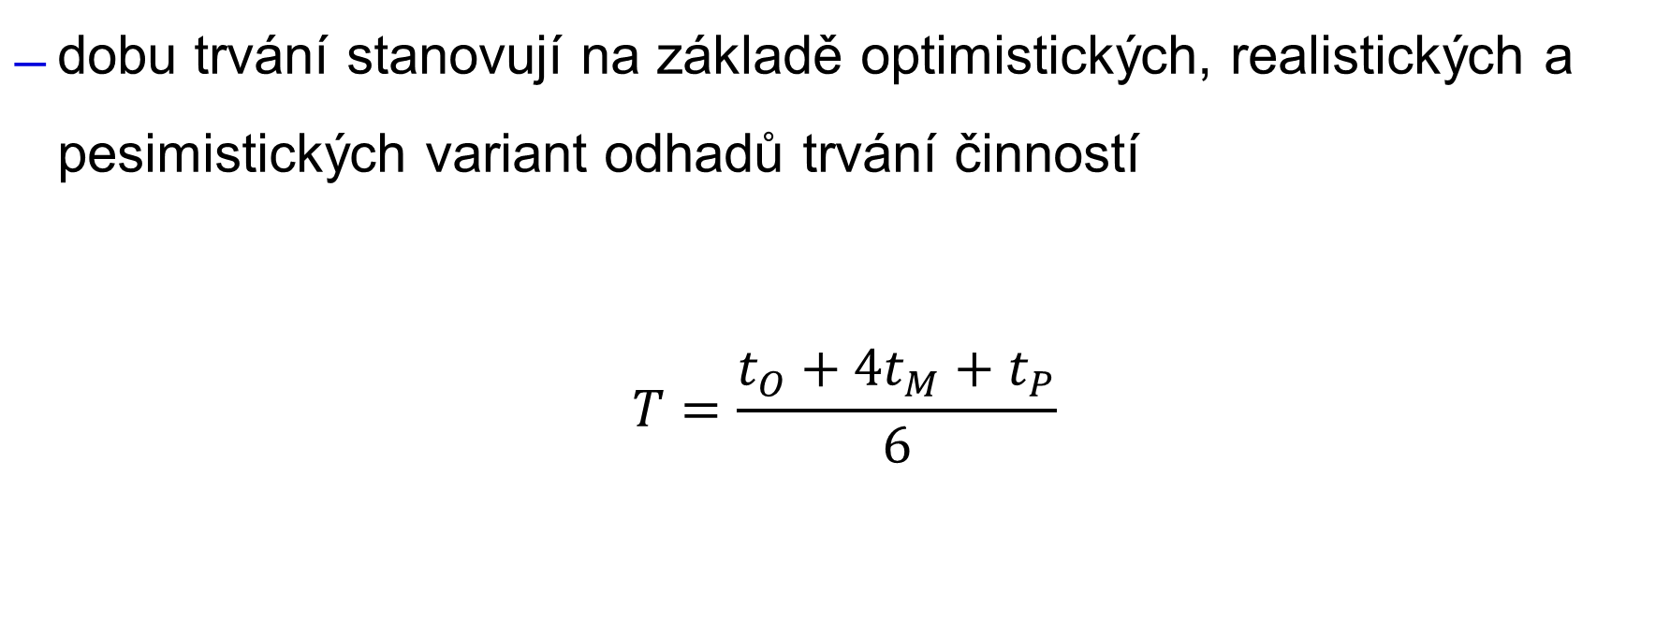
Odhadování - Three-point estimating
dobu trvání stanovují na základě optimistických, realistických a pesimistických variant odhadů trvání činností
$$T=\frac{t_{O}+{4t}_{M}+t_{P}}{6}$$
Notes:
Plánování, tři odhady, s tím, že plánovací poker bude v druhém bloku

Slide 6
Critical Path Method
CPM
An algorithm for scheduling a set of project activities
Why we need it? It provides us with:
  Project finish date
  Activities that can float in the schedule
  Activities that cannot float - RISK
Notes:
Used to calculate project finish date
To identify to what extent each activity in the schedule can slip (float) without delaying the project
To identify the activities with the highest risk that cannot slip without changing the project finish date

Slide 7
Critical Path Method - Inputs
What do we need to use CPM?
Network diagram including relations among activities
Activities duration estimates
Demands for resources for each activity
Key dates
Notes:
First two can be in Gannt chart

Slide 8
CPM – how to describe a nod (an activity)
ES – early start - the earliest date a task can start
EF – early finish - the earliest date a task can be completed
LS – late start - the latest date a task can start without delaying the project finish date
LF – late finish - the latest date a task can finish without delaying the project finish date
ES | Total float | EF
Duration (days) | Activity
LS | Free float | LF

Slide 9
Critical Path Method
How to calculte the project´s finish date?
Forward pass calculation (Early Start and Early Finish) – searching for a maximum of early finish of immediate predessesors = early start of an activity
Backward pass calculation (Late Start and Late finish) – searching for a minimun of early start of immediate successors = late finish of an activity

Slide 10
CPM example
A
2
C
1
E
4
Start
Finish
B
5
D
6
F
2
Forward pass (early start+duration= early finish) – searching for a maximum of early finish of immediate predessesors = early start of an activity
Backward pass – searching for a minimun of early start of immediate successors = late finish of an activity
Notes:
Forward pass (early start+duration= early finish) – searching for a maximum of early finish of immediate predessesors = early start of an activity
Backward pass – searching for a minimun of early start of immediate successors = late finish of an activity

Slide 11
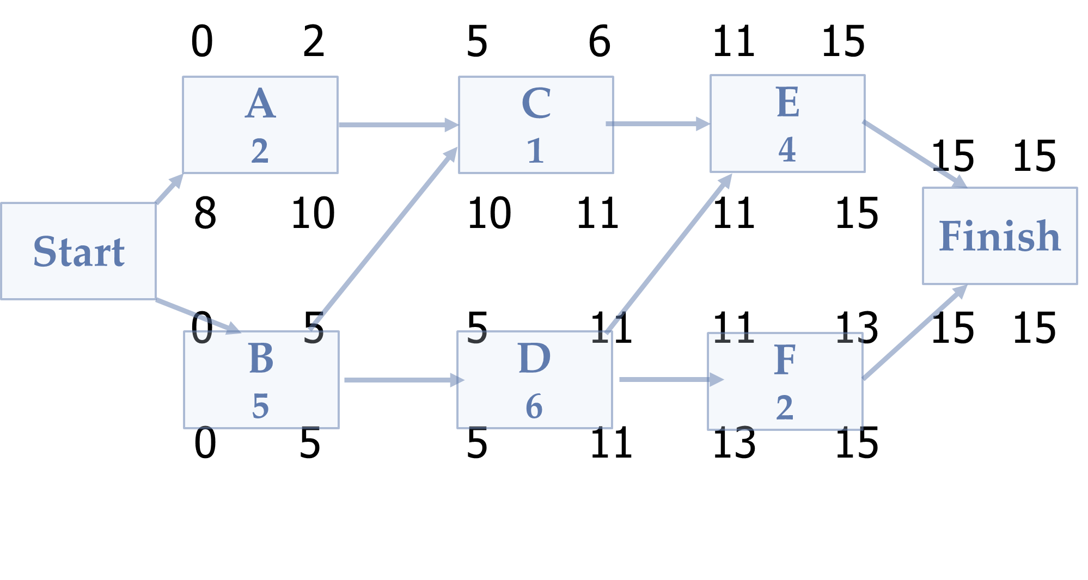
CPM example
Check www.lucidchart.com

Slide 12
Why are we doing this? ☺
The purpose of backward pass is to find a float
  Float (slack) – the amount of time an activity can be delayed or lenghtened
  Total float – the amount of time an activity can be delayed without extending the overal project´s completion time
  Free float - the amount of time an activity can be delayed without delaying the early start date of its subsequent tasks

Slide 13

Total Float: CPM example
What is the total float for activity A in our example?
Total float – the amount of time an activity can be delayed without extending the overal project´s completion time
Notes:
Total float for activity A = 8

Slide 14
Total Float
Total float – the amount of time an activity can be delayed without extending the overal project´s completion time
TF=LF-EF
TF=LF-ES-D
TF=LS-ES
ES | Total float | EF
Duration (days) | Activity
LS | Free float | LF
Notes:
TF=LF-EF=LF-(ES+D)=LF-ES-D=
=LF-D-ES=LS-ES

Slide 15
Free Float: CPM example
What is the free float for activity A in our example?
What about activity C and D?
Free float - the amount of time an activity can be delayed without delaying the early start date of its subsequent tasks
Notes:
Free float of activity A = 3
C=5
D=0

Slide 16
Critical Path Method
Why floats are important in CPM?
Critical activities have the least amount of flow
Floats determine the critical path
If an activity has a TF=0, what does it mean?
Notes:
If an activity has a TF=0, what does it mean?
There is no room for delay in that activity – delay extends duration of the whole project. It is a CRITICAL ACTIVITY.
Floats determine the criticallity of an activity.

Slide 17
Critical Path
Is made of activities that cannot be deayed without delaying the whole project
Items on critical path have zero float
Path with longest duration
Can be more than one

Slide 18
Can you find the critical path?

Slide 19
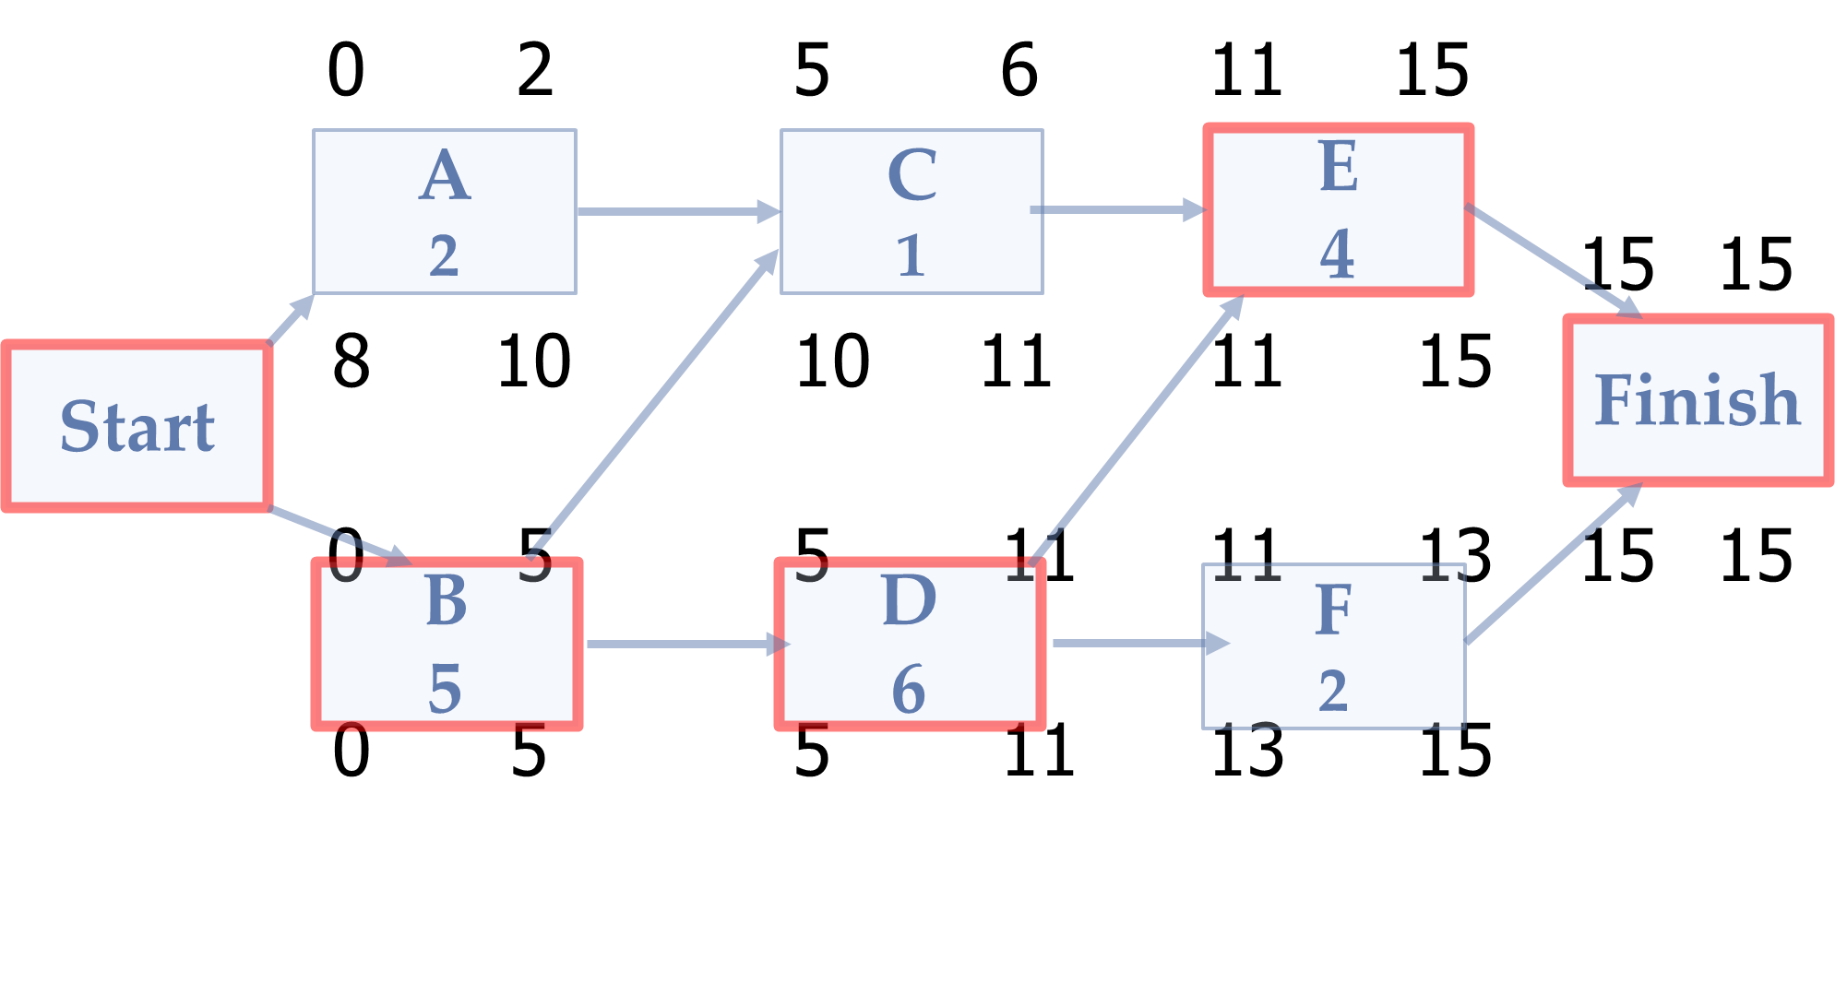
Yes, you can☺

Slide 20


Slide 21
Plánování času a zdrojů
Optimalizace plánu
Konflikty zdrojů
Fast-tracking
Crashing
Resource Leveling
Resource Smoothing

Slide 22
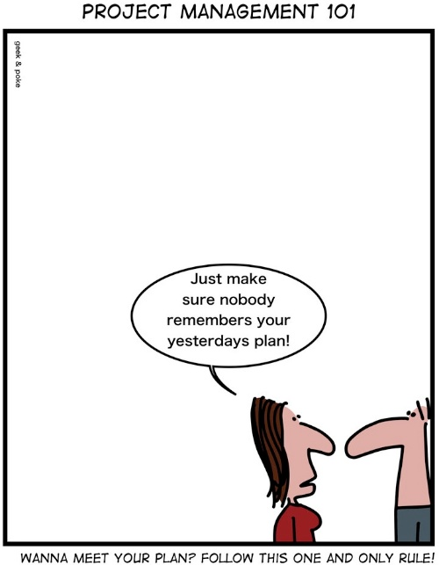

Slide 23
Děkujeme! Máte otázky?
Sylva Žáková Talpová Jan Žák
talpova@econ.muni.cz erwin@email.cz

