Slide 1
Projektový management

Slide 2
Realizace a ukončení projektu

Slide 3
PŘEDPROJEKTOVÁ FÁZE
Studie příležitosti
FÁZE ŘÍZENÍ PROJEKTU
Zahájení
POPROJEKTOVÁ FÁZE
Přínosy
Lessons learned
Studie proveditelnosti
Strategie
Plánování
Realizace + kontrola
Ukončení

Slide 4
Realizace projektu
Plán projektu schválen
Rozpočet, harmonogram, WBS – baseline
Plány – rizika, zainteresované strany
Kick-off meeting
  “If everything seems under control, you're not going fast enough.” (M. Addretti, winner of the 1978 Formula One World Championship)

Slide 5
Realizace projektu
Reportování
Srovnávání skutečnosti s plánem
  Procenta dokončenosti
  Project status/stage
  Milestones trend analysis
  Earned Value Management (EVM)

Slide 6
Earned Value Management - EVM
A way to measure and evaluate the project performance
Compares the amount of work planned with what is actually accomplished to determine whether the project is on the track
Appropriate for projects with more or less stable scope (investment property construction etc.)

Slide 7
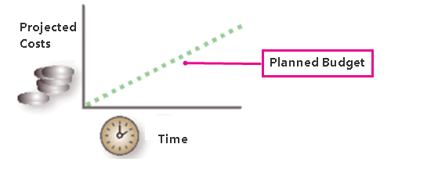
EVM: Planned Value
Planned value (PV)
the planned cost of work scheduled to be done in a given time period

Slide 8
EVM: Planned value
EXAMPLE
According to the plan, 3 employees should work on the task for 12 days.
Control time: after 6 days
Planned value (at a control time) is _____ mandays.

Slide 9
EVM: Earned Value
Earned value (EV)
the planned cost of work actually performed in a given time period
the amount of EV is determined by totaling the cost estimates for the activities that were actually completed in the time period.
EXAMPLE: According to the plan, 3 employees should work on the task for 12 days.
75% of the task is ready on the control day 6.
Earned value is _____ mandays.

Slide 10
EVM: Actual cost
Actual cost (AC)
determined by totaling the expenditures for the work performed in a given time period
EXAMPLE
According to the plan, 3 employees should work on the task for 12 days.
Report from the responsible employee (on a control day 6): “We worked on the task according to the plan, but one colleague fell ill the third day. So from the fourth day there are only two of us working on the task.”
Actual cost is ______ mandays.

Slide 11
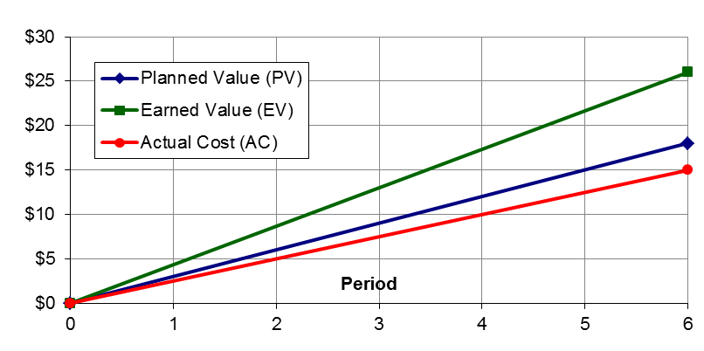
PV, EV, AC
USEFUL TEMPLATE: http://www.vertex42.com/ExcelTemplates/earned-value-management.html

Slide 12
VARIANCES
Schedule variance (SV) the difference between the planned and the actual work completed
SV=EV-PV
Ahead/behind the schedule?
Cost variance (CV)
the difference between the planned cost and the actual cost of work completed
CV=EV-AC
Under/over the budget?

Slide 13
INDEXES
SPI – schedule performance index
a ratio of work performed to work scheduled
this ratio is a measure of efficiency in the schedule
SPI=EV/PV
SPI<1 ….. a project is behind the schedule
SPI>1 ….. a project ahead of schedule

Slide 14
INDEXES
CPI – cost performance index
a ratio of budgeted costs to actual costs
this ratio is a measure of cost efficiency
CPI=EV/AC
CPI<1…..the work is costing more than planned
CPI>1…..the work is being produced for less than planned

Slide 15
INDEXES
Provide a quick snapshot of the project´s efficiencies at a given point in time
More valuable when used periodically
Used for forecasting:
  Budget at completion (BAC) - from WBS
  Estimate to complete (ETC)=(BAC-EV)/CPI
  Estimate at completion (EAC)=AC+ETC
  To complete performance index (TCPI)=(BAC-EV)/(BAC-AC)

Slide 16
EVM Exercise
The Project was scheduled to cost €1,500 and was originally scheduled to be completed today. As of today, however, the project has spent €1,350, and it is estimated that only two-thirds of the work has been completed. Calculate the schedule and cost variances and the schedule and cost indices.
SV=
CV=
CPI=
SPI=

Slide 17
Limitations
Quantification of project plan is required (x SW, research)
Project accounting is a necessary prerequisity
90-90 rule
Discretization error
https://www.pmconsulting.cz/pm-wiki/evm-earned-value-management/

Slide 18
Ukončení projektu
Akceptace
Předání výsledku projektu
Benefity – měření – později (po projektu)
Hodnocení průběhu projektu + lessons learned

Slide 19
Příklady projektů
Olkiluoto Nuclear Power Plant
BER Airport
New Coke
Elbphilharmonie Hamburg
Hoover-dam

Slide 20
Děkujeme! Máte otázky?
Sylva Žáková Talpová Jan Žák
talpova@econ.muni.cz erwin@email.cz

