Slide 1
Nonprofit-government relations: The public policy and advocacy perspectives

Slide 2
Content
Roles of CSOs
Government, Advocacy and Civil Society: Overview of the Government-Nonprofit Relations
Public policy perspective
Advocacy perspective

Slide 3
Civil society organizations
Nonprofit organizations (NPOs): organizations that are privately incorporated, but serve some public purpose (social responsibility)
Social movement organizations
Interest groups, labour unions, professional chambers, ...
Separate from the state and the market

Slide 4
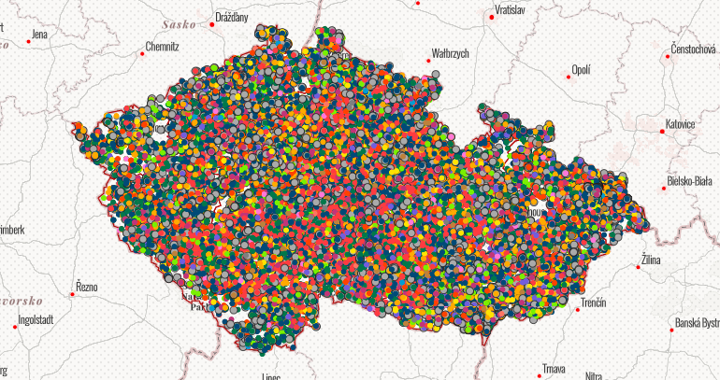
Nonprofit organizations in CZ

Slide 5

NPO in Brno

Slide 6
What are the roles of NPOs?
Social capital (“the features of social organization, such as networks, norms, and trusts, that facilitate coordination and cooperation for mutual benefit”)
Economic role
Religious role
Service
Policy (e.g. Implementing public policies)
Advocacy (e.g. Building up civic/civil society. Central to prosperous and successful democracies)
…Significant actors at global level (international perspective)

Slide 7
NPOs and government relations: Overview
Very complex relationship based on different aspects: funding, tax policy and regulations towards NPOs, direct government support, non-monetary support, involvement in policy and advocacy activities, etc.
Legal perspective
Public policy perspective
Advocacy perspective

Slide 8
Public policy perspective
Involvement of NPO in policy-making
One of principal functions of NP sector, major contribution to society, promoting common good
Pressuring government to respond to disadvantaged groups
Theoretical models: based on the character of relationship Weisbrod, 1988; Douglas, 1987; Salamon, 1995, 2002; Young, 2000; Najam, 2000

Slide 9
What is the character of relationship?
Public
Sector
(Government)
Substitute and supplement (Weisbrod, 1988; Douglas, 1987)
Complement (Salamon, 1995, 2002)
Adversary
Nonprofit
Sector
For-Profit
Sector

Slide 10
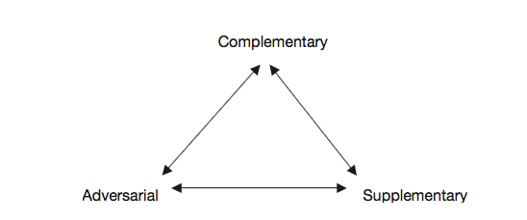
A triangular model: Young (2000)

Slide 11
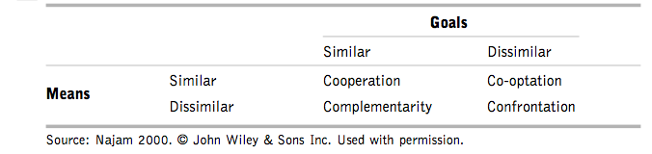
Four Cs model of government–nonprofit relations: Najam (2000)

Slide 12
Why should NPO participate in policies and policy-making?

Slide 13
Involvement of interest groups
Pros/benefits:
  Strengthens representation
  Public debate encouragement
  Expanding the space for political participation
  Barriers to abuse of power
  Ensuring political stability
Cons/critique:
  Lobbying = "buying" political influence
  Consolidating political inequality
  Failure to contribute to political integration
  Exercising Illegitimate power
  Tendency to "secrecy" in politics

Slide 14
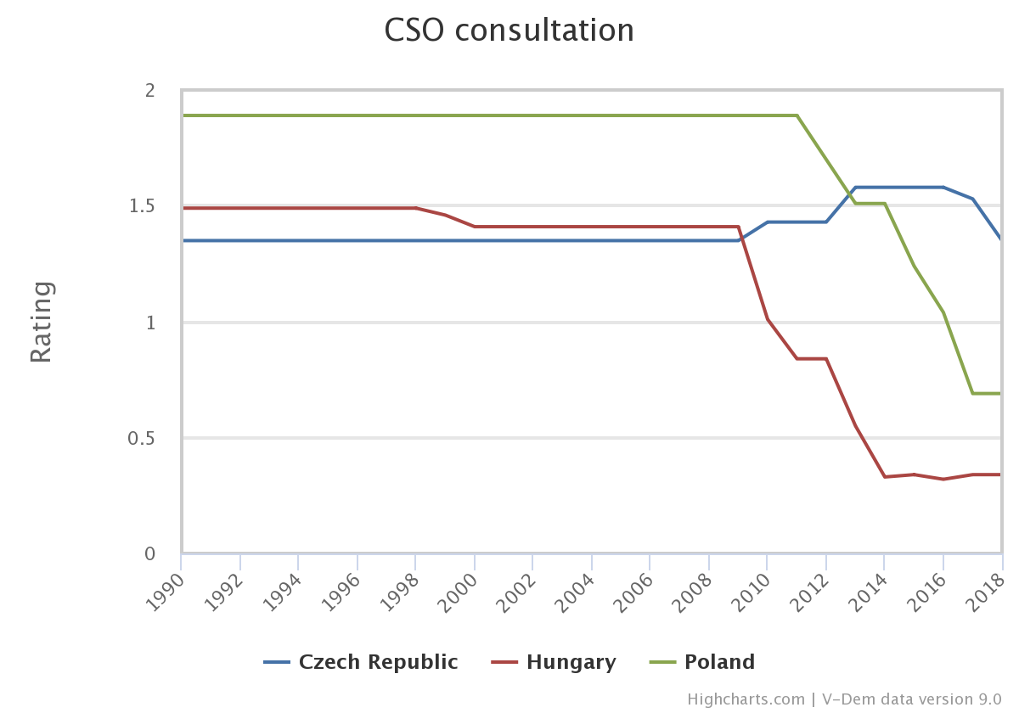
Are major civil society organizations (CSOs) routinely consulted by policymakers on policies relevant to their members?

Slide 15
Advocacy perspective
NPO’s crucial civic function
Goal: To influence government decisions; to shape the policies of private institutions and corporations; or to encourage political participation
1) NPOs mediate and directly/indirectly activate and facilitate participation – by providing structures and networks
2) NPOs engage in public-interest advocacy activities
To “correct imbalanced political representation by ensuring that a broader set of interests are voiced” (Jenkins, 2006)

Slide 16
Reasons to advocate
Focusing public attention on key social problems and solutions
Increasing the base of knowledge on which innovative policy is formed
Policymakers need expertise
Ensuring access for new and unheard voices
Fostering governmental accountability to citizens
Promoting democratic values (freedom of expression, pluralism, ...)
Giving citizens a personal sense of civic skills in the democratic process (can make a difference, can change laws)
The views of local nonprofits are important

Slide 17
Social movement theory argument
Two sectors are deeply intertwined, but conflictual relationship with government
1) first with private concerns, private action (informal, no legal status)
2) As momentum builds, the movement may evolve into formal organizations (become more institutionalized)
3) Ultimately, successful SMOs may influence government policy – by translating private concerns into public issues

Slide 18
SMOs and government
Basically a cycle:
    Initial social movement translate public concerns via formal legal entities
    NPO influence government policy
    Government responds:
      by directly addressing the issue
      or funds nonprofits
    Nonprofits in turn address these public concerns
    And nonprofits adjust their behavior to reflect public policy and government priorities
    Tries to influence again
Examples of such successful movements?

Slide 19
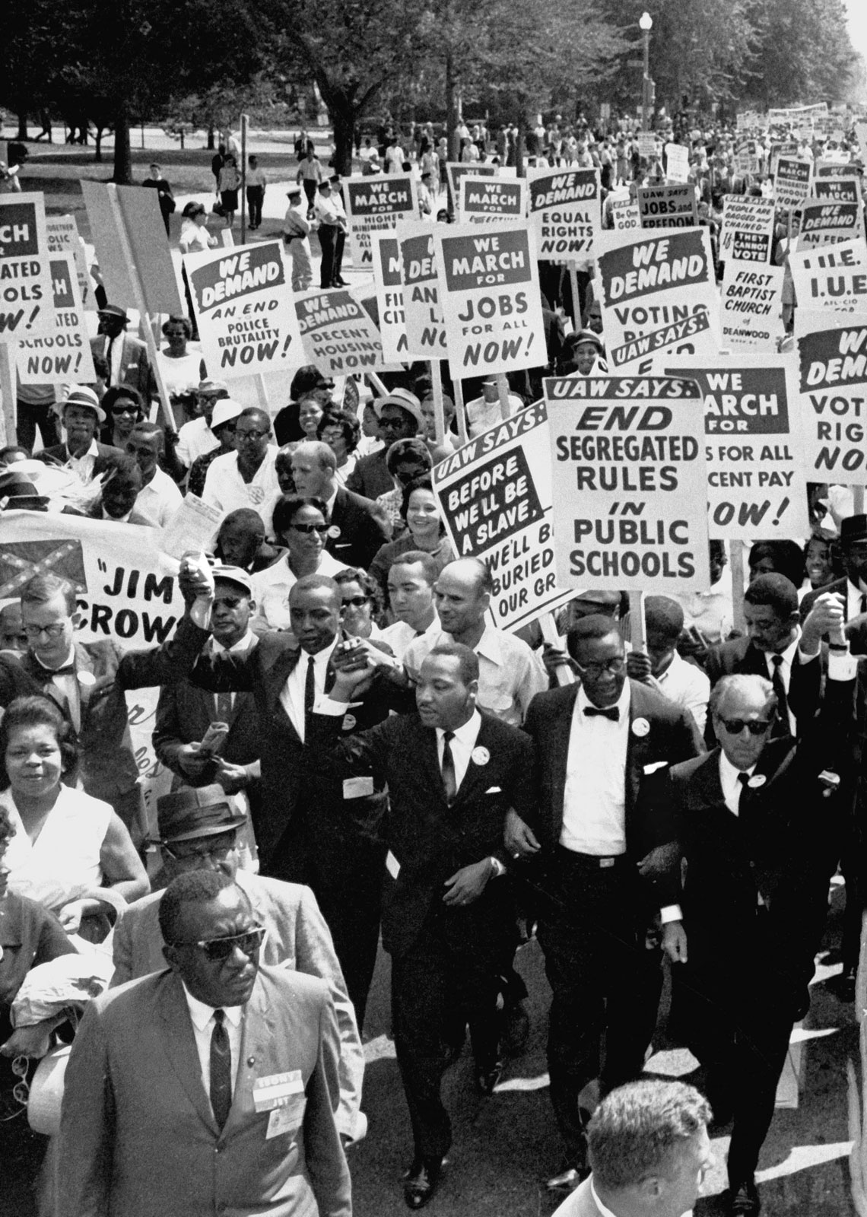
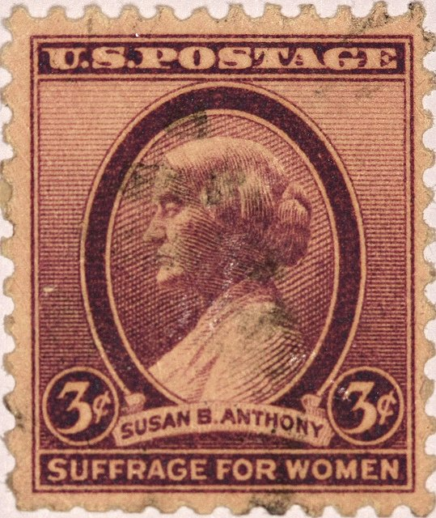

Slide 20


CSOs during migration crisis
Refugees welcome movement
Appeal for humanity (Výzva k ľudskosti) (Slovakia)
Global Migration Journey: #sharethejourney
…

Slide 21

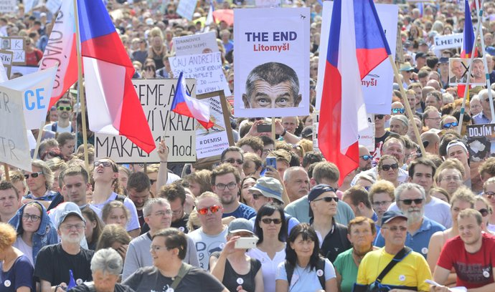
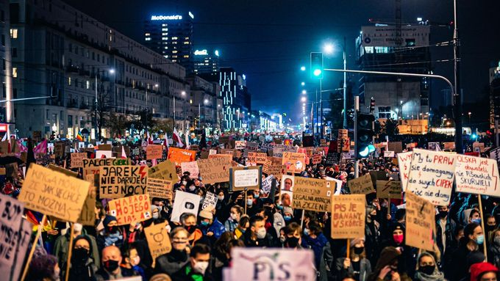


Slide 22
Challenges for (some) CSOs’ activities
Negative framing of civil society organizations and NPOs (mostly dealing with human rights or minority issues) by political elites
Worsening public image (mostly Central and Eastern Europe)
„Agents of neomarxims“ and liberalism (populist discourse)
Tools of foreign interests (Soros and „his plan“) – e.g. CEU Uni
In Czech context: „ngo-ism“ (Václav Klaus)
Declining civic engagement

Slide 23
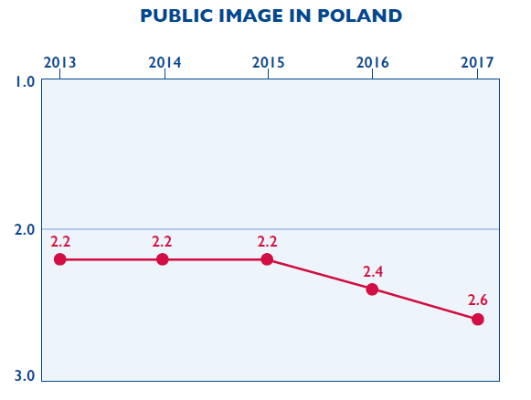
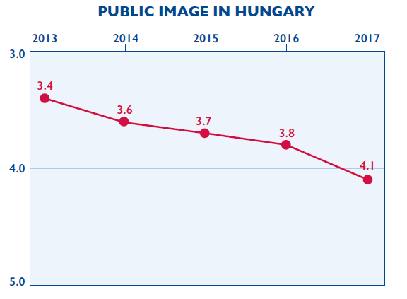
Public image of CSOs
Source: 2017 CSO Sustainability Index

Slide 24
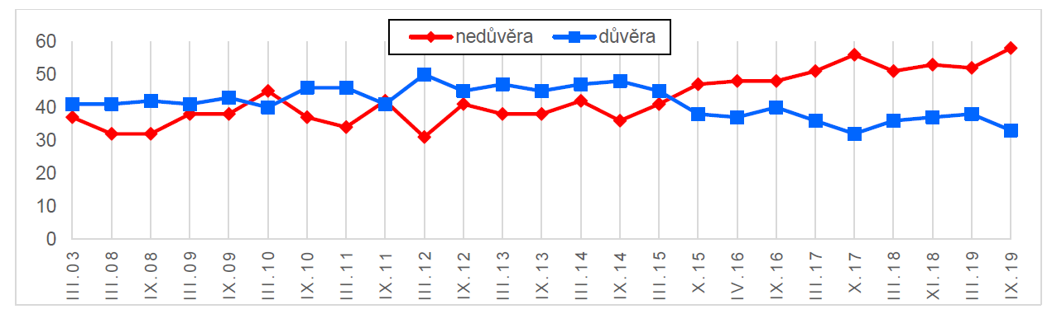
Trust in NPOs (CZE)

Slide 25
NPOs and CSOs responses
Have had to become more sophisticated
Created more complex organizational structures
Taken advantage of new technologies – Internet activism fundamentally altered civic participation and advocacy
Invested in effective research
Increasingly turned to collaborations, including some with business organizations

Slide 26
Citizen Lobbying: How Your Skills Can Fix Democracy
By Alberto Alemanno (at TEDxBrussels)
https://www.youtube.com/watch?v=WqNf2OPdu8c

Slide 27
Going the Digital Route
By Marci Harris, a former congressional staffer, founded Popvox, a non-partisan platform to engage digitally with Congress https://www.youtube.com/watch?v=5aKyYR-iWpc

Slide 28
Advocacy Through Social Media: Why Trending Topics Matter
By Karen McAlister (at TEDxUTA)
https://www.youtube.com/watch?v=o4sGLLaLq-Q

Slide 29
Thank you for your attention

