Slide 1
Social Entrepreneurship Introduction
Masarykova Univerzita, Brno
October 6th, 2017
Martin Hölz, M.A. (modified by V. Hyánek)
1

Slide 2
Introducing
https://www.youtube.com/watch?v=shbcHtvqHus

Slide 3
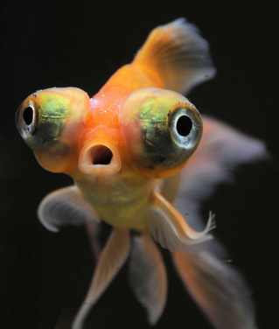
A new fish in the water?

Slide 4
.what is social entrepreneurship all about?

Slide 5
Working on and solving social problems…
… with innovative ideas. So is social entrepreneurship the research and development department of society?
… with entreprenuerial, often market-based approaches: So does social entrepreneurship overcome market failure?
… in many thematic fields: education, social services, care taking, environment, green energy, economic development on a regional scale, fairtrade etc. So does one size fit all?

Slide 6
The European Union´s point of view:
...an operator in the social economy whose main objective is to have a social impact rather than make a profit for their owners or shareholders. It operates by providing goods and services for the market in an entrepreneurial and innovative fashion and uses its profits primarily to achieve social objectives. It is managed in an open and responsible manner and, in particular, involves employees, consumers and stakeholders affected by its commercial activities.
https://ec.europa.eu/growth/sectors/social-economy_en
https://ec.europa.eu/growth/sectors/social-economy/enterprises_en

Slide 7
The Commission uses the term 'social enterprise' to cover the following types of business:
Those for who the social or societal objective of the common good is the reason for the commercial activity, often in the form of a high level of social innovation
Those whose profits are mainly reinvested to achieve this social objective
Those where the method of organisation or the ownership system reflects the enterprise's mission, using democratic or participatory principles or focusing on social justice
There is no single legal form for social enterprises. Many social enterprises operate in the form of social cooperatives, some registered as private companies limited by guarantee, some are mutual, and a lot of them are non-profit-distributing organisations like provident societies, associations, voluntary organisations, charities or foundations.

Slide 8
Social enterprises mainly operate in 4 fields:
Work integration - training and integration of people with disabilities and unemployed people
Personal social services - health, well-being and medical care, professional training, education, health services, childcare services, services for elderly people, or aid for disadvantaged people
Local development of disadvantaged areas - social enterprises in remote rural areas, neighbourhood development/rehabilitation schemes in urban areas, development aid and development cooperation with third countries
Other - including recycling, environmental protection, sports, arts, culture or historical preservation, science, research and innovation, consumer protection and amateur sports

Slide 9
The European Union´s point of view:
What is Social Enterprise?
https://www.youtube.com/watch?v=5PKBL4C4TJQ
Notes:
Thus to SE belong:
· businesses providing social services and/or goods and services to vulnerable persons (access to housing, health care, assistance for elderly or disabled persons, inclusion of vulnerable groups, child care, access to employment and training, dependency management, etc.); and/or
· businesses with a method of production of goods or services with a social objective (social and professional integration via access to employment for people disadvantaged in particular by insufficient qualifications or social or professional problems leading to exclusion and marginalisation) but whose activity may be outside the realm of the provision of social goods or services.

Slide 10
Market? State? Civil Society?
Family/ Community
Social Entrepreneurs as hybrids that combine several institutional logics
Informal
networks
Social Entrepreneur
Organization
(social economy)
CIVIL SOCIETY
NPO’s
NGO’s
State
Market

Slide 11
Market? State? Civil Society?
Civil Society Market
(Quelle: Alter 2004)

Slide 12
Stability… tability
…the social economy has emerged from the economic and financial crisis largely unscathed. Today, the sector provides paid employment to 6.3% of the working population in the EU-28, compared to 6.5% in 2012…
http://www.ciriec.ulg.ac.be/wp-content/uploads/2017/10/RecentEvolutionsSEinEU_Study2017.pdf

Slide 13
a …& broader context much broader context
…activities undertaken by Social Economy entities have a much broader context, namely the building of both participatory democracy and social capital. This applies in a special way to the Member States, which have joined the EU since 2004. Most of them were until 1989/1990 socialist countries under the domination of the Soviet Union with non-existing or very limited activities by civil society.
…while the paid employment rate in the social economy is 6.3% in the EU as a whole, the same rate in the "new" Member States amounts to an average of 2.5%
http://www.ciriec.ulg.ac.be/wp-content/uploads/2017/10/RecentEvolutionsSEinEU_Study2017.pdf

Slide 14
.overlapping semantics
Social entrepreneur
Social entrepreneurship
Social entrepreneurship organization

Slide 15
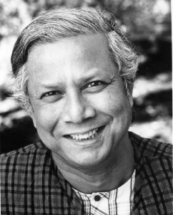
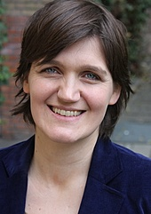
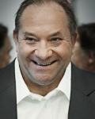
Social Entrepreneurs – some examples
Quelle: moralheroes.org
Muhammad Yunus
Grameen
Quelle: arbeiterkind.de
Katja Urbatsch
Arbeiterkind.de
Quelle: entrepreneurship.de
Anderas Heinecke Dialog im Dunkeln
A list to distinguished social entrepreneurs:
Germany: http://germany.ashoka.org/fellows
International: https://www.ashoka.org/fellows ; http://www.schwabfound.org/entrepreneurs
15 Social Entrepreneurs and Their Crazy Ideas https://www.youtube.com/watch?v=nlXKcpgPP6M

Slide 16
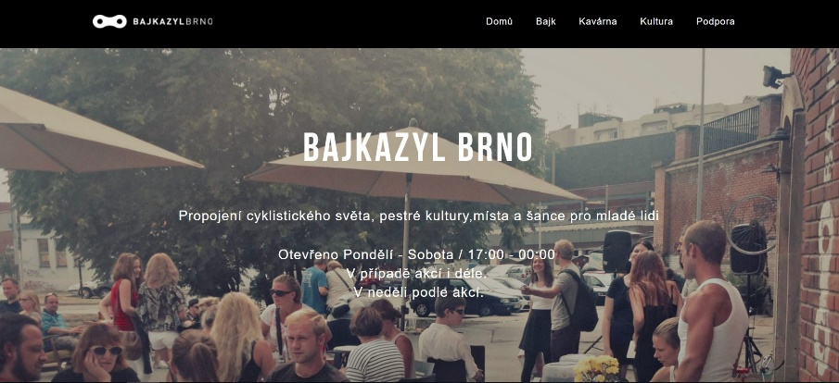
… and some „unknown“ examples:
Entrepreneurial ideas and incentives in the social service sector, by municipalities, by cooperatives:
→ Bias in the media: only few social entrepreneurs with a high „glamour“ are in the focus

Slide 17
An elite phenomena?
(Quelle: MEFOSE Studie (Jansen et al. 2013), Grafik erschienen in Enorm, Wirtschaft für den Menschen)

Slide 18
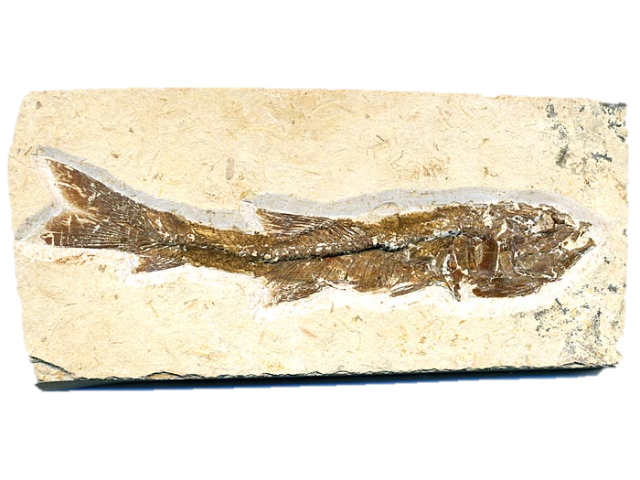
.new or fossils?
Quelle: www.fossilien.de

Slide 19
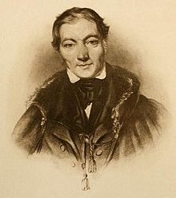
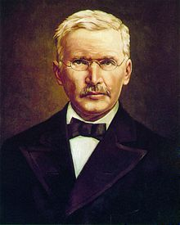
Robert Owen,
1771-1858; entrepreneur and co-founder of cooperative system
Florence Nightingale,
1820 - 1910; nurse, founder of modern nursing
Maria Montessori,
1870 - 1952; physician, founder of Montessori educational institutions
Friedrich Wilhelm Raiffeisen 1818 - 1888; official, micro credit, cooperative bank system
Social Entrepreneurs are not a new phenomenon

Slide 20
How does it work?
© national geopgrahic

Slide 21
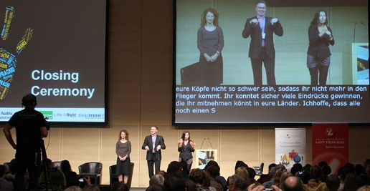
Case Studies
Verbavoice (München)
Direct SE approach of value creation
Field of activity: | services for hearing-impaired people
Approach: | providing mobile, ICT-based interpreters services that allows hearing-impaired to participate in society (education, events, public authorities, media)
Income structure: | service fees via public social service systems; growth capital from impact investment fund
Legal form: | limited liability company (GmbH)

Slide 22
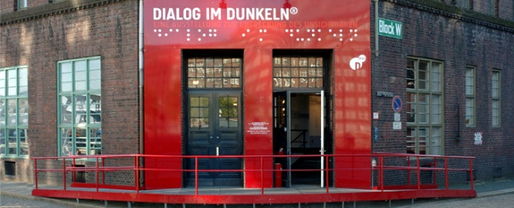
Case Studies
Dialogue in the Dark / Dialogue Social Enterprise
Direct-indirect SE approach of value creation
Field of activity: | Work integration for visually-impaired people; awareness enhancement
Approach: | Visually impaired people serve as guides or coaches in public exhibitions and team building and leadership workshops in the dark; international franchise system
Income structure: | service fees, consultancy fees for franchisees, license payments, donations
Legal form: | limited liability company, association

Slide 23
Case Studies
Regionalwert AG
Indirect SE approach of value creation
Field of activity: | Regional agricultural / economic development
Approach: | Local shareholders invest in fund; fund facilitates local value chains by buying and leasing farms and related businesses and emphasize social and ecological production conditions
Income structure: | Rents, equity interest
Legal form: | public company / stock corporation

Slide 24
Resources
→ Hybrid financing (revenues, grants, subsidies, etc.)
→ Varies over time
Volunteering and volunteers are often mobilized ← Only seldom SE resolves market failure
(Quelle: MEFOSE Studie (Jansen et al. 2013), Grafik erschienen in Enorm, Wirtschaft für den Menschen)

Slide 25
Resources
Optional:
5 Keys to Success For Social Entrepreneurs: Lluis Pareras at TEDxBarcelonaChange
https://www.youtube.com/watch?v=Pl8c5ooHfWs

Slide 26
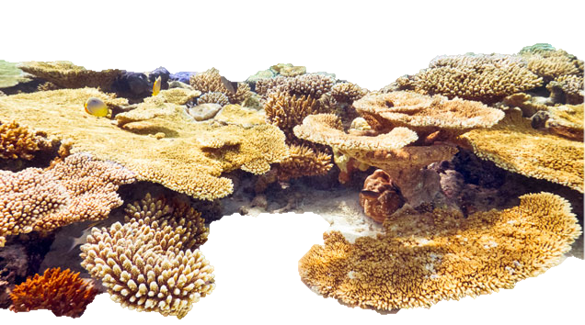
…and the environment
Quelle: www.klassewasser.de

Slide 27
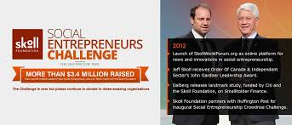
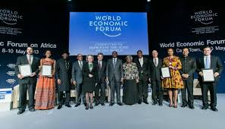
Eco system - promotion agencies

Slide 28
Eco system – social spaces
Networking and support: hubs, labs, moocs, etc.

Slide 29
Eco system – financial support
Financing: Social Investemt Funds, Foundations, Fellowship Programmes
- adapted to specific needs (e.g. duration until break even, due to innovation costs, etc. )

Slide 30
Eco system – education and research
Education: universities, private or non-profit institutes (from student to executive level)

Slide 31
Eco system – politics and policies
Policy:
EU Level: http://ec.europa.eu/internal_market/social_business/index_de.htm
Single Market Act – Social Business Initiative
National Level: http://www.bmwi.de/DE/Mediathek/publikationen,did=714908.html
Engagement Strategy of National German Government
→ The potential of social entrepreneurs and social entrepreneurship as model of solving problems is recognized [over-estimated?]

Slide 32
…where is the catch?
Quelle: www.simfisch.de

Slide 33
Problems
What does „social“ mean? → is subject to societal negotiation processes
Impact and scaling: How influential are social entrepreneurship organizations in huge social service markets? How is it possible for good approaches to be spread?
Trade offs between social and economic goals: where do they emerge / how are they tackled and solved?

Slide 34
Selection of problems (financing, surroundings, organizational development)
High local rooting with complex stakeholder structures: How is it possible to replicate / transfer this into different contexts?
Lack of qualified staff and professionals: specific demands for and in social entrepreneurship organizations, low salaries, entrepreneurial risk
Status Quo preference and competitive thinking: established actors in administration and welfare state organizations might be reluctant towards / avoid change
Organizational development and quality cntrol: Are good innovators / social entrepreneurs good managers, too?
A question of scaling: Yes? No? If yes, who is responsible?
Notes:
Kurze verbale Ausführungen zu den einzelnen Punkten inc Beispiele – ggfs auch unterscheidung zwischen SE und SI

Slide 35
Problems of financing
Structural barriers of connectivity to public funding and social security systems, as social entrepreneurs act across sector boundaries and often support preventive work
Limited offers on the free capital market barrier for non-profit organizations
Lack of broad share or competition among impact investors
Buereaucratic barriers regarding applications, reporting and monitoring
„Fear of contact“ between social and economic sector

Slide 36
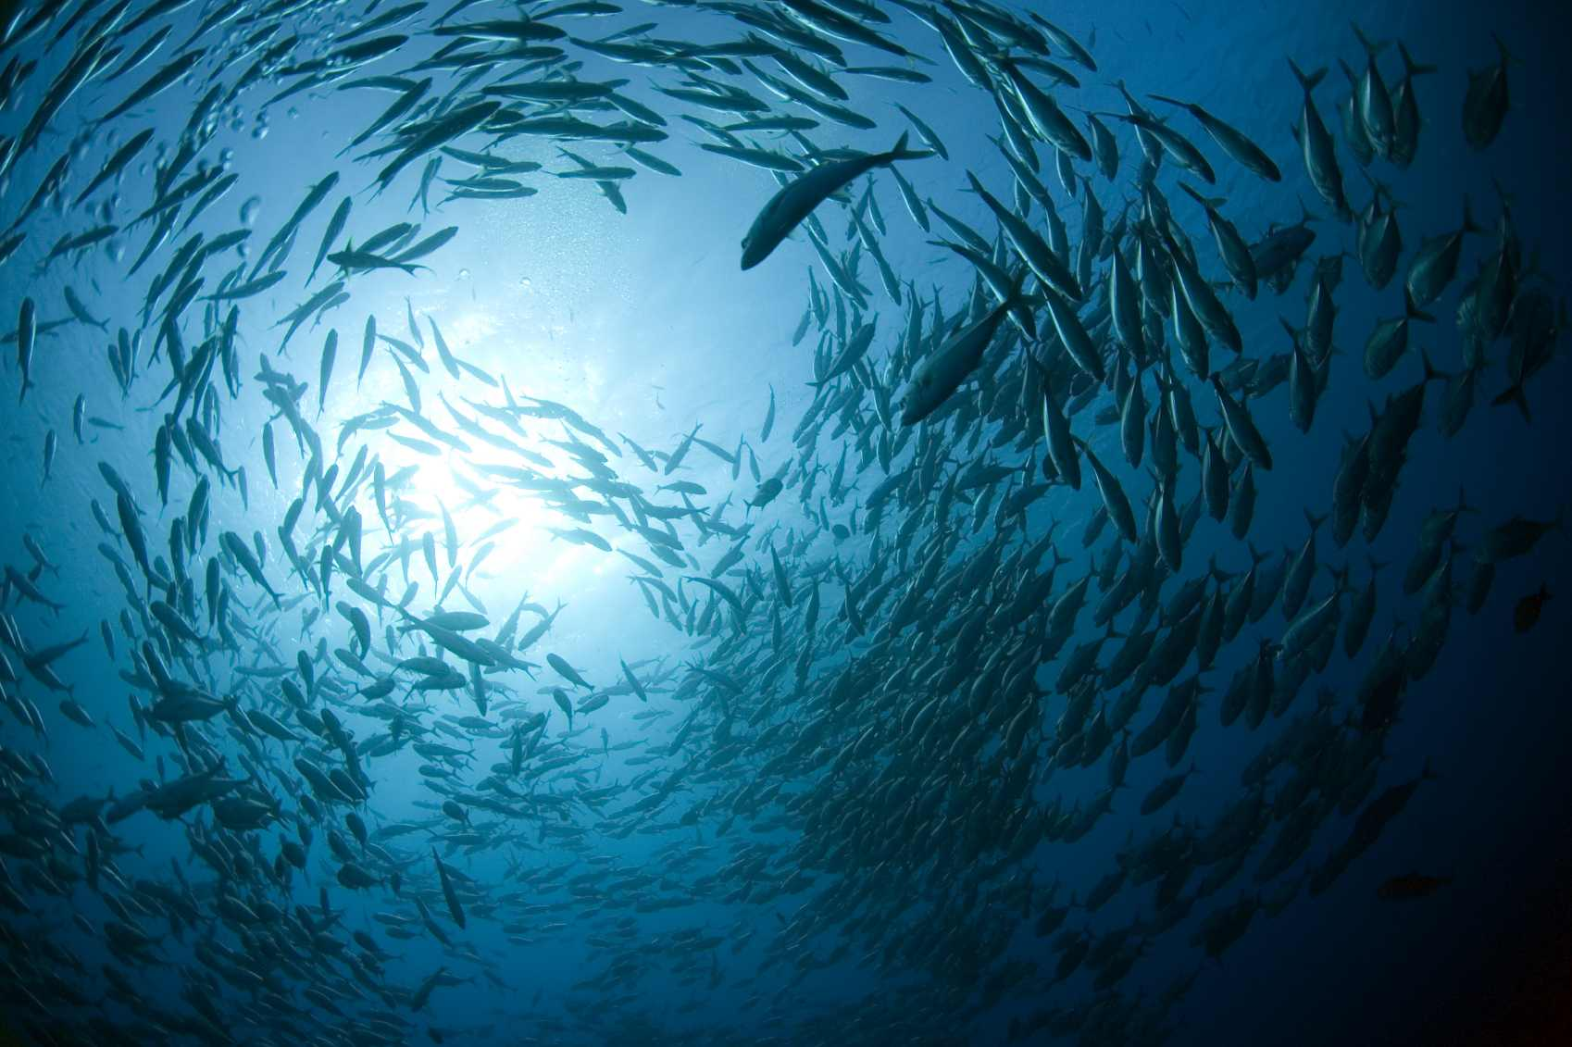
. further readings
Quelle: www.stohl.de

Slide 37
Alter, K. (2004). Social enterprise typology. Virtue Venures (Vol. 2004). Virtue Ventures LLC. http://rinovations.edublogs.org/files/2008/07/setypology.pdf
Achleiter, A.K. & Spiess-Knafl, W. (2010). Social Entrepreneurship. Eine Einführung für Studenten. TU München, http://socent.e-learning.imb-uni-augsburg.de/files/Social%20Entrepreneurship.%20Eine%20Einf%C3%BChrung.pdf
Hackenberg, Helga, Empter, Stefan (Hrsg.). (2011). Social Entrepreneurship - Social Business: Für die Gesellschaft unternehmen. Wiesbaden: Springer VS
Jansen, Stephan A, Heinze, Rolf G., Beckmann, Markus (Hrsg.) (2013). Sozialunternehmen in Deutschland - Analysen, Trends und Handlungsempfehlungen. Wiesbaden: Springer VS
Kopf, Hartmut, Müller, Susan, Rüede, Dmonik, Lurtz, Kathrin, Russo, Peter (2015). Soziale Innovationen in Deutschland. Wiesbaden: Springer VS
Nicholls, A., & Murdock, A. (2011). Social Innovation: Blurring Boundaries to Reconfigure Markets. (A. Nicholls & A. Murdock, Eds.). Hampshire, UK & New York: Macmillan.
Mair, J., Robinson, J., & Hockerts, K. (2006). Social Entrepreneurship. (J. Mair, J. Robinson, & K. Hockerts, Eds.). Basingstoke: Palgrave Macmillan.

