Slide 1
Introduction to gretl
Dali Laxton
08.10.2021

Slide 2






Outline
1 What is gretl?
2
Installing gretl
3
Importing Data
4
Saving as gretl File
5
Running a Script
6 First Exercises
7
Commands on Datasets
8
Commands on Variables
9
Graphs

Slide 3
What is gretl?
What is gretl?
gretl is an acronym for Gnu Regression Econometrics and
Time-series Library
it is free econometrics software
it has an easy Graphical User Interface (gui)
it runs least-squares, maximum-likelihood, systems estimators... it outputs results to several formats
very important for us in this course: it admits scripts (sequence of commands saved in a file)
1 / 42

Slide 4
How do I get gretl?
What is gretl?
Gretl is an open-source free software anyone can install it on home desktop without the need of license
In order to install it go to:
http://gretl.sourceforge.net
It runs on Windows, Mac, Linux
2 / 42

Slide 5
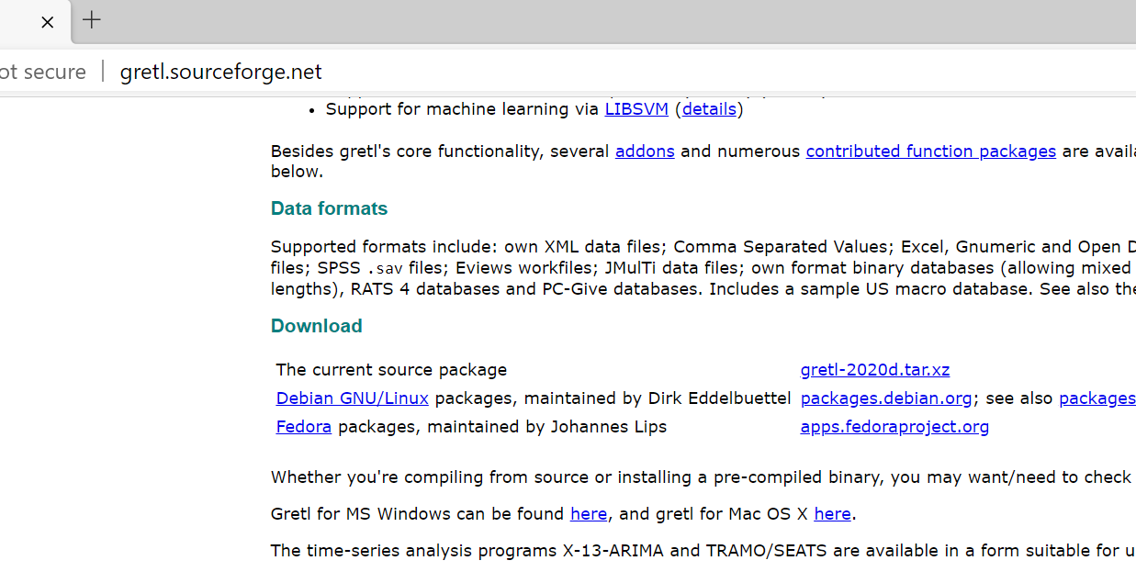
Installation
Open the webpage and go down where Download section is located. Click on the circled button for windows users

Slide 6
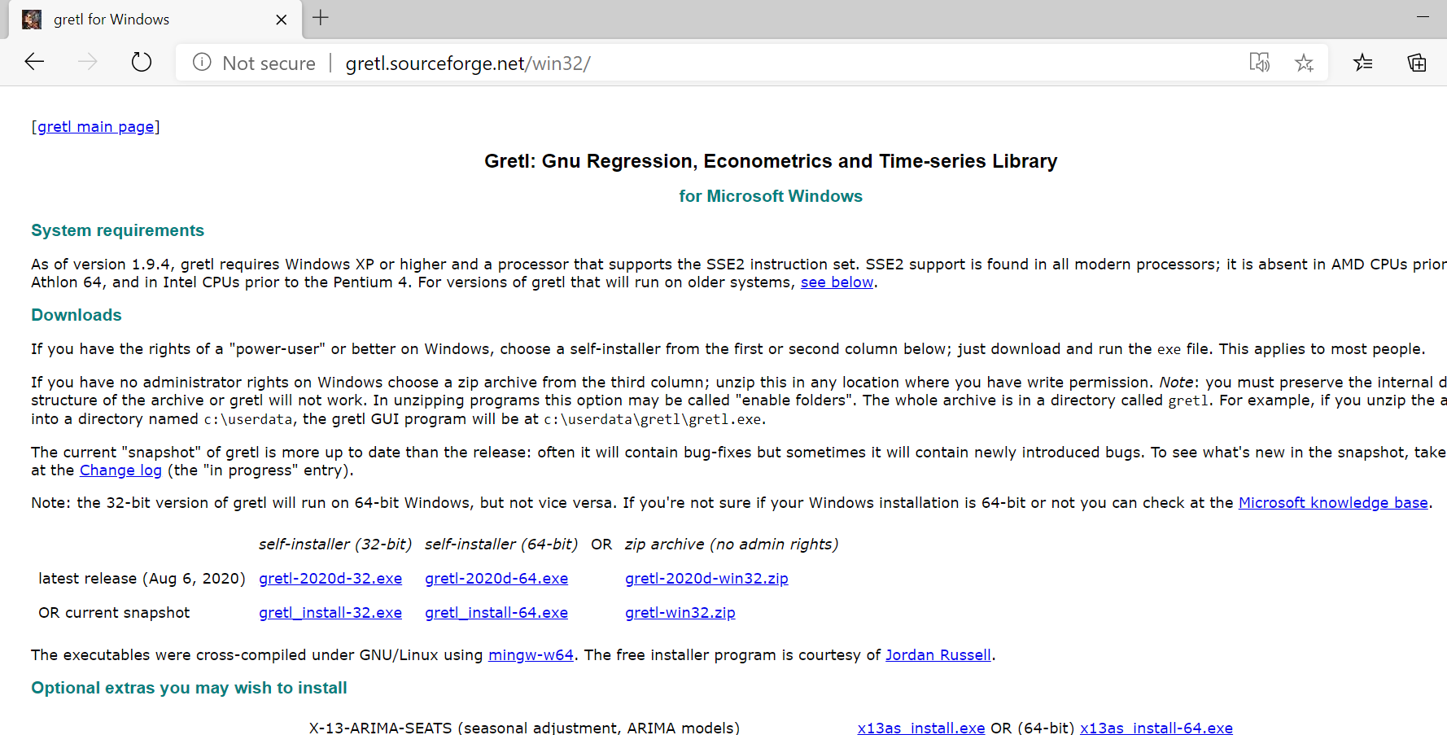
Installation
Choose the .exe file which is appropriate for your system

Slide 7
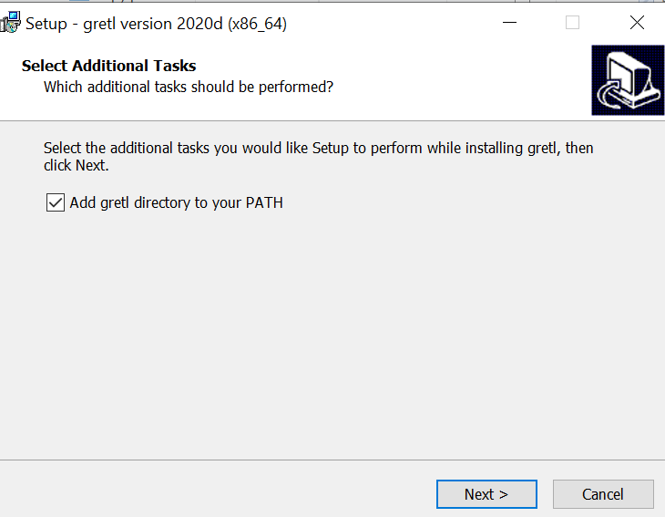
Installation
Run the .exe file and choose default options to proceed. Do not forget to add gretl directory to your PATH

Slide 8
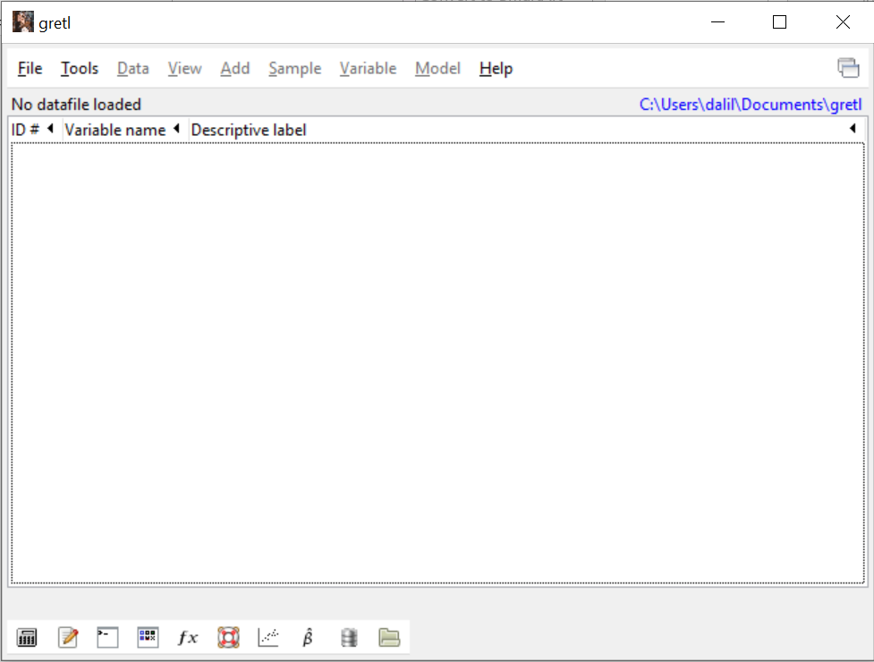
Start gretl
To start gretl you can just type gretl in your search button. Select it and an empty gretl window will pop out. You can either run commands directly in the gretl console or write scripts and save them for future use
Gretl scripts
Gretl console

Slide 9
How do I work with gretl?(1/2)
What is gretl?
the easiest way for beginners is by using its graphical user interface
you can also use the console button of the toolbar: from the prompt (?) you can execute gretl commands one line at a time.
the most efficient way is by using scripts:
1
create a script file, write gretl commands one every line, and save it run the script using the gui
inspect output
if needed, change script file, save it, and go back to step 2
2
3
4
3 / 42

Slide 10
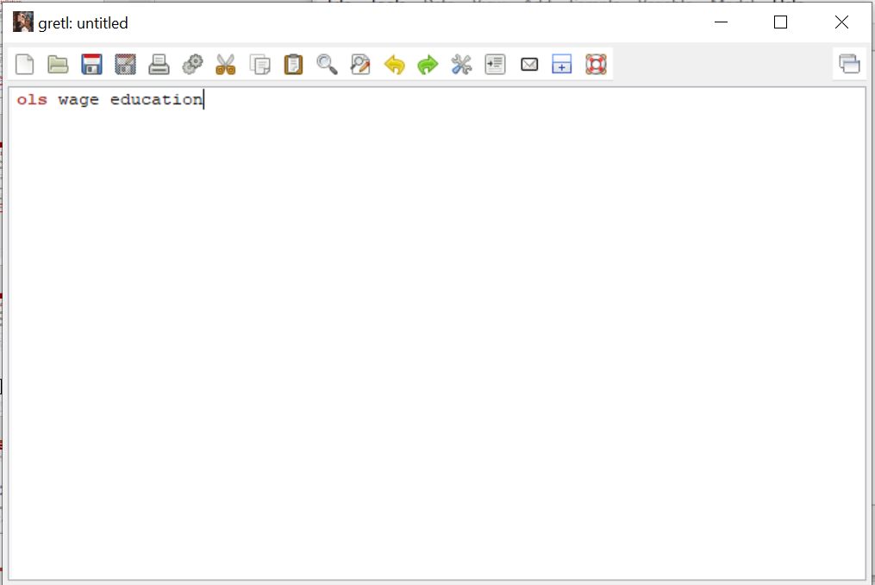
Running commands in the script
Click CTRL + R or click the button shown below. The window with outputs (or errors) will open. If you save these scripts, it will be saved as .inp file.

Slide 11
How do I work with gretl?(2/2)
What is gretl?
you know your way using the gui, but want to know about scripts...
gretl comes with over 70 practice scripts
The manual gives good advice and devotes several chapters to provide good programming solutions
This course will provide you with tested scripts
1
2
3
4 / 42

Slide 12
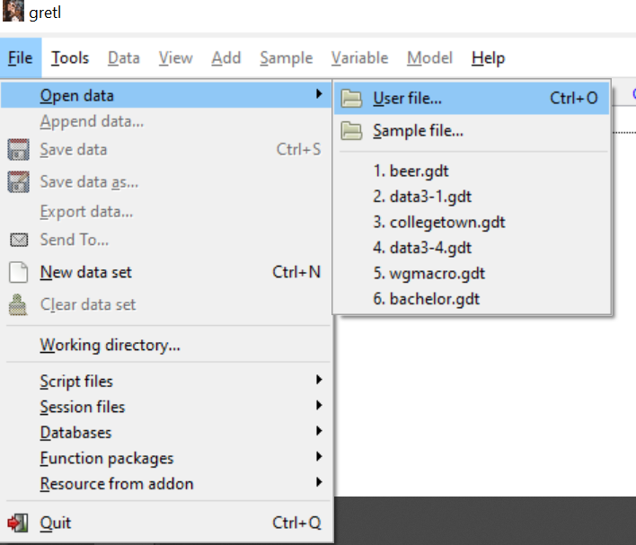
Opening datasets
Gretl comes with inbuilt datasets which you can play with
Go File -> Open data -> Sample file and this will give you lots of datasets, or alternatively, go to specific data file which you want to access in your computer by choosing User file instead of sample file

Slide 13
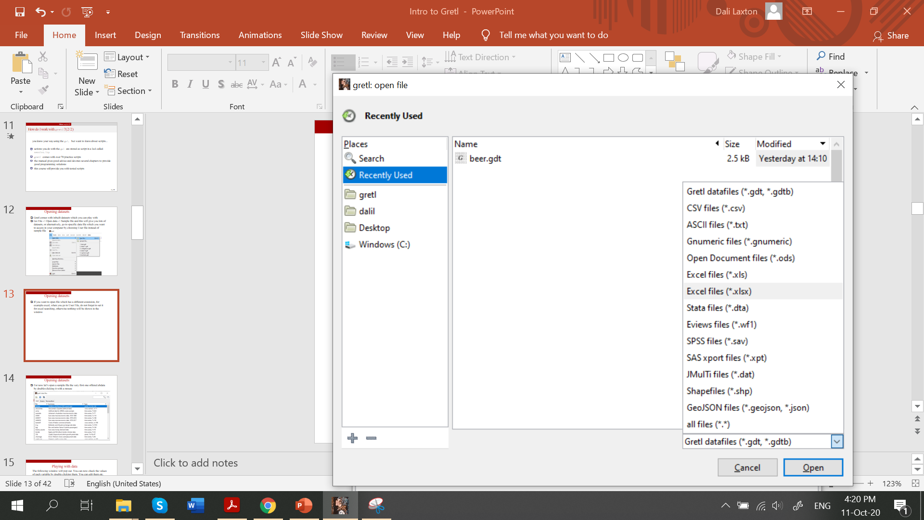
Opening datasets
If you want to open file which has a different extension, for example excel, when you go to User File, do not forget to set it for excel searching, otherwise nothing will be shown in the window

Slide 14
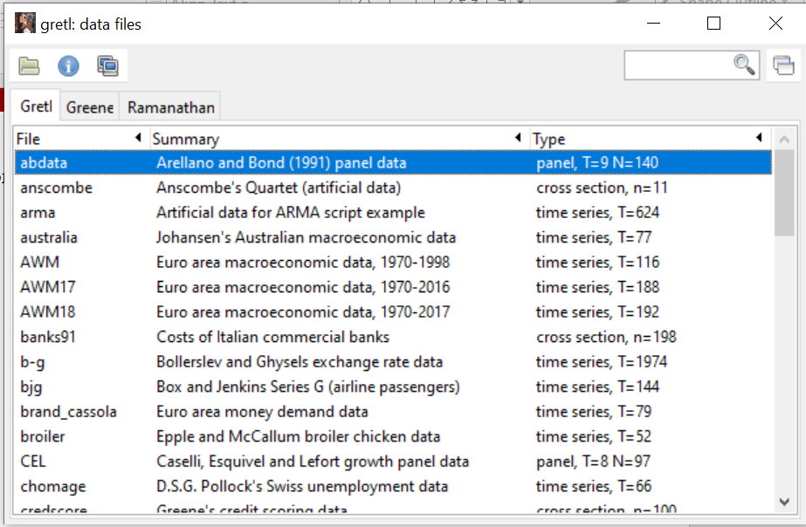
Opening datasets
For now let’s open a Sample file the very first one offered ‘abdata’ by double-clicking it with a mouse

Slide 15
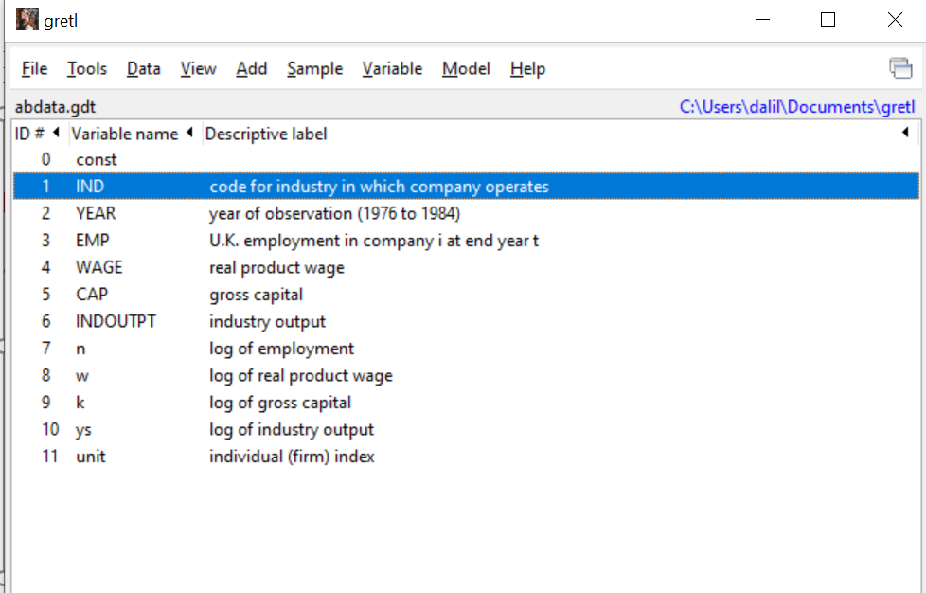
Playing with data
The following window will pop out. You can now check the values of each variable by double clicking them. You can edit them etc.

Slide 16
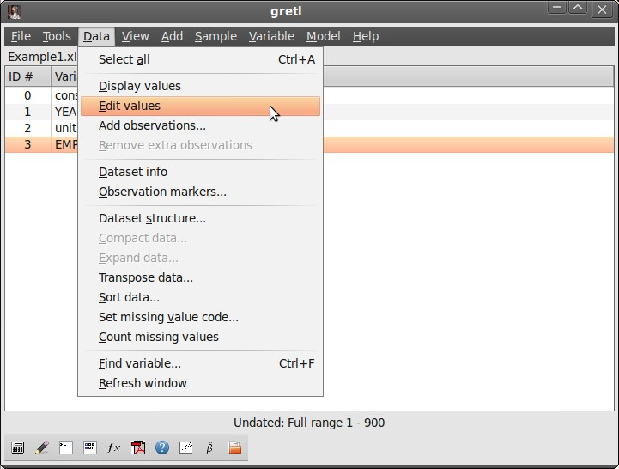
Operations on variables
See summary statistics of variables by highlighting them and clicking Variable -> summary statistics in the upper panel
Change values of variables by highlighting it and clicking Data -> Edit values

Slide 17
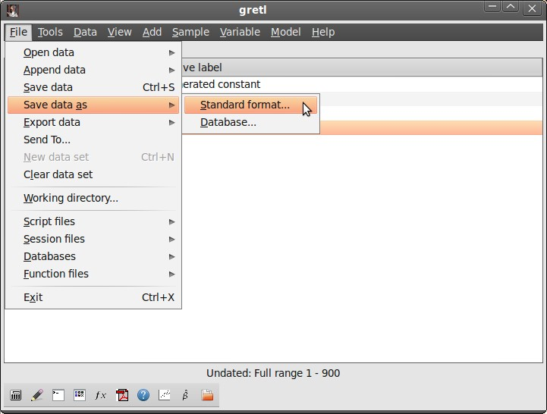
Saving as gretl File
Saving as a new gretl File
You can open any other type of file using gretl (excel), do some operations on them and then save as a gretl file (.gdt) by clicking: File ->Save Data as ->Standard format

Slide 18
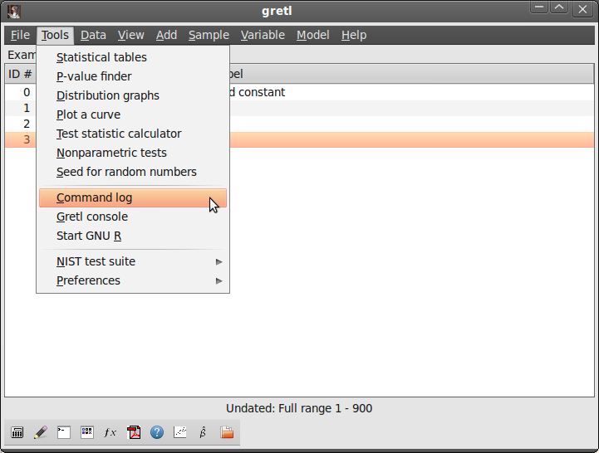
Running a Script
Looking at the Session Script
Tools > Command log displays the operations that we have done so far. It is recorded only if we run the commands from the console or GUI. If we run them from the script, logs won’t record them

Slide 19
More on scripts
Running a Script
using File/Script files/New script you open the command script editor
If you have a very long command that exceeds one line, use the backslash (\) as a continuation command
using scripts (and the console) requires you to use the correct language syntax
gretl's language is case sensitive: gretl considers x to be different from X
you can find all the commands in the gretl command reference after clicking Help -> command reference
at the console window, you can type help

Slide 20
Exercise 1
First Exercises
Load the file engel.gdt. The data set contains two variables named income and foodexp. The variable foodexp is annual expenditures on food in a household and income is annual income measured in $100 increments.
Using GUI, add natural logs of both variables.
Using GUI, summarize foodexp for households with income below the median.
Using GUI, plot foodexp against income.
Write all the commands in a script file and save it.
Open the script and run the commands.
Save the new dataset.
6

Slide 21
Exercise 2
First Exercises
The file BWGHT.csv contains information about infants' birth weight, gender and race, the income of their faimilies, their parents' education and the number of cigarettes the mother smoked per day during pregnancy (msmoke).
Import from gretl the file BWEIGHT.xlsx
Compute the average birth weight for all the babies in the sample, and separately for boys and girls.
Compute the proportion of mothers that smoked during pregnancy.
Which familiy variables do you think are related to children's birth weight? Compute the correlation among bwght and those variables.
Save the new database in gretl format.
Write down all the previous commands in a script and save it. Close your session, open the script and run all the commands together.
1
2
3
4
5
6

Slide 22
Basic commands for data management (1/2)
First Exercises
Commands on the entire data
open: opens a data file replacing any data file already open smpl: defines the sample range
dataset: sorts/clears/transposes/adds observations and more
setobs: declares the structure of the data (cross-section, time-series, panel)
append: appends the content of a data to the current dataset store: saves the data into a file

Slide 23
Basic commands for data management (2/2)
First Exercises
Basic commands on variables genr: creates a new variable delete: removes variables
setinfo: sets attributes of a variable rename: renames a variable
summary: shows summary statistics for variables print: lists the values of variables

Slide 24
Commands on Datasets
open dataname −−www −−sheet= "name"
−−coloffset=# −−rowoffset=#
opens a dataset replacing any already loaded data
−−www opens database in gretl server
with spreadsheets, it selects the worksheet, and the first column and row
the first row must contain valid variable names. In the case of an ASCII or CSV import, if the file contains no row with variable names the program will automatically add names, v1, v2 and so on.
Open C:\Users\dalil\Documents\1.Masaryk\1.Econ_Dali\Gretl−−sheet=bweight −−coloffset=2 −−rowoffset=2
opens worksheet located on C drive called bweight
reads the data from the third column and third row

Slide 25
smpl (#start #end | condition −−restrict | # −−random | full) −−replace −−balanced
Commands on Datasets
condition −−restrict: restricts the sample to observations that satisfy the condition
# −−random: # cases are ramdomly selected full: restores the full data range
sample restrictions are by default cumulative: −−replace turns off all previous restrictions
Examples
smpl YEAR!=1976 −−restrict
smpl EMP > 3 −−restrict −−replace
smpl 50 −−random

Slide 26
rename varname newname
Commands on Variables
changes the name of the variable
names must be of 15 characters maximum they must start with a letter
they must be composed of only letters, digits, and the underscore character
Example in bwght.gdt
rename bweight birth_weight

Slide 27
dataset (addobs # | transpose | sortby varname | resample # | clear)
Commands on Datasets
addobs: adds extra observations at the end transpose: transposes current data set.
sortby: sorts data by varname (dsortby: descending order) (a list of variables can be provided; available only for undated data).
resample: random sampling (Constructs a new dataset by random
sampling, with replacement, of the rows of the current dataset. The original dataset can be retrieved via the command smpl full).
clear: clears out current data
Examples
dataset sortby msmoke dataset resample 500 dataset clear

Slide 28
Commands on Datasets
setobs #freq #start (−−cross-section | −−time-series |
−−stacked-cross-section | −−stacked-time-series)
#freq represents frequency in time-series data
in panel, #freq is units in stacked cross-sections or periods in stacked time series
for cross-sections, #freq=1
#start=1 for panels and cross-sections in time series, #start is the starting date

Slide 29
setobs unitvar timevar −−panel-vars
Commands on Datasets
imposes a panel interpretation
sorts data as stacked time series, by ascending values of unitvar
Examples
setobs 1 1 −−cross-section
setobs 20 1:1 −−stacked-time-series setobs unit year −−panel-vars

Slide 30
append newdata −−time-series
Commands on Datasets
opens a data file and appends the content to the current dataset First case: additional observations for existing variables
Second case: new variables (best if #obs compatible) Third case: appends a time series in a panel
First Case
open C:\there\Example2.xls −−sheet= first100 append C:\there\Example2.xls −−sheet= moreunits
appends worksheet moreunits from C:\there\Example2.xls
Second Case
append C:\there\Example2.xls −−sheet= wages appends worksheet wages from C:\there\Example2.xls

Slide 31
append
Commands on Datasets
Third Case
You have a panel and you want to add a variable which is available in time-series form. For example, you want to add annual CPI data to a panel in order to de ate nominal income gures.
open the data: C:\there\Example2.xls −−sheet= first100 you need to have a panel: setobs unit year panel-vars append C:\there\Example2.xls −−sheet= cpi

Slide 32
[genr] newvar = formula
Commands on Variables
a formula is a well-formed function of variables
the range over which the result is written depends on the current sample
arithmetical operators: ^, *, /, + , -
boolean operators: ! (negation), && (AND), || (OR), >, <, =, >= ,
<= , !=
look at the gretl Function Reference (Help/Function Reference) for built-in functions
Examples
genr y = 3 + 2 * x1 + 5 * x2 + error D1976 = (YEAR = 1976)
genr avgy = mean(y)

Slide 33
delete [ varlist ] −−db
Commands on Variables
removes listed variables
if no varlist is given, it deletes the last (highest numbered) variable from the dataset
−−db: deletes variables from a gretl database

Slide 34
Commands on Variables
setinfo varname −d "thislabel" −n "thisname" −−discrete
−−continuous
−d "thislabel": thislabel is set as the variable's descriptive label
−n "thisname": thisname is used in place of the variable's name in graphs
−−discrete: marks variable as discrete (by default variables are continuous)
Examples
setinfo x1 −d "Description of x1" −n "Graph name" setinfo z −−discrete

Slide 35
print [varlist] −−byobs −−no-dates
Commands on Variables
prints the values of the variables in varlist
if no list is given, prints the values of all variables
−−byobs: data are printed by observation, not by variable you can also print strings
Examples
print bweight male −−byobs print bweight ; male −−byobs print "This is a comment"

