Slide 1
LECTURE 7
Introduction to Econometrics Endogeneity
Dali Laxton
November 26, 2021
1 / 25

Slide 2
A LITTLE REVISION: OLS CLASSICAL ASSUMPTIONS
Linearity: the regression model is linear in the parameters (coefficients)
Random sampling: the data is a random sample drawn from the population and each data point follows the population equation
No perfect collinearity: the values of explanatory variables are not all the same and no explanatory variable is a perfect linear function of any other explanatory variable(s)
Zero conditional mean: values of explanatory variables must contain no information about the mean of the unobserved factors - explanatory variables are uncorrelated with the error term
Homoskedasticity: the error term has a constant variance
Normality of the error term: the error term is normally distributed
2 / 25

Slide 3
ON PREVIOUS LECTURES
We discussed what happens if some of the assumptions are violated
Linearity of coefficients and no perfect multicollinearity are essential for the definition of OLS estimator
Zero mean of the error term is always ensured by the inclusion of intercept
Normality of the error term is needed for statistical inference, but it can be shown that if the number of observations is sufficiently high, the OLS estimate will have asymptotically normal distribution even if the stochastic error term is not normal
Heteroskedasticity leads to incorrect statistical inference, but we have studied tests to detect it and techniques to overcome this problem
3 / 25

Slide 4
ON TODAY’S LECTURE
The assumption of no correlation between explanatory variables and the error term is crucial
Variables that are correlated with the error term are called
endogenous variables (as opposed to exogenous variables)
We will show that the estimated coefficients of endogenous variables are inconsistent and biased
We will explain in which situations we may encounter endogenous variables
We will define the concept of instrumental variables
We will derive the 2SLS technique to deal with endogeneity
4 / 25

Slide 5
ENDOGENOUS VARIABLES
Notation:
Intuition behind the bias:
If an explanatory variable x and the error term ε are correlated with each other, the OLS estimate attributes to x some of the variation in y that actually came form the error term ε
Example: Analysis of household consumption patterns
Households with lower income may indicate higher consumption (because of shame)
Leads to inconsistent estimates
5 / 25

Slide 6
GRAPHICAL REPRESENTATION
True model
Estimated model
Y
X
6 / 25

Slide 7
INCONSISTENCY OF ESTIMATES
We can express
We assume that there exists a finite matrix Q so that
_{1 X'X} n→∞ _{Q}
−→
n
It can be shown that
This implies:
7 / 25

Slide 8
TYPICAL CASES OF ENDOGENEITY
Omitted variable bias
An explanatory variable is omitted from the equation and makes part of the error term
Selection bias
An unobservable characteristic has influence on both dependent and explanatory variables
Simultaneity
The causal relationship between the dependent variable and the explanatory variable goes in both directions
Measurement error
Some of the variables are measured with error
In all 4 cases, the sign of the bias is given by the sign of
Cov(ε_{i}, x_{i})
8 / 25

Slide 9
OMITTED VARIABLE BIAS
Studied on lecture 5
True model: y_{i} = βx_{i} + γz_{i} + u_{i}
Model as it looks when we omit variable z:
This gives
It can be remedied by including the variable in question, but sometimes we do not have data for it
We can include some proxies for such variable, but this may not reduce the bias completely and some endogeneity remains in the equation
9 / 25

Slide 10
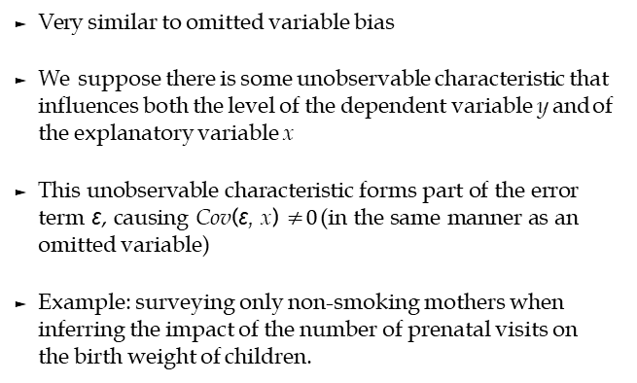
SELECTION BIAS
Very similar to omitted variable bias
We suppose there is some unobservable characteristic that influences both the level of the dependent variable y and of the explanatory variable x
This unobservable characteristic forms part of the error term ε, causing Cov(ε, x) $≠0$ (in the same manner as an omitted variable)
Example: surveying only non-smoking mothers when inferring the impact of the number of prenatal visits on the birth weight of children.
10 / 25
Notes:
Smoking affects both the number of prenatal visits and the birth weight

Slide 11
SIMULTANEITY
Occurs in models where variables are jointly determined
^{y}1i ^{y}2i
= α₀ + α₁y_{2i} + ε_{1i}
= β₀ + β₁y_{1i} + ε_{2i}
Intuitively: change in y_{1i} will cause a change in y_{2i}, which will in turn cause y_{1i} to change again
Technically:
11 / 25

Slide 12
SIMULTANEITY
Example:
^{Q}Di ^{Q}Si ^{Q}Di | = = = | α₀ + α₁P_{i} + α₂I_{i} + ε_{1i} β₀ + β₁P_{i} + ε_{2i} ^{Q}Si
Q_{D} | . . . | quantity demanded
Q_{S} | . . . | quantity supplied
P | . . . | price
I | . . . | income
where
Endogeneity of price: it is determined from the interaction of supply and demand
12 / 25

Slide 13
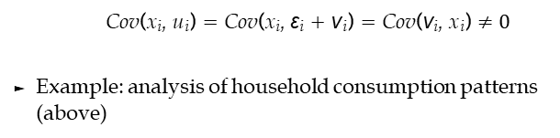
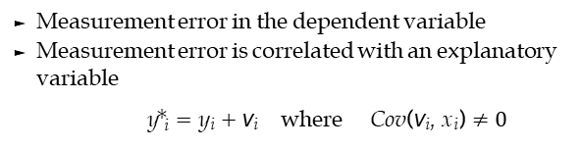
MEASUREMENT ERROR I
Measurement error in the dependent variable
Measurement error is correlated with an explanatory variable
y∗_{i} = y_{i} + ν_{i} where Cov(ν_{i}, x_{i}) $≠0$
True regression model:
Estimated regression:
u_{i} = ε_{i} + ν_{i} and so
y_{i} = β₀ + β₁x_{i} + ε_{i}
y∗_{i} = β₀ + β₁x_{i} + u_{i} where
Cov(x_{i}, u_{i}) = Cov(x_{i}, ε_{i} + ν_{i}) = Cov(ν_{i}, x_{i}) $≠0$
Example: analysis of household consumption patterns (above)
13 / 25

Slide 14
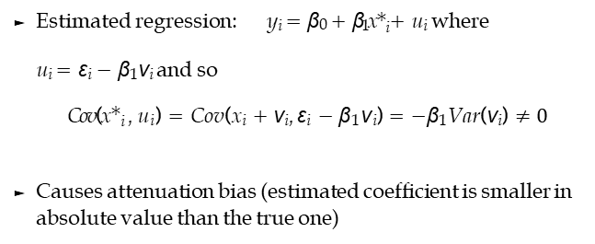
MEASUREMENT ERROR II
Classical measurement error in the explanatory variable
x∗_{i} = x_{i} + ν_{i} where Cov(ν_{i}, x_{i}) = 0
True regression model:
y_{i} = β₀ + β₁x_{i} + ε_{i}
Estimated regression: y_{i} = β₀ + β₁x∗_{i} + u_{i} where
u_{i} = ε_{i} − β₁ν_{i} and so
Cov(x∗_{i} , u_{i}) = Cov(x_{i} + ν_{i}, ε_{i} − β₁ν_{i}) = −β₁Var(ν_{i}) $≠0$
Causes attenuation bias (estimated coefficient is smaller in absolute value than the true one)
14 / 25

Slide 15
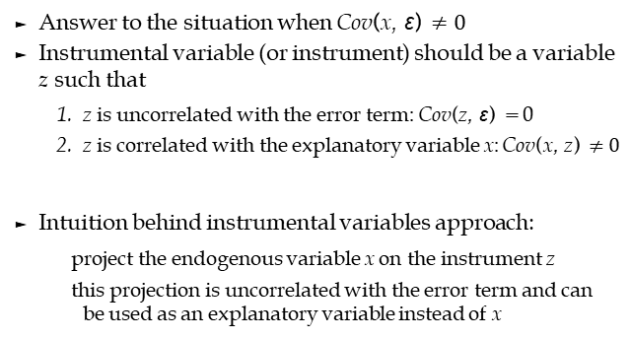
INSTRUMENTAL VARIABLES (IV)
Answer to the situation when Cov(x, ε) $≠0$
Instrumental variable (or instrument) should be a variable
z such that
  z is uncorrelated with the error term: Cov(z, ε) = 0
  z is correlated with the explanatory variable x: Cov(x, z) $≠0$
Intuition behind instrumental variables approach:
project the endogenous variable x on the instrument z
this projection is uncorrelated with the error term and can be used as an explanatory variable instead of x
15 / 25

Slide 16
INSTRUMENTAL VARIABLES
Suppose the equation we want to estimate is:
y = Xβ + η
We can have several instruments for several endogenous variables - we will use the matrix notation Z and X
X denotes endogenous variable(s)
Z denotes instrumental variable(s)
Assume that we have at least as many instruments as endogenous variables
16 / 25

Slide 17
TWO STAGE LEAST SQUARES
2SLS is a method of implementing instrumental variables approach
Consists of two steps:
  Regress the endogenous variables on the instruments
X = Zδ + ν ,
get predicted values
,
  Use these predicted values instead of X in the original equation:
17 / 25

Slide 18
TWO STAGE LEAST SQUARES
The estimate is
This estimate is consistent, but it has higher variance than OLS (it is not efficient)
Intuitively:
Only part of the variation in X that is uncorrelated with the error term is used for the estimation.
^
This ensures consistency (X that is uncorrelated with error
term).
But it makes the estimate less precise (higher variance of$\hat{β}$
because not all variation in X is used.
18 / 25

Slide 19
EXAMPLE
Estimating the impact of education on the number of children for a sample of women in Botswana
OLS:
Source | SS | df | MS
Model | 12243.0295 | 3 | 4081.00985
Residual | 9284.14679 | 4357 | 2.13085765
Total | 21527.1763 | 4360 | 4.93742577
Number of obs = 4361 F( 3, 4357) = 1915.20
Prob > F | = | 0.0000
R-squared | = | 0.5687
Adj R-squared | = | 0.5684
Root MSE | = | 1.4597
children | Coef. | Std. Err. | t | P>|t| | [95% Conf. | Interval]
educ | -.0905755 | .0059207 | -15.30 | 0.000 | -.102183 | -.0789679
age | .3324486 | .0165495 | 20.09 | 0.000 | .3000032 | .364894
agesq | -.0026308 | .0002726 | -9.65 | 0.000 | -.0031652 | -.0020964
_cons | -4.138307 | .2405942 | -17.20 | 0.000 | -4.609994 | -3.66662
19 / 25

Slide 20
EXAMPLE
Education may be endogenous - both education and number of children may be influenced by some unobserved socioeconomic factors
Omitted variable bias: family background is an unobserved factor that influences both the number of children and years of education
Finding possible instrument:
Something that explains education
But is not correlated with the family background
A dummy variable
20 / 25

Slide 21
EXAMPLE
Intuition behind the instrument:
The first condition - instrument explains education:
School year in Botswana starts in January
⇒ Thus, women born in the first half of the year start school when they are at least six and a half.
Schooling is compulsory till the age of 15
⇒ Thus, women born in the first half of the year get less education if they leave school at the age of 15.
The second condition - instrument is uncorrelated with the error term:
Being born in the first half of the year is uncorrelated with the unobserved socioeconomic factors that influence education and number of children (family background etc.)
21 / 25

Slide 22
EXAMPLE

Slide 23
EXAMPLE
Instrumental variables (2SLS) regression
Number of obs =
4361
Wald chi2(3) Prob > chi2 R-squared Root MSE
= 5300.22
= 0.0000
= 0.5502
= 1.49
children | Coef. | Std. Err. | z | P>|z| | [95% Conf. | Interval]
educ | -.1714989 | .0531553 | -3.23 | 0.001 | -.2756813 | -.0673165
age | .3236052 | .0178514 | 18.13 | 0.000 | .2886171 | .3585934
agesq | -.0026723 | .0002796 | -9.56 | 0.000 | -.0032202 | -.0021244
_cons | -3.387805 | .5478988 | -6.18 | 0.000 | -4.461667 | -2.313943
Instrumented: educ
Instruments: age agesq frsthalf

Slide 24
EXAMPLE
Compare the estimates from OLS and 2SLS:
OLS:
children | Coef. | Std. Err. | t | P>|t| | [95% Conf. | Interval]
educ | -.0905755 | .0059207 | -15.30 | 0.000 | -.102183 | -.0789679
2SLS:
children | Coef. | Std. Err. | z | P>|z| | [95% Conf. | Interval]
educ | -.1714989 | .0531553 | -3.23 | 0.001 | -.2756813 | -.0673165
Is the bias reduced by IV?
Are these results statistically different?
24 / 25

Slide 25
SUMMARY
We showed that the estimated coefficients of endogenous variables are inconsistent and biased
In which situations we may encounter endogenous variables
Omitted variable (omitting important variable which is correlated to independent variable)
Selection bias (unobserved factors influencing both dependent and independent variable)
Simultaneity (causality goes both ways)
Measurement error (in either dependent or independent variable)
We can deal with endogeneity by using instrumental variables (2SLS technique)
25 / 25

