Slide 1
Natural Backround of Landscape Management
Tomáš Koutecký
Mendel University in Brno
The Main Principles of Landscape Ecology
(with examples from the Czech Republic)

Slide 2
Content of the Lecture:
Landscape in general
(landscape structure, history, perception…)
Landscape Ecology Backround
Ecological niche concept
Metapopulation concept
Island biogeography
Landscape fragmentation
Ecological succession
Human impact and Ecosystem changes

Slide 3
Landscape
Wikipedia Definition:
A landscape is the visible features of an area of land (…)
The Features:
hills, valleys, plains, rivers, lakes, forests, meadows, fields, settlement, transport infrastructure, industrial facilities…
Geophysically defined features
Biotic landscape cover (ecosystems)
Features connected with human society

Slide 4
Natural Backround
Landscape
Human Utilization

Slide 5
Biological view:
Landscape is a mosaic of ecosystems…
Climate
Natural history
Human impact
Ecosystem
Soil
Bedrock
Geomorphology

Slide 6
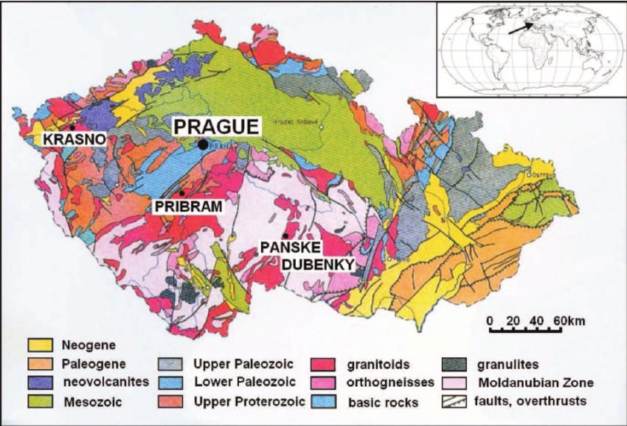
Natural backround of Czech landscape
1. Geological bedrock, relief, soils
- Landscape utilization should be consistent with environmental conditions
Bedrock, relief and soils are one of the key factors detemining vegetation
Czech geological structure is complicated. Prevailing Hercynic bedrock covers whole Bohemia and western part of Moravia, the eastern part was formed by Alpine orogenesion.
https://www.researchgate.net/profile/Lucie_Novakova3

Slide 7
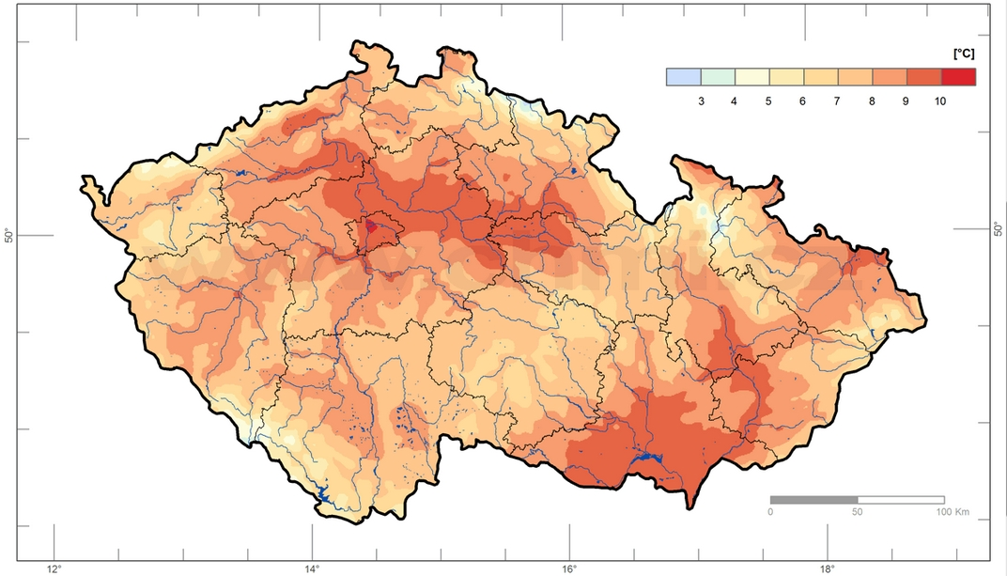
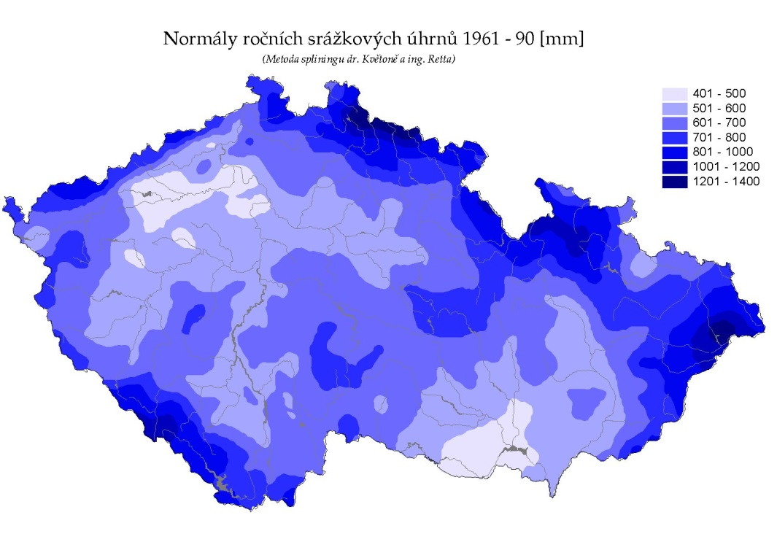
Natural backround of Czech landscape
2. Climate
- Czech climate is transitional between oceanic and continental
Mean annual temperature (°C)
Mean annual precipitation (mm)
www.chmu.cz

Slide 8
Altitudinal Zonality of Natural Vegetation in Central Europe
Altitude (m a. s. l.)
Subalpine zone
1350
Spruce forests
1200
Moutain mixed forests
Rain
900
Temperature
700
Beech-dominating forests
500
400
300
Oak-dominating forest
After excluding of human impact the strong majority of Central Europe would be covered by forest

Slide 9
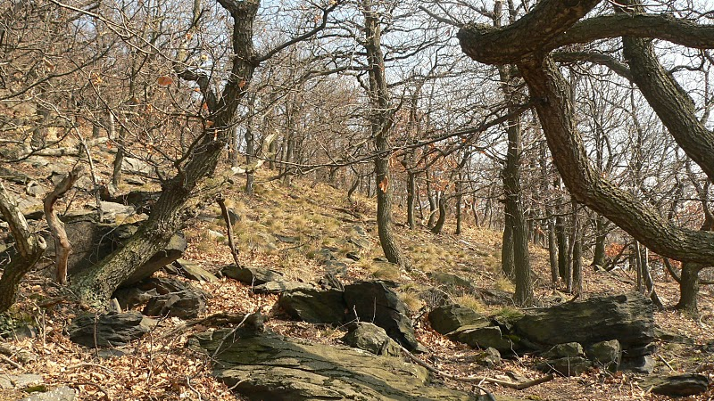
Oak-dominating Forest (lower altitudes)
picasaweb.google.com/lh/photo/mKagfLANYYYYfh4JWU7kgQ

Slide 10
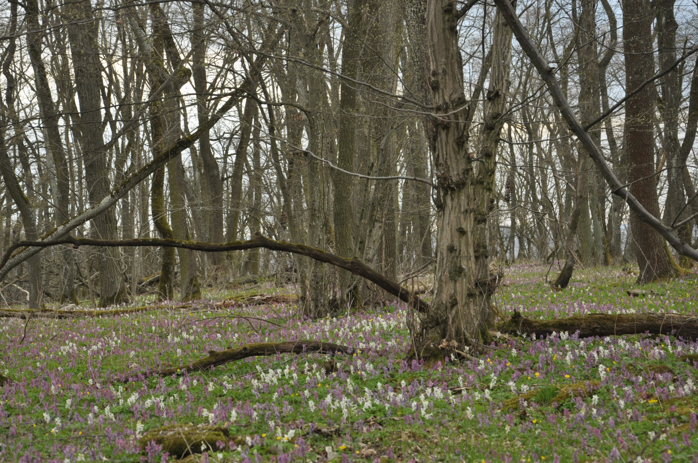
Oak-hornbeam Forest (lower altitudes)

Slide 11
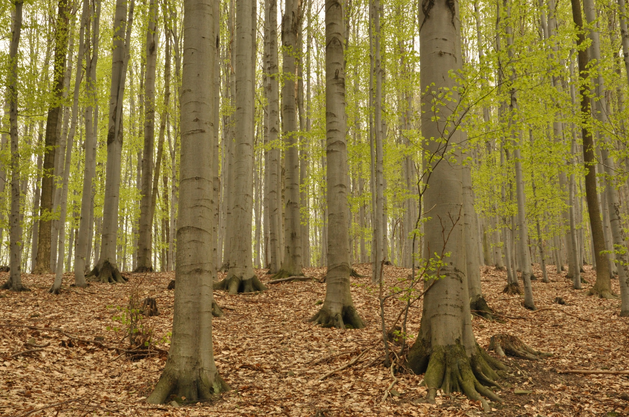
Beech Forest (middle altitudes)

Slide 12
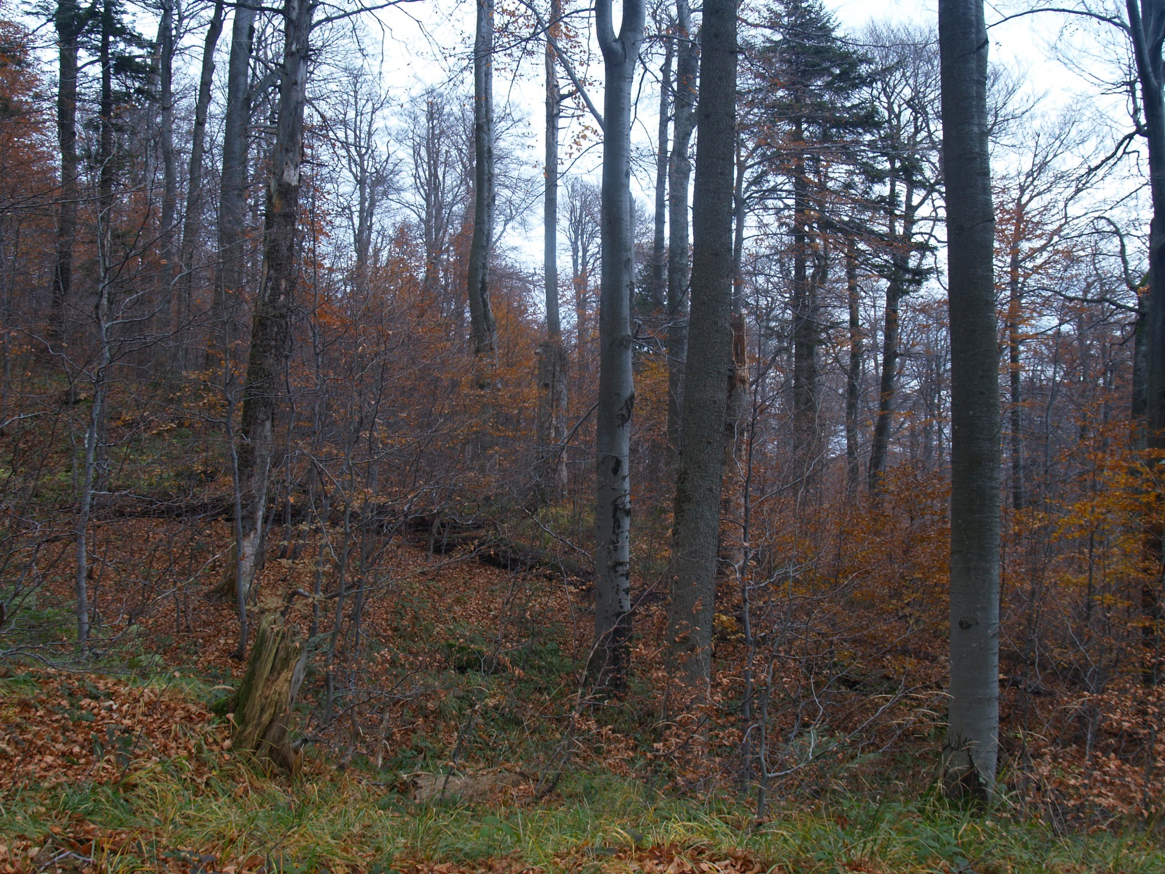
Fir-beech forest (lower mountains)

Slide 13
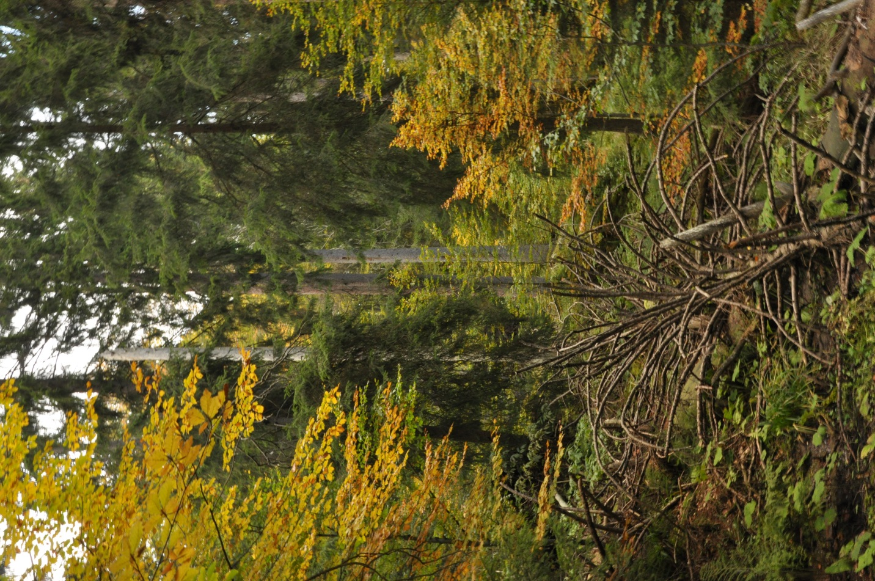
Mountain mixed forest (mountains)

Slide 14
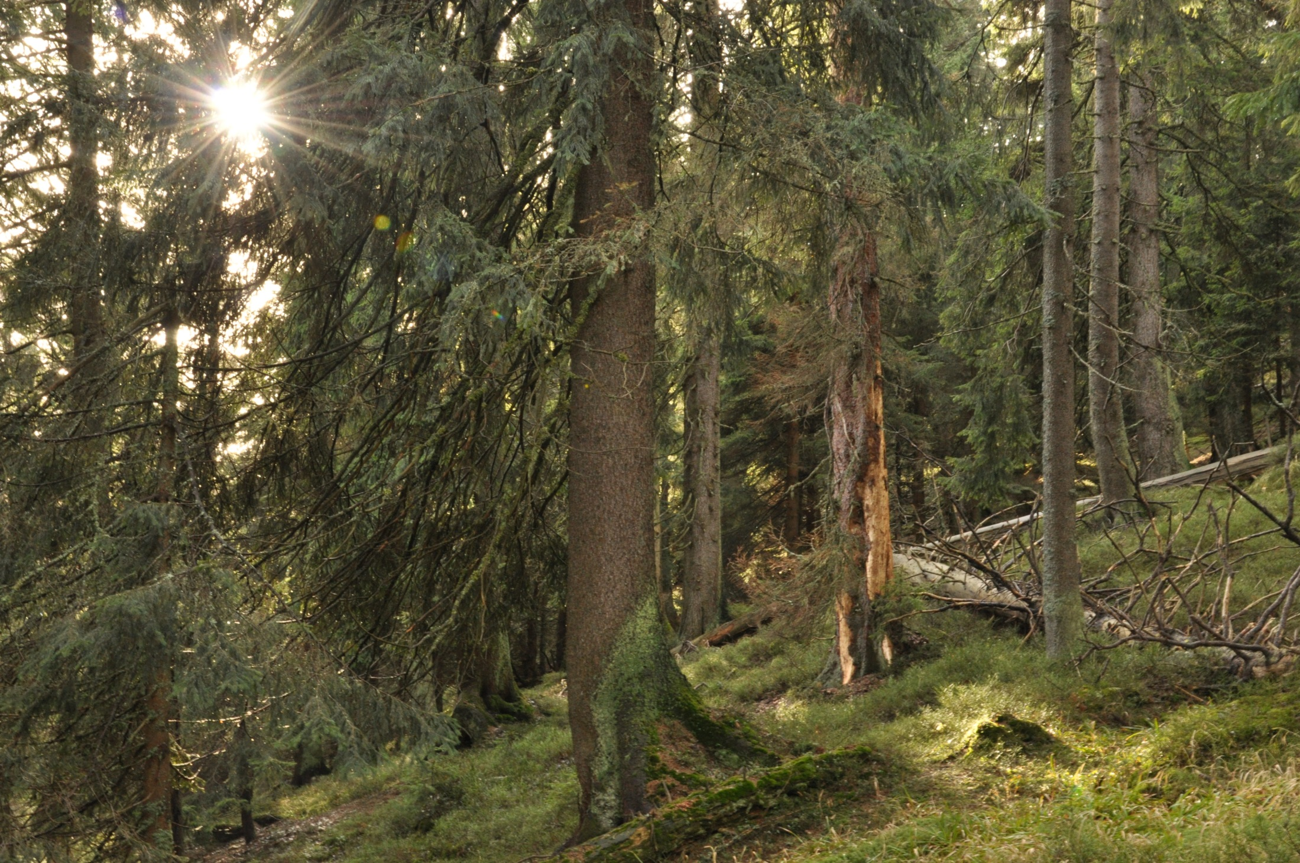
Mountain spruce forest (mountains)

Slide 15
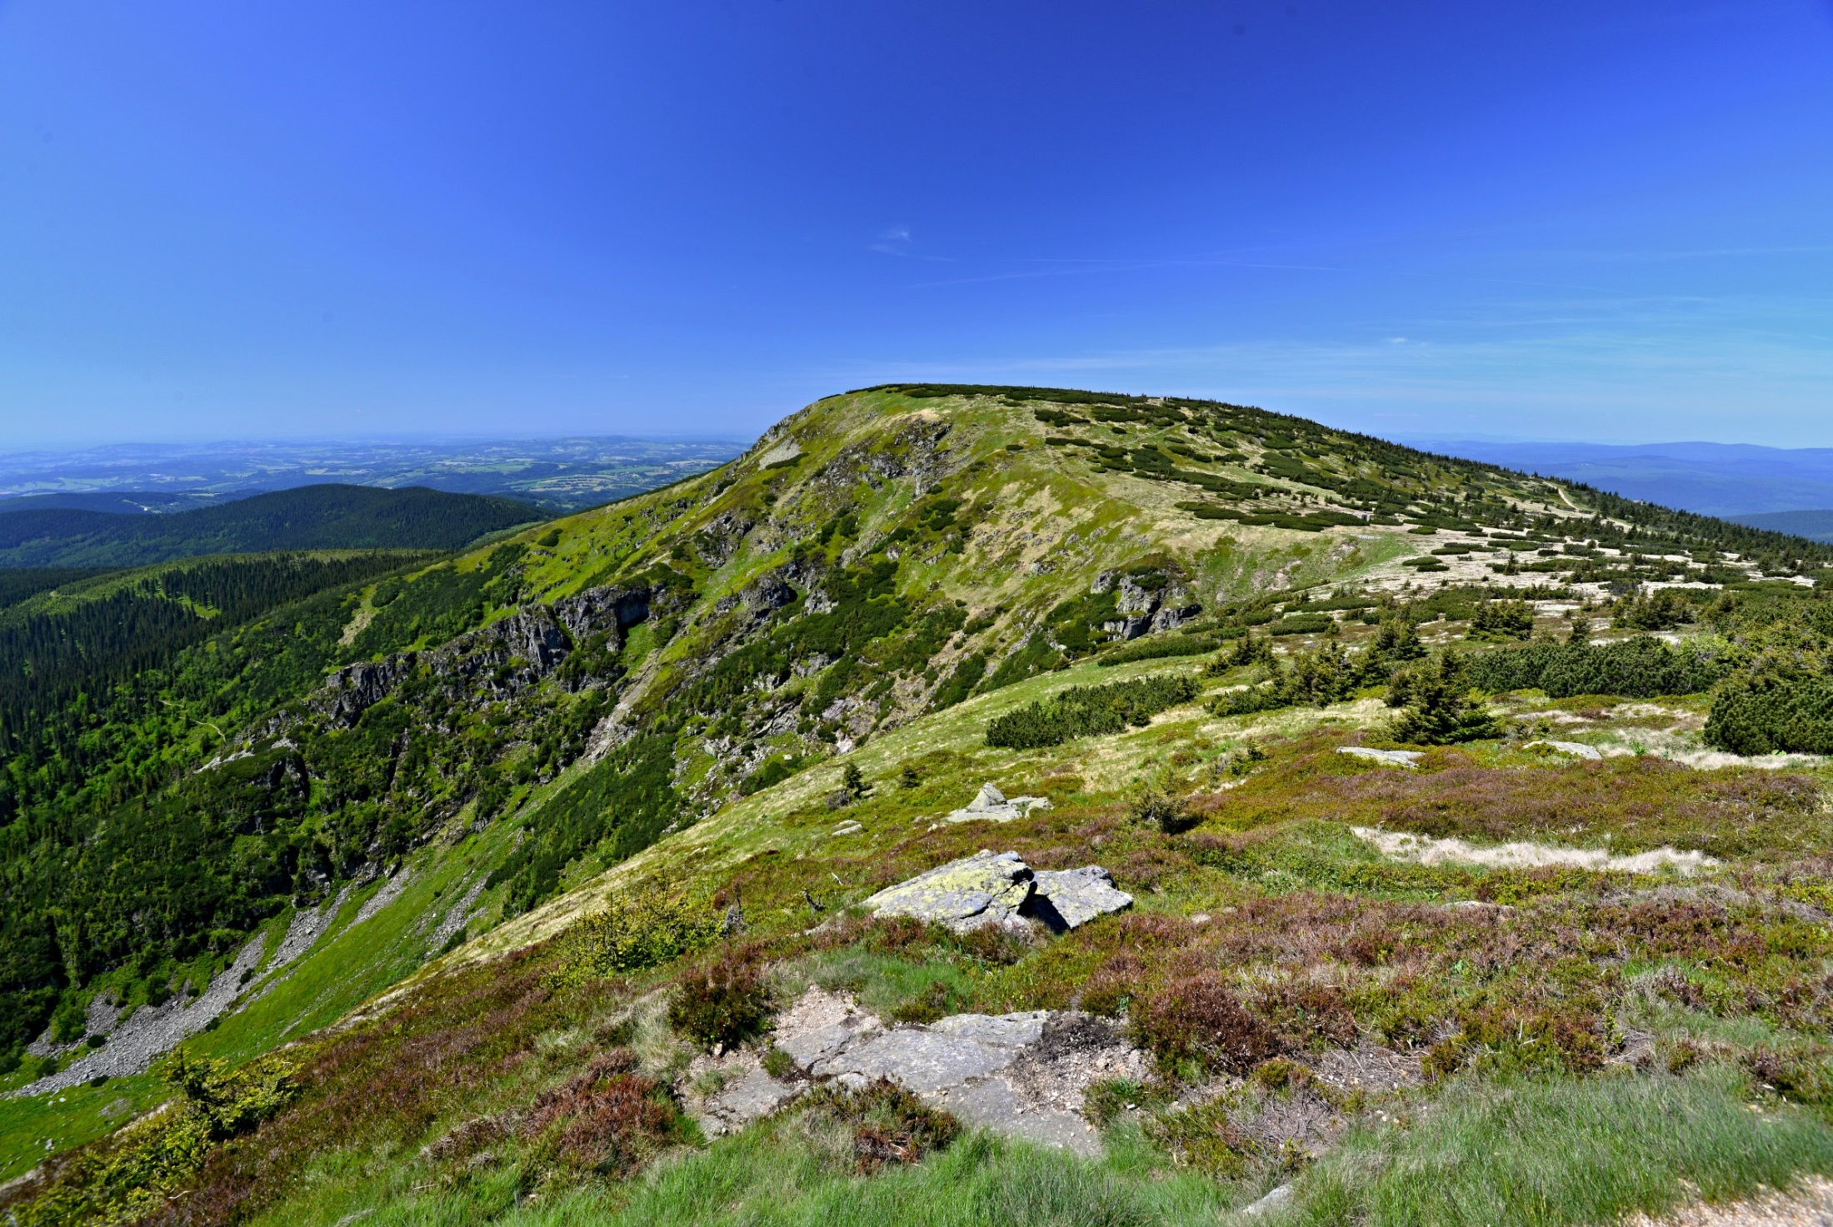
Subalpine zone (above tree line)
Studniční Peak, Krkonoše Mts.
turistika.cz

Slide 16
Natural Backround
Historical legacies
Landscape
Current processes
Human Utilization

Slide 17
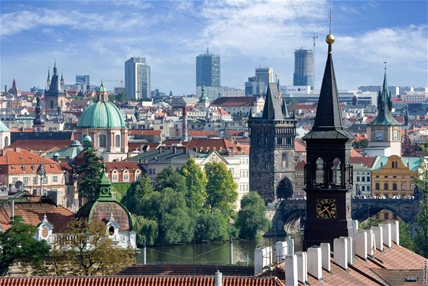
Prague – Architectural mosaic of the last 1000 years
https://www.idnes.cz/zpravy/domaci/kolik-vezi-ma-stovezata-praha-nadsenci-jich-napocitali-pres-pet-set.A100805_115917_praha-zpravy_sfo
In all landscapes you can find simillar patern…

Slide 18
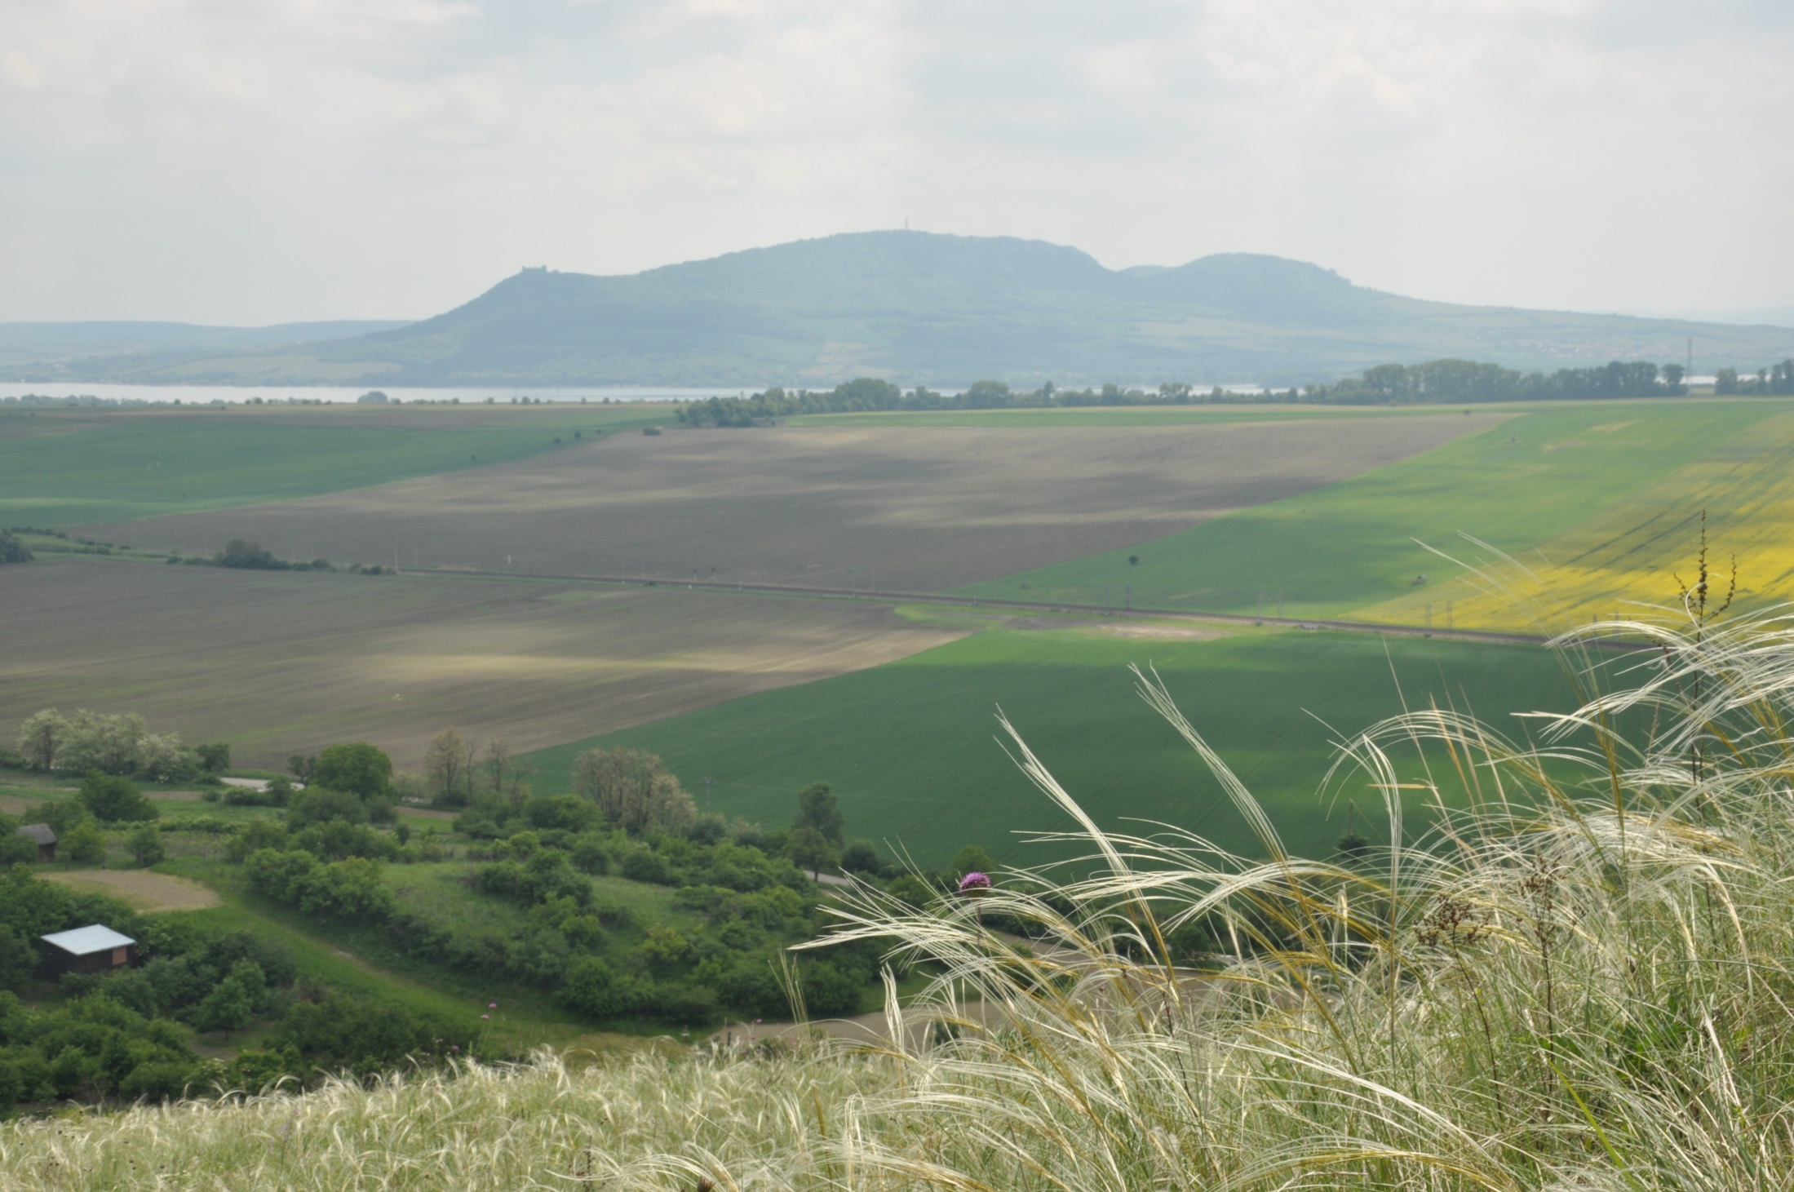
Example 1: South-Moravian landscape with natural protected areas
Both localities are famous because of high species diversity
Why species diversity is high right here?
Pálava Hills
Pouzdřanská steppe

Slide 19
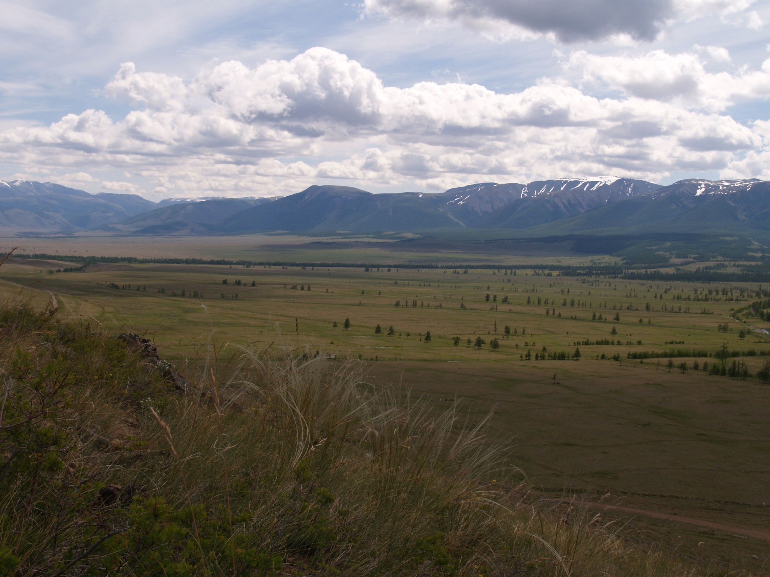
Far landscape history
May be the landscape of Central Europe in Ice Age
Taiga
Steppe
Altay, Kuray steppe, Southern Russia

Slide 20
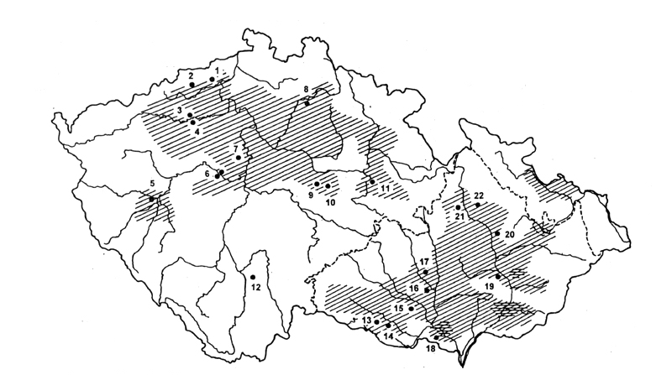
Neolithic (agricultural) Settlement 7000 BP
→ People due to landscape utilization stopped forest expansion. Especially in lowland, localities with relic species from Ice age and early Holocene were preserved.

Slide 21
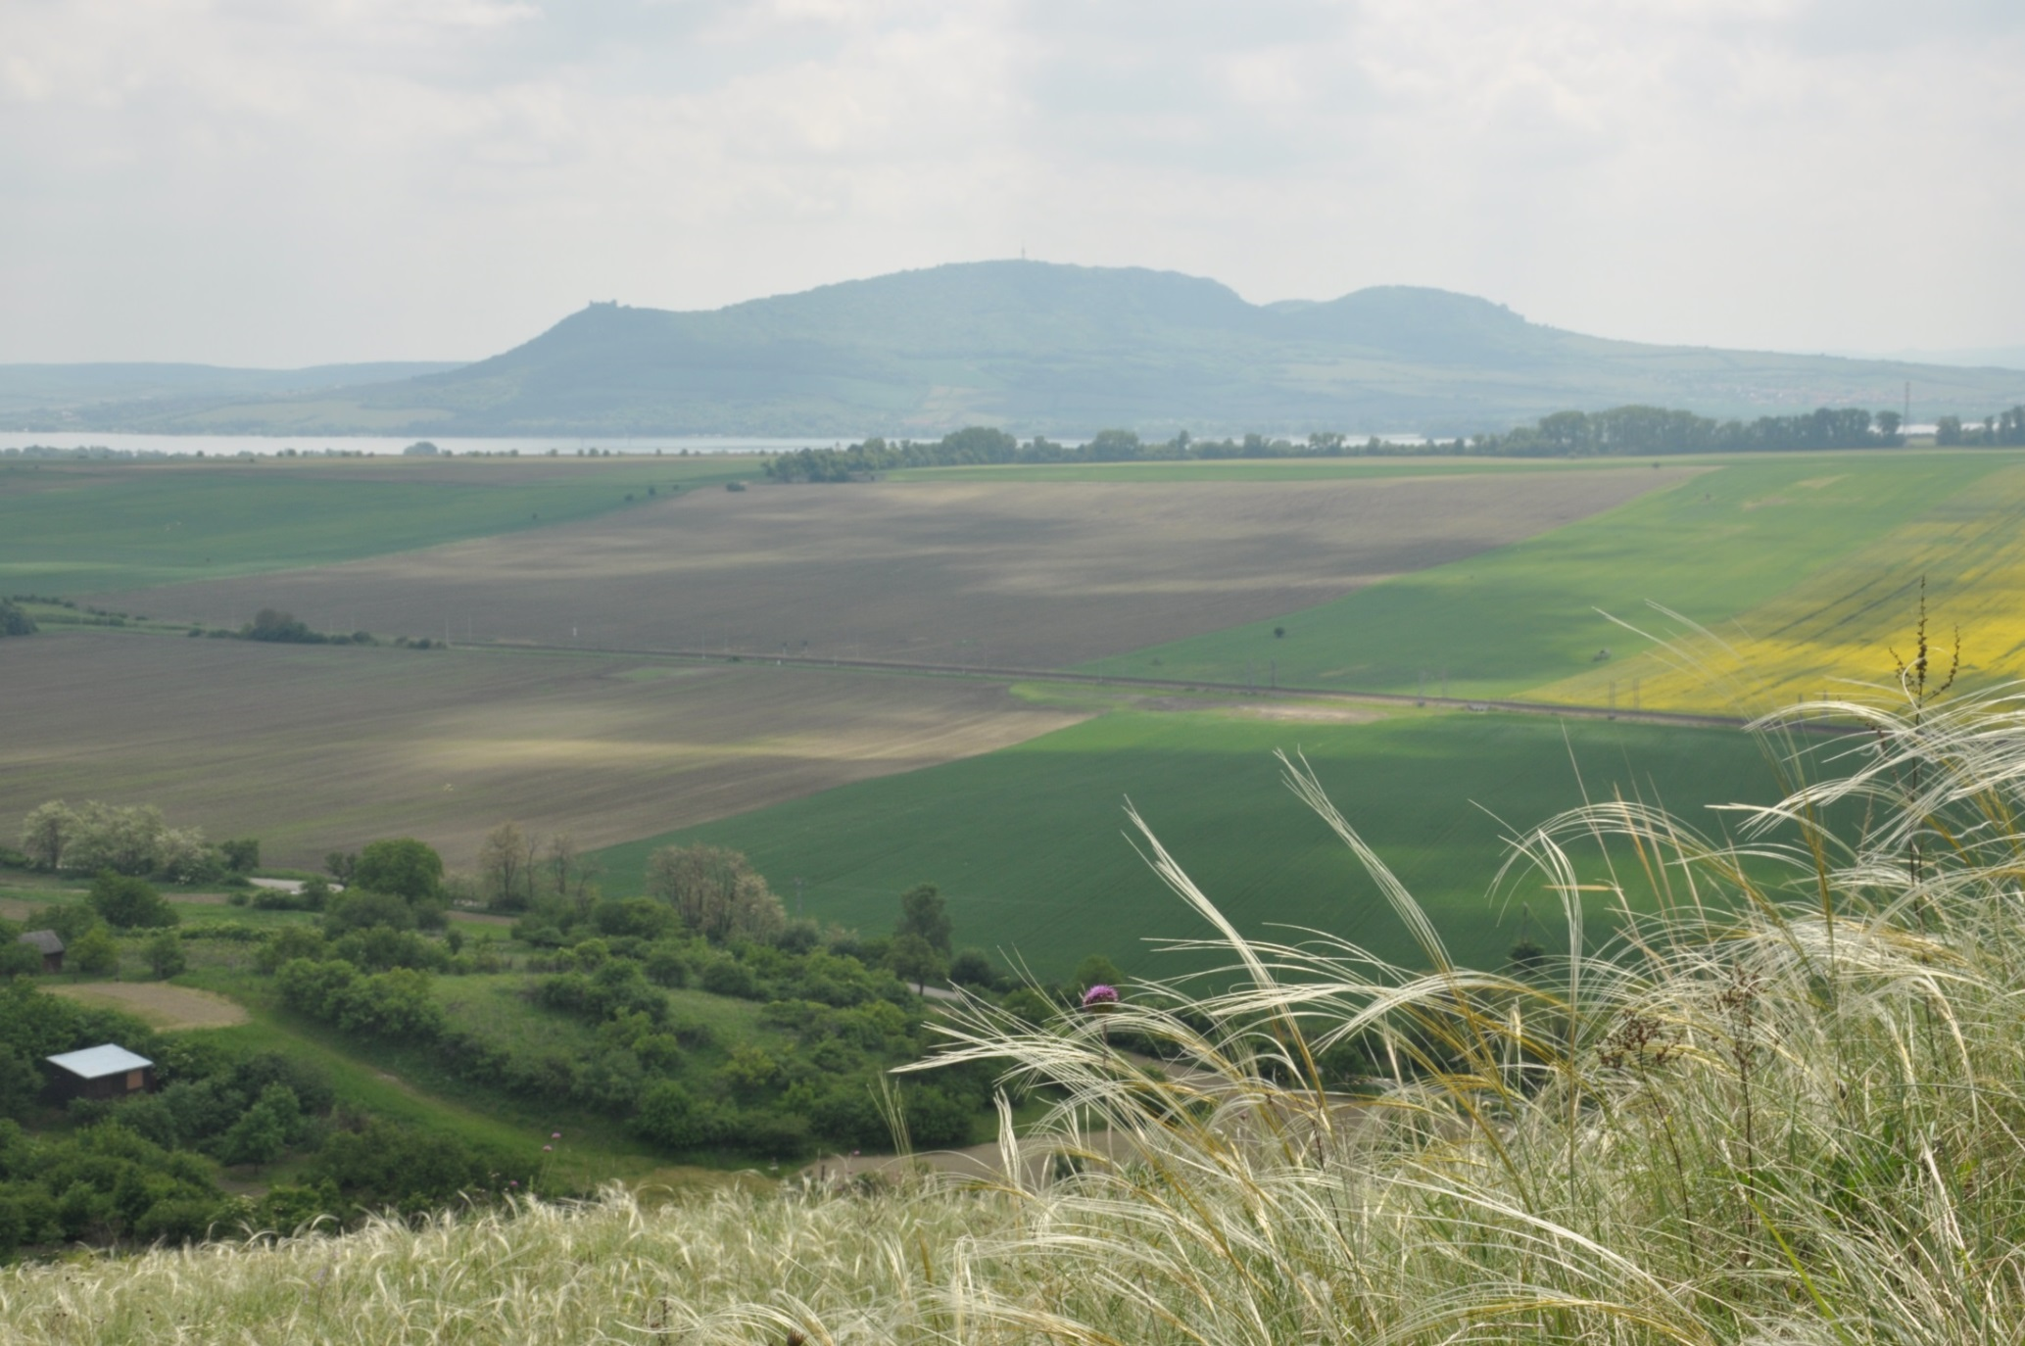
Example 1: South-Moravian landscape with nature protected areas
→ landscape with long continuity and relic habitats
Pálava
Pouzdřanská steppe

Slide 22
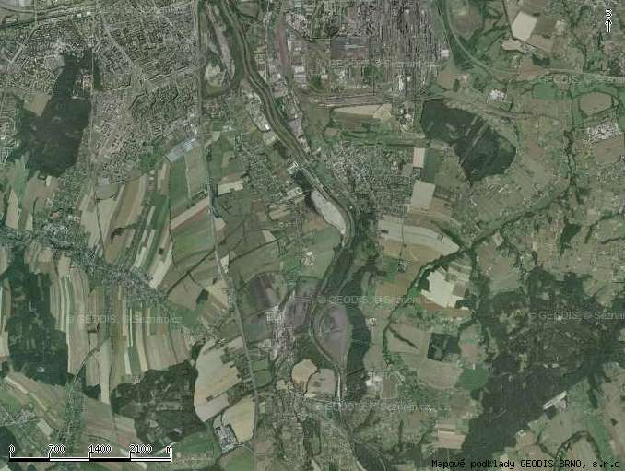
Example 2:
Legacies of historical developtment of settlement
OSTRAVA
Moravia
Silesia
Landsacape as a mirror of different law in landscape planning…
Try to think about landscape of your home on this way…
(you will find many examples like this)
Village with distinct margins
Scattered houses

Slide 23
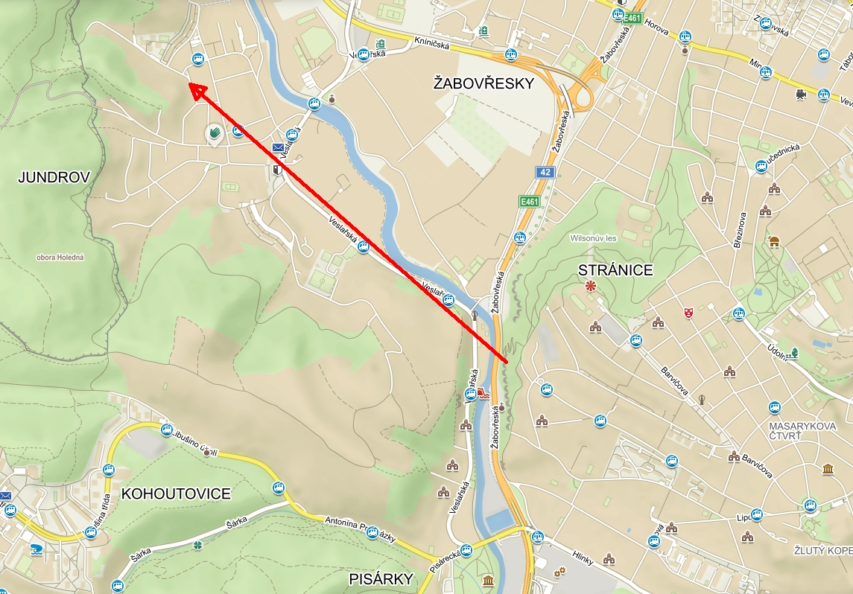
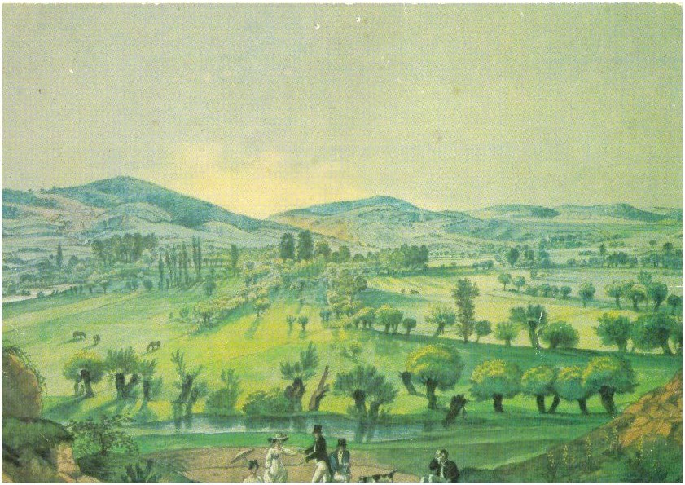
Landscape History: Testimony of Old Paintings and Photography
Possition of painter
Franz Richter (1830): Svratka Valley in Brno-Žabovřesky
Your faculty

Slide 24
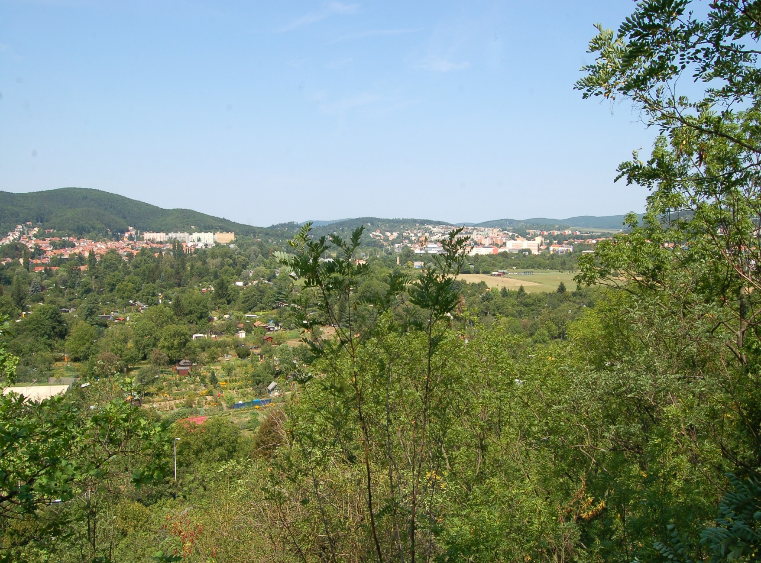
Landscape History: Testimony of Old Paintings and Photography
- Aerial images and old maps are the most powerful tools in landscape analyses.
- However, old paintings and photography provide real form of landscape with many details.
…180 years later, photo: Josef Ptáček (2012)

Slide 25
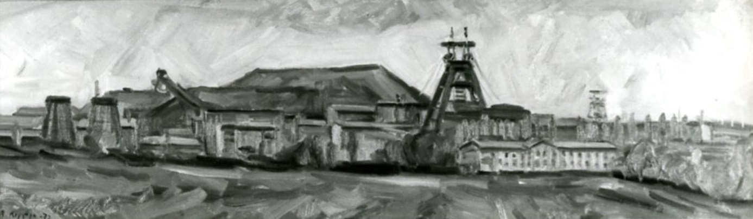
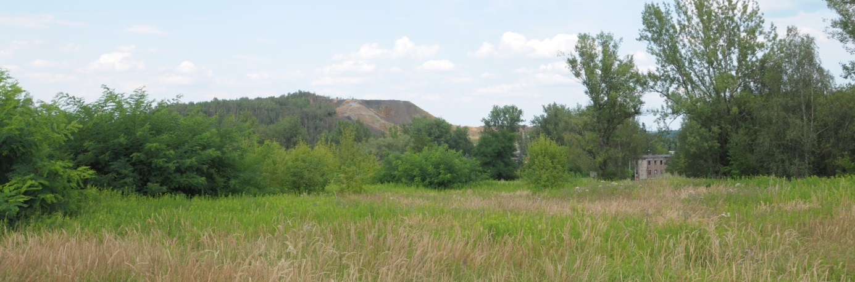
Landscape History: Testimony of Old Paintings and Photography
Bohumír Kristýn (1972): Rudý říjen Coal Mine in Ostrava
In less than 50 years, there is comletely different landscape. Changes could be surprisingly fast.
Actual view (2019)

Slide 26
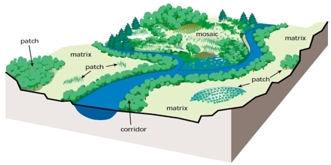
Landscape Structure
Clark, W. (2010) Principles of Landscape Ecology. Nature Education Knowledge 3(10):34
The main landscape components:
Pathes
Corridors
Matrix

Slide 27
South-Moravian agricultural landscape
Patch
Corridor
Matrix
Corridor
Mosaic
Patch

Slide 28
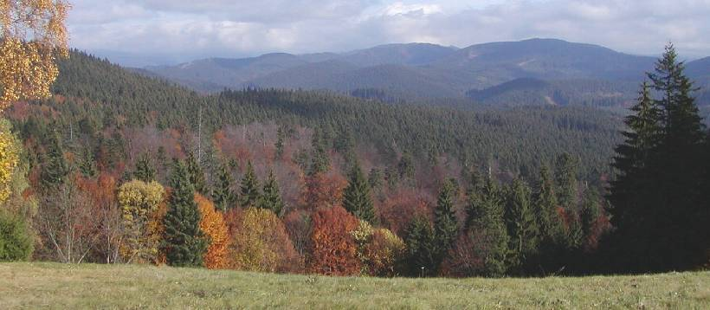
Forested landscape of Beskydy Mountains
Matrix
Subpatch (Salajka Natural Reserve)
Patch
stromy.cea.cz
- Forest cover of the Czech Republic: 34%
- Natural or near-natural forests: less than 1%

Slide 29
Perception of the landscape
1. Sensory perception
visual experience, sounds, tactical peception (heat, could, wind, wetness), smells…
…not only visual contact is important
For example, the smell could be an integral part of some place…

Slide 30
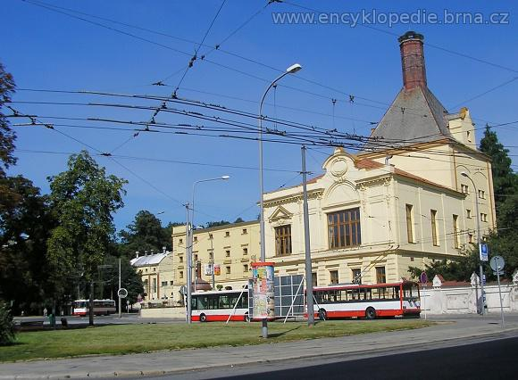
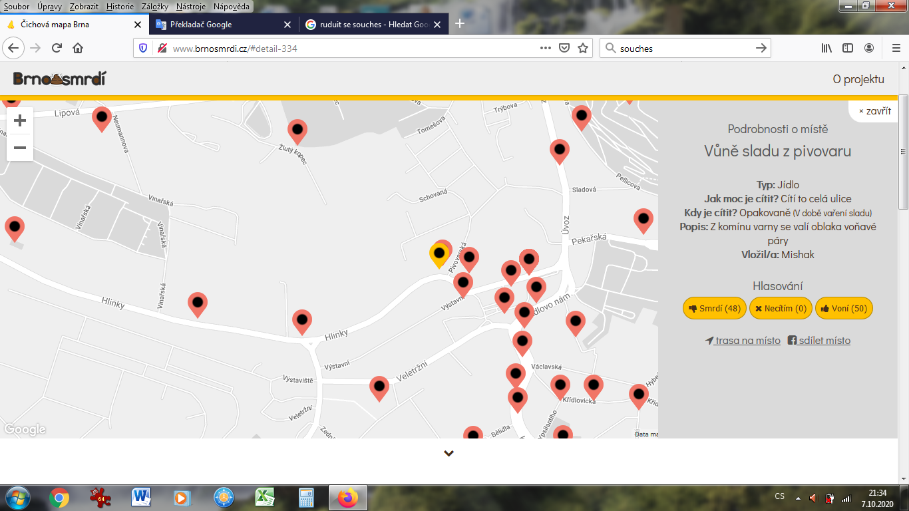
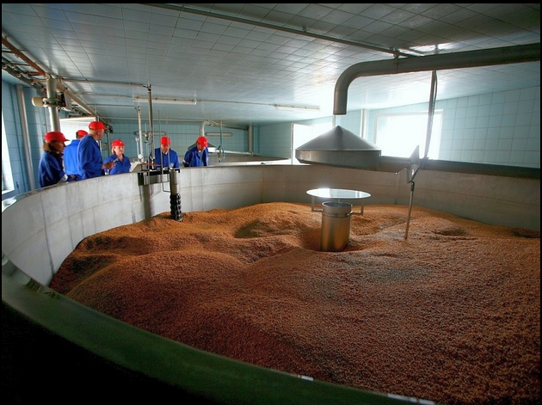
The Smell of Starobrno Brewery on Mendel Square
Brno Map of Smells
Poll about Starobrno Brewery
Stinks
Smells
Malt with specific smell
https://brnensky.denik.cz/galerie/brno-pivo-pivovar-starobrno-kometa-pivnice-exkurze-suroviny.html?photo=4

Slide 31
Perception of the landscape
1. Sensory perception
visual experience, sounds, tactical peception (heat, could, wind, wetness), smells…
2. Knowledge
3. Memories and experiences
Both are important layers of our landscape perception.

Slide 32
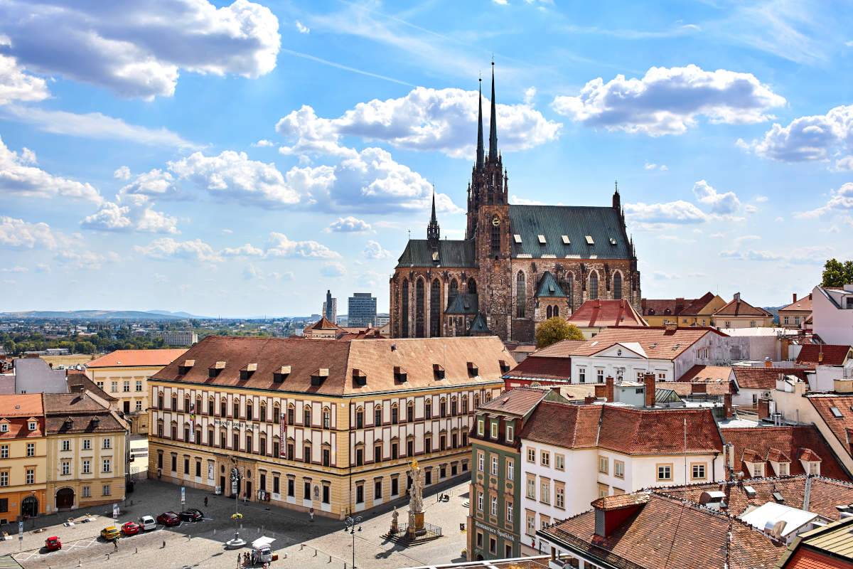
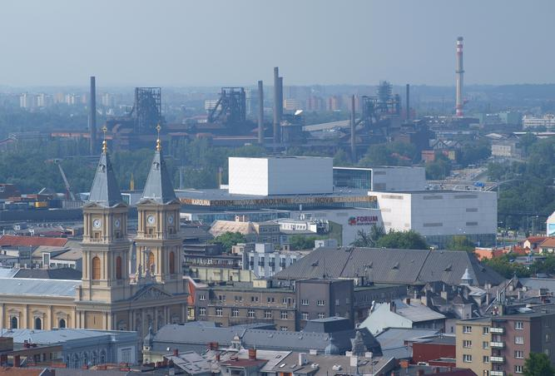
Brno
Compared to Ostrava, Brno is usually more attractive for visitors.
But the streets of Ostrava are my childhood sceneries. It makes this town very important for me…
→ Perception of the landscape is strongly individual
https://www.elogistika.info/wp-content/uploads/2020/09/plaza-catedral-brno.jpg
Ostrava
https://d34-a.sdn.cz/d_34/c_C_D/L9eB9eu.jpeg?fl=res,667,500,1

Slide 33
Landscape Ecology Backround

Slide 34
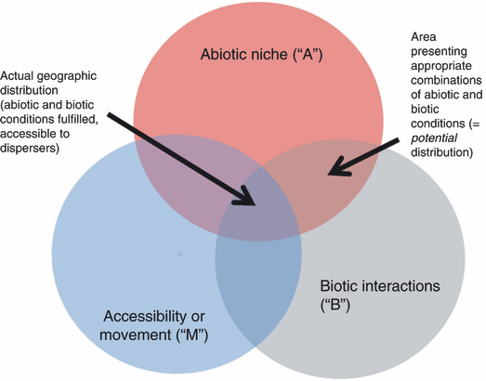
Ecological Niche Concept
…a set of conditions that allow the existence of a population of a particular species.
Potential niche
Realized niche
Climate conditions
Soil and bedrock
Competition
Mutualism
Parasitism
Dispersal ability
Dispersal barriers
In Europe there are many species with potential niche in America. But because of barrier of Athlantic Ocean they are not able to reach this area.
→ Species pool: all species avaliable to colonize focal site.
Peterson, A.T. (2011) Ecological niche conservatism: a time-structured review of evidence. Journal of Biogeography, 38, 817-827.

Slide 35
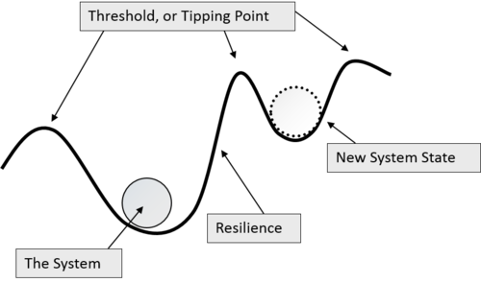
Ecological Stability Concept
Ecosystem is like a ball in the hole…
Removing of the ball from the hole imitate unreversible ecosystem change
Ecosystems with higher resilience (in deeper hole) are more stable
Ecosystem is the complex of living organisms, their physical environment, and all their interrelationships in a particular unit of space (britanica.com).
Changes of particular components due to the internal or external influences could caused ecosystem change.
Perturbation
https://ieampodcast.com/2018/10/11/finding-balance-resilience-in-era-with-marco-vighi-and-andreu-rico/

Slide 36
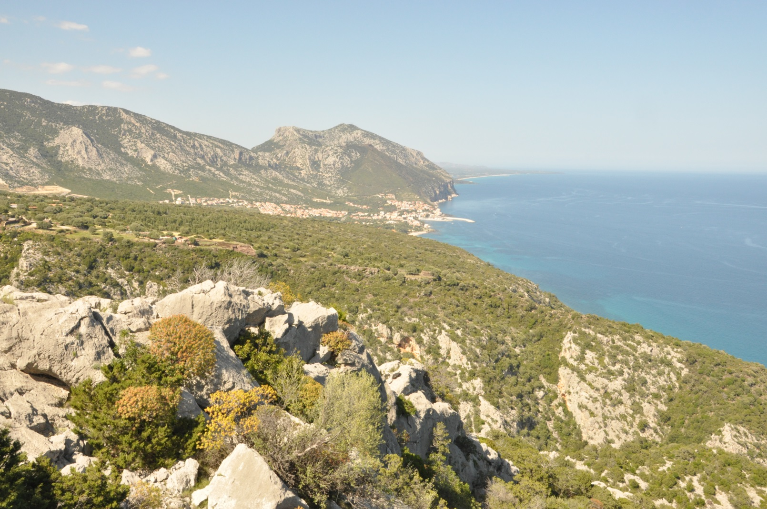
Example of ecosystem change:
The loss of former Mediterranean forests along coast
Due to timber logging, pasture and intensive soil erosion during Antiquity a new secondary shrubby vegetation of macchia and garrique developed. The change is irreversible.

Slide 37
Metapopulation / Metacommunity Concept
Levins, R. (1969), "Some demographic and genetic consequences of environmental heterogeneity for biological control", Bulletin of the Entomological Society of America, 15 (3): 237–240.
Metapopulation/metacommunity is described as a group of spatially separated populations of the same species/communities which interact at some level.
- Also unoccupied suitable (potential) habitats could be involved.
- Size of population/community and intensity of interactions are crutial for population/community developtment.
- Small populations without interaction are more vulnerable to disturbances or inbreeding potentially causing extinction.

Slide 38
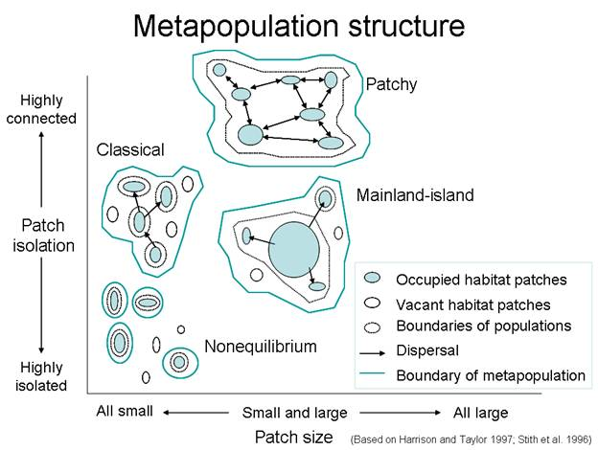
Metapopulation / Metacommunity Concept
Levins, R. (1969), "Some demographic and genetic consequences of environmental heterogeneity for biological control", Bulletin of the Entomological Society of America, 15 (3): 237–240.
Group of smaller populations with intensive interactions
One big source population supporting small island population
NOTES
The concept was derived from the butterfly communities …It better fit to the animals than to the plants
In plant kingdom a real migration is missing. „Migration“ is possible almost only via reproduction (propagules).
To capture a responce of plant communities to the changes a longterm observation is needed.
Extinction is more probable
https://sites.google.com/a/owu.edu/northern-spotted-owl/metapopulation-model

Slide 39
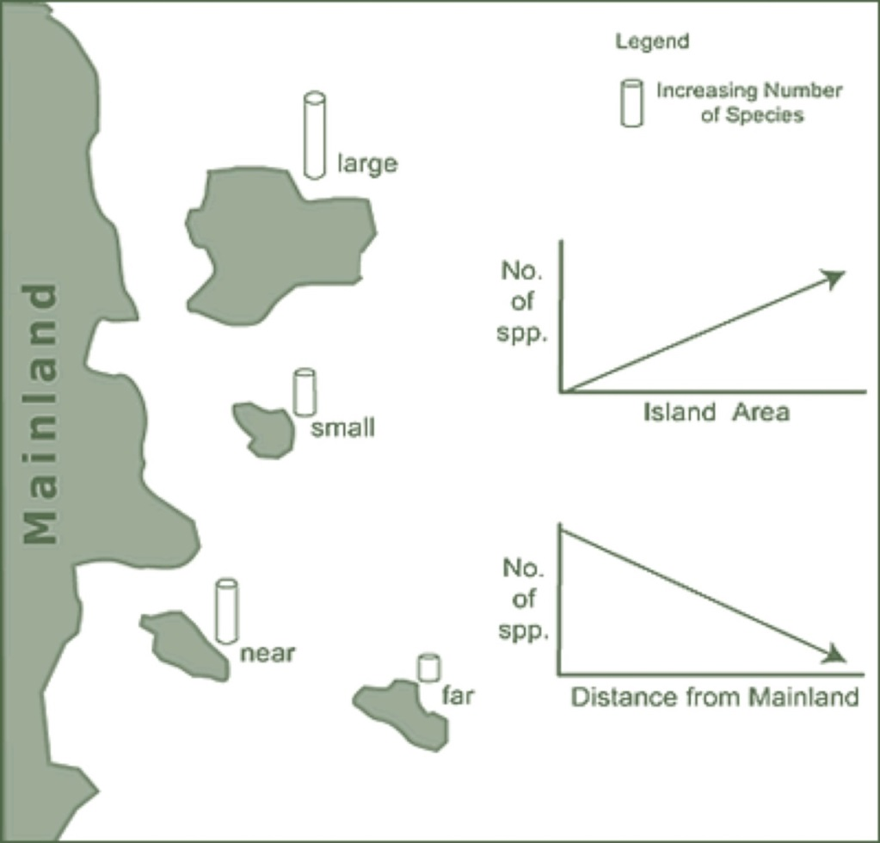
The Theory of Island Biogeography
MacArthur, R. H., Wilson, E. O. (1967) The Theory of Island Biogeography. Princeton, N.J.: Princeton University Press, 203 p.
The number of species on the island reflects balance between rate of colonisation and extinction.
Small islands have restricted resources compared to the larger ones, leading to lower species diversity.
Increasing distance from the mainland reduce colonisation intensity. The far islands therefore have less species.
https://coreybradshaw.files.wordpress.com/2016/05/ib.jpg

Slide 40
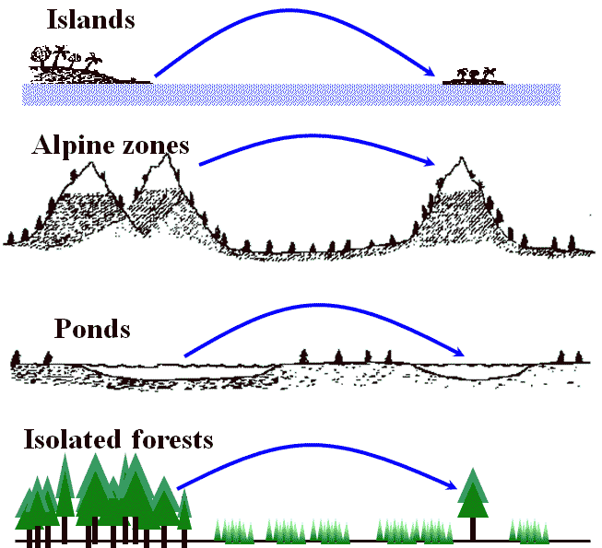
Islands are not only in the sea…
…Landscape Islands
NOTE:
The theory was derived from the newly formed volcanic islands. The general application to the terrestical ecosystems has its limits due to the complex interactions between „islands“ and surrounding landscapes. The history of „islands“ also plays an important role.
http://hosho.ees.hokudai.ac.jp/~tsuyu/top/dct/island.html

Slide 41
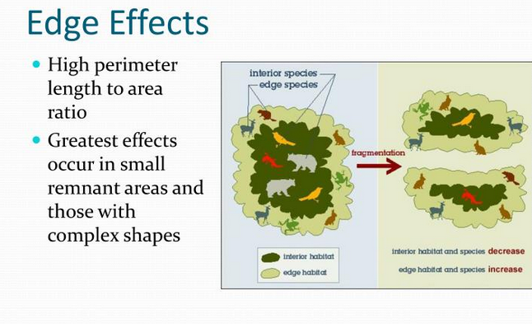
Landscape Fragmentation
Process of dividing of habitat (or vegetation type) to the smaller sections. Fragmentation is accompained by the edge effects (forming the ecotones along margins reducing original habitats).
Construction of the road through forest affects a much larger area than we would expect.
- Fragmentation causes extinction of species requiring larger interior habitats (brown bear on the picture)
https://www.slideserve.com/jovan/habitat-fragmentation-and-loss

Slide 42
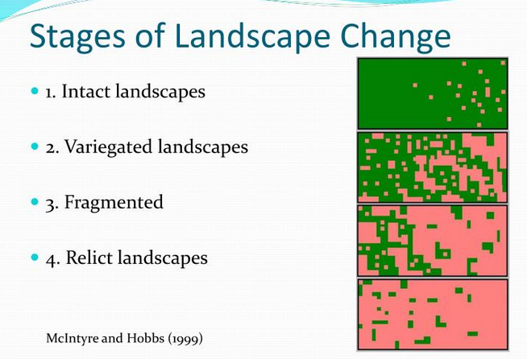
Landscape Fragmentation
Options 3 and 4: There are no interior habitats in the small remnats of former natural landscape → only edge species can be found here and repatriation of extinct interior species is problematic (common in European landscape).
https://www.slideserve.com/jovan/habitat-fragmentation-and-loss

Slide 43
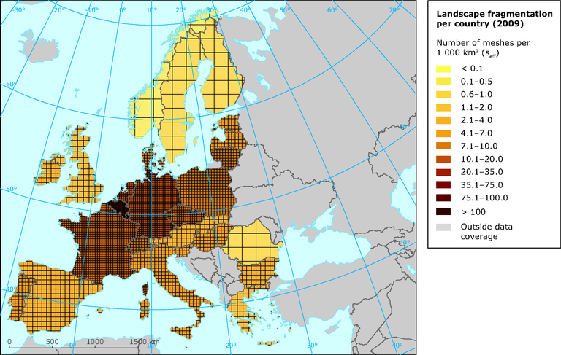
Landscape fragmentation in EU
https://www.eea.europa.eu/data-and-maps/figures/illustration-of-the-level-of/illustration-of-the-level-of/image_large

Slide 44
Ecological Succession
Wikipedia definition:
…is the process of change in the species structure of an ecological community over time due to internal or external factors
Internal: Competition, facilitation, parasitism…
External: Disturbance (natural or manmade)
Succession is accompained by increasing complexity of the community (establishing of self-perpetuating processes).
Primary succession
Colonisation of area non occupated by organisms before
(Volcanos, mining areas, areas after deglaciation…)
Secondary succession
- Developtment of community after severe disturbance or removal of a pre-existing community
Areas after fire, insect outbreak, forest decline, abandoned agricutural land…

Slide 45
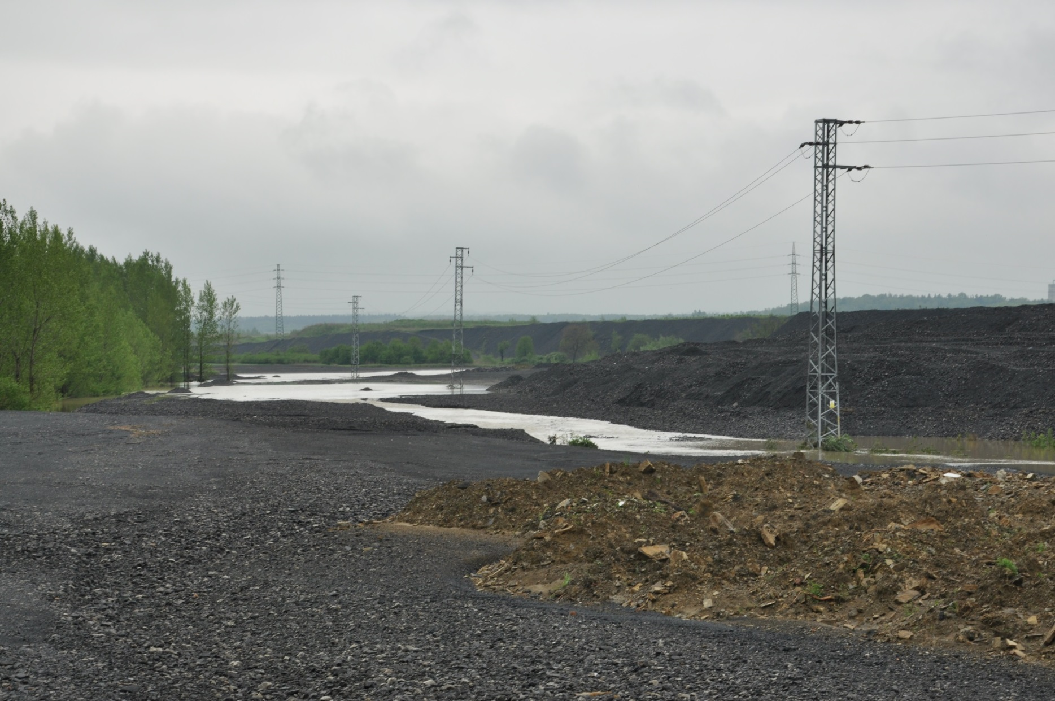
Primary succession on spoil heaps (Ostrava-Karviná Coal District)
1. The starting point: bare stone
…it was digged 1000 m below surface

Slide 46
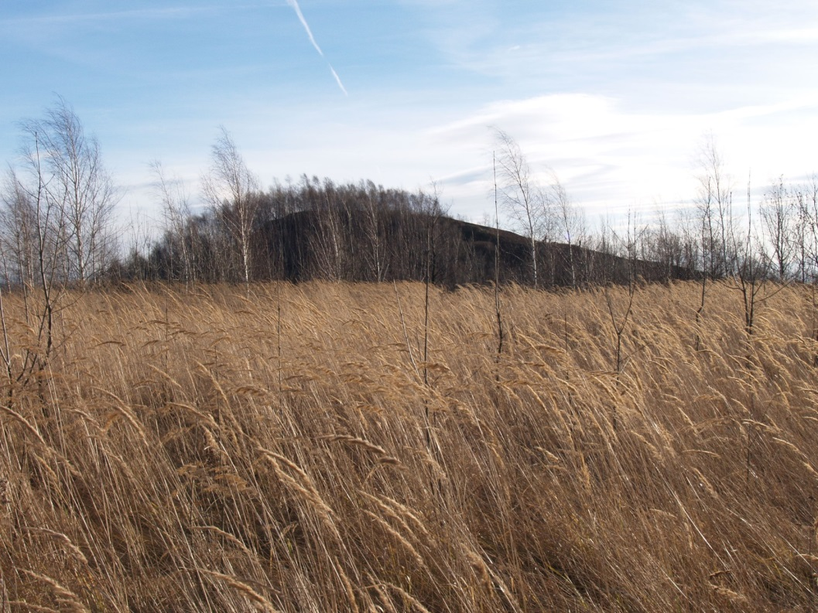
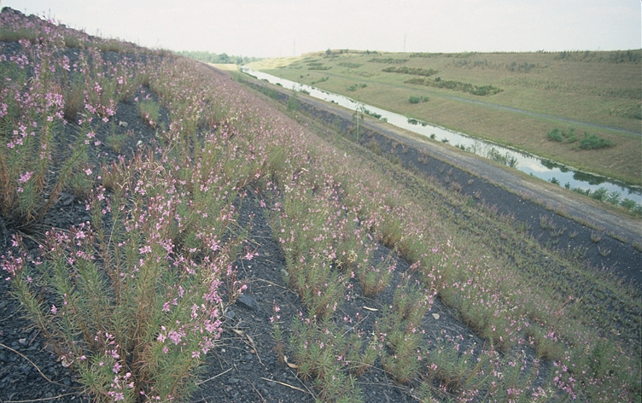
2. Initial stage of succesion and the first communites
(1-10 years)
Prevail the ruderal and stress-tolerant species
Low level of competition at the biginning
Non-woody species dominate
High abundance of non-native plant species

Slide 47
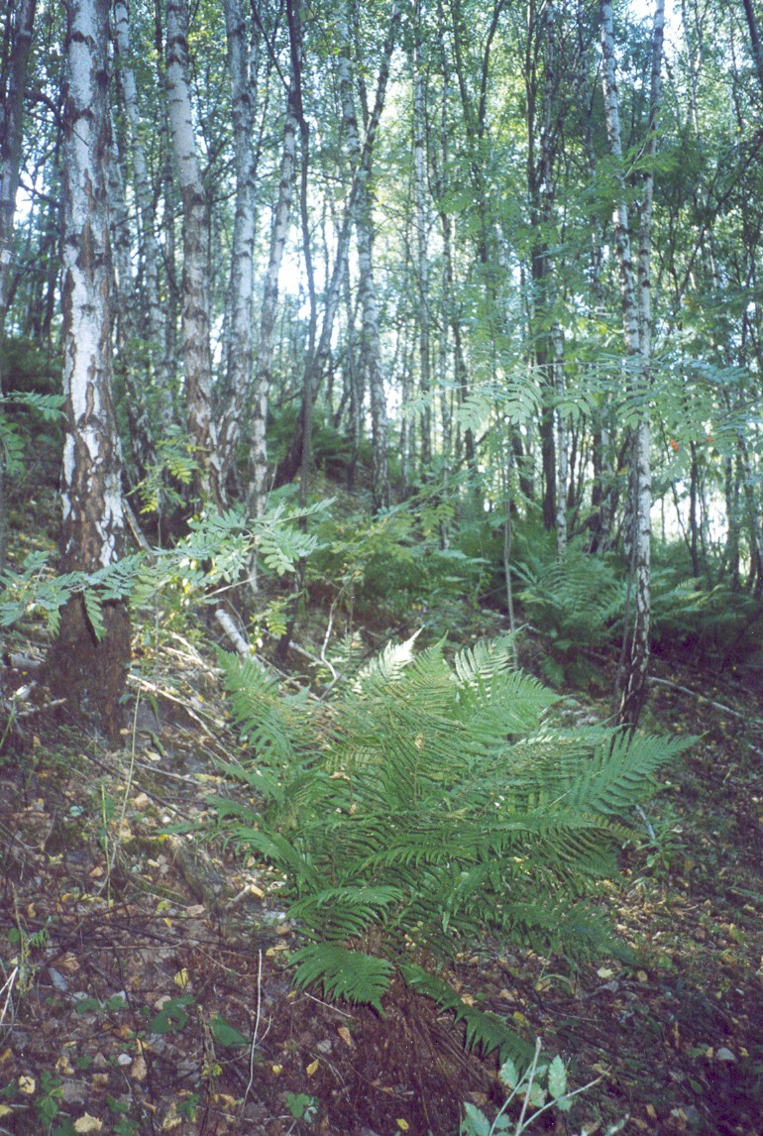
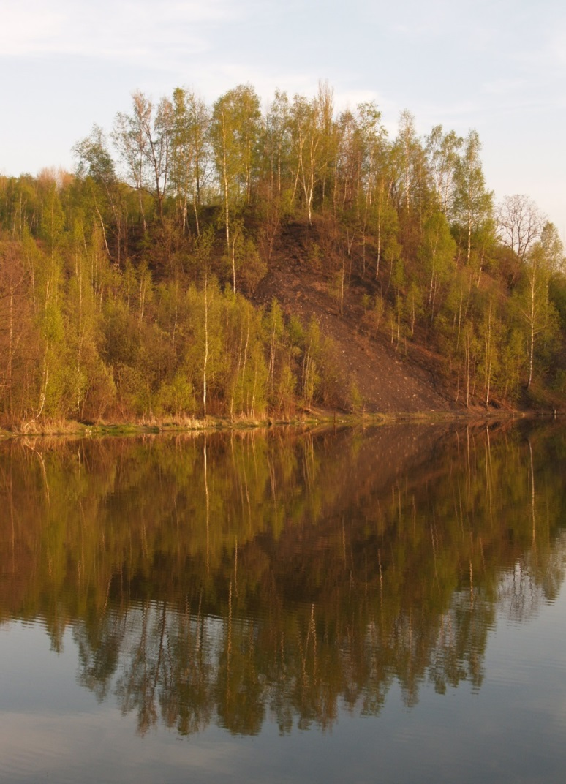
3. The first forest generation (…15 years)
Pioneer woody species
Common light demanding species in the understorey
Later the first forest species appear

Slide 48
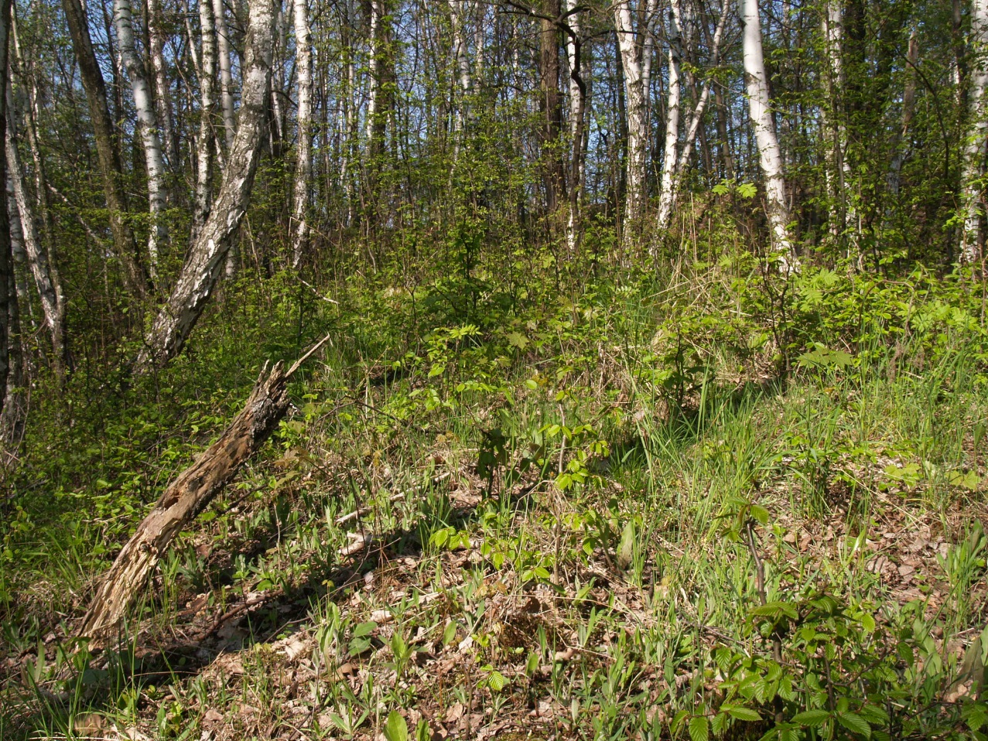
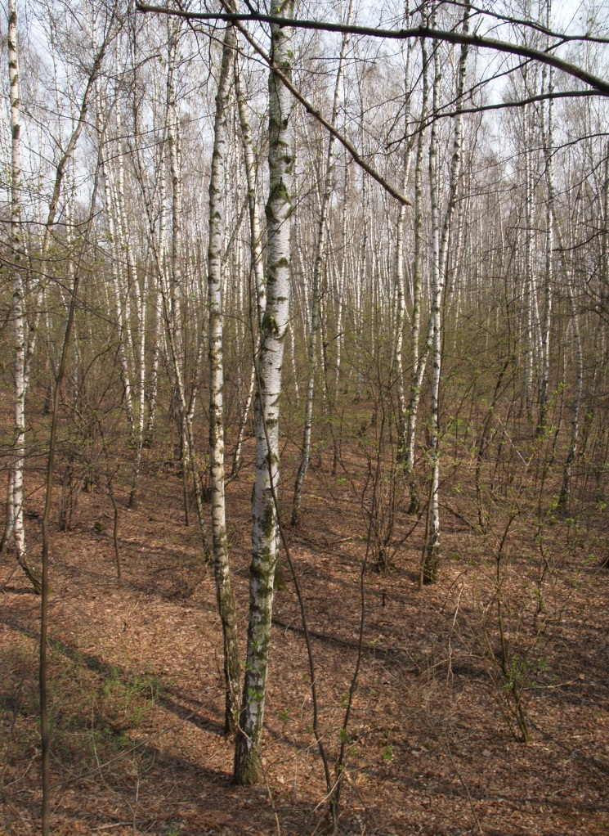
4. Regeneration of late successional tree species
(…30 years)
Odval jámy Hlubina v Karviné - Dolech
Odval Dolu Michal

Slide 49
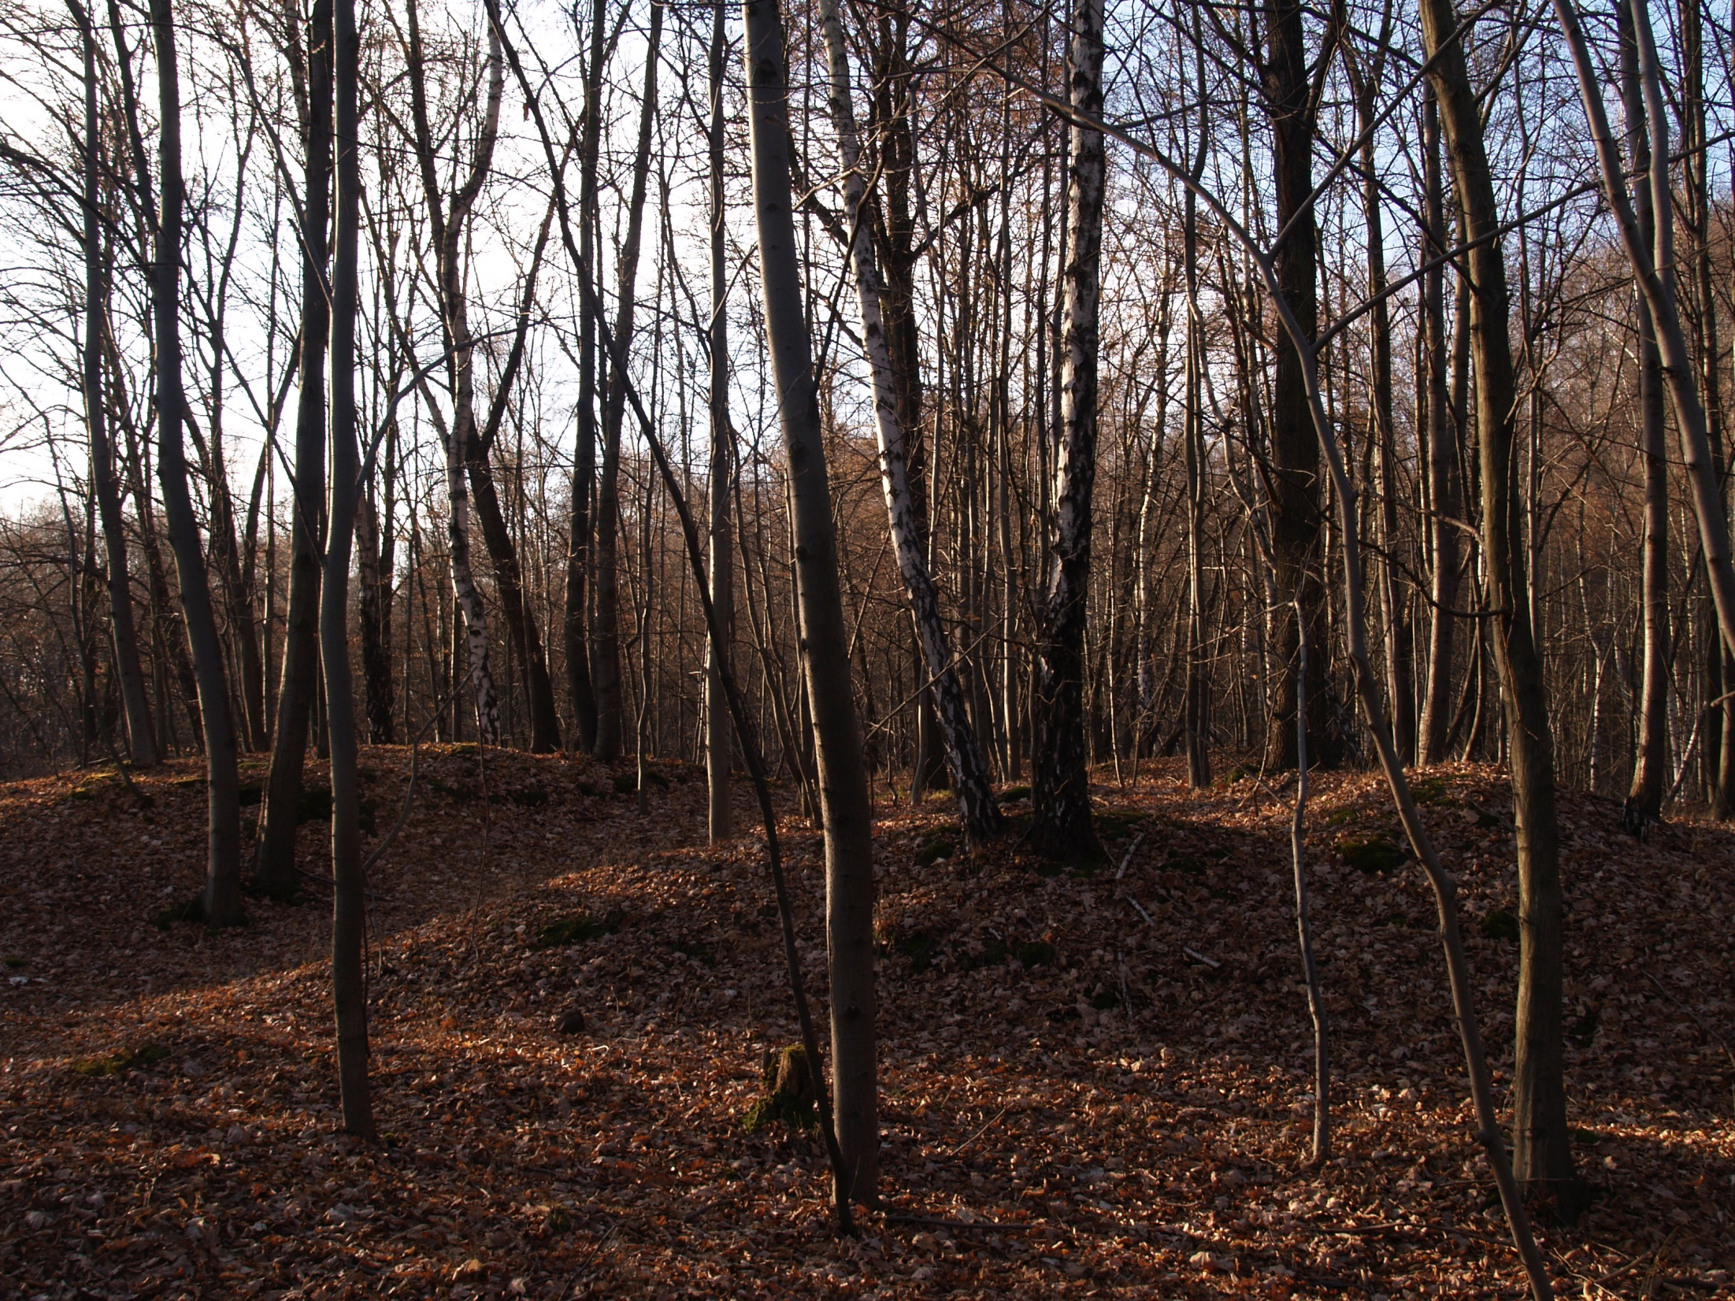
5. The second forest generation (50 – 70 years)

Slide 50
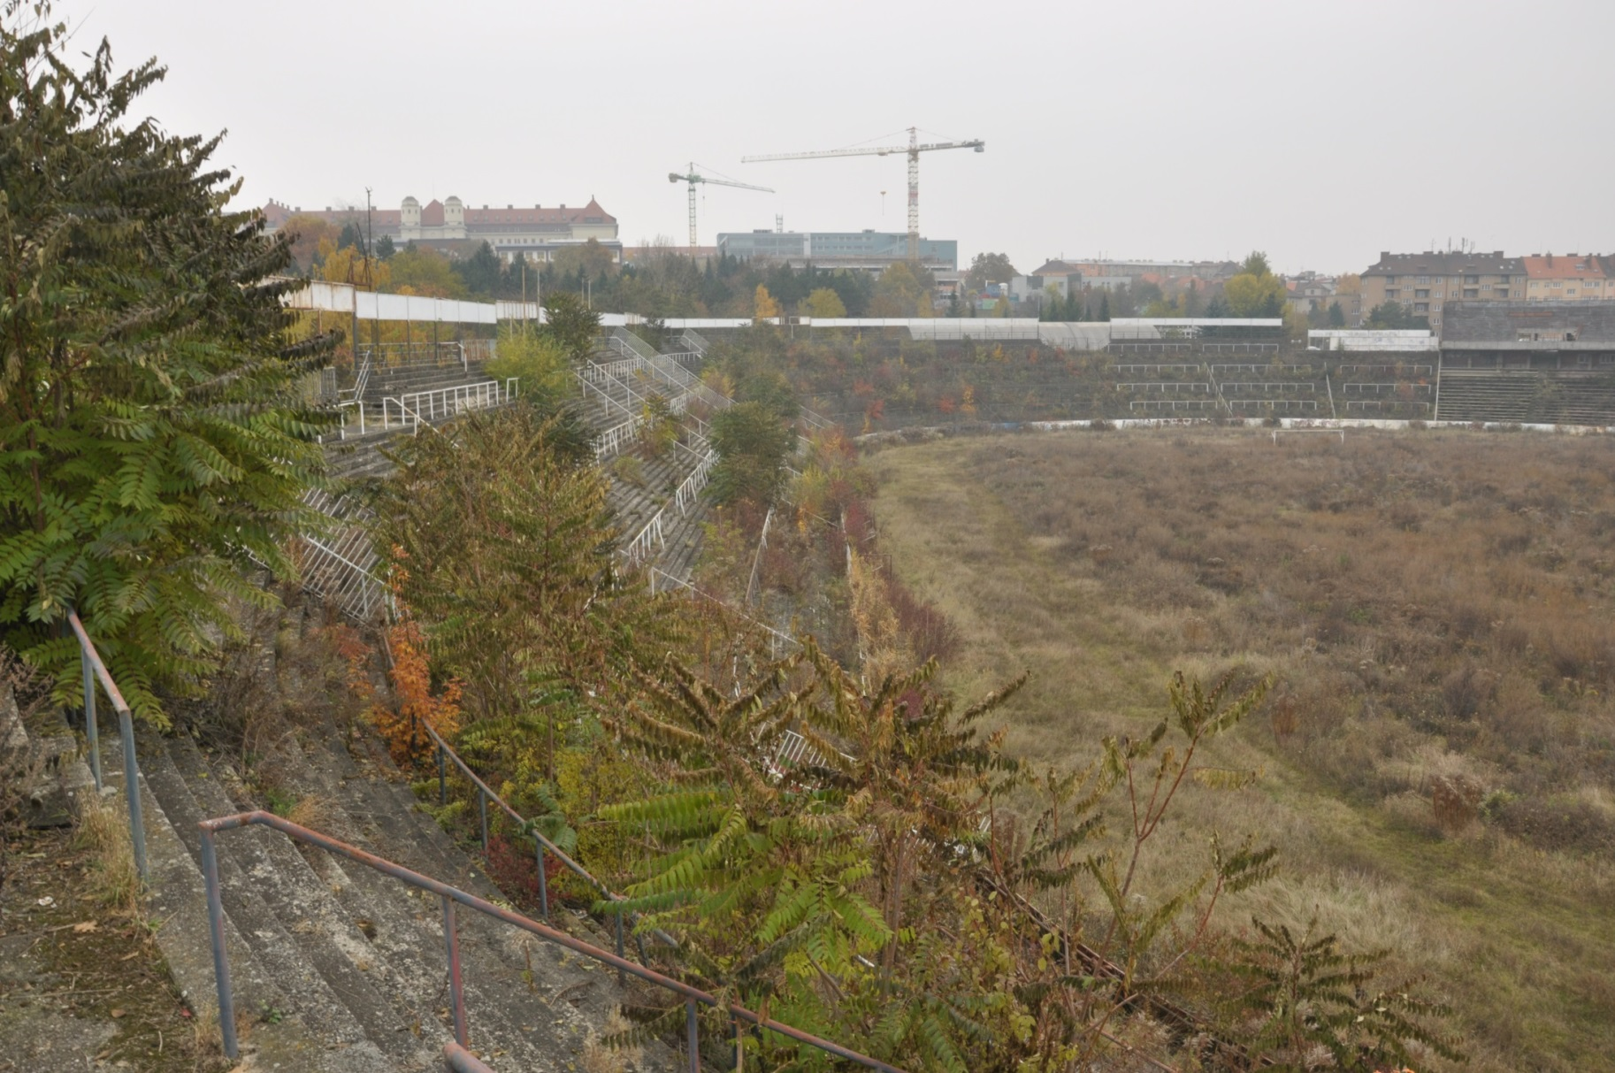
Successional Trajectories
In the same place, the succession could run in different ways.
Example from the old Lužánky Arena in Brno, where the succession trajectory depends on „soil“ properties.
Compacted soil on playground
Woody species
Non-woody species
Concrete

Slide 51
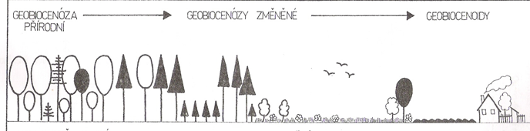
Ecosystem changes due to the human impact
Model of Central-European non-aquatic ecosytem
Natural
Cultural
Anthropogenic
Succession
Natural forest
Settlement
Artificial forest
Arable land

Slide 52
Where you can find the most ecologicaly stable parts of landscape?
Ecosystem changes due to human impact
Natural
Cultural
Anthropogenic
Natural forest
Settlement
Artificial forest
Arable land
The most ecologicaly stable landscape segments
= segments with long natural continuity
- natural and semi natural forests
- mires and wetlands
- relic habitats (remnants od steppes, rocks…)
- ecotones, extensive meadows and pastures

Slide 53
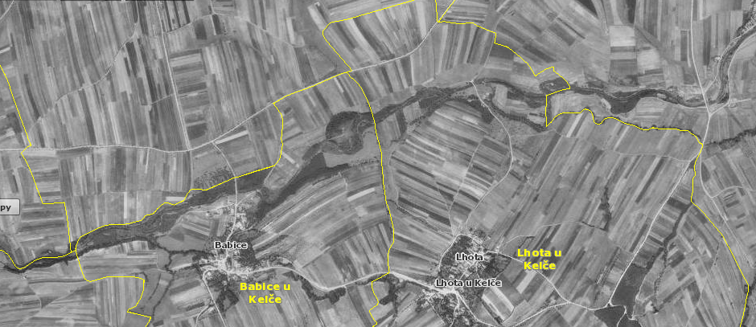
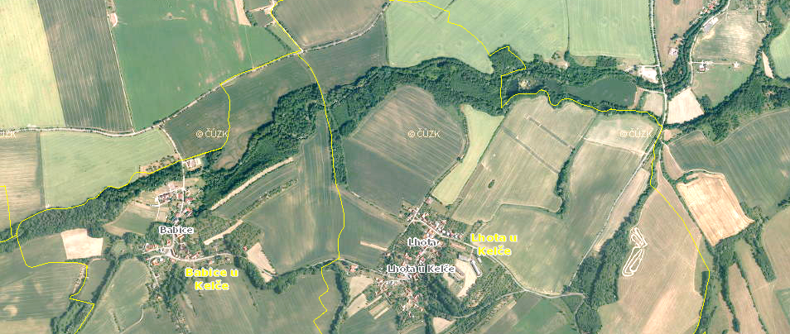
Landscape history:
Czech landscape in 1950 and today
- Landscape 70 years ago was more stable and with higher biodiversity value due to fine landscape structure.
Diversity loss was also caused by intensification of agriculture (soil consolidation, pesticides, mineral fertilisers).
Today crop production causes soil structure destruction and soil contamination.
Present landscape structure is vulnerable to extreme weather events.
Landscape needs great structural changes connected with utilization change
It will be very expensive, but without appropriate measures we will pay much more
  (loss of soil fertility, food and ground water contamination, floods…).

Slide 54
Ecological Stability Framework
Landscape segments with higher ecological value than the landscape matrix
In Central Europe usually forests take part in the framework
…but not only (meadows, wetlands, open relic habitats…)
Ecological stability of the segments differ according to landscape type
(in national park ESF is consisted from the more stable segments than in intensively utilizated agricultural landscape)
Demarcation of the ecological stability framework is a starting point for better landscape management.

Slide 55
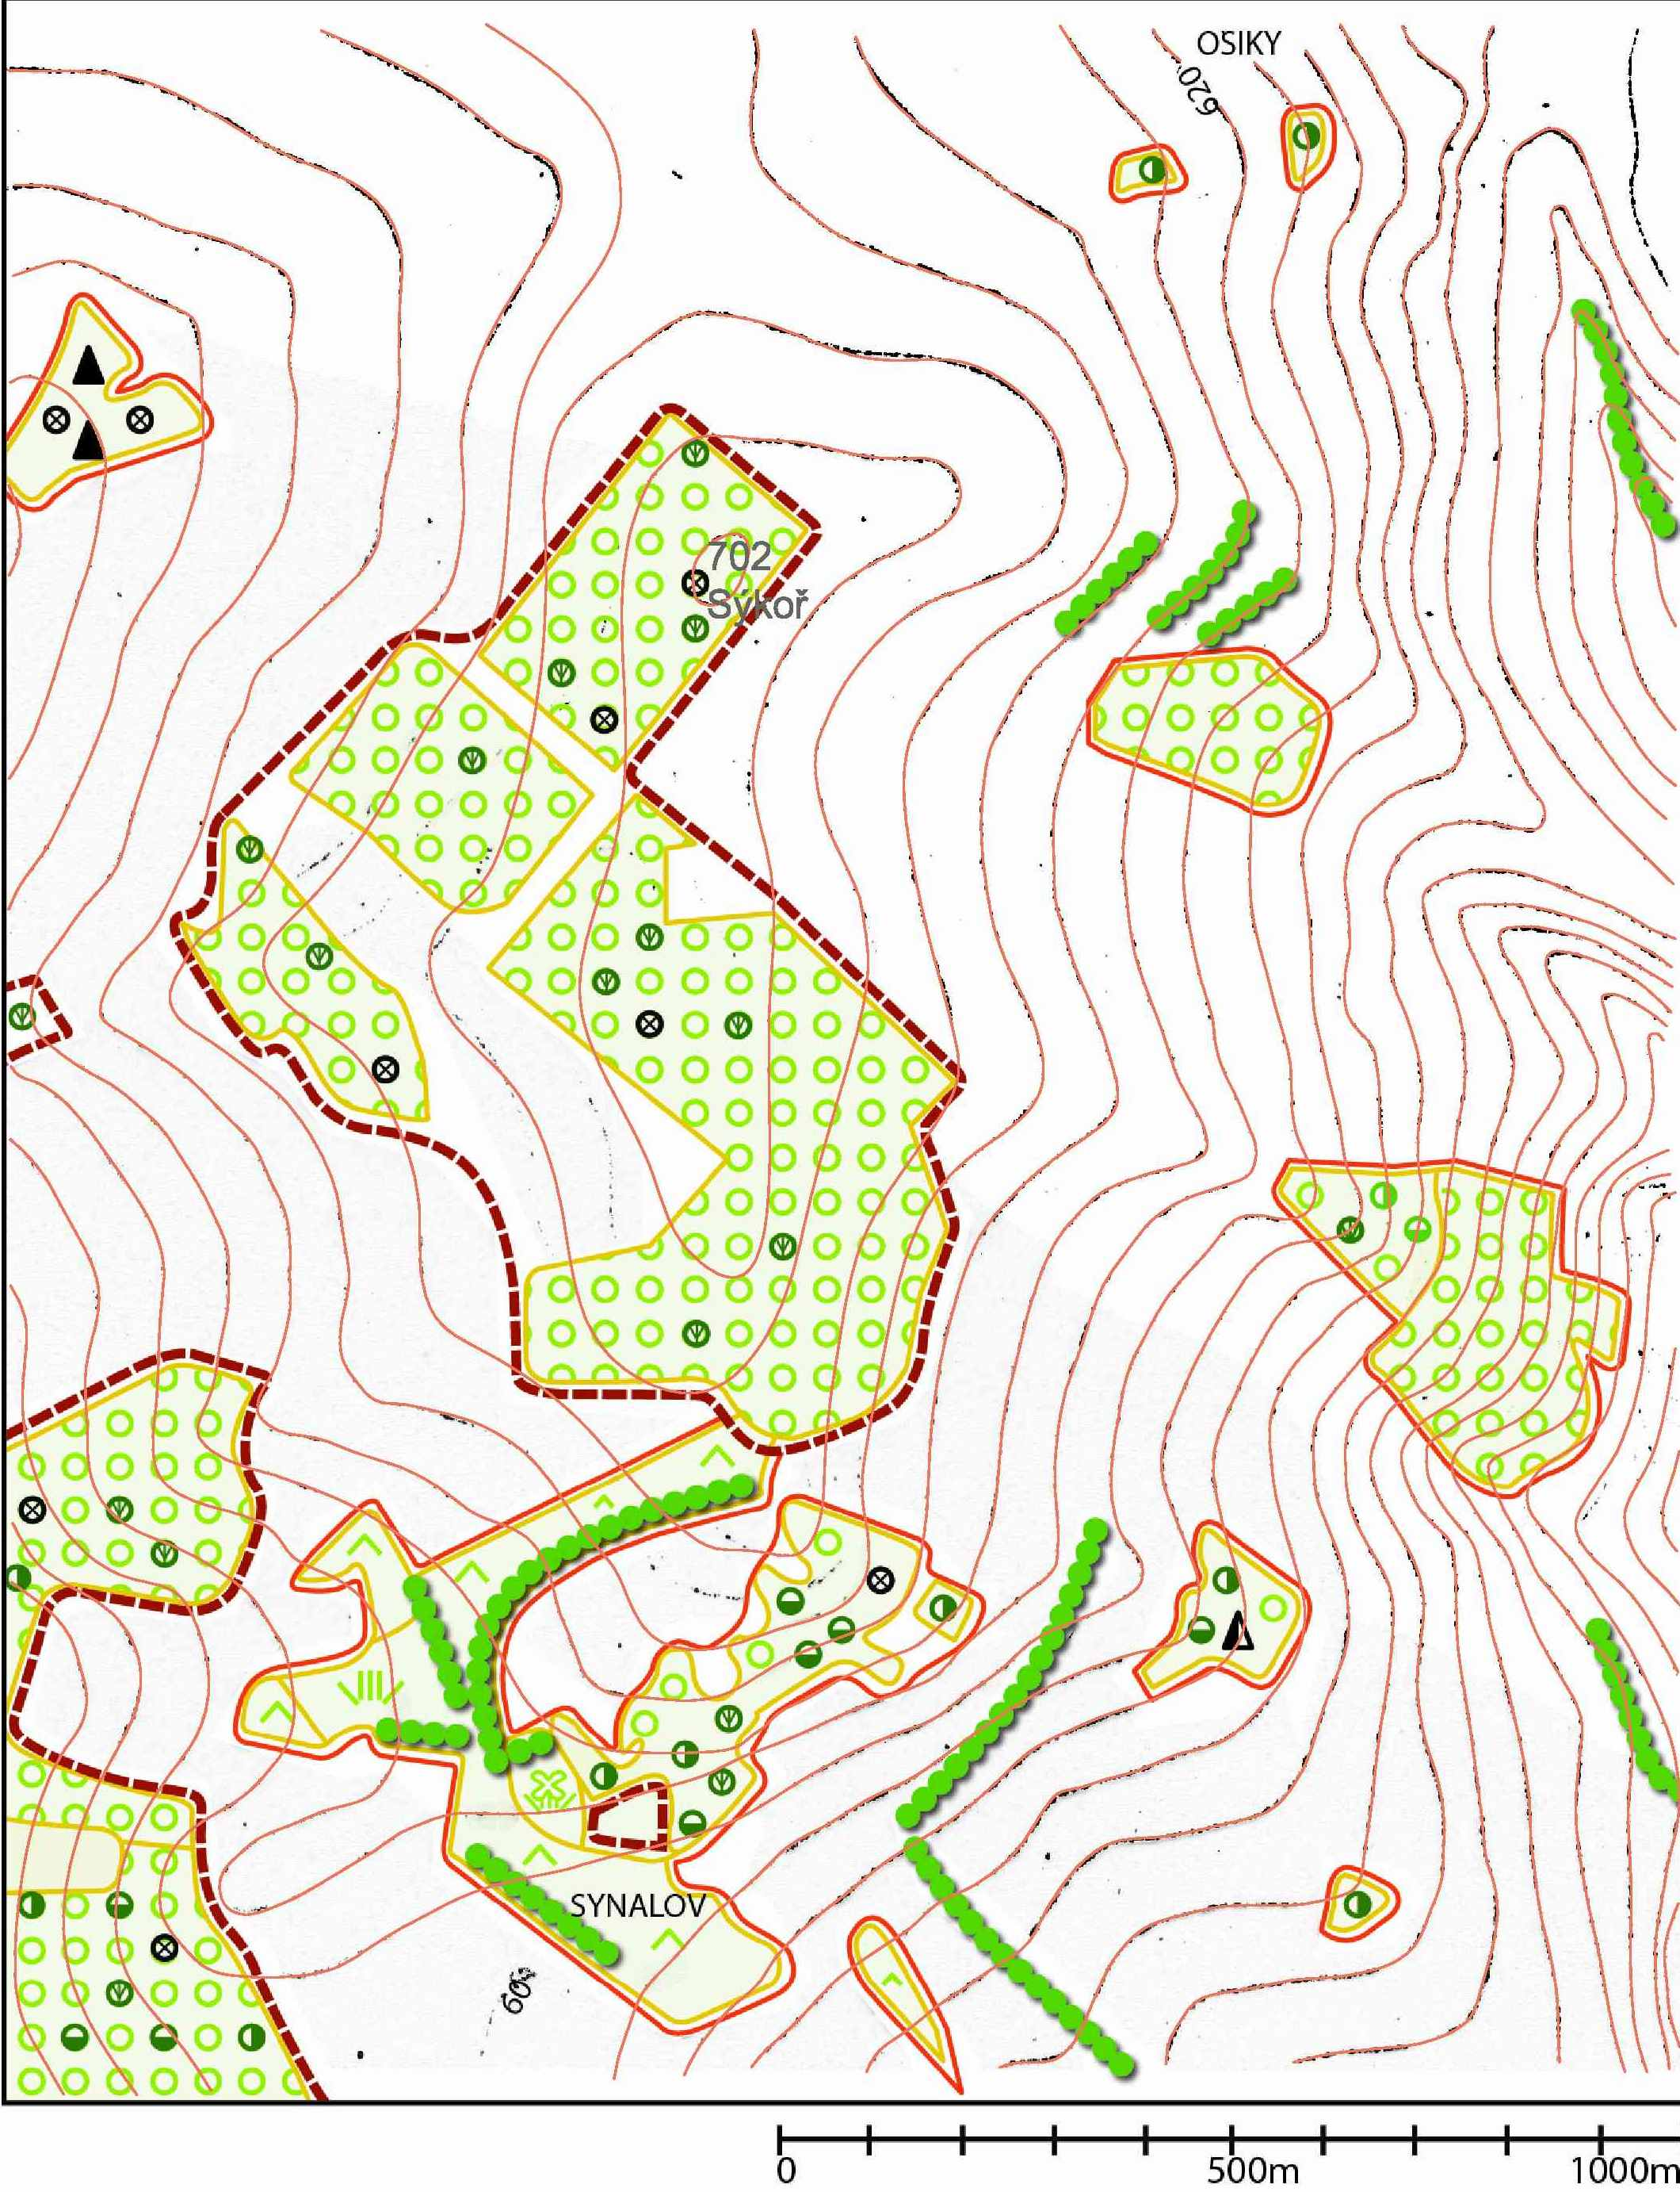

Sýkoř Model Area
Ecological Stability Framework
Territorial System of Ecological Stability
…to be continued within the lecture of prof. Viturka

