Slide 1
Understanding Policy from Data – Evidence-based Policy
Analysing Public Policy – Forecasting Expected Policy Outcomes

Slide 2
Evidence-based policy
„Evidence-based policy (EBP) is an aspiration rather than an accomplished outcome“ (Head, B., 2009:13)
„Evidence-based policy…encompasses two core elements: the application of rigorous research methods to build credible evidence about “what works”; and the use of such evidence to focus public and private resources on programs, practices, and treatments (“interventions”) shown to be effective.“ (Baron, J. 2018:40)
The implied contrast here is with policymaking based on ideology or 'common sense'. (Head, B., 2009:13)

Slide 3
Critiques
Policy-making encompasses also other types of decisions such as institutional reforms and actions based on predictions. Woodward, J. (2005). Making Things Happen: A Theory of Causal Explanation. Oxford University Press.
Therefore, mechanistic evidence and observational studies suffice for introducing institutional reforms and undertaking actions that do not modify the causes of a causal claim. Maziarz, M. (2020). The Philosophy of Causality in Economics: Causal Inferences and Policy Proposals. London & New York: Routledge.
Decision-making in order to hit pre-ordained targets…Muller, J.Z. (2017) The tyranny of metrics. Princeton.

Slide 4
EBP requirements:
good data,
analytical skills,
and political support.
The cutting-edge issues in modern EBP debates focus on problem-framing, methods for gathering and assessing reliable evidence, communicating and transferring knowledge into decision making, and evaluating the effectiveness of implementation and program delivery in complex policy areas.

Slide 5
Types of knowledge relevant to evidence-based policy
Political knowledge | Scientific rigorous knowledge | Professional– managerial knowledge | Client and stakeholder knowledge
The mass media and political culture | The mass media and political culture
Source: (Head, B., 2009)

Slide 6
Key concepts
Data Source: information that may be used as the basis for measurement, including public surveys, administrative records, interviews, focus groups and observations. Encompasses information collected specifically for the purpose of measurement and pre-existing cources, such as budgets, reports and legislative documents.
Indicator: a quantitative or qualitative factor or variable that provides a simple and reliable means to measure achievement, to reflect the changes connected to an intervention, or to help assess the performance of a development actor

Slide 7
Forecasting in policy analysis (Dunn, W.N. Public Policy Analysis)
Types of future
Principal forms:
Projection
Prediction
Conjecture
Selected methods

Slide 8
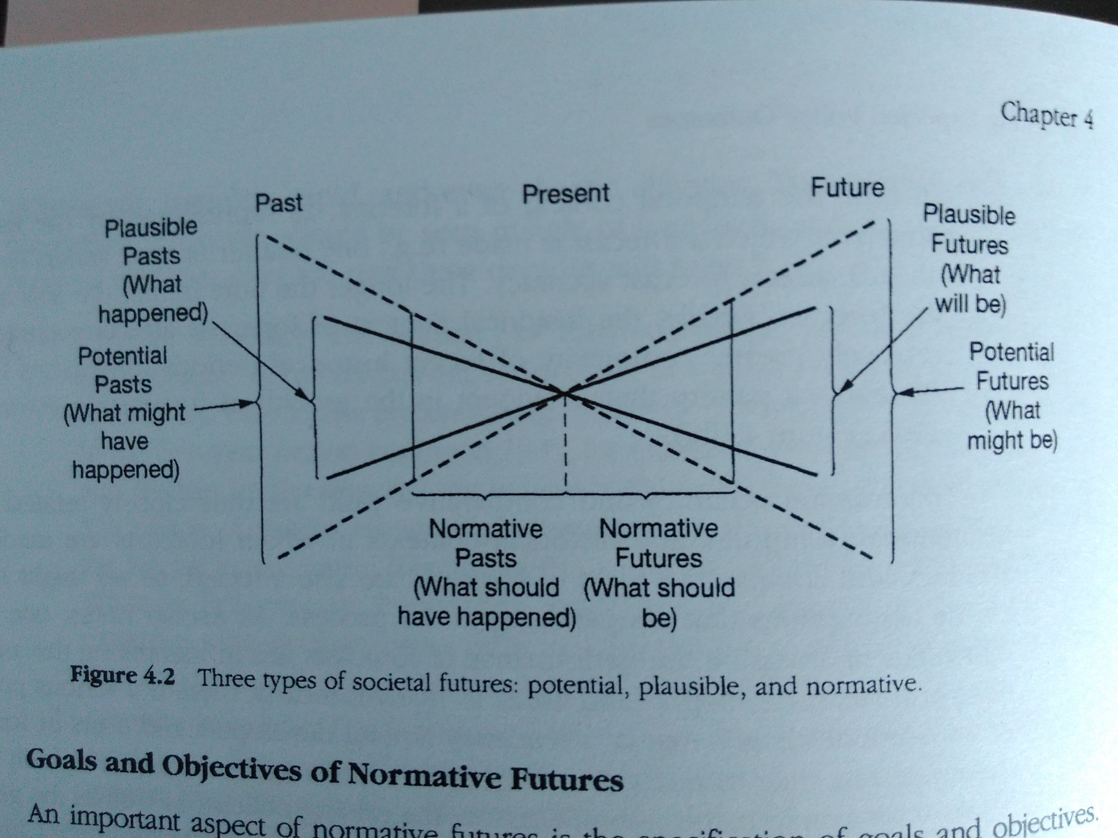
Types of future
Plausible futures
Potential futures (alternative)
Normative futures

Slide 9
Three approaches to forecasting
Approach | Bases | Appropriate technique | Product
Extrapolative forecasting | Trend extrapolation | Classical time-series analysis | Projections
 |  | Linear trend estimation
 |  | Exponential weighting
 |  | Data transformation
 |  | Catastrophe methodology
Theoretical forecasting | Theory | Theory mapping | Predictions
 |  | Causal modelling
 |  | Regression analysis
 |  | Point and interval estimation
 |  | Correlation analysis
Judgmental forecasting | Informed judgement | Conventional Delphi technique | Conjectures
 |  | Cross-impact analysis
 |  | Feasibility assessment
Notes:
Dunn, s.141

Slide 10
Bases – (the boundaries between inductive deductive, and retroductive reasoning are often blurred).
Trend extrapolation is based on inductive logic, that is, the process of reasoning from particular observations to general conclusion or claims.
Theoretical assumption is based on deductive logic, that is, the process of reasoning from general statements, laws, or proposition to particular sets of information or claims.
Informed judgment often expressed by experts and based on retroductive logic, that is, the process of reasoning that begins with claims about the future and then works backward to the information and assumptions necessary to support claims

Slide 11
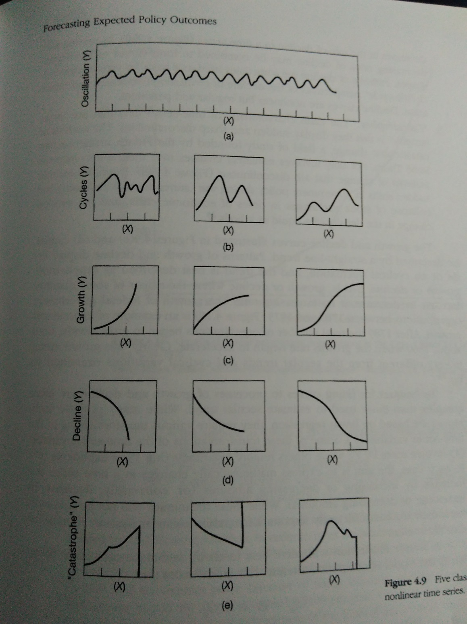
A) Extrapolative forecasting - projection
Three basic assumptions:
Persistence (Patterns observed in the past will persist in the future.)
Regularity (Past variations observed trends will regularly recur in the future.)
Reliability and validity of data.
Oscillations
Cycles
Growth curves
Decline curves
Catastrophes

Slide 12
B) Theoretical forecasting - prediction
In policy analysis, deductive reasoning is most frequently used in connection with arguments from cause that seek to establish that if one event (x) occurs, another event (y) will follow it.
Some procedures are concerned with ways to identify and systematize theoretical assumptions, while others provide better estimates of future societal states predicted from theory.
Casual modeling (covariations), Regression, Correlation analysis…

Slide 13
C) Judgemental forecasting – conjecture
Assumptions about the creative powers of persons making the forecast are used to warrant claims about the future.
The logic of intuitive forecasting is essentially retroductive, because analyst begin with a conjectured state of affairs and then work their way back to the data or assumptions necessary to support the conjecture.

Slide 14
A task for you: Test the hypothesis, answer “research questions”.
Is it true that richer countries spend a larger part of their GDP on healthcare?
Is there any corelation between tobacco consumption and countries life expectancy? How strong is it?

