Slide 1
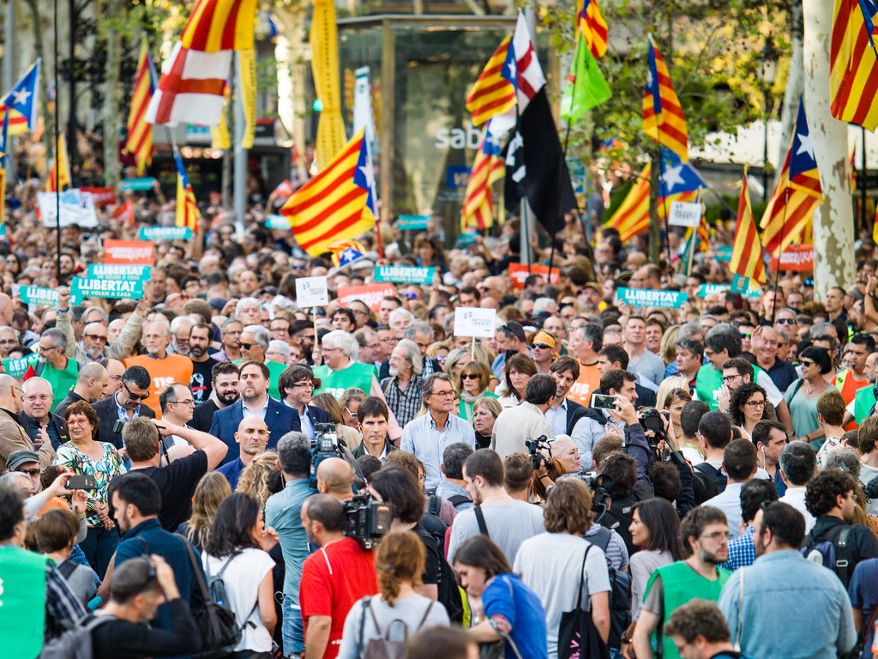
Actors of the Social Policy
Taxonomy, Influence & Interests
Tato fotka od autora Neznámý autor s licencí CC BY-SA-NC

Slide 2
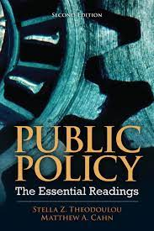
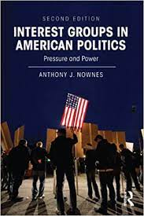
Further readings
ANTHONY J. NOWNES, author. Basic Interests: The Importance of Groups in Politics and in Political Science Frank R. Baumgartner Beth L. Leech. The Journal of Politics[online]. 1999, 61(3), 844-848 [cit. 2018-08-10]. ISSN 00223816. https://muse.jhu.edu/article/370770
CAHN, M., A. 2012. Institutional and Noninstitutional Actors in the Policy Process. Pp. 199-281 in S. Z. Theodolou, M. A. Cahn. Public Policy: The Essential Readings. 2nd Edition. Pearson.

Slide 3
Actors (Howlett, Ramesh 2003)
State Actors (Parliament, Government Bureaucracy, …)
Social Actors (Employees, Professional Societies, Trade Unions)
Political Actors (Public, Interest Groups, Political Parties,….)

Slide 4
Influence
How to measure?
  Ask others.
  What have they achieved?
  Sucessful brookers?
What matters?
Number of „members“
Cohesiveness
Others

Slide 5
Interests (What do they want? What do they maximize?)
Economical
  income
  ……….
  ……….
Others
  professional authonomy
  …..
  ……

Slide 6
Measures, tools
next time… ☺

