Slide 1
Lecture 5
Creating data by observing and measuring phenomena
DHX_MET1 Methodology 1
Stanislav Ježek
Faculty of Social Studies MU

Slide 2
Observation concerns the planned watching, recording, analysis, and interpretation of behavior, actions, or events.
(1) control (are the observations conducted in an artificial or in a natural setting?),
(2) whether the observer is a member of the group that is observed or not (participant versus nonparticipant observation) – a dimension,
(3) structure (to what extent the observation is focused, predetermined, systematic, and quantitative in nature), and
(4) concealment of observation (are the members of the social group under study told that they are being studied or not?).

Slide 3
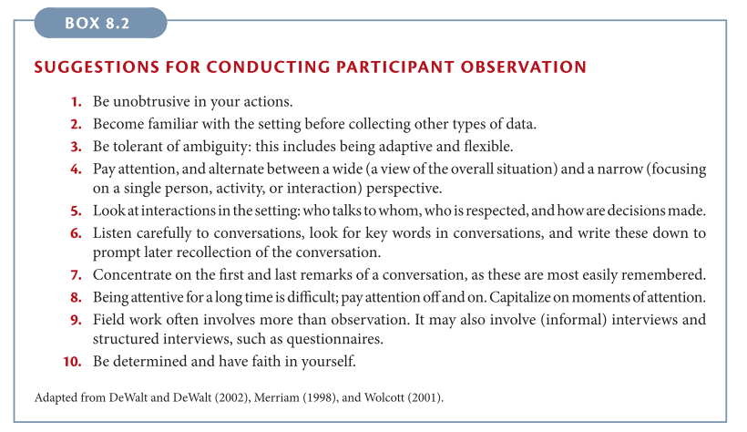
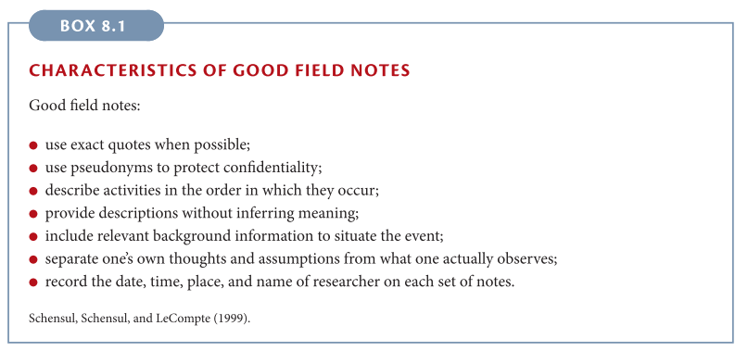
Participant observation
the researcher gathers data by participating in the daily life of the group or organization under study.
“to grasp the native’s point of view, his relation to life, to realize his vision of his world”
Somewhere between
  Pure participation has been described as “going native”; the researcher becomes so involved with the group under study that eventually every objectivity and research interest is lost
  Pure observation seeks to remove the researcher from the observed actions and behavior; the researcher is never directly involved in the actions and behavior of the group under study.
Getting permission, access -- earning acceptance & rapport – choosing key informants
Descriptive – focused – selective observation
Writing field notes

Slide 4
In unstructured observation distinguish between the following
„Pure“ descriptions of people‘s visible behavior
Our interpretations of the observed behavior – emotions, intentions, motivations, meaning
Our own feelings and impressions from the observations – the power of unconscious

Slide 5
Structured observation
Observation of predetermined phenomena – a continuous dimension of the amount of sructure
Observation of behavior (includes any observable characteristics, voluntary/involuntary, small like eyeblink to large like declaring war) of one or more people (interactions). Even oral/written language may be considered behahavior and observed. Also contextual/triggering events are included in observations.
Ex. mystery shoppers, classroom observations, usability testing
Observation schedule (coding scheme, sheet) - what
Behavior sampling – when, where

Slide 6
Observation schedule
Operationally defines what is to be observed
Paper/electronic form for recording observations with some instructions, or recording software (e.g. http://www.boris.unito.it/)
An observer must be trained in using a particular observation schedule
Items
  checks, checklist – record a behavior has been observed
  rating scales – rate, evaluate, classify the behavior
  the above can be put on a timeline(timescale), or electronically appended with timestamps
Notes:
Other software: https://psychsoft.com/products

Slide 7
Observation schedule desiderata
Clarity & Objectivity (after training) – minimal subjectivity left in what is and is not behavior of interest and how to record it
Mutually exclusive and collectively exhaustive categories
  Observed instance of behahavior should fall in one category only
  Every relevant instance of behavior should fall in some category
Minimal cognitive burden, ease of use
  Choices whether a behavior is relevant and how to code (classify, rate) it should be easy, automatic after training
  More difficult coding is to be done in the analytical phase, or from video-recordings
Minimal use of observer‘s memory
In people, focus on observable behavior, not on inferring emotions, intentions, motivations….
Inter-observer(coder) agreement as a check of the above
  Kappa coefficients – measure agreement beyond chance, (-1)…0…1

Slide 8
Sources of Observer bias and errors
Insufficient training
Reactivity to being observed
Selective attention and attention fluctuation
Memory errors – forgetting, distortions (schematizations)
Social cognition distortions – e.g. halo effect and other first impressions, projections
Fatigue
Observer drift – systematic individual changes in applying the observation schedule – the need for re-training

Slide 9
Behavior sampling
When to observe
Just like we cannot observe all people we usually cannot observe all their behaviors
Time sampling
  select time intervals & durations systematically or randomly
  good use of available time switching between focused attention and rest
  usually for frequently occurring behavior
  e.g. all personell-customer interactions are recorded for 1 min every 15 minutes in a restaurant
Event sampling
  sample of events, usually systematic
  all relevant behavior is recorded for the whole selected event
  e.g. every 10th guest‘s interactions with the personnel is recorded

Slide 10
Using measurement instruments to capture physiological correlates of psychological experience
Activation – sympathetic nervous systém, quick acting
Cardioascular indicators – blood pressure, heart rate, breathing depth and frequency
Skin conductivity – galvanic skin response
Muscle tone, incl. face muscles - electromyography
Attention – eye-tracking

Slide 11
Advantages and disadvantages of observation
Directness
Control over reliability and validity of observation
Richness of data when recording is used
Takes a lot of time and other resourses
Requires access to behavior (or ability to manipulate)
Behaviour may be affected by observation

Slide 13
CONSTRUCTION OF MEASUREMENT INSTRUMENTS - SCALES
What do we wish to measure – CONSTUCTS
CONSTRUCTS are concepts which are part of our theory explaining observable behaviour of people (or groups, organizations)
e.g. need for cognition, cohesion, climate
Measurement is the assignment of numbers or other symbols to characteristics (or attributes) of objects according to a prespecified set of rules. Traditional positivistic, but useless S.S. Stevens‘ definition of measurement.
In practice, measurement – scaling – is an attempt to
  a) create a scale reflecting the quantitative property of a construct and
  b) create an instrument allowing us to map measured objects on this scale

Slide 14
QUANTITATIVE PROPERTY OF A CONSTRUCT – based on theory
Nominal construct
  characteristic that has values that differ in quality, not in quantity
  e.g. sex of a person, preferred color, occupation
  object may only be the same or different in this characteristic
Ordinal construct
  has values that differ in quantity enough to allow us to order them
  often the values are categories
  e.g. education level, grade in school
  objects may be ordered acc. to this characteristic (transitivity)
Quantitative construct
  has values that may be ordered and the distance between values may be defined – numeric scale, discrete/continuous makes sense
  a distance of one can be (carefully) thought of as a unit
  Interval construct - distance between objects is defined (deg Celsius, IQ, risk av.)
  Ratio construct – has absolute 0, ratios of objects are defined (deg Kelvin, ?)
Notes:
Risk aversion
Market optimism
GDP
SES

Slide 15
Relationship between Quantitative property of a construct and a SCALE we want to build
Scales are also nominal, ordinal, interval and ratio – scale level
Scale level defines meaninful mathematical relations/operations on the values
  =, not =
  =, not =, <, >
  =, not =, <, >, +, -
  =, not =, <, >, +, -, x, /
For a construct we can build a scale on the same level or lower
Many combinations are possible.
X
From the perspective of operationalism, the scale defines the construct

Slide 16
OPERATIONALIZATION OF A CONSTRUCT
Deriving, from theory, all possible manifestations of the construct we are trying to measure
There are many, so some map/tree of them is usually necessary
Major areas, sets of manifestations of the same kind are often termed FACETS (S-B call them dimensions, which is a bit misleading)
Based on theory, how should people(groups, organizations) with different levels of the construct…
  …currently behave, act (in various situations, even in responding to questions)
  … feel
  … be perceived by others
  … have achieved in the past
  … should be their future goals……
Then we think of ways to observe/capture as many manifestations
  unobserved manifestations (for whatever reasons) limit validity (coverage)

Slide 17
SCALING
Observed manifestations – indicators, items
Scale is built from items by various statistical scaling techniques.
Currently most used is Likert scaling technique using Likert-type items.
The scale value (interval) is created by summing/averaging item responses (ordinal).
This simple procedure is based on a large number of assumptions together forming an underlying reflective measurement model.

Slide 18
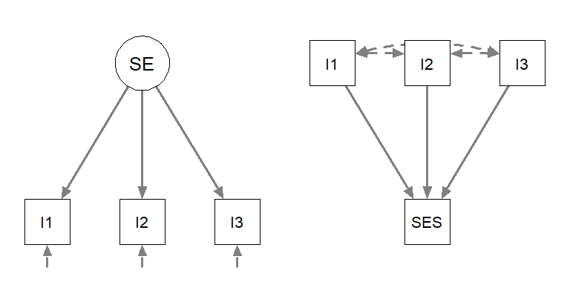
Models of Measurement
Reflective model
(e.g. self-esteem)
Formative model
(e.g. socio-economic status)
I1: On the whole, I am satisfied with myself.
I2: I feel that I have a number of good qualities.
I3: I am able to do things as well as most other people.
I1: Respondents education.
I2: Parents education.
I3: Income level.

Slide 19
The assumptions in the reflective model
The construct is a latent continuous quantitative variable (may also be nominal - latent class models)
There is only one construct (latent variable, factor)
  If there are more they must be added to the model
Item responses are only due to construct(s) and random error – residual variance
  Causality is explicit here
Items correlate only due being caused by the same construct
  Local independence of items

Slide 20
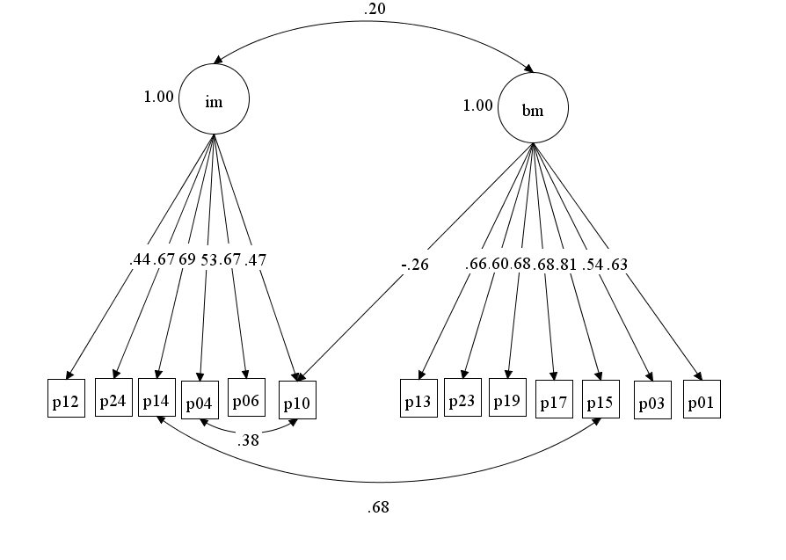
Notes:
Instructional management use by teacher
Behavioral management use by teacher
p10 – I use group work
p14 – I lead pupils to look for problem solutions and asking questions
p15 – I manage off-task pupil activities
p15 -

Slide 21
Reliability is defined through this model
  The proportion of residual error variance across the items
  McDonald‘s omega
Cross-loadings and correlations between residuals increase construct-irrelevant variance in a summation score – i.e. affect validity
Sometimes model is simplified by excluding „bad behaving“ items – may negatively affect validity
If a model is more complicated than assumed
  latent variable should be used in further analysis instead of summation score
  measure should be improved
Development of a measure im practice = looking for items functioning according to the assumptions while covering as many facets as possible.

Slide 22
DIRECT SCALING – RATING/RANKING SCALES
Often, instead of sophisticated measurement, we assign the scale values directly – ourselves or ask respondents
In this mode a single rating item is called scale and represents a single construct
  sometimes the construct is implicit, which limits critical interpretation
  confusion is created about what is meant by a scale
The measurement model is in the head of the rater
  If it were a part of observation study he/she would be trained….
  All imaginable sources of bias need to be considered
Validity & reliability of single rating/ranking items is determined mainly by comparing to criteria and repeated administration.
  Unless you have some empirical data in favor of validity & reliability of sinle items, be very, very suspicious

Slide 23
SUMMARY
Prefer used well validated measures
Observe as much as your resources allow you
Interview as much as your resources allow you after you have observed at least a bit
Survey only after you have gained knowledge – theory, observation, interview
Be sure to distinguish between survey items asking for direct scaling and items of measurement scales
Elaborate your knowledge of what is meant by validity and reliability

