Slide 1
Lecture 6
Sampling
DHX_MET1 Methodology 1
Stanislav Ježek
Faculty of Social Studies MU

Slide 2
SAMPLING
Sampling strategies and representativeness
Sample size determination

Slide 3
REPRESENTATIVENESS
Inability to collect and/or analyze ALL data – need for sampling
Samples of units
  people, organizations, economies, events…
Sampling within units (in time)
  behavior – states
Samples represent population (~ALL data) – representativeness
Representativeness
  ideal - sample differs from population only in size (or irrelevant characteristics)
  achievable only probabilistically
  R in relevant characteristics – can we list them all?

Slide 4
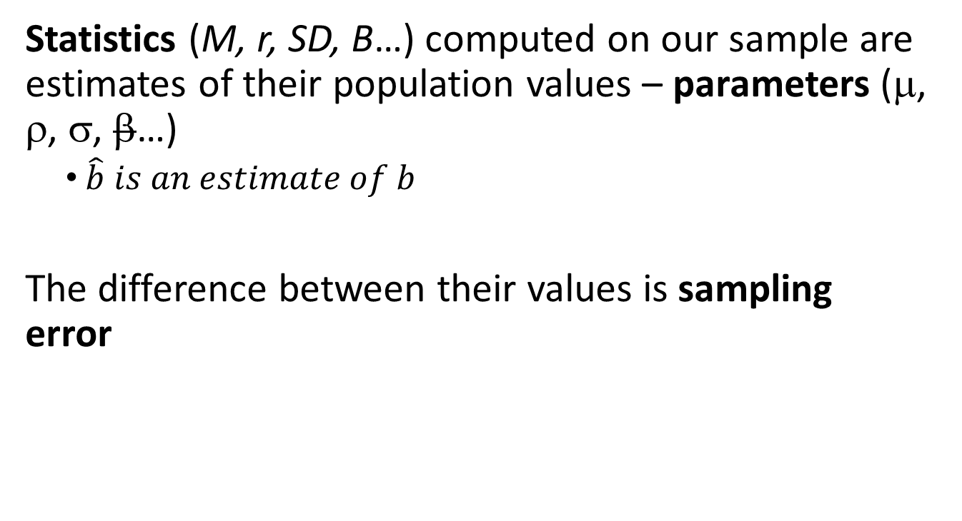
STATISTICS & PARAMETERS

Slide 5
SAMPLING ERRORS
Random
  quantifiable, estimable from probability theory
  in the long run does not bias estimates of researched characteristics
Systematic
  hard to control for unless we know exactly the process (variable) creating the error
  selection bias
  response bias

Slide 6
SAMPLING
1. Define the population.
2. Choose the sample(-ing) frame.
3. Decide the sampling design/strategy.
4. Estimate the appropriate sample size.
5. Execute the sampling process.

Slide 7
POPULATION
SAMPLING FRAME
SAMPLE (approached)
SAMPLE

Slide 8
POPULATION
NOT necessarily population in demographic sense
POPULATION
  a set of all units to which I want to generalize
  a set of all units I want to have a sample of
Widely/vaguely defined populations hard to sample
Better to have a representative sample of a narrowly defined population than a biased sample of a wide one.

Slide 9
SAMPLING FRAMES
LISTS, SETS of (all) units in a population from which we can select
  SETS of approachable units in some communication channel, place…
  Registries of all kind
Function of sampling frames
  Allow sampling, allow for a level of control over sampling stratégy
  Allow reasoning about external validity - generalization
First, come up with a frame, second, consider its limitations

Slide 10
SAMPLING STRATEGIES
NON-STRATEGIES
  Convenience samples
  Self-selected samples
  Naive snow-ball
PURPOSIVE, NON-PROBABILISTIC STRATEGIES
  Careful creation of a sample making it representative in relevant variables
  Quota sample
PROBABILISTIC STRATEGIES
  Strategies based on random selection

Slide 11
SAMPLING – NON-STRATEGIES
(convenience sampling)
We have little to no control (or knowledge) over the processes leading to including a particular unit in or sample
Difficult to argue about bias
Difficult to argue the processes are the same as in other studies
Difficult to apply statistical inference
„Heterogeneity“ nor „homogeneity“ are not the solution if not considered systematically
Making the sample bigger makes it worse – false confidence
If it must be used, strive for maximum randomness

Slide 12
SAMPLING – NON-PROBABILISTIC
QUOTA SAMPLING
  building the sample so that it is representative in particular characteristics
  typically demographics – settlement, age, race, gender…
  quota = proportion of units in each category found in population
  unless the quota variables are super-relevant it may not be worth the effort
PURPOSIVE SAMPLING, THEORETICAL SAMPLING
  selection of individual units based on current needs of a (qualitative) study
  to compare, contrast…
  Emmel, N. (2013). Sampling and choosing cases in qualitative research. A realist approach. Sage.

Slide 13
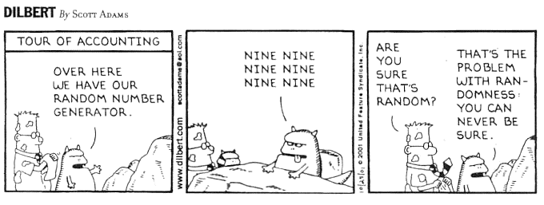
SAMPLING – PROBABILISTIC STRATEGIES
Probabilistically unbiased estimates of parameters
SIMPLE RANDOM, SYSTEMATIC
STRATIFIED – let‘s assist probability; need for sub-population parameters
  PROPORTIONAL (proportionate)
  NON-PROPORTIONAL (disproportionate), e.g. oversampling rare subgroups
CLUSTER (MULTISTAGE) – let‘s make it more practical
  Hierarchical sampling procedure – higher-order units, lower-order units, individuals
  At all levels we need sufficient numbers of units
SNOW-BALL (probabilistic)
  network sampling, link-tracing

Slide 14
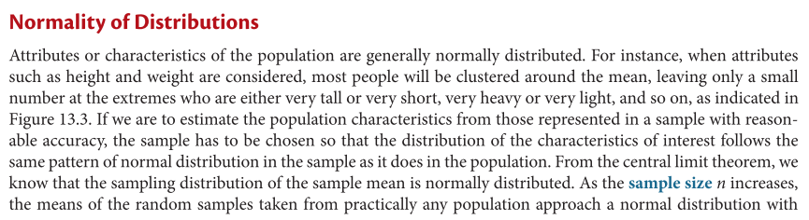

Slide 15
SAMPLING – WHAT SAMPLE SIZE DO WE NEED?
Large enough to make sure that relevant observed properties of the sample are unlikely to be due to sampling error
  High „signal-to-noise ratio“
QUAN - Power analysis, precision analysis
QUAL – Saturation
Often seems difficult to determine beforehands – rules of thumb, e.g.
  high tens of participants in each group for a between-subject experiment
  hundreds of participants for regression models
  low tens for a within-subject experiment
  3-5 cases for IPA
  about 10 for a GT
Rules of thumb (like p.264) should be avoided – world is just not that simple.

Slide 16
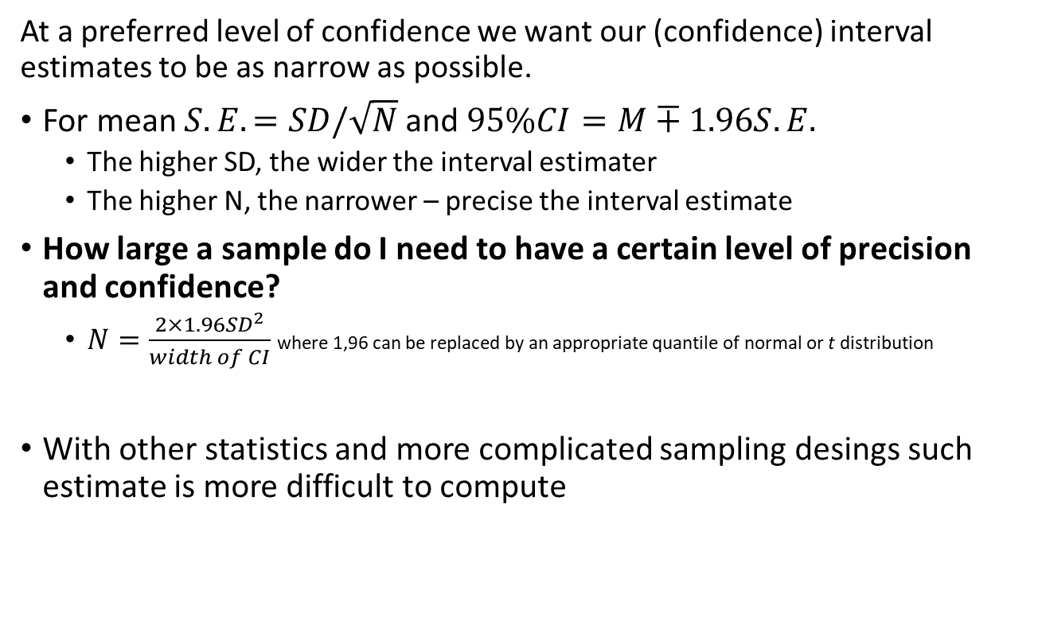
PRECISION

Slide 17
STATISTICAL POWER (1–β)
In the context of statistical hypothesis testing – the probability that an effect will be found statistically significant (provided it exists)
  P(p<α|H₀)
  Probability of avoiding Type II error
Factors affecting power
  (signal) – effect size, measurement reliability
  (noise) – standard error … sample size, design
  (required certainty) - alpha
Simulation: https://rpsychologist.com/d3/NHST/

Slide 18
CONSEQUENCES…
…OF INSUFFICEINT POWER (eg. 60%)
even if you are right about your hypothesis & have designed your study well, the data may not support your hypothesis
gambling with funding money & participants time -> ethics
effect size inflation
  in confirmatory studies due to publication bias
  in exploratory studied due to publication bias, fishing and insufficent correction of p-values for multiple tests
… OF EXTREMELY HIGH POWER (eg. > 95%)
  may be just an inefficient use of research budget
  combined with fishing and other metodological sins (QRPs) allows to identify very small significant efects - artefacts

Slide 19
Practically - 2 big questions:
1. What is the expected effect size?
  Many standardized measures of effect size
    distance based – Cohen‘s d, Hedges‘ g….
    based on explained variance – R², r, η², ω²…
  It is safer to consider published effect sizes inflated, unless they come from meta-analysis
2. How to do power analysis for more complicated analyses than a t-test?
  G*Power: http://www.gpower.hhu.de/
  Dattalo, P. (2008). Determining sample size: balancing power, precision, and practicality. OUP.

Slide 20
SAMPLING IN QUALITATIVE RESEARCH
Representativeness – what is to be represented?
If there are relevant phenomena in the the studied population we want to be fairly confident they could have been encountered during study.
Purposive sampling
  careful selection of each case based on accummulated knowledge and immediate needs
  Some selected before analysis, some after analyses of first cases
  Often return to cases
(Theoretical) Saturation – subjective belief that adding further cases would not improve the theory enough to be justifiable
Both the reasons for selecting each case and reasons behind saturation are reported/discussed in the research report.
Again, rules of thumb should be avoided

Slide 21
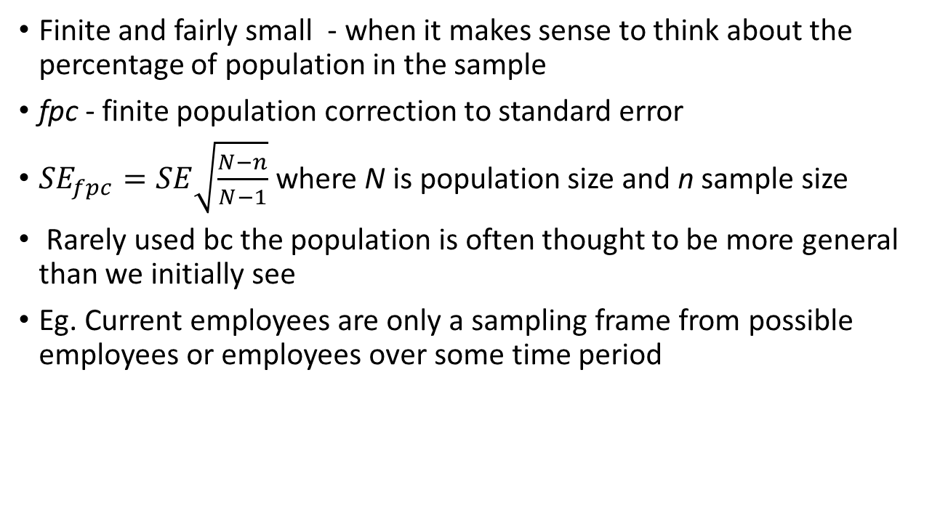
Sampling from finite populations
Finite and fairly small - when it makes sense to think about the percentage of population in the sample
fpc - finite population correction to standard error
${SE}_{fpc}=SE\sqrt{\frac{N−n}{N−1}}$ where N is population size and n sample size
Rarely used bc the population is often thought to be more general than we initially see
Eg. Current employees are only a sampling frame from possible employees or employees over some time period

