Slide 1
11. TRANSPORT APPRAISAL

Slide 2
Readings for Lecture 11
Nash, C. (2015). When to invest in high speed rail. Journal of Rail Transport Planning & Management, 5(1), 12-22.
Preston (2013): The economics of investment in HSR

Slide 3
Learning Outcomes
Understand why we appraise
Understand main methods of appraisal
The economics of high speed rail
When to invest in high speed rail

Slide 4
11.1 CBA

Slide 5
Transport investment
Transport investment involves expenditure on particular project in situation of limited resources.
The task is to choose the project that brings maximum return

Slide 6
Appraisal
Appraisal is a way of predicitng how much utility we as society will derive from the expenditure on one project compared to another, by predicting the utility that will arise from each
It is fundamental to realise that, inherent in appraisal there is some kind of prediction or forecasting required

Slide 7
Cost benefit analysis (CBA)
CBA estimates and totals up the equivalent money value of the benefits and costs to establish whether they are worthwhile.
The result of CBA is a number; this shows the ratio of benefits to costs.
The basis of CBA is that a monetary value needs to be allocated to all benefits and costs

Slide 8
How does CBA work?
Choose options
Choose length of time
Use a predictive model
Calculate time savings
Take away benefits from cost to find out whether benefits exceed costs and, if so, by how much

Slide 9
Key elements of CBA
Project appraisal period
The benefits that are assessed
Forecasting and modelling
Present value
Values of time
Accident valuation
Operating costs
Revenue
Discounting

Slide 10
Criticism and problems with CBA
Valuing time savings
Discount rate and length of time of project appraisal
What does NPV show us?
Equity and distributional effects
Project pricing – optimism and inaccuracy

Slide 11
Too low residual value?
See: Jones et al. (2014)

Slide 12
Exercise (1) – Discount rate
The effect of the discounting rate and project time period
First, discount the following stream of benefits from a project and derive a total NPB for price base year 2002. Use a discount rate of 3.5 per cent.
Year | Benefit (undiscounted) (£)
2003 | 35,000
2006 | 60,000
2008 | 100,000
2010 | 25,000
2014 | 40,000
2017 | 70,000

Slide 13
Exercise (2) – Value of licence
Suppose you are interested in operating a taxi and you are considering purchasing a taxi operating certificate form an existing operator. You estimate that the current operator makes annual excess profits equal to 100.000 CZK. At a 5% rate of interest, what is the maximum price you are willing to pay for this license? Would you be willing to pay this same price if the interest rate were 10%?

Slide 14
Exercise (3) – Investments „needs“
Critique the following statement: “We currently do not have sufficient airport capacity to meet the continuing growth in airline traffic. In order to avoid gridlock at our nations airport, we need to build additional airports”.

Slide 15
Exercise (4) – Value of time
Decide which values of time you should use for a person who is travelling by underground train on works’ business; and for a person who is travelling to work by bus. Why do you think that values of time when travelling in working time are highest for travellers on the underground and lowest for those on the bus?

Slide 16
11.2 The Economics of Investment in High Speed Rail
based on J. Preston (2013)

Slide 17
Introduction
Origin in Japan - Shinkansen (1964)
Defined as new rail lines capable of operating speeds of 250 kilometres per hour or more
World HSR network (2013) – 22.000 km
China, Japan, France, Spain
Germany, UK, Italy, Korea, Taiwan, ……
HSR extremely costly
Better understanding of the economics of HSR needed

Slide 18
Design
Largely freestanding systems (Japan, China) x systems integrated with conventional rail (France, Spain, Germany)
HSR may penetrate city centres using conventional tracks (France) or new tracks (Japan) or may serve edge of city locations (China)

Slide 19
Aims
Capacity = separating fast and slow trains
Speed = rail to compete with air
Promoting national champions (in supply)
Journey time reliability (UK)
Economic development (China)
Political integration/centralization (Spain)
Enviroment (UK)

Slide 20
Appraisal and Evaluation
In both ex-ante appraisal and ex-post evaluation of HSR cost-benefit analysis is the dominant methodological tool
Sometimes distributional impacts are important

Slide 21
Benefits of HSR (UK evidence)
30% revenue
50% users time savings
10% reduction of rail overcrowding
10% wider economic benefits
Benefits from reduced rpoad congestion and enviroment improvement were relatively minor

Slide 22
HSR traffic (European evidence)
30% abstracted from air
30% abstracted from classic rail
15% from road (predominantly car)
25% generated

Slide 23
Capital costs
High capital costs are required to achieve grade separation, curvature and gradient
Costs higher when high population densities, high land values and unfavourable topography
Costs may vary from below EUR 10 million per km (China) to over EUR 100 million per km (HS1 approaches to London)
Economies of density important
Operating speed is a key driver of capital costs

Slide 24
Demand
High degree of variability in demand for HSR schemes from below 4 million passengers per annum (Madrid-Seville) to over 200 million passenger per annum (for the Tokaido and Sanyo Shinkansen)
Determinants: population, spatial structures, fare levels, HSR stations location, national and sometimes regional borders
Demand estimations: gravity model

Slide 25
Competition
Intermodal competition – very intensive, low cost airlines
Italy – HSR open access competition between Trenitalia and NTV:
    30% reduction in fares
    45% increase in services
    30% increase in demand
    It is not clear whether this competition will be sustainable
High access charges (typically 25-45% of HSR revenue) can limit open access competition

Slide 26
Analysis
Paralysis by analysis (UK, US) – many studies, minimum service
Build and see (China, Spain) – large increases in HSR network
Step by step x big bang approach

Slide 27
Test for HSR investment
Does HSR make a commercial return?
Does HSR make a social return?
Does HSR make a social return including impacts on other transport systems and wider economic benefits?
Does HSR have social returns when qualitative wider benefits are taken into account?

Slide 28
Conclusion
A key metric is the level of passenger demand with gravity model formulations providing a useful basis for high level startegic forecasts in advance of subsequent detailed modelling

Slide 29
11.3 When to invest in HSR?
Nash (2015): When to invest in HSR?

Slide 30
Introduction
This paper starts by a general review of the costs and benefits of high speed rail, of how they are measured in cost–benefit analysis and of the circumstances in which benefits may be expected to exceed costs.
Two approaches are taken to the latter; first, examining models in which values of key parameters are varied to see in what circumstances benefits exceed costs, and secondly looking at the limited evidence from ex post studies, mainly for France and Spain.

Slide 31
EU policy
European Commission calling for a trebling of the kilometres of high speed line in Europe by 2030.
Yet high speed rail is an enormous investment, and it is necessary to consider very carefully in what circumstances such an outlay is justified.

Slide 32
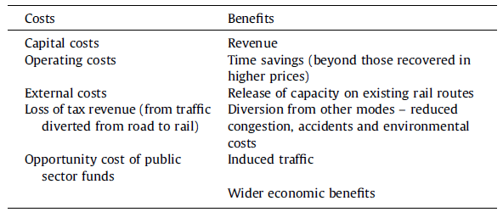
HSR costs and benefits

Slide 33
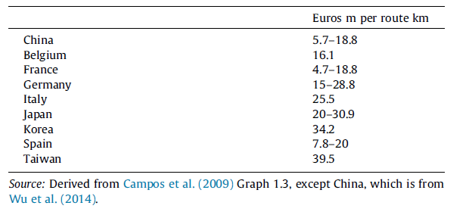
Construction costs of HSR (2005 prices)

Slide 34
Construction strategy
Given these high costs, it is obviously sensible to ask whether the costs may be reduced by using upgraded conventional tracks for all or part of the network.
Much will depend on what already exists and whether it has spare capacity.

Slide 35
Operational costs
In terms of operating cost, it appears that high speed trains are no more expensive than conventional trains when the capital cost of the vehicles is taken into account.
Whilst energy consumption and maintenance costs are higher than for conventional trains, high speed means staff and rolling stock can achieve much higher utilization rates than conventional rail, offsetting the increased costs

Slide 36
External costs
Of the external costs of high speed rail projects, noise, global warming and loss of amenity through land take and visual intrusion are the major issues.
Noise costs and loss of amenity can be minimised at the expense of additional capital cost, ultimately by tunnelling.

Slide 37
Capacity
The construction costs of high speed rail are largely fixed regardless of traffic.
High speed rail almost invariably requires a double track main line with cab signalling.
If all trains are identical in performance and leave the main line at high speed turnouts before slowing down to stop at any intermediate stations, then in principle operation at 3 min headways is feasible, offering 20 trains per hour.

Slide 38
Frequency
Some margin to recover from delays is necessary, but already France runs 13 trains per hour in the peak between Paris and Lyon
Japan 15 between Tokyo and Osaka.
Britain plans a peak service of 18 trains per hour on HS2.
France is already operating trains with pairs of double deck units offering around 1000 seats.

Slide 39
Fixed costs of HSR
Only the costs of rolling stock, stations and depots vary significantly with traffic volumes.
Thus high speed rail systems have very high fixed costs which can only be justified by high traffic volumes.

Slide 40
Passengers
The world’s first high speed line, from Tokyo to Osaka, carried 39 m passengers in its first full year of operation (1965) and this had grown to 149 m by 2008 (Albalate and Bel, 2012) with the help of extensions to the line.
Paris–Lyon opened with 19.2 m passengers in 1985, whilst the following Atlantic, North, Connection, Rhone-Alpes and Mediterranean lines all opened with similar numbers (Paix, 2010).
However not all lines have attracted traffic in these sorts of volumes. At the other extreme, the Madrid–Seville line opened with as few as 2.5 m passengers, and Madrid–Barcelona with only 5.0 m (Sanchez-Borras, 2010).

Slide 41
Population
Volumes of the necessary size may be obtained by linking individual very large cities (e.g. Paris and London) or by linking a chain of large cities so that flows between different cities are aggregated together and trains remain busy throughout the route (the so called ‘string of pearls’).
Japan is clearly a case of the latter, with 127 m people living at very high population densities mainly in large cities along the coastal strip.

Slide 42
Rail competitiveness
Clearly the volume attracted is not simply a matter of the population but also its propensity to travel and the competitiveness of rail with other modes.
An upgraded conventional rail system may achieve a commercial speed of the order of 160 kmph, whilst for high speed rail designed for 300 kmph, 240 kmph may be feasible.
The journey time for each in terms of hours for certain distances is shown in Table.

Slide 43
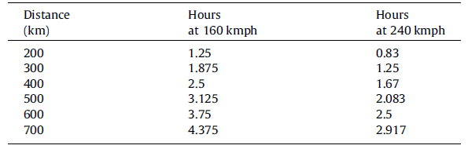
Comparative journey times for upgraded conventional and high speed rail

Slide 44
Competition with car
However, competitiveness in terms of door to door journey time also depends on access to the station and frequency of service.
Car provides door to door service with no waiting time or schedule delay.
For a door to door journey largely on motorway, a 100 kmph average may be feasible.
If rail involves an additional 2 h in terms of access, egress and waiting time then even high speed rail will only be faster than car for journeys of well over 300 km

Slide 45
Competition with car
If part or all of the road journey is on congested or low speed roads, then rail may be competitive over much shorter distances, and even with upgraded conventional lines.
Indeed for shorter journeys, a frequent service calling at easily accessible stops may be preferable to a high speed service calling only at the very busiest stations and made up of high capacity less frequent trains, with other passengers having to change into the trains at these stops.

Slide 46
Competition with air
In comparison with air, it has been argued that – because for most passengers it involves less access, egress and waiting time – rail can compete with air provided the station to station rail journey is not more than 3 h.
Table shows that indeed rail generally has more traffic than air in these circumstances.

Slide 47
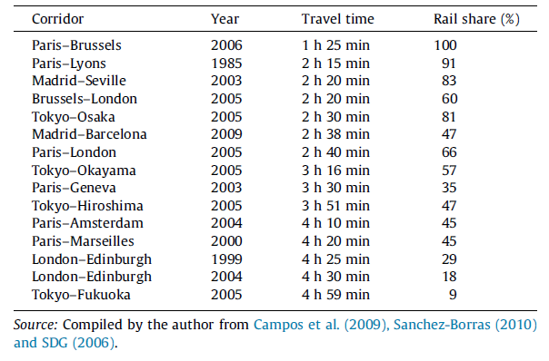
Rail share of rail/air market and rail station to station journey time

Slide 48
HSR/Air competition
However Table reveals a diversity of rail share for the same rail journey time.
A major factor here is the geography of the catchment areas. In a dense city with high quality public transport focused on the city center and frequent inter city services, access, egress and waiting time for rail may typically add less than 2 h to the door to door journey time
Whilst for a more remote airport, including time spent at the airport, for air it may be at least three.
In a low density city, with weaker public transport, the advantage of rail in access and egress may be much lower.

Slide 49
Time savings
Substantial time savings may be made by passengers previously using even upgraded conventional trains.
For car or air, the time saving depends very much on the length of journey; if the journey is close to the breakeven point between the modes then the time saving may be much smaller.
However, it is not always appreciated that many aspects of comfort and convenience may also be included in the value of (generalised) time used in economic appraisal.

Slide 50
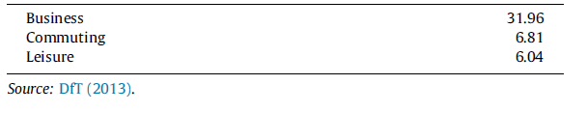
Values of time used in British rail appraisals (GBP per hour; 2010 prices and values)

Slide 51
Capacity
Building a high speed line which will divert a substantial volume of traffic from an existing route not only creates a huge capacity for high speed traffic itself
It may also permit growth of other types of traffic on the existing line.
Removing all the fastest services from a route will reduce the spread of speeds and thus release more capacity than simply the number of paths formerly taken by the diverted trains.

Slide 52
Diversion from other modes
The benefits of diversion from other modes take the form of reductions in externalities – congestion, accidents and emissions.
Against these must be set any excess of mode specific taxes and charges over and above marginal cost of infrastructure provision and maintenance.

Slide 53
Induced traffic and wider economic benefits
For induced traffic, the standard argument is that, since the person was unwilling to travel at the previous generalised cost and is willing at the new, the benefit must lie somewhere between that derived by an existing passenger and zero;
Agglomeration externalities. It appears that there is a direct link between accessibility and labour productivity, perhaps because in a larger labour market workers are better fitted to the jobs they do, innovations spread more quickly and there are economies of scale leading to better supply of business services.

Slide 54
In what circumestances will benefits exceeds costs?
There are essentially two approaches to answering this question.
The first is to construct a model and explore the values of variables for which benefits exceed costs.
The second is to examine actual ex post case studies.

Slide 55
Conclusion
It is concluded that the main factors determining economic success for high speed rail projects are construction costs, value of time saving per passenger and traffic volume and degree of congestion of existing transport networks.
The biggest uncertainty regarding the case for high speed rail surrounds the possibility of wider economic benefits.

Slide 56
11.4 HSR around the world

Slide 57
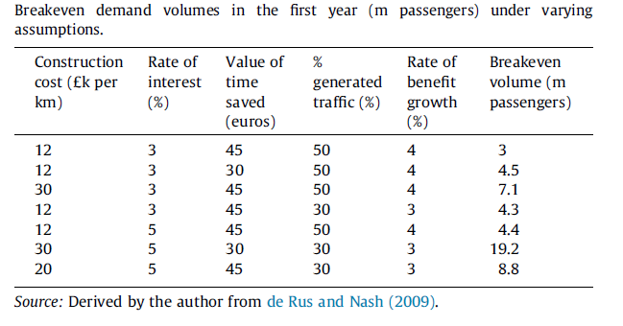
Breakeven demand

Slide 58
Ex post evaluations
The number of ex post evaluations to be found in the literature is rather limited, and of course none are truly ex post inasmuch as they were generally undertaken something like 5 years after opening of a very long lived asset.
So these appraisals still involve forecasting, but forecasting from the position of knowing what the construction cost turned out to be and having data for the first few years of quality of service, traffic, revenue and operating cost.

Slide 59
Legal requirement
In France it is a legal requirement that all major government funded projects are subject to an independent ex post evaluation, to check that they have provided value for money and to learn lessons from any problems that are found.
Next slide provides the results of ex post appraisals of the first six French high speed lines.

Slide 60
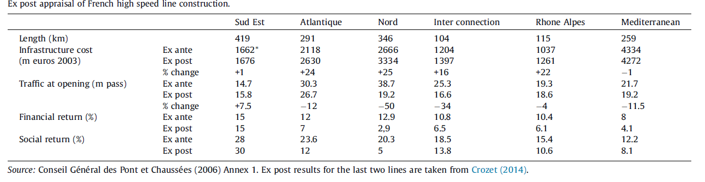
HSR France

Slide 61
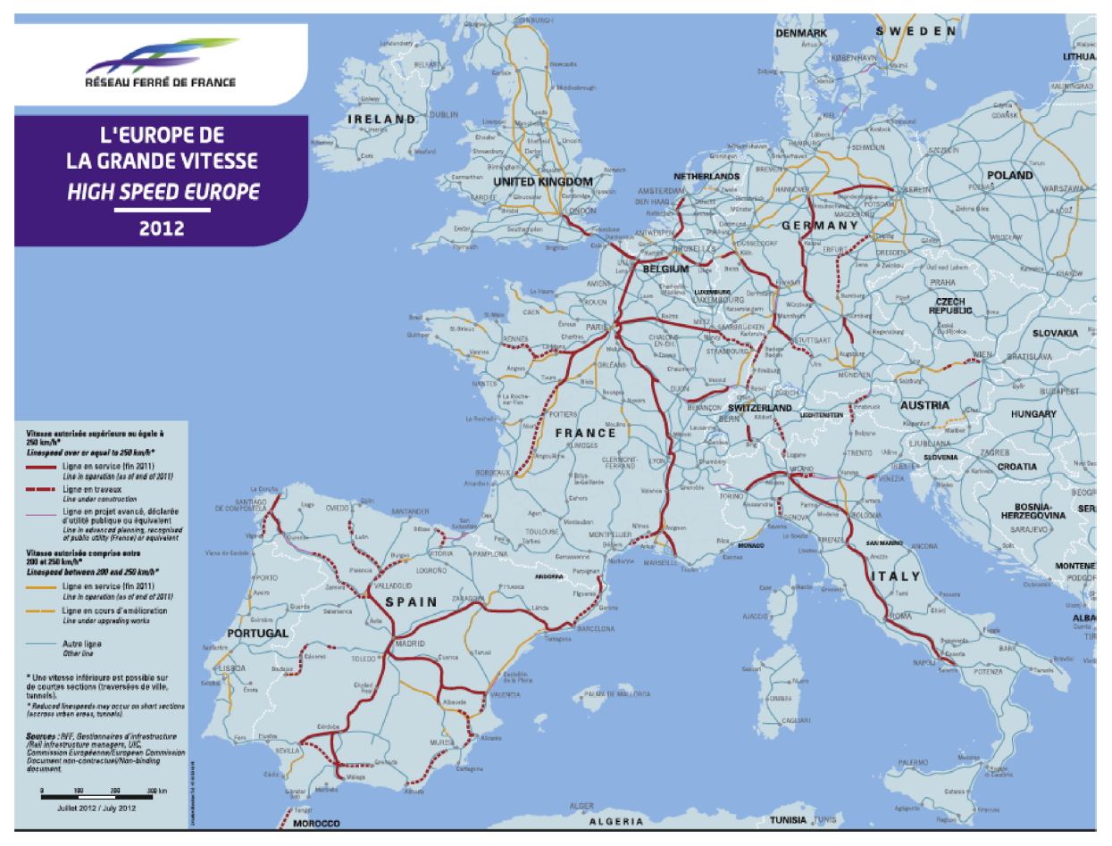
HSR network in Europe

Slide 62
France – extending network
Worse lines
Competition x financing

Slide 63
CBA of HSR in Spain

Slide 64
CBA of HSR in Britain
Nash (2015)

Slide 65
CBA of proposed HSR in Britain
Nash (2015)

Slide 66
Nash - China
Is HSR a solution to capacity problems?

Slide 67
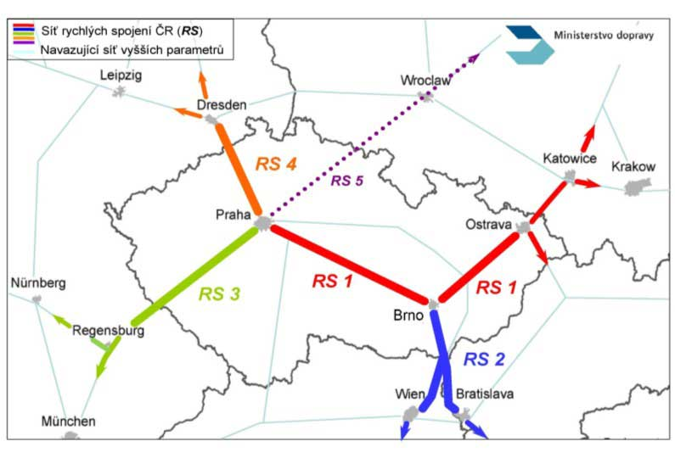
Is it a good idea to build HSR in the Czech Republic?

Slide 68
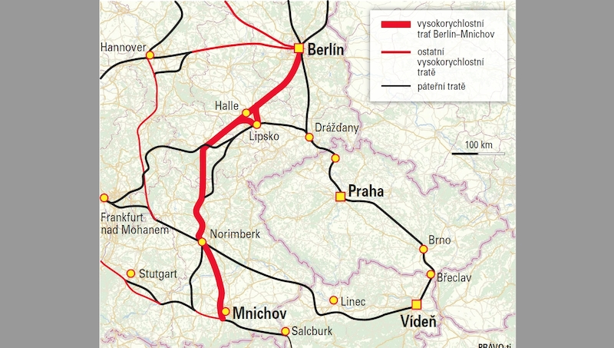
The „threat“ of being excluded from HSR network in Central Europe

Slide 69
11.5 Summary

Slide 70
Summary
CBA estimates and totals up the equivalent money value of the benefits and costs to establish whether they are worthwhile.
The main factors determining economic success for high speed rail projects are construction costs, value of time saving per passenger and traffic volume and degree of congestion of existing transport networks

Slide 71
Final Reading
Börjesson, M. (2014). Forecasting demand for high speed rail. Transportation Research Part A: Policy and Practice, 70, 81-92.

