Slide 1
1. TRANSPORT MARKETS

Slide 2
Readings for Lecture 1
Button, K. (2010) Transportation economics: Some developments over the past 30 years. Journal of the Transportation Research Forum

Slide 3
Learning Outcomes
The law of demand and its main determinants
The law of supply and its main determinants
The market and economic principles that underpin the provision of transport services
The important role of the price mechanism
That even where transport markets are closely controlled and regulated by public authorities, underlying economic principles still apply

Slide 4
1.1 Basics
based on Cowie (2010): The Economics of Transport, chapter 3

Slide 5
Market analysis
Market demand and supply
State regulation and intervention
Ceteris paribus clause

Slide 6
The law of demand
Law of demand states that, all else being constant, as the price of a product increases (↑), quantity demanded falls (↓)

Slide 7
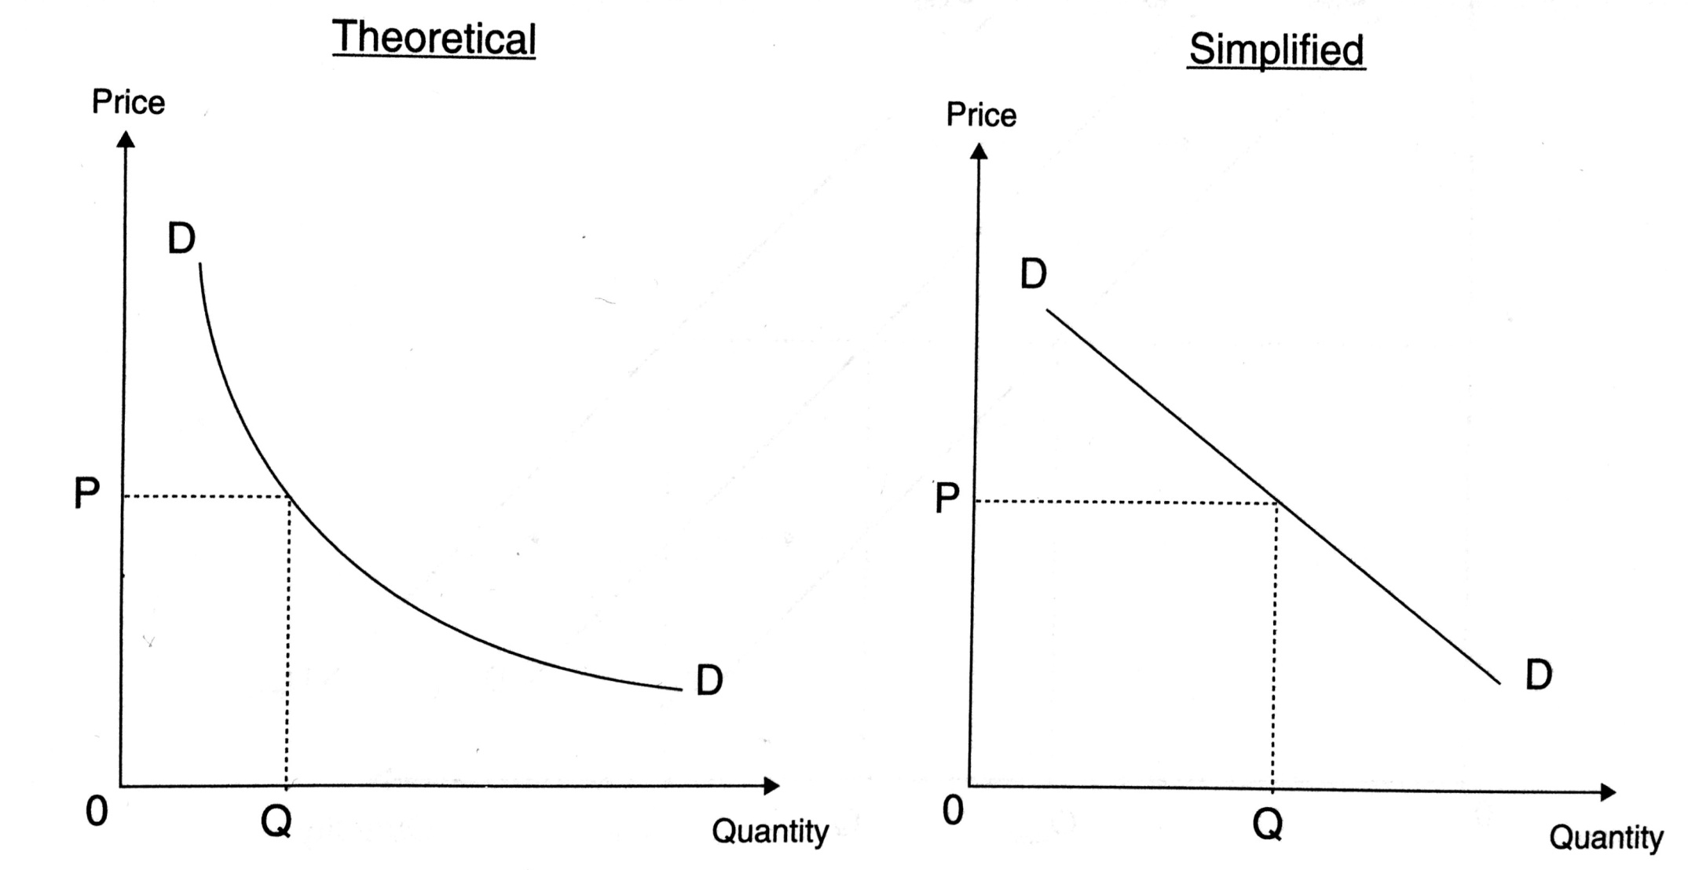
Demand curves
Figure 3.1

Slide 8
Demand determinants
Income ↑
Price of substitutes ↑
Price of complements ↓
Fashion
Expectations

Slide 9
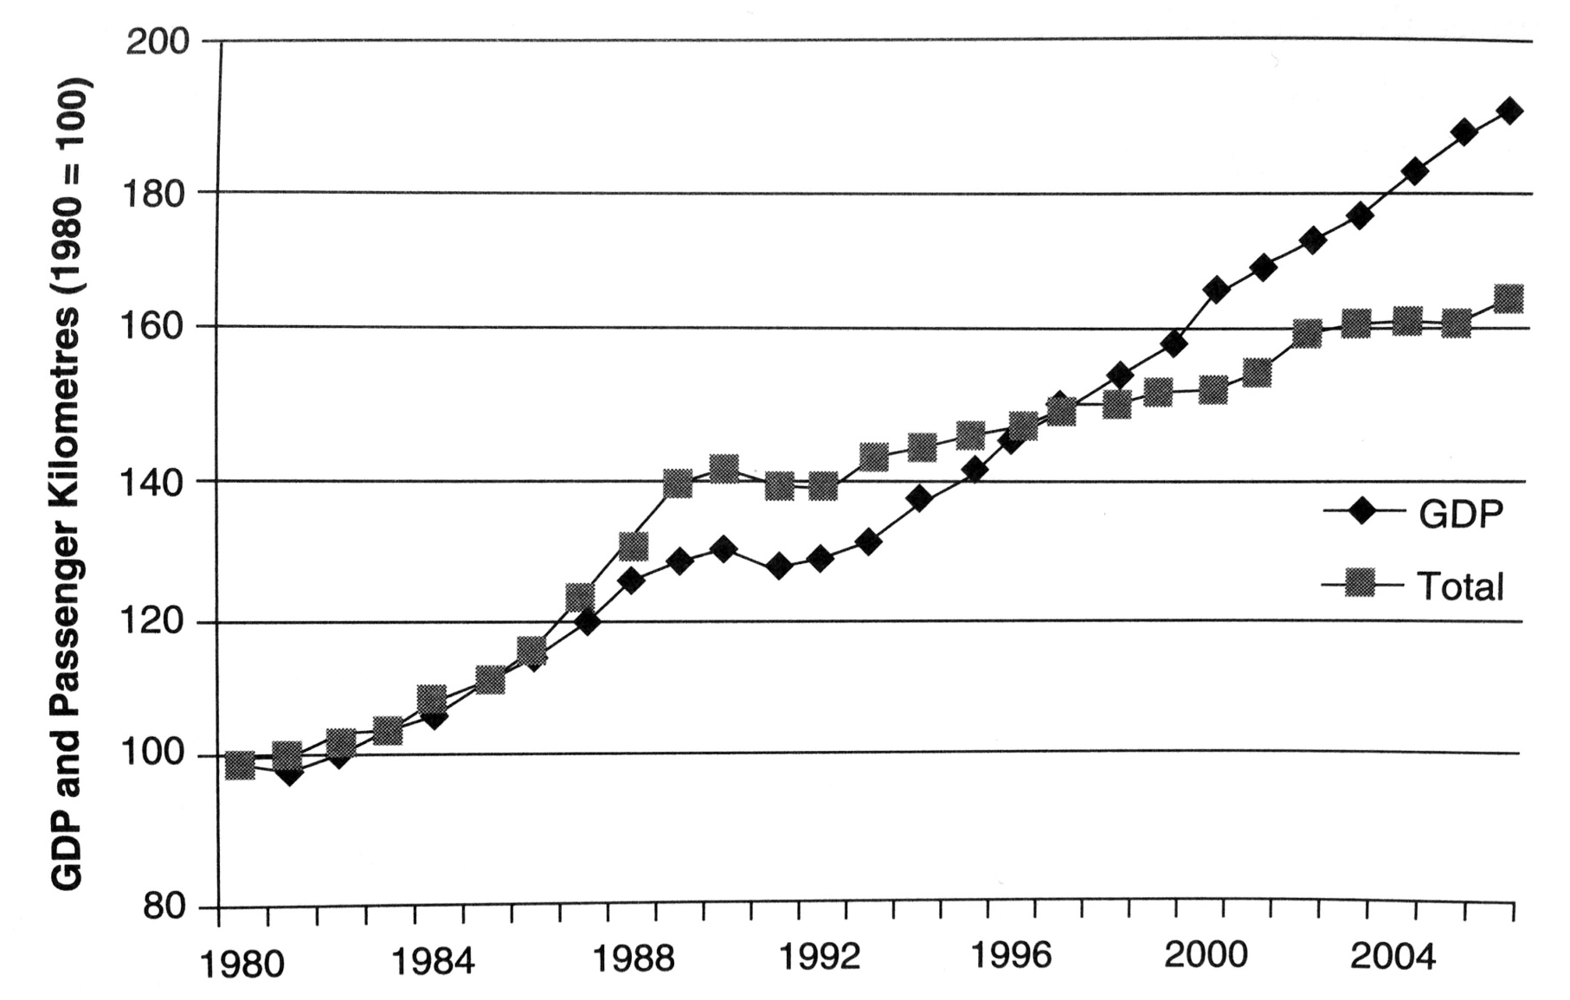
Case 1: Impact of income on demand

Slide 10
Theory of supply
The law of supply is a fundamental principle of economic theory which states that, all else equal, an increase in price results in an increase in quantity supplied

Slide 11
Supply determinants
The cost of production
Government policy
The price of goods in joint supply
Natural shocks
Aims of producer

Slide 12
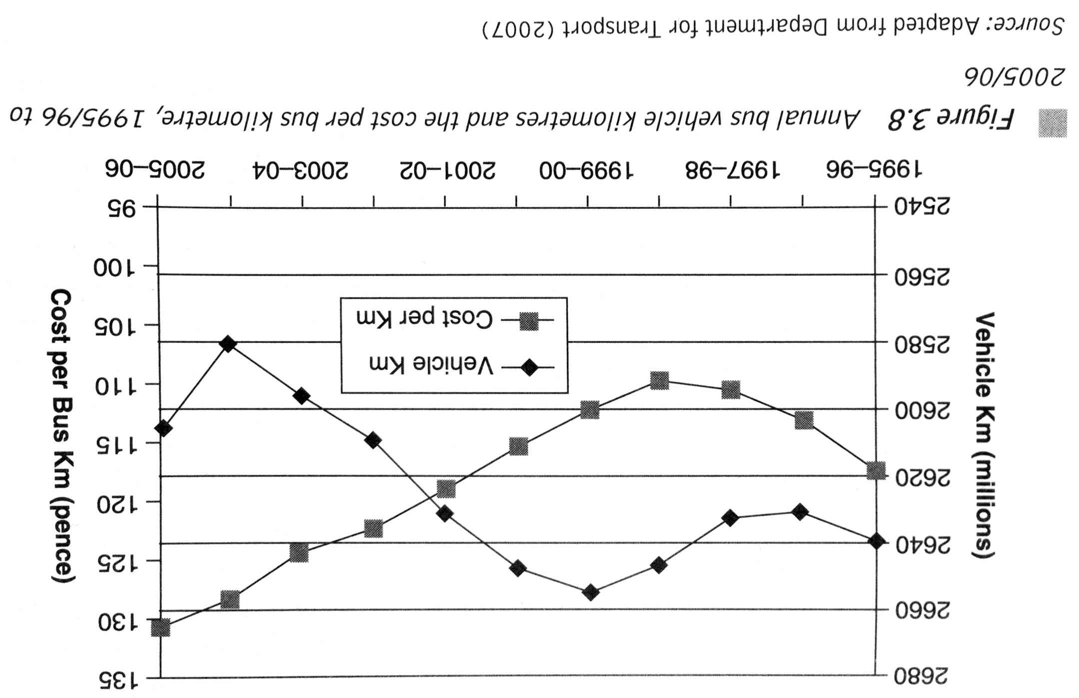
Case 2: British bus industry

Slide 13
Organization of Supply
Integration or Fragmentation?
Monopoly or Competition?
Intervention or Liberalism?
See: Quinet – Vickermann (2004): Principles of Transport Economics. Chapter 6: The Nature of Markets and Public Intervention

Slide 14
Market workings
Putting together demand and supply
Incorporate market imperfections
Adding government intervention and regulation

Slide 15
1.2 Exercises

Slide 16
Transport economics problems?
Listed below are seven major transport related issues facing society today. Your task is to identify which ones are related to “the economics of transport”:
The privatisation of the railways.
The negative impact on the natural environment of all transport related activities.
Increasing levels of traffic congestion in towns and cities.
The high levels of subsidy required to sustain public transport industries.
The increasing amounts of land that are being given over to support transport activities.
The role of transport in “unifying” the European Union.
The subsidisation of public transport services in rural and socially deprived areas.

Slide 17
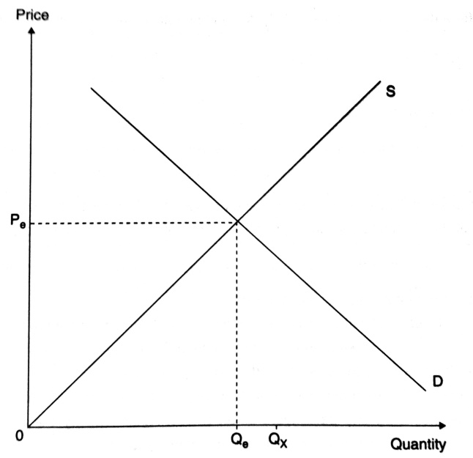
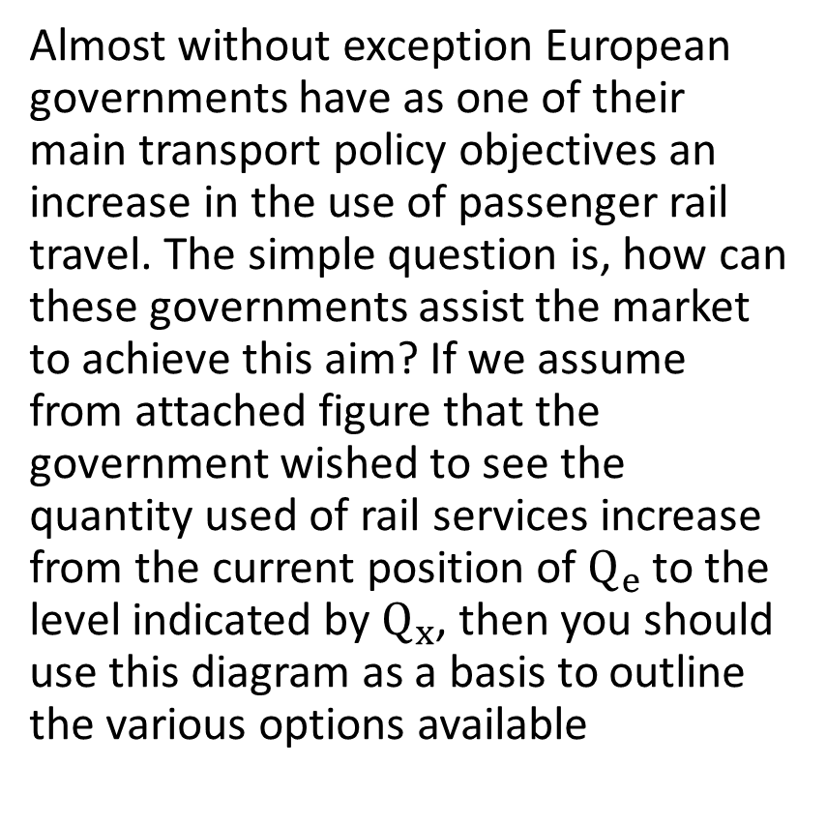
Increasing the use of the railways
Almost without exception European governments have as one of their main transport policy objectives an increase in the use of passenger rail travel. The simple question is, how can these governments assist the market to achieve this aim? If we assume from attached figure that the government wished to see the quantity used of rail services increase from the current position of $Q_{e}$ to the level indicated by $Q_{x}$, then you should use this diagram as a basis to outline the various options available

Slide 18
Public transport as an inferior good?
Public transportation is oftentimes argued to be the inferior good.
Identify why this might be so.
Is public transportation an inferior good at all levels of income? If so, why; and if not, why not?

Slide 19
Demand for air travel
Consider the following observations:
between 2009 and 2017 real per capita income increased by 15%;
during the same time span there was a decrease in the average number of hours spent working;
there was an increase in the number of single households and households with unrelated members.
Why might you expect each of these factors to increase the demand for air travel?

Slide 20
The role of infrastructure
The US highway interstate system was started in 1950 and completed in 1973.
Use market demand and supply curves to characterize the effect that the completed interstate system had on the market for intercity motor vehicle passenger trips.
Similarly, illustrate with market demand and supply curves how the completed system affected shippers’ transportation rates.
What effect, if any, would you expect the interstate system to have upon rail rates?

Slide 21
Monetary and time costs
Evaluate the following statement: “When transportation markets are functioning well, the opportunity cost of transportation will primarily reflect monetary costs. To the extent that time costs are present, they will be small.”

Slide 22
Economic and econometrics models
Suppose that we have a simple economic model that shipper demands for transportation services depend upon the transportation rate charged.
Identify the cause and effect relationship in this model.
Why is this model a qualitative model of shipper demands?
How would you transform this economic model into an econometric model of shipper demand?
In your econometric model, how would you test the hypothesis that demand depends upon transportation rate charged?

Slide 23
Basic econometrics
Consider the following econometric model of T individual bus demands:
(Bus Trips)_{t} = α + β (Fare)_{t} + γ (Income)_{t} + ε_{t}
where (Fare)_{t} is the fare (in dollars) per bus trip paid by individual t and (Income)_{t} (in dollars) is individual t’s income.
What sign would you expect β and γ, respectively, to have, and why?
From the econometric model, what impact will a 50-cent increase in bus fare have upon ridership? What impact will a $1 increase in household income? What about a $1000 increase in household income?

Slide 24
1.3 Readings
Button, K. (2010). Transportation economics: Some developments over the past 30 years. In Journal of the Transportation Research Forum (Vol. 45, No. 2).

Slide 25
Transport economics
Why study Transport Economics?
Is better to study Economics of Transport or Transport Economics?

Slide 26
Markets and interventions
What are differences between Continental and Anglo-Saxon approaches to transport markets regulation?
Are (transport) markets always delivering efficient solutions?

Slide 27
Further topics
Regulation
Costs and efficiency
Congestions
VOTT
Demand modelling
Future path

Slide 28
Further Readings
Button, K. (1998). The good, the bad and the forgettable—or lessons the US can learn from European transport policy. Journal of Transport Geography, 6(4), 285-294.

Slide 29
1.4 Summary

Slide 30
Summary (1)
Demand and supply were combined in order to examine how the markets operate in practice
Principally this is through the price mechanism. Market principles still apply even where heavy government intervention exists.

Slide 31
Summary (2)
„Only the psychologically disturbed or inadequate want transport for its own sake“ (Munby, 1968).
The economist are often reluctant to work with those from other disciplines and are still frequently poor at stating their case in a way that business people and policy makers can appreciate (Button, 2010).

Slide 32
Summary (3)
An economic model identifies the most important factors that explain the behavior of some underlying economic variable of interest. Economic models are explanatory, generally characterize average behavior, and identify the qualitative relationships between variables.
An econometric model is a statistical model that enables one to quantify the casual relationships identified in an economic model. Econometric models are used to make statistical inferences on the importance of “explanatory variables” in explaining the variation in the “dependent” variable.
See: Appendix

Slide 33
Readings for Lecture 2
Paulley, N. et al. (2006). The demand for public transport: The effects of fares, quality of service, income and car ownership. Transport Policy, 13(4), 295-306.

Slide 34
Appendix: The statistical analysis of economic relations
Based on P. McCarthy (2001): Transportation Economics. Chapter 2

Slide 35
Economic model
Economic model – simplified description of behavior which purports to identify primary cause and effect relationships between economic variables
Economic models are:
      Explanatory
      Representative
      Qualitative
Models are useful in formulation of policy because they identify the important causal linkages between economic variables.

Slide 36
Econometric model
An econometric model is a statistical specification of an economic model that enables the analyst to quantify the economic relationships identified in the theoretical framework.

Slide 37
An Econometric Model of Airline Demand
To illustrate the relationship between an economic and econometric model, consider the following economic model of the demand for airline passenger miles:
Miles = f(Price per Mile, Per Capita Income)
= β₁ + β₂ Price Per Mile + β₃ Per Capita Income + ε

Slide 38
Least Squares Regression
The method of obtaining parameter estimates by minimizing the sum of squared residuals is referred to as the method of least squares.
The least squares estimator is the formula that is used to produce the least squares estimate.
OLS estimator is unbiased, consistent and efficient

Slide 39
Estimating the Demand for Airline Travel
Hypotheses:
All else constant, an increase in Price per Mile is expected to reduce the quantity of passenger miles demanded
All else constant, an increase in Per Capita Income is expected to increase the demand for airline travel
OLS estimation:
Miles = 15.7 - 8.7 Price Per Mile + 0.031 Per Capita Income

Slide 40
Confidence Intervals
Each estimated coefficient is a random variable that has an associated probability distribution
A standard method that is used for determing how close each coefficient estimate is to the true parameter values is to construct a confidence interval around our estimate

Slide 41
t statistics
It can be shown that statistics (β_{i} – β_{i})/s_{βi} has a t- distribution with degrees of freedom equal to the sample size minus the number of parameters estimated.
s_{βi} is the square root of the estimated sample variance and is referred to as the standard error of the estimate.
If we want to construct a 95% confidence interval, than we want to identify lower and upper bound numbers for the true parameter value

Slide 42
Confidence Intervals for Airline Travel
Miles = 15.7 - 8.7 Price Per Mile + 0.031 Per Capita Income
(1.0) (0.0013)
95% Confidence intervals:
Price per Mile (-10.80; -6.60)
Per Capita Income (0.0284; 0.0337)

Slide 43
Hypothesis tests
A major objective of many empirical studies is to test hypothesis regarding the relationship between the dependent and independent variables.
The methodology for hypothesis testing first requires that we identify two hypotheses, a null hypothesis (H_{o}) and an alternative hypothesis (H_{a})
H_{o}: β = 0
H_{a}: β ≠ 0

Slide 44
Issues in hypotheses testing
One tail and two tail tests
Type I and Type II error
Significance level (1%***; 5%**; 10%*)
Reject x Not reject null hypothesis

Slide 45
Goodness of fit and R2
In addition to examining whether our estimated model is consistent with the implications of economic theory, it is of interest to know how well model fits the data.
R2 = goodness of fit = the statistics that gives the proportion of variation in the dependent variable that is due to all of the explanatory variables in the model

Slide 46
Cross section and time series data
Cross section data reflect observation on individuals, households, firms, countries, or some other unit of analysis at a given point of time. Usual problem: heteroscedasticity → solution: robust standard errors.
Time series data are different because each observation corresponds to a different time period. Problem (1): autocorrelation → solution: robust standard errors. Problem (2): unit roots → risk: spurious regression → solutions: trend inclusion; differencing, cointegration.

Slide 47
Model specification
A time trend is a variable that is included in time series models to capture the influence of factors that are correlated with time but are excluded from the model because they are either unquantifiable or the data are unavailable. A time trend is often use to reflect technological change.
A dummy variable is a variable that either has a value of 0 or a value of 1. It is often use for analysis of structural changes.

Slide 48
Functional Form

Slide 49
Marginal effects

Slide 50
Elasticity measures

Slide 51
The Airline Demand Model Revisited

Slide 52
The Airline Demand Model Revisited

Slide 53
Elasticity measures

