Slide 1
3. TRANSPORT DEMAND ISSUES

Slide 2
Readings for Lecture 3
Buehler, R., & Pucher, J. (2012). Demand for public transport in Germany and the USA: an analysis of rider characteristics. Transport Reviews, 32(5), 541-567.

Slide 3
Learning Outcomes
To understand various aspects of transport demand
To understand binary logit model

Slide 4
3.1 Issues

Slide 5
1. The Notion of Need
There are some advocates of the idea that transport services, or at least some of them, should be allocated according to need rather than effective demand.
The idea is that just as everyone in a civilized society is entitled to expect a certain standard of education, medical care, security and so on, so they are also entitled to enjoy a certain minimum standard of transport provision.

Slide 6
The problem of rural demand
The provision of public transport services to satisfy demand in rural areas has always been problematic.
Such services have high costs, but low revenues due to low load factors. They are uneconomic.
However, the demand for these services is very real, as rural populations require them to get to work, to do their shopping, to access schools and medical care and for social reasons.

Slide 7
The problem of rural demand
This problem has worsened in recent times for four main reasons:
  Greater car usage
  Growth of urban conurbations
  Public services co
  ncentrated in urban centres
  Population ageing
Suggested reading: White, P. (2015). Report on public transport provision in rural and depopulated areas in the United Kingdom.

Slide 8
2. Problem of peak
In economics it is usually assumed that demand is constant per unit of time
In transport economics this assumption cannot be made as there are peaks in demand that occur on a regular basis

Slide 9
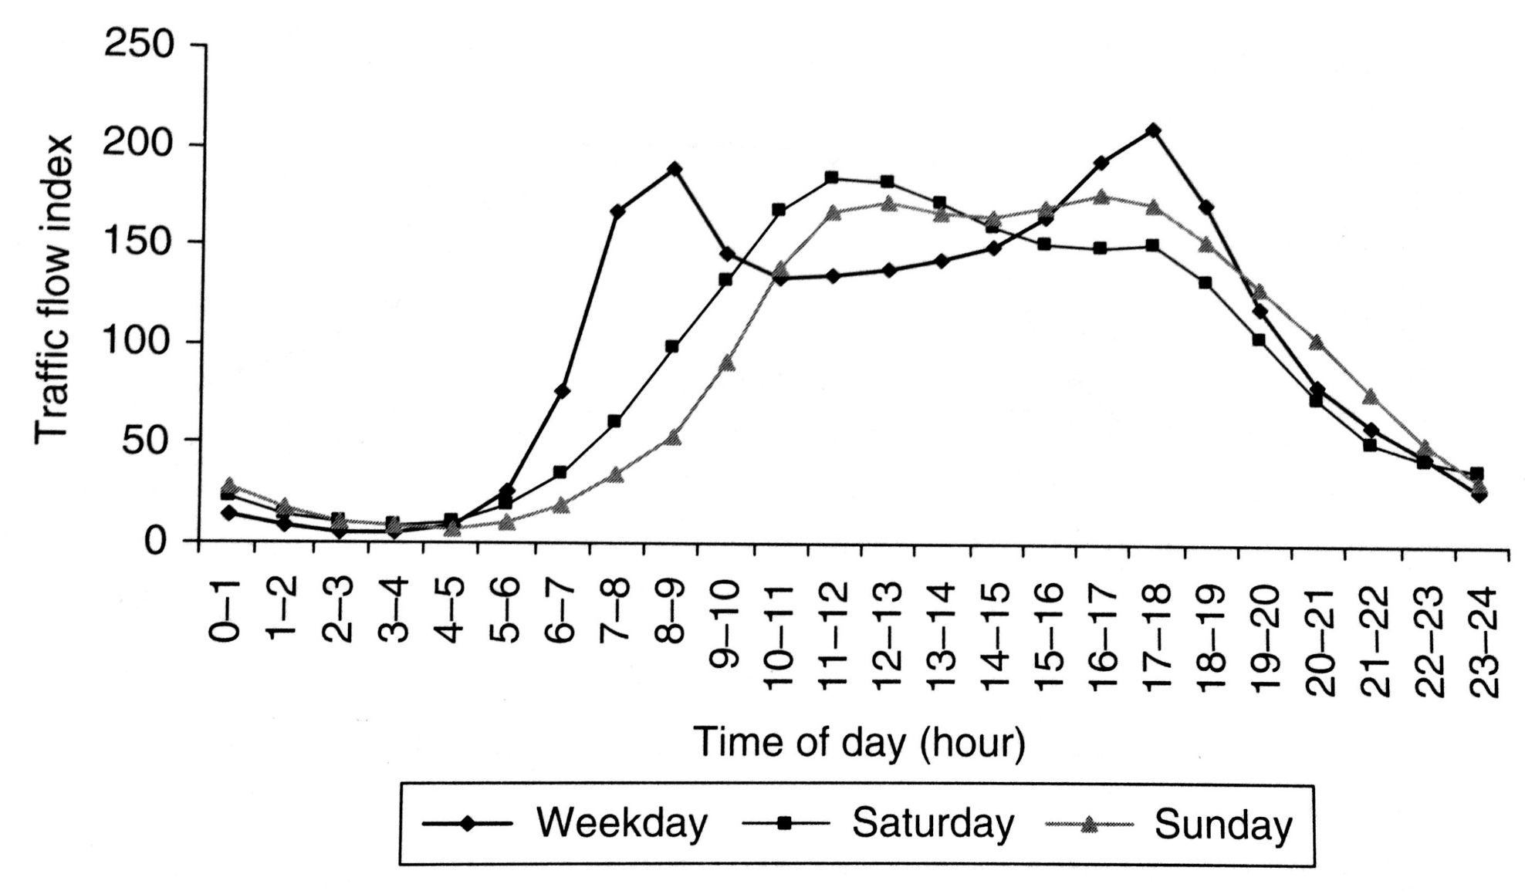
Distribution of traffic by time of the day, UK, 2004: Cars

Slide 10
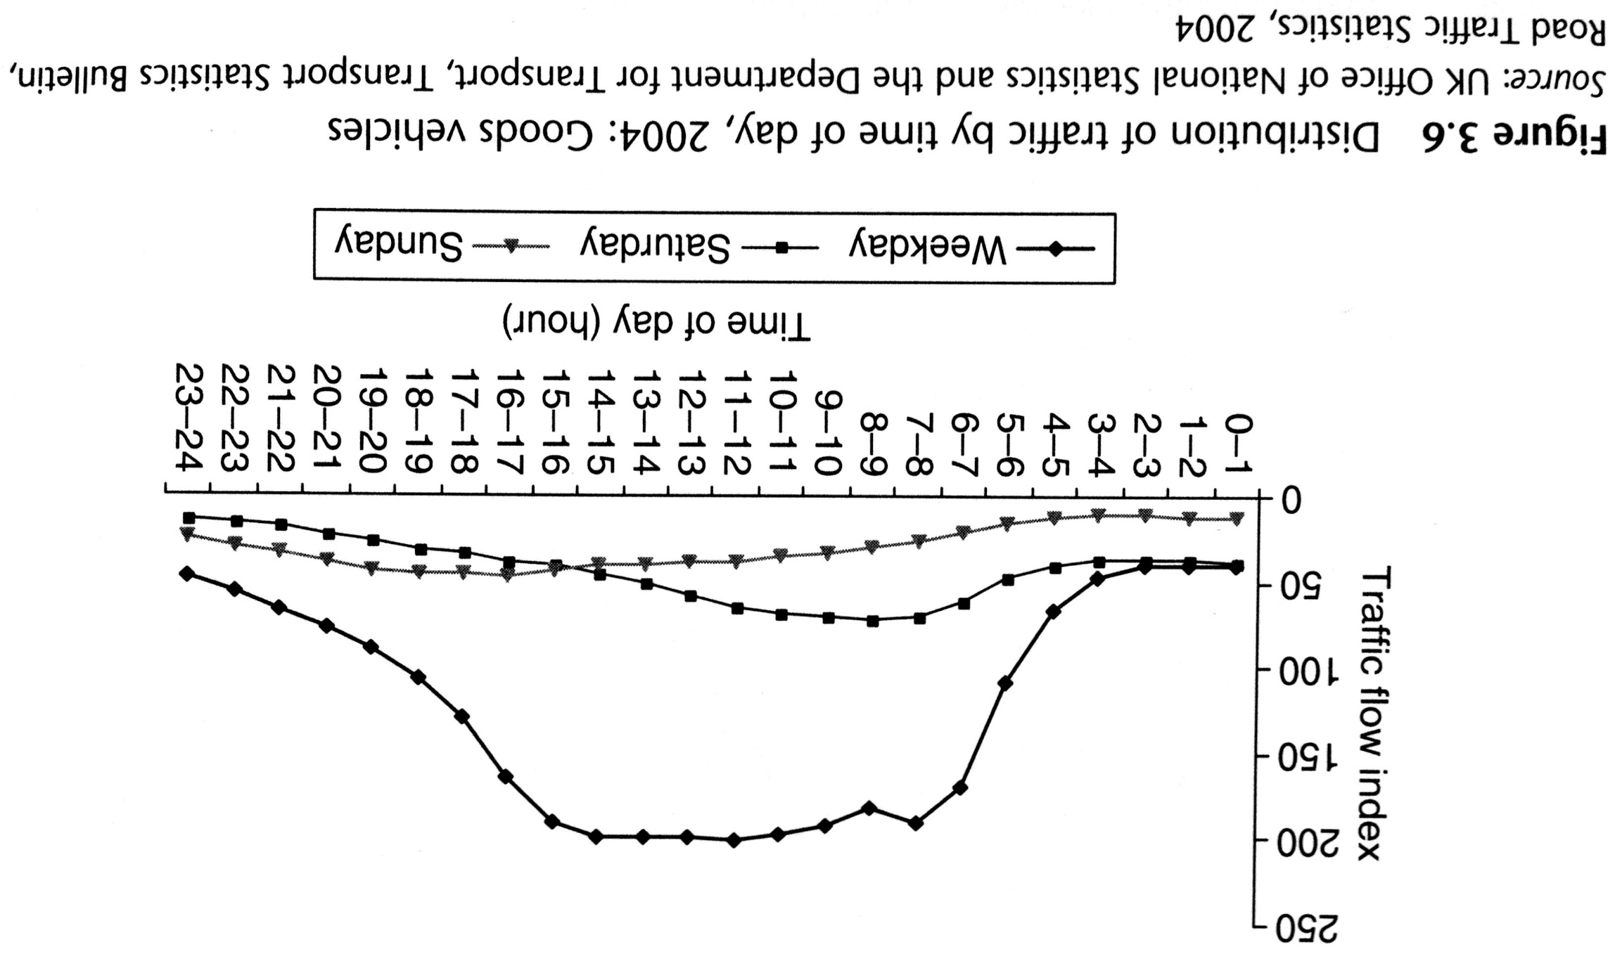
Distribution of traffic by time of the day, UK, 2004: Goods vehicles

Slide 11
3. Valuation of time
The importance of travel time in transport economics should now be apparent.
Transport time savings re normally considered to be a major component of any scheme designed to improve transport efficiency.

Slide 12
Value of time
A value of time can be inferred from logit model by looking at changes in the dependent variable that result from change in either time or costs difference.

Slide 13
Value of time
There are differences between values of working times and non-working times.
Also there are differences in the values of walking/waiting times and in-vehicle times.
This has important consequences for design fo public transport.
Suggested reading: Small, K. A. (2012). Valuation of travel time. Economics of transportation, 1(1), 2-14.

Slide 14
4. Demand for car
While demand for cars is not a strictly transport matter, the importance of the automobile in travel behaviour, land use patterns and the environment makes it a matter of considerable interest to transport economist.
Two approaches to modelling demand for car ownership:
Hedonic approach
Product life cycle

Slide 15
Is demand for car already saturated?
Suggested reading:
Metz, D. (2013). Peak car and beyond: the fourth era of travel. Transport Reviews, 33(3), 255-270.
Buehler, R., Pucher, J., Gerike, R., & Götschi, T. (2017). Reducing car dependence in the heart of Europe: lessons from Germany, Austria, and Switzerland. Transport Reviews, 37(1), 4-28.

Slide 16
5. Demand for public transport
What is the research question?
What is the paper form?
What is the methodology?
Do you agree with the results?
Buehler, R., & Pucher, J. (2012). Demand for public transport in Germany and the USA: an analysis of rider characteristics. Transport Reviews, 32(5), 541-567.

Slide 17
3.2 Exercises

Slide 18
Monetary and time costs
In 1983, 87.4 % of household trips to work were by private motor vehicle, 4.6 % by public transit, and 8.0 % by other modes of travel (for example, bicycle or walk).
For private transportation, the average length of work trip (one way) was 8.5 miles, with an average commute time equal to 20 minutes. The operating cost per mile for private transportation was 8.36 cents.
For public transit, the average commute time was 46.1 minutes per one-way trip, with an average fare equal to 60 cents.
For other work-trip modes, the average one-way trip length was 5.6 miles, with an average trip time equal to 30 minutes.
For each of the three modes, what is the monetary cost per trip?
Assuming an average hourly wage rate equal to $10.00, what is the total cost pet work trip on each mode?
Given the work-trip prices in (b) and the modal percentages, graph representative demand curves for each of the three modes.

Slide 19
Modal choice
Most studies of modal choice find that the value of in-vehicle travel time is less than the value that travellers place upon waiting time.
What do these results tell us about the marginal disutility of in-vehicle travel time in comparison with the marginal disutility of out-of-vehicle travel time?
Discuss why the value-of-time estimates derived from discrete choice models are oftentimes interpreted as marginal rates of substitution.
Suppose that you’re an economist for a commuter railroad system. The manager of the agency is considering either of two policies: adding additional stops, with the expected result of reducing on-line speeds but also reducing the headway (that is, the average time between trains); or removing some stops, which would increase on-line speeds but also entail longer headways. Overall, both policies are predicted to have the same effect on total travel time for the average consumer. Discuss how you would use information on riders’ values of time in your police recommendation.

Slide 20
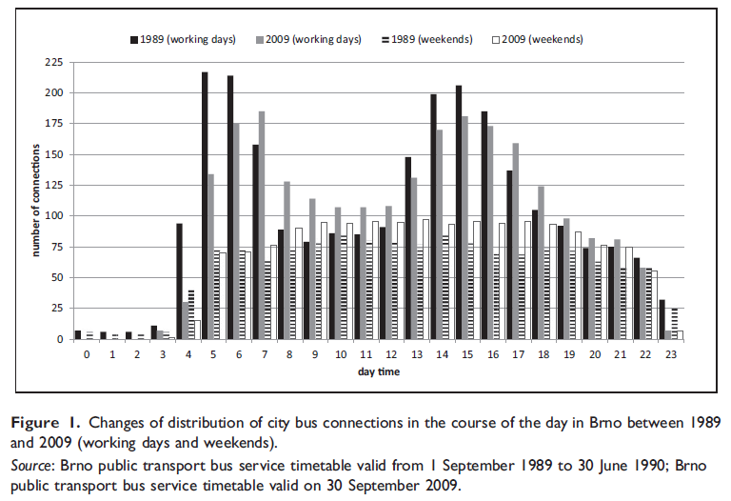
Peak and off peak periods
Mulíček – Osman – Seidenglanz (2016) constructed frequency distribution of bus services in Brno during the day in 1989 and 2009. Discuss the reasons why the distribution has changed.

Slide 21
OLS regression revision
Explain how dummy variable can improve accuracy of a forecast model?
What is multicollinearity and autocorrelation in a regression model?
Explain the difference between seasonal and cyclical variations. Give an example how airlines respond to cyclical variations.
If a regression analysis had a R2 of .89, what does this mean?
In a regression analysis how would you incorporate seasonal variations and other important

Slide 22
Population density (1)
One would expect that the demand for automobile ownership in metropolitan areas would be influenced by population density. Holding all else constant, the denser the area, the more public transit will be provided. Also, the denser the area, the more traffic congestion will be present.
Assuming that the public transit fare remains constant, explain why an increased supply of public transit in denser areas would reduce the opportunity cost of public transit.
Assuming no change in the per-mile monetary cost of automobile travel, explain why increased congestion will increase the opportunity cost of automobile travel.

Slide 23
Population density (2)
Based upon 65 large US central cities in 1970, Kain (1983) assumed that the demand for automobiles depended upon median household income and population density. He obtained the following linear regression results:
Autos per Household = 0.224 + 0.069 (Median Income)***
– 0,013 (Population Density) ***
where Median Income is in thousands of dollars and Population is in thousands of persons per square mile.
Are these results consistent with expectations?
What effect will a $1,000 increase in median family income have upon automobile ownership? From these results, what difference in automobile ownership would you expect to see between a household earning $50,000 per year and one earning $20,000 per year?

Slide 24
Population density (3)
Assume that Median Income is $25,000. According to Kain’s model, how many automobiles will a typical household own if it resides in a low-density area characterized by 50 persons per square mile? Compare this with a high-density city that has 100 persons per square mile.
Throughout the 20th century, we saw population movements away from rural areas and into urban areas. At the same time, household median income rose steadily. Using Kain’s empirical model, what can you say about the net effect of these changes on automobile ownership? From the above results, which has the greater effect – a $1,000 increase in median income or a 1,000-person increase in population density?

Slide 25
Bus travel (data exercise)
This application relates the number of people who travel by bus to various factors that affect it. Bus_travel contains cross-section data for 40 cities across the United States. The variable are as follows:
BUSTRAVL = Demand for urban transportation by bus in thousands of passenger hours (range 18.1 – 13103)
FARE = Bus fare in dollars (range 0.5-1.5)
GASPRICE = Price of gallon of gasoline in dollars (range 0.79–1.03)
INCOME = Average income per capita (range 12349-21886)
POP = Population of city in thousands (range 167-7323)
DENSITY = Density of city in persons per square mile (range 1551-24288)
LANDAREA = Land area of the city in square miles (range 18.9 – 556.4)
Identify determinants of bus travel and interpret the results.

Slide 26
3.3 Urban transportation mode choice
Binary logit model

Slide 27
Introduction
Some transportation choices are inherently discrete (either – or choice)
In this case we extend the theory of consumption to explicitly consider goods which have an either – or character

Slide 28
Domenich – McFadden (1975)
Binary logit model for automobile and public transit base upon a sample od 115 commuter trips.
The analysis focused upon a suburban and downtown corridor in the Pittsburgh metropolitan area.
Of the 115 trip-makers, 54% commuted by automobile and 46% by public transport.
For each of the commuters, the observable indirect utilities for automobile and public transport respectively were:

Slide 29
Observable indirect utilities

Slide 30
Specification
Time and cost are generic variables, since the marginal effect of travel time and travel costs on indirect utility is assumed to be the same for the automobile and public transit modes, respectively.
Observed indirect utility for the automobile includes three alternative specific variables: Automobile/Worker, Race and White Collar. They are called alternative specific variable, because each is associated with a specific alternative, automobile choice.
β₀ is difference between the indirect utility of automobile choice and bus choice.

Slide 31
Hypotheses
1) By the law of demand we expect:
κ₁ < 0, β₁ < 0, κ₂ < 0
2) Income plays role in consumption + household use of automobile is constrained by the numbers of automobile available. Therefore: β₂ > 0
3) Socioeconomic characteristics such as Race and White Collar are included to reflect differences in preferences among consumers in automobile travel. A priori, however, we have no basis for expecting these variables to have a positive or negative sign.

Slide 32
Estimation results (1)

Slide 33
Estimation results (2)

Slide 34
Demand
1) All else constant, an increase in the cost of automobile trip to work reduces Pa, the probability of taking an automobile to work.
2) The coefficient estimate of Time is negative, which implies that higher automobile and bus travel times, respectively, decrease the probability of taking an automobile or bus in the journey to work.
3) An increase in Walk Time means that the bus stop is further away and, all else constant, is expected to reduce the probability of taking a bus in the work trip.

Slide 35
Change in the demand

Slide 36
Automobile choice elasticities

Slide 37
Modal demands and the value of time
The coefficient Walk Time is more than four times as large as coefficient estimate for Time.
Value of Travel Time –0.0382/-0.0256 = 1.49 cents/minute =0.89 USD/hour.
Value of Walk Time –0.158/-0.0256 = 6.17 cents/minute =3.70 USD/hour.
Important implications for he design of transport facilities.

Slide 38
3.5 Summary

Slide 39
Summary (1)
The demand for transport x the right for transport
There important fluctuations of demand between peak and off peak periods
Value of time is an important input in transport investment CBA.
There are two approaches to car demand modelling – hedonic and life cycle
The public transport is much widely used in Europe than in the US. Why?

Slide 40
Summary (2)
Consistent with other studies, an analysis of transportation mode choice in the trip to work indicates that workers are sensitive to a mode’s travel time and travel trip to work indicates that workers are sensitive to a mode’s travel time and travel cost.
In addition, workers’ mode choices are more sensitive to out-of-vehicle time than in-vehicle time. Workers’ choices were twice as sensitive to an increase in walk time relative to travel time.
Also consistent with other studies, workers in this analysis valued out-of vehicle time much more highly than in-vehicle travel time.

Slide 41
Readings for Lecture 4
Button, K. (2005). The economics of cost recovery in transport: introduction. Journal of Transport Economics and Policy, 39(3), 241-257.
Glaeser, E. L., & Kohlhase, J. E. (2004). Cities, regions and the decline of transport costs. Papers in regional Science, 83(1), 197-228.

