Slide 1
4. TRANSPORT COSTS

Slide 2
Readings for Lecture 4
Button, K. (2005). The economics of cost recovery in transport: introduction. Journal of Transport Economics and Policy, 39(3), 241-257.
Glaeser, E. L., & Kohlhase, J. E. (2004). Cities, regions and the decline of transport costs. Papers in regional Science, 83(1), 197-228.

Slide 3
Learning Outcomes
How transport costs behave in the short run and long runs
Returns to scale and economies of scale in the transport industries
The relevance of production costs to the supply of transport services

Slide 4
4.1 Theory

Slide 5
Introduction
A major factor affecting supply is the cost of production
Monetary costs + Time costs = Generalised costs of transport
How to maintain downward pressure on public transport costs?

Slide 6
Cost categories
Monetary costs; Time costs
Infrastructure costs; Operators costs
Environmental costs; Accident costs

Slide 7
Costs classification
Fixed costs (FC) = costs that are the same irrespective of the level of output that is produced
Variable costs (VC) = costs that change as the level of output changes
Semi-variable costs (SVC) = costs that are fixed over a certain range of output, but then change once the upper limit of that range is reached

Slide 8
Short run and long run
Short run = at least one factor of production is fixed
Long run = variations in output can be achieved through variation of all of the inputs

Slide 9
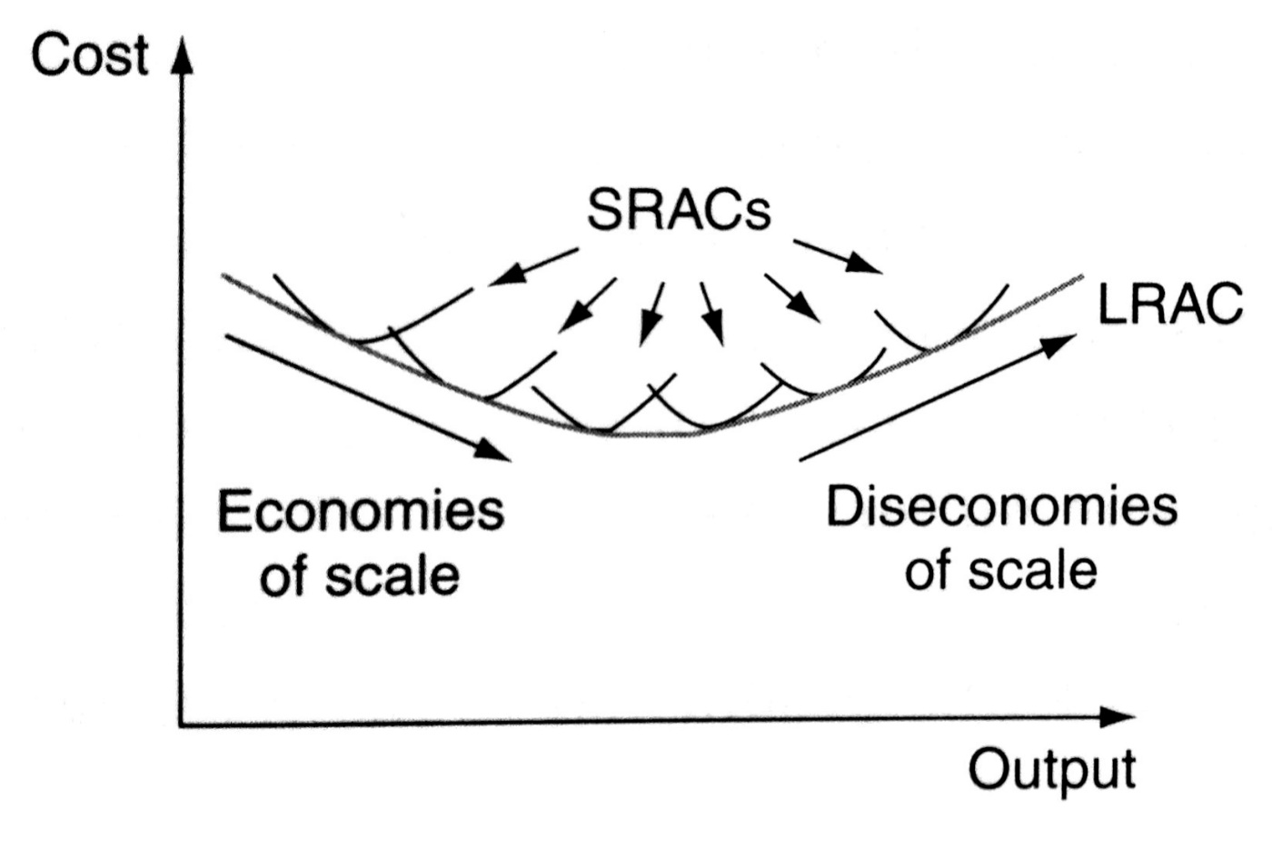
The long run average cost curve

Slide 10
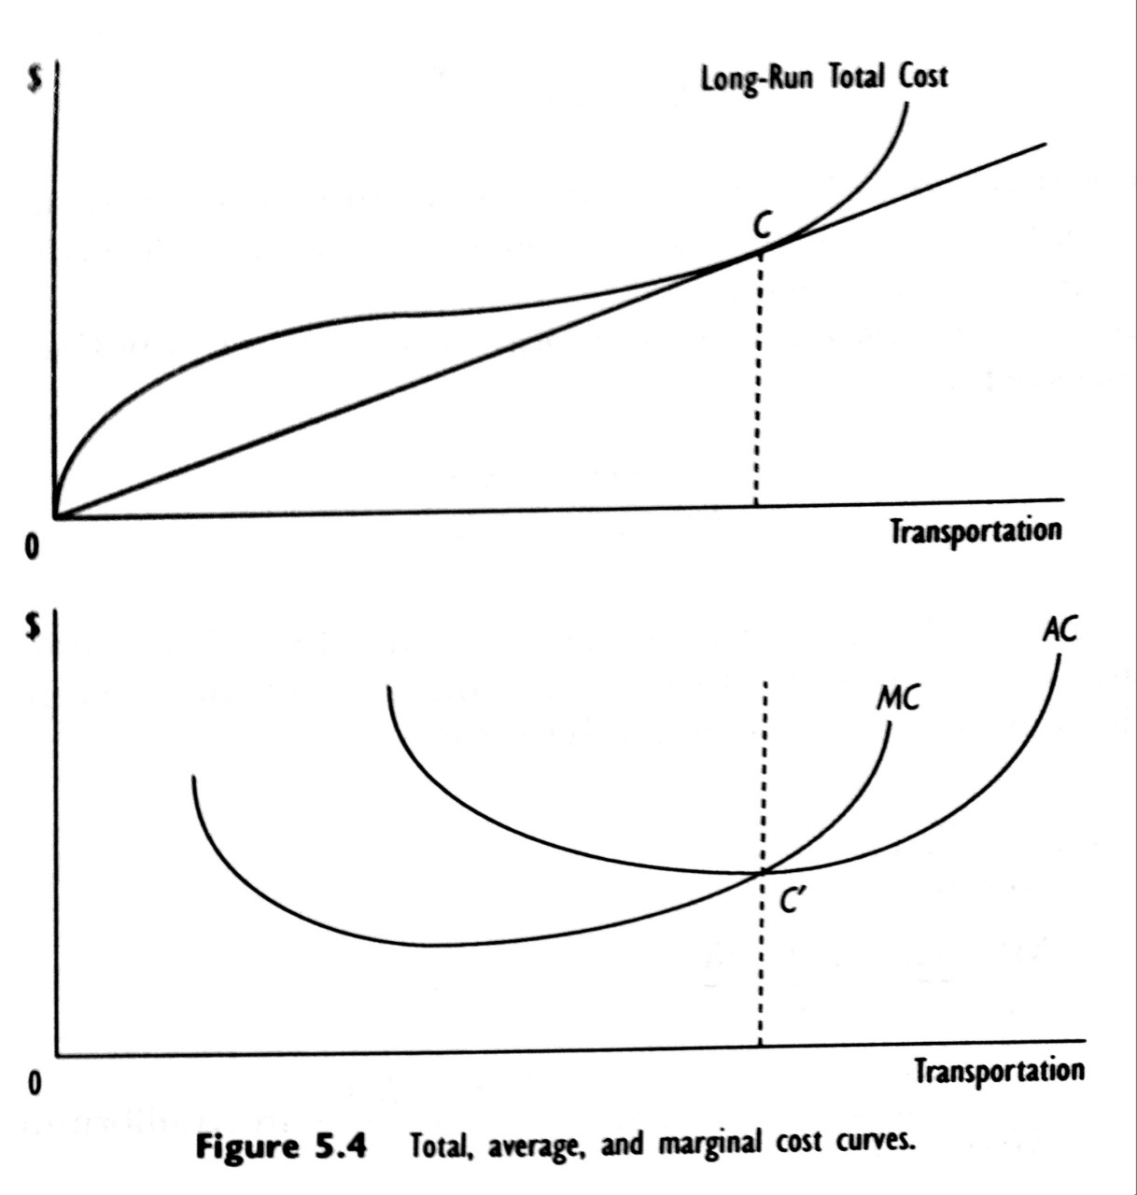
Long run costs curves

Slide 11
The relationship between economies of scale and cost elasticity
Former equation tells us that, for constant input prices, there is an inverse relationship between production RTS and elasticity of total cost with respect to output:
Therefore, analysis of firm cost s provides economically relevant information on a firm’s production technology without having to separately estimate a firm’s production function.

Slide 12
Changes in long run market supply

Slide 13
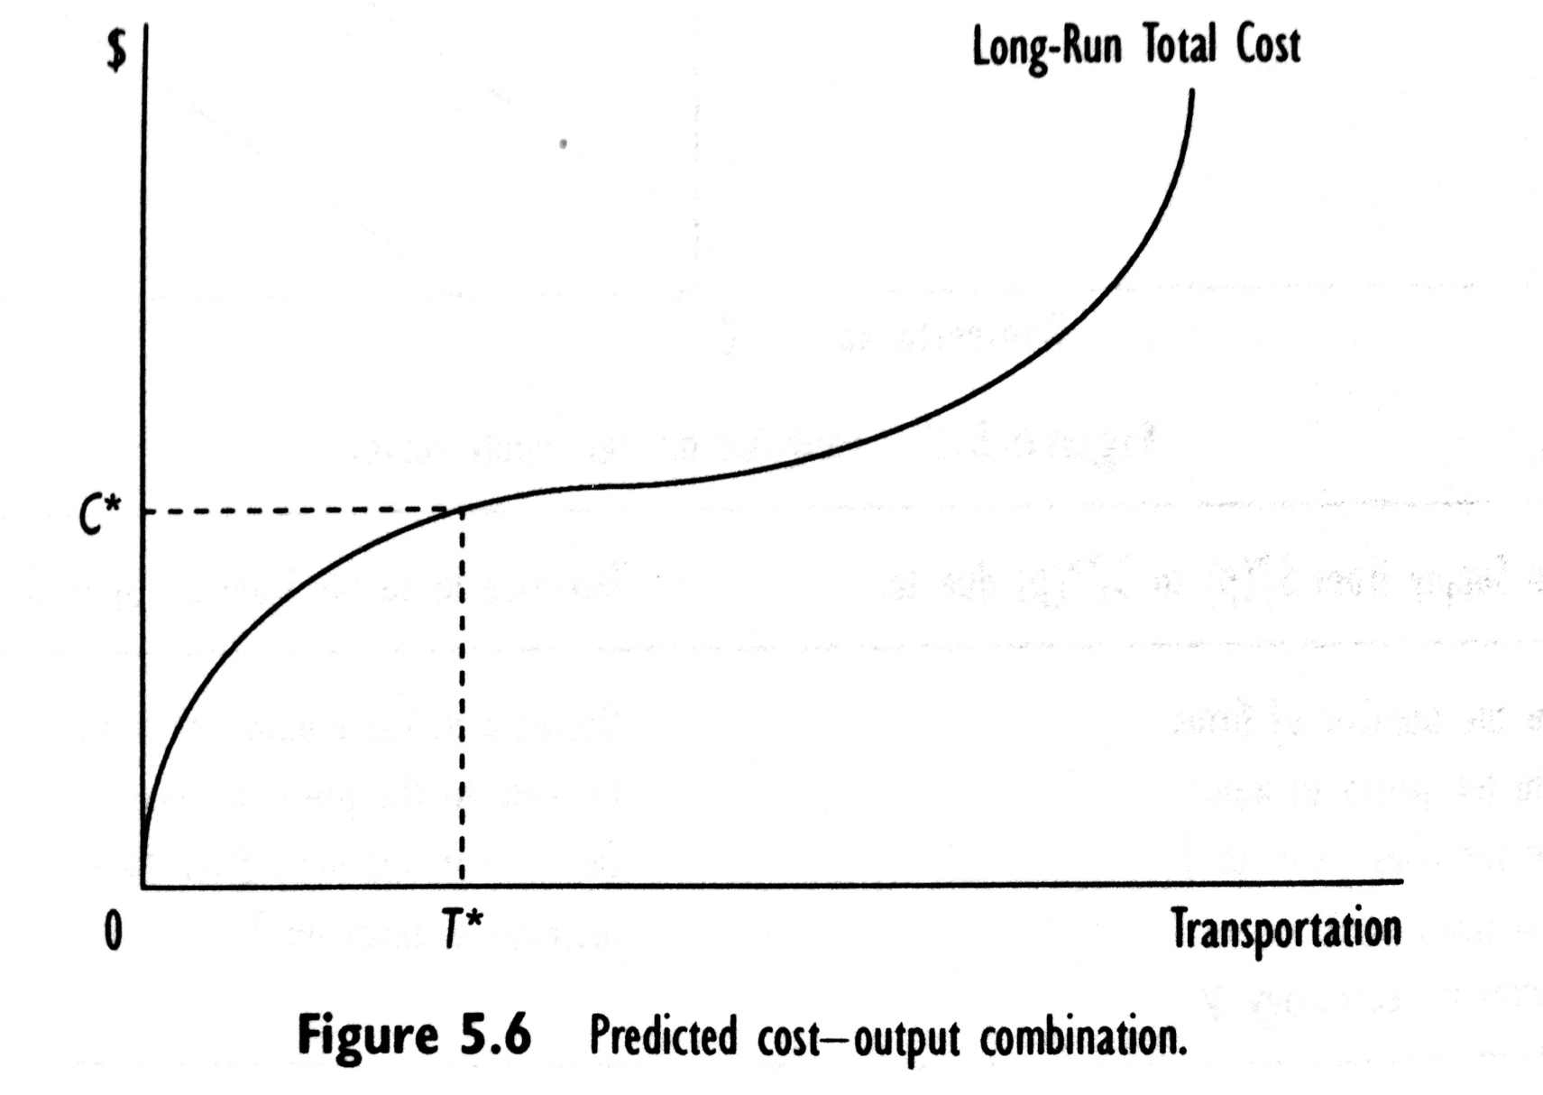
Estimating long run cost functions

Slide 14
Cobb Douglas cost function

Slide 15
Flexible cost functions (translog)

Slide 16
Short run – level of capital fixed
In the short run at least one factor of production is fixed (we assume capital)
In the short run, a discussion of returns to scale is no longer relevant, since all inputs cannot change in the same proportion.
Adding more workers to a fixed amount of capital reduces MP_{L} = law of diminishing returns.

Slide 17
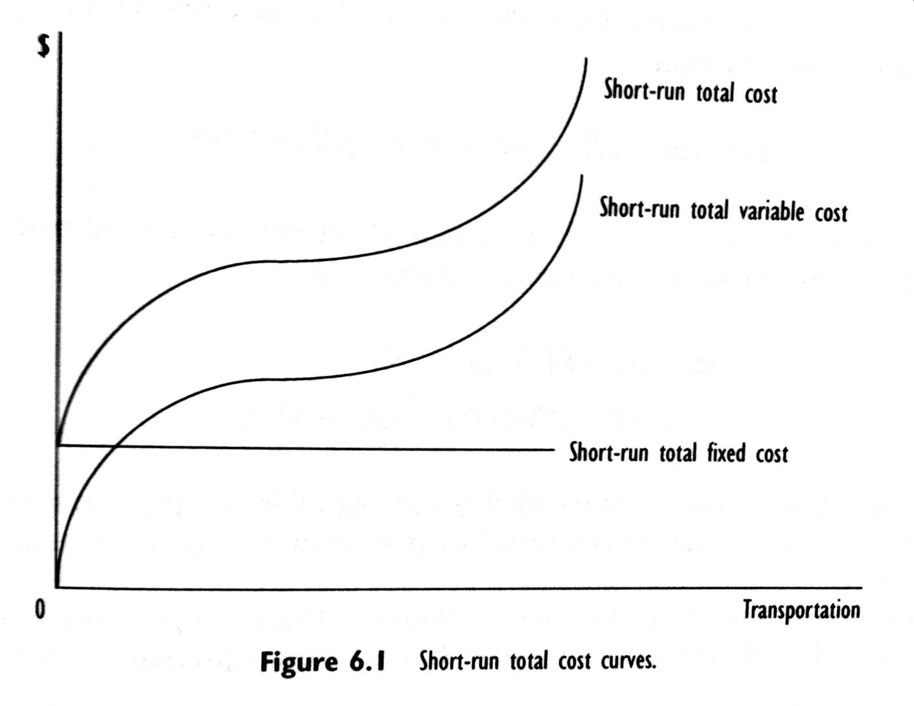
Short run cost curves

Slide 18
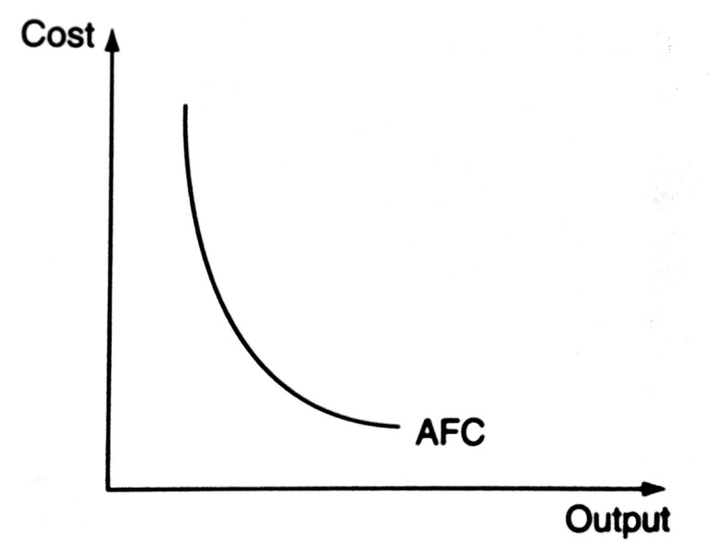
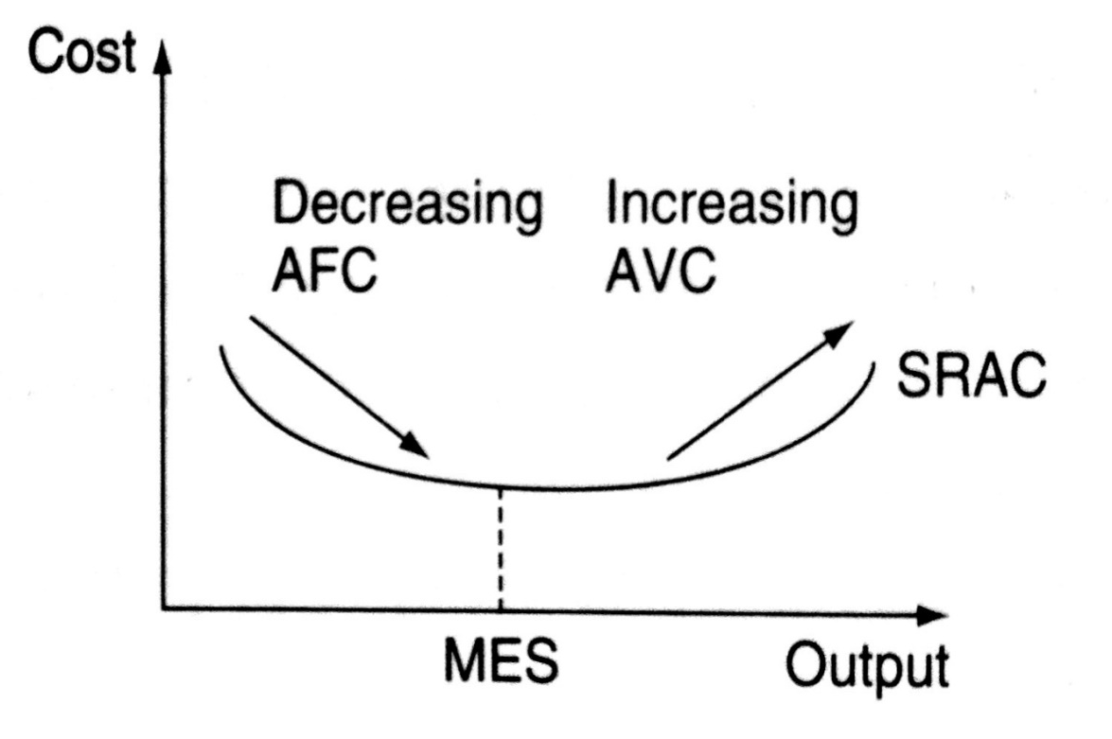
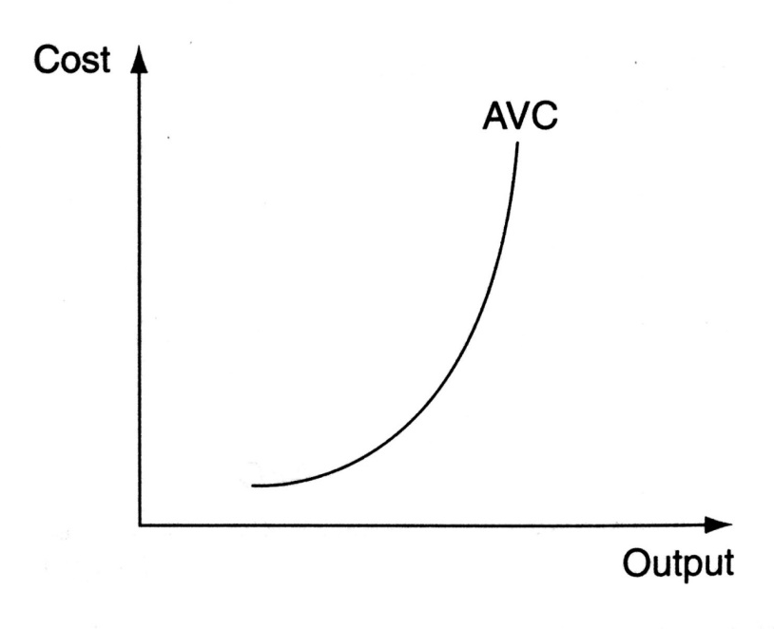
The short run average cost curve

Slide 19
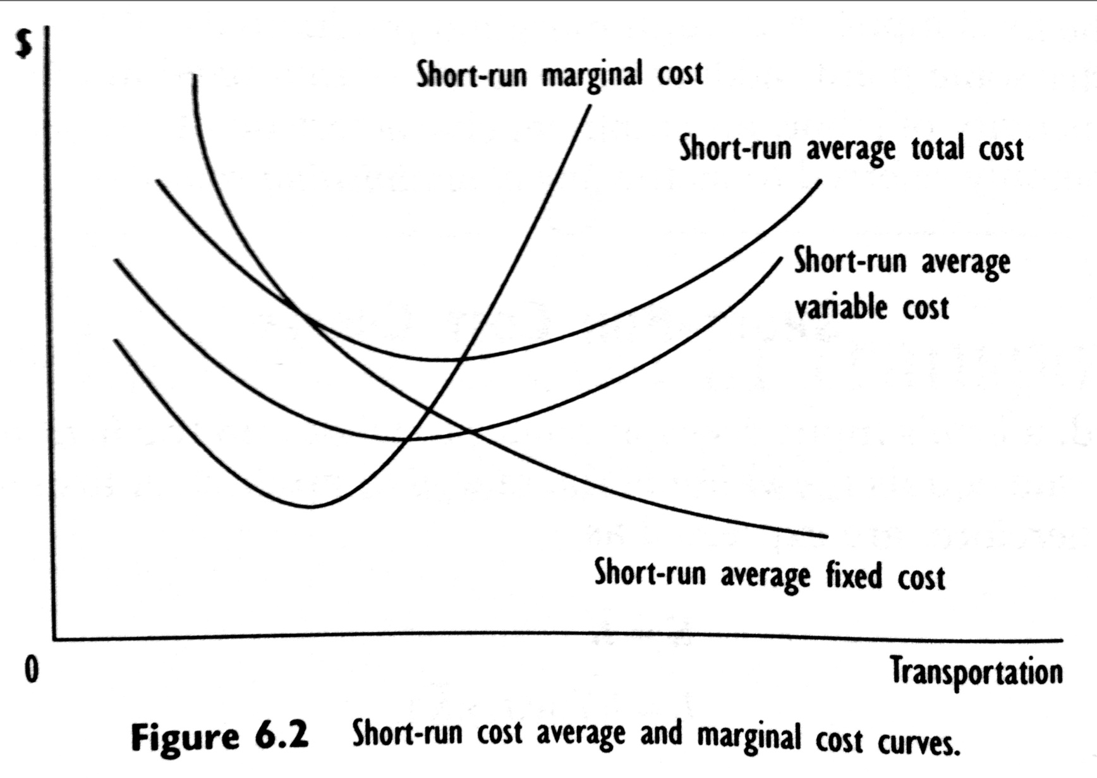
Short run cost curves

Slide 20
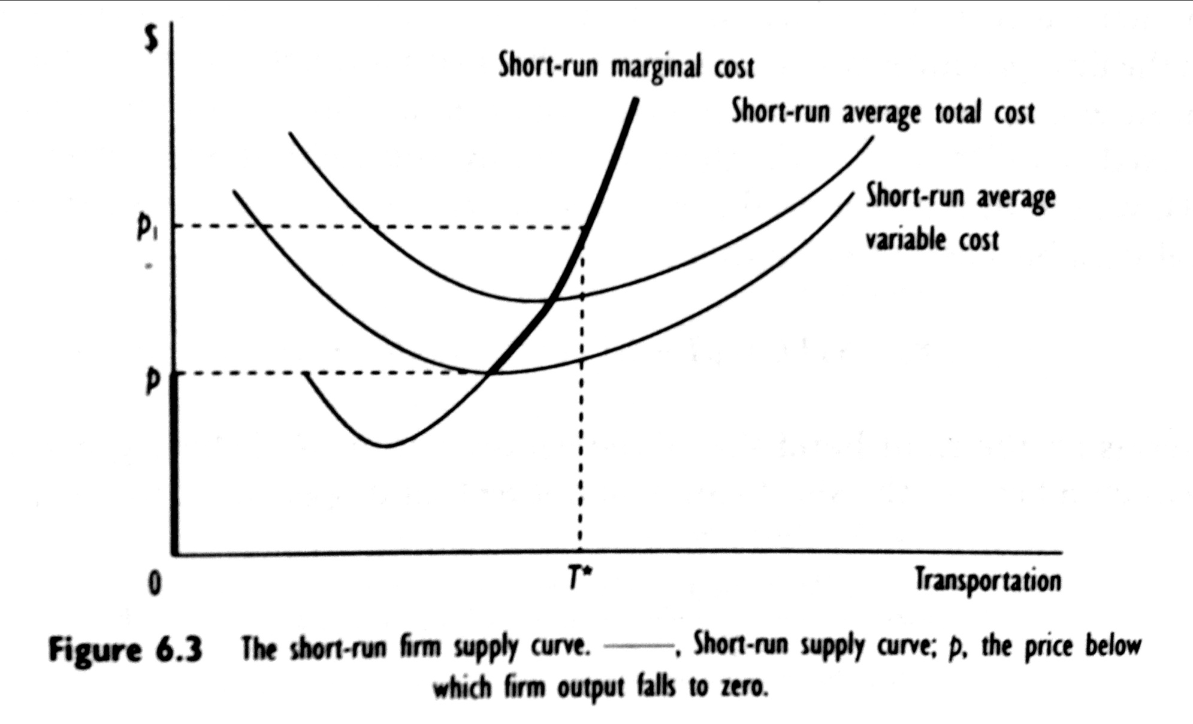
Short run market supply

Slide 21
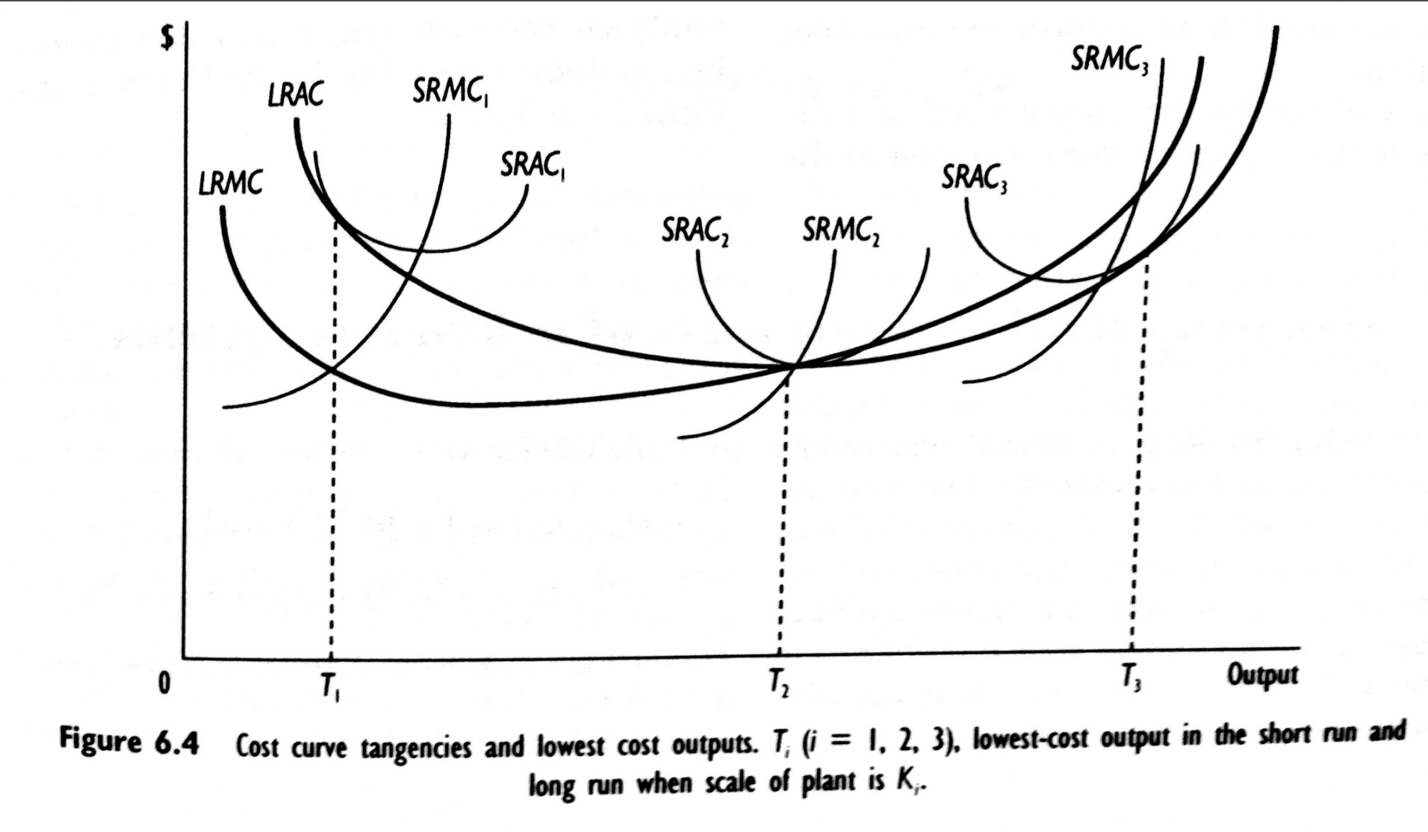
The relationship between short run and long run costs

Slide 22
Exercises (1)
Identify reasons why airlines would want to take over other airlines.
Please provide one particular industry as an example to illustrate that MC is not U shaped.
Please provide one particular industry as an example to illustrate that MC is U shaped.
What is the difference between economies of scale and economies of density?

Slide 23
Exercises (2)
What is the difference between economies of scale and economies of scope?
For many airlines in the short run, a major portion of the cost of production such as aircraft and terminal space are fixed. Should these very large FCs be ignored when the revenue managers are making output and pricing decisions? Why?
Critically evaluate the following statement: “All constraints on behaviour are costly, which explains why the short-run total cost curve lies above the long-run total cost curve.”

Slide 24
Exercise (3)
Fuel costs are important inputs to any transportation activity. Suppose that real energy prices fall. Graphically depict the impact that this would have upon a firm’s total short-run and long-run cost structure. Would you expect a firm’s long-run response to a fall in energy to be greater, less, or equal to its short-run response to a fall in energy prices? What does this suggest about the firm’s short-run input price elasticity of fuel relative to its long-run input price elasticity of fuel?

Slide 25
Exercise (4)
Suppose that you are given the following information on All Around Airlines:
The average variable cost of producing airline trips varies between 11.5 cents a mile when 50,000 trips per year are produced and 16.7 cents per mile when 500,000 trips per year are produced. Its lowest value is 11.5 cents a mile when 250,000 trips are produced.
The average total cost of producing trips varies between 15.3 cents per mile when 250,000 trips are produced and 17.3 cents per mile when 500,000 trips are produced. The minimum short-run average total cost is 13.0 cents when 300,000 trips are produced.
Questions:
  Approximately, how many trips will be produced in the short run if the fare is 15.4 cents per mile?
  Will any trips be produced if the fare is 12.1 cents per mile? If so, why; and if not, why not?
  Will any trips be produced if the fare is 10 cents per mile? If so, why; and if not, why not?

Slide 26
Exercise (5)
The July 7, 1993 Wall Street Journal provides the following information: “Northwest Airlines averted – at least for now – a threatened federal bankruptcy-law filling after its pilots’ union agreed to a last-minute pact to save the carrier $365 million over three years.” Using Northwest’s short-run cost curves, depict where Northwest was operating before and after the agreement with the pilots’ union.

Slide 27
Exercise (6)
Economies of scale in railway operations
List what you believe to be the main sources of economies of scale in the rail industry. Once you have produced this list, indicate which arise as a result of returns to scale and which are cost savings.
What on the other hand do you believe are the main sources of diseconomies of scale in larger integrated railways?
If you were a rail industry regulator in Britain today, what other factors apart from economies of scale would you take into account when deciding on the number of operators to have in the market?

Slide 28
Exercise (7)

Slide 29
Exercise (8)

Slide 30
4.2 Applications

Slide 31
Case: Mode cost comparison

Slide 32
The importance of cost structure in the business model of low-cost airlines

Slide 33
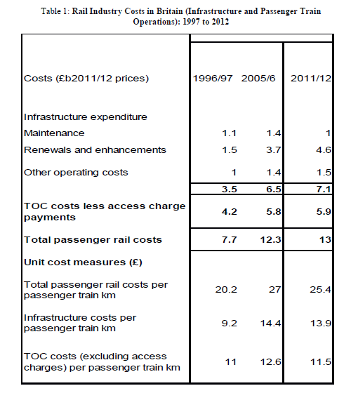
Costs at privatized British railways

Slide 34
Economies of scale, scope and density
If an equal proportionate increase in all outputs and route kilometers leads to the same proportionate increase in costs → constant returns to scale
If an equal proportionate increase in all outputs holding route kilometers constant leads to the same proportionate increase in costs → constant returns to density
If splitting the production of passenger and freight outputs and of infrastructure leads to increased costs → the railway is said to experience economies of scope
Nash, C. (2011). Competition and regulation in rail transport. Handbook of Transport Economics.

Slide 35
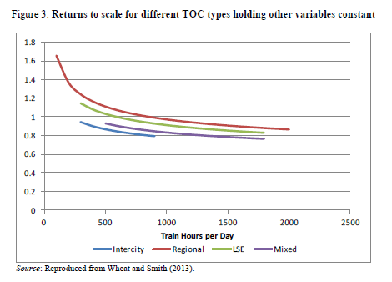
Economies of scale

Slide 36
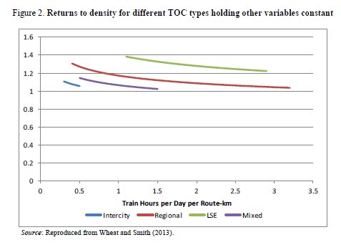
Economies of density

Slide 37
Fixed costs issue
When fixed costs are present and there is a competitive supply, then competition will push prices down to marginal costs, but they will be insufficient for capital cost recovery
The challenge confronting the transport supplier is thus how to ensure sufficient revenue
Empty core problem
Button, K. (2005). The economics of cost recovery in transport: introduction. Journal of Transport Economics and Policy, 39(3), 241-257.

Slide 38
Methods of capital recovery
Subsidies
Monopolies
Internal coalitions
Long term contracts between supplier and customer
Advance revenue
Vertical integration
Discriminate pricing
Two part tariff

Slide 39
Decline of transport costs
The theoretical framework of urban and regional economics is built on transportation costs for manufactured goods. But over the twentieth century, the costs of moving these goods have declined by over 90% in real terms, and there is little reason to doubt that this decline will continue.
Moreover, technological change has eliminated the importance of fixed infrastructure transport (rail and water) that played a critical role in creating natural urban centres. In this article, we document this decline and explore several simple implications of a world where it is essentially free to move goods, but expensive to move people.
We find empirical support for these implications.
Glaeser, E. L., & Kohlhase, J. E. (2004). Cities, regions and the decline of transport costs. Papers in regional Science, 83(1), 197-228.

Slide 40
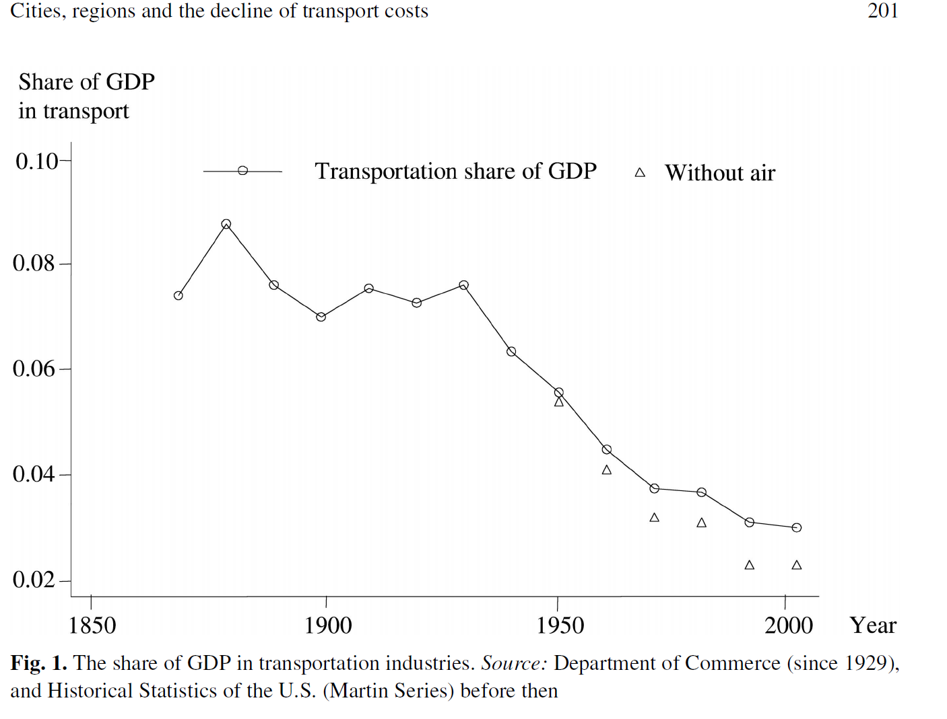
Transportation costs

Slide 41
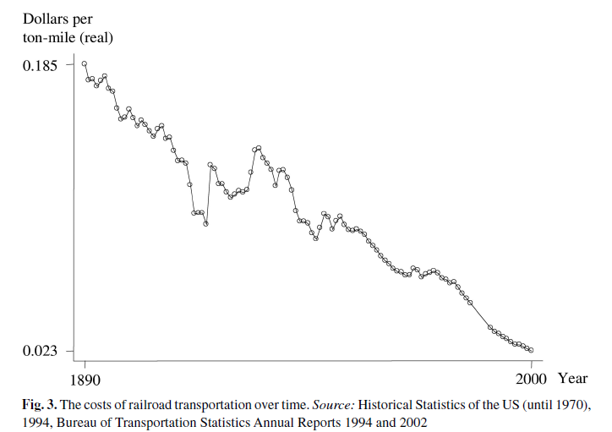
Railroad costs

Slide 42
Implications (1)
People are no longer tied to natural resources
Consumer-related natural advantages are becoming more important
Population is increasingly centralised in a few metropolitan regions
People are increasingly decentralised within those regions

Slide 43
Implications (2)
High density housing and public transportation are becoming increasingly irrelevant
Services are in dense areas; manufacturing is not
The location of manufacturing firm is not driven by proximity to customers or suppliers, the location of service firms is determined by proximity
Density and education go together

Slide 44
4.3. Urban bus transportation cost and production

Slide 45
Introduction
An often stated economic argument for the justification of a single bus system, a market structure that chracterizes most urban mass transit systems in the USA, is the presence of large economies of scale.
Source of scale economies: costs of administrative staff, economies of capital stock utilization, traffic density and generalized economies of scale.
Viton (1981) analyzed the cost and production structure of bus systems operating in the United States and Canada

Slide 46
Specification
Viton specified a translog empirical cost model in which short-run total variable cost was assumed to depend upon a bus system’s produced output, defined as vehicle/miles (millions), input prices for labor (p_{l}) and fuel (p_{f}) and a fixed factor of production (buses), which is defined as the number of buses in the bus system. Specifically, the empirical cost model is:

Slide 47
Hypotheses
Bus transit systems operate under increasing returns to capital utilization → α₁ < 1.
α₂ > 0, α₃ > 0 α₂ + α₃ = 1
An increase in a bus system rolling stock is expected to decrease short-run total variable costs: α₄ < 0.

Slide 48
Estimation results

Slide 49
Utilization economies

Slide 50
Optimal bus fleet size

Slide 51
Long run economies

Slide 52
Comments
In the short run bus companies will have trouble covering their variable costs of service.
Bus systems in general appear to be overcapitalized.
Even with optimal fleets, smaller bus systems require subsidies.

Slide 53
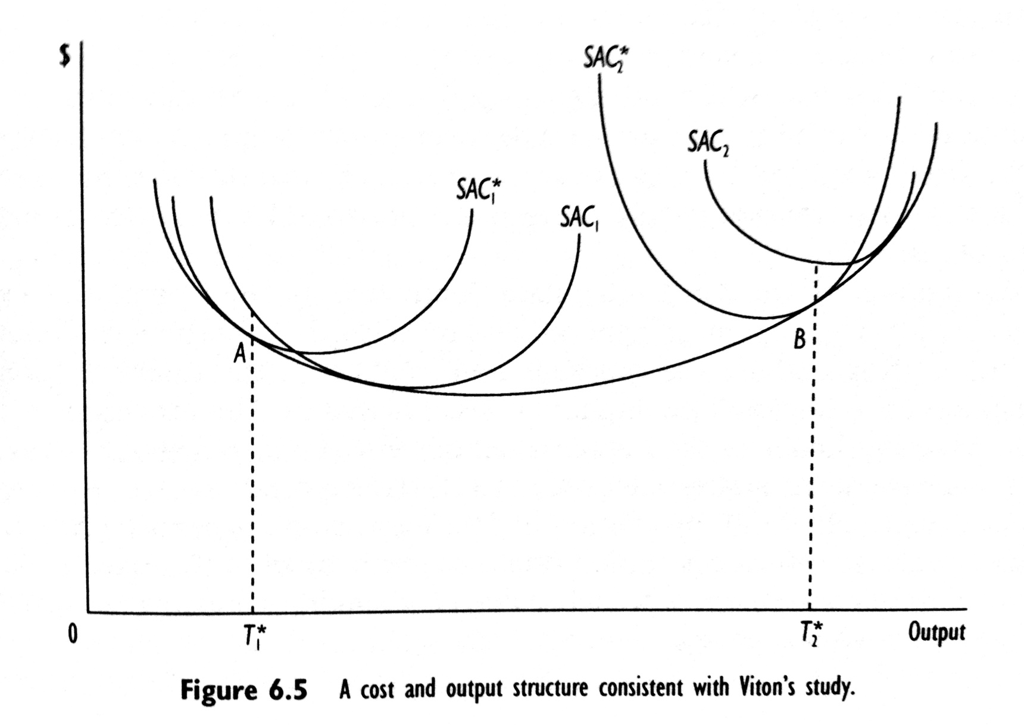
Short-run and long-run cost curves

Slide 54
Review questions
Viton’s 1981 study of urban transit costs found that urban transit firms operating in small cities (where fewer than 1 million vehicle-miles are produced annually) operate under increasing returns to scale, in medium-sized cities (which produce between 1 million and 5.5 million vehicle-miles annually) they operate under decreasing returns to scale.
Assuming that fares are set at marginal cost, what do these results imply about the possibility of small-scale profitable entry in small, medium, and large cities?
Based upon Viton’s results, are there any benefits to decentralizing urban transit systems in the largest cities?

Slide 55
4.4 Summary

Slide 56
Summary
Both short and long average costs curves are U shaped
In the short run it is due to the law of diminishing returns, in the long run due to economies/diseconomies of scale

Slide 57
Readings for Lecture 5
Nash, C., Crozet, Y., Nilsson, J. E., & Link, H. (2016). Liberalisation of passenger rail services. CERRE Report.

