Slide 1
5. COMPETITION (1)

Slide 2
Readings for Lecture 5
Nash, C., Crozet, Y., Nilsson, J. E., & Link, H. (2016). Liberalisation of passenger rail services. CERRE Report.

Slide 3
Learning Objectives
High prevalence of imperfect market structures in transport markets
The main sources of barriers to entry
Competition for the market and competition on the market

Slide 4
5.1 Theory

Slide 5
Review of basic micro
1. What is a normal profit?
2. Does perfect competition exist in the real world?
3. What happens when markets do not have enough competition?
4. What are barriers to entry in the airline industry?
5. How is price established in an oligopoly market?

Slide 6
Perfect competition (assumptions)
Many buyers and sellers
No barriers to entry or exit
All firms are profit maximisers
All consumers are utility maximizers
Perfect information
Homogenous product
No economies of scale
Non rivarly in consumption
Absense of externalities
No governemnt intervention

Slide 7
Barriers to entry
Firm size
High sunk costs
Product differentiation
Legal protection
Control of factors of production
Exclusive dealership
Branding

Slide 8
Barriers to entry (exercise)
For the following transport industries: a) Bus production b) Provision of rail services c) Provision of the rail infrastructure d) Road haulage e) Air services f) Parcels markets; identify the main barriers to entry into each of these markets for a potential market entrant under the headings of structural and strategic barriers. Then place these industries on a scale, where 1 represents the industry with the lowest barriers to entry and 6 the industry with the highest. What does this tell you?

Slide 9
Disadvantages of monopoly
Production inefficiencies
Higher prices charged and lower output produced
Reduction of consumer surplus and is regressive
Net welfare loss
X-efficiency
The market no longer regulates itself

Slide 10
Advantages of monopoly
A higher level of expenditure on R a D
Market size – a natural monopoly
Wasteful competition
Hotellings law

Slide 11
Contestable markets
Baumol (1982) – it is unneccessary for the market to be in perfect competition in order to produce economically efficient results. It is enough to be a contestable market.
Contestable market = entry to the market is free and exit is costless

Slide 12
Review question
Examine the extent to which you believe that the low cost airline market meets the conditions of the contestable market.

Slide 13
Case: Contestability in airlines
The sector is becoming more contestable because:
Control over landing slots is lower
The spread of information through Internet
The frequent flyer initiative is on retreat
The growth of LCA

Slide 14
Discussion question
Are railways contestable markets?
Why yes?
Why no?
Compare: Shires, J. D., Preston, J. M., Nash, C. A., & Wardman, M. (1994). Rail privatisation: the economic theory.

Slide 15
5.2 Competition on x for the market

Slide 16
Competition on x for the market
Competition on the market = this occurs where there is no restriction on entry. Operators are competing directly against each other.
Competition for the market = where entry to the network is restricted, it is possible to organize competition for the exclusive right to service individual routes

Slide 17
Competition on the market
Direct impact on efficiency and costs
Enterpreunership spirit and flexibility regarding entry and exit
No arbitrary borders of franchises

Slide 18
Competition for the market
Enables creation of long term contracts between operator and public authority, including investment liablities
Contracts may include specification of services (frequency, quality, punctuality and so on)
Competition for the market may be organized for wider regions and therefore it may internalize more network externalities than open access operators on single

Slide 19
European rail
Competition on the market:
Praha – Ostrava; Praha – Brno
Wien – Salzburg; Roma – Milano
Stockholm - Goteborg
Competition for the market:
British franchising
Germany regional traffic
Many others
See: Nash, C., Crozet, Y., Nilsson, J. E., & Link, H. (2016). Liberalisation of passenger rail services. CERRE Report.

Slide 20
British buses
Competition for the market – London
Competition on the market – rest of England

Slide 21
5.3 Case study
Nash, C., Crozet, Y., Nilsson, J. E., & Link, H. (2016). Liberalisation of passenger rail services. CERRE Report.

Slide 22
Introduction
Passenger rail services may be liberalised in two ways.
The first is by means of competitive tendering for public service contracts. (competition for the market)
The second is by open access for the operation of commercial services. (competition on the market)

Slide 23
Competition for the market
Britain has adopted franchising by means of competitive tender for almost all passenger services, subsidised and commercial; state-owned British Rail was not allowed to bid and ceased to exist as a train operator.
Sweden has adopted it for virtually all subsidised services; most are procured by the regions, and 45% of all services in Sweden are now operated by new entrants.
In Germany, the federal states are responsible for procuring all subsidised services; there is a trend toward competitive tendering and 18% of regional services are operated by new entrants

Slide 24
Competition on the market
All three countries have at least some commercial open access operation, but the country that has taken this furthest is Italy, where a new entrant provides frequent services in competition with the state-owned operator on the high-speed network.

Slide 25
France – no competition
By contrast, France has no competitive tendering or open access competition (except on a couple of international routes).

Slide 26
Has passenger rail market liberalization been a success?
Existing evidence on:
Growth of traffic
Subsidies
Costs

Slide 27
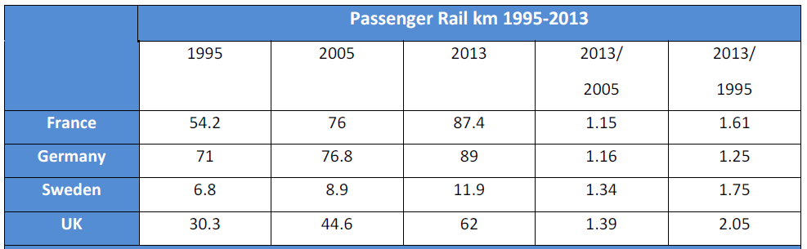
Trends in passenger rail traffic

Slide 28
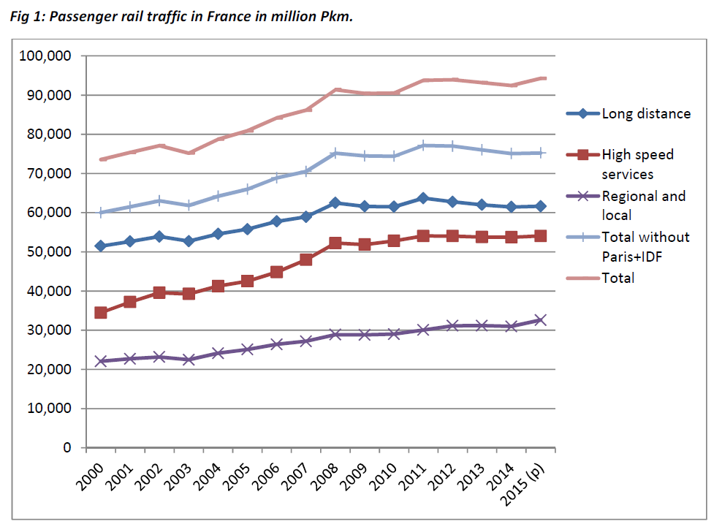
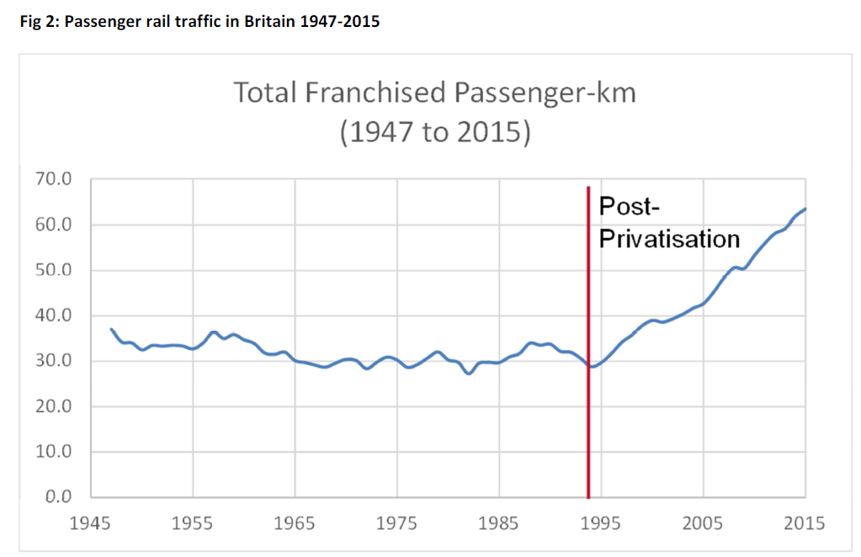
Traffic in France and Britain

Slide 29
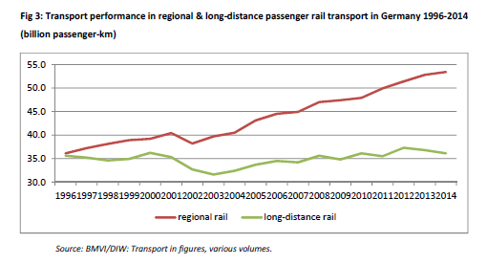
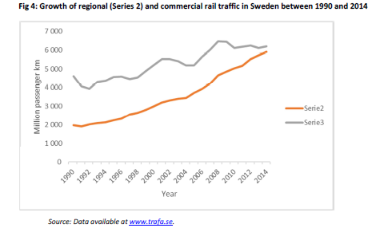
Traffic in Germany and Sweden

Slide 30
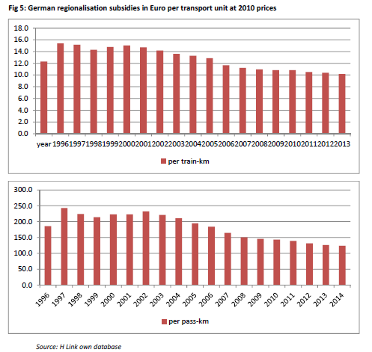
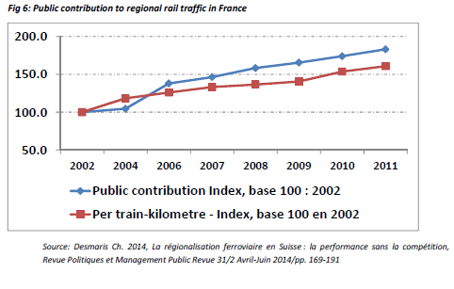
Subsidies in Germany and France

Slide 31
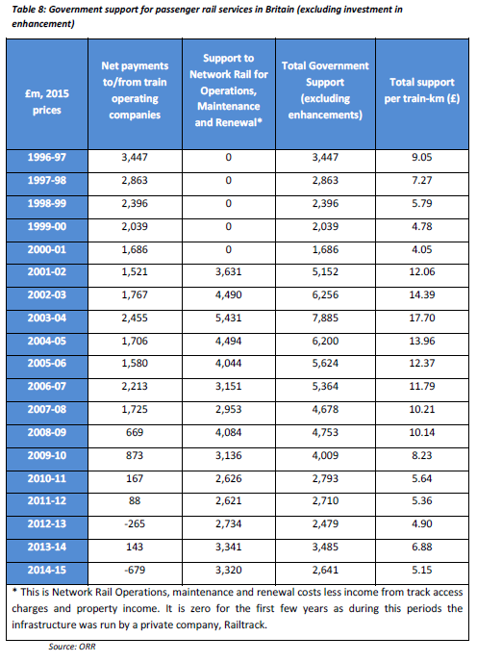
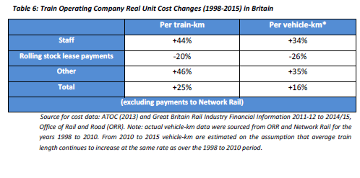
Costs and subsidies in Britain

Slide 32
Franchising - discussion
What organization should be responsible for franchising?
What is the optimal size and length of franchises?
How to manage risk sharing?

Slide 33
Greater role for open access?
In Britain, open access has to date been limited by a ‘not primarily abstractive’ test; only open access operations where revenue new to the rail industry is at least 30% of that abstracted from existing operators are permitted.
Germany has had very little new entry in practice, perhaps because of the relatively high track access charges and strong competition from air and now intercity bus.
Open access has only applied in Sweden for a short period of time, but already there is intense competition on one key intercity route, between Stockholm and Goteborg.
For more experience of on-track competition, we have to look outside our case study countries, to Italy, Austria and the Czech Republic.

Slide 34
Conclusions
In all three countries – Sweden, Germany and Britain - there has been rapid growth in demand for regional services, and subsidy per train km has generally fallen. By contrast in France, with no competition, it has risen substantially.
Whilst in Germany and Sweden costs have been reduced, in Britain train operating costs have actually risen, although this has been more than offset by increased revenue.
A factor in this is thought to be that in Britain the winner of a franchise takes over an existing company including its staff, wages and conditions. In Germany and Sweden, the winner is responsible for assembling its own staff.
For a country such as France first introducing competitive tendering on a large scale, the issue of how to handle existing staff is the biggest barrier;

Slide 35
5.4 Summary

Slide 36
Summary (1)
Contestable market = entry to the market is free and exit is costless
Competition on the market = operators are competing directly against each other.
Competition for the market = where entry to the network is restricted, it is possible to organize competition for the exclusive right to service individual routes

Slide 37
Summary (2)
The evidence we have in Britain, Germany, Sweden and France suggest that passenger market intorducing competition to date has been a success.
Although it is not the main cause of traffic growth, franchising has contributed to the provision of improved services carrying more traffic, particularly in the regional market to which (except in Britain) it has been largely confined.
At the same time, in Germany and Sweden it has led to stabilising or declining support per train km. Even in Britain, a substantial increase in cost per train km has been offset by a rise in revenue, due both to increases in traffic per train km and in fares, leading to reducing support.
All this is in marked contrast to the experience of France, where under a state monopoly support per train km has increased by 60%.

Slide 38
Readings for Lecture 7
Tomeš, Z., Kvizda, M., Jandová, M., & Rederer, V. (2016). Open access passenger rail competition in the Czech Republic. Transport Policy, 47, 203-211.
Hunold, M., & Wolf, C. (2013). Competitive procurement design: Evidence from regional passenger railway services in Germany.
Preston, J., & Almutairi, T. (2013). Evaluating the long term impacts of transport policy: An initial assessment of bus deregulation. Research in transportation economics, 39(1), 208-214.

Slide 39
Appendix

Slide 40
Contestable market theory
Based on McCarthy (2001), chapter 6

Slide 41
Theory
Contestable markets are primarily concerned with competition for the market, not with competition among incumbent producers.
It is the markets that are contested and, as a result, potential competitors rather than actual competitors play prominent roles in discipling the behaviour of incumbent firm
Assumption: there are no barriers to entry or exit from the market, there must be a pool of potential entrants .

Slide 42
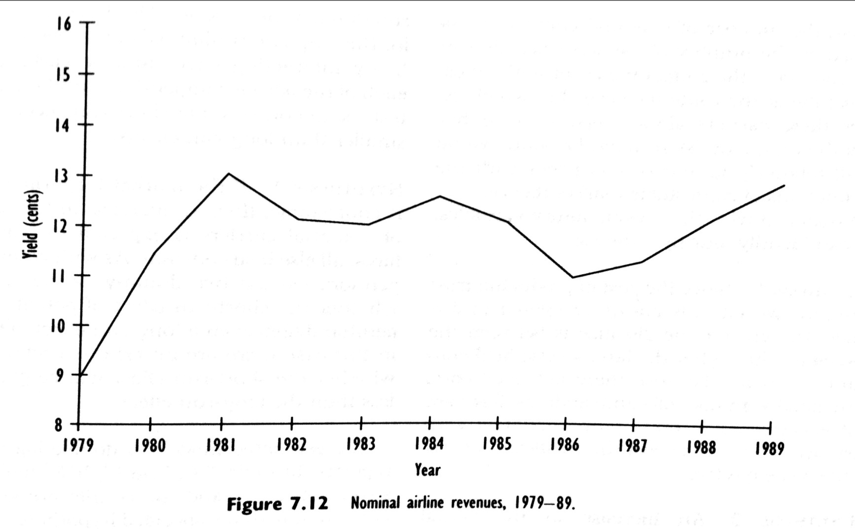
Case: Competition and contestability in the US airline industry

Slide 43
Case: Competition and contestability in the US airline industry
The rise in air fares in the latter part of the 1980s prompted governmental concern, among other issues, over whether hubbing had contributed to the nominal price rise.
This raises a basic question of the roles tht actual and otential competition play in price behaviour over time.
From a sample of 18573 routes between 1978 and 1988, Morrison and Winston (1990) invetsigated the importance of actual competitors versus potential competitors in determing nominal airline prices.

Slide 44
Variables
In their analysis, Morrison and Winston assume, that airline fares depend upon five basic determinants:
  the distance (in miles) between the airports on a route
  the number of effective competitors on routes at fixed-slot airports
  the number of effective competitors on routes at nonfixed-slot airports
  the minimum number of effective competition at route’s endpoints
  the number of potential carriers

Slide 45
Hypotheses
The coefficient of Distance is expected to be positive
An increase in actual competition will reduce fares → coefficients of number of competitors are expected to be negative
It is expected that the effects of actual competition will be greater in the long run than in the short run.
If the market for airline routes is contestable, then an increase in the number of potential carriers is expected to reduce air fares.

Slide 46
Results

Slide 47
Interpretation
Are the results consistent with contestable markets? Yes a and no.
The finding that actual competition induces price reduction implies that airline routes are not perfectly contestable.
But the results do indicate that these markets are imperfectly contestable.
The increase in the number of potential carriers leads to price reductions, however this effect is relatively small.

