Slide 1
7. OWNERSHIP

Slide 2
Readings for Lecture 7
Reform of the Railway Sector and its Achievements - Network Industries Quarterly - Vol 18 - No 4 (December 2016)
Preston, J., & Robins, D. (2013). Evaluating the long term impacts of transport policy: The case of passenger rail privatisation. Research in Transportation Economics, 39(1), 14-20.

Slide 3
Learning Outcomes
The reasons behind public ownership
The main motives behind a general movement towards reform of public ownership

Slide 4
7.1 Basics

Slide 5
Discussion question – to heat up
What do you see as the main advantages and disadvantages of public ownership in transport markets?
What do you see as the main advantages and disadvantages of involving the private sector in the provision of public transport services?
What are benefits and risks of privatization?
In what sense can it be said that the government controls the means of production for the airline industry?

Slide 6
Introduction
Due to many market imperfections, transport markets usually cannot be left entirely to market forces to resolve economic transport issues.
In most cases, therefore, they need some form of external intervention in order to correct for market failures

Slide 7
Government control
Government control of transport markets can be achieved through one of two measures:
Regulation - control through direct command; i.e. telling operators what to do
Ownership – the transport authority can own the assets and the means of production. The market is brought into public sector and thus it does not have to operate along market principles

Slide 8
Reasons for public ownership
Eradicate wasteful competition
Military significance
Public goods
Essential to the economy
A large employer
Key industry
High project development costs

Slide 9
Reasons for privatization
Increasing discontent with the model of public ownership
Changing macroeconomic enviroment combined with social change
The desire to introduce competition into the provision of transport services

Slide 10
7.2 Japan

Slide 11
Introduction
In rail system – passenger traffic dominant
Honsu island geography
Freight rail marginal – due to sea traffic
HSR Shinkansen – starting from 1964 on Tokyo-Osaka line
Highly successful – leading to build up of further lines with lower commercial potential
1980s – high indebtness of JNR , overemployment

Slide 12
1986 Reform
Sack of management
Horizontal separation (JR Freight)
Geographical separation (JR East, JR Central a JR West - commercialization, JR Hokkaido, JR Shikoku a JR Kyushu - subsidies)
Yardstick competition – comeptition on the edges only
Indebtness – partial bail-out, partial transfer to JR East, Central and West
Privatization of JR East, Central and West in 1990s

Slide 13
Japan rail

Slide 14
Results
Between 1987-1991: traffic + 20%; employment down from 280.000 to 160.000
Labor productivity: +68% between 1985-88 and another +25% between 1988-98
JR East, Central and West – profitable +3 bn income taxes per year (5 bn subsidies to JNR before reform)
JR Freight and JR JR Hokkaido, JR Shikoku a JR Kyushu – stable traffic, operational subsides
Better quality and responsivness to customers

Slide 15
Assesment
Successful reform/privatization
Main goals: to decrease indebtness and bigness of JNR
No competition!
More efective structure and incentives

Slide 16
7.3 New Zealand

Slide 17
General characteristics
Rail primarily oriented towards freight traffic
In passenger traffic there is important commuting to Wellington and Auckland and a few intercity connections
Until 1993 vertically and horizontally integrated structure in state ownership
Strong intermodal comeptition and worsening economic results

Slide 18
Nez Zealand rail map

Slide 19
1993 privatization
NZ government in 1993 sold it railway for 400 million USD to consortium of private investors
In the years after privatization, profits rose, however not enough to cover costs of capital
Freight traffic rose steadily

Slide 20
Problems
Private owners had increasing problems with operations of passenger rail transport and in 2002 sold commuter rail network back to government
Financial problems were increasing and in 2004, private owners sold back rail infrastructure to NZ state for 1 USD
NZ governemnt agreed to infrastructure investment, however bitter disputes over the level of infra charges emerged
This led to complete purchase of remaining rail enterprise by NZ governemnt for 690 million dollars. What was considered to be highly overpriced purchase

Slide 21
Lessons
Very problematic privatization in New Zealand (and very similar case in Tasmania) shows dangers of rail privatization involving passenger transport
Passenger rail transport in developer countries is usually not very profitable, however politically sensitive

Slide 22
7.4 Estonia
Based on Lust, A. (2017). Broken rails: the privatisation of Estonian railways. Post-Communist Economies, 29(1), 71-89.

Slide 23
Reform
In 2000–2001, Estonia sold the passenger carrier and a portion of the track to domestic businessmen posing as a British strategic investor, and the main freight carrier and most of the track to an American-led consortium.

Slide 24
Passenger and freight
The passenger carrier continued to receive government subsidies but closed several rail lines, which led to protests by passengers.
The freight carrier earned large profits from the transit of Russian oil to Europe, but invested its money in buying used American locomotives, rather than rebuilding the track.

Slide 25
Final part
Both companies laid off about half of their workforce, provoking the first private-sector strike in Estonia since the collapse of Communism.
In 2006, a new government bought back the freight services and track at more than twice the sale price, an expensive lesson in the perils of privatisation.

Slide 26
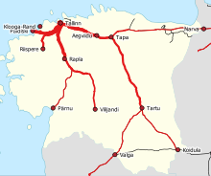
Train frequencies

Slide 27
7.5 Britain

Slide 28
Introduction
British rail reform – probably the most complex and complicated one
Vertical, horizontal and geographical separation of the industry (1993-1997)
Fragmentation of former British Rail into more than 100 companies
Competition and privatization on all levels

Slide 29
Discussion question
Can you see any drawback/problem with such reform strategy?

Slide 30
Privatization
Privatization of the infrastructure manager (1996)
Privatization of freight operators (6 companies) – subsequently merged into 2
ROSCOs – rolling stock private owners – leasing to franchisee
Passenger operations - franchising

Slide 31
Franchising
25 regional franchisee
Private firms bid for the right to operate it (competition for the market)
No British Rail in these tenders!
Limited role of open access (competition on the market)
First, second and third round of franchising (1996, 2002, 2010)

Slide 32
Discussion question
Why do you think open access was not granted higher role in British rail reform?

Slide 33
Map of franchisee

Slide 34
Regional Usage

Slide 35
Hatfield
Fatal accident in October 2000
Due to broken rail (bad maintanance?)
Railtracked panicked and introduced severe speed limits
Result: operational chaos, financial troubles of Railtrack and its bankruptcy in 2001
Higher involvement of governemnt (subsidies) into rail after Hatfield

Slide 36
Results
Growth of traffic (especially passenger)
Subsidies (firstly sharply down, up after Hatfield, then again down)
Costs (growth if unit costs; Why?)

Slide 37
Assesment
Mix of successes (traffic, innovations) and failures (costs, Hatfield)
Rail important in intercity and commuting transport (role of London!)
Therefore, governemnt can hardly hope that by privatization will solve the „rail problem“

Slide 38
Discussion question
Can you imagine a better way how to reform British railways?

Slide 39
7.6 Case: privatization of UK railways
Preston, J., & Robins, D. (2013). Evaluating the long term impacts of transport policy: The case of passenger rail privatisation. Research in Transportation Economics, 39(1), 14-20.

Slide 40
Rail privatization in Britain – success or failure?
Britain’s national rail system was ‘privatised’ as a result of the 1993 Railways Act, with most of the organisational and ownership changes implemented by 1997.
This paper examines the long term impacts of these changes.
A key issue when examining long term changes is that of the counterfactual – what would have happened if the changes had not occurred?
.

Slide 41
Methodology
A simple econometric model of the demand for passenger rail services was developed and used in conjunction with extrapolative methods for key variables such as fares and train km to determine demand-side counterfactuals.
Extrapolative methods were also used to determine counterfactual infrastructure and train operation costs

Slide 42
Main constraint
Evaluation research is tortured by time constraints
The effects of a policy change are distorted by exogenous variables such as changes in population and income and are overtaken by other policy initiatives.

Slide 43
Brief history
1980s - the disposal of ancillary businesses
1993 – Railways Act
1994 – Railtrack (IM) emergence (privatised 1996)
1996-97 – 1st round of franschising
2000 – Hatfield accident
2001 – Railtrack bankrupt
2002 – Network Rail (IM) emerged

Slide 44
Demand

Slide 45
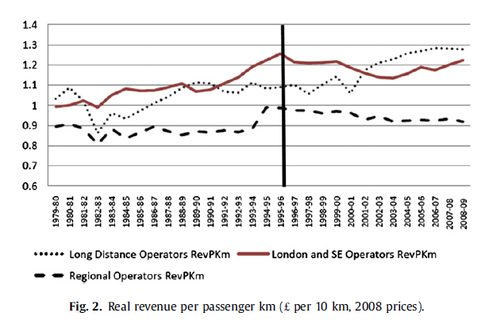
Fares

Slide 46
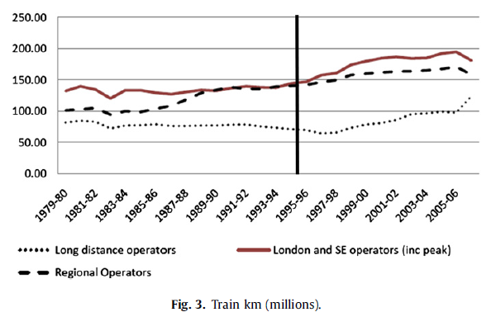
Supply

Slide 47
Costs

Slide 48
Subsidies

Slide 49
Model

Slide 50
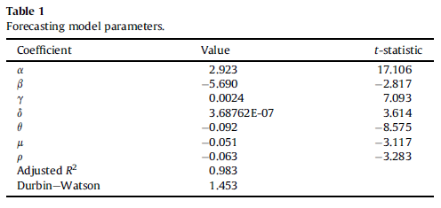
Estimation results
Preston, J., & Robins, D. (2013). Evaluating the long term impacts of transport policy: The case of passenger rail privatisation. Research in Transportation Economics, 39(1), 14-20.

Slide 51
Interpretation
Privatisation suppressed demand between 1992/3 and 2005/6 by around 8.8% (1 - exp θ)
The Hatfield accident suppressed demand between 2000/1 and 2006/7 by a further 5.0% (1 - exp μ)
The strikes in the years 1992/3 (ASLEF) and 1991/2 (Signalmen) were estimated to reduce demand by around 6.1% (1 - exp ρ)

Slide 52
Elasticities
A feature of the negative exponential specification is that demand elasticities are directly proportional to the relevant policy variables.
At the mean values in the data, the elasticity of demand
with respect to RPKM was computed to be 0.62,
with respect to TKM it was calculated to be 0.90
and with respect to GDP it was found to be 0.39.
These values are broadly consistent with some other studies

Slide 53
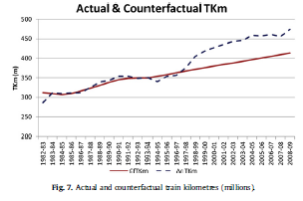
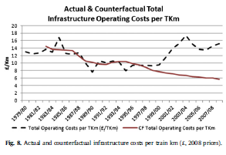
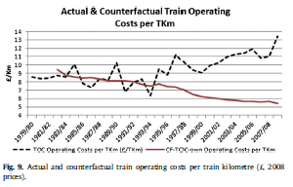
Counterfactuals

Slide 54
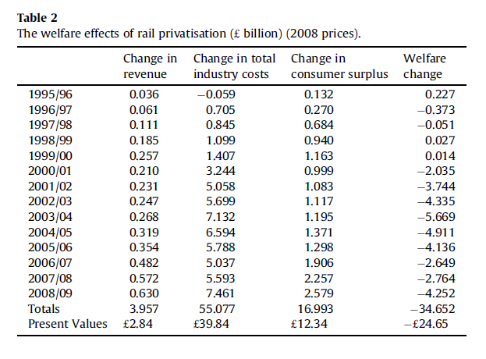
Welfare analysis

Slide 55
Discussion
The role of assumptions
Winners and losers
Vertical and horizontal fragmentation

Slide 56
Conclusions (1)
Although our results are sensitive to the assumptions we have made concerning the counterfactual they suggest a number of impacts.
Since privatisation, rail demand has grown strongly but our analysis indicates that transitional disruptions suppressed demand by around 9% over a prolonged period (1992/3 to 2005/6), whilst the Hatfield accident reduced demand by about 5%, albeit over a shorter period (2000/1 to 2006/7)
A welfare analysis suggests that although consumers seem to have gained as a result of privatisation, for most years this has been offset by increases in costs. An exception is provided by the two years immediately before the Hatfield accident.

Slide 57
Conclusions (2)
Overall the loss in welfare since the reforms were introduced far exceeds the net receipts from the sale of rail businesses.
Thus although the reforms have had aadvantages in terms of lower fares and better service levels than otherwise would have been the case, this appears to have been offset by increased infrastructure and train operations costs.
The source of these high costs remains an area of speculation but appear to be related to aspects of both market and regulatory failure.

Slide 58
7.7 Summary

Slide 59
Readings for Lecture 8
Caves, D. W., & Christensen, L. R. (1980). The relative efficiency of public and private firms in a competitive environment: the case of Canadian railroads. Journal of political Economy, 88(5), 958-976.
Boardman, A. E., Laurin, C., Moore, M. A., & Vining, A. R. (2013). Efficiency, profitability and welfare gains from the Canadian National Railway privatization. Research in Transportation Business & Management, 6, 19-30.
Tomeš, Z. (2017). Do European reforms increase modal shares of railways?. Transport Policy, 60, 143-151.

