Slide 1
8. OWNERSHIP (2)

Slide 2
Readings for Lecture 8
Caves, D. W., & Christensen, L. R. (1980). The relative efficiency of public and private firms in a competitive environment: the case of Canadian railroads. Journal of political Economy, 88(5), 958-976.
Boardman, A. E., Laurin, C., Moore, M. A., & Vining, A. R. (2013). Efficiency, profitability and welfare gains from the Canadian National Railway privatization. Research in Transportation Business & Management, 6, 19-30.
Tomeš, Z. (2017). Do European reforms increase modal shares of railways?. Transport Policy, 60, 143-151.

Slide 3
Learning Outcomes
Is competition or ownership structure more important in determination of efficiency or output?
Differences in organization or rail industry in North America and Europe
Local public transport structures

Slide 4
8.1 Case: Canada freight railways

Slide 5
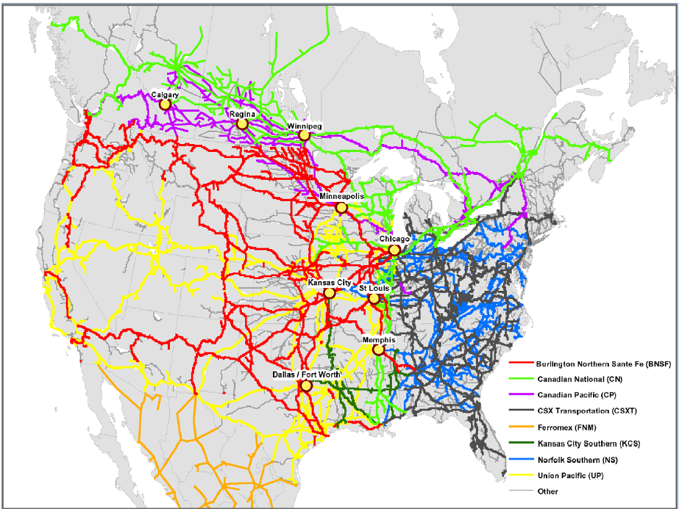
North American rail market
Source: Rodriguez (2008)

Slide 6
Canada rail sector
In the 20th century two big transcontinetal railroads:
Canadian National (CN) – public
Canadian Pacific (CP) - private

Slide 7
Ownership/competition
Public ownership Non-competitive enviroment | Private ownership Non-competitive enviroment
Public ownership Competitive enviroment | Private ownership Competitive enviroment

Slide 8
Canada (1980): Public ownership does or does not matter?
The efficiency of public and private firms is usually compared in industries which have heavy regulation and limited competition. In this paper we present a case study in which the effects of property rights can be isolated from the effects of regulation on noncompetitive markets. We compare the postwar (1956–1975) productivity performance of the Canadian National (public) and Canadian Pacific Railroads (private).
Caves, D. W. – Christensen, L. R. (1980): The Relative Efficiency of Public and Private Firms in a Competitive Enviroment: The Case of Canadian Railroads. Journal of Political Economy

Slide 9
Methodology
Comparison of total factor productivity (TFP) – real output per unit of input
In the paper, they estimated both the rates of growth of TFP and the relative levels of TFP for the CN and CP during the period 1956-75

Slide 10
Estimates
Table: Average annual growth rate of productivity of CN and CP
 | CN | CP | CN relative to CP
1956-63 | 1.9 | 1.7 | 0.2
1963-74 | 4.4 | 3.3 | 1.1
1956-75 | 3.1 | 2.5 | 0.7

Slide 11
Conclusions
Contrary to the predictions of the property rights literature, we find no evidence of inferior performance by the government-owned railroad. We conclude that any tendency toward inefficiency resulting from public ownership has been overcome by the benefits of competition.

Slide 12
Discussion question
Can you spot any weak point in argumetation of Caves and Christensen (1980)?

Slide 13
Privatization of CN
In 1995 was Canadian National privatized after careful three years preparation
Can we infer any interesting information out of this privatization?

Slide 14
Hypothesis
If Caves and Christensen were right than we can expect no change in performance of CN due to privatization

Slide 15
Canada (2013)
This article describes and analyzes the privatization of Canadian National Railway (CN), a large railroad privatization.
It uses data from 1990 to 2011 to compare CN's post-privatization operating performance with its pre-privatization performance.
Boardman, A. E., Laurin, C., Moore, M. A., & Vining, A. R. (2013). Efficiency, profitability and welfare gains from the Canadian National Railway privatization. Research in Transportation Business & Management, 6, 19-30.

Slide 16
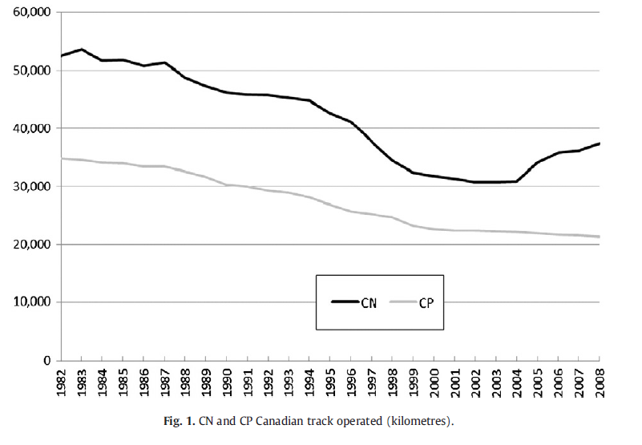
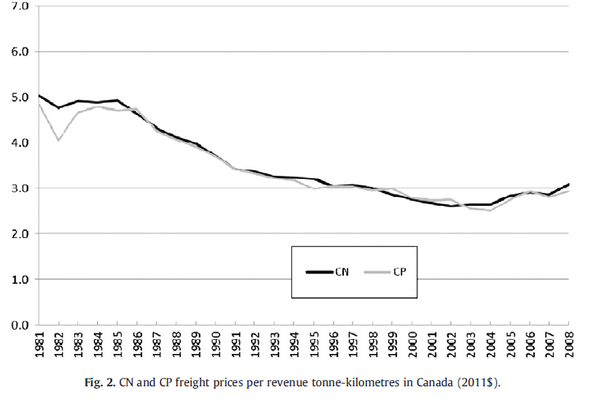
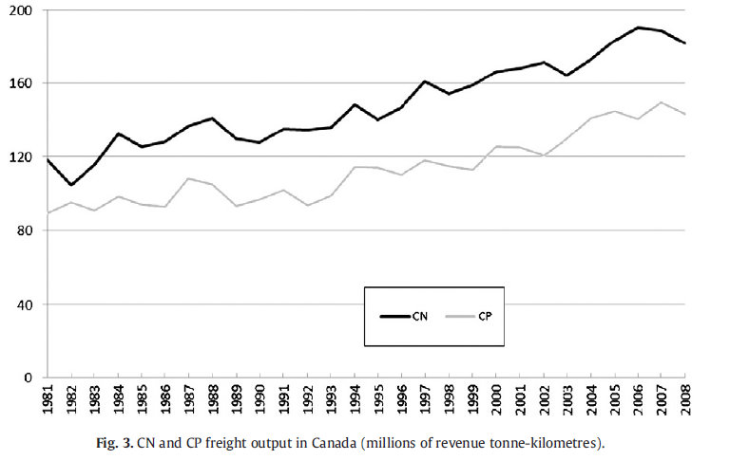
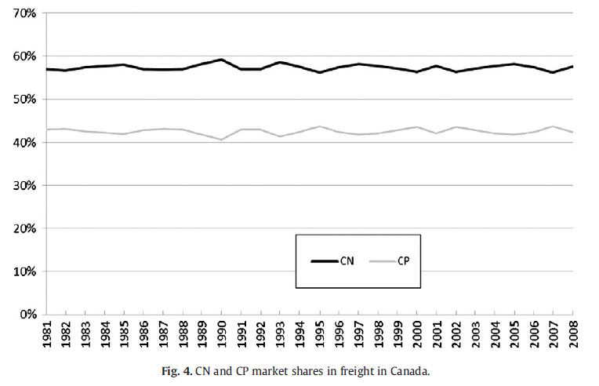
Canada: Output

Slide 17
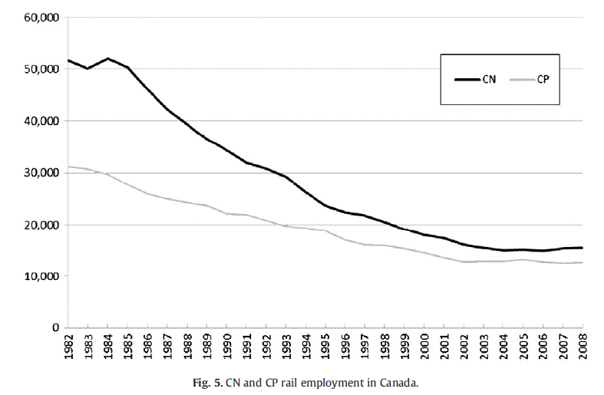
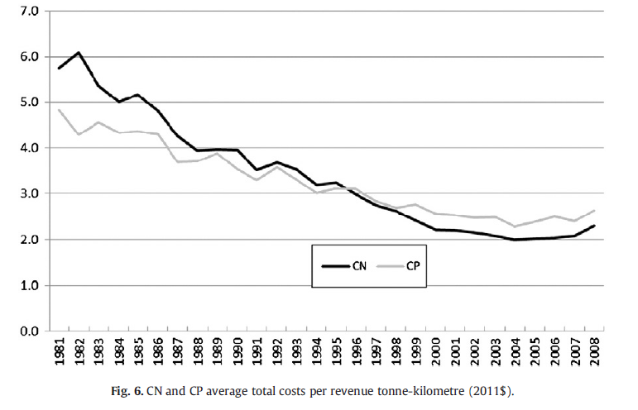
Canada: Employment and costs
Boardman, A. E., Laurin, C., Moore, M. A., & Vining, A. R. (2013). Efficiency, profitability and welfare gains from the Canadian National Railway privatization. Research in Transportation Business & Management, 6, 19-30.

Slide 18
Canada (2013): Ownership does matter?
The overall results demonstrate that CN performed substantially better following privatization, both from an operational perspective and from a broader social welfare perspective.
We find statistically significant increases over the long term (16 years following privatization) in sales, capital investment, assets, profit, profitability, productivity, dividends and corporate taxes paid.
There was little change in the capital structure of CN and a significant decrease in employment.
Using Canadian Pacific Railway as a basis for the counterfactual, we estimate that CN's privatization generated social welfare gains of approximately $25 billion in 2011 Canadian dollars.
The Canadian government received almost half of these gains, while CN's shareholders (most of whom were non-Canadian) captured the rest.
Boardman, A. E., Laurin, C., Moore, M. A., & Vining, A. R. (2013). Efficiency, profitability and welfare gains from the Canadian National Railway privatization. Research in Transportation Business & Management, 6, 19-30.

Slide 19
Discussion question
What are lessons from Canadian case study?

Slide 20
8.2 Competition or Privatization?
Tomeš, Z. (2017). Do European reforms increase modal shares of railways?. Transport Policy, 60, 143-151.

Slide 21
Motivation
50% of road freight over 300 km should shift to rail and water and the majority of medium distance passenger transport should go by rail by 2050 (EC, 2011)
These goals underpinned by reform initiatives (vertical separation and especially competition entry)
However, there are many factors causing long term structural decline of railways (DiPietrantonio – Pelkmans, 2004) and net benefits of vertical separation are questioned by some scholars (Pittman 2003, van de Velde et al. 2012)
Do European reforms actually increase modal share of railways? Or could be privatization more effective?

Slide 22
Railway reforms in the EU
Vertical separation = a complete institutional separation of the infrastructure manager and the incumbent operator
Competition entry = actual entry of the non-incumbent operators on the freight and passenger rail market
Horizontal separation = institutional separation between passenger and freight operations of the incumbent
Freight privatization = privatization of freight operator

Slide 23
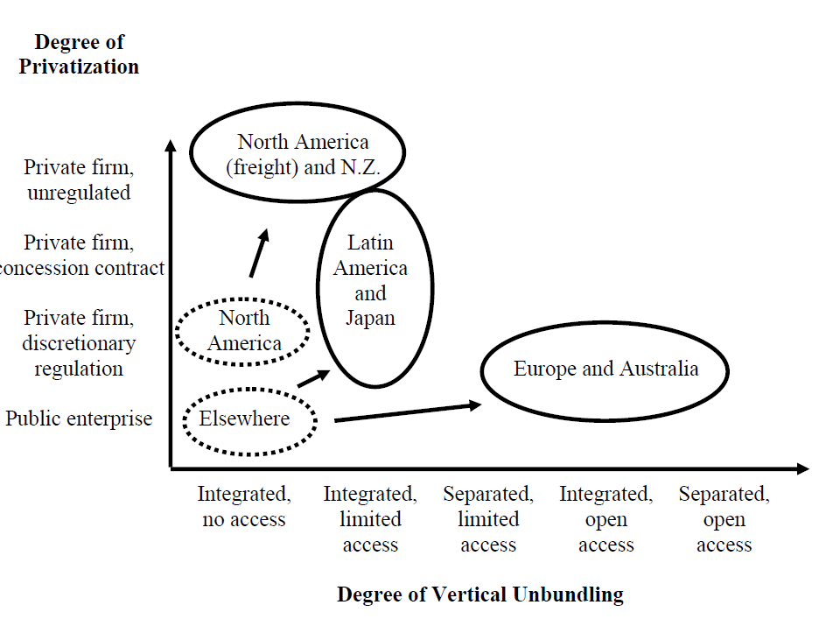
Reform options
(Gómez-Ibánez, 2006)

Slide 24
Western x Eastern Europe
 | Western | Eastern
Modal shares | Stable/rising | Falling
Government support | Stable | Insufficient/erratic
Incumbent’s profits | Positive | Negative
Infrastructure investment | High | Low
Regulatory capacity | High | Low

Slide 25
Previous studies (1) – impact of reforms on effiecency
 |  |  |  | EFFECT OF:
Authors | Period | Sample | Meth | Vertical separation | Horizontal separation | Competition entry passenger | Competit entry freight
Cantos Sánchez (2001) | 1973-1990 | 12 | COST | ~ | +
Driessen (2006) | 1990-2001 | 13 | DEA | + |  | + | -
Wetzel (2008) | 1994-2005 | 22 | SFA | 0 |  | - | +
Growitsch – Wetzel (2009) | 2000-2004 | 27 | DEA | -
Asmild et al. (2009) | 1995-2001 | 23 | DEA | 0 |  | + | +
Friebel et al. (2010) | 1980-2003 | 12 | SFA | + |  | + | +
Cantos Sánchez et al. (2010) | 1985-2004 | 16 | DEA | + | + | + | +
Cantos Sánchez et al. (2012) | 2001-2008 | 23 | DEA | 0 |  | + | +
Mizutani et al. (2012) | 1994-2007 | 25 | COST | ~ | +
Mizutani et al. (2014) | 1994-2010 | 28 | COST | ~ | + | 0 | 0

Slide 26
Previous studies (2) – impact of reforms on modal shares
 |  |  | EFFECT OF:
Authors | Period | Sample | Vertical separation Passenger Freight | Horizontal separation Passenger Freight | Competition entry Passenger Freight
Drew-Nash (2011) | 1998-2008 | 25 | 0 0
Laabsch-Sanner (2012) | 1994-2009 | 9 | - 0 |  | + 0
Van de Velde et al. (2012) | 1994-2010 | 26 | - 0 | 0 0 | - 0
Kougioumtzidis (2014) | 2003-2011 | 28 | - 0

Slide 27
Empirical strategy
include all reform variables (VS, CE, HS)
include broad sample of countries (27 = EU_15 + Switzerland and Norway + EU_10)
explicitly control for differences between West and East
data for period 1995-2013

Slide 28
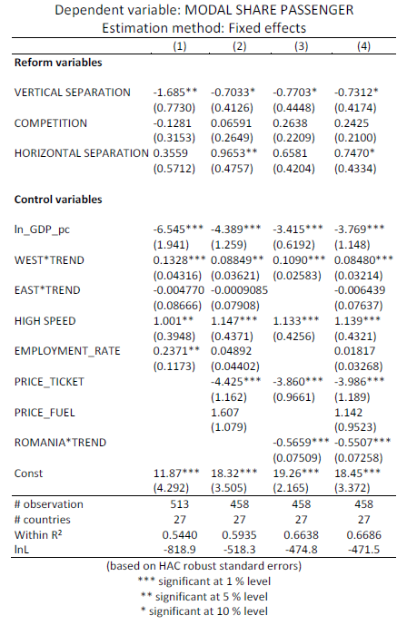
Passengers

Slide 29
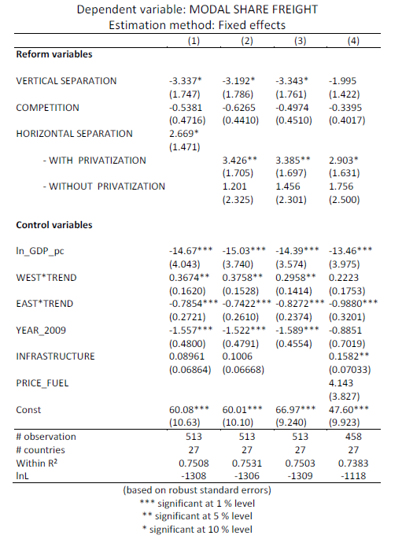
Freight

Slide 30
Results
Main results: vertical separation has a weakly negative impact on modal shares, competition an insignificant effect and horizontal separation a positive impact, especially when followed by freight privatization.
These results in line with previous studies, but with stronger effects from horizontal separation with privatization.

Slide 31
Change in the modal share of passenger rail 1995-2013 (%)

Slide 32
Change in the modal share of freight rail
1995-2013 (%)

Slide 33
Discussion
Vertical separation and competition entry do not increase modal shares of railways
    Possible reasons? → incentives misalignment; advantages of integrated structures; strong intermodal competition.
Horizontal separation generates better results, especially when followed by freight privatization.
    Why? → elimination of internal cross-subsidies, higher managerial and financial independence of freight; less pressure from domestic political representation.

Slide 34
Conclusion
There is no evidence that principal European reforms (vertical separation and competition entry) are increasing modal shares of European railways.
The more promising reform strategy seems to be horizontal separation, especially when followed by freight privatization.
There are significant differences in the long term development of railway’s modal shares between Western and Eastern Europe.

Slide 35
8.3 Competition or Privatization?
Local public transport

Slide 36
Local public transport
Boitani – Nicolini - Scarpa (2010) investigated whether competition and ownership matter in local public transport in Europe. This paper investigates how the ownership and the procedure for the selection of firm operating in the local public transport sector affect their productivity.

Slide 37
Methodology
In order to compare different institutional regimes, they carried out a comparative analysis of 72 companies operating in large European cities.
This allows them to consider firms selected either through competitive tendering or negotiated procedures.
They also control for ownership form

Slide 38
Exercise
Their results are in the table. You task is to identify whether competition or ownership has higher impact on their productivity. Based on their results, what are other important determinants of productivity?

Slide 39
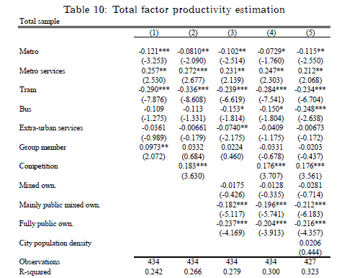
Results

Slide 40
Conclusions (1)
Firms selected through competition for the market present higher levels of productivity.
Ownership matters: public firms are generally less productive than private firms, and so are mixed firms.
Moreover, our results provide support to the idea that the presence of some private shareholders is associated to higher productivity, probably because of the influence exerted on managerial choices by private shareholders.
This result calls for further theoretical investigation on the nature and performance of mixed ownership firms.
Finally, we observe that available indicators of city characteristics rarely affect local public transport firms TFP, except for possible negative congestion effects on ground transport services in large cities.

Slide 41
Conclusions (2)
Caution is needed when drawing policy implications from our results.
However, there is a mild indication that in the European countries under exam competitive processes have been able to select more efficient firms than negotiated procedures. This may well depend on the poor quality of the local bodies in charge at negotiating the contracts, or on other causes which are beyond the scope of the present analysis.
Whatever the reason, policy proposals advocating a limitation of competitive procedures in this institutional context would need to provide very strong evidence that negotiations yield better results.

Slide 42
Conclusions (3)
As for ownership, the results above show no ambiguity: firms in public hands are less productive than private ones.
However, the higher productivity of private firms may have at least two drivers. The first is that private shareholders simply have stronger incentives to make sure that the firm is efficient.
The second one is that during the privatization process of the last few years more productive and profitable firms have been sold to private shareholders, so that only less productive firms have now remained in public hands.

Slide 43
Conclusions (4)
Understanding which explanation is preferable would require further analysis.
However, it is apparent that privatization could be a solution only if the power of incentives is the dominant driver of private firms higher productivity.
Otherwise, the path to efficiency is far more complex. If one wants to consider the privatization option, our evidence indicates that mixed firms are still less efficient than private ones.
Hence, if privatization is to be chosen, it seems preferable to go all the way (or most of the way) to private ownership.

Slide 44
Conclusions (5)
However, both competition and privatization are no panacea: indeed, they may have different effects in different set-ups, and may fail to deliver the expected benefits under some circumstances.
In particular, although available data do not include the contractual structure, it has to be highlighted that a careful contractual design is crucial in providing the proper incentives to efficiency, with or without competitive tendering, with privately or publicly owned firms.

Slide 45
8.4 Summary

Slide 46
Summary (1)
Caves- Christensen (1980) we find no evidence of inferior performance by the government-owned railroad CN. They conclude that any tendency toward inefficiency resulting from public ownership has been overcome by the benefits of competition.
Boardmann et al. (2013): The overall results demonstrate that CN performed substantially better following privatization, both from an operational perspective and from a broader social welfare perspective.

Slide 47
Summary (2)
In European rail freight, the privatization is more effective than comeptition entry in stimulating output and efficiency
In local public transport, firms selected through competition for the market present higher levels of productivity. Also ownership matters: public firms are generally less productive than private firms, and so are mixed firms.

Slide 48
Readings for Lecture 9

