Slide 1
9. REGULATION

Slide 2
Readings for Lecture 9
Goetz, A. R., & Vowles, T. M. (2009). The good, the bad, and the ugly: 30 years of US airline deregulation. Journal of Transport Geography, 17(4), 251-263.

Slide 3
Learning Objectives
Basic principles of regulation
Case study of British infra provider

Slide 4
9.1 REGULATION

Slide 5
Introduction
This presentation is concerned with control and specifically the control by relevant authorities on the levels and behaviour of transport users and operators under their control
It concerns all areas of transport, whether that be public, private or freight

Slide 6
Forms of regulation
Specify the price to be charged
Specify the maximum increase in price allowed
Regulate the (final) price through the tax charged on the good or service
Specify the rate of return (profit) to be gained
Through introducing yardstick competition
Specify a minimum frequency
Limit market entry

Slide 7
The rationale for the regulation
To overcome the market failure or imperfect/asymetric information
The market can no longer regulate itself
To correct for externalities
To ensure the quality of the service provided
To provide a transport service where none existed before
To improve efficiency within the industry

Slide 8
The drawbacks of economic regulation
Limits free enterprise
Inefficient, second best solution
Asymmetry of information
The issue of regulatory capture
Cumbersome regulatory procedures make avoidance of regulatory measures possible

Slide 9
Discussion questions
1. What are some of the main problems associated with government regulation of transport industries?
2. What are some of the ways in which the effects of an airport monopoly might be countered in the marketplace?
3. If monopolies are social undesirable why does a government actually support having some?

Slide 10
Discussion questions
4. Provide examples illustrating how markets change from one structure to another when technology or other market conditions change.
5. What are the implications for the regulatory authorities of the existence of contestable markets?
6. Outline the main role and responsibilities of a regulator in the transport industries.

Slide 11
9.2 Regulation and deregulation
Based on Ch. Nash (2005) Privatization in Transport

Slide 12
History (1)
1970s – in much of the world, transport had become a largely public sector activity
Roads, railways, airports and many ports were publicly owned
Rail most bus and coach services and many air services were provided by public sector operators
The one big exception to the rule was road haulage

Slide 13
History (2)
1980s – transport policy moved progressively in the direction of the market approach and widespread privatization of transport operations and sometimes even infrastructure took place
UK under M. Thatcher – deregulation of express coach services in 1980s; deregulation and privatization of most local bus services, privatization of the major airports, ports and British Airways; privatization of rail

Slide 14
Why public ownership?
Natural monopoly argument
Transport so fundamental that it requires a degree of central planning and control
Large external benefits and costs of the transport

Slide 15
What went wrong?
Government decision taking may not always be competent (SR political advantage x LR objectives)
Publicly owned organizations lacked strong incentives to achieve high quality services at minimum cost
Transport sector has heavy requirements for investment

Slide 16
Is privatization the solution?
Privatization can lead to clear and explicit objectives, where operators are motivated by profits
Politicians need to make explicit arrangements, through regulation, taxes, or subsidy, to achieve their political and social objectives
Together with hard budget constraint and takeover threats should be enough to increase efficiency

Slide 17
Competition …. ?
However, privatization has most often been accompanied by action to open up the market to competition, by removing regulatory and other barriers to entry
Competition would lead to provision of services and infrastructure at minimum costs and maximum innovations

Slide 18
Potential pitfalls
Much of the transport sector was seen as a natural monopoly – competition can lead to loss of economies of density
Technical efficiency is likely to be maximized by a competitive approach, whereas revenue from asset sale is highest when the company concerned retains a monopoly

Slide 19
Solution?
Natural monopoly confined to the infrastructure and it is perfectly possible to have competing operators over the same infrastructure.
What about the infrastructure? – privatization, cost-plus regulation, franchising?

Slide 20
9.3 Rail freight deregulation in North America

Slide 21

Exercise
Larson (2013) analysed deregulation of US rail industry that happened after 1980. Based on the table would you call this deregulation success or failure?
 | CDRR | BTM | TnC | Haul | TM/EH | Track | Class I | Oil | Prime
1970 | 5.96 | 765 | 2.363 | 490.4 | 605 | 336.3 | 71 | 3.35 | 7.91
1980 | 5.94 | 919 | 3.059 | 615.8 | 863 | 270.6 | 40 | 37.38 | 15.26
1990 | 3.69 | 1034 | 6.207 | 725.7 | 1901 | 200.1 | 14 | 24.49 | 10.01
2000 | 2.54 | 1466 | 9.177 | 843.3 | 3293 | 168.5 | 8 | 30.30 | 9.23
2007 | 2.82 | 1771 | 12.027 | 912.8 | 4182 | 161.1 | 7 | 72.36 | 8.05

Slide 22
History
Railways in North America privately owned and vertically integrated
From 1890s – tight regulation of rail freight tariffs + obligation to operate loss-making passenger rail services
20th century → tight regulation + increasing competition from road and air = problems (losses) for US rail companies

Slide 23
Penn Central
1970 – bankruptcy of Penn Central – threat to all rail traffic and industrial production in north-east of the US
US government took action → it took over Penn Central, restructured it (7.8 bn USD) and privatized again (2 bn USD) in 1987

Slide 24
Amtrak
1971 – US government created Amtrak – state owned operator of passenger rail services that took over from private companies 50% of the operation of unprofitable passenger rail operations. The other 50% was cancelled one for all
Amtrak subsidized by US government by 1 bn USD per year
Amtrak owns 1000 km of attractive infra (North East Corridor) -

Slide 25
Amtrak
Amtrak owns 1000 km of attractive infrastructure in North East (Boston-New York-Washington) where due to high speed parameters creates about 50% of total revenues
In the rest of the network is Amtrak host operator on the infrastructure of freight railways, however it has the legal right for entry at marginal costs

Slide 26
Deregulation
1980 → Staggers Act; higher freedom to set rates
Results: impressive growth of output + significant employment decline = efficiency improvement jump
Welfare gains → net benefits to customers because due to competition, tariffs went down
Operators → profitable again

Slide 27
Competition
Competition of vertically integrated firms
Significant process of mergers and acquisitions
7 big Class I railways

Slide 28
Recommendations
Eliminate cross-subsidies
Intermodal competition and competition of vertically integrated rail companies
Deregulation leads to better services
Rail freight to be vertically integrated and private
To have pragmatic approach both in ownership and competition attitude

Slide 29
9.4 Deregulation of US airlines
Based on Goetz, A. R., & Vowles, T. M. (2009). The good, the bad, and the ugly: 30 years of US airline deregulation. Journal of Transport Geography, 17(4), 251-263.

Slide 30
Deregulation
Deregulation Act – October, 1978
The government no longer engaged in economic regulation of the airline industry
Private airlines allowed to make all decisions regarding entry, exit and fares

Slide 31
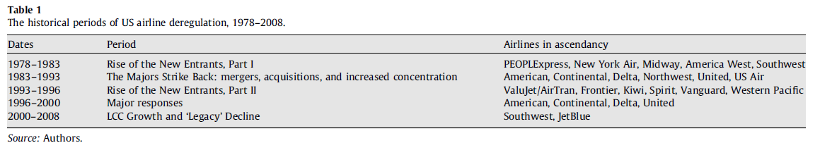
History

Slide 32
Assessment
Many experts claim the deregulation is a big success in terms of fares and ridership
Others expressed concern regarding concentration, profitability and pockets of pains
What is the fair assessment of the results of US airline deregulation?

Slide 33
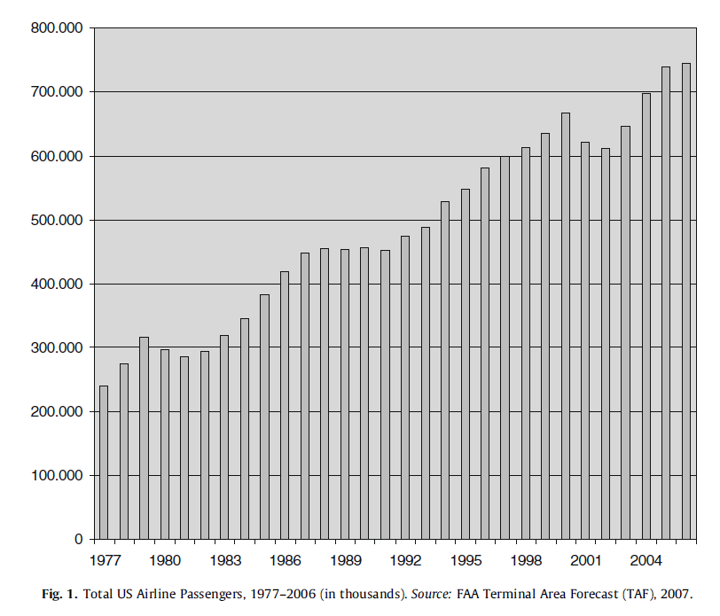
Ridership

Slide 34
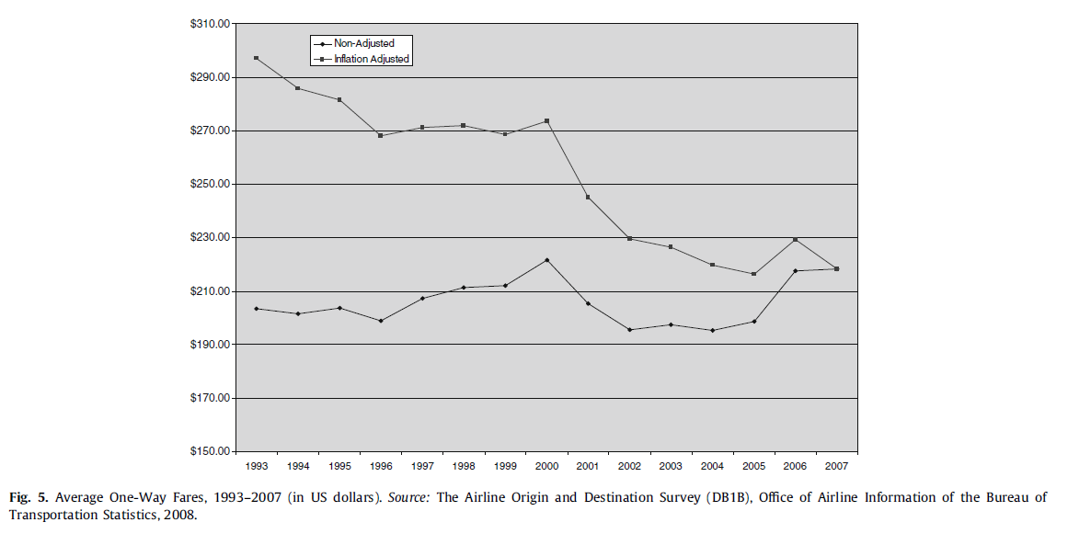
Fares

Slide 35
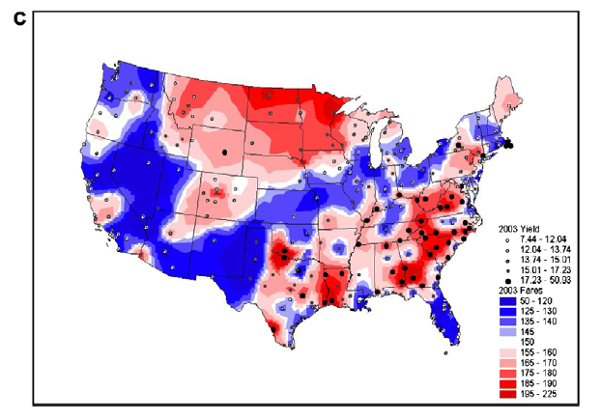
Fare distribution

Slide 36
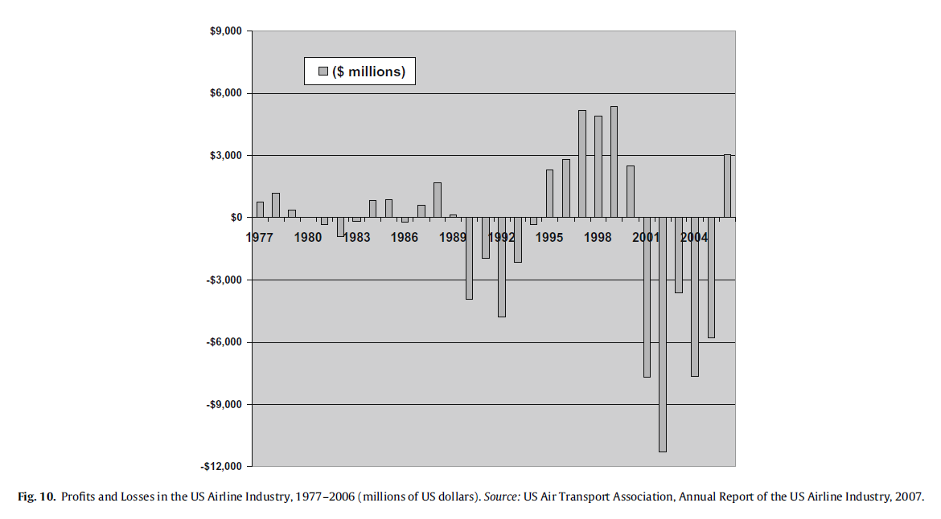
Profitability

Slide 37
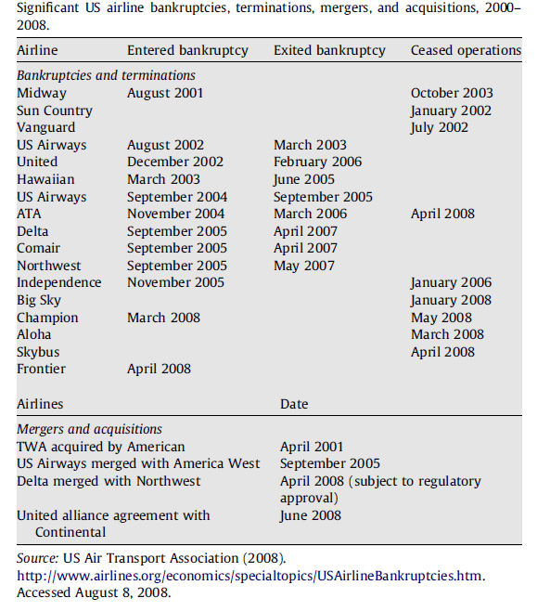
Bankruptcies

Slide 38
Conclusions
Good → fares, services, ridership
Bad → uneven distribution of results
Ugly → financial and employment instability

Slide 39
9.5 Regulation of the infrastructure provider. Case study: Railtrack

Slide 40
Case: Regulation of the British railway industry
1945 - 1994 – British Rail. Vertically and horizontally integrated single nationalized operator in the UK.
1994 - 1997 – British railway reform. British Rail divided into 104 separate companies with the main purpose to introduce competition at all levels of railway operation (train operating companies, rolling stock leasing companies, infrastructure maintenance and renewal companies).
The majority of these companies were privatized

Slide 41
British infrastructure provider
The one exception was the infrastructure provider, where it was considered that the advantages of having a single national network operator significantly outweighed the drawbacks of splitting the network up into separate geographical areas.
This therefore left a monopoly provider of the infrastructure throughout the country
This was organized into a company called Railtrack which was floated on the stock exchange
All infrastructure access charges were to be at full cost
As a result, the firm would return a profit and receive no direct subsidy except to assist the funding of railway investment
The strong regulation was introduced to prevent the abuse of monopoly power

Slide 42
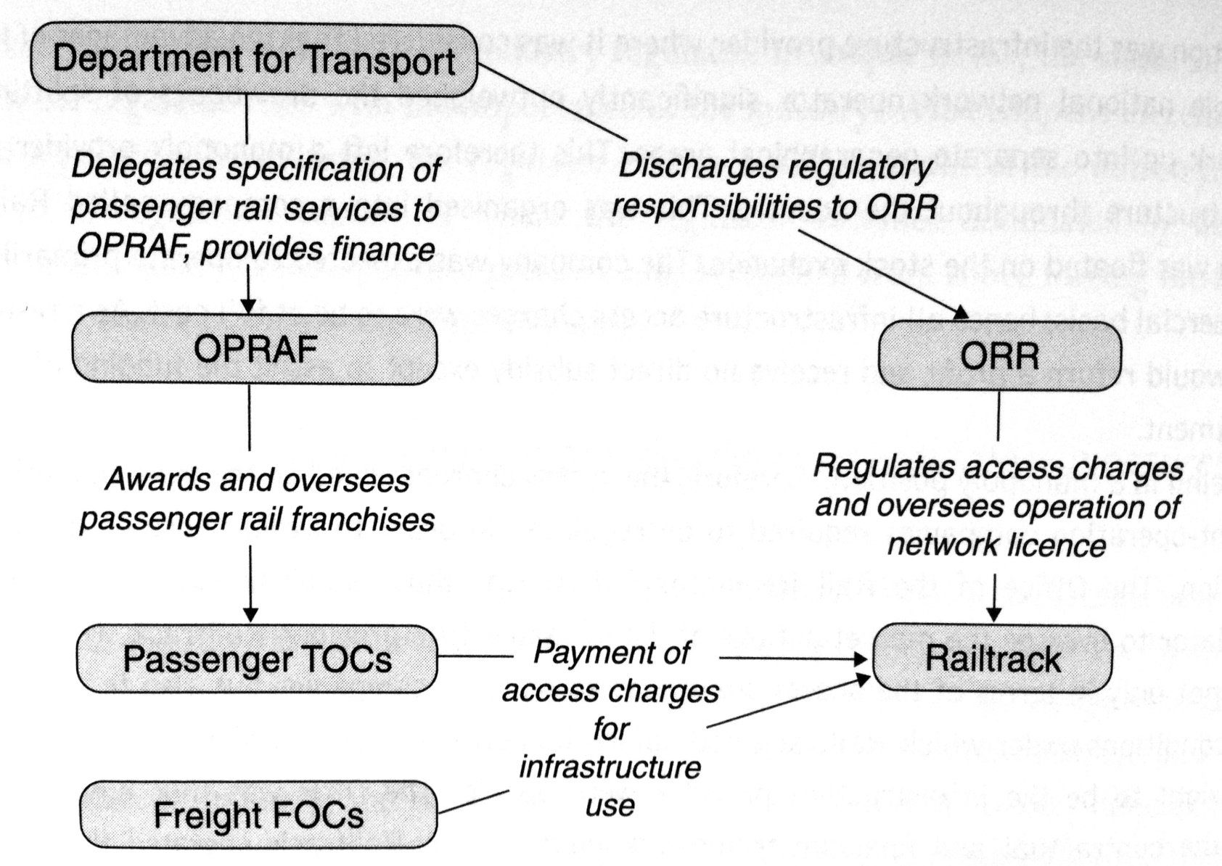
British rail industry regulatory structure 1997 - 2001

Slide 43
What went wrong?
Railtrack investment needs, costs overruns on the major infrastructure projects
Railtrack had effectively very little control over its own costs; loss of engineering expertise
Broken rail at Hatfield (October 2000), resulting in a train derailment and four fatalities. Railtrack panicked and overreacted imposing severe speed limits on the network leading to widespread delays and chaos (2000 – 2001).
Under the terms of track access agreements, Railtrack had to pay more than 500m GBP to train operating companies as a result of the disruption caused.
This combined with major cost overruns led to bankruptcy of Railtrack in October 2001 and it was replaced by non-profit organization Network Rail.

Slide 44
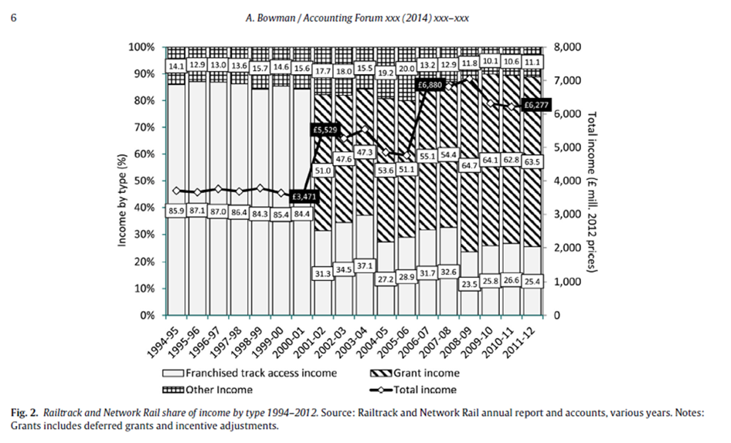
British rail infrastructure provider – results

Slide 45
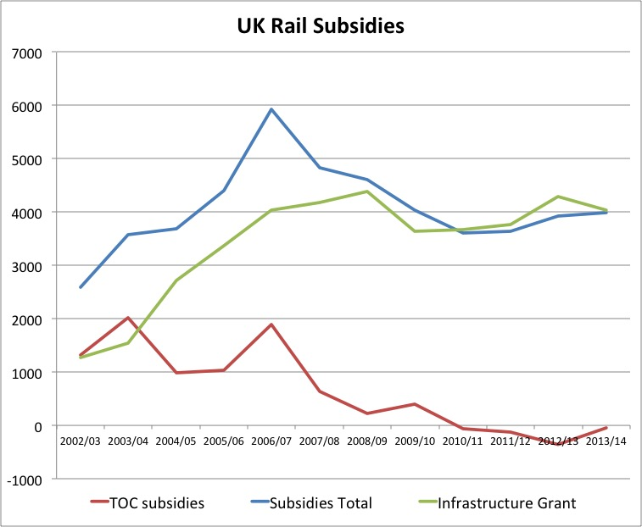
Exercise: UK rail reform (again :-)
In the following graph you can observe the development of subsidies into British railway sector. How would you interpret it? One of crucial goals of British railway reform was to decrease rail subsidies. Was the reform successful in this respect?

Slide 46
9.6 Summary

Slide 47
Summary
There is a balance between the issues of regulation and ownership
The experiment with private ownership of rail infrastructure in Britain went wrong
Subsidy plays a vital role in the operation of transport markets

Slide 48
Readings for Lecture 10
Alexandersson, G., & Hultén, S. (2006). Predatory bidding in competitive tenders: A Swedish case study. European Journal of Law and Economics, 22(1), 73-94.

