Slide 1
Auditing – Lecture 6
Part II. Audit process by phase: Phase III. Testing

Slide 2
Content
Review process
Analytical procedures
Evidence (sampling)
Recommended reading
Appendices: ISA 500, 501, 505, 520, 530, 540

Slide 3
Review process*
Review process – the process of planning, executing, and drawing conclusions from analytical procedures. There are several views of the subprocesses (phases) involved in analytical review:
Expectation - phase one of the analytical review process when the auditor develops expectations of what amounts should appear in financial statement account balances based on prior year financial statements, budgets, industry information and non-financial information. Expectations are the auditor’s estimations of recorded accounts or ratios. The auditor develops his expectation in such a way that a significant difference between it and the recorded amount will indicate a misstatement.
Forming an expectation is the most important phase of the analytical procedure process. The closer the auditor’s expectation is to the correct balance or relationship, the more effective the procedure will be at identifying potential misstatements. Expectations are formed from a variety of sources. The use of industrial, economic, or environmental
Notes:
*See Appendix: ISA 520

Slide 4
Review process*
data can improve the predictive ability of analytical procedures. Other resources include industry data, data about similar businesses, and auditor experience. Expectations are also based on the entities prior financial statements, same store sales, non-financial data, budgets and public reports.
Identification - phase two of the analytical review process when the auditor compares his expected value with the recorded amount. Audit efficiency and effectiveness depend on competency in recognizing error patterns in financial data and in hypothesizing likely causes of those patterns to serve as a guide for further testing.
The auditor must consider how large a difference between expected value and recorded amount he will accept. In other words, at what point is the difference material (e.g. if the difference is 20 percent)? This point could be called a materiality threshold. In substantive testing, an auditor testing for the possible misstatement of the book value of an account determines whether the audit difference was less than the auditor’s materiality threshold. If the difference is less than
Notes:
*See Appendix: ISA 520

Slide 5
Review process*
acceptable threshold, the auditor accepts the book value without further investigation. If the difference is greater, the next step is to investigate the difference.
Investigation - phase three of the analytical review process when the auditor undertakes an investigation of possible explanations for the expected-recorded amount difference. The difference between an auditor’s expectation and the recorded book value of an account not subject to auditing procedures can be due to misstatements, inherent factors that affect the account being audited, and factors related to the reliability of data used to develop the expectation.
The greater the precision of the expectation, the more likely the difference between the auditor’s expectation and the recorded value will be due to misstatements. Conversely, the less precise the expectation, the more likely the difference is due to factors related to inherent factors, and the reliability of data used to develop the expectation.
Where differences between expectation and recorded amounts
Notes:
*See Appendix: ISA 520

Slide 6
Review process*
are found, the first step is usually to ask management for an explanation. However, it is important that the auditor maintains his professional skepticism when considering these answers and it is suggested that the auditor conduct other audit procedures to corroborate them.
Evaluation - final phase (phase four) of the analytical review process, which involves evaluating the impact on the financial statements of the difference between the auditor’s expected value and the recorded amount. It is usually not practical to identify factors that explain the exact amount of a difference investigated. The auditor attempts to quantify that portion of the difference for which plausible explanations can be obtained and, where appropriate, corroborated. If the amount that cannot be explained is sufficiently small, the auditor may conclude there is no material misstatement.
Notes:
*See Appendix: ISA 520

Slide 7
Review process*
Formulating expectations - expectations are developed by identifying plausible relationships that are reasonably expected to exist based on the auditor’s understanding of the client and of his industry. These relationships may be determined by comparisons with the following sources:
comparable information for prior periods;
anticipated results (such as budgets and forecasts, or auditor expectations);
similar industry information;
non-financial information.
Sources of information and precision of expectations - the source of information on which the expectations are based determines, in part, the precision with which the auditor predicts an account balance. For example, information from other, similar stores in the same retail chain is more precise than general industry information. Recent years’ financial statements are more precise a predictor of this year’s balance than older financial
Notes:
*See Appendix: ISA 500, 501, 540
The auditor can identify account balances that have changed significantly simply by comparing the current client data with prior period data. He may compare the current year’s account balances with that of the preceding year; the current trial balance with similar detail for the preceding year; and ratios and percentage relationships between years. He compares current recorded account balances of the entity with results expected by the entity. For example, company budgets may be compared with actual results for indications of potential misstatements or the auditor calculates the expected balance for interest expense (notes payable monthly balance times average monthly interest rate) and compares this to recorded interest rates.
One of the standard bases of comparison is with like companies in the same industry. For example, the auditor compares the gross margin of the industry to the client’s gross margin.
Analytical procedures may include consideration of relationships between financial information and relevant non-financial information, such as payroll costs to number of employees. Another example is the revenue of a hotel may be estimated by multiplying the average room rate times the number of rooms times the average occupancy percentage (e.g. $100 average rate " 20 rooms " 60 percent average occupancy). Similarly revenues may be calculated for school tuition (average number of students enrolled times the average tuition cost), payroll, and cost of materials sold using non-financial factors.

Slide 8
Review process*
statements. The desired precision of the expectation varies according to the purpose of the analytical procedure. Precision is more important for analytical procedures used as substantive tests than for those used in planning.
Nature of account and characteristics of data - the more reliable the source of the data, the more precise the expectation will be. Reliability of data is determined by:
Effectiveness - is a function of the nature of the account and the reliability and other characteristics of the data. In determining the nature of the account the auditor considers whether the balance is based on estimates or accumulations of transactions, the number of transactions represented by the balance, and the control environment. Subjectively determined balances are more easily manipulated than accumulations of transactions. If the characteristic of the account is that it comprises millions of transactions (e.g. retail revenue, it should be more predictable than those comprising a few transactions
Notes:
*See Appendix: ISA 500, 501, 540

Slide 9
Review process*
(e.g. obsolete inventory). Fixed expenses (e.g. leases) are more predictable than variable expenses (e.g. shipping).
Aggregation – is the level of detail on which the auditor is able to base his expectation and the reliability of the data are key characteristics. In general, the more disaggregated the data, the more precise the expectation. For example, the use of monthly instead of annual data tends to improve the precision of the expectation. Preparing an expectation by division is also more precise than an expectation based on consolidated data. Accounting researchers conclude that disaggregated monthly, segment, or product line balances are required to implement reliable attention-directing analytical procedures.
Notes:
*See Appendix: ISA 500, 501, 540

Slide 10
Analytical procedures*
Analytical procedures (AP) are defined by US GAAS and ISA as evaluations of financial information made by a study of plausible relationships among financial and nonfinancial data involving comparisons of recorded amounts to expectations developed by the auditor. Analytical procedures use comparisons and relationships to assess whether account balances or other data appear reasonable relative to the auditor’s expectations.
Types of AP:
General AP - trend analysis, ratio analysis, regression and statistical analysis, and reasonableness tests. Determining which type of analytical procedure is appropriate is a matter of professional judgment. A review of audit practice indicates that simple judgmental approaches (such as comparison and ratio analysis) are used more frequently than complex statistical approaches (such as time series modeling or regression analysis). These tests are generally carried out using computer software (i.e. CAATs).
Trend analysis - is the analysis of changes in
Notes:
*See Appendix: ISA 520

Slide 11
Analytical procedures*
an account balance or ratio over time. Trend analysis could compare last year’s account balance to the current unaudited balance or balances in many time periods. Trend analysis works best when the account or relationship is fairly predictable (e.g. rent expense in a stable environment). It is less effective when the audited entity has experienced significant operating or accounting changes. The number of years used in the trend analysis is a function of the stability of operations. The more stable the operations over time, the more predictable the relations and the more appropriate the use of multiple time periods. Trend analysis at an aggregate level (e.g. on a consolidated basis) is relatively imprecise because a material misstatement is often small relative to the aggregate account balance. The most precise trend analysis would be on disaggregated data (e.g. by segment, product, or location, and monthly or quarterly rather than on an annual basis).
Notes:
*See Appendix: ISA 520

Slide 12
Analytical procedures*
Ratio analysis - is the comparison of relationships between financial statement accounts, the comparison of an account with non-financial data, or the comparison of relationships between firms in an industry. Ratio analysis is most appropriate when the relationship between accounts is fairly predictable and stable (e.g. the relationship between sales and accounts receivable). Ratio analysis can be more effective than trend analysis because comparisons between the balance sheet and income statement can often reveal unusual fluctuations that an analysis of the individual accounts would not. Like trend analysis, ratio analysis at an aggregate level is relatively imprecise because a material misstatement is often small relative to the natural variations in the ratios.
There are five types of ratio analysis used in analytical procedures: (1) ratios that compare client and industry data; (2) ratios that compare client data with similar prior period data; (3) ratios that compare client data with
When to use AP – timing
CAAT
Types of AP
General AP
AP by phase
AP – special (substantive tests)
AP – Data mining and GAS
Notes:
*See Appendix: ISA 520

Slide 13
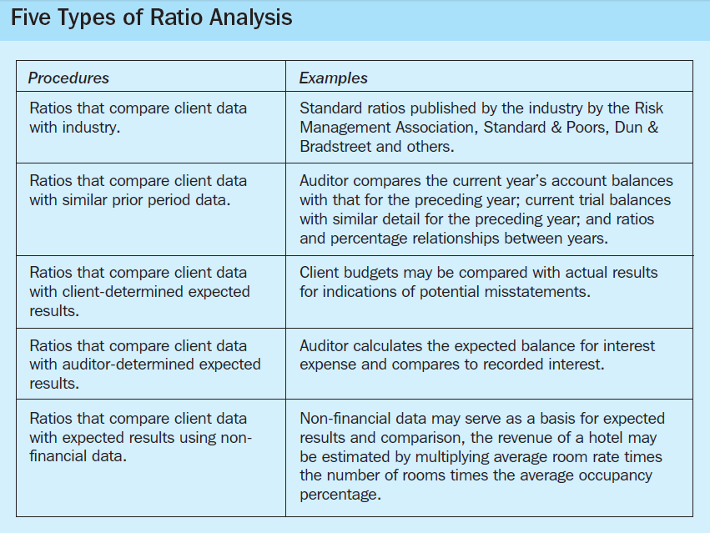
Analytical procedures*
client-determined expected results; (4) ratios that compare client data with auditor-determined expected results; (5) ratios that compare client data with expected results using non-financial data.
Notes:
*See Appendix: ISA 520

Slide 14
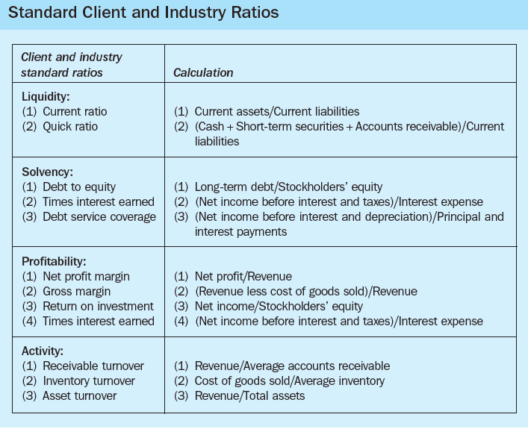
Analytical procedures*
Notes:
*See Appendix: ISA 520

Slide 15
Analytical procedures*
Reasonableness testing - is the analysis of account balances or changes in account balances within an accounting period in terms of their “reasonableness” in light of expected relationships between accounts. This involves the development of an expectation based on financial data, non-financial data, or both. For example, using the number of employees hired and terminated, the timing of pay changes, and the effect of vacation and sick days, the model could predict the change in payroll expense from the previous year to the current balance within a fairly narrow dollar range.
In contrast to both trend and ratio analyses (which implicitly assume stable relationships), reasonableness tests use information to develop an explicit prediction of the account balance. The auditor develops assumptions for each of the key factors to estimate the account balance. Considering the number of units sold, the unit price by product line, different pricing structures, and an understanding of industry trends during the period
Notes:
*See Appendix: ISA 520

Slide 16
Analytical procedures*
could explicitly form a reasonableness test for sales. This is in contrast to an implicit trend expectation for sales based on last year’s sales. The latter expectation is appropriate only if there were no other factors affecting sales during the current year, which is not the usual situation.
Trend analysis, ratio analysis, and reasonableness tests compared – differ as to the number of independent predictive variables considered, use of external data, and statistical precision. Trend analysis is limited to a single predictor, that is, the prior periods’ data for that account. Trend analysis, by relying on a single predictor, does not allow the use of potentially relevant operating data, as do the other types of procedures. Because ratio analysis employs two or more related financial or non-financial sources of information, the result is a more precise expectation. Reasonableness tests and regression analysis further improve the precision of the expectation by allowing potentially as many variables (financial and non-financial)
Notes:
*See Appendix: ISA 520

Slide 17
Analytical procedures*
as are relevant for forming the expectation. Reasonableness tests and regression analysis are able to use external data (e.g. general economic and industry data) directly in forming the expectation. The most statistically precise expectations are formed using statistical and data mining analysis.
AP by phase - AP are used: (a) to assist the auditor in planning the nature, timing, and extent of audit procedures; (b) as substantive procedures; and (c) as an overall review of the financial statements in the final stage of the audit. The auditor is required to apply analytical procedures at the planning and overall review stages of the audit.
Planning - AP performed in the planning stage are used to identify unusual changes in the financial statements, or the absence of expected changes, and specific risks. During the planning stage, analytical procedures are usually focused on account balances aggregated at the financial statement level and
Notes:
*See Appendix: ISA 520

Slide 18
Analytical procedures*
relationships between account balances. The auditor should apply analytical procedures at the planning stage to assist in understanding the business and in identifying areas of potential risk.
Substantive testing - During the substantive testing stage (phase III of the audit process), analytical procedures are performed to obtain assurance that financial statement account balances do not contain material misstatements. In substantive testing, analytical procedures focus on underlying factors that affect those account balances through the development of an expectation of how the recorded balance should look.
Overall review - AP performed during the overall review stage (phase IV of the audit process) are designed to assist the auditor in assessing that all significant fluctuations and other unusual items have been adequately explained and that the overall financial statement presentation makes sense based on
Notes:
*See Appendix: ISA 520

Slide 19
Analytical procedures*
the audit results and an understanding of the business. The auditor should apply analytical procedures at or near the end of the audit when forming an overall conclusion as to whether the financial statements as a whole are consistent with the auditor’s knowledge of the business. Moreover, they assist in determining the reasonableness of the financial statements. They may also identify areas requiring further procedures.
Special AP (substantive tests - ST) - substantive procedures in the audit are designed to test for dollar misstatements (often called monetary misstatements) that directly affect the correctness of financial statement balances. Auditors rely on three types of substantive tests: substantive tests of transactions, substantive analytical procedures, and tests of details of balances.
Tests of details vs substantive AP – tests of details include agreeing the financial statements to the accounting records, examining material adjustments made during the course of preparing the financial
Notes:
*See Appendix: ISA 520

Slide 20
Analytical procedures*
statements, and other procedures relating to the financial reporting closing process. Substantive AP are generally more applicable to large volumes of transactions that tend to be predictable over time. Tests of details are ordinarily more appropriate to obtain audit evidence regarding certain financial statement assertions, including existence and valuation.
Timing of ST – there are several considerations in determining the timing of substantive procedures. In some instances, primarily as a practical matter, substantive procedures may be performed at an interim date. Only using interim testing procedures will increases the risk that misstatements existing at the period end will not be detected. That risk increases the longer the time between interim and period end.
Extent of ST – the greater the risk of material misstatement, the greater the extent of substantive procedures. In planning tests of details of transactions or balances, the extent of testing is ordinarily thought of in
Notes:
*See Appendix: ISA 520

Slide 21
Analytical procedures*
terms of the sample size, which is affected by the risk of material misstatement. The use of CAATs (i.e. computer assisted audit techniques) may enable more extensive testing of electronic transactions and files. For example, in performing audit procedures, such techniques may be used to test an entire population instead of a sample. Because the risk of material misstatement takes account of internal control, the extent of substantive procedures may be reduced if tests of control show that controls are adequate.
Types of ST:
Tests of transactions - they are used to determine whether all six transaction related audit objectives have been satisfied for each class of transactions. When auditors are confident that all transactions were correctly recorded in the journals and correctly posted, considering all six transaction-related audit objectives, they can be confident that general ledger totals are correct.
Notes:
*See Appendix: ISA 520

Slide 22
Analytical procedures*
Tests of details of balances – focus on the ending general ledger balances for both balance sheet and income statement accounts. The primary emphasis in most tests of details of balances is on the balance sheet. Examples include confirmation of customer balances for accounts receivable, physical examination of inventory, and examination of vendors’ statements for accounts payable.
Tests of ending balances are essential because the evidence is usually obtained from a source independent of the client, which is considered highly reliable. Much like for transactions, the auditor’s tests of details of balances must satisfy all balance-related audit objectives for each significant balance sheet account.
Notes:
*See Appendix: ISA 520

Slide 23
Analytical procedures*
CAAT and data mining for AP - the use of computer assisted audit techniques (CAATs) may enable more extensive testing of electronic transactions and account files. CAATs can be used to select sample transactions from key electronic files, to sort transactions with specific characteristics, or to test an entire population instead of a sample. CAATs generally include regression and statistical analysis as well as the more widely used file interrogation techniques using generalized audit software (GAS) such as data manipulation, calculation, data selection, data analysis, identification of exceptions and unusual transactions.
Regression and statistical analysis – it is the use of statistical models to quantify the auditor’s expectation in financial (euro, dollar) terms, with measurable risk and precision levels. For example, an expectation for sales may be developed based on management’s sales forecast, commission expense, and changes in advertising expenditures.
Notes:
*See Appendix: ISA 520

Slide 24
Analytical procedures*
Regression analysis provides a very high level of precision because an explicit expectation is formed in which all relevant data can be incorporated in a model to predict current year sales.
Generalized audit software (GAS) packages - contain numerous computer-assisted audit techniques for both doing analytical procedures and statistical sampling bundled into one piece of software. There are widely used GAS packages such as ACL and Idea, and the Big Four audit firms have their own software such as Deloitte and Touche’s STAR and MINI MAX. GAS packages provide the auditors with the ability to access, manipulate, manage, analyze, and report data in a variety of formats. This software allows the auditor to move from analytical procedures to statistical sampling for analytical procedures fairly easily.
Data mining techniques - data mining is a set of computer-assisted techniques that use sophisticated statistical
Notes:
*See Appendix: ISA 520

Slide 25
Analytical procedures*
analysis including artificial intelligence techniques, to examine large volumes of data with the objective of indicating hidden or unexpected information or patterns. In database terms, data mining is referred to as knowledge discovery in databases (KDD). Data mining can be used in all types of databases or other information repositories. Data to be mined can be numerical data, textual data or even graphics and audit.
GAS’s capability to assist in the overall audit process while requiring little technical skill is a major reason for its success. However, GAS has been criticized because it makes some tasks easier but it cannot complete any data analysis by itself. Data mining, on the other hand, analyzes data automatically but is more difficult to employ.
Notes:
*See Appendix: ISA 520
GAS vs Data mining
GAS’s capability to assist in the overall audit process while requiring little technical skill is a major reason for its success. However, GAS has been criticized because it makes some tasks easier but it cannot complete any data analysis by itself. Data mining, on the other hand, analyzes data automatically but is more difficult to employ.
Data mining tools remain promising in a variety of application areas. With the development of appropriate data mining tools for the auditing profession, it may be expected to replace some professional expertise required in certain auditing processes. For now, although data mining procedures are useful in almost all steps of the audit process, its most practical and useful applications are in analytical procedures. Data mining may use many methods and techniques and algorithms to analyze client data. Data mining methods include data description, dependency analysis, classification and prediction, cluster analysis, outlier analysis and evolution analysis The most frequently used algorithms are decision trees, apriori algorithms, and neural networks. The purpose of dependency analysis is to search for the most significant relationship across large number of variables or attributes. Classification is the process of finding models, also known as classifiers, or functions that map records into one of several discrete prescribed classes.
The objective of data description is to provide an overall description of data, either in itself or in each class or concept. There are two main approaches in obtaining data description – data characterization and data discrimination. Data characterization is summarizing general characteristics of data and data discrimination, also called data comparison, by comparing characters of data between contrasting groups or classes. The objective of evolution analysis is to determine the most significant changes in data sets over time. In other words, it is other types of algorithm methods (i.e. data description, dependency analysis, classification or clustering) plus time-related and sequence-related characteristics.
The objective of cluster analysis is to separate data with similar characteristics from the dissimilar ones. The difference between clustering and classification is that while clustering does not require pre-identified class labels, classification does. Outliers are data items that are distinctly dissimilar to others and can be viewed as noises or errors. However, such noises can be useful in some cases, such as fraud detection, where unusual items or exceptions are major concerns.
An example of the use of the clustering method is when the auditor clusters accounting transactions in such categories as assets, liabilities, revenue, expenses, etc. This might reveal those small transactions that occur repeatedly in a certain period of the month or the same transactions recorded in different account numbers. The auditor might find that sales in some months or divisions are excessively higher or lower than the normal. Expenses that are highly variable during the year might be found. Clustering might show the repeated purchase of the same fixed asset. Loans that are transacted between related companies and subsidiaries may be uncovered.

Slide 26
Audit evidence (sampling)*
Evidence can be defined as any information used by the auditor to determine whether the information being audited is stated in accordance with the established criteria. The information varies greatly in the extent to which it persuades the auditor whether financial statements are fairly stated. Evidence includes information that is highly persuasive, such as the auditor’s count of marketable securities, and less persuasive information, such as responses to questions of client employees. The use of evidence is not unique to auditors. Evidence is also used extensively by scientists, lawyers, and historians. In scientific experiments, researchers obtain evidence to test hypotheses using controlled experiments, such as a drug trial to test the effectiveness of a new medical treatment. Similarly, gathering evidence is a large part of what auditors do. Although these professionals rely on different types of evidence, and use evidence in different settings and in different ways, lawyers, scientists, and auditors all use evidence to help them draw conclusions.
Notes:
*See Appendix: ISA 530

Slide 27
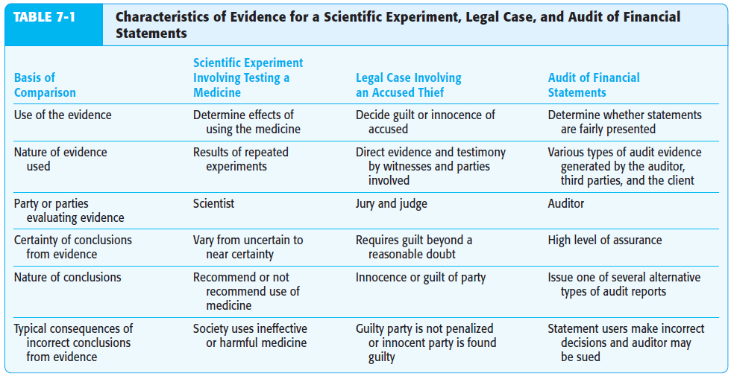
Audit evidence (sampling)*
Notes:
*See Appendix: ISA 530

Slide 28
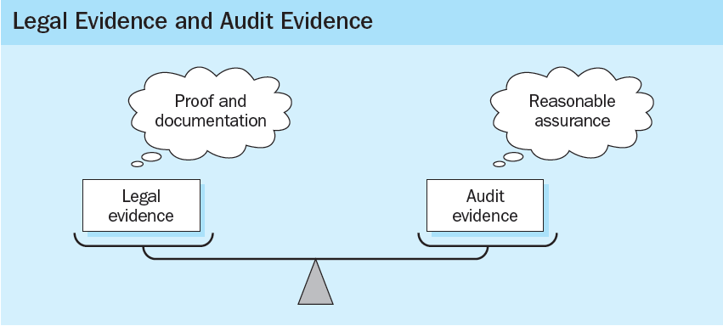
Audit evidence (sampling)*
Basis of evidence - evidence for proof of audit assertions is different from evidence in a legal sense. Audit evidence needs only to prove reasonable assurance, whereas in a legal environment there is a more rigorous standard of proof and documentation.
Notes:
*See Appendix: ISA 530

Slide 29
Audit evidence (sampling)*
Documentary evidence - is gathered from written, printed or electronic sources. Documentary evidence consists of computer files and records, e-mail, accounting records, paper (invoices, writings, pictures), documents (contracts, deed, reports), commercial records (e.g. from banks, brokerage, retailers, credit card) and government records (licenses, real estate, legal). The best proof of the contents of a document is the original document itself. However, if the original has been destroyed or is otherwise unavailable and the court accepts the explanation of its unavailability, secondary evidence may be used. Secondary evidence may a copy of the evidence.
Electronic evidence - some of the entity’s accounting data and other information may be available only in electronic form. For example, entities may use electronic data interchange (EDI) or image processing systems. In EDI, the entity and its customers or suppliers use communication links to transact business electronically. In image processing
Notes:
*See Appendix: ISA 530

Slide 30
Audit evidence (sampling)*
systems, documents are scanned and converted into electronic images to facilitate storage and reference, and the source documents may not be retained after conversion. Certain electronic information may exist at a certain point in time, but may not be retrievable after a specified period of time if files are changed and if back-up files do not exist. The electronic nature of the accounting documentation usually requires that the auditor use computer-assisted audit techniques (CAATs).
Notes:
*See Appendix: ISA 530

Slide 31
Audit evidence (sampling)*
Pervasiveness of audit evidence - Audit standards require the auditor to accumulate sufficient appropriate evidence to support the opinion issued. Because of the nature of audit evidence and the cost considerations of doing an audit, it is unlikely that the auditor will be completely convinced that the opinion is correct. However, the auditor must be persuaded that the opinion is correct with a high level of assurance. By combining all evidence from the entire audit, the auditor is able to decide when he or she is persuaded to issue an audit report. The two determinants of the persuasiveness of evidence are appropriateness and sufficiency.
Appropriateness - is a measure of the quality of evidence, meaning its relevance and reliability in meeting audit objectives for classes of transactions, account balances, and related disclosures. Note that appropriateness of evidence deals only with the audit procedures selected. Appropriateness cannot be improved by selecting a larger sample size or different population items. It can be improved only by selecting audit procedures that are
Notes:
*See Appendix: ISA 530

Slide 32
Audit evidence (sampling)*
more relevant or provide more reliable evidence.
Relevance of evidence - evidence must pertain to or be relevant to the audit objective that the auditor is testing before it can be appropriate. For example, assume that the auditor is concerned that a client is failing to bill customers for shipments (completeness transaction objective). If the auditor selects a sample of duplicate sales invoices and traces each to related shipping documents, the evidence is not relevant for the completeness objective and therefore is not appropriate evidence for that objective. A relevant procedure is to trace a sample of shipping documents to related duplicate sales invoices to determine whether each shipment was billed. The second audit procedure is relevant because the shipment of goods is the normal criterion used for determining whether a sale has occurred and should have been billed. By tracing from shipping documents to duplicate sales invoices, the auditor can determine whether shipments have been billed to
Notes:
*See Appendix: ISA 530

Slide 33
Audit evidence (sampling)*
customers. In the first procedure, when the auditor traces from duplicate sales invoices to shipping documents, it is impossible to find unbilled shipments.
Relevance can be considered only in terms of specific audit objectives, because evidence may be relevant for one audit objective but not for a different one. In the previous shipping example, when the auditor traced from the duplicate sales invoices to related shipping documents, the evidence was relevant for the occurrence transaction objective. Most evidence is relevant for more than one, but not all, audit objectives.
Reliability of evidence - refers to the degree to which evidence can be believable or worthy of trust. Like relevance, if evidence is considered reliable it is a great help in persuading the auditor that financial statements are fairly stated. For example, if an auditor counts inventory, that evidence is more reliable than if management gives the auditor its own count amounts.
Notes:
*See Appendix: ISA 530

Slide 34
Audit evidence (sampling)*
Reliability, and therefore appropriateness, depends on the following six characteristics:
Independence of provider - evidence obtained from a source outside the entity is more reliable than that obtained from within. Communications from banks, attorneys, or customers is generally considered more reliable than answers obtained from inquiries of the client. Similarly, documents that originate from outside the client’s organization, such as an insurance policy, are considered more reliable than are those that originate within the company and have never left the client’s organization, such as a purchase requisition.
Effectiveness of client’s internal controls - when a client’s internal controls are effective, evidence obtained is more reliable than when they are weak.
Auditor’s direct knowledge - evidence obtained directly by the auditor through physical
Notes:
*See Appendix: ISA 530

Slide 35
Audit evidence (sampling)*
examination, observation, recalculation, and inspection is more reliable than information obtained indirectly.
Qualifications of individuals providing the information - although the source of information is independent, the evidence will not be reliable unless the individual providing it is qualified to do so. Therefore, communications from attorneys and bank confirmations are typically more highly regarded than accounts receivable confirmations from persons not familiar with the business world. Also, evidence obtained directly by the auditor may not be reliable if the auditor lacks the qualifications to evaluate the evidence. For example, examining an inventory of diamonds by an auditor not trained to distinguish between diamonds and glass is not reliable evidence for the existence of diamonds.
Degree of objectivity - objective evidence is more reliable than evidence that requires considerable
Notes:
*See Appendix: ISA 530

Slide 36
Audit evidence (sampling)*
judgment to determine whether it is correct. Examples of objective evidence include confirmation of accounts receivable and bank balances, the physical count of securities and cash etc. Examples of subjective evidence include a letter written by a client’s attorney discussing the likely outcome of outstanding lawsuits against the client, observation of obsolescence of inventory during physical examination etc.
Timeliness - can refer either to when it is accumulated or to the period covered by the audit. Evidence is usually more reliable for balance sheet accounts when it is obtained as close to the balance sheet date as possible. For example, the auditor’s count of marketable securities on the balance sheet date is more reliable than a count 2 months earlier. For income statement accounts, evidence is more reliable if there is a sample from the entire period under audit.
Notes:
*See Appendix: ISA 530

Slide 37
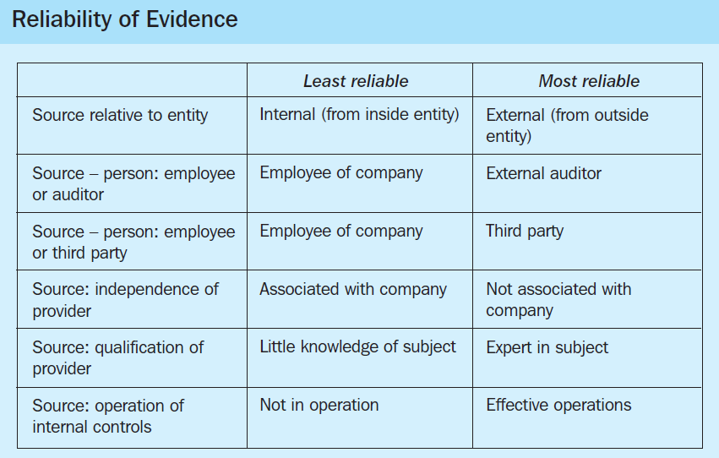
Audit evidence (sampling)*
Notes:
*See Appendix: ISA 530

Slide 38
Audit evidence (sampling)*
Sufficiency - is measured primarily by the sample size the auditor selects. For a given audit procedure, the evidence obtained from a sample of 100 is ordinarily more sufficient than from a sample of 50. Several factors determine the appropriate sample size in audits. The two most important ones are the auditor’s expectation of misstatements and the effectiveness of the client’s internal controls.
In addition to sample size, the individual items tested affect the sufficiency of evidence. Samples containing population items with large dollar values, items with a high likelihood of misstatement, and items that are representative of the population are usually considered sufficient. In contrast, most auditors usually consider samples insufficient that contain only the largest dollar items from the population unless these items make up a large portion of the total population amount.
Combined effect - the persuasiveness of evidence can be evaluated only after considering the combination of appropriateness and sufficiency, including the effects of the
Notes:
*See Appendix: ISA 530

Slide 39
Audit evidence (sampling)*
factors influencing appropriateness and sufficiency. A large sample of evidence provided by an independent party is not persuasive unless it is relevant to the audit objective being tested. A large sample of evidence that is relevant but not objective is also not persuasive. Similarly, a small sample of only one or two pieces of highly appropriate evidence also typically lacks persuasiveness. When determining the persuasiveness of evidence, the auditor must evaluate the degree to which both appropriateness and sufficiency, including all factors influencing them, have been met.
Pervasiveness and cost – in making decisions about evidence for a given audit, both persuasiveness and cost must be considered. It is rare when only one type of evidence is available for verifying information. The persuasiveness and cost of all alternatives should be considered before selecting the best type or types of evidence. The auditor’s goal is to obtain a sufficient amount of appropriate evidence at the lowest possible total cost.
Notes:
*See Appendix: ISA 530

Slide 40
Audit evidence (sampling)*
Audit evidence decisions – design of the sample:
Sample size – when selecting and designing audit procedures, the auditor should determine appropriate means of selecting items for testing. The means available to the auditor are: (1) selecting all items (100% examination); (2) selecting specific items; and (3) audit sampling. The decision as to which approach to use will depend on the circumstances. While the decision as to which means, or combination of means, to use is made on the basis of audit risk and audit efficiency, the auditor needs to be satisfied that methods used are effective in providing sufficient appropriate audit evidence to meet the objectives of the test.
Timing - an audit of financial statements usually covers a period such as a year. Normally an audit is not completed until several weeks or months after the end of the period. The timing of audit procedures can therefore vary from early in the accounting period to long after it has ended. In part,
Notes:
*See Appendix: ISA 530
Selecting of items:
Selecting all items - The auditor may decide that it will be most appropriate to examine the entire population of items that make up an account balance or class of transactions (or a stratum within that population). 100% examination is unlikely in the case of tests of control; however, it is more common for substantive procedures. For example, 100% examination may be appropriate when the population constitutes a small number of large value items, when both inherent and control risks are high and other means do not provide sufficient appropriate audit evidence, or when the repetitive nature of a calculation or other process performed by a computer information system makes a 100% examination cost effective.
Selecting Specific Items - The auditor may decide to select specific items from a population based on such factors as knowledge of the client’s business, preliminary assessments of inherent and control risks, and the characteristics of the population being tested. The judgmental selection of specific items is subject to non-sampling risk. Specific items selected may include:
High value or key items. The auditor may decide to select specific items within a population because they are of high value, or exhibit some other characteristic, for example items that are suspicious, unusual, particularly risk-prone or that have a history of error.
All items over a certain amount. The auditor may decide to examine items whose values exceed a certain amount so as to verify a large proportion of the total amount of an account balance or class of transactions.
Items to obtain information. The auditor may examine items to obtain information about matters such as the client’s business, the nature of transactions, accounting and internal control systems.
Items to test procedures. The auditor may use judgment to select and examine specific items to determine whether or not a particular procedure is being performed.

Slide 41
Audit evidence (sampling)*
the timing decision is affected by when the client needs the audit to be completed. In the audit of financial statements, the client normally wants the audit completed 1 to 3 months after year-end. The SEC currently requires that all public companies file audited financial statements with the SEC within 60 to 90 days of the company’s fiscal year-end, depending on the company’s size. However, timing is also influenced by when the auditor believes the audit evidence will be most effective and when audit staff is available. For example, auditors often prefer to do counts of inventory as close to the balance sheet date as possible.
Approaches to sampling - the decision whether to use a statistical or non-statistical sampling approach is a matter for the auditor’s judgment regarding the most efficient manner to obtain sufficient appropriate audit evidence in the particular circumstances. For example, in the case of tests of control the auditor’s analysis of the nature and cause of errors will often be more important than the statistical analysis of the mere presence or absence (that is, the count) of errors.
Notes:
*See Appendix: ISA 530

Slide 42
Audit evidence (sampling)*
Selecting the sample - the auditor should select items for the sample with the expectation that all sampling units in the population have a chance of selection. Statistical sampling requires that sample items are selected at random so that each sampling unit has a known chance of being selected. The sampling units might be physical items (such as invoices) or monetary units. With non-statistical sampling, an auditor uses professional judgment to select the items for a sample. Because the purpose of sampling is to draw conclusions about the entire population, the auditor endeavors to select a representative sample by choosing sample items which have characteristics typical of the population, and the sample needs to be selected so that bias is avoided.
Discovering the errors - the auditor should consider the sample results, the nature and cause of any errors identified, and their possible effect on the particular test objective and on other areas of the audit.
In analyzing the errors discovered, the auditor may observe that many have a common feature, for example, type of
Notes:
*See Appendix: ISA 530

Slide 43
Audit evidence (sampling)*
transaction, location, product line or period of time. In such circumstances, the auditor may decide to identify all items in the population that possess the common feature, and extend audit procedures in that stratum. In addition, such errors may be intentional, and may indicate the possibility of fraud.
Sometimes, the auditor may be able to establish that an error arises from an isolated event that has not recurred other than on specifically identifiable occasions and is therefore not representative of similar errors in the population (an anomalous error). To be considered an anomalous error, the auditor has to have a high degree of certainty that such error is not representative of the population.
Evaluating sample results - the auditor should evaluate the sample results to determine whether the preliminary assessment of the relevant characteristic of the population is confirmed or needs to be revised. In the case of a test of
Notes:
*See Appendix: ISA 530

Slide 44
Audit evidence (sampling)*
controls, an unexpectedly high sample error rate may lead to an increase in the assessed level of control risk, unless further evidence substantiating the initial assessment is obtained. In the case of a substantive procedure, an unexpectedly high error amount in a sample may cause the auditor to believe that an account balance or class of transactions is materially misstated, in the absence of further evidence that no material misstatement exists.
If the total amount of projected error [plus anomalous error] is less than but close to that which the auditor deems tolerable, the auditor considers the persuasiveness of the sample results in the light of other audit procedures, and may consider it appropriate to obtain additional audit evidence. The total of projected error plus anomalous error is the auditor’s best estimate of error in the population. However, sampling results are affected by sampling risk. Thus when the best estimate of error is close to the tolerable error, the auditor recognizes the risk that a different sample would result in a different best
Notes:
*See Appendix: ISA 530

Slide 45
Audit evidence (sampling)*
estimate that could exceed the tolerable error. Considering the results of other audit procedures helps the auditor to assess this risk, while the risk is reduced if additional audit evidence is obtained.
If the evaluation of sample results indicates that the preliminary assessment of the relevant characteristic of the population needs to be revised, the auditor may: (1) request management to investigate identified errors and the potential for further errors, and to make any necessary adjustments; and or (2) modify planned audit procedures.
What do you have to do if you found (too many) errors? The first suggestion is to have the client sort out his problems and clean up the mess before you can sign off. The second solution is to do the cleaning yourself. It means more audit work and probably an adjustment of the population under review on the basis of your sample findings. If both these solutions are not feasible, the ISA suggests that you do not issue an unqualified opinion.
Notes:
*See Appendix: ISA 530

Slide 46
Recommended reading
Arens et al. (2015) – chosen chapters will be uploaded to IS
Ch. 7 (whole), 13 (whole).
Hayes et al. (2014) – chosen chapters will be uploaded to IS
Ch. 8 (whole), 10 (whole).
ISA 500, 501, 505, 520, 530, 540.

Slide 47
Appendix: ISA 500 – Audit ev-ce
Scope:
ISA 500 explains what constitutes audit evidence in an audit of financial statements, and deals with the auditor’s responsibility to design and perform audit procedures to obtain sufficient appropriate audit evidence to be able to draw reasonable conclusions on which to base the auditor’s opinion.
Objective:
The objective of the auditor is to design and perform audit procedures in such a way as to enable the auditor to obtain sufficient appropriate audit evidence to be able to draw reasonable conclusions on which to base the auditor’s opinion.
Requirements:
ISA 500 require auditor to Design and perform audit procedures that are appropriate in the circumstances;
When designing audit evidence consider the relevance and reliability of the information;
ISA 500 require auditor for management expert work:

Slide 48
Appendix: ISA 500 – Audit ev-ce
  Evaluate the competence, capabilities and objectivity of that expert;
  Obtain an understanding of the work of that expert; and
  Evaluate the appropriateness of that expert’s work as audit evidence for the relevant assertion.
ISA 500 require auditor for using information produced by the entity:
  Obtaining audit evidence about the accuracy and completeness of the information; and
  Evaluating whether the information is sufficiently precise and detailed for the auditor’s purposes.
Select the items for test of controls or test of details that are effective for meeting purpose.

Slide 49
Appendix: ISA 500 – Audit ev-ce
Scope:
ISA 501 sets out guidance additional to the ones in ISA 500 Audit Evidence to help auditor to obtain audit evidence with respect to the below certain specific financial statement account balances and disclosures.
Objective:
Auditor should obtain external confirmations from third parties to corroborate the audit evidence already available with the auditor. Auditor should determine whether positive or negative request is appropriate given the condition. Responses or events of non-responses are required to be evaluated. In events of non-responses or management refuse to permit auditor to seek confirmations, auditor shall assess if modification in the auditor’s report is necessary.
Requirements:
Understanding external confirmations - Auditor is required to obtain sufficient appropriate audit evidence to obtain reasonable assurance. In other words, audit evidence itself

Slide 50
Appendix:ISA 501 – Audit ev-ce 2
plays an important role in audit engagement. To obtain the evidence that qualifies for both sufficiency and appropriateness auditor is required to design and implement audit procedures in this regard. ISA 500 states that audit evidence is more reliable if:
  it is obtained from independent sources outside the entity
  the controls over its preparation and maintenance are effective
  it is obtained by auditor directly
  it is in documented form instead of verbal or oral evidence
  it is original rather than photocopies etc.
To obtain information directly and independent of entity’s influence auditor has the right to obtain confirmations from third parties outside the organization. Such confirmations are also referred as external confirmations.
These external confirmations are used to corroborate the information auditor already has acquired and increase the assurance of evidence already obtained.

Slide 51
Appendix:ISA 501 – Audit ev-ce 2
ISA 505 provides guidance on how to use external confirmations to collect audit evidence.
External confirmation procedures - Formally external confirmation is defined as: Audit evidence obtained as a direct written response to the auditor from a third party (the confirming party), in paper form, or by electronic or other medium. Two things to understand:
  It is served to the auditor directly by the third party
  It is a written response and may be in paper form (hard copy) or electronic form (soft copy) or any other medium
Few things auditor needs to decide regarding confirmation request include:
  Identify the information to be confirmed
  Identify the appropriate party for confirmation. Appropriate person is the one who has the knowledge of information auditor is seeking
  Determine the nature of confirmation request which is appropriate in a given situation

Slide 52
Appendix:ISA 501 – Audit ev-ce 2
  Method of sending initial and follow-up requests
While designing the confirmation auditor considers:
  The relevant assertions
  Risk of material misstatement
  Format of presentation
  Method and mode of communication
  Degree of help third party can reasonably offer
  Whether management’s authorization is necessary
  Auditor’s experience with similar client or similar type of engagements
While designing the confirmation, it is left on auditor to decide whether a positive confirmation is appropriate or negative confirmation.
Positive and Negative confirmation requests –
  Positive confirmation request - A request that the confirming party respond directly to the auditor indicating whether the confirming party agrees or disagrees with the

Slide 53
Appendix:ISA 501 – Audit ev-ce 2
  information in the request, or providing the requested information. In simple words under positive confirmation requests third party is bound to respond notwithstanding if they agree to the information sent or not. This confirmation method is suitable when auditor demands additional information or the written confirmation from third party is necessary.
  Negative confirmation request - A request that the confirming party respond directly to the auditor only if the confirming party disagrees with the information provided in the request. In simple words third party is required to respond only if they agree to the information sent. If they don’t respond in stated time then it will be considered that third party agrees to the information sent by the auditor.
Management’s refusal to permit external confirmations - If management refuses to permit auditor to seek confirmation from third parties then auditor shall:
  Ask management to know the reasons and determine if they are valid

Slide 54
Appendix:ISA 501 – Audit ev-ce 2
  Assess how management’s refusal will affect the work of auditor in obtaining sufficient appropriate audit evidence
  Apply alternative procedures to obtain audit evidence
Management’s refusal is not always unreasonable. For example if client is in dispute with the party from whom auditor intended a confirmation, then such request may hamper the dispute resolution process.
If auditor concludes that the reasons of refusal are unreasonable then auditor shall communicate the matter to those charged with governance and determine whether modification according the provisions of ISA 705.
Responses to confirmation requests - If auditor finds confirmation to be suspicious and its reliability is doubtful then auditor shall seek additional audit evidence to clear the doubts. If auditor concludes that response to confirmation is not reliable then he shall determine what changes are necessary in terms of nature, timing and extent of additional audit procedures and also assess if assessment of risk of material misstatement

Slide 55
Appendix:ISA 501 – Audit ev-ce 2
  needs revision.
The doubts may arise if:
  Confirmation was received indirectly
  Management was involved in the receipt process
  Confirmation is not from the intended source or person
  Confirmation is sent by an unauthorized person
  Confirmation has been compromised during transmission
Evaluation of responses - The auditor shall evaluate if the responses to confirmation request provide sufficient appropriate audit evidence or additional procedures are required. As discussed above auditor categorizes the responses received as follows:
  Appropriate response served by an appropriate party
  Unreliable response
  Response with exceptions
  No response

Slide 56
Appendix:ISA 505 – Confirmations
Scope:
ISA 505 provides guidance on the auditor’s use of external confirmations as a means of obtaining audit evidence.
Objective:
The auditor should determine whether the use of external confirmations is necessary to obtain sufficient appropriate audit evidence at the assertion level.
Requirements:
It indicates that, while recognizing exceptions may exist, the following generalization about the reliability of audit evidence may be useful:
  Audit evidence is more reliable when it is obtained from independent sources outside the entity.
  Audit evidence obtained directly by the auditor is more reliable than audit evidence obtained indirectly or by inference.
  Audit evidence is more reliable when it exists in documentary form.

Slide 57
Appendix:ISA 505 – Confirmations
  Audit evidence provided by original documents is more reliable than audit evidence provided by photocopies or facsimiles
External confirmation is the process of obtaining and evaluating audit evidence through a representation of information or an existing condition directly from a third party in response to a request for information about a particular item affecting assertions in the financial statements or related disclosures.
External confirmations are frequently used in relation to account balances and their components, but need not be restricted to these items. The following are examples of situations where external confirmations may be used include the following:
  Bank balances and other information from bankers.
  Accounts receivable balances.
  Stocks held by third parties at bonded warehouses for processing or on consignment.
  Property title deeds held by lawyers or financiers for safe

Slide 58
Appendix:ISA 505 – Confirmations
  custody or as security.
  Investments purchased from stockbrokers but not delivered at the balance sheet date.
  Loans from lenders.
  Accounts payable balances.
Assertions Addressed by External Confirmations - External confirmation of an account receivable provides reliable and relevant audit evidence regarding the existence of the account as at a certain date.
Confirmation also provides audit evidence regarding the operation of cutoff procedures. However, such confirmation does not ordinarily provide all the necessary audit evidence relating to the valuation assertion, since it is not
practicable to ask the debtor to confirm detailed information relating to its ability to pay the account.
Similarly, in the case of goods held on consignment, external confirmation is likely to provide reliable and relevant audit evidence to support the existence and the rights and

Slide 59
Appendix:ISA 505 – Confirmations
  obligations assertions, but might not provide audit evidence that supports the valuation assertion.
Design of the External Confirmation Request - The auditor should tailor external confirmation requests to the specific audit objective. When designing the request, the auditor considers the assertions being addressed and the factors that are likely to affect the reliability of the confirmations.
Factors such as the form of the external confirmation request, prior experience on the audit or similar engagements, the nature of the information being confirmed, and the intended respondent, affect the design of the requests because these factors have a direct effect on the reliability of the audit evidence obtained through external confirmation procedures.
Use of Positive and Negative Confirmations - A positive external confirmation request asks the respondent to reply to the auditor in all cases either by indicating the respondent’s agreement with the given information, or by asking the respondent to fill in information

Slide 60
Appendix:ISA 505 – Confirmations
A negative external confirmation request asks the respondent to reply only in the event of disagreement with the information provided in the request.
Management Requests - When the auditor seeks to confirm certain balances or other information, and management requests the auditor not to do so, the auditor should consider whether there are valid grounds for such a request and obtain audit evidence to support the validity of management’s requests. If the auditor agrees to management’s request not to seek external confirmation regarding a particular matter, the auditor should apply alternative audit procedures to obtain sufficient appropriate audit evidence regarding that matter.
If the auditor does not accept the validity of management’s request and is prevented from carrying out the confirmations, there has been a limitation on the scope of the auditor’s work and the auditor should consider the possible impact on the auditor’s report.
Characteristics of Respondents - The reliability of audit evidence provided by a confirmation is affected by the

Slide 61
Appendix:ISA 505 – Confirmations
respondent’s competence, independence, authority to respond, knowledge of the matter being confirmed, and objectivity.
The External Confirmation Process - When performing confirmation procedures, the auditor should maintain control over the process of selecting those to whom a request will be sent, the preparation and sending of confirmation requests, and the responses to those requests. Control is maintained over communications between the intended recipients and the auditor to minimize the possibility that the results of the confirmation process will be biased because of the interception and alteration of confirmation requests or responses.
No Response to a Positive Confirmation Request - The auditor should perform alternative audit procedures where no response is received to a positive external confirmation request. The alternative audit procedures should be such as to provide audit evidence about the assertions that the confirmation request was intended to provide.
Causes and Frequency of Exceptions - When the auditor forms a conclusion that the confirmation process and alternative audit

Slide 62
Appendix:ISA 505 – Confirmations
procedures have not provided sufficient appropriate audit evidence regarding an assertion, the auditor should perform additional audit procedures to obtain sufficient appropriate audit evidence. In forming the conclusion, the auditor considers the:
  Reliability of the confirmations and alternative audit procedures;
  Nature of any exceptions, including the implications, both quantitative and qualitative of those exceptions; and
  Audit evidence provided by other audit procedures.
Evaluating the Results of the Confirmation Process - The auditor should evaluate whether the results of the external confirmation process together with the results from any other audit procedures performed, provide sufficient appropriate audit evidence regarding the assertion being audited.
External Confirmations Prior to the Year-end - When the auditor uses confirmation as at a date prior to the balance sheet to obtain audit evidence to support an assertion, the

Slide 63
Appendix:ISA 505 – Confirmations
auditor obtains sufficient appropriate audit evidence that transactions relevant to the assertion in the intervening period have not been materially misstated. Depending on the assessed risk of material misstatement, the audit or may decide to confirm balances at a date other than the period end, for example, when the audit is to be completed within a short time after the balance sheet date. As with all types of pre-year-end work, the auditor considers the need to obtain further audit evidence relating to the remainder of the period. ISA 330 provides additional guidance when audit procedures are performed at an interim date.

Slide 64
Appendix: ISA 520 - AP
Scope:
ISA 520 deals with the auditor’s use of analytical procedures as substantive procedures:
  at the end of the audit that assist the auditor when forming an overall conclusion on the financial statements;
  use of analytical procedures as risk assessment procedures; and
  use of substantive analytical procedures during the course of audit.
Objective:
The objectives of the auditor are:
  To obtain relevant and reliable audit evidence when using substantive analytical procedures; and
  To design and perform analytical procedures near the end of the audit that assist the auditor when forming an overall conclusion as to whether the financial statements are consistent with the auditor’s understanding of the entity.

Slide 65
Appendix: ISA 520 - AP
Requirements:
ISA 520 require auditor in respect of designing and performing analytical procedures to:
  Determine the suitability of particular substantive analytical procedures for given assertions, taking account of the assessed risks of material misstatement and tests of details, if any, for these assertions;
  Evaluate the reliability of data from which the auditor’s expectation of recorded amounts or ratios is developed, taking account of source, comparability, and nature and relevance of information available, and controls over preparation;
  Develop an expectation of recorded amounts or ratios and evaluate whether the expectation is sufficiently precise to identify a misstatement that, individually or when aggregated with other misstatements, may cause the financial statements to be materially misstated; and
  Determine the amount of any difference of

Slide 66
Appendix: ISA 520 - AP
  recorded amounts from expected values that is acceptable without further investigation.
ISA 520 require auditor to perform analytical procedure near the end of the audit that assist the auditor when forming an overall conclusion as to whether the financial statements are consistent with the auditor’s understanding of the entity.
ISA 520 require auditors to identify fluctuations or relationships that are inconsistent with other relevant information or that differ from expected values by a significant amount, the auditor shall investigate such differences by:
  Inquiring of management and obtaining appropriate audit evidence relevant to management’s responses; and
  Performing other audit procedures as necessary in the circumstances.

Slide 67
Appendix: ISA 530 - Sampling
Scope:
ISA 530 applies when the auditor has decided to use audit sampling in performing audit ISA 530 deals with the auditor’s use of statistical and non-statistical sampling when designing and selecting the audit sample, performing tests of controls and tests of details, and evaluating the results from the sample.
Objective:
The objective of the auditor, when using audit sampling, is to provide a reasonable basis for the auditor to draw conclusions about the population from which the sample is selected.
Definitions:
Audit sampling (sampling) – the application of audit procedures to less than 100% of items within a population of audit relevance such that all sampling units have a chance of selection in order to provide the auditor with a reasonable basis on which to draw conclusions about the entire population.
Population – the entire set of data from which a sample is

Slide 68
Appendix: ISA 530 - Sampling
selected and about which the auditor wishes to draw conclusions.
Sampling risk – the risk that the auditor’s conclusion based on a sample may be different from the conclusion if the entire population were subjected to the same audit Sampling risk can lead to two types of erroneous conclusions:
  In the case of a test of controls, that controls are more effective than they actually are, or in the case of a test of details, that a material misstatement does not exist when in fact it does. The auditor is primarily concerned with this type of erroneous conclusion because it affects audit effectiveness and is more likely to lead to an inappropriate audit opinion.
  In the case of a test of controls, that controls are less effective than they actually are, or in the case of a test of details, that a material misstatement exists when in fact it does This type of erroneous conclusion affects audit efficiency as it would usually lead to additional work to establish that initial conclusions were incorrect.

Slide 69
Appendix: ISA 530 - Sampling
Non-sampling risk – the risk that the auditor reaches an erroneous conclusion for any reason not related to sampling risk.
Anomaly – a misstatement or deviation that is demonstrably not representative of misstatements or deviations in a population.
Sampling unit – the individual items constituting a population.
Statistical sampling – an approach to sampling that has the following characteristics:
  Random selection of the sample items; and
  The use of probability theory to evaluate sample results, including measurement of sampling
  A sampling approach that does not have characteristics (i) and (ii) is considered non-statistical sampling.
Stratification – the process of dividing a population into sub- populations, each of which is a group of sampling units which have similar characteristics (often monetary value).

Slide 70
Appendix: ISA 530 - Sampling
Tolerable misstatement – a monetary amount set by the auditor in respect of which the auditor seeks to obtain an appropriate level of assurance that the monetary amount set by the auditor is not exceeded by the actual misstatement in the population.
Tolerable rate of deviation – a rate of deviation from prescribed internal control procedures set by the auditor in respect of which the auditor seeks to obtain an appropriate level of assurance that the rate of deviation set by the auditor is not exceeded by the actual rate of deviation in the population.

Slide 71
Appendix: ISA 540 - Estimates
Scope:
ISA 540 sets requirements for obtaining an understanding of how management identifies those transactions, events and conditions that may give rise to the need for accounting estimates to be recognized or disclosed in the financial statements. It requires the auditor to make inquiries of management about changes in circumstances that may give rise to new, or the need to revise existing, accounting estimates.
Requirements – under ISA 540 the auditor should:
Obtain an understanding of how management makes the accounting estimates, and of the underlying data
  The method, including the model where applicable, used and changes in the method from the prior period
  Relevant controls
  Whether an expert has been used
  The underlying assumptions

Slide 72
Appendix: ISA 540 - Estimates
  Whether and, if so, how management has assessed the effects of estimation uncertainty.
Review outcome of previous accounting estimates.
Evaluate the degree of “estimation uncertainty”; where there is a high level of uncertainty in an estimate, consider whether this amounts to a significant risk.
To respond to assessed risks,
  whether management has appropriately applied the requirements of the applicable financial reporting framework relevant to the accounting estimate; and
  whether the methods for making the accounting estimates are appropriate and have been applied consistently, and whether changes, if any, in accounting estimates or in the method for making them from the prior period are appropriate in the circumstances.
  In response to assessed risks, consider whether specialized skills or knowledge in relation to aspects of the accounting estimate are needed.

Slide 73
Appendix: ISA 540 - Estimates
  Undertake one or more of the following specific procedures: reviewing events occurring up to the date of the auditor’s report (i.e. after date payments, etc).
  Test how management made the accounting estimate and the data on which it is based. In doing so, the auditor shall evaluate whether:
  The method of measurement used is appropriate in the circumstances; and
  The assumptions used by management are reasonable in light of the measurement objectives of the applicable financial reporting framework.
  Test the operating effectiveness of controls over estimates, together with appropriate substantive procedures.
  Develop a point estimate or range to evaluate management’s point estimate.
  Carry out substantive procedures in relation to significant risks identified, including:

Slide 74
Appendix: ISA 540 - Estimates
  Evaluate how management has considered alternative assumptions or otherwise addressed estimation uncertainty.
  When management has not adequately addressed estimation uncertainty (through considering alternative assumptions etc.), develop a range estimate.
  Evaluate if disclosures related to accounting estimates are reasonable within the requirements of the applicable GAAP and obtain sufficient appropriate audit evidence related to accounting estimates to determine the disclosures are in accordance with the applicable GAAP/IFRS.
  Evaluate disclosure of estimation uncertainty for significant risks.
  Consider whether management’s judgments and decisions indicate bias.

