Slide 1
The Corporate Social Responsibility
Seto Satriyo Bayu AJi
491280@muni.cz

Slide 2
Content of the lecture
What is CSR
History of CSR
Why is it important and how to do it
Critique and argument of CSR
Greenwashing
2
Notes:
2

Slide 3



Slide 4
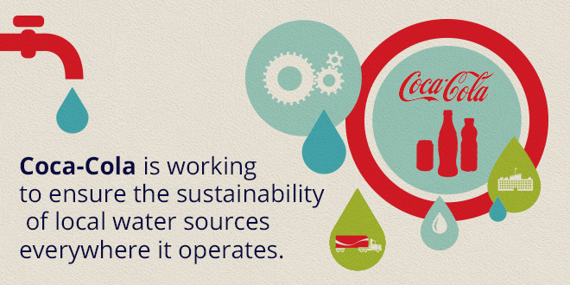


Slide 5
What is the Corporate Social Responsibility
CSR! Is that really for me? So technical, very expensive!!
I’m overwhelmed

Slide 6
What is the Corporate Social Responsibility
CSR is the continuing commitment by business to behave ethically and to contribute to economic development while improving the quality of life of the workforce and their families, local community and the society at large
(World Business Council For Sustainable Development)
6
Notes:
6

Slide 7
What is the Corporate Social Responsibility
“CSR is the commitment of business to contribute to sustainable economic development-working with employees, their families, the local community and society at large to improve the quality of life in ways that are both good for business and good for development” (World Bank, 2008).

Slide 8
What is the Corporate Social Responsibility
Corporate Social Responsibility
The responsibility of business towards the society

Slide 9
How?
Business area:
No corruption
Transparency
Good relationships with customers, shareholders, business partners
Intelectual property protection
Legal Fullfilment
Social area:
Filantrophy
Human rights
Equal opportunities
Community engagement
Enviromental area:
Efficient production
Enviroment friendly behavior on all levels

Slide 10
Why?
License to operate
Avoiding additional taxation or regulation
The most important and strategic part for every business organization in decision making
Anticipate the future needs of society
Competitive Advantage

Slide 11
Corporate Citizenship Concepts
Corporate Social…
Emphasizes…
Responsibility
Obligation, accountability
Responsiveness
action, activity
Performance
outcomes, results

Slide 12
History of CSR
Early Works
M. P. Follett, 1918, 1924: social problems are not only a government matter
Ch. Barnard, 1938: the purpose of business existence is to serve the society
J. M. Clark, 1939: Social Control of Business
T. Kreps, 1940: Measurement of the Social Performance of Business
Howard Bowen 1953, was the first author who published a book on corporate social responsibility

Slide 13
History of CSR
Conditions
excess of demand over supply
enormous labor specialization
need for large amounts of capital
growth of capital intensity

Slide 14
History of CSR
Boom
H. Bowen, 1953: Social Responsibilities of a Businessman
A. B. Carroll: A Three Dimensional Conceptual Model of Corporate Performance.
Mid: 70s a project focusing CSR at Harvard Business School
World Economic Forum Meeting (Davos), 1973: Managers’ Code of Conduct
Notes:
CSR Europe was founded at the instigation of European commission

Slide 15
Historical Perspective
Economic model – the invisible hand of the marketplace protected societal interest
Legal model – laws protected societal interests
Modified the economic model
  Philanthropy
  Community obligations
  Paternalism

Slide 16
CSR’s evolution
Early definitions (1950s-1970s): broad and heavily rooted in the ‘social’ element
‘Conceptualisations’ and models (1970s-1980s): efforts to produce a model of CSR and its institutional role
Business case grows (1980s-): research turned towards analysing the financial impacts and competitive advantages offered

Slide 17
Corporate Social Responsibility (CSR)
Business Responsibilities in the 21st Century
Demonstrate a commitment to society’s values and contribute to society’s social, environmental, and economic goals through action.
Insulate society from the negative impacts of company operations, products and services.
Share benefits of company activities with key stakeholders as well as with shareholders.
Demonstrate that the company can make more money by doing the right thing.

Slide 18
The Benefits of CSR for the company
Benefits of CSR for the company
Making profits
License to operate
Avoiding government regulations
Employee motivation
Differentation from other brands
Attracting Investors
Cost reduction
Good relations with stakeholders
Improved quality
Customer loyalty
Desire to ‘do good’
Risk mitigatition
Avoiding legal actions
Building a brand image
Paulina Księżak (2016)

Slide 19
Advantage against competitors within CSR elements
creating a positive image of a company
shaping proper relations with all of the stakeholders
increasing employees’ morale
taking social responsibility of a company into consideration by potential consumers
Source : Gołaszews- ka-Kaczan (2009)

Slide 20
The Benefits of CSR for the society
Benefits of CSR for the Society
Technology and infrastructure
Higher standar of living
Improved quality
Economic development
Increased health
Social activation
Better employment opportunities
Sense of seurity
Education
Natural environment protection

Slide 21
Doing Well and Doing Good
Doing Well (Profit)
Doing Good (CSR)
Doing Poor (Losses)
Creating Shared Value (CSV)
Source : Hategan (2018)

Slide 22
How to do CSR: Principles
Voluntariness
ACTIVE cooperation with ALL involved parties
Transparency
Systematic and long-term nature
Responsibility towards the society
Tripple bottom line

Slide 23
Why to do CSR: CSR activities should result in
Higher margins, better access to additional capital, lower costs, better image
Higher turnover and productivity, ability to attract better employees
Lower risk, lower scrutiny
The other side:
Higher costs, cash outflows

Slide 24
Why to do CSR: Empirical research issues
Corporate financial performance
Corporate social performance
  Domini 400 Social Index (DSI 400)
  Standard and Poors 500 Index for socially responsible firms
  Best employers, most respectable companies, etc.
Direction
Causality

Slide 25
CSR: Evolving Viewpoints
CSR considers the impact of the company’s actions on society.
CSR requires decision makers to take actions that protect and improve the welfare of society as a whole along with their own interests.

Slide 26
CSR: Evolving Viewpoints
CSR supposes that the corporation has not only economic and legal obligations, but also certain responsibilities to society which extend beyond these obligations.
CSR relates primarily to achieving outcomes from organizational decisions concerning specific issues or problems which (by some normative standard) have beneficial rather than adverse effects upon pertinent corporate stakeholders. The normative correctness of the products of corporate action have been the main focus of CSR.

Slide 27
Carroll’s Four Part Definition
CSR encompasses the economic, legal, ethical and discretionary (philanthropic) expectations that society has of organizations at a given point in time

Slide 28
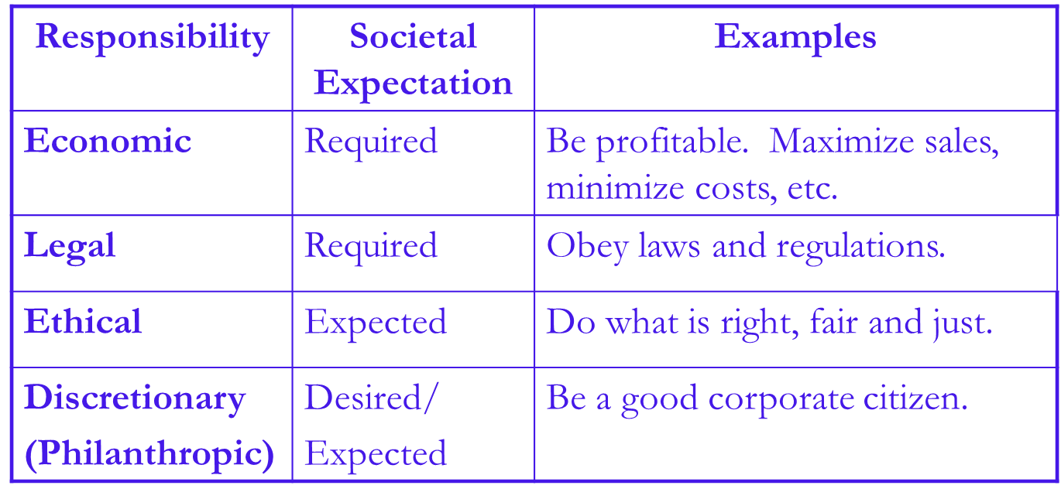
Carroll’s Four Part Definition

Slide 29
The Pyramid of CSR
Philanthropic Responsibilities
Be a good corporate citizen.
Ethical Responsibilities
Be ethical.
Legal Responsibilities
Obey the law.
Economic Responsibilities
Be profitable.

Slide 30
Critique of CSR
Mullerat (2010) notes that CSR, as many other concepts, can betwisted and used only as a PR tool.
“I do not think that most Czech companies are as responsible and fair as many of them say about themselves. Some companies have just adopted what foreign sources call “pinkwashing” or “greenwashing”; i.e. creation of an impression of a socially responsible company” (Čanik 2007)
Moon (2014) points out the difficulty of measuring the actual impact of CSR implementation
Visser and Tolhurst (2010): “it will allow companies to feel good about themselves, while communities crumble, ecosystems collapse and economies descend into chaos”

Slide 31
Critique of CSR
Restricts the classic economic goal of profit maximization
Business is not equipped to handle social activities
Dilutes the primary purpose of business
Increases the power of business
Limits the ability to compete in a global marketplace

Slide 32
Arguments For CSR
Addresses social issues brought on by business, and allows business to be part of the solution
Protects business self-interest
Wards off future government intervention
Addresses issues by using business resources and expertise
Addresses issues by being proactive
The public supports CSR

Slide 33
Myths surrounding CSR
CSR is not for small businesses
It is too complicated and technical
It is too expensive
It is a market gimmick
It is a separate corporate initiative

Slide 34
CONTROVERSY ON CSR
One of the most controversial thing about CSR is “Greenwashing”

Slide 35
What is Greenwashing?
“Greenwashing is the process of conveying a false impression or providing misleading information about how a company's products are more environmentally sound”
It is to make the consumers to believe that the products are environmentally safe but are actually not

Slide 36
It’s greenwashing when a company or organization spends more time and money claiming to be “green” through advertising and marketing than actually implementing business practices that minimize environmental impact.

Slide 37
Examples:
Claiming the air conditioners as CFC free even after a ban on CFCs to create impression on the product makes no sense
An area rug is labeled “50% more recycled content than before” The manufacturer increased the recycled content from 2% to 3%. Although technically true, the message conveys the false impression that the rug contains a significant amount of recycled fiber
Many food products have packaging that evokes an environmentally friendly imagery even though there has been no attempt made at lowering the environmental impact of its production

Slide 38

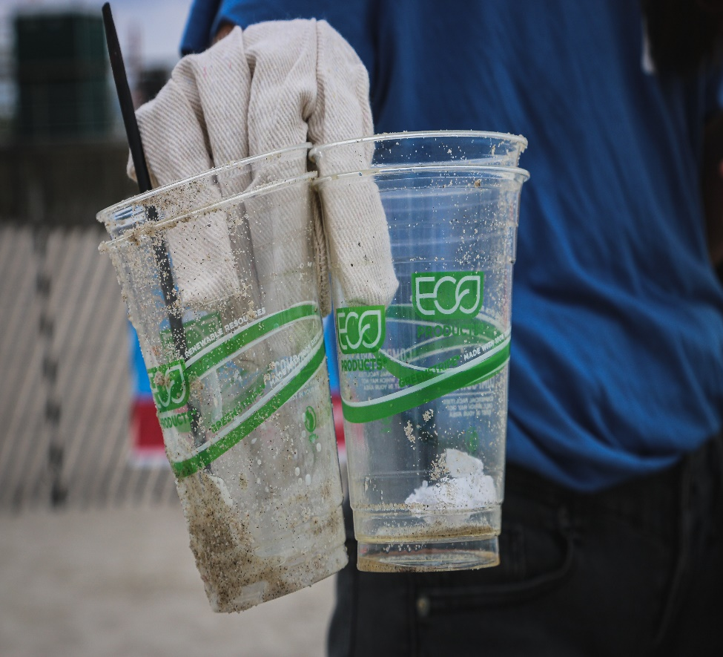

Slide 39
“Seven Sins of Greenwashing”
The sin of suggestive pictures
Green images that indicate a (un-justified) green impact,
like flowers blooming from exhaust pipes

Slide 40
“Seven Sins of Greenwashing”
The sin of the hidden trade off
Suggestion of being Green, based on a single environmental attribute, while blurring all other parameters which are maybe more important, like a Hummer that is claiming that it is a Hybrid

Slide 41
“Seven Sins of Greenwashing”
The sin of no proof
Claims that could be right, but are not supported by any evidence, or by any reliable third- party certification,
like Household lamps that promote their energy efficiency without any supporting figures or certification

Slide 42
“Seven Sins of Greenwashing”
The sin of vagueness
Claims that are expressed with fluffy language with no clear meaning , like ‘planet-friendly’ packaging

Slide 43
“Seven Sins of Greenwashing”
The sin of irrelevance
Environmental claims that are redundantand unimportant for customers seeking environmentally preferable products. It is irrelevant and therefore distracts the consumer from finding a truly greener option, Like ‘unleaded fuel (all fuel in Europe is
unleaded

Slide 44
“Seven Sins of Greenwashing”
The sin of lesser of two evils
These are “green” claims that may be true within the product category, but that risk distracting the consumer from the greater Health or other negative impacts of the category as a whole, Like organic cigarettes

Slide 45
“Seven Sins of Greenwashing”
The sin of fibbing
Out-right lying, and produce totally fabricated claims or data Like driving climate neutral

Slide 46
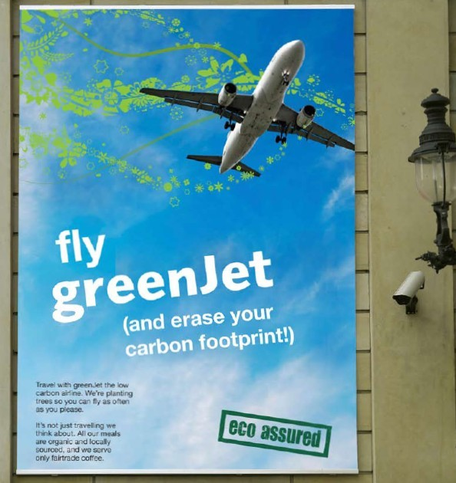
Find me 5 sins of Greenwashing in this ad

Slide 47


Slide 48
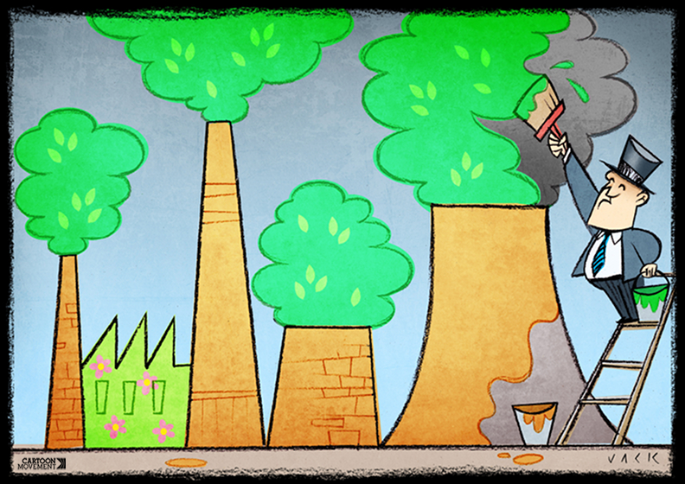

Slide 49
Open questions about CSR
Should companies do CSR?
Should CSR be regulated?
Should CSR be obligatory?
Do CSR have risks?

Slide 50

50
Notes:
50

