Slide 1
Business Central Introduction (ERP=Microsoft Dynamics 365 Business Central) Budgets and Account Schedules basics
Ing.Jaromír Skorkovský,CSc.
Masaryk University Brno
Czech Republic

Slide 2
Budget creation, G/L data creation and comparing budget data and G/L data
Reasons
Creation of Budget
Creation of entries –actual data
Creation of Account schedule to compare actual and budget data

Slide 3
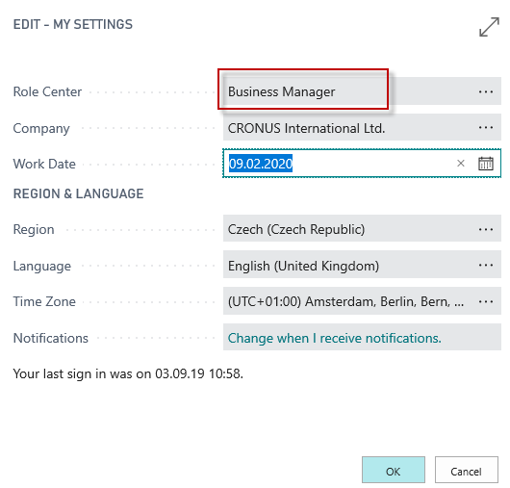
Settings

Slide 4
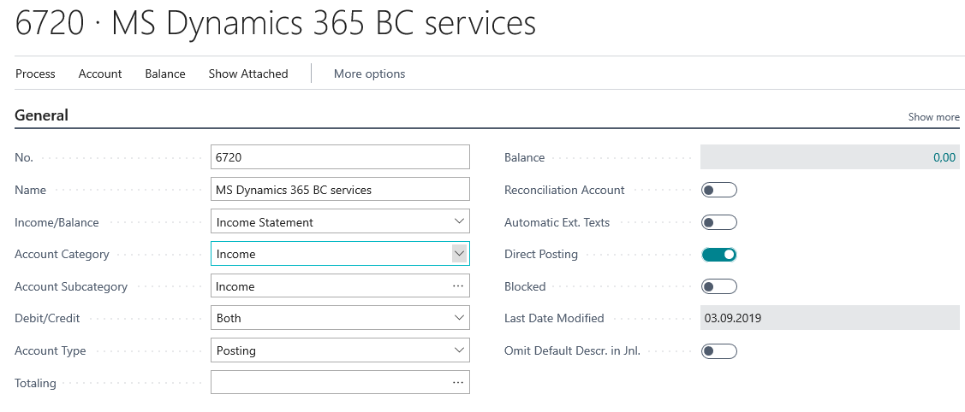
Used tools and new account creation in chart of accounts
Chart of Account
Account Schedules
Sales Budgets
Dimensions
In our exaples we created
also other G/L Account such as 6730 and 6740

Slide 5
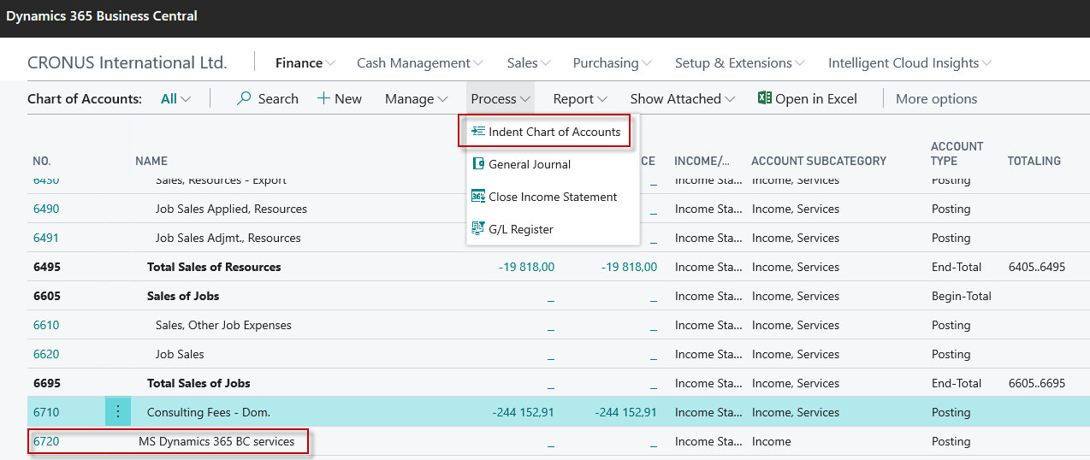
Chart of accounts

Slide 6
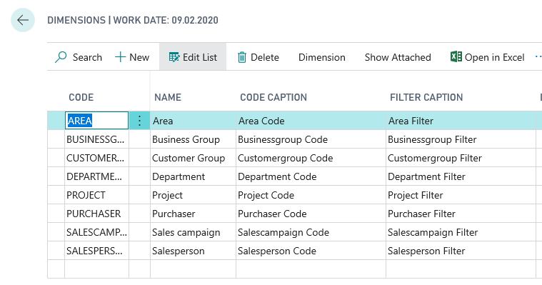
Dimensions (cost centers, income centers)

Slide 7
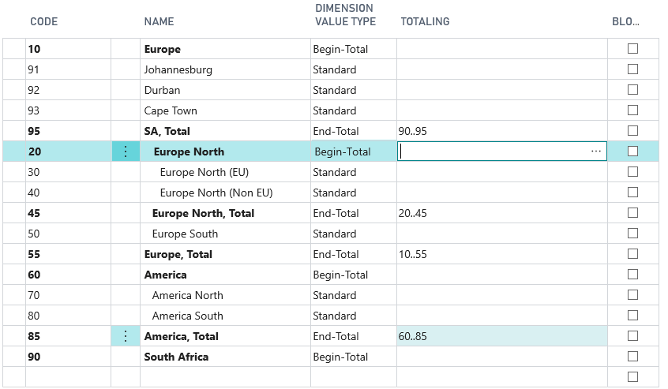
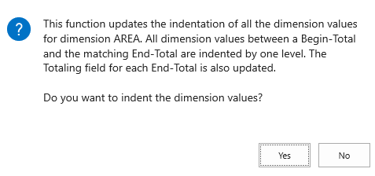
Dimension values (we created here three new areas (91-93)

Slide 8
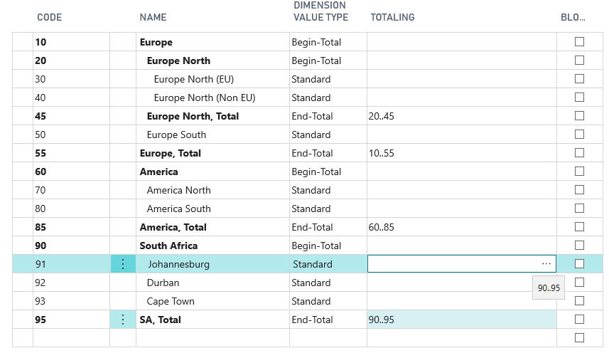
After dimension value indent-1st example
These dimensions
will be used
in our examples

Slide 9
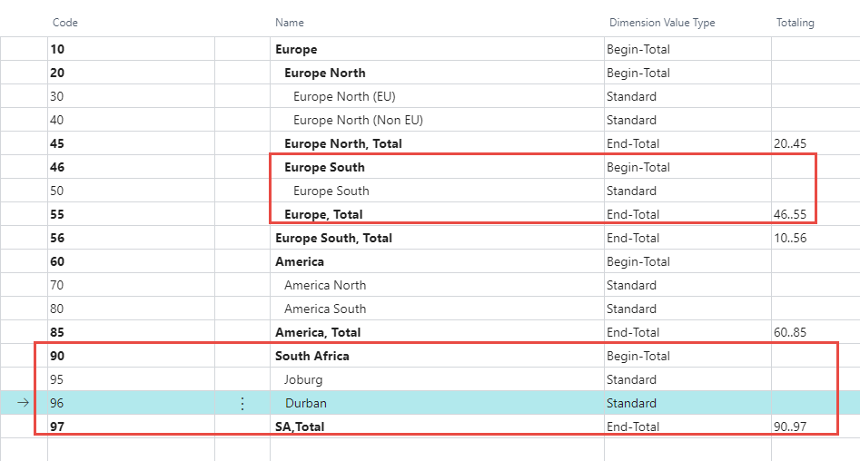
After dimension value indent-2nd example

Slide 10
G/L Budget data entry in this model we use account 6730 and budget 2022
See G/L budget matrix next slide

Slide 11
G/L data entry – how to enter data into budget(use of 3 dots icon)
The reason we enter amounts with
a negative sign in the budget is that
it is the Credit side
Area dimension values entered
as a options manually

Slide 12
G/L Budget after data entry
5000 = 800+1200+2000+1000
Note that the calculation is displayed in absolute value

Slide 13
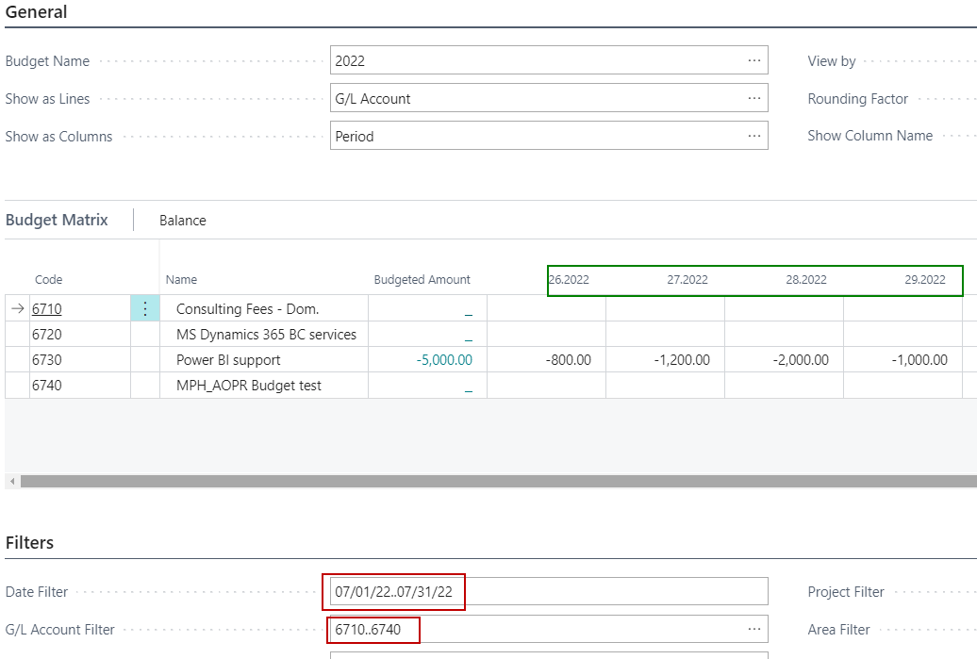
G/L budget matrix with already entered data

Slide 14
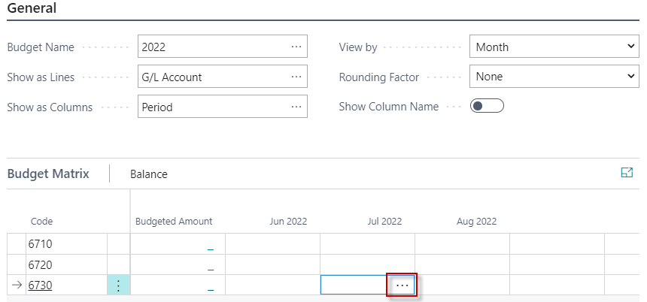
Budget matrix
The account filter will depend on how many
G/L accounts students in the chart of account creation.
Suggestion: every student has their Passwordxx+
and a new G/L account will be set to 66xx, and G/L account
name will be UČO SW Support activity

Slide 15
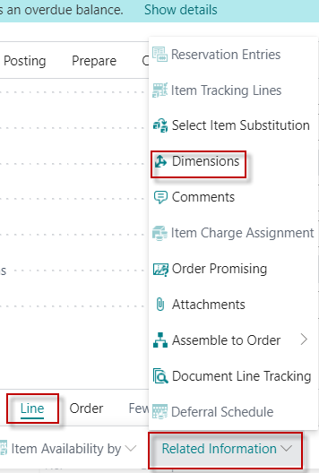
Actual data creation-Sales Invoice I (actual data creation)
F9
Budget=800 Sales order line =700

Slide 16
Second part of the invoice II (actual data creation)
Budget=1200 Sales order line =900
So we will use the same data entry creation by use of second sales invoice
but the amounts will differ intentionally from the figure in budget.

Slide 17
Third Sales invoice III (actual data creation)
Budget=2000 Sales order line =1800

Slide 18
Forth Sales invoice IV (actual data creation)
Budget=1000 Sales order line =3000

Slide 19
G/L Entries
Here you see, that during actual data creation we had to change working dates

Slide 20
How to get G/L Account Balace Budget by period
Cursor must be here

Slide 21
Simple Budget operations (not use of Account Schedule report)
Change the view by Month ---→Week

Slide 22
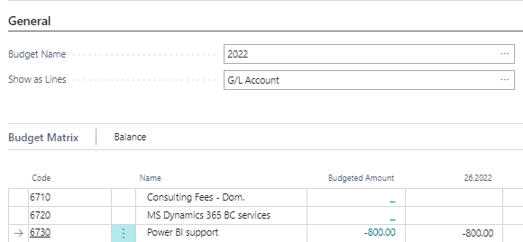
Use of area dimension – firsty go back and enter area dimension value to filter subform

Slide 23
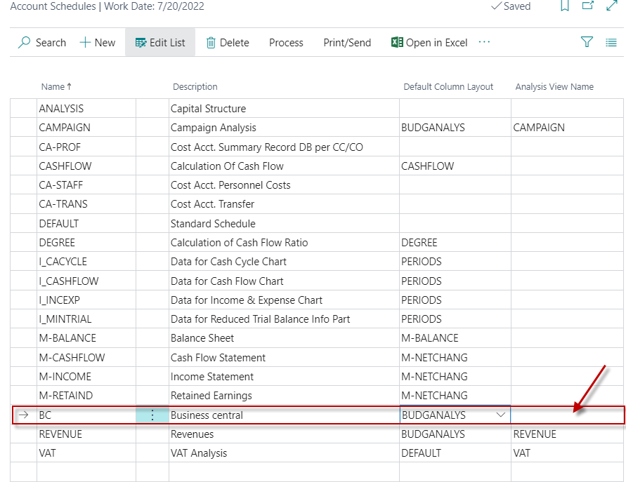
Account schedule list and new one creation

Slide 24
Default column layout based on the rule of three

Slide 25
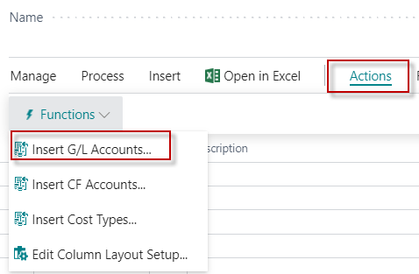
New account schdele
All chosen account in the new template
were entered by use of icon Insert G/L account
We must create a new Analysis View name (BC) and see the default column layout for budget

Slide 26
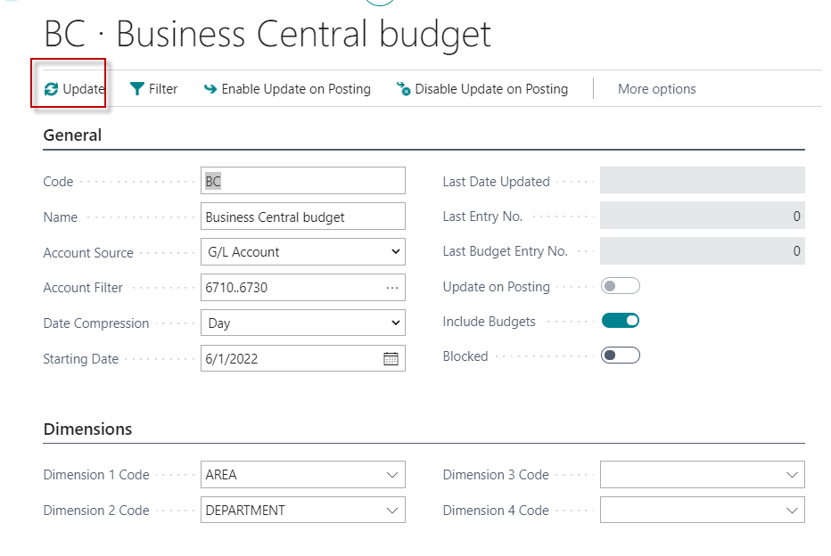
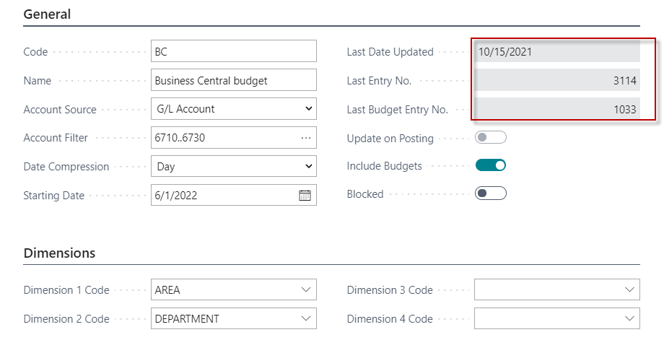
New account schedule view
By use of searching window you will get
To see also budget data
represented by budget entries
After a set of parameters (Account number and so on),
this view must be updated

Slide 27
Default column layout based on the rule of three

Slide 28
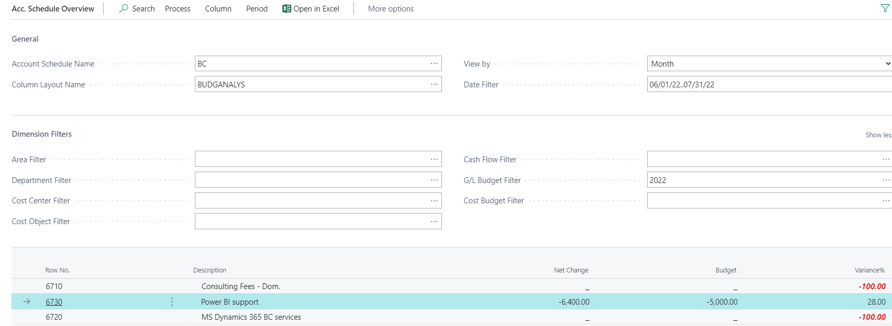
Account Schedule overview

Slide 29
Account Schedule overview- Johannesburg-Durban

