Slide 1
Business Central Introduction III Applying item entries Microsoft Dynamics 365 Business Central)
Ing.Jaromír Skorkovský,CSc.
Masaryk University

Slide 2
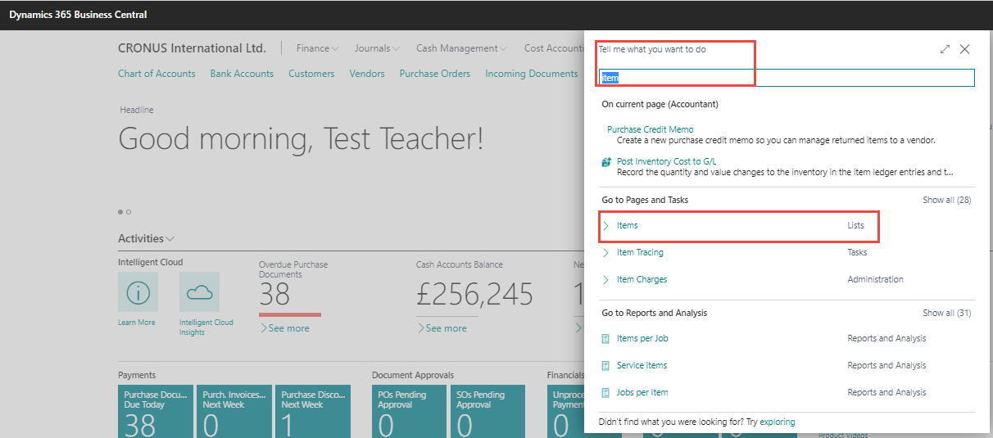
Creation of the new item using new item template
Preparation of data and tables for modeling

Slide 3
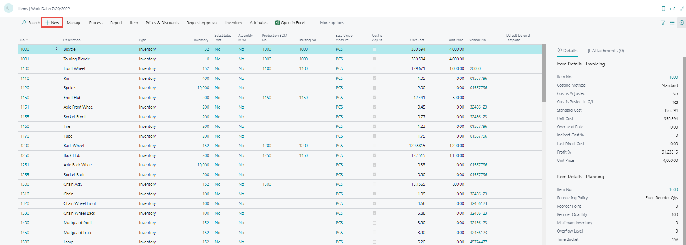
List of items

Slide 4
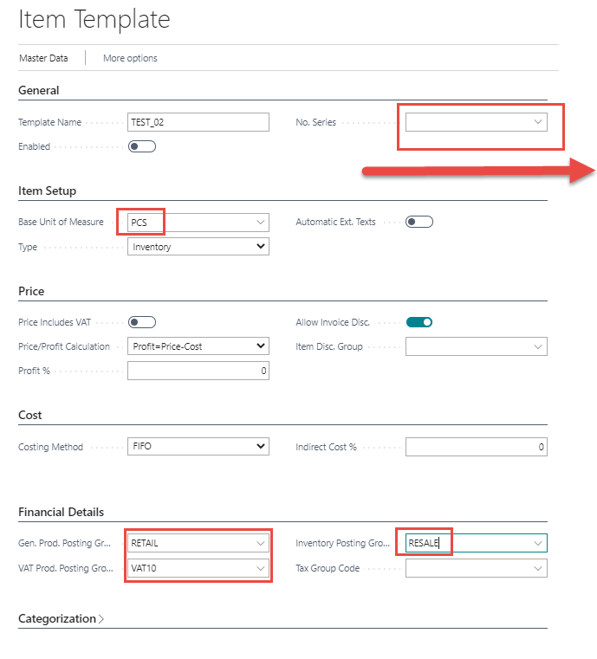
Template creation I.
Here you need to create a new number series,
that will allow you to number the items created
according to this template

Slide 5
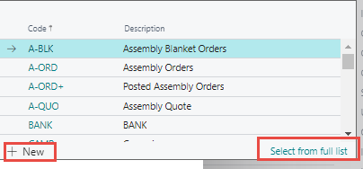
Number of series creation
Here you first enter the series number and its name, the date of creation, in our case by selecting the code T, which means today, and the initial string, which will be incremented by the selected increment for each newly created item.
You need to check this box
with the name Default Number

Slide 6
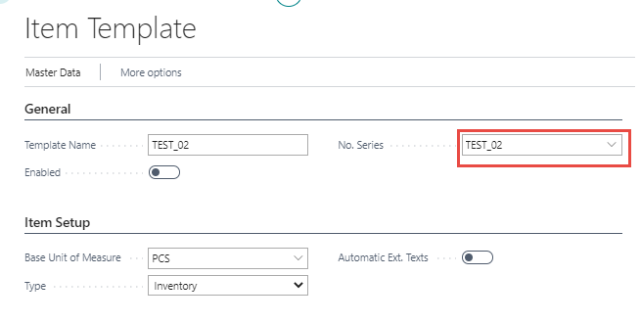
Item template ready
You can now create new items

Slide 7
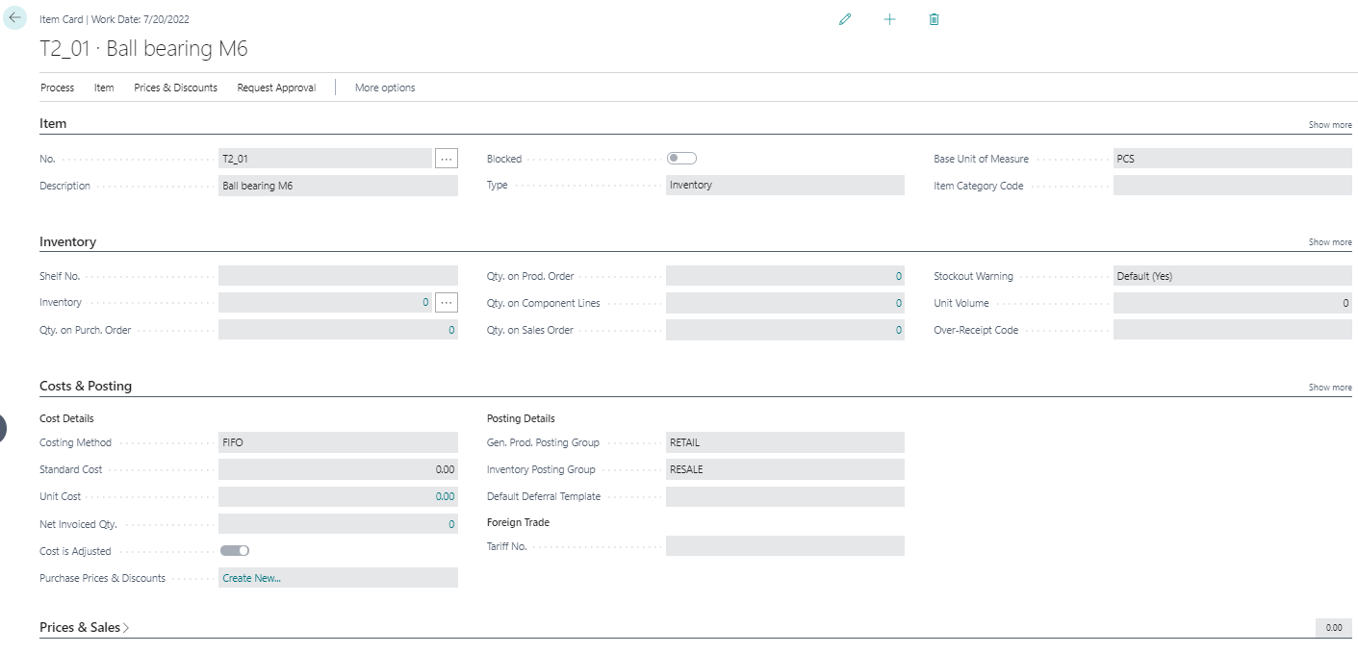
New created item card

Slide 8
Value entries- explanantion
Each inventory transaction, such as a purchase receipt or a sales shipment, posts two entries of different types
QUANTITY
Reflects the change of quantity in inventory. This information is stored in item ledger entries. Accompanied by item application entries.
VALUE
Reflects the change of inventory value. This information is stored in value entries. One or more value entries can exist for each item ledger entry or capacity ledger entry.
Item card
Example : purchase T2-01 1O pcs Cost = 7 USD and overhead cost 1= USD
Ctrl-F7
Purchase Cost amount =80 USD Quantity=10 Entry number =1
Item ledger entry=ILE
Entry number = EN
Ctrl-F7
Entry type =Direct cost Cost amount =70 USD ILE=1 EN=1
Value ledger entries
Entry type =Indirect cost Cost amount =10 USD ILE=1 EN=2

Slide 9
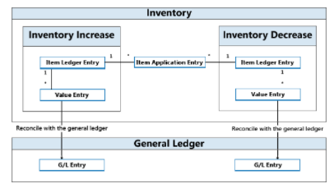
Main principle related to value entries

Slide 10
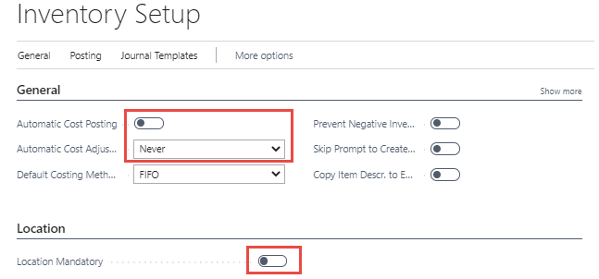
Inventory setup – relation to inventory adjustment
Specifies if value entries are automatically posted to the inventory account, adjustment account, and COGS account in the general ledger when an item transaction is posted. Alternatively, you can manually post the values at regular intervals with the Post Inventory Cost to G/L batch job
COGS = Cost Of Good Sold

Slide 11
Purchasing 2x item T2_01 by use of Inventory journal
Same Purchase procedure but without vendor specification
F9=Post
See next slide

Slide 12
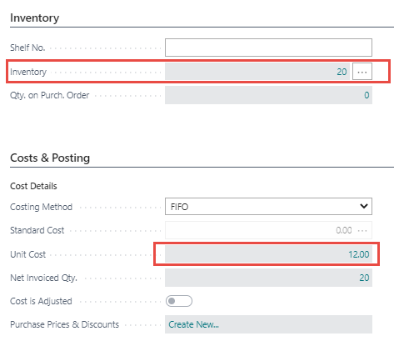
Created item ledger entries and chosen tabs of item card
Total cost of purchased item = 10*12 +10*14 = 120+140=260 and average =260/20=13

Slide 13
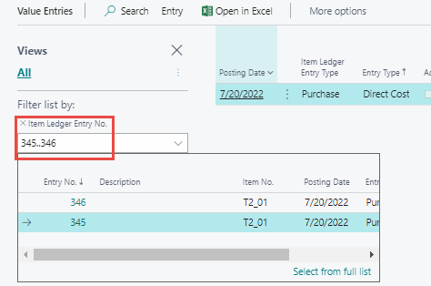
Item ledger entries and related value entries
Ctrl-F7
Setting the filter to Item ledger entry numbers
to see all automatically created value entries

Slide 14
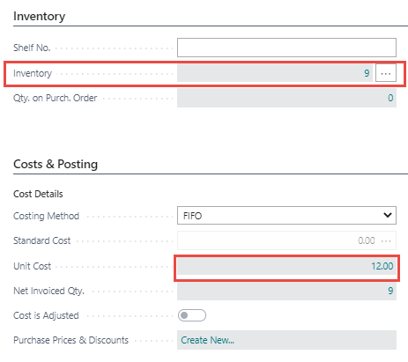
Selling 11 pcs of our item T2_01 by use of item journal
The selling price is set at 20 USD / pc, and as can be seen, the cost is 12 USD / pc, although one piece of the purchased item should have a cost of 14 USD/pc from the FIFO point view.
COGS should be 10*12+1*14=120+14=134 and cost of remaining 9 pcs should be 260-134=126 and average cost per one item-> 126/9= 14
BC calculated closing cost as 260-11*12=260-132= 128 and 128/9=14,22

Slide 15
Item ledger entries and Value entries

Slide 16
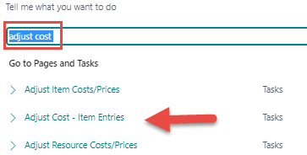
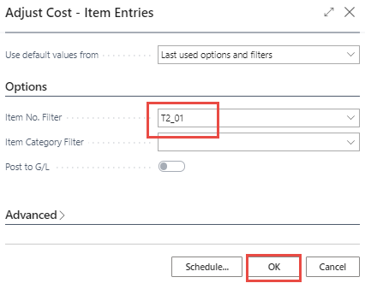
Start inventory adjustment batch Adjust cost - item entries –manual procedure

Slide 17
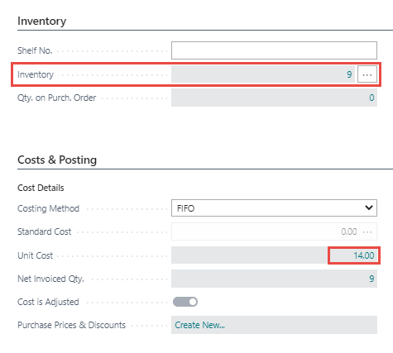
Result of inventory cost adjustment
12,18=134/11

Slide 18
Item ledger entries and related value entries
Another value entry has been created, showing the difference of USD 2 between the original cost of 132 and the new adjusted cost of 134. For the unit, it is then 2/11 = 0.18

Slide 19
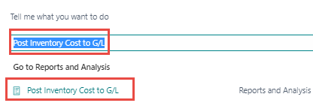
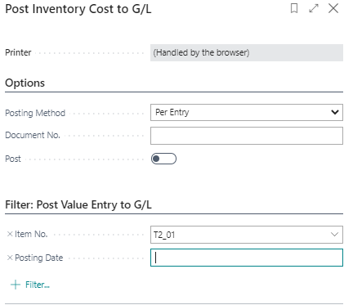
Post inventory costs to general ledger

Slide 20
Post inventory costs to general ledger

Slide 21
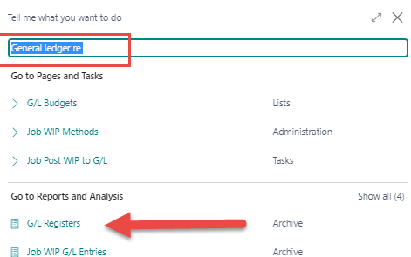
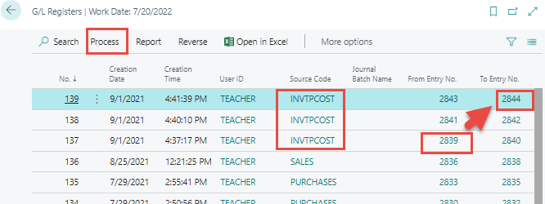
Post inventory costs to general ledger

