Slide 1
Operation Management (OM) Introduction
Ing.J.Skorkovský, CSc,
Department of Corporate Economy
FACULTY OF ECONOMICS AND ADMINISTRATION
Masaryk University Brno
Czech Republic

Slide 2
Coordinates (will be part of OM Intro as well)
Lecturer : Ing.Jaromír Skorkovský, CSc.
  Department of Corporate Economy (5th floor)
  miki@econ.muni.cz
  +420 731113517
Study material : will be updated regularly after every lesson (is.muni.cz and Interactive Syllabi )
So far there is a lot of material there but mind you that nearly every part will be slightly or more heavily modified this year. So the correct material will have at the end of its name specification …20YY mmdd e.g. 20YYMMDD if not specified otherwise in advance (e.g. 20210920)
Attendance : seminar and lectures are obligatory – see subject specification (is.muni.cz) – first vital condition to be admitted to exam !!!!)
Excuses : if serious reason emerges- only written form is accepted
Seminar work : will be assigned after some theory will be presented. Accepted seminar work is the second condition to be admitted to an exam. Assign time: 10.11.2021
Tuition plan : at the end of this slide show
Name of the tuition plan file : Tuition plan for AOPR_20YYMMDD
For the case of normal contact teaching : AOPR: P312 (308)- every monday on16:00 and VT206 and every Wednesday on 12:00
In case of online teaching during a pandemic : MS TEAMS

Slide 3
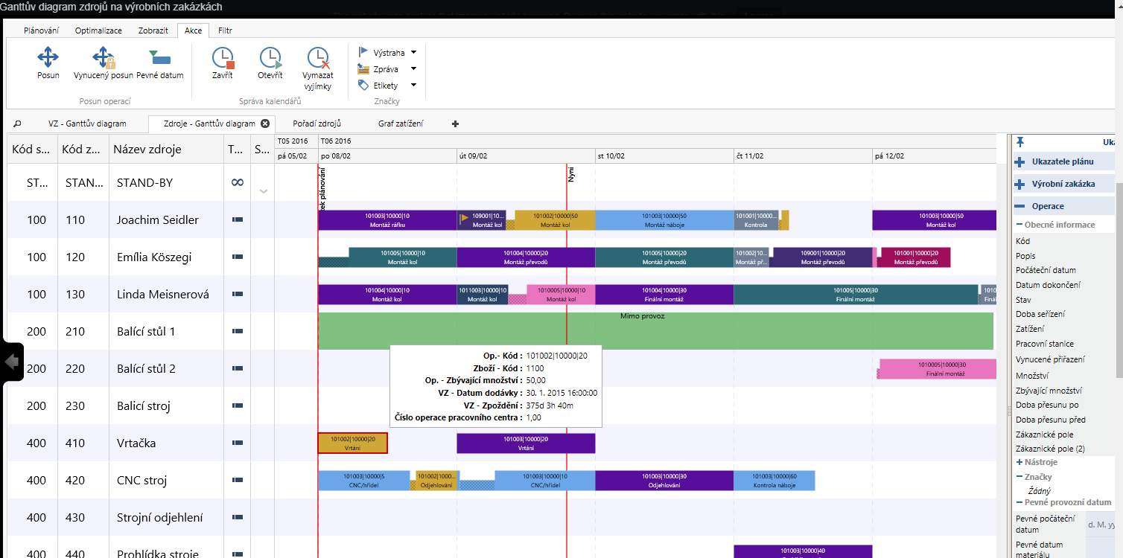
Tutor experiences from latest projects
ITEC Johannesburg
Peter Paper Johannesburg (https://www.peterspapers.co.za/)
Training of personel for Navertica South Africa
SW localisations
  Boltrics (Warehouse Management)
  Planner One (Ortems)

Slide 4
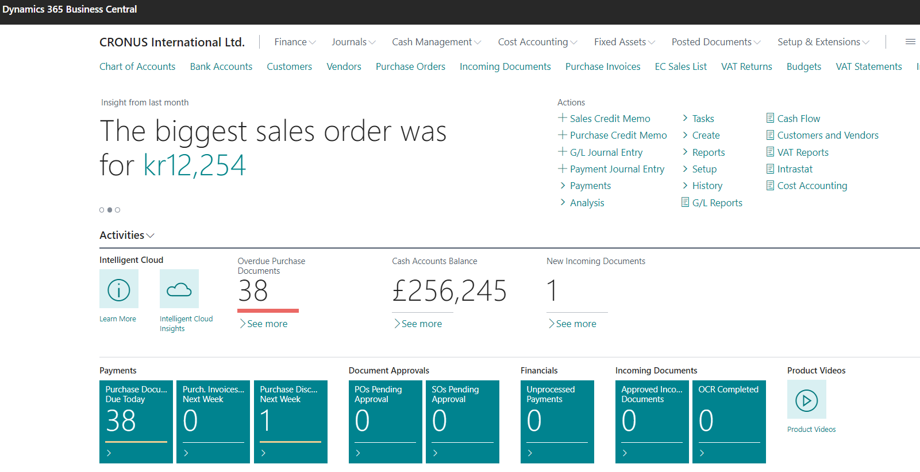
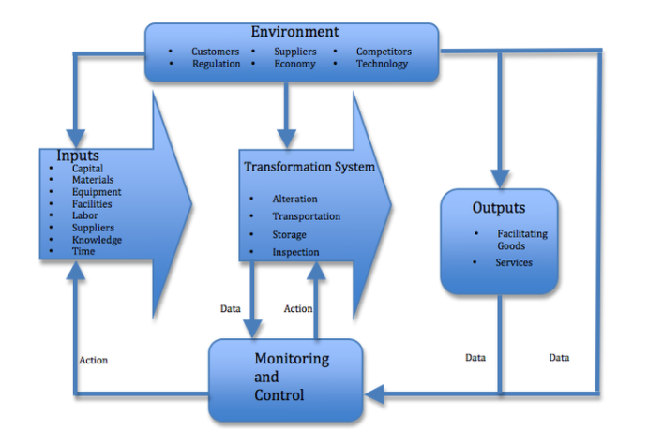
Principles
Management philosophy
Information technology
Feedback

Slide 5
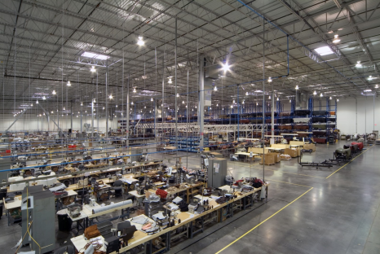
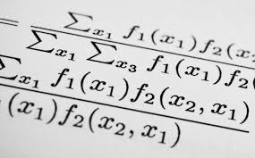
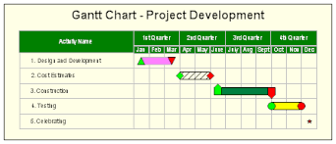
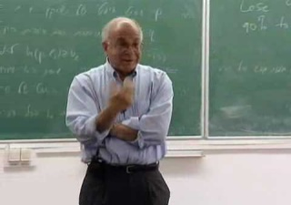
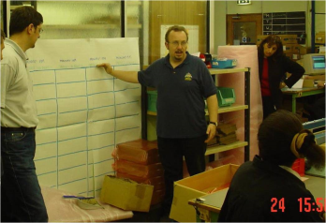
What is going on ?
Use of Operations Management (OM) in external environment
(main target)
General knowledge of OM methods acquired at university and long-standing experience
Knowledge of methods and experience from research and literature - teachers
Knowledge of methods and experience from outside world – consultants, managers, …
Extent of knowledge
Extent of knowledge
Synergy and put OM into practice

Slide 6
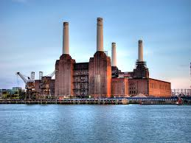
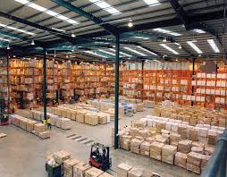


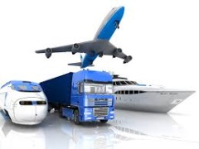

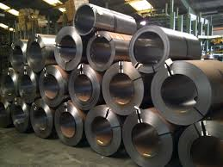
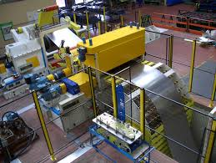
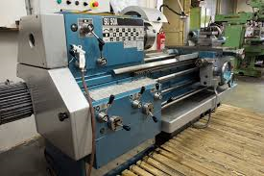
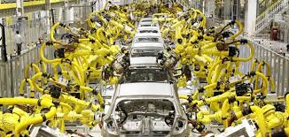
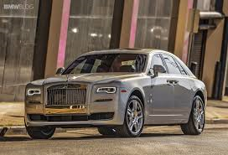
OM all around us
OM is the management of all processes used to design, supply, produce, and deliver valuable goods and services to customers
INBOUND
Processing-transformation
OUTBOUND
TQM = Total Quality Management,Six Sigma,…
ERP: Logistics, Transportation ,
MRP, JIT, APS, Lean Manufacturing, Little´s law
ERP: Marketing, Selling, Invoicing, Payment,….

Slide 7
Selected OM methods, which will be kicked around as time will move on
Theory of Constraints (TOC) -(AOPR)
Balanced Scorecard -(AOPR)
Project Management methods (Critical Chain) -( AOPR)
Material Requirement Planning (MRP) and Just-in-Time principles
-(more in detail live in ESP MS Dynamics NAV 2018w1 or MS Dynamics 365 Business Central)
Advanced Planning and Scheduling (APS) -(AOPR only basics)
Six Sigma – quality management -(AOPR- reason -> JIT introduction)
Boston matrix and PLC, SWOT and Magic Quadrant Matrices -(AOPR)
Little´s Law (relations between WIP, Throughput and Cycle time) -(AOPR)
Linear programming – optimization prinicples- (AOPR)
Yield Management - (AOPR)
Kepner-Tregoe (support of decision making) - (AOPR)
Decision trees -(AOPR)
WIP=Work in Progress, APS=Advanced Planning and Scheduling
PLC=Product Life Cycle

Slide 8

Some tools which have to be used
ERP-Enterprise Resource Planning (MS Dynamics NAV 2018w1 or MS Dynamics 365 Business Central)
  Necessary installation, handling, and system setup-prinicples
  Inventory – Items – Transports –Availability of components (items)
  Purchase –dealing with Suppliers (SCM)>Payables
  Selling – dealing with Customers-> Reveivables
  Payment – bank operations
  Accounting basics
  CRM- Customer Relationship Management
  Manufacturing – Planning and Shop Floor Control->WIP,COGS,…
  Budgets
  Reporting
SCM=Supply Chain Management, COGS=Cost of Good Sold
ERP serves as the magnifying glass to processes…

Slide 9
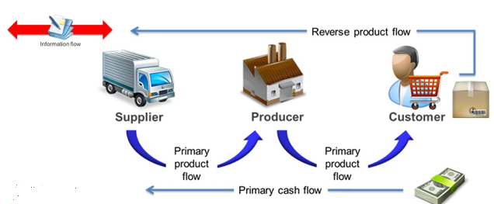
Controlling processes in Supply Chain Management (SCM)
Supply | Production | Orders
 | Operation Strategies and Innovations , R&D
Forecasts, Blank Orders | Long term planning | Marketing
Logistic operations | Routing control, TQM | Packaging , Transportation
MRP, Replenishment | MRP_II ; JIT, Capacities | Cash flow
Strategic
Demand Planning
Planning levels
Tactical
Operational
Operational
Used abbreviations : R&D –Research and Development; TQM-Total Quality Management; JIT- Just –In-Time; MRP_II-Manufacturing and Resource Planning
Used abbreviations (slide number 3 ): : ERP - Enterprise Resource Planning ; APS – Advanced Planning and Scheduling , MRP-Material Requirement Planning

Slide 10
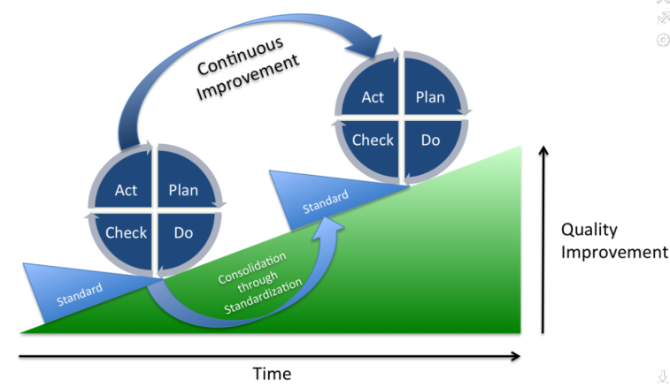
Deming cycle (based on periodicity)
Plan: Define the problem to be addressed, collect relevant data, and ascertain the problem's root cause (e.g. by use of TOC=Theory of Constraint)
Do: Develop and implement a solution; decide upon a measurement to gauge (assess) its effectiveness.
Check: Confirm the results through before-and-after data comparison.
Act: Document the results, inform others about process changes, and make recommendations for the problem to be addressed in the next PDCA cycle.
Used abbreviations : TOC – Theory of Constraints

Slide 11

Another PDCA angle of view
This will be modified in following South African project show (use of Balanced Score Card)
Project management
Theory of constraints
Production
Linear programming
Total quality
management
Product postitioning
Business Intelligence
Workflow
Critical chain
Drum –Buffer-Rope
MRP-MRP-II,JIT,APS
Cutting, blending
Pareto, ishikawa
Boston Matrix
Gartner QM
Decision
Making -trees
SCRUM
CONWIP
Logistics
Pareto, Ishikawa
Product Life Cycle
Kepner-Tregoe
EOQ
Six Sigma
Yield management
Hurwitz
ABC
Prospect Theory
LEAN
Function block Logistic more in detail
will be presented later in this show
Little´s law
Used abbreviations : QM– Quadrant Matrix; CONWIP – Constant Work in Progress; EOQ – Economic Order Quantity ; MRP - Material Requirement Planning

Slide 12
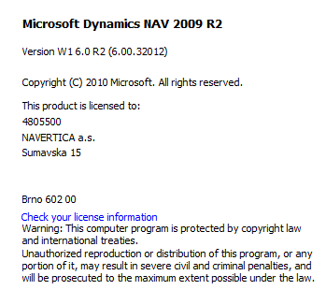
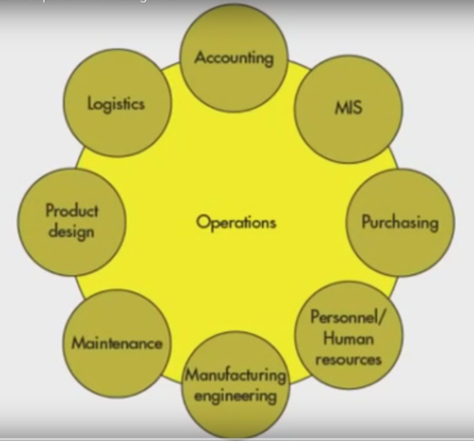
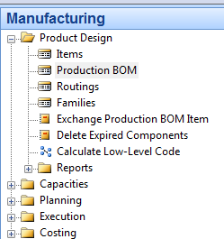
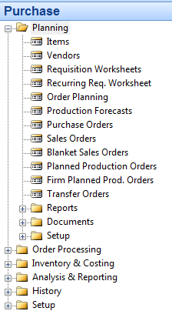
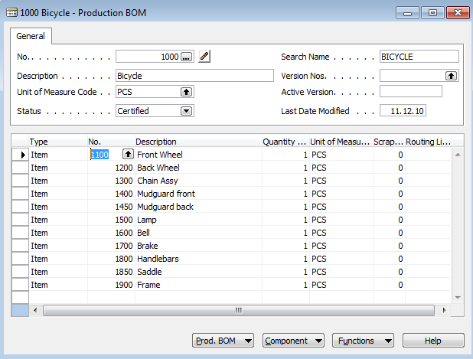
A subset of ERP-driven operations (NAV)
See next slide
Bill of material

Slide 13
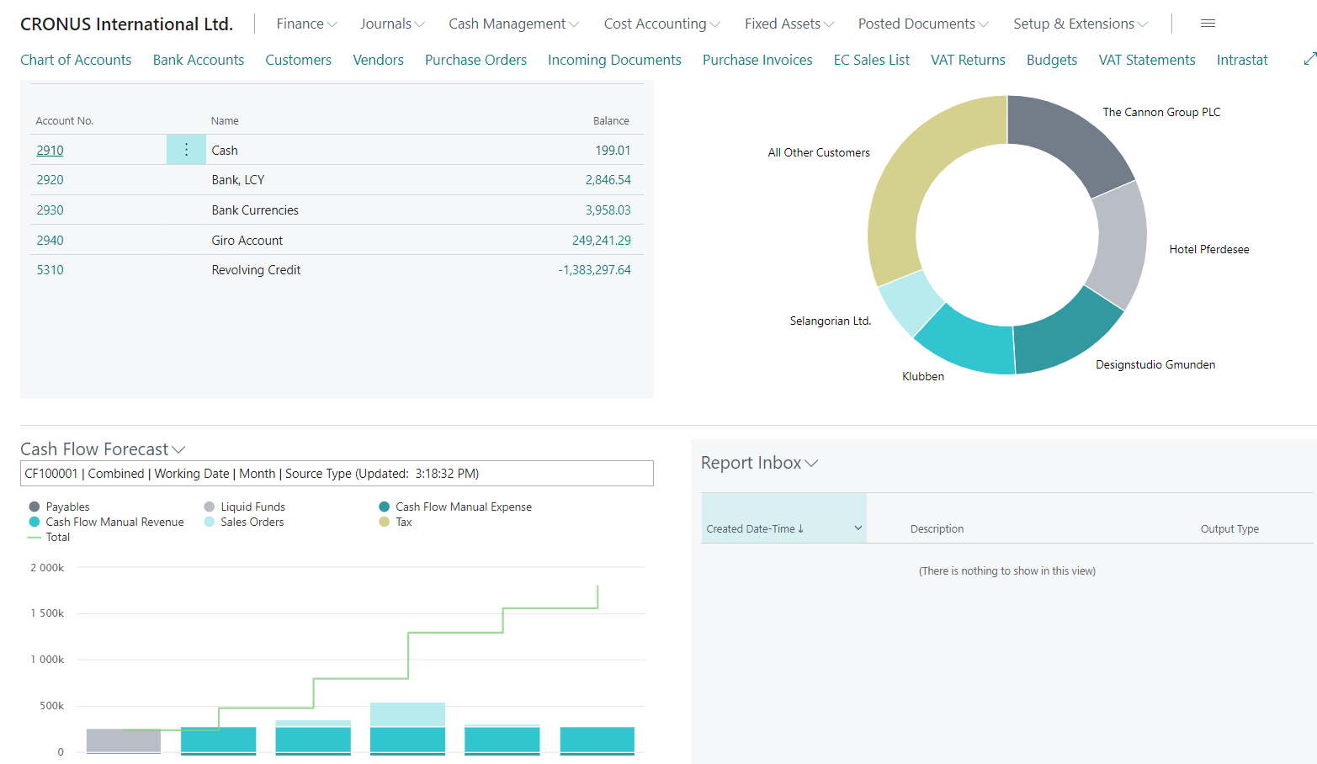
MS Dynamics 365 Business Central

Slide 14
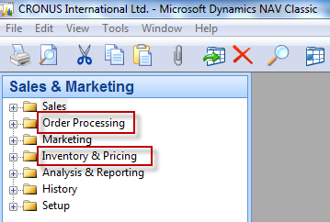
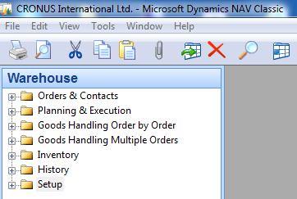
Function block Logistic-simplified
Inventory Management
Orders (Dependent demand)
Inventory Costing
Warehouse Management
Forecasts (Independent demand)
Transportation
Will be part of our course regarding ERP system MS Dynamics NAV

Slide 15
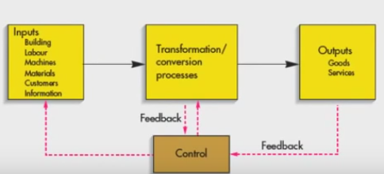
Procedures-simplified (feedback control)
Color agenda used later
Input
Transformation
Output
Resource (modified) : dowtsx

Slide 16
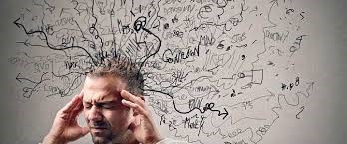
Processing (not organised set of processes, will be presented also as a introduction to project management PWP presentation later)
Load-despatch
Purchase Order
Reporting
Statistics
Consumption registration
Production Output registration
Inventory value
calculation
Output check
(Quality control)
Delivery
Production Planning
Sales Order
Component replenishment
Process flow ?
Transfer
to
Production
Put-away
Cross-docking
Input check
Finished
goods to
Inventory
Picking from
Inventory
Invoicing
Payment
Resource : Skorkovský

Slide 17
Your main task (to organize processes based on business logic)
Sales Order
(demand)
Production Planning
Component replenishment
Purchase Order
Input check
Consumption registration
Transfer
to
Production
Picking from
Inventory
Inventory value
calculation
Put-away
Production Output registration
Inventory value
calculation
Cross-docking
Finished
goods to
Inventory
Load-despatch
Payment to
Vendor
Inventory value
calculation
Shipment
Invoicing
Output check
Payment from
Customer
Reporting
Statistics
Transformation
Output
Agenda
Input
Control
Logistics
Resource : Skorkovský

Slide 18


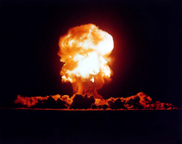
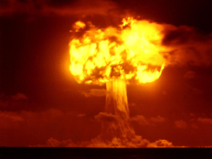
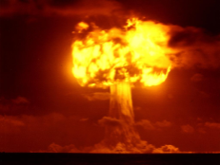
Your main task (possible problems, bottlenecks, undesirable effects..)
Sales Order
Production Planning
Component replenishment
Purchase Order
Input check
Consumption registration
Transfer
to
Production
Picking from
Inventory
Inventory value
calculation
Put-away
Production Output registration
Inventory value
calculation
Cross-docking
Finished
goods to
Inventory
Load-despatch
Priorities ?
Payment to
Vendor
Inventory value
calculation
Shipment
Invoicing
Output check
Payment from
Customer
Reporting
Statistics
Application of TOC ->thinking tools->Current Reality Tree – first stage
Resource : Skorkovský

Slide 19

Your main task
(Search - HOW ??? Measure impacts –HOW ??? and Destroy – HOW ???)
Cause-Effect relation
Cause-Effect relation
Cause-Effect relations
Cause-Effect relation
Cause-Effect relation
Root Problem
(e.g.l ow profit, crippled cash flow )
Notes:
https://www.toc.tv/TV/video.php?id=701&open=excerpt#.V6xCP00kpFo

Slide 20

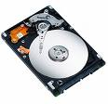
Basic problem I. (one of many)
Quantum computers ?
We have
a huge data
quantity
Moore's law is the observation that the number of transistors in a dense integrated circuits doubles approximately every two years – so -> capacity of memory is going up –>applications (SW) temporarily solve such a constraint and it is still valid after more than 50 Years !!!

Slide 21
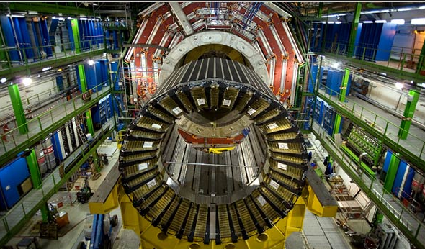
Big data and analysis problem
In test and measurement applications, engineers and scientists can collect vast amounts of data every second of every day.
For every second that the Large Hadron Collider at CERN runs an experiment, the instrument can generate 40 terabytes of data.
For every 30 minutes that a Boeing jet engine runs, the system creates 10 terabytes of operations information.
For a single journey across the Atlantic Ocean, a four-engine jumbo jet can create 640 terabytes of data.
Multiply that by the more than 25,000 flights flown each day, and you get an understanding of the enormous amount of data that exists (Rogers, 2011). That’s “Big Data.”
Hardon Collider-accelerator
CERN = Conseil Européen pour la Recherche Nucléaire –Resource : https://home.cern/about

Slide 22
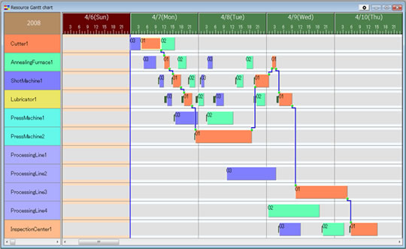
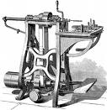

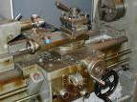
Basic problem II. (we need reliable data )
To solve it we should use Finite capacity scheduling (APS)- will be presented later
Gantt
T1+T2=X
Opt=Min(X)
T2
Op1
T2 = 0
Op1
Op2
Op2
Op3
Op3
T1 = 0
T1

Slide 23
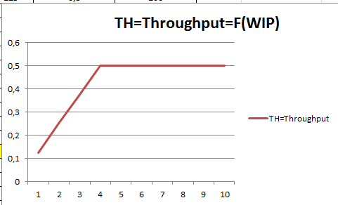
Basic problem III.
Will be explained in Little´s law presentation (AOPR) : WIP= Work In Progress

Slide 24
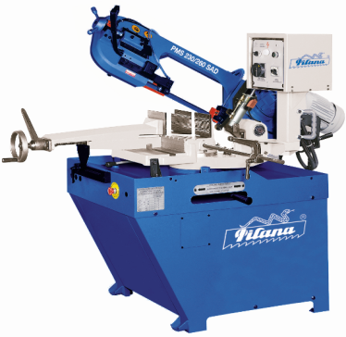
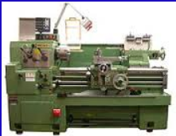
Basic problem- colouring IV.
Black
White
White
Black
(Black ->White, Setup time=60 minut)
(White->Black, Setup time = 20 minut)
Main aim ->setup time minimization

Slide 25
Basic problem V-I. (availability of components)
Op1
A0
20 pcs of A7 and 20 pcs of A8
A1
A2
Op2
10 pcs of A4 and 10 pcs of A5
(will be delivered in T1+X time )
A3
T0
Lead time
to produce A6
Op3
Lead time
to produce A3
A4
A5
T1
T2
A6
Op1
A7
A8
X= slack = delay
Bill Of Material=BOM
(tree structure)
Op2
T1
T1+X
Op3
For sake of simplicity we did not mentioned components A1 and A2 and possible delays having cause in delivery times of bad quality !!!
Same with capacities of machines allocated to OP1-OP2-OP3 ( due to unexpected sudden breakdowns)

Slide 26
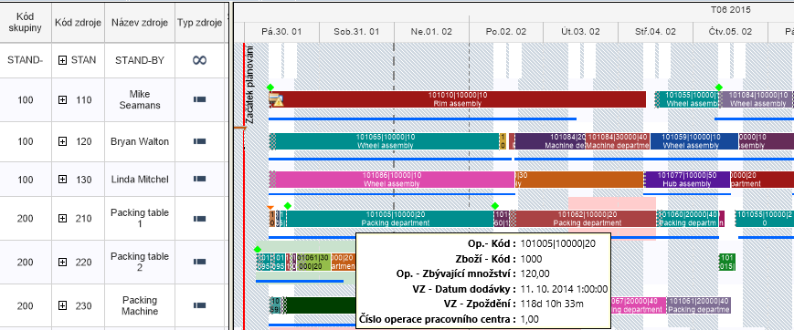
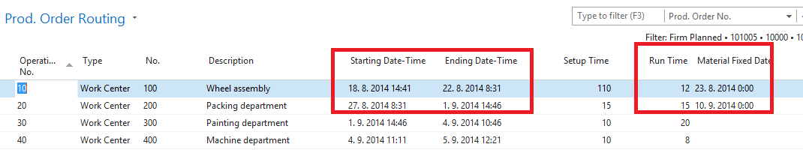
Basic problem V-II. (availability of components and capacity )
Gannt chart
APS result ->18.8.->23.8. a 27.8.->10.9
APS = Advanced Planning and Scheduling result

Slide 27
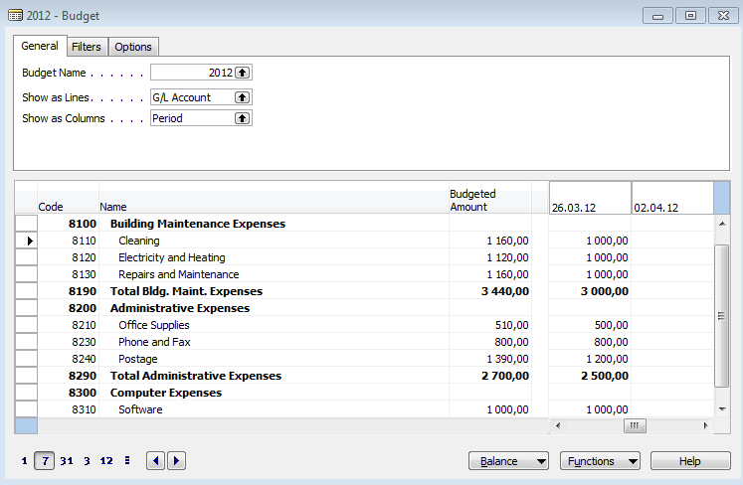
Basic problem VI-I. (budget exceeded)

Slide 28
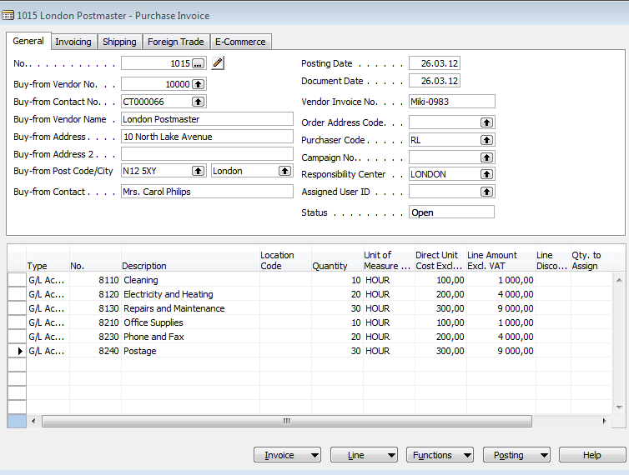
Basic problem VI-II. (budget exceeded)
Creation of the actual costs figures

Slide 29
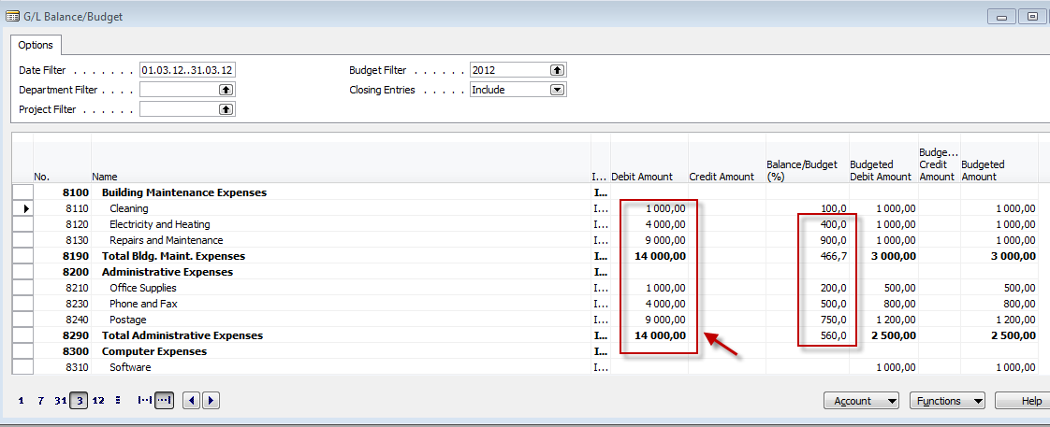
Basic problem VI-III. (budget exceeded)

Slide 30

Thanks for your attention

