Slide 1
Introduction to MS Dynamics NAV (Discounts)
Ing.J.Skorkovský,CSc.
MASARYK UNIVERSITY BRNO, Czech Republic
Faculty of economics and business administration
Department of corporate economy

Slide 2
Discounts
Use of discounts:
  Support of „Sales“ actions->lower stock value and better liquidity
  Support of marketing ->new clients
  Basic incentives for any client
  To differentiate between clients (based on sales in the last period or other criteria)
  Types :
  Price ->modification of Unit Price (It is a change in the absolute value of the unit price)
  Line ->change the final price (Unit price) in %
  Invoice Discount ->based on the level of invoiced amount

Slide 3
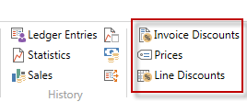

Basic Blocks
Customer
Discount Group
Window used
for Invoice Discount
Customer
Allow Line
Discount in %
Window used
for Price Discount sestup
Sales
header
Sales line
Window used
for Line Discounts setup
ITEM
Item Discount
Group
Unit Price
Allow Invoice
Discount
Can be accessed either from
Customer Card or Item Card

Slide 4
Window used for Line Discounts Setup (%)
Sales Type | Sales Code | Type (Related to item) | Code | Unit of Measure | Minimum (Discount limit) | Line discount % | Starting date | Ending date
Customer (specific one) | 10000 | 70102 (Item number) |  | PCS | 10 | 2
Customer Discount Group | Large Account | Item Discount Group | RESALE |  | 20 | 4
All Customers |  |  |  |  | 5 | 1
Campaign (part of CRM) | Spring Campaign | Item Discount Group | BOOKS |  | 3 | 7

Slide 5
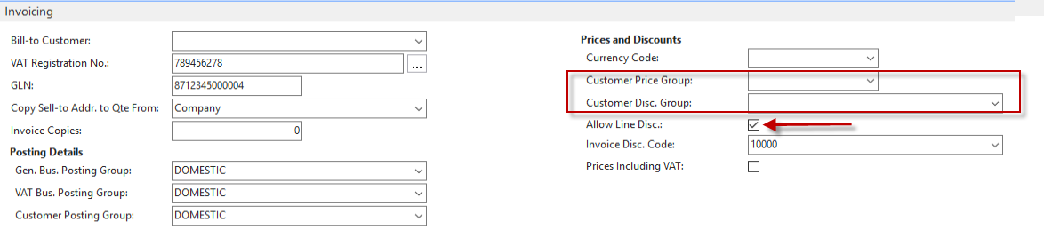
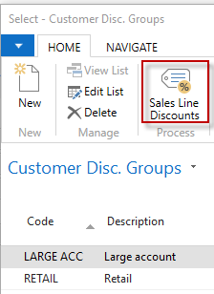
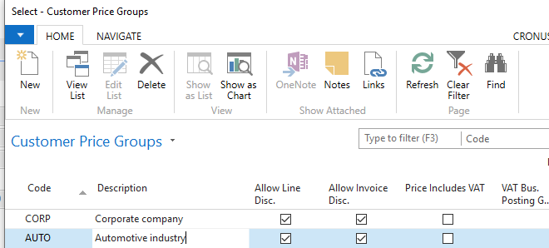
Customer card and discounts (Invoicing tab)

Slide 6
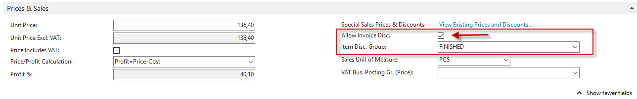
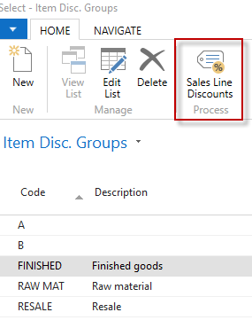
Item card and discounts (Prices &Sales tab)

Slide 7
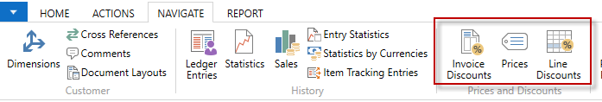
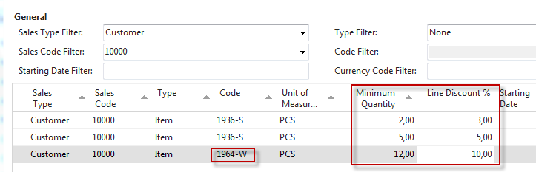
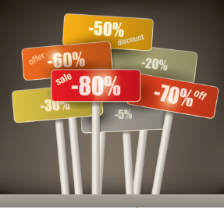
Window used for Line Discounts Setup (%)
Customer ->Navigate ->Sales Section->Line discounts
Our example is setting a discount for a single customer and his % of line discounts for different quantities of different items. In the real model fabricated in class, it will be similar, but for one item

Slide 8
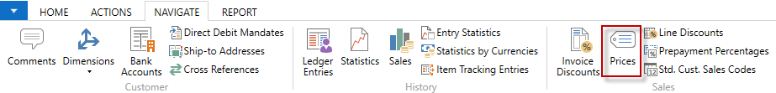
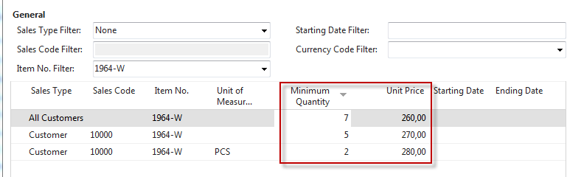

Window used for Sales Line Discounts Setup (absloute value)
Customer card ->Navigate ->Sales section->Prices
(Original Unit price on the Item card is 293)
In this model (in the seminar) enter
only two lines for one customer which means
not Sale type =All customer

Slide 9

Discount combination-example (explanantion)
Price reduced from 100 to 90
Discount in % =10 %
Final price after discounts were applied = 90*0,9=81,0

Slide 10
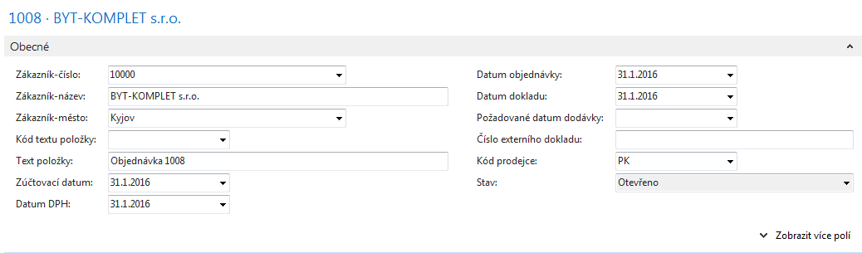
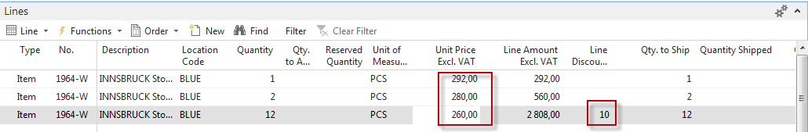
Sales lines of the Sales Order
Header
Lines

Slide 11
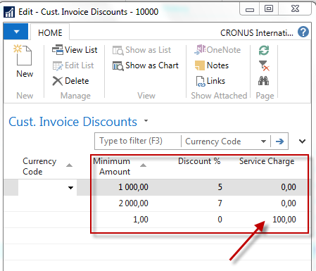
Invoice discount application
Setup
Invoice discount must be allowed and manually confirmed before
you start to calculate it !!!

Slide 12
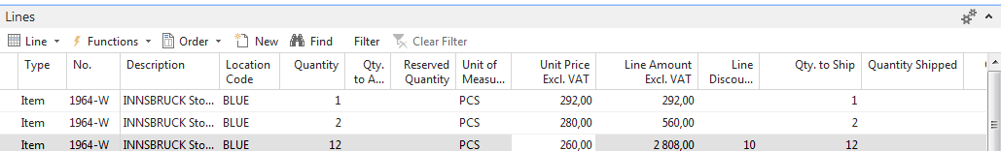
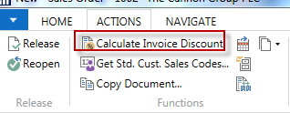
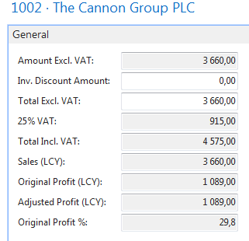
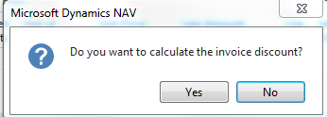
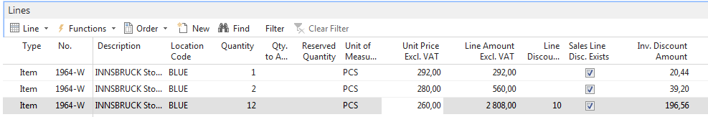
Invoice Discount calculation
Sales line
F7
(Statistics)
You must confirm

Slide 13
Statistics F7

Slide 14
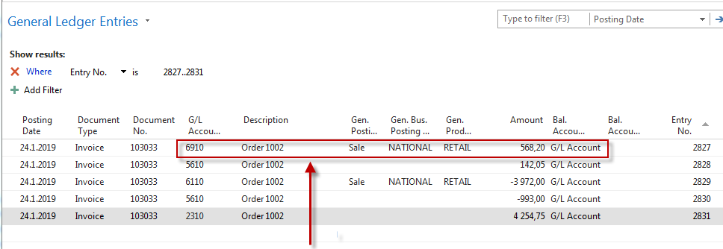
General Ledger entries after posting F9
Departments->Financial Management ->General Ledger ->Archive->History->G/L Registers
Discount granted
After posting the sales order, I also showed a payment of the posted invoice
within eight days, so in addition to the discount posted on account 6910,
there was also a payment discount of two percent posted on G/L account
9250. See next slide. Mind you, that presented window on the next slide
does not correspond to the above figures. It was taken from a real model

Slide 15
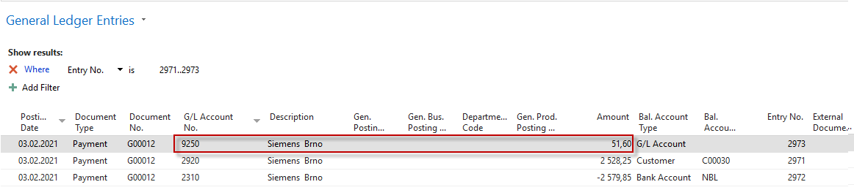
After early payment

Slide 16
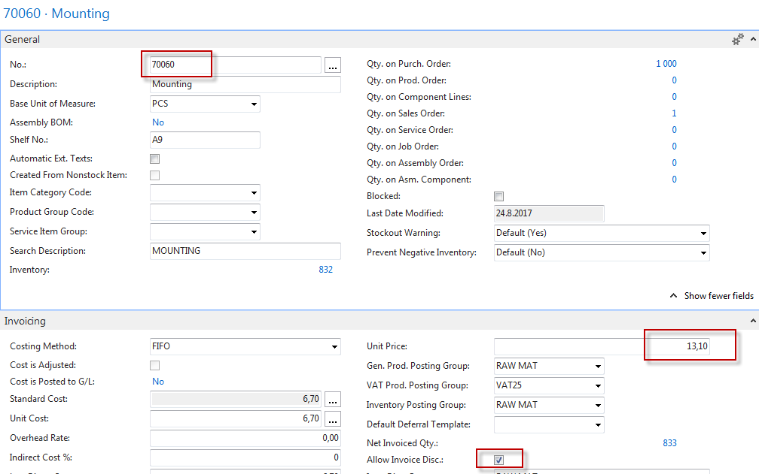
Item card used in modeling item charges

Slide 17
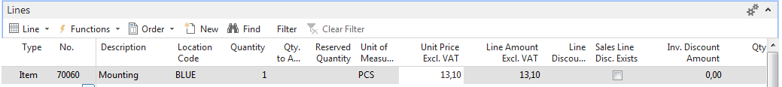
Sales Order with low unit price
Customer =10000

Slide 18
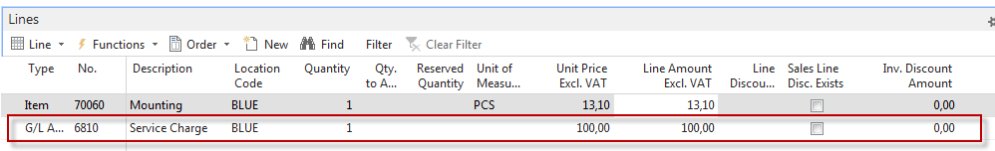
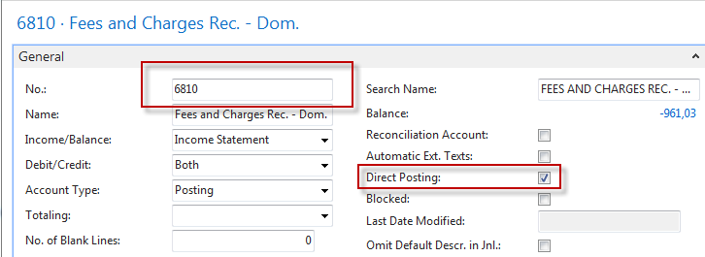
Sales order with low unit price
Customer =10000
Header
Therefore, we had to add one more line so that the invoice's total amount would match the terms of the billing discount. We used instead of item to sell services on a specific account

Slide 19
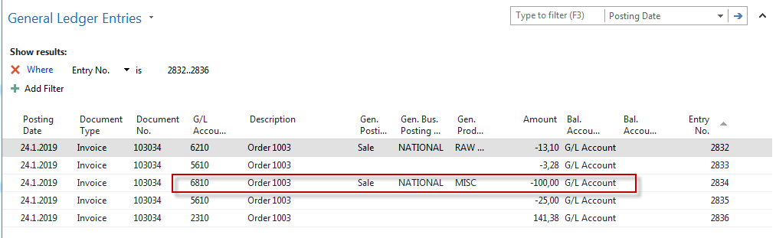
G/L Entries after posting F9
141,38 | 100,00
 | 25,00
 | 3,28
 | 13,10
141,38 | 141,38
Last task: print posted invoice to see granted discounts. It would help if you went to
Customer ledger entries, use tool, Navigate to show posted invoice and then
to print it.

Slide 20
Best price calculation
When you have recorded special prices and line discounts for sales
and purchases, Dynamics NAV ensures that your profit on item trade is always
optimal by automatically calculating the best price on sales and purchase
documents.
The best price is the lowest permissible price with the highest permissible line discount
on a given date. Dynamics NAV automatically calculates this when it inserts
the unit price and the line discount percentage for items
on new document and journal lines.

Slide 21

End of the section
(Discounts)
This is the end
Beautiful friend
This is the end
My only friend, the end…
So why worry now ……

