Slide 1
Nonprofit-government relations: The public policy and advocacy perspectives

Slide 2
Content
Roles of CSOs
Government, Advocacy and Civil Society: Overview of the Government-Nonprofit Relations
Public policy perspective
Advocacy perspective

Slide 3
Civil society organizations
CSOs: non-state, non-for-profit groups that are separate from the state and the market
Non-profit organizations, interest groups, professional chambers, labor unions, social movements
NPOs: organizations that are privately incorporated, but serve some public purpose (social responsibility)

Slide 4
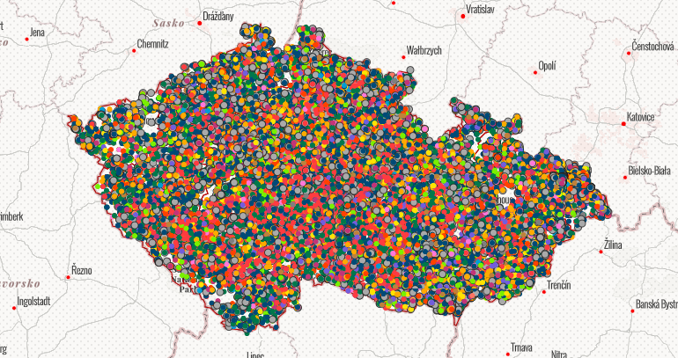
Nonprofit organizations in CZ

Slide 5

NPO in Brno

Slide 6
Why are they important?

Slide 7
Functions of NPOs
Social capital (“the features of social organization, such as networks, norms, and trusts, that facilitate coordination and cooperation for mutual benefit”)
Economic role
Religious role
Service
Policy (e.g. Implementing public policies)
Advocacy (e.g. Building up civic/civil society. Central to prosperous and successful democracies)
…Significant actors at global level (international perspective)

Slide 8
NPOs and government relations: Overview
Complex relationship based on different aspects: funding, tax policy and regulations towards NPOs, direct government support, non-monetary support, involvement in policy and advocacy activities, etc.
Dynamic relationship
Legal perspective
Public policy perspective
Advocacy perspective

Slide 9
Public policy perspective
Involvement of NPO in policy-making
One of principal functions of NP sector, major contribution to society, promoting common good
Pressuring government to respond to disadvantaged groups
Theoretical models: based on the character of relationship Weisbrod, 1988; Douglas, 1987; Salamon, 1995, 2002; Young, 2000; Najam, 2000

Slide 10
What is the character of relationship?
Public
Sector
(Government)
Substitute and supplement (Weisbrod, 1988; Douglas, 1987)
Complement (Salamon, 1995, 2002)
Adversary
Nonprofit
Sector
For-Profit
Sector

Slide 11
Why should NPO participate in policies and policy-making?

Slide 12
Involvement of interest groups
Pros/benefits:
  Strengthens representation
  Public debate encouragement
  Expanding the space for political participation
  Barriers to abuse of power
  Ensuring political stability
Cons/critique:
  Lobbying = "buying" political influence
  Consolidating political inequality
  Failure to contribute to political integration
  Exercising Illegitimate power
  Tendency to "secrecy" in politics

Slide 13
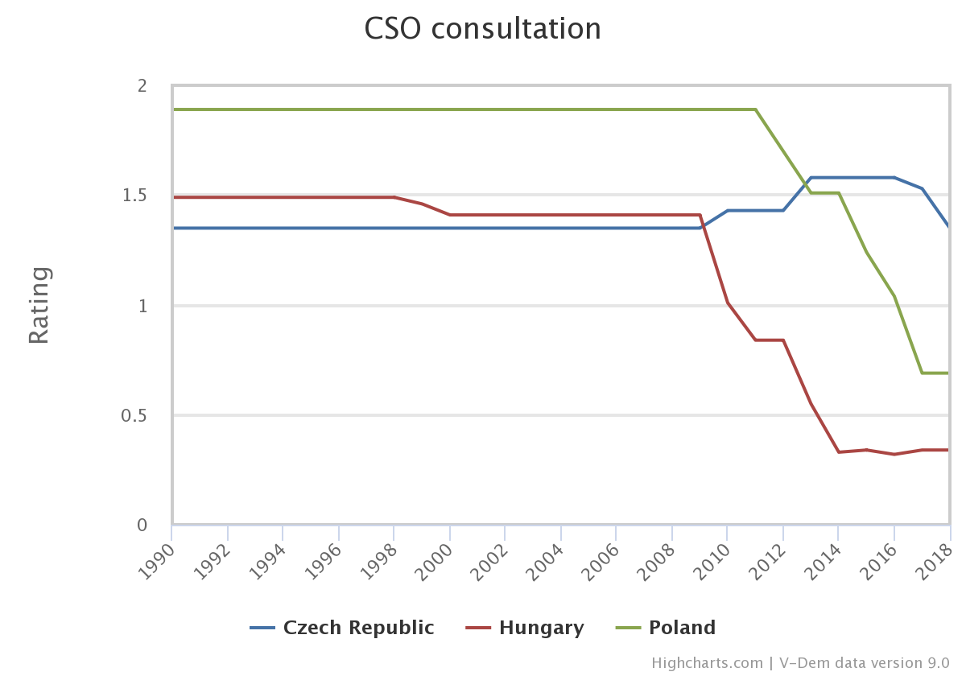
Are major civil society organizations (CSOs) routinely consulted by policymakers on policies relevant to their members?

Slide 14
Advocacy perspective
Builds heavily on political sociology
CSOs crucial vehicles for advocacy and civic participation
CSOs = an opportunity for citizens to become engaged in politics
Investigates whether and how CSOs give citizens a voice for political participation, provide avenues for societal integration
1) Mediate and facilitate participation
2) Engage in public-interest advocacy activities

Slide 15
Social movement theory argument
Two sectors are deeply intertwined, but conflictual relationship with government
What are social movements?
How can we describe a government–nonprofit relationship from social movement perspective?

Slide 16
A cycle
1) First with private concerns, private action (informal, no legal status)
2) The movement may evolve into formal organizations – translates public concerns into public issues, lobby government
3) Successful SMO may influence government policy
4) Government responds
5) SMO addresses public issues again

Slide 17
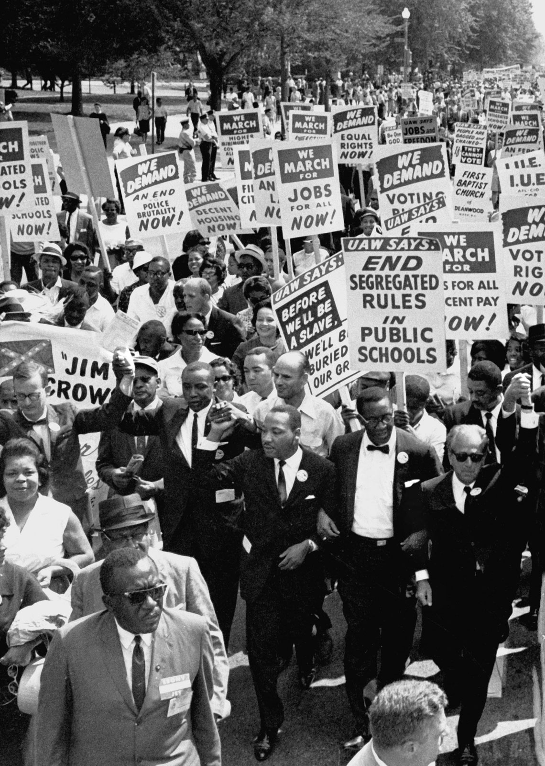
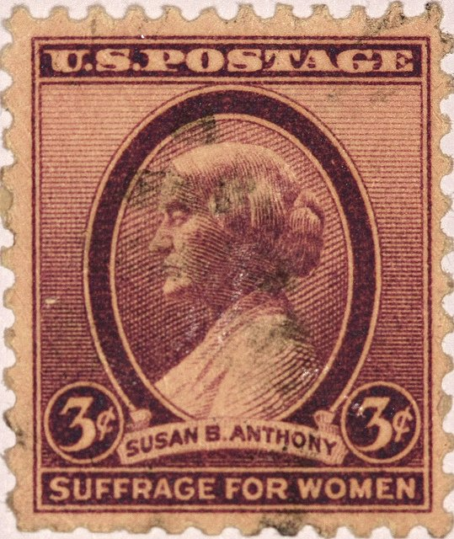

Slide 18

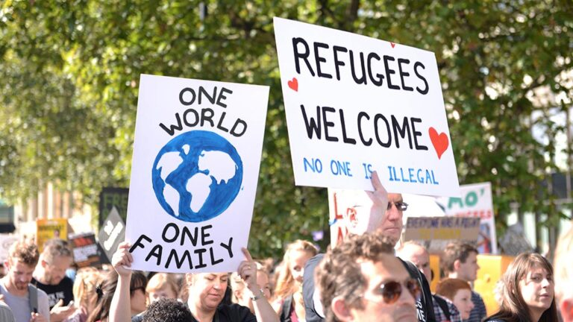
CSOs during migration crisis
Refugees welcome movement (across Europe)
Appeal for humanity (Výzva k ľudskosti) (Slovakia)
Global Migration Journey: #sharethejourney
…

Slide 19
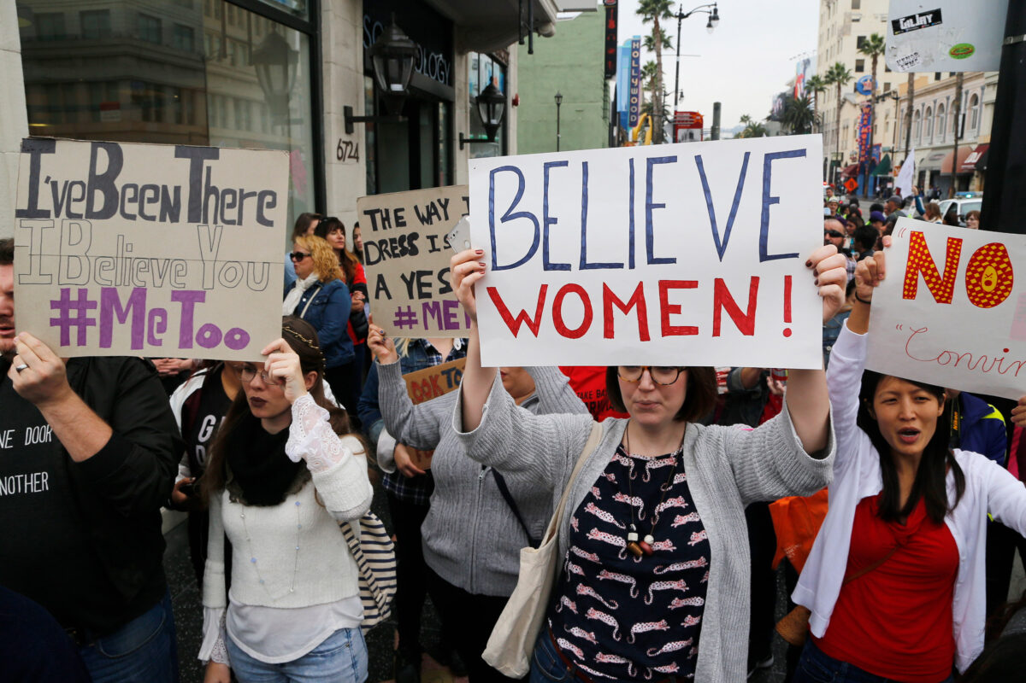
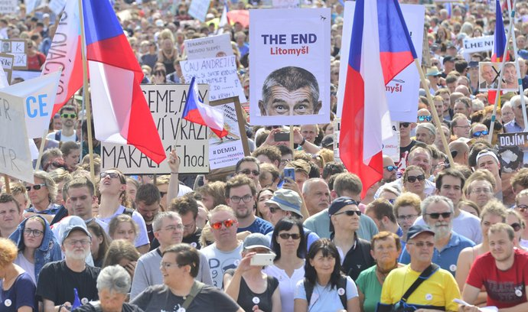

Slide 20
Public interest advocacy
NPO’s crucial civic function: to “correct imbalanced political representation by ensuring that a broader set of interests are voiced” (Jenkins, 2006)
Goal: To influence government decisions; to shape the policies of private institutions and corporations; or to encourage political participation

Slide 21
What are reasons to advocate?

Slide 22
Reasons to advocate
Focusing public attention on key social problems and solutions
Increasing the base of knowledge on which innovative policy is formed
Policymakers need expertise
Ensuring access for new and unheard voices
Fostering governmental accountability to citizens
Promoting democratic values (freedom of expression, pluralism, ...)
Giving citizens a personal sense of civic skills in the democratic process (can make a difference, can change laws)
The views of local nonprofits are important

Slide 23
Challenges for (some) CSOs’ activities
Negative framing of civil society organizations and NPOs (mostly dealing with human rights or minority issues) by political elites
Worsening public image (mostly Central and Eastern Europe)
„Agents of neomarxims“ and liberalism (populist discourse)
Tools of foreign interests (Soros and „his plan“) – e.g. CEU Uni
In Czech context: „ngo-ism“ (Václav Klaus)
Declining civic engagement

Slide 24
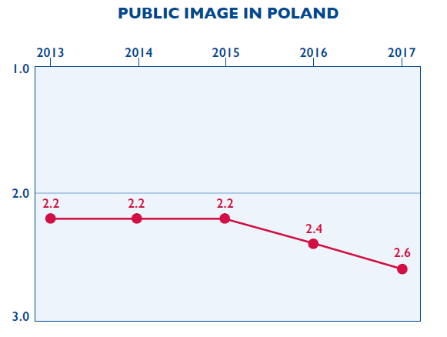
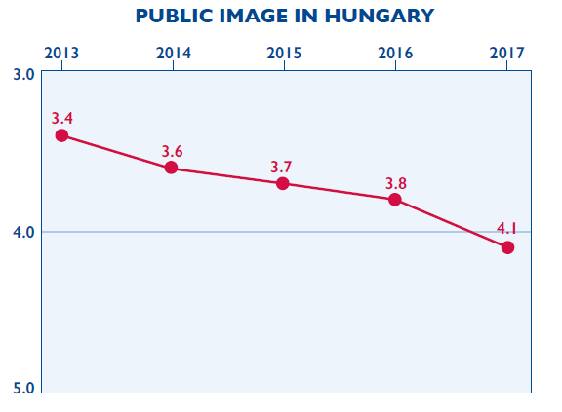
Public image of CSOs
Source: 2017 CSO Sustainability Index

Slide 25
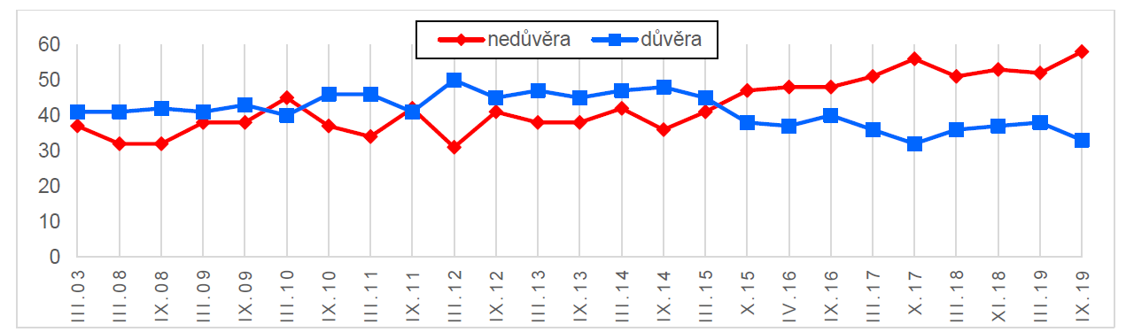
Trust in NPOs (CZE)

Slide 26
CSOs responses
Have had to become more sophisticated
Created more complex organizational structures
Taken advantage of new technologies – Internet activism fundamentally altered civic participation and advocacy
Invested in effective research
Increasingly turned to collaborations, including some with business organizations

Slide 27
Citizen Lobbying: How Your Skills Can Fix Democracy
By Alberto Alemanno (at TEDxBrussels)
https://www.youtube.com/watch?v=WqNf2OPdu8c

Slide 28
Going the Digital Route
By Marci Harris, a former congressional staffer, founded Popvox, a non-partisan platform to engage digitally with Congress https://www.youtube.com/watch?v=5aKyYR-iWpc

Slide 29
Advocacy Through Social Media: Why Trending Topics Matter
By Karen McAlister (at TEDxUTA)
https://www.youtube.com/watch?v=o4sGLLaLq-Q

Slide 30
Thank you for your attention

