Slide 1
CONTESTABILITY
AND MARKET REGULATION
Juan Montero

Slide 2
CONTESTABILITY AND MARKET REGULATION
1. Introduction. The traditional paradigm.
2. Baumol: The theory of contestable markets.
3. Contestability and market liberalization.
4. Contestability and digital markets.

Slide 3
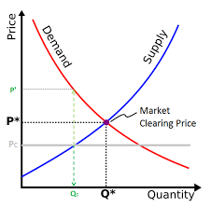
1. Introduction
The neoclassical paradigm relies on assumptions:
  Perfect competition between a high number of sellers and buyers, all parties have rational preferences, individuals maximize utility and firms maximize profit, homogeneus product, there is full information, no barriers to entry or exit…
But the “real world” rarely is in line with such assumptions.
Is it possible to define an alternative model with no or more realistic assumptions, starting with the high number of players?

Slide 4
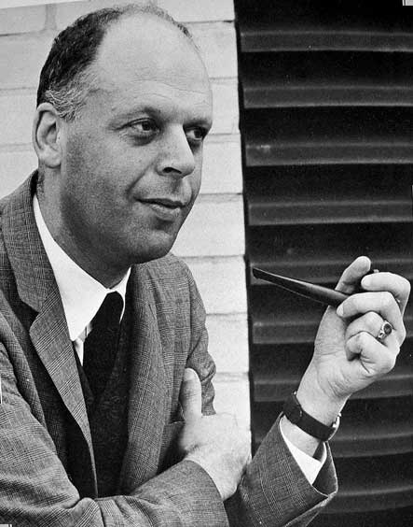
2. Baumol: The theory of contestable markets
In 1982 William Baumol publishes:
  “Contestable Markets and the Theory of Industry Structure” (with Panzar and Willig).
  "Contestable Markets: An Uprising in the Theory of Industry Structure",
    https://www.sfu.ca/~wainwrig/Econ400/Baumol-contestableMkts.pdf
It is not necessary to have a high number of competitors if:
  IF … there are no barriers to entry or exist… Hit-and-run competition:
  A price above marginal price and abnormal profits will attract competitors.
  Potential competition is enough for welfare maximization.
  No need of a “perfect competition” model.
  The number of competitors, the market structure, is not relevant.

Slide 5
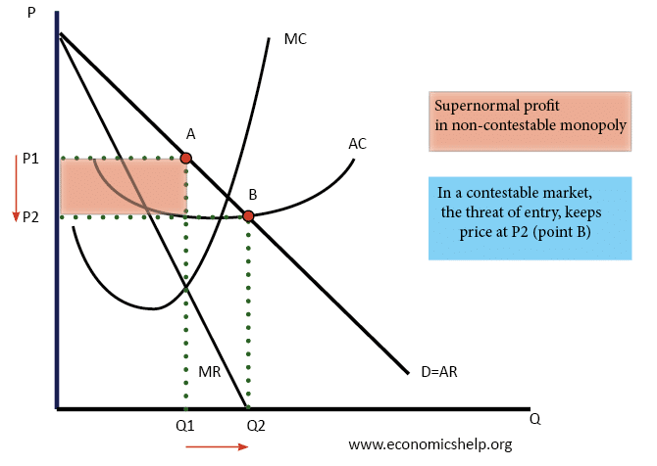
2. Baumol: The theory of contestable markets

Slide 6
2. Baumol: The theory of contestable markets
Market structure (number of competitors) is not relevant:
  “In free markets, there is an “endogenous determination of industry structure”: “natural duopoly”.
Contestable markets evolve in the long run to efficient: 1) Equilibrium prices; 2) Outputs; 3) Industry structure.
CONCLUSION
“Whatever industry structure minimize total costs for the equilibrium output vector must turn out to be the only structure consistent with industry equilibrium in the long run”.

Slide 7
2. Baumol: The theory of contestable markets
Policy consequences:
  Reduce competition law intervention: “absence of entry in an industry and a high concentration index may be signs of virtue, not vice”.
  Eliminate entry-and-rate regulation: “questionable desirability of artificial impediments to entry, such as regulators were long inclined to impose”.
An uprising!

Slide 8
2. Baumol: The theory of contestable markets
Are markets contestable in reality?
Market entry is usually free… but it is not costless or easy:
    Intellectual property, technology advantage, difficulty and relevance to grow scale.
  Equally important is free exit:
    No sunk costs.
    No labor costs.

Slide 9
3. Contestability and market liberalization
    POLICY: Eliminate legal barriers to entry: exclusive or special rights, as in most transport modes.
    BUT THEN: Engage in an active regulatory policy to reduce barriers to entry (and exit). Regulation for competition, not against competition.

Slide 10
3. Contestability and market liberalization
    No tying: so vertical unbundling of infrastructure management and service provision (rail, electricity).
    Reduce barriers to entry (and exit):
      crate pools of rolling stock to be leased (not acquired) by rail undertakings.
      Allow access to third party ticketing facilities.
    Create “small” markets in the form of concession contracts for medium term.
    No lock-in: number portability in telecoms.

Slide 11
4. Contestability and digital markets
    Regulation (EU) 2022/1925 of the European Parliament and of the Council of 14 September 2022 on contestable and fair markets in the digital sector and amending Directives (EU) 2019/1937 and (EU) 2020/1828 (Digital Markets Act)
    Obligations imposed on gatekeepers (very large platforms) in core platform services (search engines, social networks, online intermediation services, operating systems, etc).
    Novelty: no previous exclusive or special rights (as in liberalization).
    But: maybe anticompetitive behavior led to winner-take-all.
    Very “orthodox” approach, going back to Baumol!

Slide 12
4. Contestability and digital markets
No lock-in (data portability).
Art. 6(9): “The gatekeeper shall provide end users and third parties authorised by an end user, at their request and free of charge, with effective portability of data provided by the end user or generated through the activity of the end user in the context of the use of the relevant core platform service, including by providing, free of charge, tools to facilitate the effective exercise of such data portability, and including by the provision of continuous and real-time access to such data”.

Slide 13
4. Contestability and digital markets
Data as a barrier to entry to search engine market: access to data.
Art. 6(11): “The gatekeeper shall provide to any third-party undertaking providing online search engines, at its request, with access on fair, reasonable and non-discriminatory terms to ranking, query, click and view data in relation to free and paid search generated by end users on its online search engines. Any such query, click and view data that constitutes personal data shall be anonymized”.

Slide 14
4. Contestability and digital markets
Interoperability in communications platforms (WhatsApp, Skype) as in telephony:
Art. 7: “1. Where a gatekeeper provides number-independent interpersonal communications services […] it shall make the basic functionalities of its number-independent interpersonal communications services interoperable with the number-independent interpersonal communications services of another provider offering or intending to offer such services in the Union, by providing the necessary technical interfaces or similar solutions that facilitate interoperability, upon request, and free of charge.
2. The gatekeeper shall make at least the following basic functionalities referred to in paragraph 1 interoperable where the gatekeeper itself provides those functionalities to its own end users:
(a) following the listing in the designation decision pursuant to Article 3(9):
(i)end-to-end text messaging between two individual end users; (ii) sharing of images, voice messages, videos and other attached files in end to end communication between two individual end users;
(b) within 2 years from the designation:
(i) end-to-end text messaging within groups of individual end users; (ii) sharing of images, voice messages, videos and other attached files in end-to-end communication between a group chat and an individual end user;
(c) within 4 years from the designation:
(i) end-to-end voice calls between two individual end users; (ii) end-to-end video calls between two individual end users; (iii) end-to-end voice calls between a group chat and an individual end user; (iv) end-to-end video calls between a group chat and an individual end user”.

Slide 15
DISCUSSION juan.montero@eui.eu

