Slide 1

Economic Policy
Lecturer: Monika Jandová
jandova@econ.muni.cz

Slide 2
Assessment methods
Policy seminar paper + presentation = project (1/2; max. 100)
  During the last 3 lessons
  Topic list will be published, students will enroll
  Each presentation should last around 5’ and be based on ppt or equivalent handout
Final written exam (1/2; max. 100)
  List of questions will be available in the Interactive Syllabus

Slide 3
Important dealines
30. 9. 2022: Announcement of project topics ("Topic Lists")
4. 10. 2022 till 31. 10. 2022:Enrollment to project topics via Information System
25. 11. 2022: Submitting the project to Homework Vault ("Project")
!!! Follow the instructions in the Interactive Syllabus / read emails !!!

Slide 4
Course contents (subject to change)
— Concepts of Economic Policy (L#01) ̶ Foreign Economic Policy (L#06)
— Limits of Economic Policy (L#02)
— Growth Policies (L#07)
— Fiscal Policy (L#03)
— Labor Market Policy (L#08)
— Monetary Policy (L#04)
— Social Policy (L#09)
— Competition policy (L#05)
— Policy seminars (L#10-12)

Slide 5
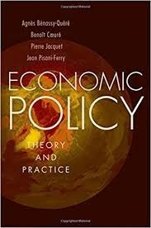
Recommended literature
— HPO-832

Slide 6
The concept of economic policy
I.

Slide 7
The Concept of Economic Policy
Approaches to economic policy
Objectives of economic policy
Functions of economic policy
Why intervene?

Slide 8
Economic Policy
— the actions that states (governments, central banks) take in the economic field
Microeconomics
„Real world“
Political Science
Macroeconomics
Economic Policy
Law

Slide 9
Three approaches (1/2)
Positive economics:
  Economists are outside observers
  Studying the effects of economy policy (EP) choices on the economy => EP is regarded as exogenous
  Determining transmission channels (e.g. impact of an interest rate cut)
Normative economics:
  Economist is adviser
  Making recommendations to the Prince
  Based on positive-economics results
  Needs other instruments to compare alternative solutions

Slide 10
Three approaches (2/2)
Political economics
  Viewpoint of an external observer
  Political decision-maker is part of the market
  Government is a machine directed by rational players with specific objectives and facing specific constraints
e.g. objective of politicians is to maximize their re-election chance
— Role of economist is to study processes and the incentives, which influences the economic policy

Slide 11
The main tasks of policymakers
Set and enforce the rules of the economic game (competition policy, bank regulation, protection of private property etc.)
Tax and spend (governments spend 35-50 % GDP)
Issue and manage the currency (central banks)
Produce goods and services (health care, education)
Negotiate with other countries

Slide 12
A general framework of EP making
Policymaker
Objectives
Instruments
Limits
Political context
Institutions

Slide 13
Role of institutions
Douglass North (1993): “Institutions are the humanly devised constraints that structure human interaction. They are made up of formal constraints (rules, laws, constitutions), informal constraints (norms of behavior, conventions, and self imposed codes of conduct), and their enforcement characteristics.”
Institutional framework affects directly market equilibriums and effectiveness of EP instruments.

Slide 14
Objectives of EP (examples)
Humphrey-Hawkins Act (USA):
  “promote full employment and production, increased real income, balanced growth, a balanced Federal budget, adequate productivity growth, proper attention to national priorities, achievement of an improved trade balance..”
Article 3 of the Treaty on the EU:
  “work for the sustainable development of Europe based on balanced economic growth and price stability, a highly competitive social market economy, aiming at full employment and social progress, and a high level of protection and improvement the quality of the environment.”
=> Objectives of EP are numerous and sometimes contradictory.

Slide 15
EP as a succession of trade-offs
Number of instruments < number of objectives
=> there are inevitable trade-offs
To reach an independent objectives government needs at least an equal number of EP instruments
̶ => Tinbergen rule: to reach an independent objectives government needs at least an equal number of EP instruments.

Slide 16
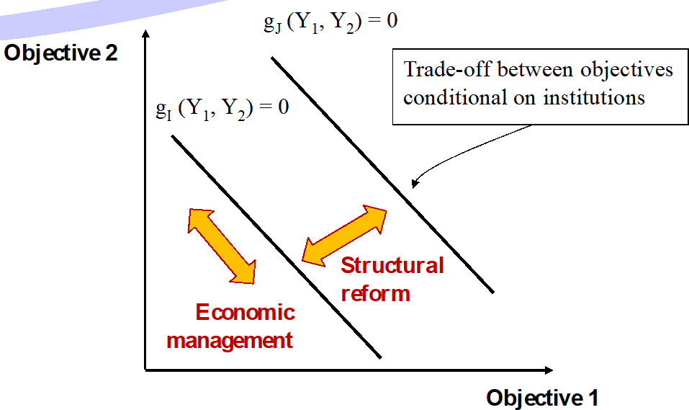
Economic management vs. structural reform
Economic management uses standard instruments such as tax rates, interest rates and public spending.
Structural reforms aim to modify EP trade-offs by changing the institutions (CB independence, choosing a currency regime, adopting framework for budgetary policy etc.)

Slide 17
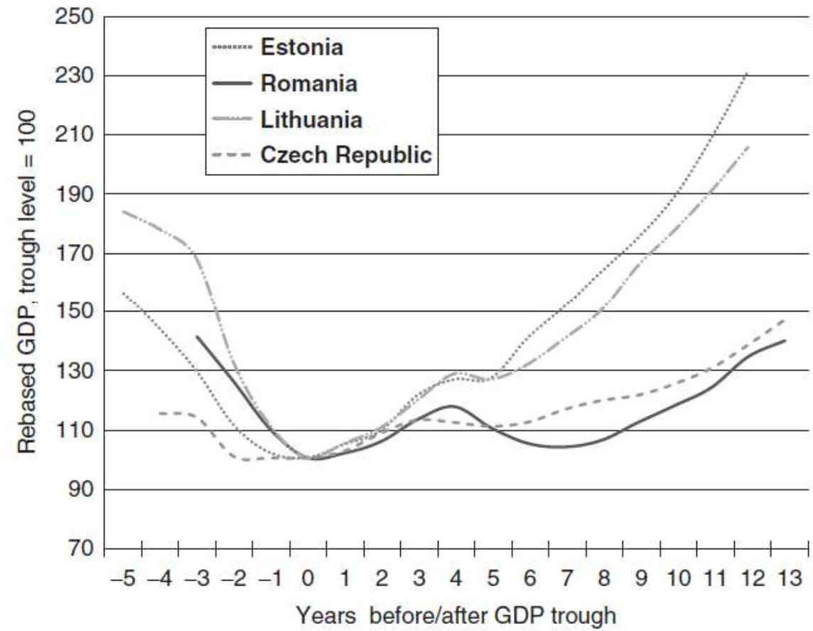
Structural reforms in post-communist countries
Structural reforms often have negative short-term, but positive long-term effects.

Slide 18
Functions of economic policy
Allocation
Macroeconomic stabilization
Income redistribution

Slide 19
Ad 1) More on allocation
Assignment resources to alternative uses which should help to market efficiency (state intervention is justified when it can remedy market failures)
Imperfect competition:
  Instruments: antitrust, intellectual property, regulation etc.
Externalities (an effect of production or consumption on agents who were not participate in the decision to produce or consume):
  Instruments: regulation, taxes
Imperfect information: innovation rents, consumer illiteracy, moral hazard, conflicts of interest
  Instruments: mandatory financial disclosure, financial regulation, etc.

Slide 20
Ad 2) More on stabilization
— J. M. Keynes (1883-1946):
— Private instability (‘animal spirit‘) rigidities)
+ ineffective self-correcting mechanisms (nominal
̶ → Need for counter-cyclical policies to smooth out economic fluctuations and prevent economic depressions.

Slide 21
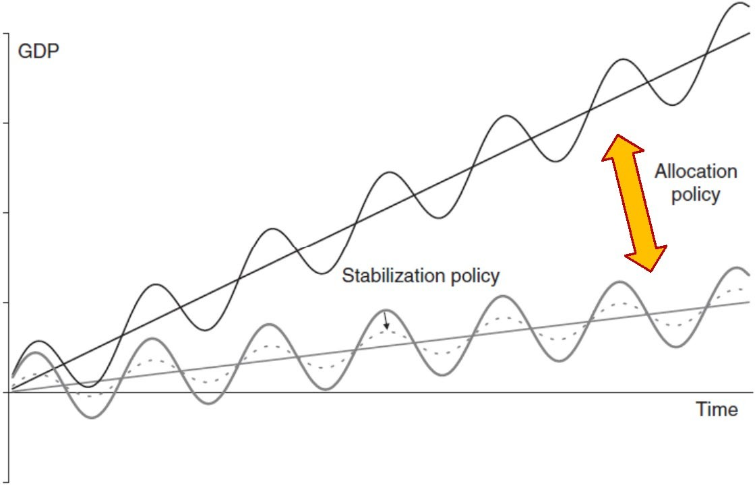
Stabilization vs. allocation policies
Allocation policies impact potential output
Stabilization policies impact the output gap

Slide 22
Ad 3) More on redistribution
Two arguments:
  Pareto optimality does not ensure social justice
  Efficiency-enhancing policies (e.g., free trade) make winners and losers
Income distribution can be corrected in a non-distortionary way through lump-sum transfers
Difficult to implement in practice => frequent equity-efficiency trade-offs

Slide 23
Reference textbook
— Bénassy-Quéré, A. et al. Economic Policy: Theory and practise. Oxford University Press, 2010. Chap. 1.1. - 1.2

