Slide 1

Limits of Economic Policy
II.

Slide 2
Economic Policy
— the actions that states (governments, central banks) take in the economic field
Policymaker
Objectives
Instruments
Limits
Political
context
Institutions

Slide 3
The expansion of the role of the public sector
The 20th century saw a gradual but large expansion in the role of the state in the economy because:
  Political and ideological factors:
  Marxist and socialistic thinking (government should play significant role in redistributing income, shift toward a „mixed“ economy)
  Keynesian thinking (countries with large public sector were believed to be less subject to business cycles)

Slide 4
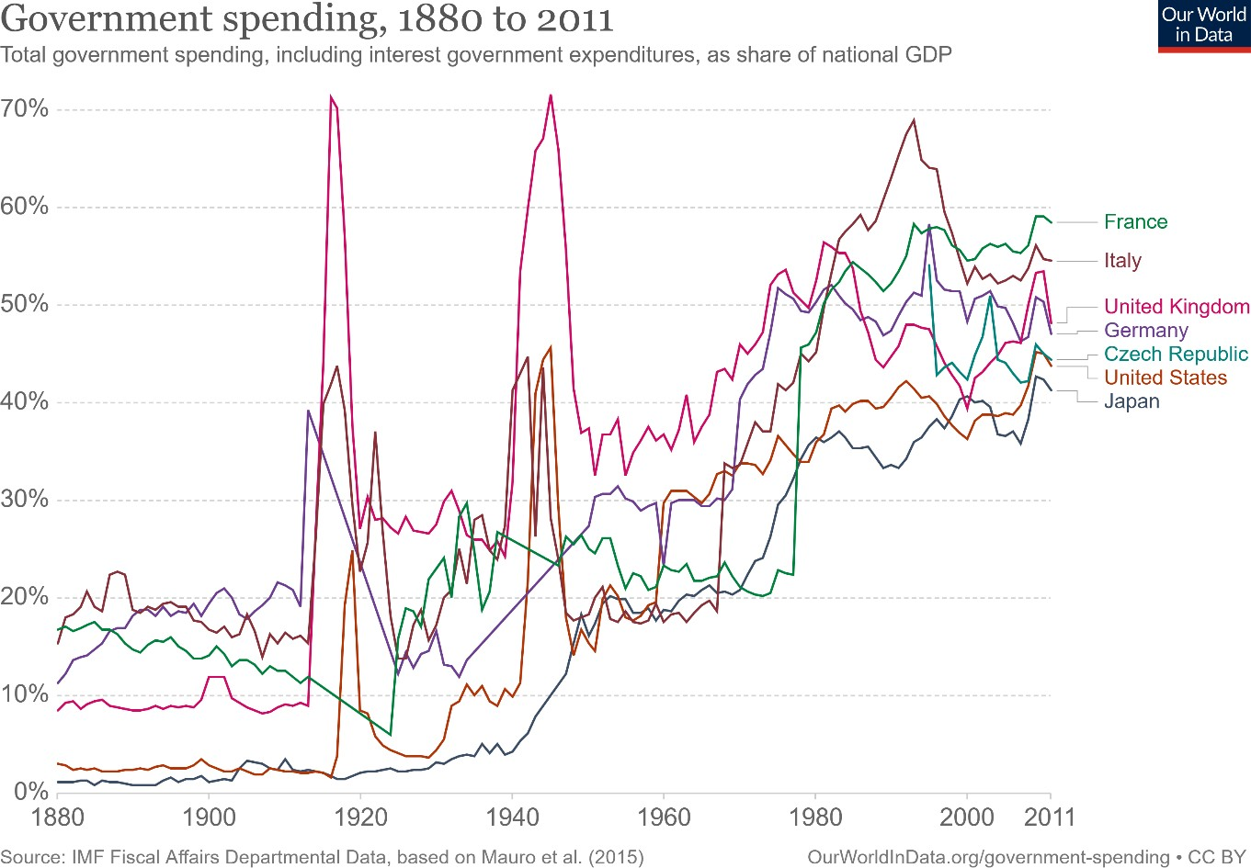

Slide 5
The expansion of the role of the public sector
It was implicitly (if not explicitly) assumed that:
  The governments had abilities lacking in the private sector (better managerial skills, higher level of expertise, sufficient amounts of capital)
  The actions of the public sector were driven by the objective of promoting social welfare
  Economic decisions were made in rational and transparent way
  Policymakers have all relevant info and full control over the policy instruments

Slide 6
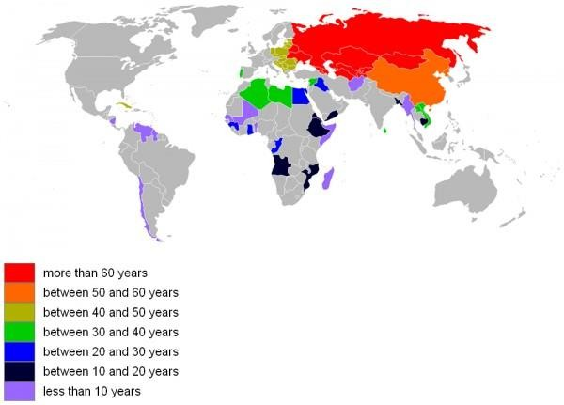
Socialist economy at some point

Slide 7




Nationalisation in Western Europe
Spain
  1944: Iberia
  1945: 79 % of Telefónica
United Kingdom
  1946: Coal industry
  1947: Central Electricity Generating Board
  1948: National rail and inland water transport
  1967: British Steel Corporation
France
  1945: Crédit lyonnais, Société générale, Renault
  1946: Electricite de France, Gaz de France
Sweden
  1939-1948: private railway companies
  1957: the mining company LKAB

Slide 8
The end of naive picture
Governments are not as omniscient and omnipotent as was implicitly assumed after WWII till 1970s.
There are five main limits to the “traditional” approach to EP:
Governments have imperfect knowledge about the structure of economy and of future risks.
Firms and households devise their own strategies, and they react to (and anticipate) economic policy measures.
Governments may not be able to convince private agents that they will actually do what they have announced.
Policymakers may not have the information they need to take decisions.
Policymakers may not pursue the general interest.

Slide 9
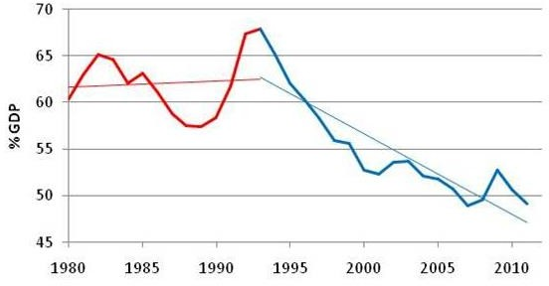
Sweden´s government spending

Slide 10
The limits of knowledge: uncertainty and risk
A government is not able to predict the consequences of some action exactly
=> uncertainty about adequate choice of policy tools
The government does not have all the information to take action, but it cannot wait until it has all the information.
Many policy decisions have irreversible consequences
=> e.g., joining Eurozone

Slide 11
Uncertainty and risk
Exchange rate: 24,6 Crude oil Brent: 91 USD

Slide 12
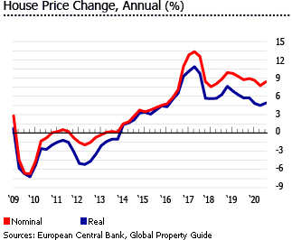
Current forecast risks and uncertainty
Cut of natural gas supplies from Russia
to the European Union
COVID-19
Inflation expectations
Fiscal consolidation
Labour market
Integration of refugees from Ukraine
Overvaluation of residential
property prices

Slide 13
Time lags
Cognitive delay
Planning delay
Administrative delay
Implementation delay
Efficiency delay
Monetary Policy – 18 months

Slide 14
The limits of confidence: credibility problems
Arise from intertemporal inconsistency = time inconsistency
= a temptation for government to mislead private agents in the name of general interest ex post and ex ante optimal policies do not coincide.

Slide 15
The limits of confidence: credibility problems
Example:
A government announces a decrease of taxes on fixed capital to encourage investment. Then it abandons the promise because it is socially optimal ex post to finance public goods by taxing capital. What will be the result?
Another application to monetary policy, exchange-rate policy, management of the public debt
Unfulfilled promises undermine confidence in EP and hamper its effectiveness.
How can the credibility problem be solved?

Slide 16
The limits of confidence: credibility problems
Solutions:
  Delegation to independent agencies: central banks, regulatory agencies,…
  Banish discretionary policies and follow fixed policy rules: inflation targeting, fiscal rules, agreements for the promotion and protection of investments
  Transparency

Slide 17
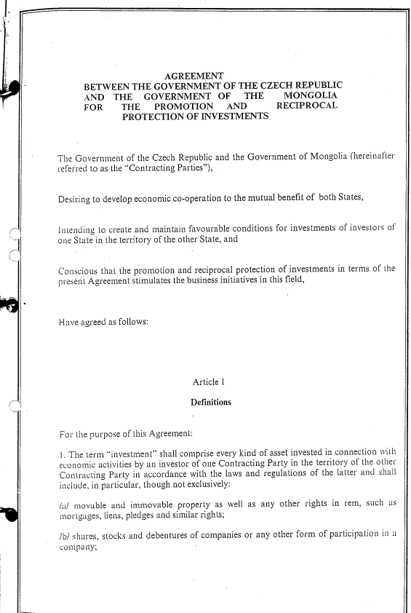
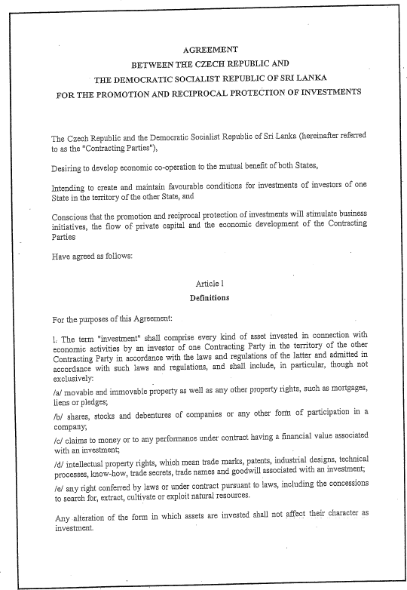
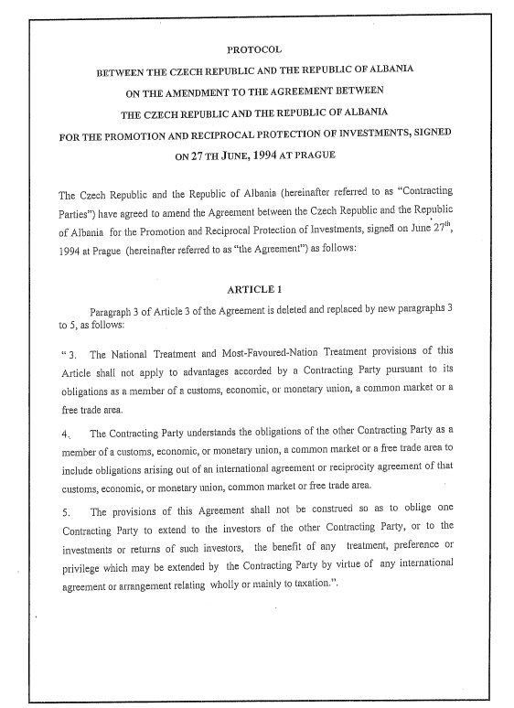
Examples of Agreement for the promotion and protection of investments

Slide 18
The limits of confidence: moral hazard
Arise when probability of government intervention changes private behavior and induces more risk taking
Examples: IMF interventions in emerging countries, role of lender of last resort of the central bank, public insurance schemes…
How can the credibility problem be solved?

Slide 19
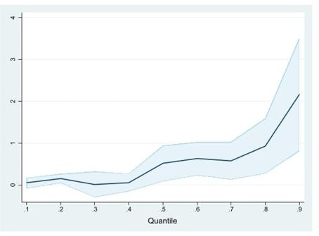
The limits of confidence: moral hazard
The impact of supplementary health insurance on doctors' visits
— A solution:
— Make public intervention rare and costly
Hansoo Ko (2020)

Slide 20
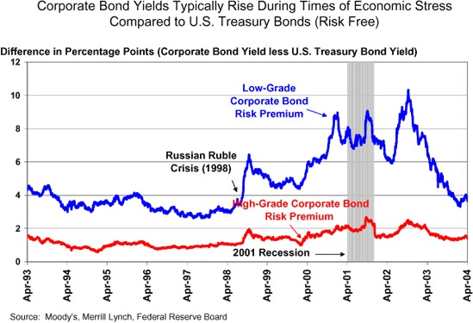
The limits of confidence: moral hazard

Slide 21
The limits of information
Policymakers do not have full access to all information
Information is used strategically by those with access to it
Risk of regulatory capture
Major issue for:
  Regulation and supervision in technical areas (telecom, energy, finance…)
  Contracts (e.g., for provision of government-financed services such as health care)
  Internal organisation of government

Slide 22
The limits of information
Gosplan = a central planning commission in the Soviet Union
Companies had information
  Over-estimated their need for inputs
  Under-estimated their productivity
https://mises.org/library/use-knowledge-society

Slide 23
The limits of information
Principal-agent model
e.g. a relationship between lenders and borrowers, producers and consumers
Theory:
  Principal-agent model: the principal, who delegates a task to the agent, does not have info about agent’s capabilities and performance suboptimal results
Solution:
  Incentive contracts - such as performance-related compensation and promotion: e.g. Walsh contract for central bankers – the wage negatively dependent on the difference between the actual and the target inflation rate.

Slide 24
Conflict of interests
Why may politicians deviate from general interest?
  Short-sightedness (electoral cycles)
  Pressures from interest groups (“pork‐barrel politics”)
  Reelection motivation (political business cycles)
  Partisan behavior
  Divided electorate

Slide 25
Conflict of interests
Solutions:
  Incentive contracts for politicians
  Procurement rules
  Anti-bribery laws
  Delegation to independent agencies

Slide 26
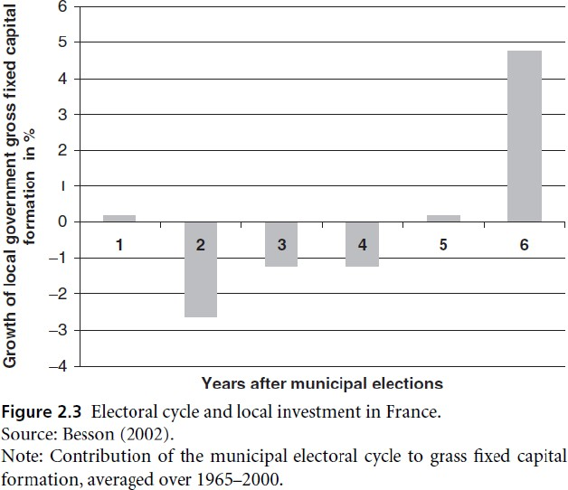
Evidence of politically‐motivated decisions

Slide 27
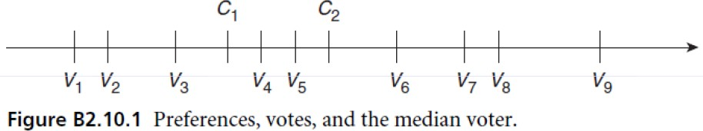
The median voter
— A voter chooses the party whose preferences are close to his or her own:
e.g. voters V1 to V4 will for example vote for candidate C1 and voters V5 to V9 to candidate C2.
—If there are only two parties (left‐wing and right‐wing), they will converge on the preference of the median voter V5 a limited programme differentiation

Slide 28
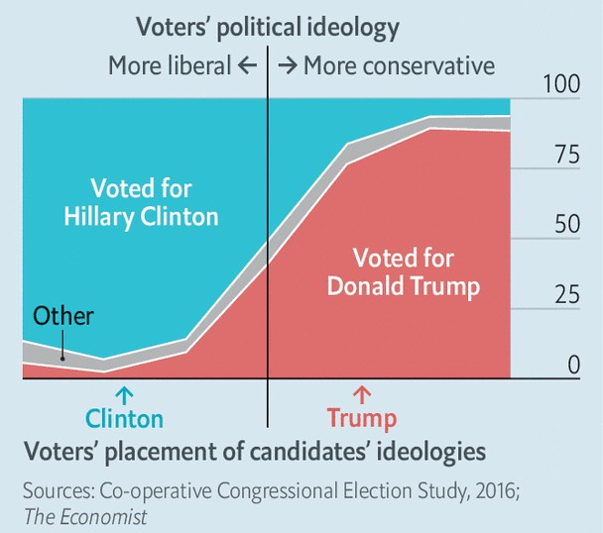
The median voter

Slide 29
Should policymaking be delegated?
Technocrats are better in presence of:
  Technical complexity (e.g., financial/safety regulation)
  Stable social preferences
  The decisions in question and their effects are not easily observable by voters (merger control)
  The decision with vulnerable to time inconsistency
  The decision affect the distribution of income between generations

Slide 30
Should policymaking be delegated?
But decision needs to remain political when:
  Social preferences are unstable
  Policy involves unavoidable trade‐offs
  Policy involves significant redistributions within generations

Slide 31
Reference textbook
— Benassy-Quéré, A. et al. Economic Policy: Theory and practise.
Oxford University Press, 2010. Chap. 2.1

