Slide 1

Monetary Policy
IV.

Slide 2
Overview
Money is old device, but the concept of monetary policy (MP) emerged during interwar period = emerged after hyperinflation experiences of the 1920s
During 50s and 60s MP was eclipsed by ﬁscal policy and primarily concentrated on minimizing the cost of public borrowing
In the 70s the role of MP was reassessed as a consequence of the made in the response of the inflationary shocks (+ independence)
By the late 90s MP geared toward achieving price stability
Financial crisis in 2008 highlighted the role of CB as guarantors of ﬁnancial stability, CB engaged in unconventional MP actions

Slide 3

Terms
Inflation = an increase in the general price level
in the economy
Deflation = price level falls
Rising inflation = the price level is increasing at an increasing rate
Disinflation = falling inflation (the inflation rate is falling)
Core inflation = change in the costs of goods and services but does not include those from the food and energy sector

Slide 4

What’s wrong with inflation?
Redistributing income from creditors and those on nominally fixed incomes to debtors
  = decline in nominally fixed incomes (like pensioners)
  = decline in real interest rates
real interest rate (%) = nominal interest rate (%) − the inflation rate (%) (Fisher equation)
Big price changes create uncertainty and make it more difficult for households and firms to make decisions based on prices.
Menu costs (the resources used in setting and changing prices)
Shoe leather costs (inflation increases the opportunity cost of holding cash; it is still needed to carry out transaction “more trips to a bank“

Slide 5

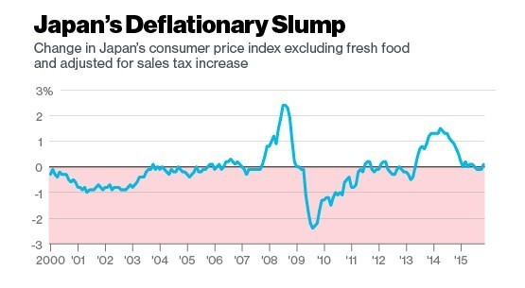
What’s wrong with deflation?
When prices are falling, households will postpone consumption (because they expect goods will be cheaper in the future)
Redistributing income from debtors to creditors and those on nominally fixed incomes
  = Increase in nominally fixed incomes
  (like pensioners)
  = Increase in real interest rates

Slide 6
Inflation x deflation
A little bit of inflation is a good thing, as long as it remains stable
Some amount of inflation gives the central bank more ability to boost the economy
Low inflation fosters investment
Low inflation helps with downward wage and price rigidities

Slide 7
What do central banks do?
Central bank = an institution that manages the currency and monetary policy, and oversees their commercial banking system
Tasks to:
Issue banknotes
Provide banks with liquidity
Impose compulsory reserves on commercial banks
Act as ’lender of last resort’ to banks

Slide 8
a + b) Liquidity provision + reserve requirements
= To maintain price stability and promote a safe and efficient payment system
Liquidity is provided through:
Open market operations (purchases of ﬁnancial assets by the CB from commercial banks)
Repurchase agreements or repos (short-term agreement between CB and commercial bank under which commercial bank sells a security to the CB and CB provides commercial bank with liquidity; CB holds the corresponding assets for a ﬁxed period)
In so doing central banks set price of liquidity and control the quantity of base money.
CB can also inﬂuence the banks’ lending behaviour through reserve requirements (the amount of funds that a bank holds in reserve to ensure that it is able to meet liabilities in case of sudden withdrawals).

Slide 9
c) Lender of last resort
Banks turn to their lender of last resort when they cannot get the funding they need for their daily business.
This can happen in periods of financial crisis, when banks may have doubts about lending to each other and lots of people may suddenly want to withdraw their money from their bank account.
CB helps protect people and businesses from the difficulties that can arise when
banks are in trouble.

Slide 10
Central bank credibility
CB credibility is very important for eﬀective MP.
How can CB enhance its credibility?
  By adequate institutional design (independence, transparency and accountability)
  By tying its hands: exchange rate peg, monetary policy rules
  By selecting conservative central bankers, i.e. more adverse to inﬂation than the average of society
  By incentive contracts

Slide 11
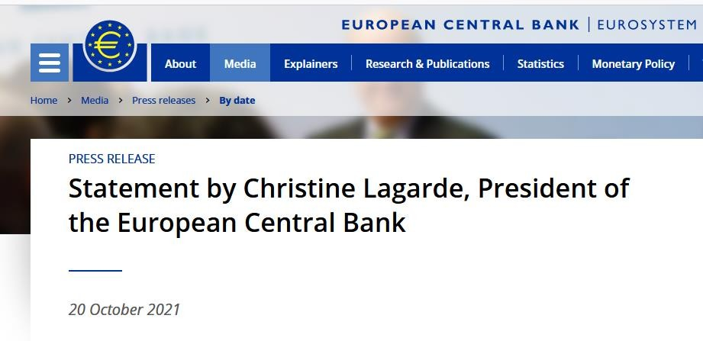
Communication
Communicating relevant information about macroeconomic fundamentals, the condition of ﬁnancial institutions and the ﬁnancial sector more generally, and the conduct of policy can reduce uncertainty.
Their communication diﬀers quite a lot
  ECB Press conference (ECB)
  Disclosure of meetings minutes and individual votes
  Disclosure of expected interest rate path by Swedish Riskbank, Bank of Norway, Fed

Slide 12
Importance of CB independence
Why is CB independence so important?
  An independent central bank is insulated from the political pressures
  Fiscal policy tends to follow a political business cycle, if central banks were subject to political approval, monetary policy would also follow this volatile pattern
  Elected politicians do not have enough knowledge to conduct monetary policy
  If the CB was hold to political interests, the government could accumulate large budget deﬁcits then turn to the CB to pay oﬀ its debts

Slide 13
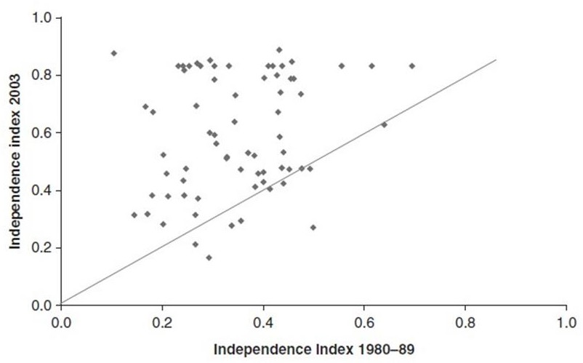
CB independence
— Increasing number of countries granted full independence to their CB during 1990s and 2000s.

Slide 14
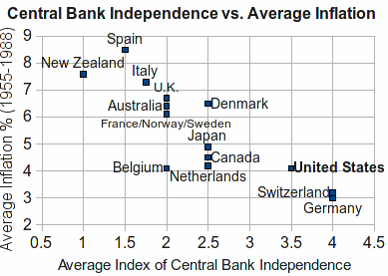
CB independence and inﬂation
— This institutional move to independence resulted from the better ability of independent CB to cope with the inﬂationary pressures

Slide 15
Central bank independence
Consider three measures of CB independence:
  Instrument independence: a central bank is free to set any monetary policy instrument
  Goal independence: a central bank is free to set its own goals for monetary policy
  Political independence: a central bank is able to conduct monetary policy without legislative inﬂuence

Slide 16
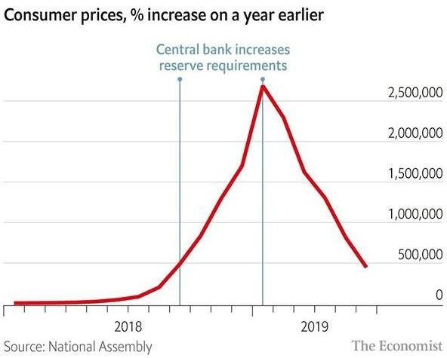
Central bank independence
40
35
30
25
20
15
10
5
0
Target Inflation rate
Turkey
Venezuela

Slide 17
The objectives of monetary policy
The objectives of MP have varied signiﬁcantly over time:
In 70s CB had broad mandates involving diﬃcult trade-oﬀs between alternative targets
After inﬂation period during 70s price stability emerged as dominant goal
Some CBs pursue other objectives simultaneously
After ﬁnancial crisis 2007-09 discussion about gearing MP more towards ﬁnancial stability

Slide 18
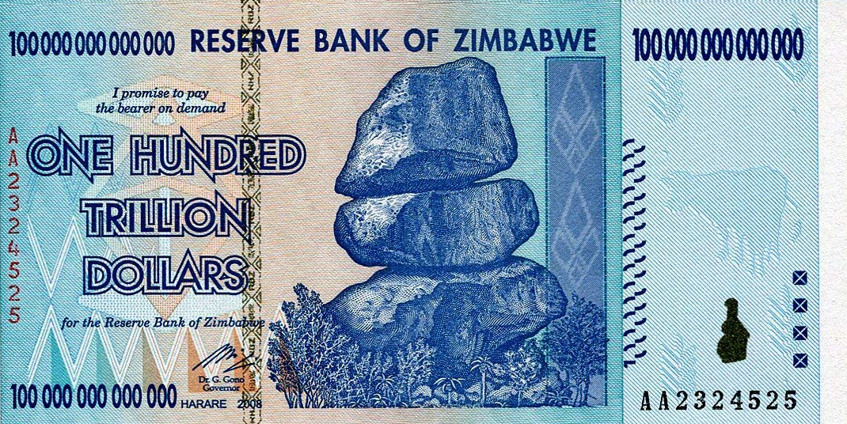
1. The objectives of MP: price stability (1/2)
To maintain the real value of money
Most central banks aim at keeping inflation Inflation should be neither too high:
Shoe leather costs, menu costs, redistribution eﬀects, implicit taxation, risk of hyperinﬂation etc.
Ex: Germany in the 1920s, Argentina in the 80s, Zimbabwe in the 2000s,..

Slide 19
The objectives of MP: price stability (2/2)
… nor too low
– Risk of deﬂation and liquidity trap (interest rates are low, saving rates are high MP is ineffective)
Most central banks have objectives between 1-3%

Slide 20
2. The objectives of MP: exchange rate stability
Until 90s transition countries relied on a ﬁxed exchange rates as a means of controlling inﬂation
MP of many European countries focused on maintaining the external value of the currency vis-à-vis some larger country (Austria and Germany)
The attraction of ﬁxed exchange rates has faded away in recent years
Apart from China, only smaller countries (Denmark, some Carribean countries) continue peg their exchange rate

Slide 21
3. The objectives of MP: output stabilisation
MP can be used to stabilise aggregate demand, i.e. support demand through an expansionary MP in recession and a restrictive MP when demand is ballooning.
The rationale for counter-cyclical MP goes back to the Great Depression in 1930s.
But desirability and eﬀectiveness of counter-cyclical MP are debated because of time lags which can transform MP into a procyclical policy.

Slide 22
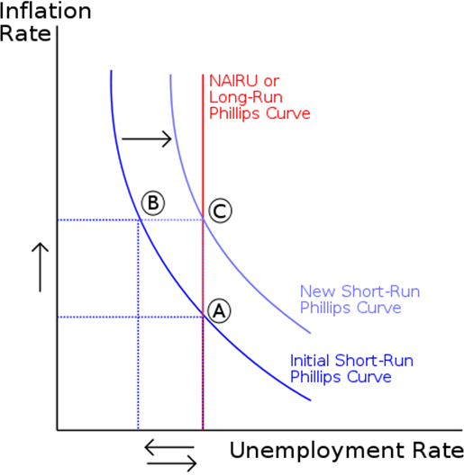
4. The objectives of MP: full employment
Full employment was one of the leading objectives of the central bank (it was mostly abandoned at the end of the 20th century)
Full employment is still a relatively important objective (most central banks would take action if employment starts keeping up)

Slide 23
5. The objectives of MP: ﬁnancial stability
Financial stability = a proper functioning of banks and financial markets
Usually not a formal objective
Lender of last-resort; CB regulates and controls commercial banks
Responsibility of the CB as a lender of last-resort to banks is inevitable, but should be exerted with great caution because of:
  Moral hazard problem
  Possible incompatibility with price stability

Slide 24

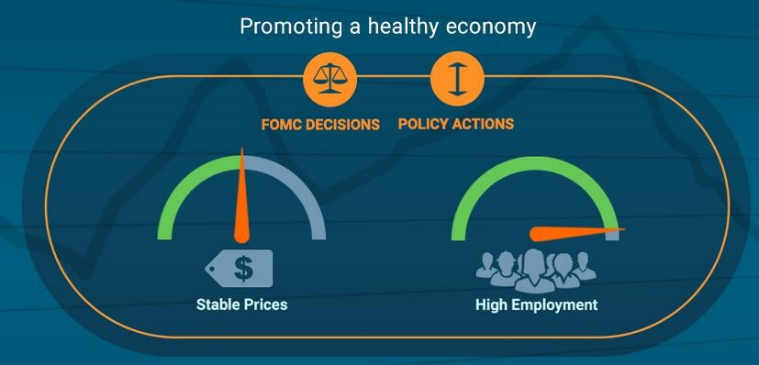
The mandates of four central banks: US Fed
Legal vehicle:
  Full Employment and Balanced Growth Act (“Humphrey Hawkins Act”)
  of 1978
Objectives:
  Maximum employment (without a fixed goal for employment)
  Stable prices, meaning low, stable inflation (2 % p. a.)
  (Financial stability)

Slide 25

The mandates of four central banks: ECB
Legal vehicle:
  EU Treaty (since Maastricht Treaty of 1992) Article 127
Objective:
  To maintain price stability (2 % over the medium term)
  Without prejudice to the objective of price stability, the ECB shall support the general economic policies in the EU with a view to contributing to the achievement of the objectives of the EU
  Financial stability is not an explicit goal of ECB

Slide 26

The mandates of four central banks: Bank of England
Legal vehicle:
  Bank of England Act, 1998
Objective:
  Price stability; deﬁnition of price stability belongs to government (2 %)
  Without prejudice to the objective of price stability, BoE shall support the economic policy of the government, including its objectives for growth and employment
  (Financial stability)

Slide 27

The mandates of four central banks: Bank of Japan
Legal vehicle:
  Bank of Japan Law, 1997
Objectives:
  Price stability (inflation 2 % p.a.), thereby contributing
  to the sound development of the national economy
  (Financial stability)

Slide 28
Mandates of CB: key diﬀerences
US Fed has dual mandate of full employment and price stability, while ECB and BoJ have not
ECB, Fed and BoJ decides on objectives, while BoE do not
Crisis has prompted fresh discussion on the central bank role in ﬁnancial stability
— Example: creation in 2011 of European Systemic Risk Board chaired by ECB President

Slide 29
Standard instruments of monetary policy
Open market operations (refinancing operations)
  Used for steering interest rates in the economy
  Executed in the form of repo operations (CB accepts liquidity from banks and in return transfers eligible securities
to them as a collateral or CB provides with liquidity to commercial banks)
Automatic facilities
  Used for providing and depositing liquidity overnight
deposit facility: commercial banks may overnight deposits of surplus liquidity with the CB
marginal lending facility: commercial banks may overnight obtain liquidity from the CB
Minimum reserves
  Every commercial bank is required to hold minimum reserves on its account with the CB
  The role is declining

Slide 30
CS: Instruments of European Central Bank (ECB)
Minimum reserves (1 % of the demand deposits and of time deposits shorter than two years)
Two overnight standing facilities:
Marginal lending facility (high rate): 1.50 %
  Marginal deposit facility (low rate): 0.75 %
              These three rates are sometimes called leading interest rates
Weekly reﬁnancing operations (competitive bids through
which ECB provides liquidity against collateral =
reﬁnancing rate (the main rate of Eurosystem): 1.25 %
Interbank rate (EURIBOR) ﬂuctuates between ﬂoor and ceiling rate and in normal time close to reﬁnancing rate.

Slide 31
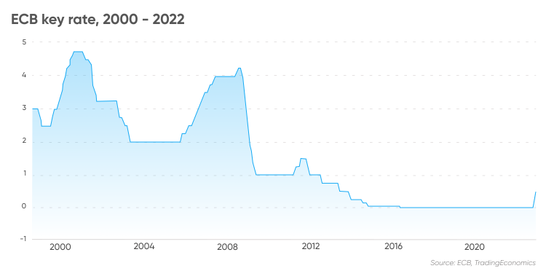
Historical ECB rates

Slide 32
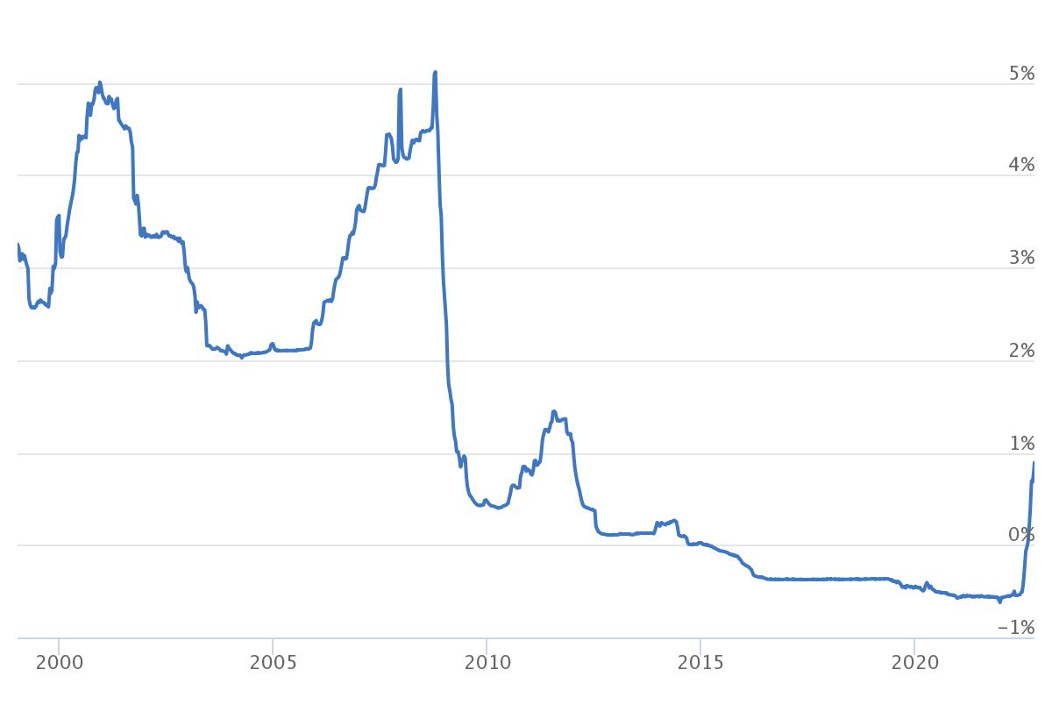
Historical Euribor rates

Slide 33
Negative interest rates
When the economy is in a slump, nominal interest rate of zero may not be low enough to get the economy going again
Negative interest rate banks are more likely to charge lower interest rates on loans to customers boost GDP growth and inflation
It can raise financial instability (it can lead to housing or stock market bubble)

Slide 34
Quantitative easing (QE)
Aim: to increase aggregate demand by buying assets, even when the policy interest rate is zero
CB buys bonds (both government and corporate) and other financial assets (it creates additional base money)
This decreases the yield and interest rate on bonds
QE lower the cost of borrowing throught the economy, including for the government
This boost spending and AD

Slide 35
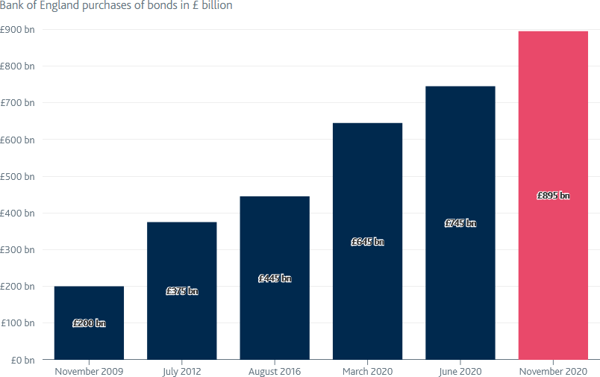
CS: Quantitative easing (QE) in the UK
2009 – Financial crisis
2012 – Eurozone debt crisis
2016 – Brexit referendum result
2020 – Coronavirus pandemic

Slide 36

Transmission channels of MP
= the way monetary policy decisions aﬀect output and inﬂation
Interest rate
Asset-price
Credit
Foreign-exchange

Slide 37
1. The interest rate channel
Traditional Keynesian channel:
  Monetary expansion in the presence of nominal rigidities leads to a fall in the interest rate, hence to a revival of investment and durable-goods consumption and via multiplier aﬀect to rise of aggregate demand (AD) inflation
  Uncertainty: CB can directly aﬀect overnight nominal interest rate, while AD rather depends on expected real long-term interest rates.

Slide 38
2. The asset-price channel
Lower interest rate raises asset prices held by households who in turn partially consume this extra wealth, which then stimulates AD inflation
The importance of this channel has increased as a consequence of the general rise in the wealth-to-income ratio.

Slide 39
3. The credit channel
— Lower interest rates stimulate commercial banks to release credit constraints and hence to stimulate credit supply AD inflation

Slide 40
4. The foreign-exchange channel
With a lower interest rate, demand for that country’s bonds declines = international investors are less attracted by the country´s financial assets
— with the demand for bonds lower, the demand for the currency to buy those bonds declines the decline in demand for the currency will lead to depreciation
Lower interest rates stimulate net exports through an exchange-rate depreciation (Mundell-Fleming)
Important in small and open economies

Slide 41
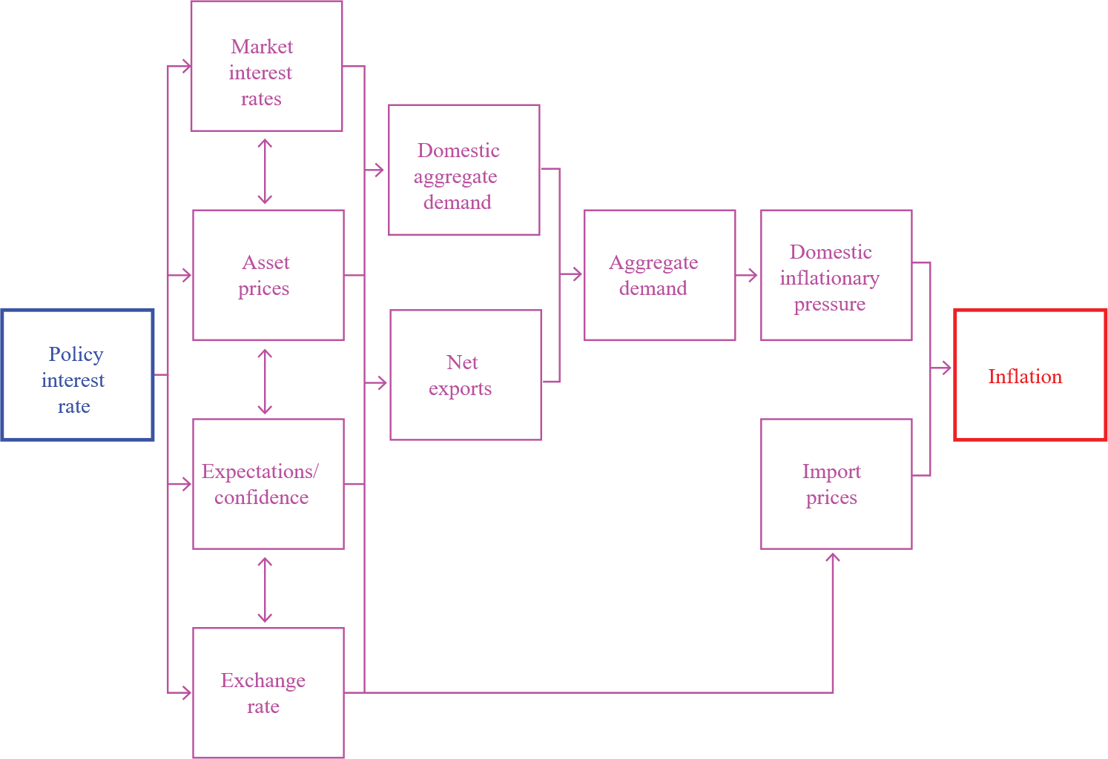
Bank of England - transmission mechanism

Slide 42
Reference textbook
— Benassy-Quéré, A. et al. Economic Policy: Theory and practise.
Oxford University Press, 2010. Chap. 4.

