Slide 1
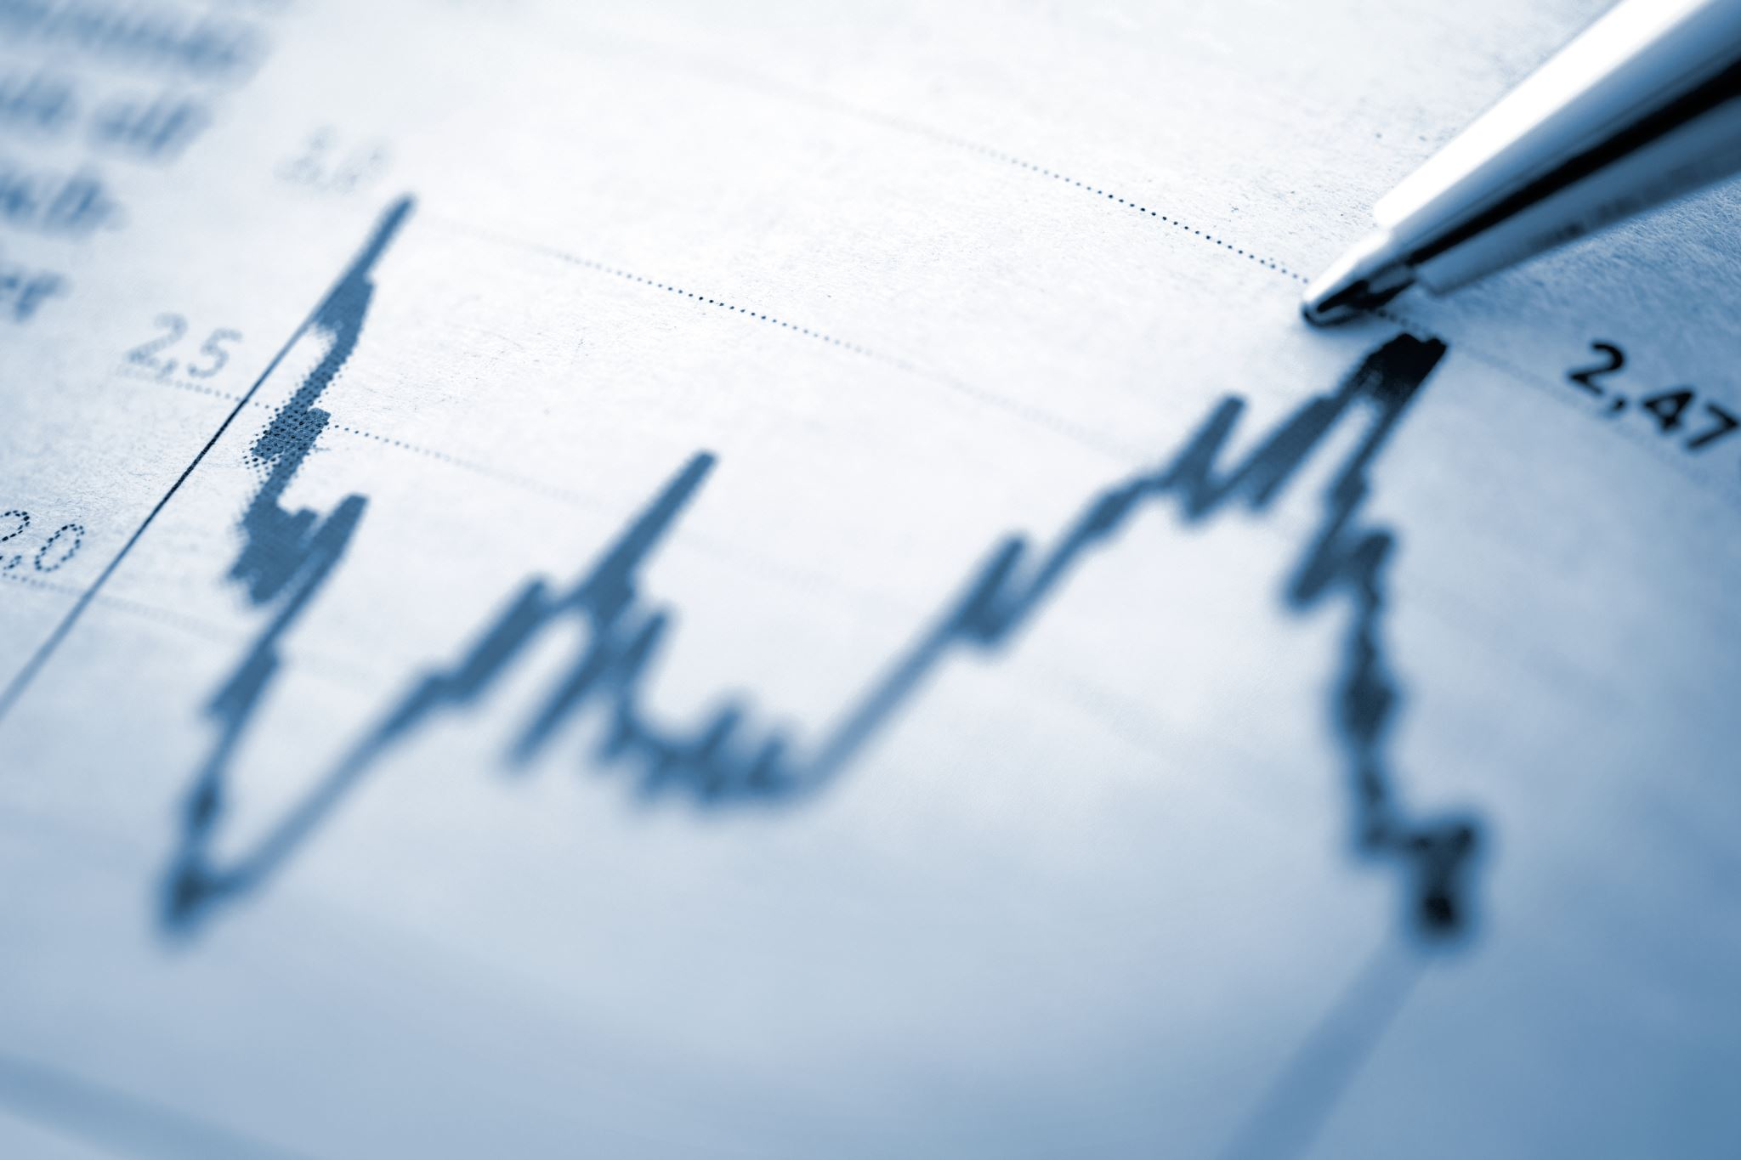
Redistribution,
social policy and welfare
V.

Slide 2


1. Distribution and justice
̶
Distribution of income and wealth has been a major concern throughout the history of economics
̶
̶
Positive and normative economics is difficult to separate in this area.
Two main views of justice in distribution:
̶
Commutative justice: each person should receive income in proportion to his contribution to
the productive process
̶
Distributive justice: implies approximate equality in income distribution
3
Redistribution, social policy and welfare state

Slide 3
Issues in distribution
The are several specific areas of concern in the debate about distribution:
̶
The distribution of income between persons irrespective of the source of income
̶
The distribution of income between factors of production, in particular between labour
and capital
̶
̶
̶
The distribution of earnings between different types of labour
The distribution of wealth
Poverty
4
Redistribution, social policy and welfare state

Slide 4
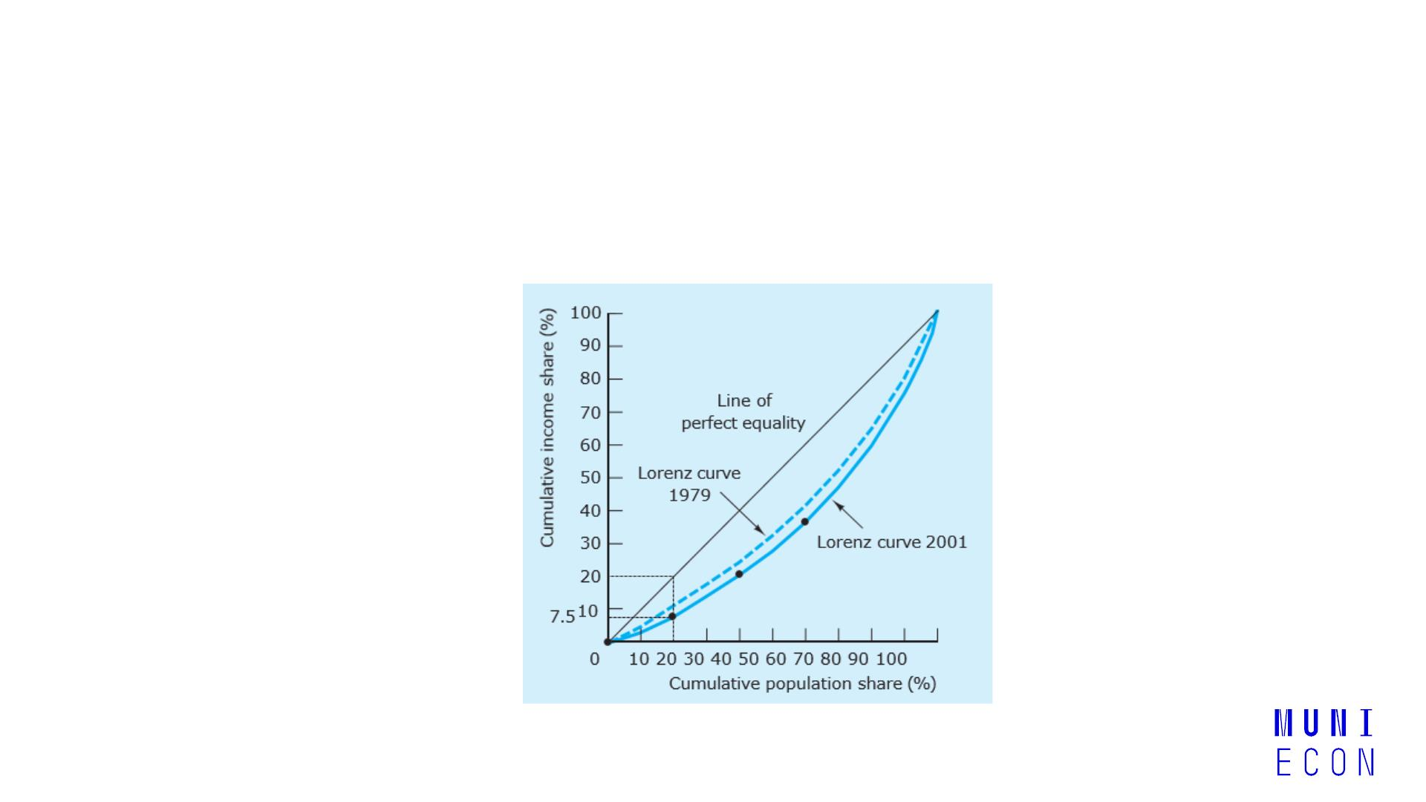
Income distribution between people
̶
The conventional mean of illustrating income distribution is the Lorenz curve
Lorenz curves in UK (1979, 2001)
5
Redistribution, social policy and welfare state

Slide 5
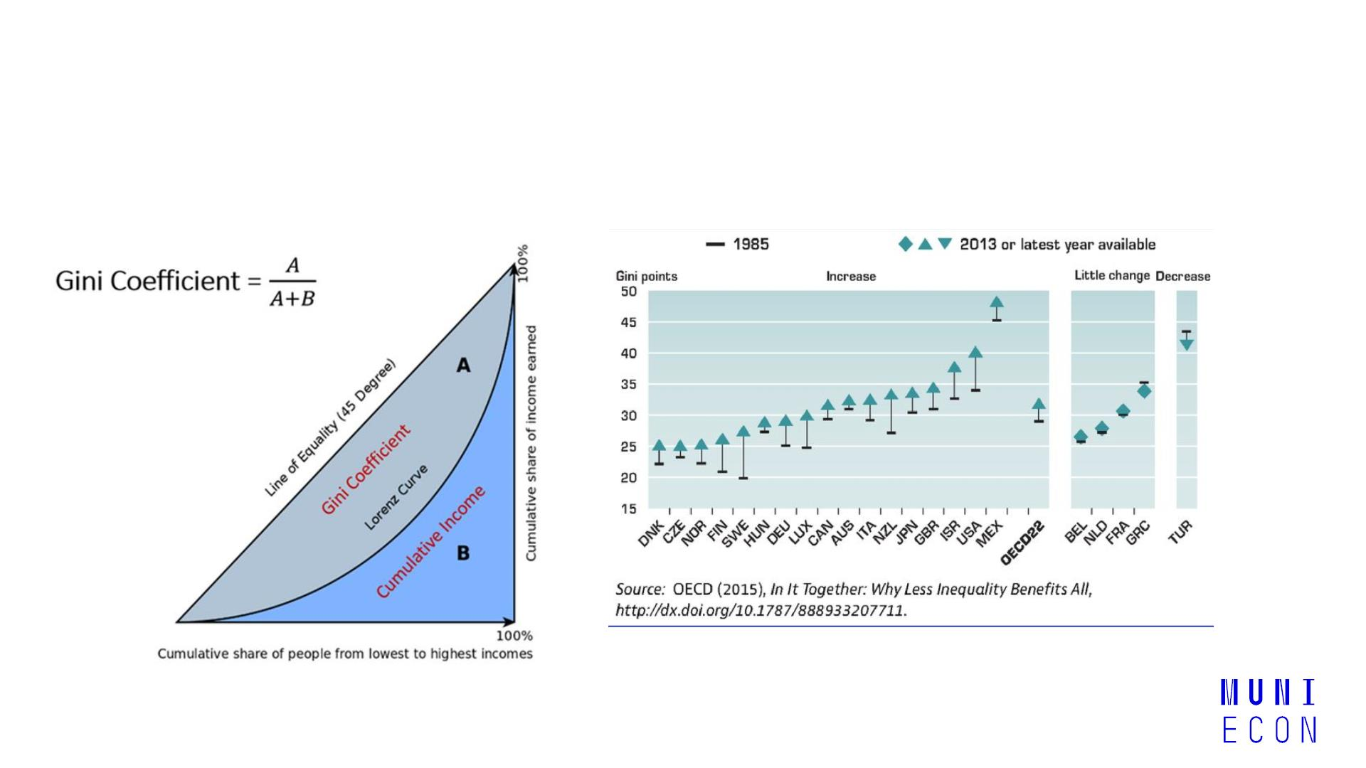
Income distribution between people
̶
and the Gini coefficient.
6
Redistribution, social policy and welfare state

Slide 6
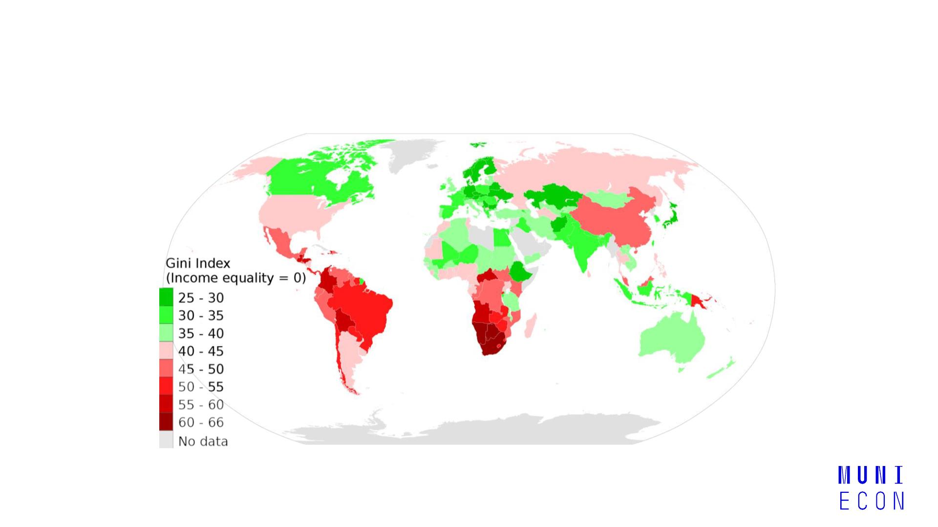
Gini coefficient
7
Redistribution, social policy and welfare state

Slide 7
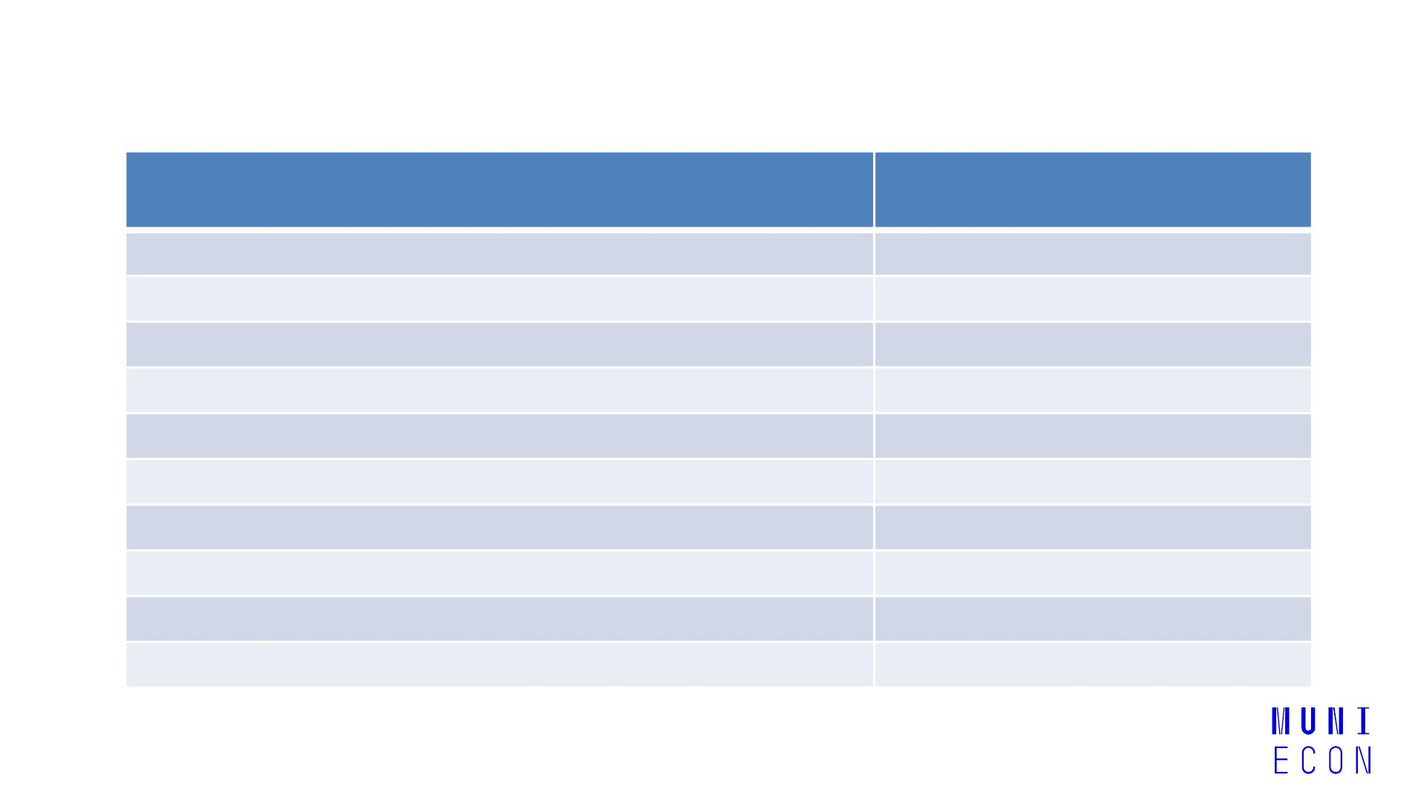
The earnings distribution
Median gross weekly wage
(all occupations = 100)
Occupational group
Managers and senior officials
Professional occupations
146
142
113
76
Associate professional and technical occupations
Administrative and secretarial occupations
Skilled trades occupations
93
Personal service occupations
67
Sales and customer service occupations
Process, plant and machines operatives
Elementary occupations
61
85
66
All occupations
100
Table: Relative earnings by occupational groups (UK)
8
Redistribution, social policy and welfare state

Slide 8
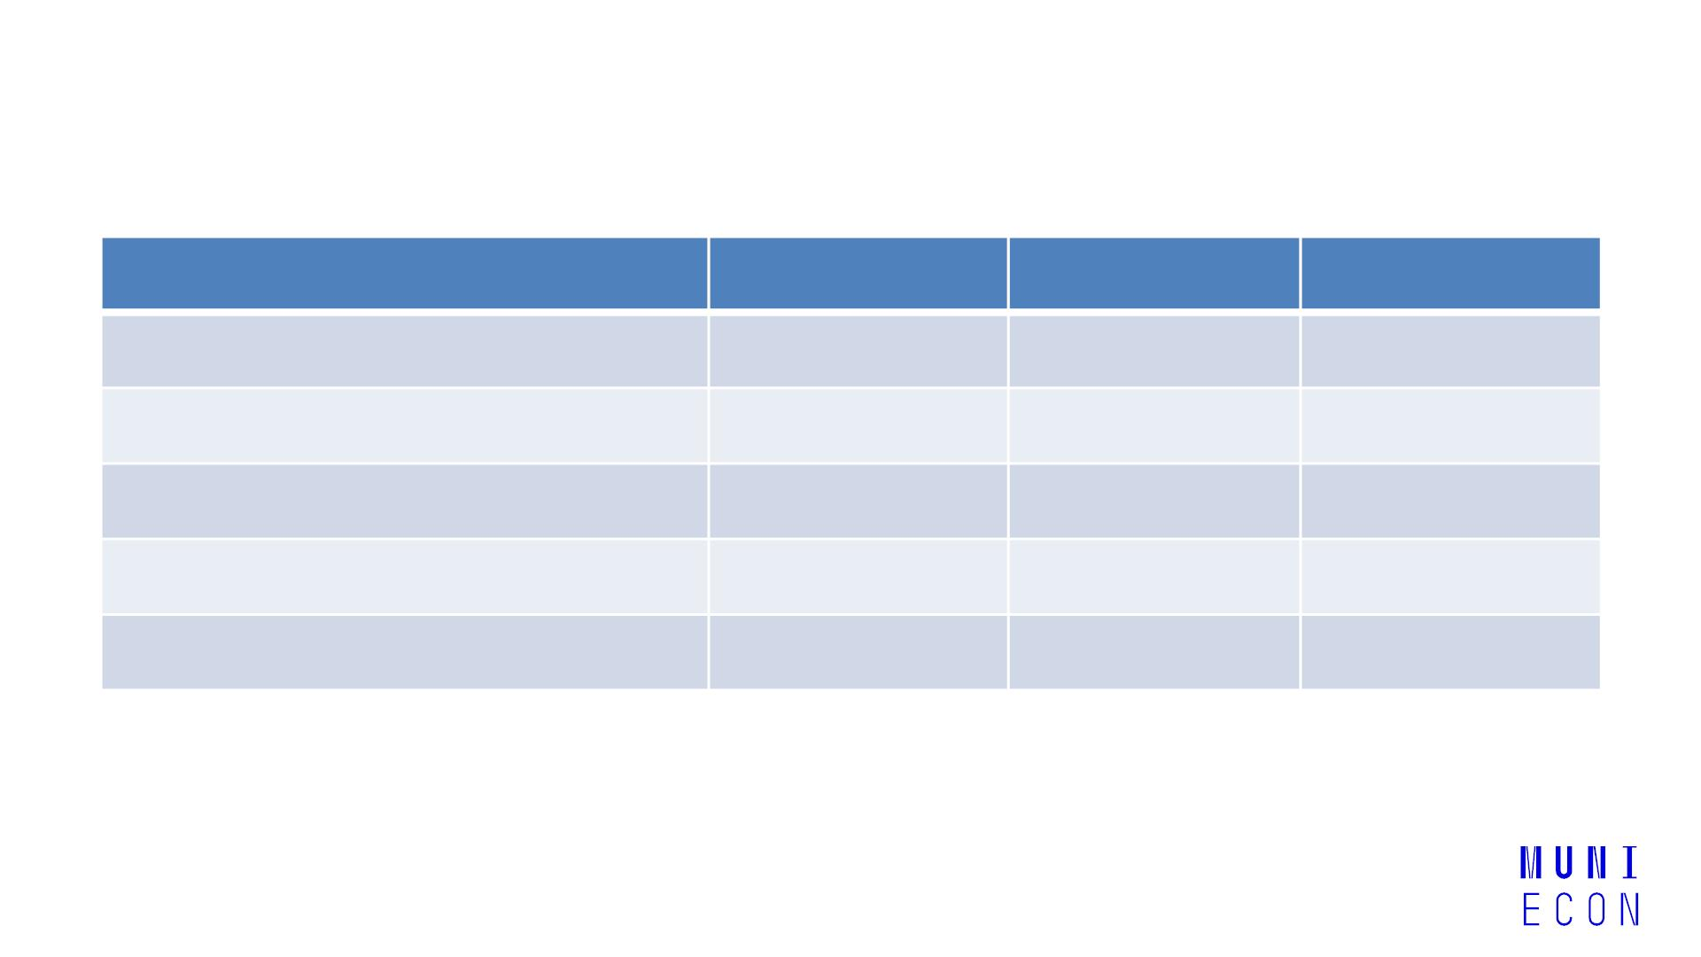
The distribution of wealth
Percentage of wealth owned by:
Most wealthy 1 % of population
Most wealthy 5 % of population
Most wealthy 10 % of population
Most wealthy 25 % of population
1971
31
1986
18
2006
21
52
36
40
65
50
54
87
73
77
Most wealthy 50 % of population
97
90
94
Table: Ownership of marketable wealth (UK)
9
Redistribution, social policy and welfare state

Slide 9
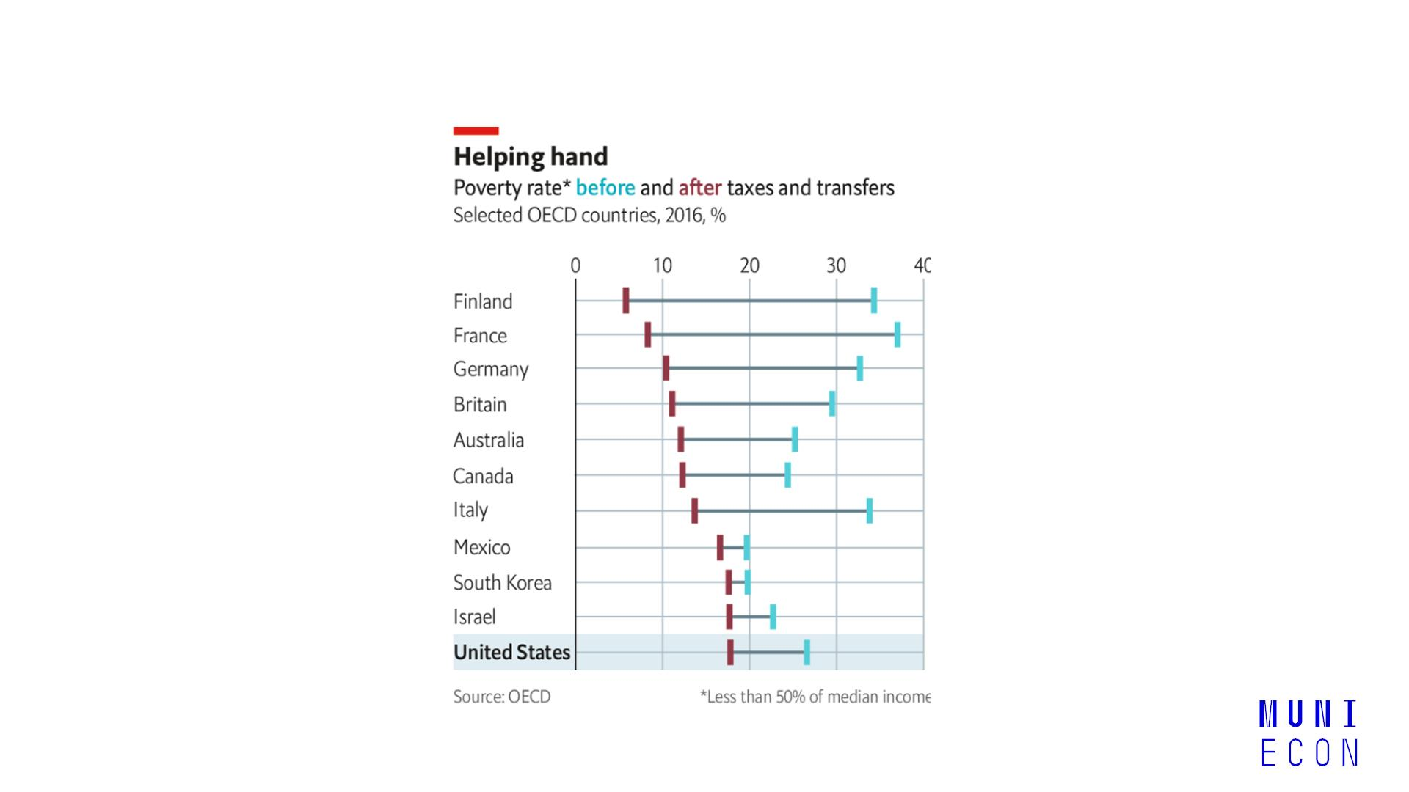
Poverty
10 Redistribution, social policy and welfare state

Slide 10
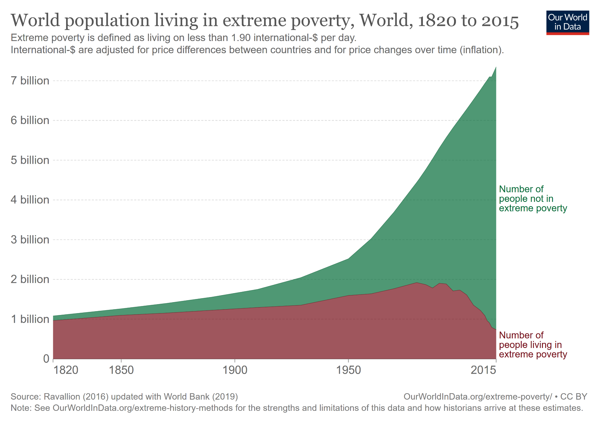
Extreme poverty (people living on less than $1.90 a day)
11 Redistribution, social policy and welfare state

Slide 11
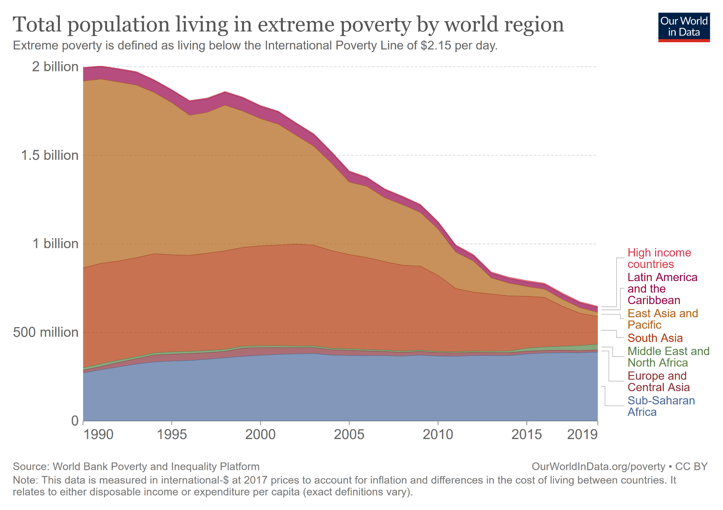
Extreme poverty (people living on less than $1.90 a day)
11 Redistribution, social policy and welfare state

Slide 12
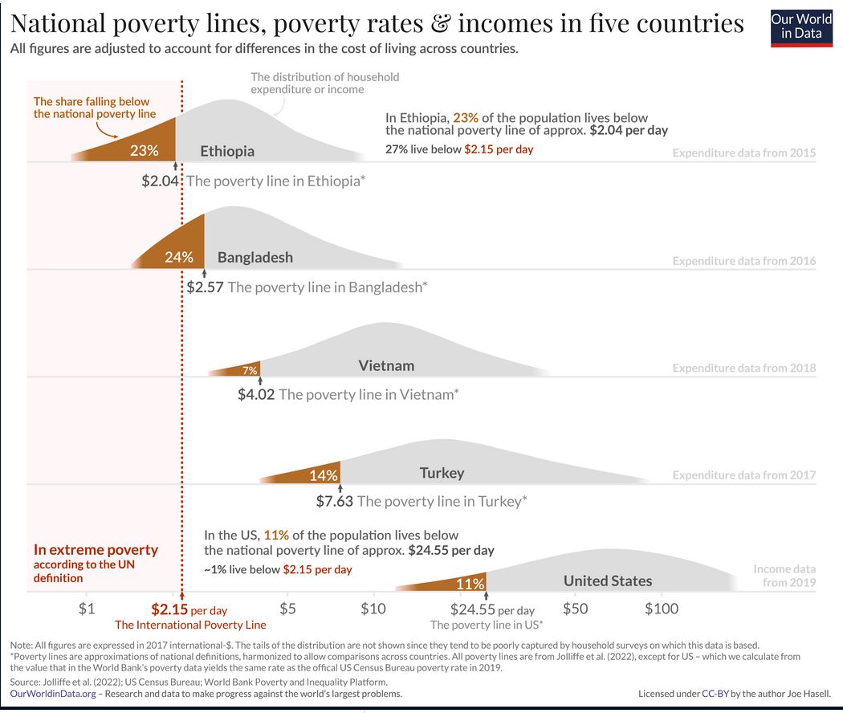
Extreme poverty (people living on less than $1.90 a day)
11 Redistribution, social policy and welfare state

Slide 13
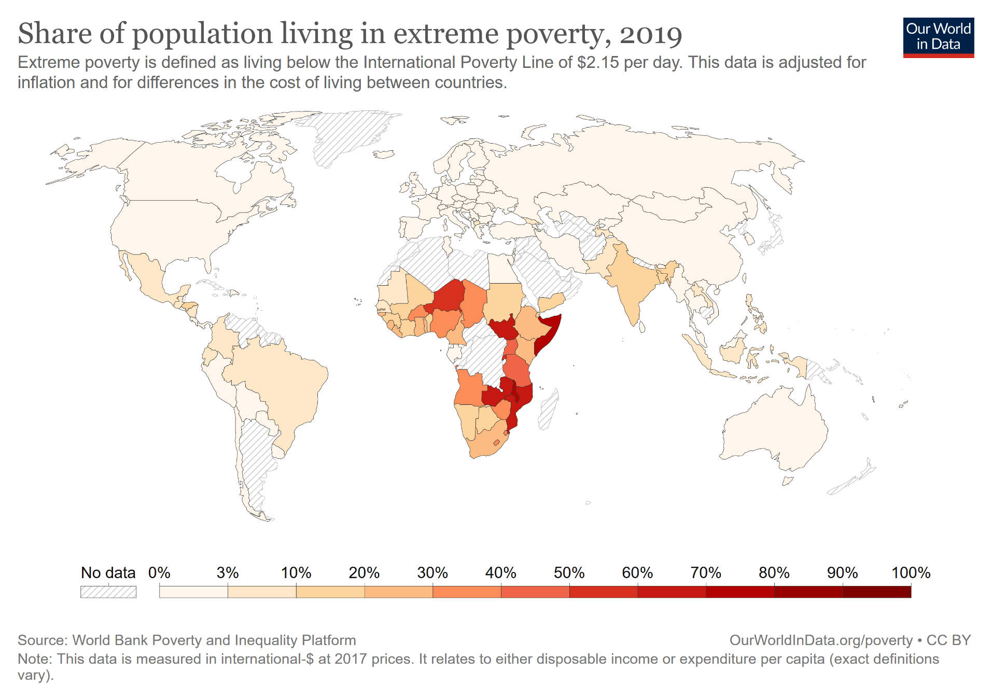
Extreme poverty (people living on less than $1.90 a day)
12 Redistribution, social policy and welfare state

Slide 14
Why is income inequality rising?
̶
̶
̶
Globalisation
̶
A key role for technology => replacement low-skilled workers by machines
Labour vs. capital: a shifting balance
̶
Larger share of income belongs to capital owners
Change in the workplace:
̶
Increase in part-time working
̶
Decline in trade union membership
̶
Changing in societies:
̶
Growing tendency to marry people very similar social and educational backgrounds
13 Redistribution, social policy and welfare state

Slide 15
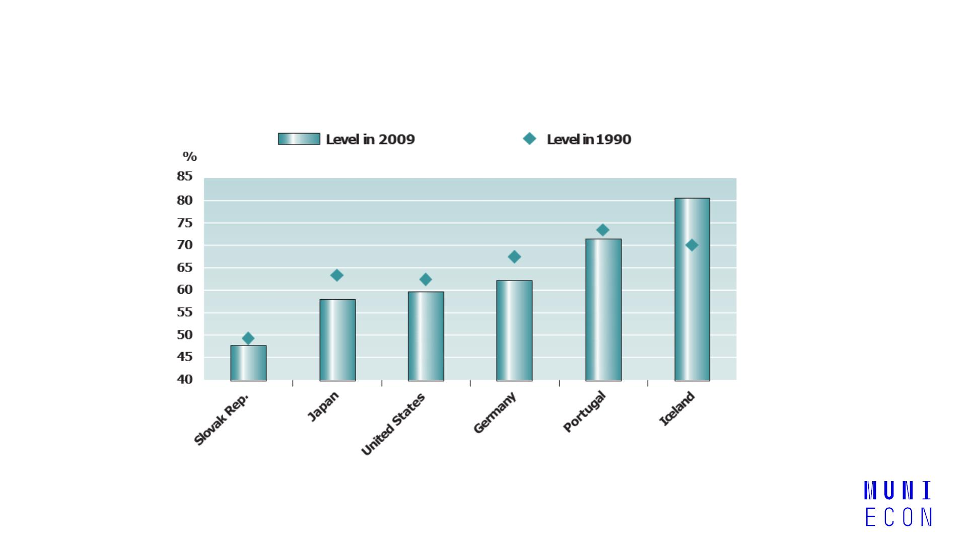
Labour share of national income in OECD countries (1990 and 2009)
14 Redistribution, social policy and welfare state

Slide 16
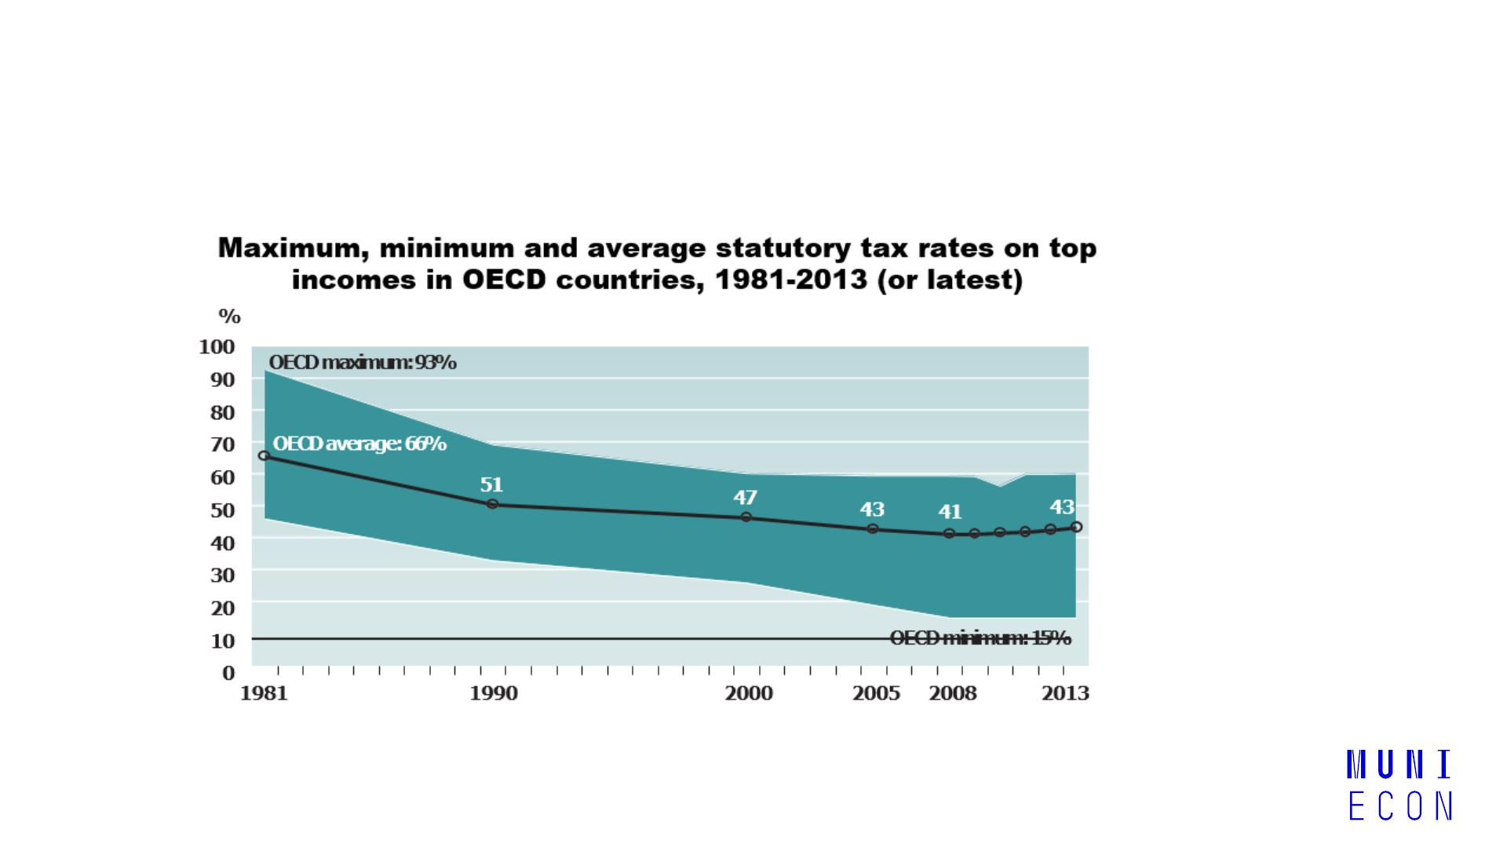
Why is income inequality rising?
15 Redistribution, social policy and welfare state

Slide 17

2. Welfare state (WS)
̶
The WS is a concept of government in which the state plays a key role in the
protection and promotion of the social and economic well-being of its citizens
̶
WS is funded through taxes and provides cash or in-kind transfers.
̶
In-kind transfers consist of goods or services, not money
16 Redistribution, social policy and welfare state

Slide 18
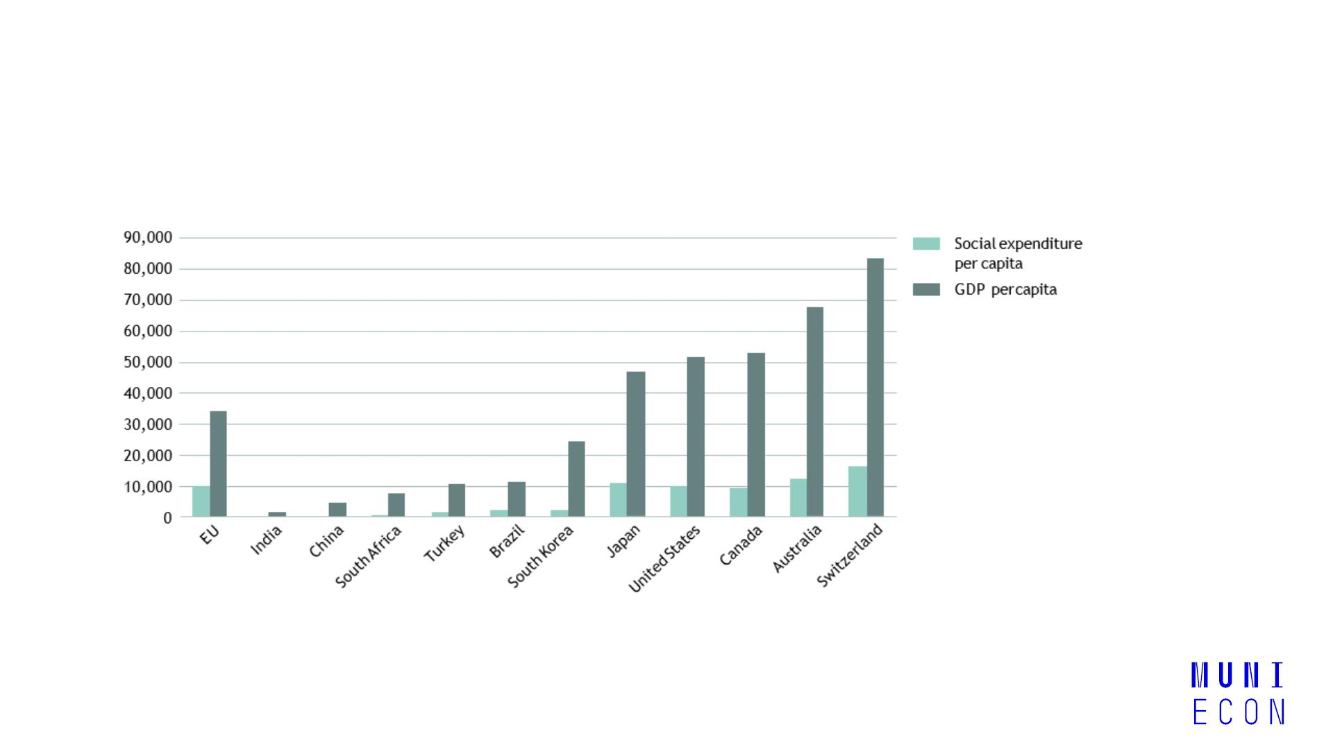
Social protection expenditure and GDP per capita (US$)
17 Redistribution, social policy and welfare state

Slide 19
Diversity of welfare states
̶
̶
Differing welfare models evolved after WWII.
Esping-Andersen (The Three Worlds of Welfare Capitalism, 1990) identified models of welfare state according to stratification and the different providers of welfare:
Social-democratic (Scandinavian) model
Corporatist (continental) model
Liberal (Anglo-Saxon) model
Southern model
18 Redistribution, social policy and welfare state

Slide 20
a) Social-democratic (Scandinavian) model
̶
̶
̶
̶
̶
Prevalent in Denmark, Sweden, Norway
Generous replacement of market earnings through the state (e.g. for unemployed)
Social welfare is an universal right
State as a main provider of social welfare
Characterised by high social expenditure, active labour market policies and increased public-sector employment
19 Redistribution, social policy and welfare state

Slide 21
b) Corporatist (continental) model
̶
̶
Typified by Germany and France
Main provider of welfare is the family, but contributory principle ties many benefits to
employment history
̶
Basic security supplemented with contributory benefits (pensions, unemployment, etc.)
20 Redistribution, social policy and welfare state

Slide 22
c) Liberal (Anglo-Saxon) model
̶
̶
̶
̶
̶
United Kingdom, Ireland
Seeks to increase demand for labour through liberalization and wage flexibility
Mostly private forms of insurance
Benefits comparatively low and linked to means-testing
Poverty relief through minimum wages, but less of a focus on equality.
21 Redistribution, social policy and welfare state

Slide 23
d) Southern model
̶
̶
̶
̶
Spain, Italy, Greece, Portugal
Extended family as a core unit
Income maintenance
Strong jobs protection – favouring, for example, full-time over temporary
22 Redistribution, social policy and welfare state

Slide 24
Challenges for welfare states
̶
̶
̶
Demographic change: population ageing and living longer increases financial burden
Globalisation: reducing governments’ ability to sustain or reform welfare institutions
Changes in a family structure (societal change): e.g. increase the participation rate of women, the shift away from the male-breadwinner model affects certain aspects of the welfare model
̶
̶
Problem of welfare state and efficiency: especially administrative costs and the disincentive effects on the labour supply
New technologies and the changing mix of jobs
23 Redistribution, social policy and welfare state

Slide 25
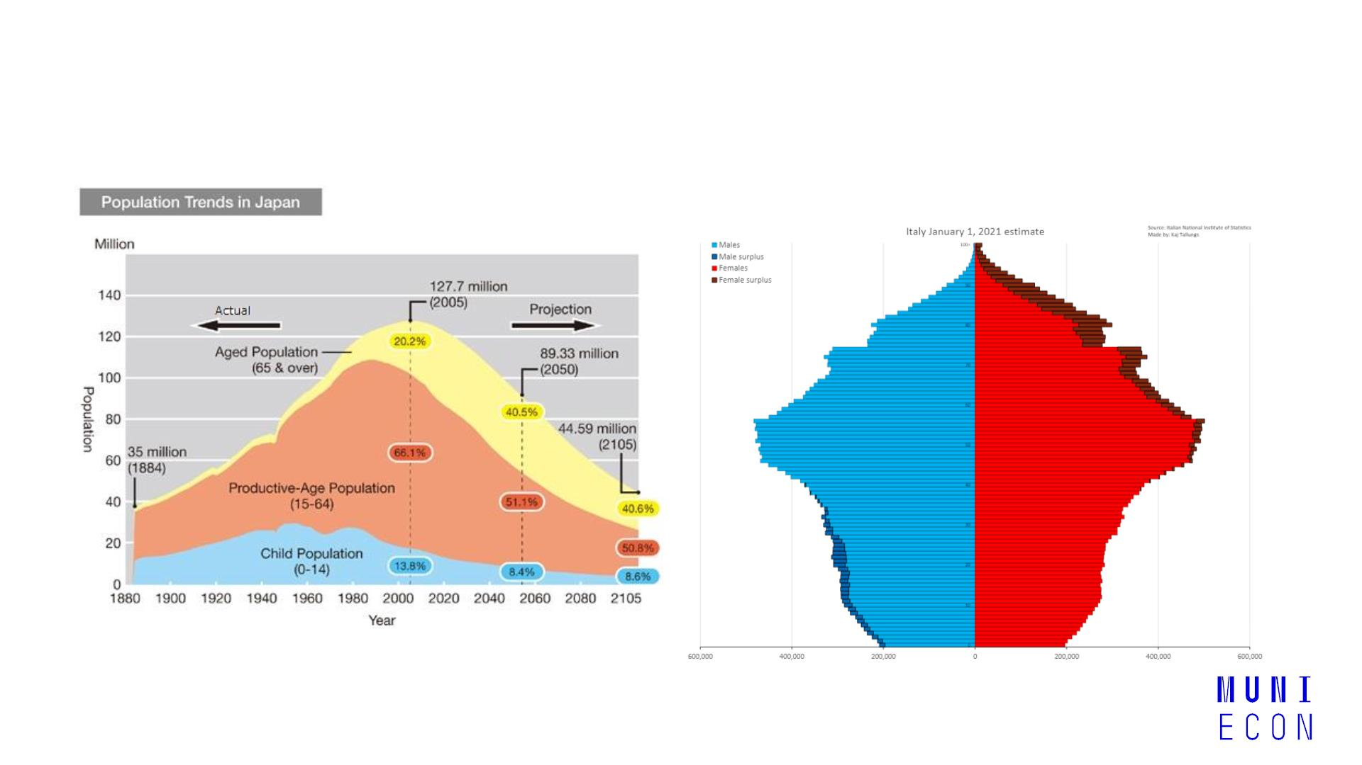
Challenges for welfare states
24 Redistribution, social policy and welfare state

Slide 26
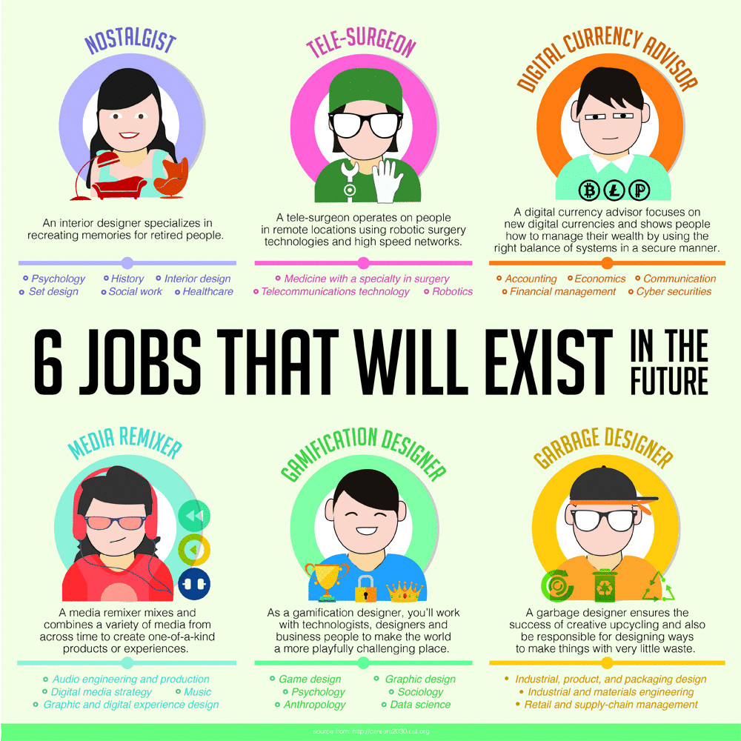

Slide 27

25 Redistribution, social policy and welfare state

