Slide 1

Foreign exchange & growth policy
VI.

Slide 2
Foreign exchange policy
VI.

Slide 3
Content
Foreign-Exchange Policy
  History of monetary system
  Convertibility and Exchange-rate regimes
  Theory of optimum currency areas
  Balance of payments
Growth Policies
  Measuring growth
  Stylized facts about growth
  Growth enhancing policies
3 Foreign-Exchange Policy

Slide 4
Monetary policy x exchange-rate policy
MP = internal value of currency (the purchasing power of money in terms of goods and services produced locally)
E-RP = external value of currency (the purchasing power of money in terms of goods and services produced abroad)
+ Exchange rate is an important transmission channel
There cannot be a long-term divergence between the internal and external purchasing power of a currency
4 Foreign-Exchange Policy

Slide 5
Brief history of the international monetary system
— System of Gold Standard was extended to all major economies in the 1880s and lasted until WWI: value of national currency was determined by a given gold weight
Fixed exchange rates between national currencies
Pound sterling developer as an International currency parallel to gold (reserves of Bank of England did not cover the whole currency issue)
—
5 Foreign-Exchange Policy

Slide 6
Brief history of the international monetary system
1920 – 1924 – Exchange rates between major currencies were left to market forces
Gold Standard was temporarily restored in the end of 1920s but finally abandoned during 1930s as the countries turned to protectionist measures and competitive devaluations in response to the Great Depression.
6 Foreign-Exchange Policy

Slide 7
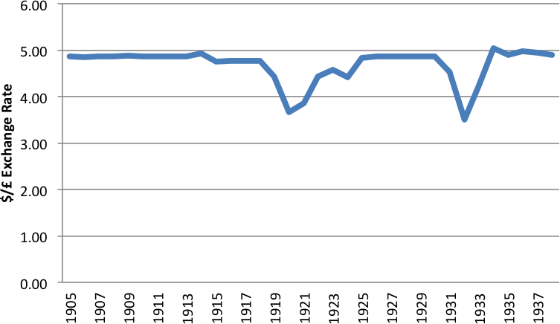
Golda standard – Exchange rate
$ = 23.22 grains of pure gold
£ = 113 grains of pure gold
$4.8665 per pound sterling
7 Foreign-Exchange Policy

Slide 8
Brief history of the international monetary system
After WWII Bretton Woods Conference: Gold Exchange Standard
  all currencies were convertible to US dollar which were convertible into gold at a fixed rate of $35 per ounce
  IMF – monitors world payments and helps countries that experience temporary balance-of-payments difficulties to avoid a crisis.
Contradiction between the need to supply a rapidly growing world economy with enough liquidity and the need to maintain confidence in the dollar, which implied keeping its issuance in line with the gold reserves.
This system broke down in 1972.
8 Foreign-Exchange Policy

Slide 9
Brief history of the international monetary system
1972: European countries: „European Snake“ (sets the fluctuation margins between European currencies and between these currencies and the US dollar)
1979: European Monetary System (EMS)
  all cross exchange rates had to fluctuate within margins of +/- 2.25 % (in some cases +/- 6 %) around a central rate
1993: Maastricht Treaty
  Economic and Monetary Union
1999: European monetary union was initiated
US dollar is still core currency for international monetary system.
9 Foreign-Exchange Policy

Slide 10
Currency convertibility and exchange rate regimes
- When the domestic currency is at least partially convertible, its price can either be set freely by the market or managed by the government and the central bank.
Governments need to make two crucial decisions:
on the conditions for exchanging the domestic currency for foreign currencies
=> currency convertibility
on the extent of exchange rate flexibility => exchange rate regime
10 Foreign-Exchange Policy

Slide 11
Currency convertibility
Currency is nonconvertible if the government set the value of the exchange-rate and submit foreign-exchange transactions to prior authorization (e.g., Soviet bloc before 1990).
In all other cases, the currency is convertible.
  current account convertibility: the currency can be exchanged freely for the purpose of importing good and services, current transfers and factor income
  financial account convertibility: direct investments, portfolio investments and bank loans
without restriction (=> capital mobility)
Capital is actually never fully mobile, because there are valid reasons for control (e.g., fight against money laundering and
terrorist finance)
11 Foreign-Exchange Policy

Slide 12
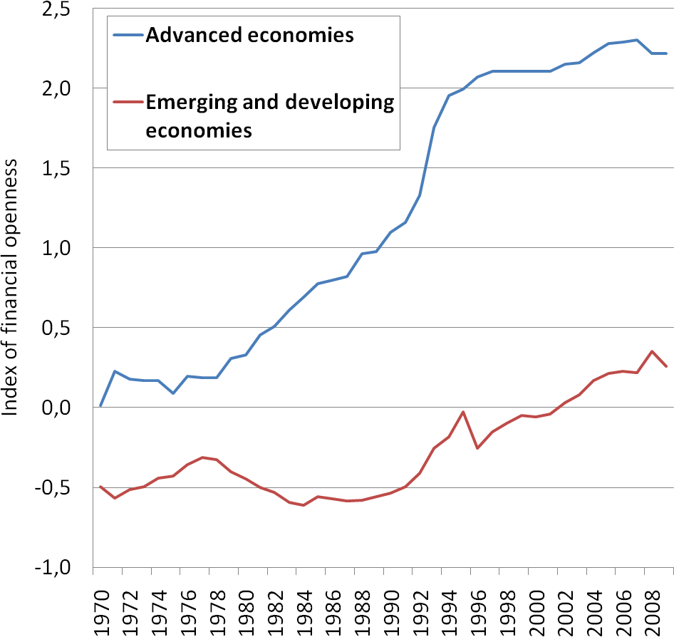
Financial openness
— While advanced economies have liberalized capital flows in the 1980s, this movement is still incomplete in developing countries.
12 Foreign-Exchange Policy

Slide 13
The pros and cons of capital openness
Theoretical advantages:
enables the capital to flow to the most efficient places – helping both investors as well as all stakeholders
allows emerging economies to grow faster
capital flows from capital rich to capital poor countries as they should have higher returns
  reduce cost of capital
  enable investments
  increase growth
13 Foreign-Exchange Policy

Slide 14
The pros and cons of capital openness
Potential problems:
Capital inflow is connected with appreciation of domestic currency. It can
make domestic manufacturers less competitive in global markets
Fear of hot money; inflows and consequently sudden outflows of funds can
cause huge economic crisis
Fear of large capital inflows, that can cause price bubbles
Fear of loss of monetary autonomy; see impossible trinity
14 Foreign-Exchange Policy

Slide 15
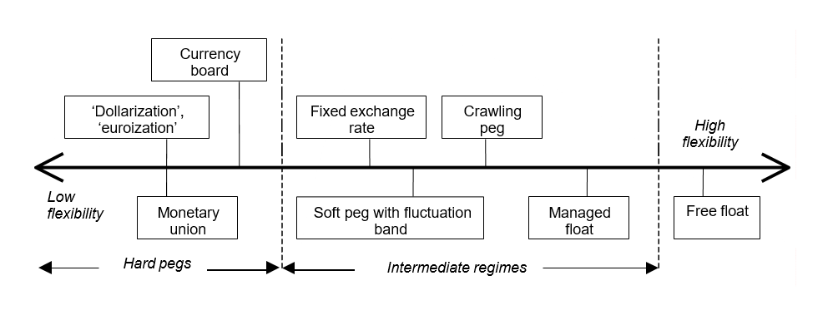
Exchange-rate regimes
Large exchange-rate fluctuations are source of uncertainty for the economy
In developing countries, foreign liabilities are denominated in key foreign currencies => depreciation of the domestic currency raises the value of the external debt.
=> governments may to wish to reduce the extent of exchange-rate fluctuations.
14 Foreign-E
xchange Policy

Slide 16
Exchange-rate regimes
Dollarization, euroization: the currency of another country circulates as the sole legal tender: dollar (e.g., Panama, Ecuador), euro (e.g., Montenegro and San Marino).
— Countries are unable to control the domestic money supply and its central bank is left with the sole mission of performing technical
tasks.
Currency board: explicit legislative commitment to exchange domestic currency at a fixed rate, issuance of domestic currency is backed by foreign assets only (e.g., Bosnia and Hercegovina, Bulgaria).
Fixed exchange rates: the country pegs its currency within margins of +/- 1 % or less vis-à-
vis another currency or basket of currencies (e.g., Mali, Niger).
16 Foreign-Exchange Policy

Slide 17
Exchange-rate regimes
Soft pegs with fluctuation band: the value of the currency is maintained within certain margins of fluctuation of more than +/- 1 % around a fixed central rate (e.g., Denmark).
Managed floating: The CB attempts to influence the exchange rate without having a specific exchange rate path or target (e.g., Albania, Chile, Hungrary, Moldova, Ukraine)
Free floating: the exchange rate is fully market-determined (e.g., Czech Republic, eurozone, USA, United Kingdom, Poland)
17 Foreign-Exchange Policy

Slide 18

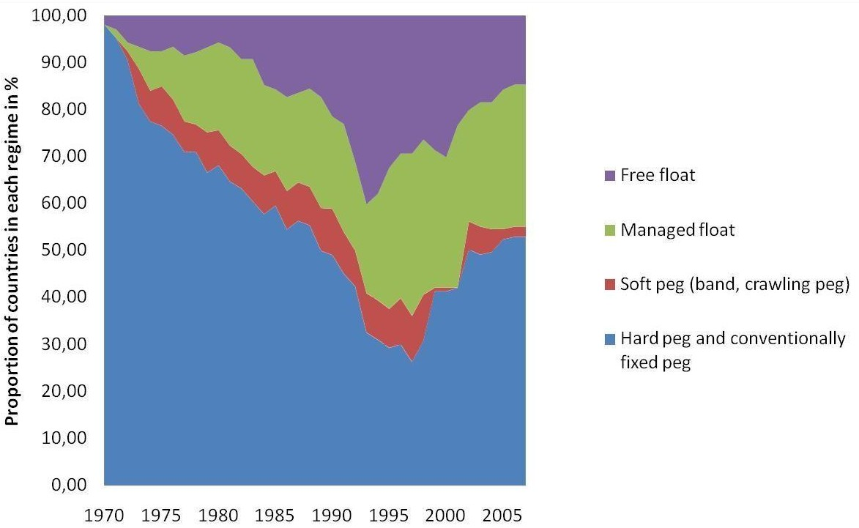
Exchange-rate regimes
18 Foreign-Exchange Policy

Slide 19
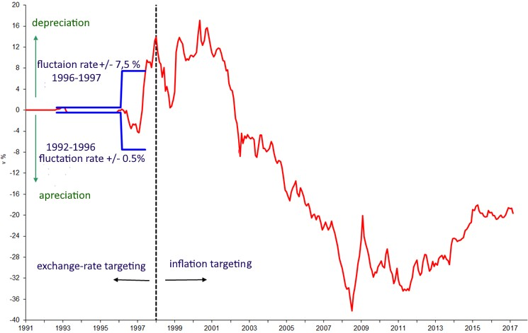
Exchange-rate regimes – Czech Republic
19 Foreign-Exchange Policy

Slide 20
The Exchange Rate Regime Dilemma: the pros and cons of fixed regime
The risk of speculative attacks when the firmness of the commitment is being questioned that can lead to currency crisis.
A country must keep large quantities of foreign currency.
By committing to a fixed rate a country commits itself not to engage in inflationary policies.
CB must give up independent monetary policy.
20 Foreign-Exchange Policy

Slide 21
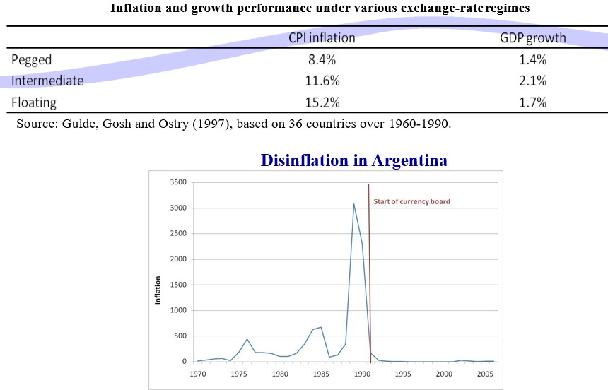
The benefits of pegs: credibility
21 Foreign-Exchange Policy

Slide 22
The Exchange Rate Regime Dilemma: the pros and cons of floating
Large exchange rate fluctuations are a major source of uncertainty.
Exchange rate fluctuations affect the relative value of assets and liabilities => depreciation raises the value of the external debt.
Monetary independence of the CB is sustained.
Countries are better able to absorb economic shocks
22 Foreign-Exchange Policy

Slide 23
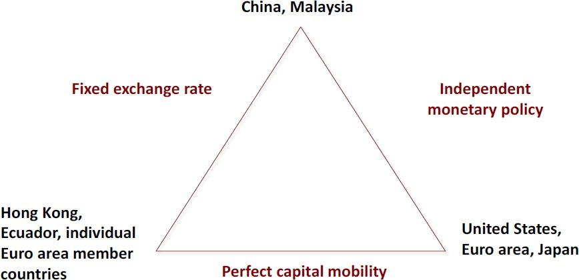
Convertibility and exchange-rate regime: a joint choice
— A country cannot simultaneously enjoy an independent MP, a stable
exchange rate and a perfectly mobile capital (Mundell’s impossible trinity)
23 Foreign-Exchange Policy

Slide 24
Regime choice: the optimum currency area theory (OCA)
— The OCA theory predicts that fixed exchange rates are most appropriate for areas closely integrated through international trade and factor movements.
24 Foreign-Exchange Policy

Slide 25
The optimum currency area theory – benefits
Saving from avoiding the uncertainty, confusion, and calculation and transaction costs that arise when exchange rates float
Are higher, the higher the degree of economic integration between the joining country and the fixed exchange rate area
25 Foreign-Exchange Policy

Slide 26
The optimum currency area theory – costs
arise because a country that joins an exchange rate area gives up its ability to use the exchange rate and monetary policy for the purpose of stabilizing output and employment
are lower, the higher the degree of economic integration between a country and the fixed exchange rate area that it joins
26 Foreign-Exchange Policy

Slide 27
The optimum currency area theory – criteria
Degree of trade openness and integration
Product diversification
Labour mobility
Wage flexibility
Level of debt
Fiscal transfer possible
Homogenous policy preferences
High degree of solidarity with other nations
27 Foreign-Exchange Policy

Slide 28

Is the euro area an optimal currency area?
Degree of trade openness and integration – high
Product diversification – high
Labour mobility – low
Wage flexibility – low
28 Foreign-Exchange Policy

Slide 29
Is the euro area an optimal currency area?
Level of debt – varies from low to high
Fiscal transfer possible – limited
Homogenous policy preferences – regional/limited
High degree of solidarity with other nations – regional/limited
29 Foreign-Exchange Policy

Slide 30
Is the euro area an optimal currency area?
The Euro Zone does not come close to an OCA by most criteria, because:
  The core group of EU countries are broadly similar (Germany + France + Netherlands + Belgium) but peripheral countries have big structural differences
  There are barriers to the mobility of labour
  Price and wage flexibility is rather low
  The role of fiscal transfers is limited
Euro is more a political than an economic project
30 Foreign-Exchange Policy

Slide 31
growth policy
VII.

Slide 32
Growth vs. stabilization policies
Stabilization policy seeks to mitigate short-term cyclical fluctuations whereas growth policies aim at raising potential level of production in the long run.
But, there are interrelations between long-term trends and short-term fluctuations because of:
  precautionary behaviour: excessive inflation is bad for long-term growth
  unemployment hysteresis: skills of unemployed workers deteriorate and they become less employable even in boom

Slide 33
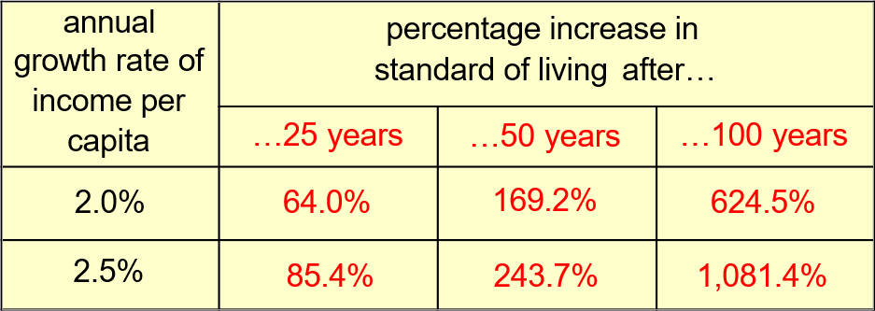
Why growth matters
— Anything that effects the long-run rate of economic growth – even by a tiny amount – will have huge effects on living standards in the long run.

Slide 34
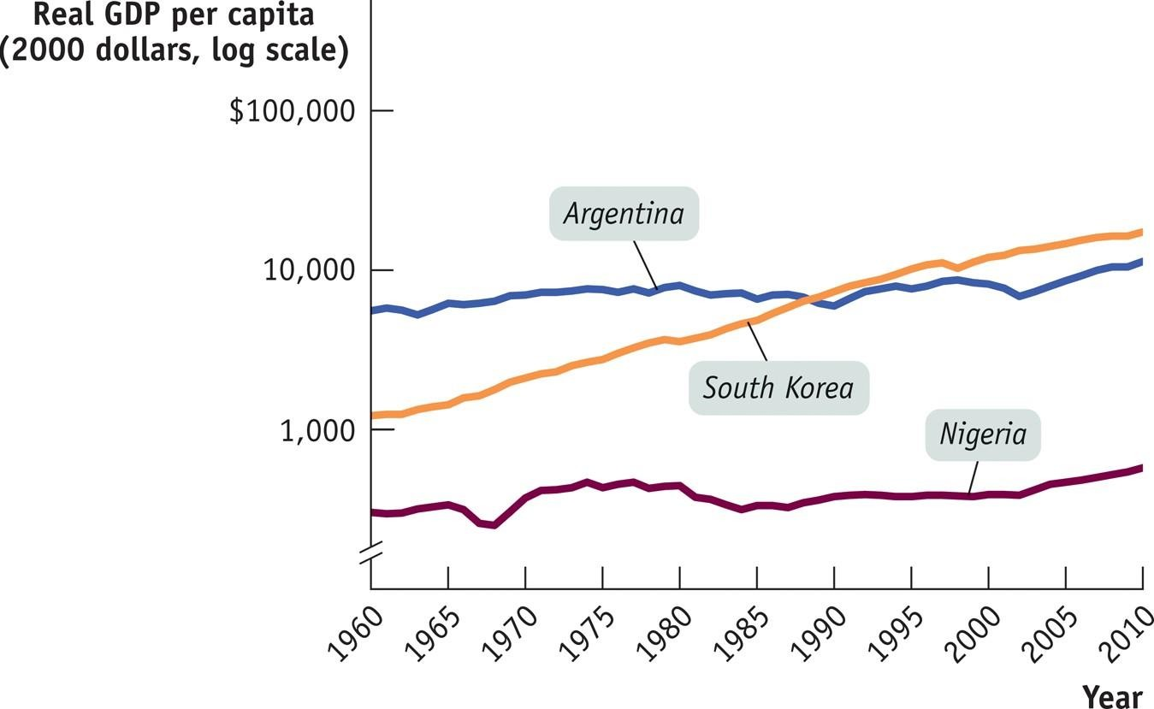
Three stories of economic growth: success, disappointment and failure

Slide 35
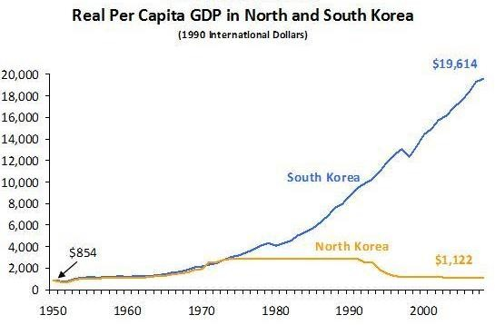
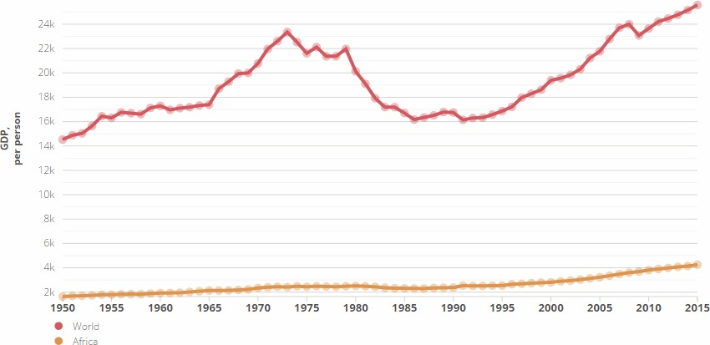
Economic Growth

Slide 36
Measuring economic growth
GDP per person (per capita) corresponds to the average standard of living (GDP (nominal) x GDP (PPP))
GNP, HDI (GNP, life expectancy, access to public, education)
Labour productivity reflects effectiveness of production system
Comparability issues (prices, exchange rates ...)
GDP per person is not well-being
— correction for: pollution, working time, life expectancy, precariousness, inequality, sustainability

Slide 37
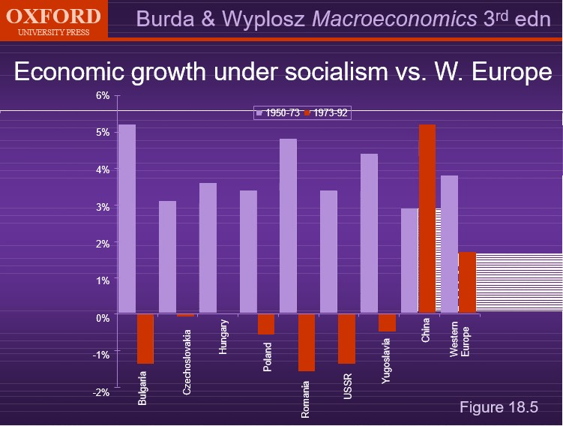
Economic growth: CPEs vs. Western Europe

Slide 38
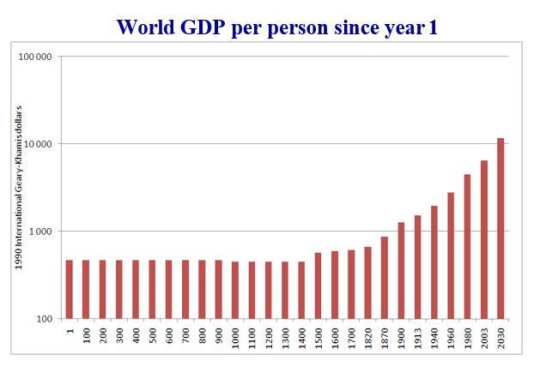
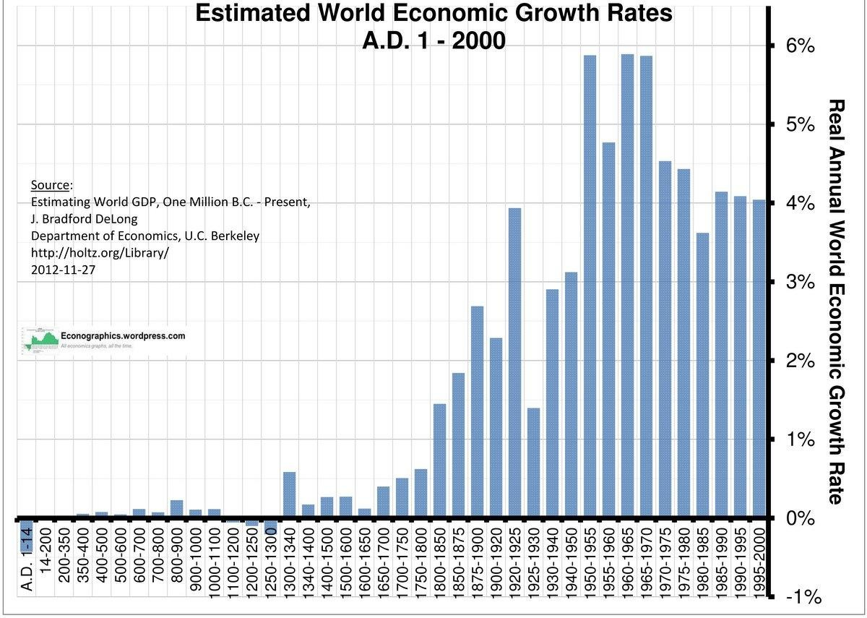
Some stylized facts about growth
— Growth is a recent phenomenon by historical standards.

Slide 39
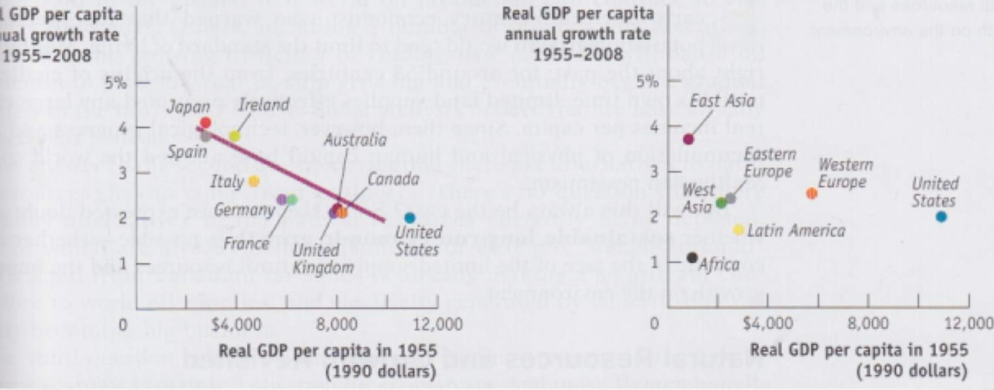
Convergence and inequality
— Some countries have caught up towards the richest countries, some have not and even further diverged.

Slide 40
Convergence and inequality
Who benefits from the increase of world income and wealth?
No stable relationship between inequality and growth, but growth tends to increase inequality within rich countries.
Among advanced economies, technological change and growth may increase income inequalities.

Slide 41
Growth and income distribution: a two way relationship
Growth → inequality
  Kuznets (1955): U-shaped relationship between development level and income inequality
  Unequal access to finance, education
Inequality → growth
  Inequality → inequality of opportunities
  Risk of political instability/deadlock
  Demand for redistributive taxation (Alesina and Rodrik, 1994)

Slide 42
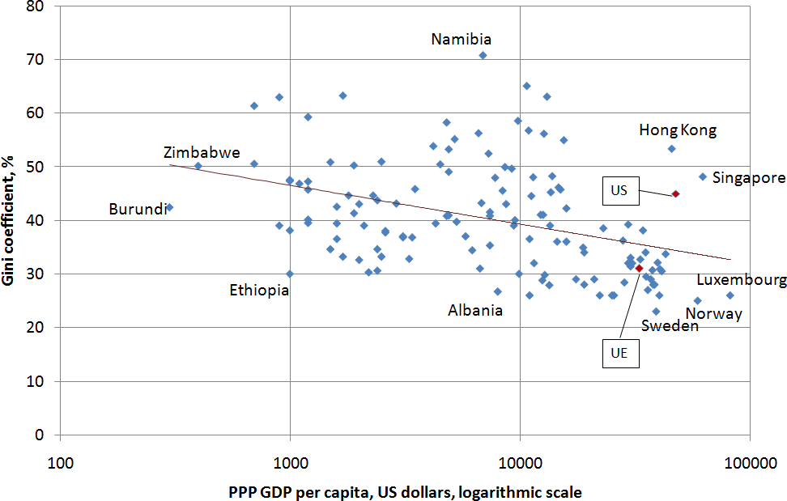
Growth and income distribution

Slide 43
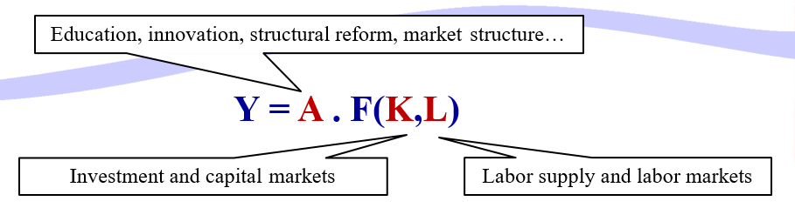
Theoretical background – growth accounting
Solow (1956)

Slide 44
Theoretical background
In the short run (a few months to a few years), potential output is exogenous; growth is dominated by cyclical fluctuations and by stabilization policies
In the medium run (a few years), governments can influence potential output through investment and labour supply
In the long run (many years), GDP and the labour/capital mix are determined
by demography, technology, institutions and market structures

Slide 45
Policies
Education
Research
Infrastructure
— Externalities

Slide 46
Policies - Education
Public financing is justified by credit constraints and unequal access to knowledge. It is difficult to assess private and social return to human capital
— It is difficult to know which part of the supplementary wage income generated by an additional year of higher education measures the marginal yield of study, pre-existing talent, or rent accruing to belonging to a particular social, ethnic or gender group
Discrepancy between Europe and US in total expenditures on tertiary education

Slide 47
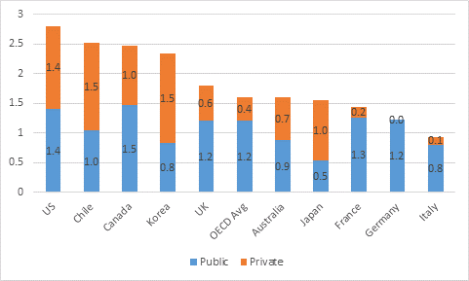
Spending on tertiary education (% GDP)

Slide 48
R&D and innovation
Social return on research spending generally exceeds its private return
Market imperfection: investments to R&D are constrained by the unavailability
of funds
⇒ Public funding of fundamental research and university clusters
⇒ Incentives to private funding of applied research
  Intellectual protection
  Innovation-friendly competition regime
  Tax rebates

Slide 49
Unequal R&D effort
R&D expenditures:
  Discrepancy among countries (see next slide)
Different dynamics:
  US: new innovating SMEs
  EU: firms already in place
In the US, innovating firm creation encouraged by:
  risk capital and initial public offerings
  lower entry cost

Slide 50
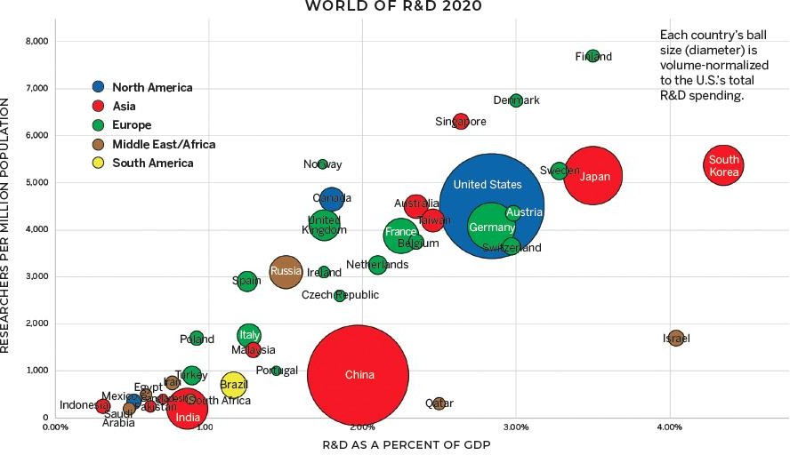

Slide 51
Public infrastructures
Government intervention is needed, because:
  many infrastructures are natural monopolies
  Infrastructures involve externalities
  market cannot finance infrastructures by itself
=> European networks program, public-private partnerships

Slide 52
Labour supply
How to increase labour supply?
Through family-oriented policies
Immigration
Welfare-to-work:
  In-work benefits
  pension reforms

Slide 53
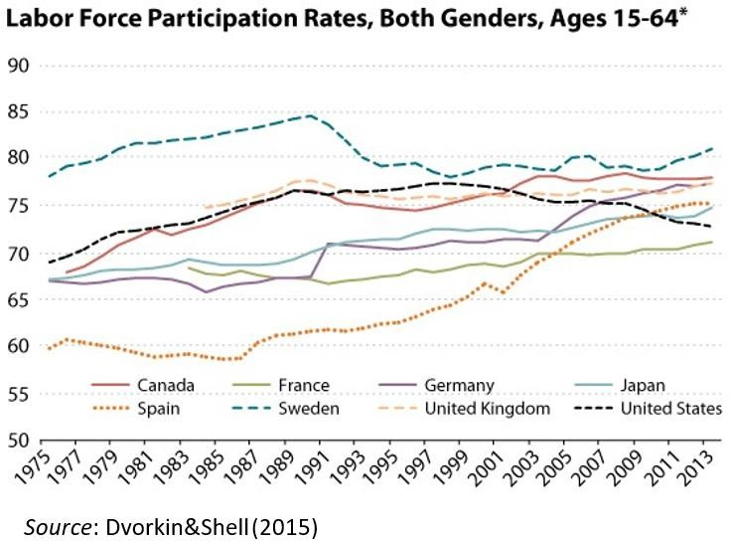

Slide 54
Developing financial markets
Often neglected in growth strategies
Channels on influence on long-term growth:
  Lower cost of capital
  Higher savings
=> Increase in GDP per capita
  Better allocation of capital
Information
Risk diversification Finance innovation

Slide 55

Growth and institutions
Institutions: “The humanly devised constraints that structure human interaction. They are made up of formal constraints (rules, laws, constitutions), informal constraints (norms of behaviour, conventions, and self-imposed codes of conduct), and their enforcement characteristics.”
D. North and R. Fogel (1990)

Slide 56
Improving institutions
General recommendations:
  Create legal framework which is conducive to private initiative
  Put in place effective market regulation
  Achieve macroeconomic stability
It is difficult to identify a set of specific recommendations because of different institutional set-ups

Slide 57
Reference textbook
Foreign-Exchange Policy: Benassy-Quéré, A. et al. Economic Policy: Theory and practise. Oxford University Press, 2010. Chap. 5.
Growth Policies: Benassy-Quéré, A. et al. Economic Policy: Theory and practise. Oxford University Press, 2010. Chap. 6.

