Slide 1
LECTURE 2
Introduction to Econometrics
INTRODUCTION TO LINEAR REGRESSION ANALYSIS I
Dali Laxton
September 30, 2022

Slide 2
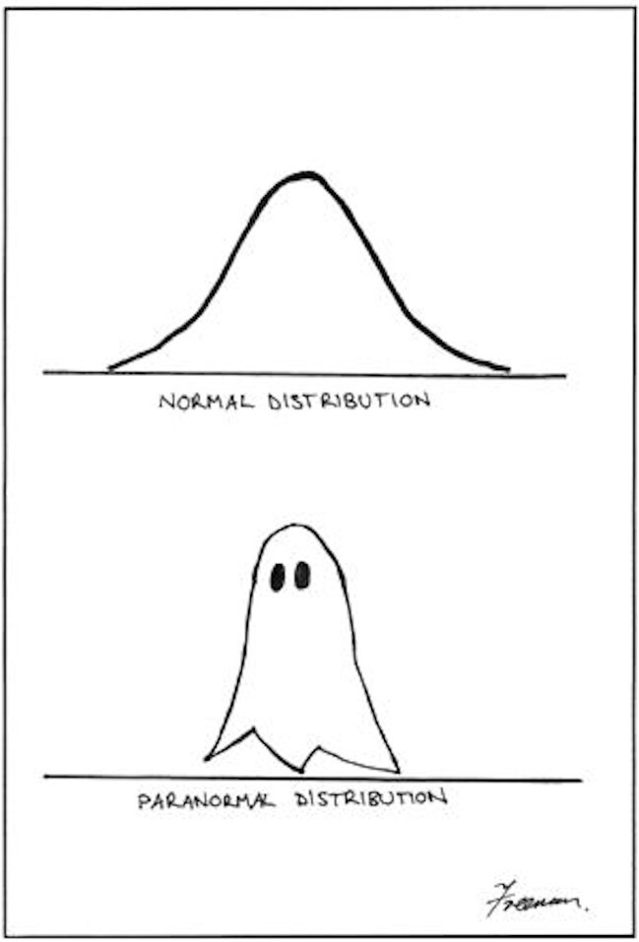
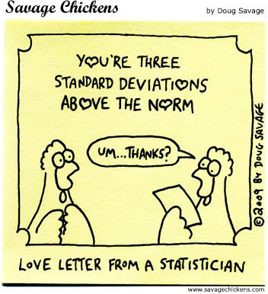
PREVIOUS LECTURE...
Introduction, organization, review of statistical background
random variables
mean, variance, standard deviation
covariance, correlation, independence
normal distribution
standardized random variables
Notes:
A random variable X is a variable whose numerical value is determined by chance. It is a quantification of the outcome of a random phenomenon.

Slide 3
WARM-UP EXERCISE
What is the correlation between X and Y?
Correlation: Corr(X, Y) = ^{Cov(X,Y)}
σ_{X}σ_{Y}
Covariance:
Cov(X, Y) = E [(X − E[X]) (Y − E[Y])] = E [XY] − E[X]E[Y]
Notes:
0.93

Slide 4
LECTURE 2.
e Introduction to simple linear regression analysis
Sampling and estimation
OLS principle
e Readings:
Studenmund, A. H., Using Econometrics: A Practical Guide, Chapters 1, 2.1, 16.1, 16.2
Wooldridge, J. M., Introductory Econometrics: A Modern Approach, Chapters 2.1, 2.2

Slide 5
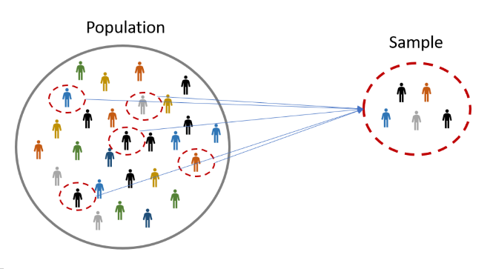
SAMPLING
e Population: the entire group of items that interests us
e Sample: the part of the population that we actually observe
e Statistical inference: use of the sample to draw conclusion about the characteristics of the population from which the sample came
e Examples: medical experiments, opinion polls
Notes:
Note that if we do not randomly select the sample and choose only blue colored population in this picture, we will have a selection bias. Good medical experiment example currently is coronavirus vaccination

Slide 6
RANDOM SAMPLING VS SELECTION BIAS
e Correct statistical inference can be performed only on a random sample - a sample that reflects the true distribution of the population
e Biased sample: any sample that differs systematically from the population that it is intended to represent
e Selection bias: occurs when the selection of the sample systematically excludes or under represents certain groups
Example: opinion poll about tuition payments among undergraduate students vs all citizens
e Self-selection bias: occurs when we examine data for a group of people who have chosen to be in that group
Example: accident records of people who buy collision insurance

Slide 7
EXERCISE 1
e American Express and the French tourist office sponsored a survey that found that most visitors to France do not consider the French to be especially unfriendly.
e The sample consisted of 1,000 Americans who have visited France more than once for pleasure over the past two years.
e Is this survey unbiased?
Notes:
Of course not – French tourist office sponsored it, they are interested to spread good news about trips to France to attract more tourists. They interviewed Americans who had visited France more than once, obviously they liked it and that’s why they went back there

Slide 8
ESTIMATION
e Parameter: a true characteristic of the distribution of a variable, whose value is unknown, but can be estimated
Example: population mean E[X]
e Estimator: a sample statistic that is used to estimate the value of the parameter
Example: sample mean
Note that the estimator is a random variable (it has a probability distribution, mean, variance,...)
e Estimate: the specific value of the estimator that is obtained on a specific sample

Slide 9
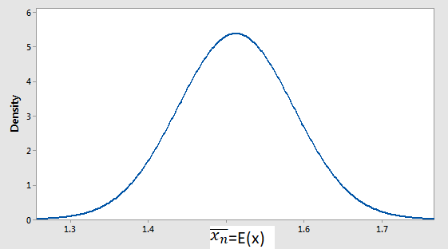
PROPERTIES OF AN ESTIMATOR
e An estimator is unbiased if the mean of its distribution is equal to the value of the parameter it is estimating
e An estimator is consistent if it converges to the value of the true parameter as the sample size increases
e An estimator is efficient if the variance of its sampling distribution is the smallest possible

Slide 10
EXERCISE 2
e A young econometrician wants to estimate the relationship between foreign direct investments (FDI) in her country and firm profitability.
e Her reasoning is that better managerial skills introduced by foreign owners increases firms’ profitability.
e She collects a random sample of 8,750 firms and finds that one sixth of the firms were entered within last few years by foreign investors. The rest of the firms are owned domestically.
e When she compares indicators of profitability, such as ROA and ROE, between the domestic and foreign-owned firms, she finds significantly better outcomes for
foreign-owned firms.
e She concludes that FDI increases firms’ profitability. Is this conclusion correct?
Notes:
there could be a selection bias – foreign investors simply chose the best companies in the market to invest in, so these companies were already more profitable in the first place. We would say that some variables that influence the profitability is not captured in this model (in the regression of FDI on profitability). For example, the profitability of firms before FDI was made. In fact, many variables are missing here. Pay attention “young” sounds like not very experienced :D The fact that only 1/6th was entered by foreign investors, does not necessarily imply that it is not comparable, because population proportion could be the same too. What matters is that the number of firms reviewed is very large and even 1/6th is very large and also that the selected sample is random.

Slide 11
ECONOMETRIC MODELS
e Econometric model is an estimable formulation of a theoretical relationship
e Theory says: Q = f (P, P_{s}, Y)
Q . . . quantity demanded
P . . . commodity’s price
P_{s} . . . price of substitute good
Y . . . disposable income
e We simplify: Q = β₀ + β₁P + β₂P_{s} + β₃Y
e We estimate: Q = 31.50 − 0.73P + 0.11P_{s} + 0.23Y

Slide 12
ECONOMETRIC MODELS
e Today’s econometrics deals with different, even very general models
e During this course we will cover just linear regression models
e We will see how these models are estimated by
Ordinary Least Squares (OLS)
Generalized Least Squares (GLS)
Instrumental Variables (IV)
e We will perform estimation on different types of data
Notes:
What linear means? Fitted curve is a line

Slide 13
DATA USED IN ECONOMETRICS
cross-section
sample of units (eg. firms, individuals)
taken at a given point in time
repeated cross-section
several independent samples of units
(eg. firms, individuals)
taken at different points in time
time-series
observations of variable(s) in different points in time
(eg. GDP)
panel data
time series for each cross-sectional unit in the data set
(eg. GDP of various countries)

Slide 14
DATA USED IN ECONOMETRICS - EXAMPLES
e Country’s macroeconomic indicators (GDP, inflation rate, net exports, etc.) month by month
e Data about firms’ employees or financial indicators as of the end of the year
e Records of bank clients who were given a loan
e Annual social security or tax records of individual workers

Slide 15
STEPS OF AN ECONOMETRIC ANALYSIS
Formulation of an economic model (rigorous or intuitive)
Formulation of an econometric model based on the economic model
Collection of data
Estimation of the econometric model
Interpretation of results

Slide 16
EXAMPLE - ECONOMIC MODEL
e Denote:
p
c
. . . price of the good
. . . firm’s average cost per one unit of output
q(p) . . . demand for firm’s output
Firm profit:
π = q(p) · (p − c)
e Derive:
Demand for good:
q(p) = a − b · p
b
q = ª − · c
2 2
e We call q dependent variable and c explanatory variable

Slide 17
EXAMPLE - ECONOMETRIC MODEL
e Write the relationship in a simple linear form
q = β₀ + β₁c
a b
(have in mind that β = and β = −
0
1
2 2
e There are other (unpredictable) things that influence firms’ sales ⇒ add disturbance term
q = β₀ + β₁c + ε
e Find the value of parameters β₁ (slope) and β₀ (intercept)

Slide 18
EXAMPLE - DATA
e Ideally: investigate all firms in the economy
e Reality: investigate a sample of firms
We need a random (unbiased) sample of firms
e Collect data:
Firm | 1 | 2 | 3 | 4 | 5 | 6
q | 15 | 32 | 52 | 14 | 37 | 27
c | 294 | 247 | 153 | 350 | 173 | 218

Slide 19
EXAMPLE - DATA
50
40
Output 30
20
10
150
200
250
300
350
Average cost

Slide 20
EXAMPLE - ESTIMATION
50
40
Output 30
20
10
150
200
250
300
350
Average cost

Slide 21
EXAMPLE - ESTIMATION
OLS method:
Make the fit as good as possible
⇓
50
Make the misfit as low as possible
Minimize the (vertical) distance between data points and regression line
Minimize the sum of ssquared deviations
Output
20 30 40
10
150
200
Ave ²⁵⁰ cost
300
350
rage

Slide 22
TERMINOLOGY
y_{i} = β₀ + β₁x_{i} + ε_{i} . . . regression line
y_{i} . . . dependent/explained variable (i-th observation)
x_{i} . . . independent/explanatory variable (i-th observation)
ε_{i} . . . random error term/disturbance (of i-th observation)
β₀ . . . intercept parameter ( β^₀ . . . estimate of this parameter)
β₁ . . . slope parameter ( β^₁ . . . estimate of this parameter)

Slide 23
ORDINARY LEAST SQUARES
e OLS = fitting the regression line by minimizing the sum of vertical distance between the regression line and the observed points
50
40
Output
20 30
10
150
200
Ave ²⁵⁰ cost
300
350
rage

Slide 24
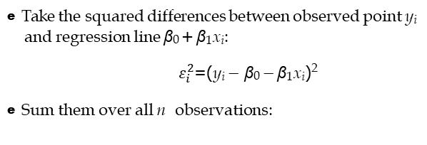
ORDINARY LEAST SQUARES - PRINCIPLE
e Take the squared differences between observed point y_{i} and regression line β₀ + β₁x_{i}:
$ε_{i}^{2}$=(y_{i} − β₀ − β₁x_{i})²
e Sum them over all n observations:
^
^
e
Find β and β such that they minimize this sum
0
1

Slide 25
ORDINARY LEAST SQUARES - DERIVATION

Slide 26
RESIDUAL
e Residual is the vertical difference between the estimated regression line and the observation points
e OLS minimizes the sum of squares of all residuals
e It is the difference between the true value y_{i} and the estimated value
e We define:
e Residual e_{i} (observed) is not the same as the disturbance ε_{i}
(unobserved)!!!
e Residual is an estimate of the disturbance: ^

Slide 27
RESIDUAL VS. DISTURBANCE
50
True relationship
40
Output 30
Disturbance
Residual
20
Estimated relationship
10
150
200
250
300
350
Average cost

Slide 28
GETTING BACK TO THE EXAMPLE
We have the economic model
b
q = ª − · c
2 2
We estimate
q_{i} = β₀ + β₁c_{i} + ε_{i}
a
b
(having in mind that β = and β
= − )
0
2
1
2
Our data:
Firm | 1 | 2 | 3 | 4 | 5 | 6
q | 15 | 32 | 52 | 14 | 37 | 27
c | 294 | 247 | 153 | 350 | 173 | 218

Slide 29
GETTING BACK TO THE EXAMPLE
e When we plug in the formula:
-0.177
29 / 33

Slide 30
GETTING BACK TO THE EXAMPLE
e When we plug in the formula:
-0.177
-0.177c
0.353
29 / 33

Slide 31
MEANING OF REGRESSION COEFFICIENT
e Consider the model
q = β₀ + β₁c
estimated as
q . . . demand for firm’s output
^
- 0.177c
q = 71.74 − 1.77c
c . . . firm’s average cost per unit of output
e Meaning of β₁ is the impact of a one unit increase in c on the dependent variable q
e When average costs increase by 1 unit, quantity demanded decreases by 1.77 units

Slide 32
BEHIND THE ERROR TERM
e The stochastic error term must be present in a regression equation because of:
omission of many minor influences (unavailable data)
measurement error
possibly incorrect functional form
stochastic character of unpredictable human behavior
e Remember that all of these factors are included in the error term and may alter its properties
e The properties of the error term determine the properties of the estimates

Slide 33
SUMMARY
e We have learned that an econometric analysis consists of
definition of the model
estimation
interpretation
e We have explained the principle of OLS: minimizing the sum of squared differences between the observations and the regression line
e We have derived the formulas of the estimates:

Slide 34
WHAT’S NEXT
e In the next lectures, we will
derive estimation formulas for multivariate models
specify properties of the OLS estimator
start using Gretl for data description and estimation

