Slide 1
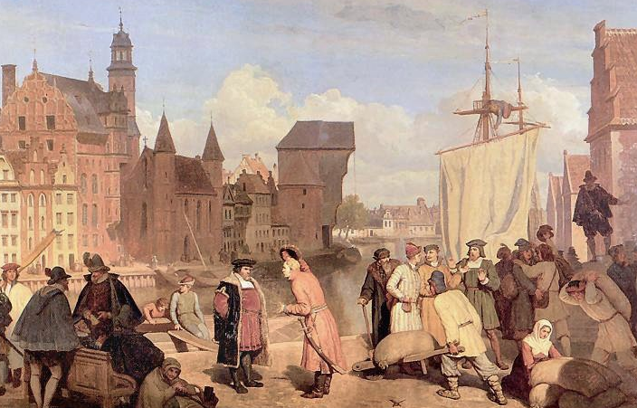
Masaryk University
Microeconomics I
Dali Laxton
Wojciech Gerson (1831-1901)
Monopolistic Competition
Chapter 16
Lecture
6.2

Slide 2
In this chapter, look for the answers to these questions
What market structures lie between perfect competition and monopoly, and what are their characteristics?
How do monopolistically competitive firms choose price and quantity? Do they earn economic profit?
How does monopolistic competition affect society’s welfare?
What are the social costs and benefits of advertising?

Slide 3
INTRODUCTION:
Between Monopoly and Competition
0
Two extremes
  Perfect competition: many firms, identical products
  Monopoly: one firm
In between these extremes: imperfect competition
  Oligopoly: only a few sellers offer similar or identical products.
  Monopolistic competition: many firms sell similar but not identical products.
Notes:
2

Slide 4
Characteristics & Examples of Monopolistic Competition
0
Characteristics:
  Many sellers
  Product differentiation (location)
  Free entry and exit
Examples:
  apartments
  books
  bottled water
  clothing
  fast food
  night clubs
Notes:
3

Slide 5
Comparing Perfect & Monop. Competition
0
Perfect competition
Monopolistic competition
number of sellers
many
many
free entry/exit
yes
yes
long-run econ. profits
zero
zero
the products firms sell
identical
differentiated
firm has market power?
none, price-taker
yes
D curve facing firm
horizontal
downward-sloping
Notes:
4

Slide 6
Comparing Monopoly & Monop. Competition
0
Monopoly
Monopolistic competition
number of sellers
one
many
free entry/exit
no
yes
long-run econ. profits
positive
zero
firm has market power?
yes
yes
D curve facing firm
downward-sloping
(market demand)
downward-sloping
close substitutes
none
many
Notes:
5

Slide 7
A Monopolistically Competitive Firm Earning Profits in the Short Run
0
The firm faces a downward-sloping
D curve.
At each Q, MR < P.
To maximize profit, firm produces Q where MR = MC.
The firm uses the
D curve to set P.
Price
profit
MC
P
ATC
ATC
D
MR
Q
Quantity
Notes:
6

Slide 8
A Monopolistically Competitive Firm
With Losses in the Short Run
0
For this firm,
P < ATC
at the output where MR = MC.
The best this firm can do is to minimize its losses.
Price
MC
losses
ATC
ATC
P
D
MR
Q
Quantity
Notes:
7

Slide 9
Monopolistic Competition and Monopoly
0
Short run: Under monopolistic competition,
firm behavior is very similar to monopoly.
Long run: In monopolistic competition,
entry and exit drive economic profit to zero.
  If profits in the short run:
  New firms enter market,
  taking some demand away from existing firms,
  prices and profits fall.
  If losses in the short run:
  Some firms exit the market,
  remaining firms enjoy higher demand and prices.
Notes:
8

Slide 10
A Monopolistic Competitor in the Long Run
0
Entry and exit occurs until
P = ATC and
profit = zero.
Notice that the firm charges a markup of price over marginal cost and does not produce at minimum ATC.
Price
MC
ATC
P = ATC
markup
D
MC
MR
Q
Quantity
Notes:
9

Slide 11
Why Monopolistic Competition Is
Less Efficient than Perfect Competition
0
1. Excess capacity
  The monopolistic competitor operates on the downward-sloping part of its ATC curve,
  produces less than the cost-minimizing output.
  Under perfect competition, firms produce the quantity that minimizes ATC.
2. Markup over marginal cost
  Under monopolistic competition, P > MC.
  Under perfect competition, P = MC.
Notes:
10

Slide 12
Monopolistic Competition and Welfare
0
Monopolistically competitive markets do not
have all the desirable welfare properties of perfectly competitive markets.
Because P > MC,
market quantity < socially efficient quantity.
Yet, not easy for policymakers to fix this problem: Firms earn zero profits, so cannot require them
to reduce prices.
Notes:
11

Slide 13
Monopolistic Competition and Welfare
0
Number of firms in the market may not be optimal, due to external effects from the entry of new firms:
  The product-variety externality:
  surplus consumers get from the introduction
  of new products
  The business-stealing externality:
  losses incurred by existing firms
  when new firms enter market
The inefficiencies of monopolistic competition are subtle and hard to measure. No easy way for policymakers to improve the market outcome.
Notes:
12

Slide 14
ACTIVE LEARNING ₁
Advertising
1. So far, we have studied three market structures: perfect competition, monopoly, and monopolistic competition. In each of these, would you expect to see firms spending money to advertise their products? Why or why not?
2. Is advertising good or bad from society’s viewpoint? Try to think of at least one “pro” and “con.”

Slide 15
Advertising
0
In monopolistically competitive industries, product differentiation and markup pricing
lead naturally to the use of advertising.
In general, the more differentiated the products,
the more advertising firms buy.
Economists disagree about the social value of advertising.
Notes:
14

Slide 16
The Critique of Advertising
0
Critics of advertising believe:
  Society is wasting the resources it devotes to advertising.
  Firms advertise to manipulate people’s tastes.
  Advertising impedes competition—it creates the perception that products are more differentiated than they really are, allowing higher markups.
Notes:
15

Slide 17
The Defense of Advertising
0
Defenders of advertising believe:
  It provides useful information to buyers.
  Informed buyers can more easily find and exploit price differences.
  Thus, advertising promotes competition and reduces market power.
Results of a prominent study:
Eyeglasses were more expensive in states
that prohibited advertising by eyeglass makers
than in states that did not restrict such advertising.
Notes:
16

Slide 18
Advertising as a Signal of Quality
0
A firm’s willingness to spend huge amounts
on advertising may signal the quality of its product
to consumers, regardless of the content of ads.
  Ads may convince buyers to try a product once,
  but the product must be of high quality for people
  to become repeat buyers.
  The most expensive ads are not worthwhile
  unless they lead to repeat buyers.
  When consumers see expensive ads,
  they think the product must be good if the company
  is willing to spend so much on advertising.
Notes:
17

Slide 19
Brand Names
0
In many markets, brand name products coexist with generic ones.
Firms with brand names usually spend more on advertising, charge higher prices for the products.
As with advertising, there is disagreement about the economics of brand names…
Notes:
18

Slide 20
The Critique of Brand Names
0
Critics of brand names believe:
  Brand names cause consumers to perceive differences that do not really exist.
  Consumers’ willingness to pay more for brand names is irrational, fostered by advertising.
  Eliminating govt protection of trademarks
  would reduce influence of brand names,
  result in lower prices.
Notes:
19

Slide 21
The Defense of Brand Names
0
Defenders of brand names believe:
  Brand names provide information about quality to consumers.
  Companies with brand names have incentive
  to maintain quality, to protect the reputation of their brand names.
Notes:
20

Slide 22
CONCLUSION
0
Differentiated products are everywhere; examples of monopolistic competition abound.
The theory of monopolistic competition describes many markets in the economy,
yet offers little guidance to policymakers looking to improve the market’s allocation of resources.
Notes:
21

Slide 23
Summary
A monopolistically competitive market has
many firms, differentiated products, and free entry.
Each firm in a monopolistically competitive market has excess capacity—it produces
less than the quantity that minimizes ATC.
Each firm charges a price above marginal cost.

Slide 24
Summary
Monopolistic competition does not have all of the desirable welfare properties of perfect competition. There is a deadweight loss caused by the markup of price over marginal cost. Also, the number of firms (and thus varieties) can be too large or too small. There is no clear way for policymakers to improve the market outcome.

Slide 25
Summary
Product differentiation and markup pricing lead to the use of advertising and brand names. Critics of advertising and brand names argue that firms use them to reduce competition and take advantage of consumer irrationality. Defenders argue that firms use them to inform consumers and to compete more vigorously on price and product quality.

