Slide 1
Critical literary research
Methodology 1 course (DXH_MET1)
Martin Guzi, 2022

Slide 2
Outline
Critical literature review
Citation format
Citation signals
Literature search

Slide 3
What is critical literature review?
"Critical" does not mean "negative".

Slide 4
What is literature review?
An overview of published and unpublished materials which help answer fundamental questions.
  What are the current theoretical or policy issues and
  debates related to your topic?
  What is the current state of knowledge about
  these issues and problems?

Slide 5
A literature review surveys books, scholarly articles, and any other sources relevant to a particular issue, area of research, or theory, and by so doing, provides a description, summary, and critical evaluation of these works in relation to the research problem being investigated.
Literature reviews are designed to provide an overview of sources you have explored while researching a particular topic and to demonstrate to your readers how your research fits within a larger field of study.
Fink, Arlene. Conducting Research Literature Reviews: From the Internet to Paper. Fourth edition. Thousand Oaks, CA: SAGE, 2014.

Slide 6
What is Critical Reading?
Reading for facts = non-critical
Reading for interpretation = critical
To the critical reader, any single text provides but one portrayal of the facts, one individual’s “take” on the subject matter. Critical readers thus recognize not only what a text says, but also how that text portrays the subject matter. They recognize the various ways in which each and every text is the unique creation of a unique author.

Slide 7
What a Text Says, Does, and Means:
Reaching for an Interpretation
Three steps or modes of analysis are reflected in three types of reading and discussion:
What a text says – restatement
What a text does – description
What a text means – interpretation

Slide 8
What a Text Says, Does, and Means:
Reaching for an Interpretation
You can distinguish each mode of analysis by the subject matter of the discussion:
What a text says – restatement – talks about the same topic as the original text
What a text does – description – discusses aspects of the discussion itself
What a text means – interpretation — analyzes the text and asserts a meaning for the text as a whole

Slide 9
What is a Critical Literature Review?
The aim of a literature review is to show that the writer has studied existing work in the field with insight.
It is not enough merely to show what others in your field have discovered. You need to synthesize, analyze and evaluate the relevant work of others critically.

Slide 10
Read academic papers critically
What is the motivation for the research? Why should we care about this research (why is it important)?
What is the identification strategy that helps to answer research questions?
(e.g. experiment design; change in legislation; cross-country differences; an exogenous shock)
What is a key part of the research that allows authors
to claim what they claim?
What are the main findings? Are these surprising or rather expected? What implications do authors claim these findings have?
How is this research new?

Slide 11
Begin by moving from a more general, wider view of the research area to the specific area you wish to focus on
‘Previous literature has looked at/concentrated on ...’
‘Previous work has focused on …’
‘Early research investigated …’
‘Substantial work has been carried out on …’
‘Work done by … (was) built on …’
‘Recent work has concentrated on …’

Slide 12
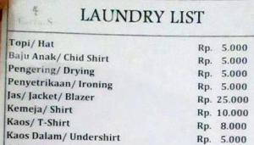
Avoid the laundry list literature review
The laundry list is often called
‘He said, she said”
Williams (1985) discovered... Stevens (1988) conducted similar experiments and find that … Later Randle (1991) concluded that…
By focusing on writers rather than the substantive issue under discussion, you may end up listing and then trying to draw things together. Your goal is not to summarise who said what but on interpretations of the term.

Slide 13
The purpose of a literature review is to:
Place each work in the context of its contribution to understanding the research problem being studied.
Describe the relationship of each work to the others under consideration.
Identify new ways to interpret prior research.
Reveal any gaps that exist in the literature.
Resolve conflicts amongst seemingly contradictory previous studies.
Identify areas of prior scholarship to prevent duplication of effort.
Point the way in fulfilling a need for additional research.
Locate your own research within the context of existing literature [very important].

Slide 14
Example
Produce an argument – do not simply report summaries of other people’s work, but make one/two points supported by evidence.
Clarifying the concept of neoliberalism is not an easy task. The term neoliberalism is often used as a synonym for capitalism or the inequalities of the economy more generally (Ferguson 2010). Some scholars use the term very loosely, drawing connections between unrelated life events to suggest that a clandestine power is ‘pulling the strings’ (Bell and Green, 2016, after Latour, 2005). Neoliberalism is also almost always derogatory when used to refer to economic/political policy (Fish, 2009) which produces austerity through the rationality of markets, entrepreneurialism and competition (De Lissavoy, 2014). The term is also associated with ‘bureaucratisation’ (Hibou, 2015), processes of rationalisation and professionalization, driven by the quest for neutrality, objectivity and professionalization, which govern key aspects of everyday life.
Compare with:
How then can the term neoliberalism be understood? Barnett (2005) suggests that it refers to the discreet alteration of the class-driven reform of the state to benefit free markets. Neoliberalism is a form of ideologically driven policies and government that supports privatisation, the free market and increased competition.
https://patthomson.net/2017/09/11/avoiding-the-laundry-list-literature-review/

Slide 15
avoid the repetitive use of he says, finds, proposes etc.
made the writing more authoritative – remove the author’s own view via ‘therefore’
moved some sentences from passive to active voice.
highlighted the most important work that the author is using
produced an argument – I’m not simply reporting summaries of other people’s work, but have made two points supported by evidence.

Slide 16
The following reading strategies can help you to identify the argument of a source
Identify the author’s thesis (central claim or purpose) or research question. Both the introduction and the conclusion can help you with this task.
Look for repetition of key terms or ideas, especially those occurring in the thesis. Follow them through the text and examine what the author does with them.
Notice whether and how a theory is used to interpret evidence. Identify the method used to investigate the problem/s addressed in the text.
Notice how the text is laid out and organized. What are the main sections? What is emphasized? Why? Accounting for why will help you move beyond listing contents and toward accounting for argument. Look also for paragraphs that summarize the argument.

Slide 17
In your literature review you might:
Give a new interpretation of old material or combine new with old interpretations,
Trace the intellectual progression of the field, including major debates,
Depending on the situation, evaluate the sources and advise the reader on the most pertinent or relevant research, or
Usually in the conclusion of a literature review, identify where gaps exist in how a problem has been researched to date.

Slide 18
Questions Your Literature Review Should Answer
What do we already know in the immediate area concerned?
What are the characteristics of the key concepts or the main factors or variables?
What are the relationships between these key concepts, factors or variables?
What are the existing theories?
Where are the inconsistencies or other shortcomings in our knowledge and understanding?

Slide 19
What research designs or methods seem unsatisfactory? What views need to be (further) tested?
What evidence is lacking, inconclusive, contradictory or too limited?
Why study (further) the research problem?
What contribution can the present study be expected to make?

Slide 20
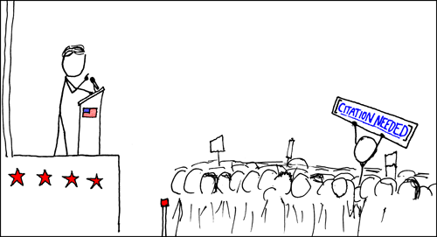
In-Text Citations (APA format)

Slide 21
Basic principles
Cite only works that you have read
Cite primary sources when possible
You can use both past and present tense for citations
e.g. Jones (1998) found; Jones (1998) has found; Jones (1998) finds
All sources that are cited in the text must appear in the reference list at the end of the paper (ensure the spelling of author names)
Avoid using online sources that cannot be retrieved
If an idea or theory is in a textbook and does not carry a specific citation there, then you probably do not need to cite anyone.
BUT empirical work is nearly always specific and must be cited.
If in doubt – cite it!

Slide 22
Use of direct quotation
When you use the work of others as primary data
When you want to appeal to their authority
When the specific words of your source matter because
the wording of the original is particularly pertinent to an idea you are discussing
To avoid any ambiguity or misrepresentation of source material
You dispute your source and you want to state her case fairly
The words of the source are especially vivid or significant

Slide 23
Direct quoting from a work
Short quotations appear in double quotation marks
Long quotations (40+ words) appear in the block quotation format
Include the author, year of publication, and page number
Use the abbreviation “p.” (for one page) or “pp.” (for more pages) before listing the page number(s). Use en dash for page ranges.
For example: (Jones, 1998, p. 199) or (Jones, 1998, pp. 199–201)
Do not use italics for quotations.
Use italics for words in other languages, for titles of works, to provide emphasis, or to define the key terms.
https://apastyle.apa.org/style-grammar-guidelines/italics-quotations/italics

Slide 24
According to Jones (1998), "students often had difficulty using APA style, especially when it was their first time" (p. 199).
Jones (1998) found "students often had difficulty using APA style" (p. 199); what implications does this have for teachers?
She stated, "Students often had difficulty using APA style" (Jones, 1998, p. 199), but she did not offer an explanation as to why.
Mindfulness is defined as "the act of noticing new things, a process that promotes flexible responding to the demands of the environment" (Pagnini et al., 2016, p. 91).

Slide 25
Place long quotations (40+ words) in a free-standing block of typewritten lines and omit quotation marks.
Short quotation
Long quotation
Text highlighting

Slide 26
Paraphrasing Sources
When you are more interested in content, in findings or claims, than in how a source expresses himself
To summarize or acknowledge another author’s ideas
When you want to explain difficult material in a way which is easier for your reader to understand
Don’t cobble together a paper out of a series of quotations. You must make your own arguments with your own claims and evidence

Slide 27
Indirect citation
Paraphrase as much as possible, rather than quote
In parenthetical citations (Author, year) there is a comma between the author and year
In narrative citations Author (year), there is the date in parentheses after the author
For 3+ authors abbreviate author names
(e.g., first author plus “et al.”)
All works in the reference list need to be cited in the text
Avoid patchwriting = omit a few words and substitute synonyms
Avoid overcitation = for longer paraphrases use one citation when introducing the idea and not repeated the citation
https://apastyle.apa.org/instructional-aids/in-text-citation-checklist.pdf

Slide 28
There were distinct perceptions of family and caste in 19th century accounts of bathing resorts (Somloi, 2001), which on closer analysis can reveal a great deal about the nature of perceptions of caste in society generally.
There were, as Somloi (2001) has rightly pointed out, distinct perceptions of family and caste in 19th century accounts of bathing resorts. Closer analysis of these perceptions can reveal a great deal about the nature of perceptions of caste in society generally.
Somloi, G. (2001) “Spa Resorts in 19th Century Hungary”, Hungarian Historical Journal Vol.23, no.4

Slide 29
Citation and Qualification Signals

Slide 30
Reporting Verbs
Hard sciences have a more detached reporting style
  The relevant theory was developed by Bruno.
  Stein et al. reported that a typical force..
  Paiva and Venturinit presented an alternative formulation…
Contrasted with soft sciences:
  Baumgarter and Bagozzi (1995) strongly recommend the use of…
  Law and Whitley (1989) argued, for instance, that…..
Plus use of evaluative adverbial comment
  He argues, correctly to my mind, that…
  Churchland justifiably rejects this notion….
  As Stern and Terrell, correctly assert…

Slide 31
Hedges
Reduce the force of statements
Reinforce tentativeness of proposition or an appropriate degree of prudence
  ...it could plausibly be reported that what seems attractive about it are just…
  This suggests that a competition exists….which might account for…
  In all probability, the sub-routines would require further development…

Slide 32
Boosters
Increase the force of statements
Allow writers to express certainty (or strong probability), mark solidarity with a source or audience, show conviction in argument
  The essential role of interference between coherent wave functions is further strengthened by…
  This clearly indicates that attractive interactions alone cannot explain…

Slide 33
Dimensions of Praise and Criticism
Critique specific issues, praise more global features:
  Klein’s work is significant, not only for the detailed careful study she presents, but also for the myriad issues she raises….
  In section IV, however, it is not made clear why the competitive inhibition of….
  But this claim turns out to be misleading.
  It does not give much of an explanation why neural networks are useful, and does not derive any of the equations
  I found the model quite robust at the simplest level of explaining how the banking sector operated, but less convincing in explaining why the sector collapsed in the face of….

Slide 34
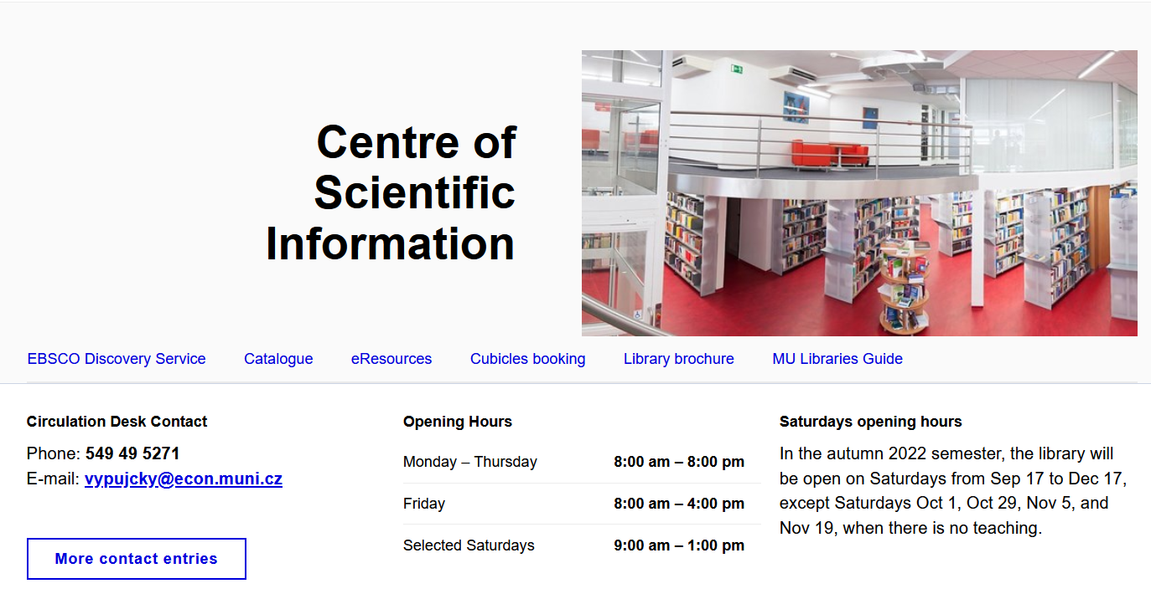
Scientific information at ECON MUNI
https://www.econ.muni.cz/en/library

Slide 35
Remote access to electronic resources
(outside eduroam network)
https://ezdroje.muni.cz/vzdaleny_pristup/?lang=en
To use a remote access please choose one of these options:
Use links to the EIZ only from the Portal of electronic resources. After clicking to a link you will be prompted to sign in with your UCO and password; if these data are valid, you will be automatically redirected to a required EIZ and will be able to work with it immediately).
Set up a VPN on your computer (see OpenVPN). Recommended for frequent and intensive work with the resources.

Slide 36
University Library Catalogue
katalog.muni.cz
Records of all paper books
    With links to scanned versions (e-loans)
Records of permanently acquired e-books
    With links to full text
English interface
    And English written books filter

Slide 37
University Discovery Service (EBSCO)
discovery.muni.cz
Searches within almost all subscribed journals
    And offers link to the articles' full texts
Indexes books & e-books from Discovery as well
    Additionally offers subscribed e-books
List of available journals and books at MU
    Where You can browse by discipline
This search engine is similar to Google Scholar.

Slide 38
The most important publishers
Cambridge UP
De Gruyter
EBSCO
Elsevier
Oxford UP
ProQuest
SAGE
Springer
Taylor & Francis
John Wiley & sons
ezdroje.muni.cz/prehled/index.php?lang=en&fids=7&type=fakulty

Slide 39
Access to OECD library
OECD iLibrary
  Collection of OECD electronic resources
  International statistical indicators
  Browse books/reports by country/theme

Slide 40
Magazines & Newspapers
The Economist Historical Archive
  All content from 1843–2020
  Key economic indicators available
  Country & industry reports, supplements, and surveys
PressReader
  Newspapers and magazines from around the world
  120 countries, 60 languages
  3 months archive for the most titles

Slide 41
Literature study tips
Notice all interesting items
    Read abstract and research result
    Write down 2–3 sentences describing outcome
    Use a citation manager like Citace PRO
Be disciplined
    Evaluate the quality of publications (journals)
    Stop reading when you're supposed to start writing
    Cite all the ideas taken

Slide 42
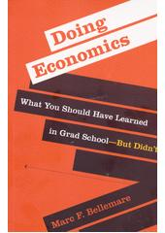
Suggested book
Doing economics : what you should have learned
in grad school-but didn’t (2022), Bellemare, Marc
E-book is available as E-Loan
https://katalog.muni.cz/Record/MUB01006507361
Chapter on Writing Papers is available in pdf
https://is.muni.cz/auth/do/econ/sm/akap/akademicky_text_a_proces_jeho_vzniku/Writting_papers_Bellemare_MIT_2022.pdf

