Slide 1
The scope and environment of international finance
Characteristics of main players
Michala Moravcová
Department of Finance, Masaryk University
International Finance
International Finance

Slide 2
Contents
Growth of International Trade
Globalization Process of MNCs
Important International Players
Source: Bekaert, G. J., and Hodrick, R. J. (2012). International Financial Management, 2nd edition. Chapter 1.
International Finance

Slide 3
Why we study International Finance?
We live in a highly globalized and integrated world economy.
Continuous liberalization of international trade and investments and rapid advances in telecommunication and transportation technologies, the world is getting more integrated.
Financial managers of MNCs should learn how to manage foreign exchange and political risk using proper tools and instruments, deal with market imperfections and benefit from the expanded investment and financing opportunities with the aim of contribution to share holder wealth maximization.
International Finance

Slide 4
1.1 Introduction “The world economy is becoming increasingly globalized“
Globalization
Increasing connectivity and integration of countries and corporations and the people within them in terms of their economic, political, and social activities
Multinational corporations dominates the corporate landscape
Produce and sell goods or services in more than one nation (e.g. Coca-Cola, IBM, Nestle, ..)
BRIC countries (Brazil, Russia, India and China)/emerging markets offer a lot of opportunities for expansion (Why?)
International scope creates opportunities but also challenges
Recent crisis (others?)
International Finance

Slide 5
1.2 Globalization and two main trends: The Growth of International Trade and Capital Flows
The growth of international trade
The theory of comparative advantage (advanced by David Ricardo) says:
It is mutually beneficial for countries if they specialize in the production of those goods they can produce most efficiently and trade those goods among them. It is not a “zero-sum game” in which one country benefits at the expense of another country. It is “increasing-sum” game at which all players are winners.
Assumptions:
Free trade
Perfect competition
No uncertainty
Costless information
No government interference
Comparative advantage still explains why some countries are better for export
International Finance

Slide 6
1.2 Globalization and two main trends: The Growth of International Trade and Capital Flows
Trade liberalization so countries can specialize at production of goods for which they have a comparative advantage
1960s only 20% of countries were open
Firms (1980s), the fall of the Iron Curtain in 1990 and subsequent trade liberalizations in many developing countries and privatization
By 2000, over 70% of countries were open
International Efforts to Promote Free Trade (Free trade agreements)
General Agreement on Tariffs and Trade GATT (1947)
World Trade Organization WTO (1986)
Regional Trade agreements (European Union, NAFTA, ASEAN)
More open economies, tend to grow faster (Frankel and Romer (1999), Sachs and Warner (1995), Alcal and Ciccone (2004), and Wacziarg and Welch (2008)).
The examples of protectionist policies: tariffs on imports, subsidies to local producers, quotas on imported products, onerous regulations applying to imported products
Advances in information technology supported Outsourcing of services
Shifting of non-strategic functions to specialist firms to reduce costs (IT, payrolls, logistics, maintenance facilities)
21st century comparative advantage is based on services and supply chain outsourcing
International Finance

Slide 7
1.2 Globalization and the Growth of International Trade and Capital Flows
The evolution of trade openness dramatically increased trade flows between countries. One measure of trade openness is the sum of exports and imports in a given year divided by a measure of output (GDP)
The growth in trade (patterns)
Germany is most open, United States is least open
China’s trade jumped due to trade reforms
Countries that border oceans tend to trade more
Large countries tend to trade less than small (USA, China is exception)
International Finance

Slide 8
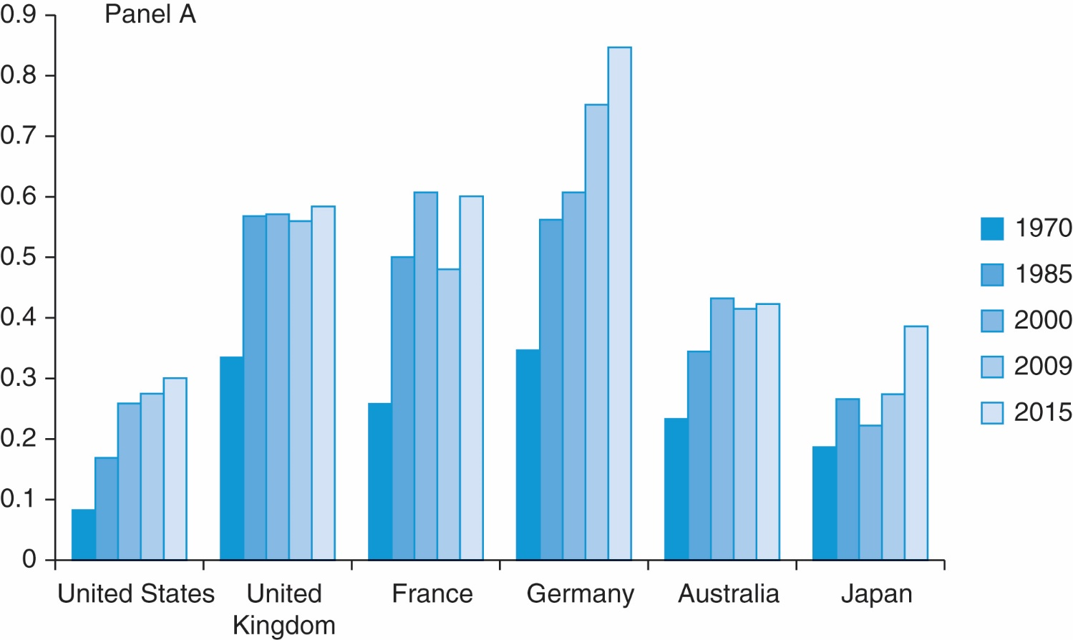
Exhibit 1.1 (Panel A) International Trade as a Percentage of GDP
International Finance

Slide 9
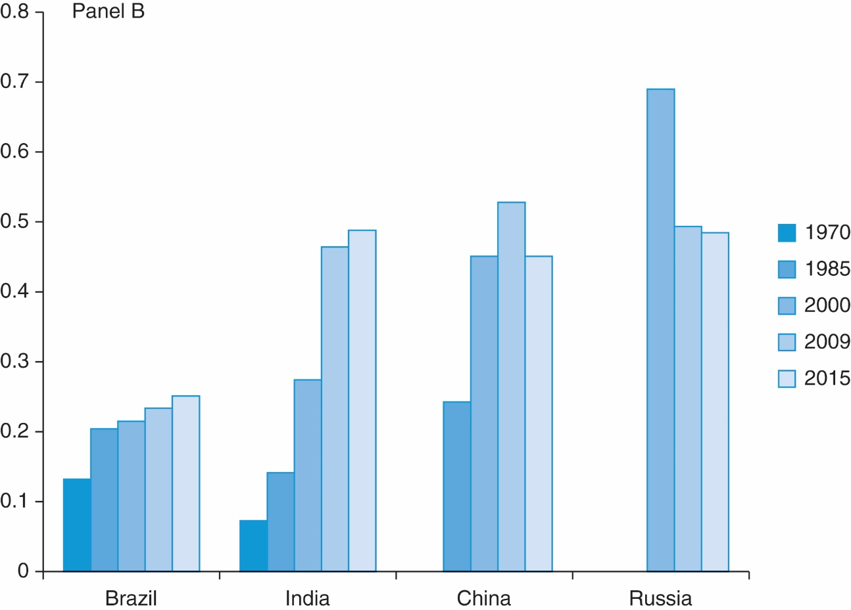
Exhibit 1.1 (Panel B) International Trade as a Percentage of GDP (BRIC countries)
International Finance

Slide 10
1.2 Globalization and the Growth of International Trade and Capital Flows
Incredible growth in MNCs after WWII boosted international trade
37,000 MNCs in 1990
82,053 in 2010
More than 50% of international trade occurs within MNCs
Globalization of financial markets improved MNCs access to foreign capital, and enhanced their ability to reduce financing costs
Trends in financial openness
Countries open financially and allow foreigners to invest in their markets (1980s) and vice versa (= free flow of capital across borders)
Creation of new asset class – emerging markets
New financial landscape – derivatives (← deregulation, advance in technology)
An investment whose payoff over time is derived from the performance of underlying assets (futures, forwards, …)
Securitization – repackaging of “pools” of loans or other receivables to create a new financial instrument
Derivatives and securitization improved the ability of banks and corporations to manage financial risk
International Finance

Slide 11
1.2 Globalization and the Growth of International Trade and Capital Flows
Globalization of financial markets
Pros and cons of development
Pro – banks (and companies) could hedge against risk
Cons – smart financiers exploit differences in country-specific regulations and complexity of instruments created opaqueness in the financial system
Global Financial Crisis – 2008 – 2010
Started in U.S.
Longest and deepest in the postwar era
Scale and depth of crisis raises deep issues about the functioning of the global financial system
International Finance

Slide 12
1.3 Multinational Corporations
A parent company in the firm’s originating country and operating subsidiaries, branches, and affiliates abroad
UN calls these “transnational corporations”
How they enter foreign markets
Exporting / Importing
Licensing – gives local firms right to manufacture their products in exchange for a fee (royalties) (difficult to maintain quality standards)
Franchising – the firm provides sales or service strategies in exchange for fees
Joint venture – two or more firms form a new legal entity, jointly owned by all of the firms
Buying foreign company
Greenfield investments – starting company from scratch (part of FDI)
International Finance

Slide 13
1.3 Multinational Corporations
Goals of an MNC
Maximize shareholder wealth
Australia, Canada, U.K. and U.S.
Appropriate time horizon is long
Maximize stakeholder wealth
Europe and Asia
Agency Theory – stockholders hire managers who make decisions about production and marketing. How can the ultimate owners of the assets motivate the managers to act in the owners’ interest?
The studies problems that arise from the separation of ownership and control
Corporate governance – legal/financial structure controlling relationship the relationship between a company’s shareholders and its management. Establish the framework within which the managers operate and to mitigate the principal–agent problem.
Corporate fraud
Enron, WorldCom, Tyco, Parmalat
International Finance

Slide 14
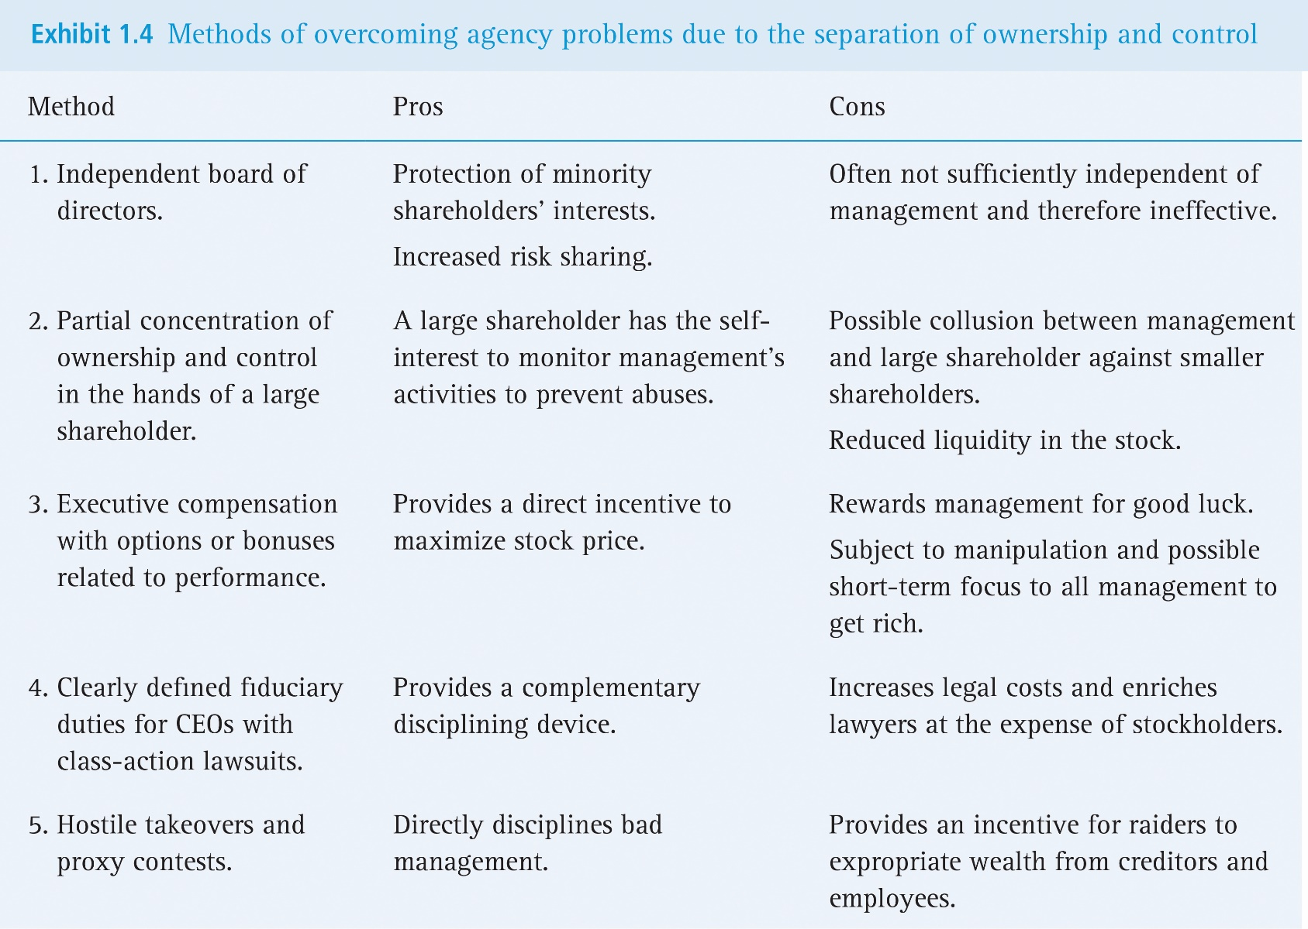
Exhibit 1.4 Methods of Overcoming Agency Problems Due to the Separation of Ownership and Control
International Finance

Slide 15
1.3 Multinational Corporations
Foreign Direct Investment (FDI)
When a company from one country buys at least 10% of a company in another country
Has grown from $7.5 trillion in 2000 to $25.0 trillion in 2015
Mergers and acquisitions (M&A) play a huge role in this trend
International Finance

Slide 16
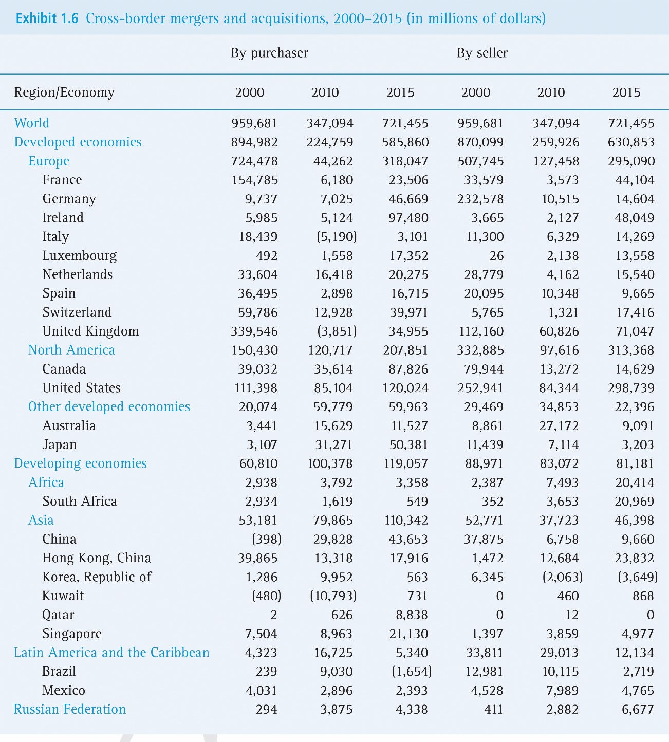
Exhibit 1.6 Cross-Border Mergers and Acquisitions, 2000–2015 (in millions of dollars)
International Finance

Slide 17
1.4 Other Important International Players
International banks (CitiBank, HSBC, Global Asset management firms for M&As)
International institutions
International Monetary Funds (IMF)
Member organization whose goal is to ensure the stability of the international monetary and financial system through surveillance and technical assistance. IMF helps to resolve crises when they occur, and to promote growth and alleviate poverty.
The World Bank
The World Bank also provides advisory services to developing countries and is actively involved with efforts to reduce and cancel the international debt of the poorest countries
International Finance

Slide 18
1.4 Other Important International Players
Multilateral development banks
Provide financial support and professional advice for economic and social development activities in developing countries
Regional development banks (including World Bank and regional banks in Africa, Asia and Europe) who provide financing and grants
World Trade organization (WTO)
Mediates trade disputes
Organization for Economic Cooperation and Development (OECD)
Examines, devises and coordinates policies across 34 relatively wealthy nations to foster sustainable economic growth and employment, rising standards of living and financial stability
Bank for International Settlements (BIS)
Fosters international monetary and financial cooperation – central banks’ central bank
International Finance

Slide 19
1.4 Other Important International Players
European Union (EU)
Cooperation among countries in this region and (in most cases) the adoption of the same currency to promote international business
Economic and monetary union (EMU)
Governments
Individual investors
Institutional investors
Sovereign wealth funds
Government-run investment pools
Hedge funds
Private equity funds
International Finance

Slide 20
1.5 Globalization and the MNC: Benefactor or Menace?
Countries who had opened their markets to foreigners subsequently fell into crisis
Benefits of openness
Channels savings to most productive uses
Sharing of risk beyond what is possible domestically
Domestic recessions can be buffered through borrowing
Cost of capital decreases, leading firms to invest more, which increases growth
Costs of openness
Sometimes capital is not used wisely (price boom)
Foreign capital can leave quickly causing financial volatility
Difficulty in taxing profits – MNCs shift to avoid
Capital control effectiveness decreases
International Finance

Slide 21
1.5 Globalization and the MNC: Benefactor or Menace?
Anti-globalist movement and MNCs
Movement opposing globalization
Identifies MNCs as a main “villain” of globalization
Criticize global financial institutions such as the World Bank, IMF and WTO
They fear that MNC activities will harm the environment
They argue that globalization is seen as a threat to employment in their own country
International Finance

Slide 22
1.5 Globalization and the MNC: Benefactor or Menace?
Final thoughts on globalization
Can be valuable
Some evidence that workers in developed countries have not benefited
Globalization destroys some jobs and creates others
Some believe that government must intervene to better spread the newly created wealth by helping those that have been displaced by globalization
Retraining
Benefits of openness should be fairly shared among countries.
International Finance

Slide 23
Questions
What is agency theory? How does corporate governance the issues raised by agency theory?
Why is ownership more concentrated in developing countries than in developed countries?
Go to the Web site of your favorite multinational firm and determine where it operates thoughout the world. How many employees does it have worldwide? Has it done any interesting cross-border mergers and acquisitions during the last year?
Go to UNCTADstat at http://unctadstat.unctad.org. Update the data in Exhibit 1.6 on cross-border mergers and acquisitions for the most recent years.
(country profile for the Czech Rep. http://unctadstat.unctad.org/CountryProfile/GeneralProfile/en-GB/203/index.html).
International Finance

