Slide 1
2. TRANSPORT DEMAND ELASTICITY

Slide 2
ELASTICITY
Elasticity of demand is the responsiveness of demand to a change in one of its determinants
PRICE
CROSS - PRICE
INCOME

Slide 3
PRICE ELASTICITY
=

Slide 4
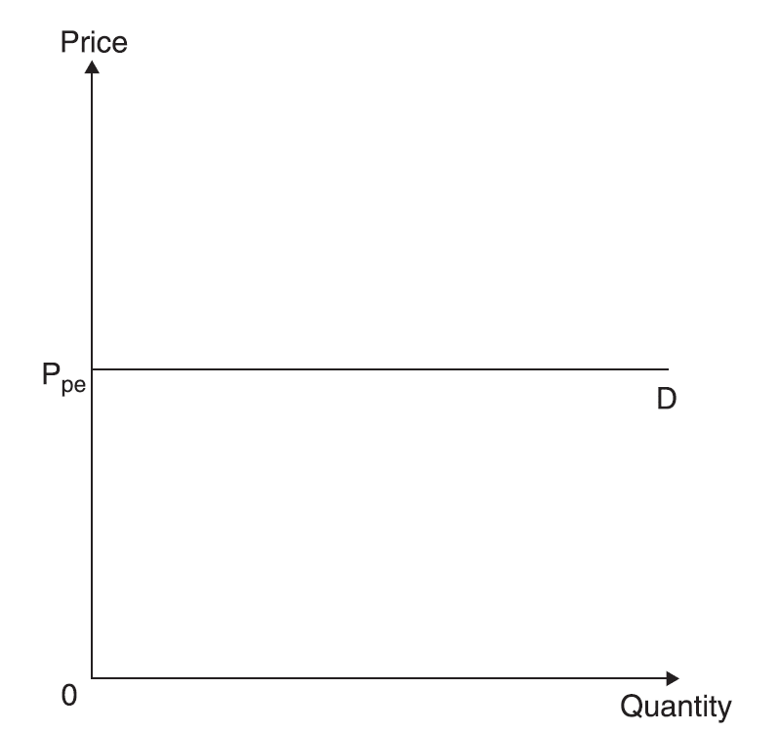
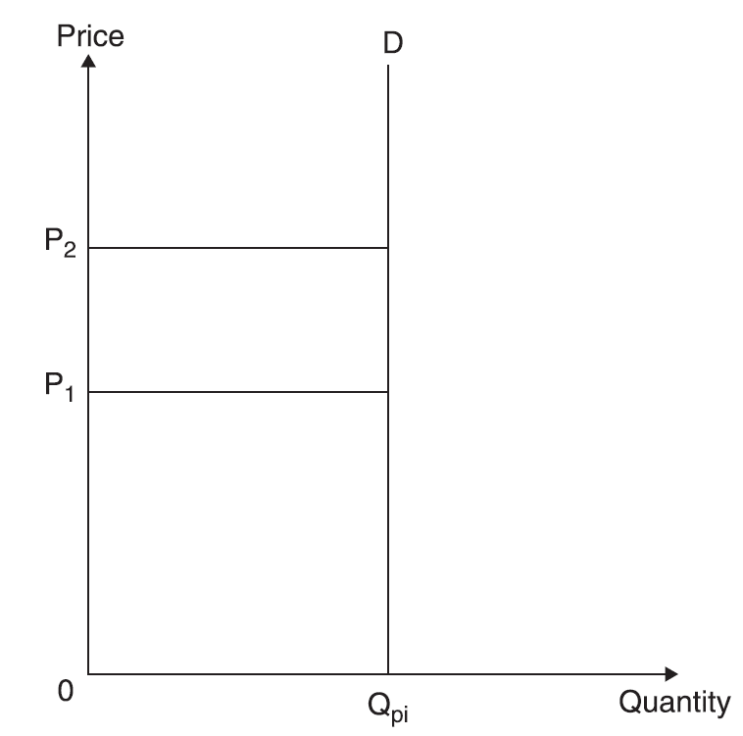
Demand curves
Elastic Inelastic Unitary

Slide 5
Determinants of price elasticity
The number and closeness of alternative modes of travel (substitutes)
Proportion of disposable income spent on the mode of travel
Time dimension

Slide 6
Time dimension

Slide 7
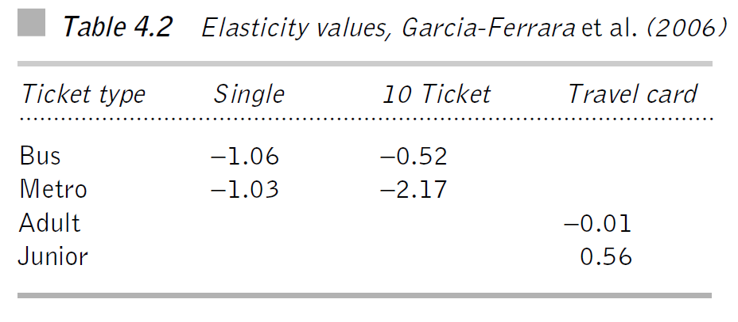
Variability

Slide 8
Peak and Leisure

Slide 9
Overview

Slide 10
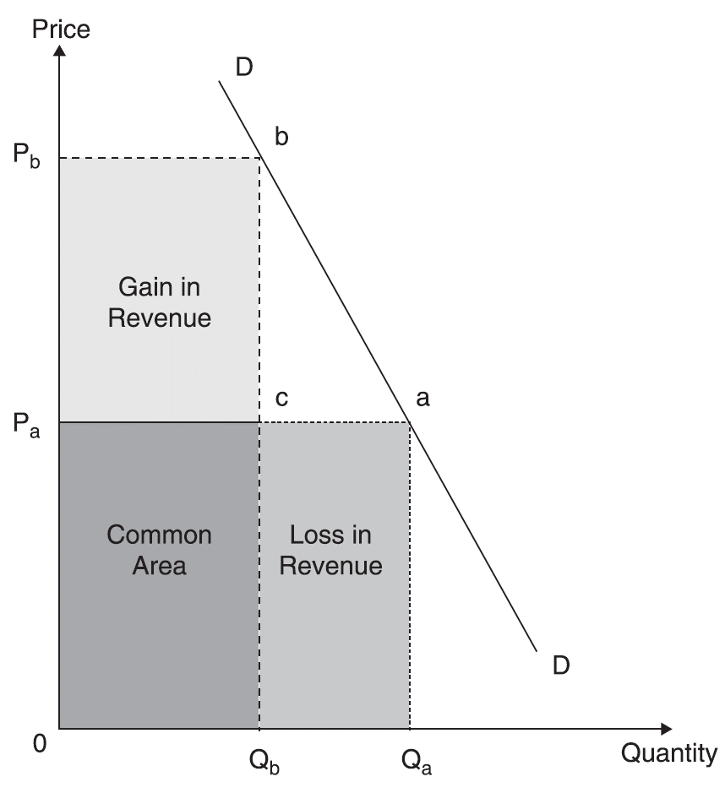
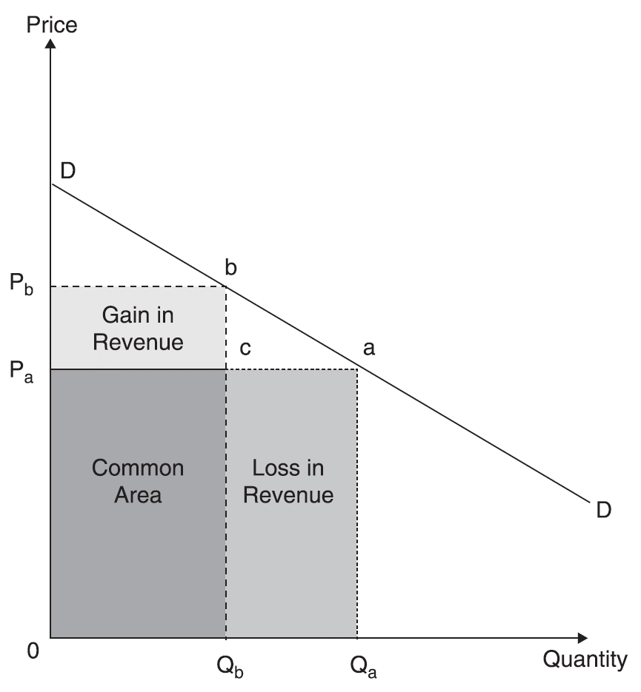
Price elasticity and total revenue
Q: If operators face inelastic demands, why don't they simply keep increasing the fare?

Slide 11
Exercises
Is the price elasticity of demand for airline industry in short-haul markets more or less than long-haul markets? Why?
What are the factors that influence the elasticity of demand for pilots?
The price elasticity of demand for Amtrak, the US rail passenger service, among vacation travellers has been estimated as –1.20. Given that Amtrak faces the market demand for rail passenger trips, what effect will a 15% increase in fares have upon market demand? What effect will the fare increase have upon revenues?

Slide 12
Demand estimations
According to demand theory, the market demand curve for transportation is downward-sloping.
You are a transportation economist for rail operator and you are asked to estimate the price elasticity of demand for rail services. Describe in some detail what steps you would follow to obtain the price elasticity of demand.
Suppose that your analysis found that the price elasticity of demand for rail services was –0.78. What impact would a 10% increase in price have upon the quantity of rail services demanded? Do you know whether revenues would rise or fall?

Slide 13
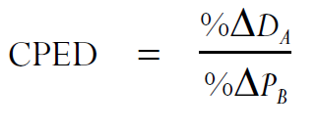
CROSS PRICE ELASTICITY

Slide 14
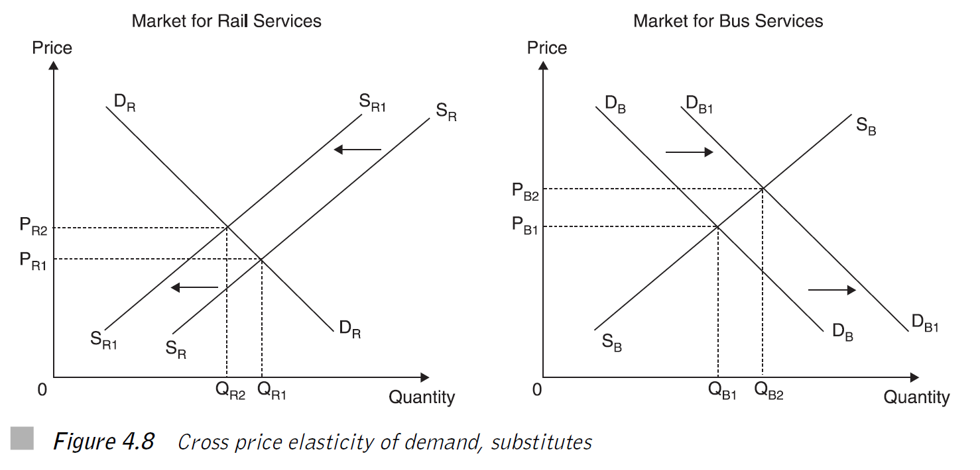
Substitutes

Slide 15
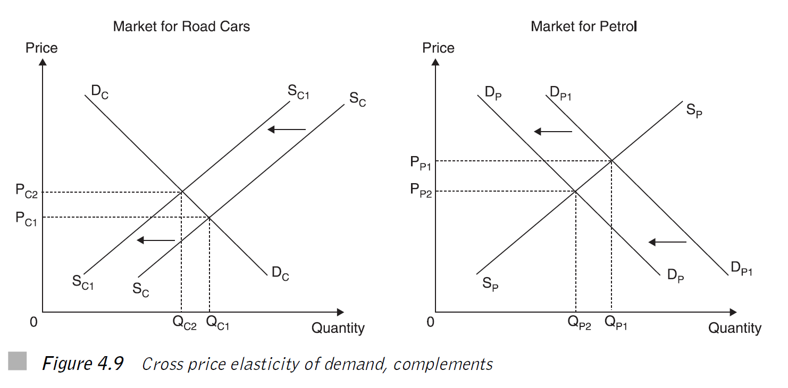
Complements

Slide 16
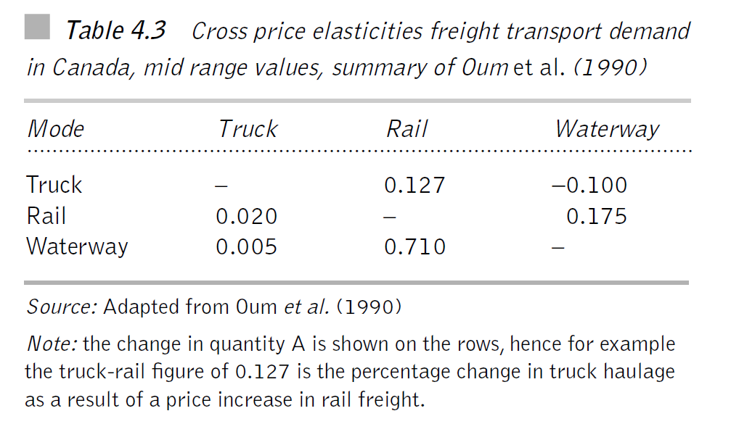
Freight

Slide 17
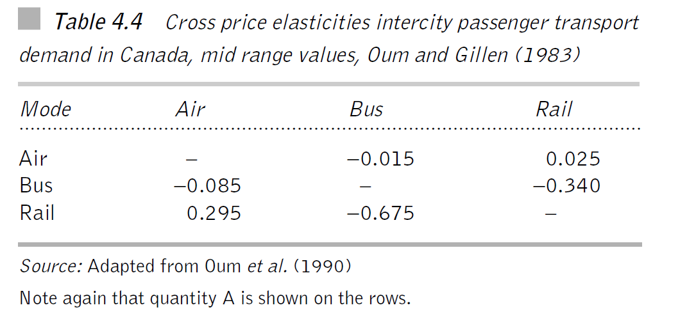
Passenger

Slide 18
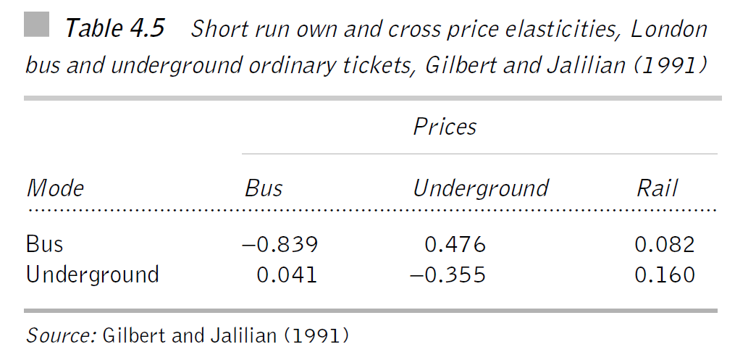
Public transport

Slide 19
INCOME ELASTICITY

Slide 20
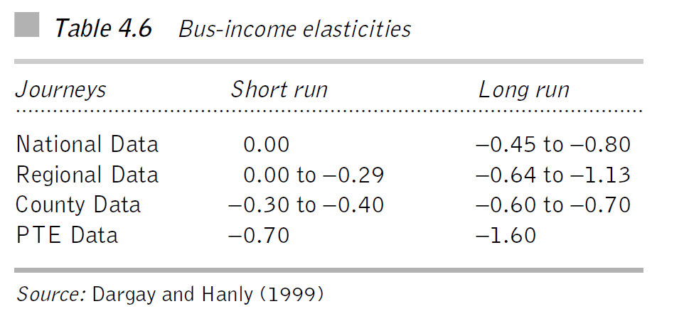
Time dimension

Slide 21
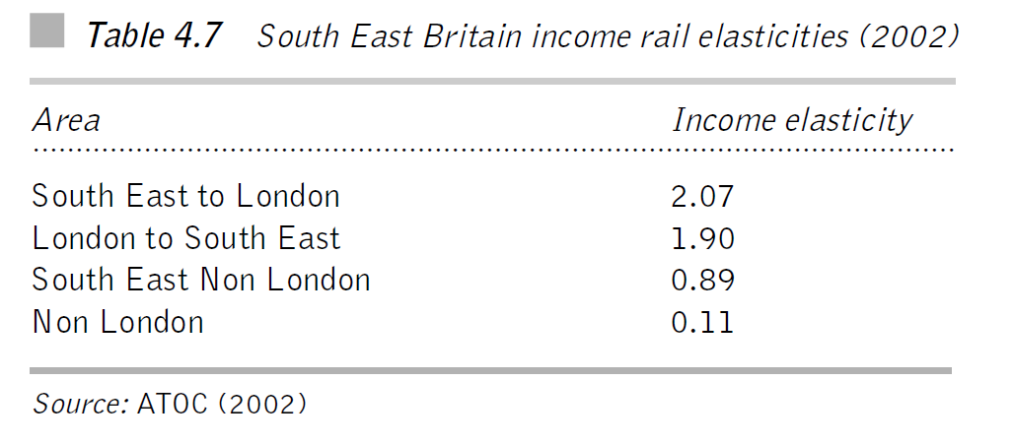
Commuting

Slide 22
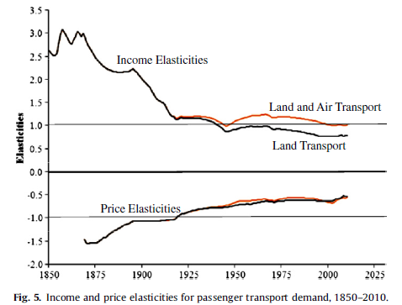
Historical income elasticities
Fouquet, R. (2012). Trends in income and price elasticities of transport demand (1850–2010). Energy Policy, 50, 62-71.

Slide 23
Exercise
Suppose the income elasticity of demand for good is -4. Is this good a normal good or an inferior good? If it is a normal good, then is it a luxury or a necessity? Why?

Slide 24
Public transport as an inferior good?
Public transportation is oftentimes argued to be the inferior good.
Identify why this might be so.
Is public transportation an inferior good at all levels of income? If so, why; and if not, why not?

Slide 25
Free fare policies
Many cities have recently introduced free fare policies in public transport in order to decrease car congestion and boost the public transport usage.
What do you think of such policies?

Slide 26
Rising fuel prices
With changes in fuel prices what kind of effects should we see in the market for travel?

Slide 27
EXERCISE 4.3

