Slide 1
3. TRANSPORT DEMAND ISSUES

Slide 2
PUBLIC TRANSPORT
This paper first provides a brief review of trends in public transport demand from 1980 to 2010 in 16 countries in Europe, North America, and Australia.
The focus, however, is on a detailed analysis of public transport demand in Germany and the USA, using uniquely comparable national travel surveys from 2001/2002 and 2008/2009 for both countries.
Public transport has been far more successful in Germany than in the USA, with much greater growth in overall passenger volumes and trips per capita.
Buehler, R., & Pucher, J. (2012). Demand for public transport in Germany and the USA: an analysis of rider characteristics. Transport Reviews, 32(5), 541-567.

Slide 3
Germans and Americans
Even controlling for differences between the countries in demographics, socio-economics, and land use, logistic regressions show that Germans are five times as likely as Americans to use public transport.
Moreover, public transport in Germany attracts a much broader cross-section of society and for a greater diversity of trip purposes.

Slide 4
Explanation?
The success of German public transport is due to a coordinated package of mutually supportive policies that include the following:
(1) more and better service
(2) attractive fares and convenient ticketing
(3) fullmultimodal and regional integration
(4) high taxes and restrictions on car use
(5) land-use policies that promote compact,
mixed-use developments.

Slide 5
Conclusion
It is the integrated package of complementary policies that explains why public transport in Germany can compete so well with the private car, even among affluent households.
Conversely, it is the lack of complementary policies that explains the continuing struggle of public transport in the USA.

Slide 6
DEMAND FOR PUBLIC TRANSPORT
Q: Do you agree with the explanation and conclusion of Buehler and Pucher?
Buehler, R., & Pucher, J. (2012). Demand for public transport in Germany and the USA: an analysis of rider characteristics. Transport Reviews, 32(5), 541-567.

Slide 7
DEMAND FOR TRANSPORT MODES
Two approaches to modelling demand for transport modes
SR: Hedonic approach (P, P^{S},P^{C}, GDP, POP)
LR: Product life cycle

Slide 8
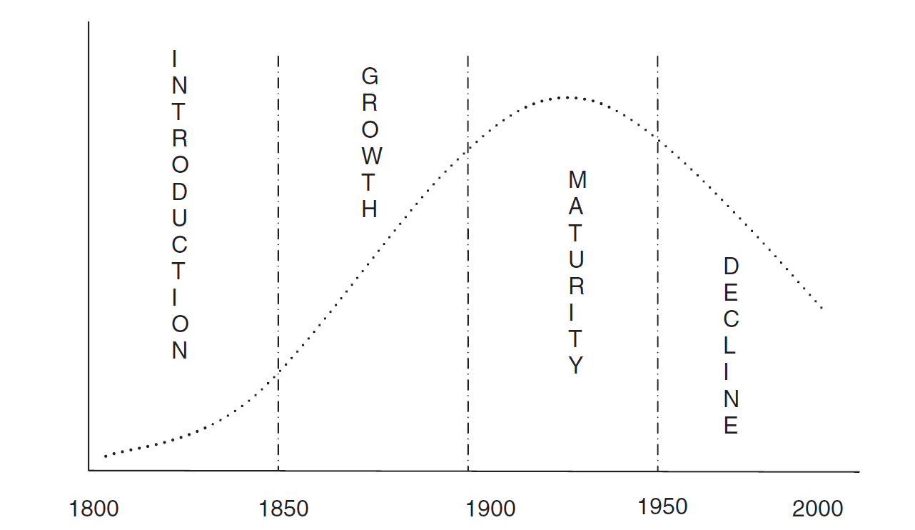
Life cycle curve for railways
Tomes, Z. (2008). Applying the life-cycle theory: The rise and fall of railways. The Journal of Transport History, 29(1), 120-124.

Slide 9
Metz, D. (2013). Peak car and beyond: the fourth era of travel. Transport Reviews, 33(3), 255-270.
Peak car
There is emerging evidence that personal daily travel, particularly by car, has ceased to grow in the developed economies. This can be attributed to saturation of demand, given high levels of access and choice now widely available, together with constraints on higher speeds.
We are therefore at a time of transition from an era of growth of per capita travel to an era of stability, in which the future factors determining the growth of total travel demand are demographic — population growth, increasing longevity, and urbanisation.
The peak car phenomenon, which marks this transition, is seen in successful cities that attract a growing population whose travel needs are increasingly met by investment in rail-based transport, the revival of which is a characteristic of the new era

Slide 10
Reducing car dependence
Buehler, R., Pucher, J., Gerike, R., & Götschi, T. (2017). Reducing car dependence in the heart of Europe: lessons from Germany, Austria, and Switzerland. Transport reviews, 37(1), 4-28.
Munich, Berlin, Hamburg, Vienna, and Zurich – the largest cities in Germany, Austria, and Switzerland – have significantly reduced the car share of trips over the past 25 years in spite of high motorisation rates.
The key to their success has been a coordinated package of mutually reinforcing transport and landuse policies that have made car use slower, less convenient, and more costly, while increasing the safety, convenience, and feasibility of walking, cycling, and public transport.

Slide 11
Reducing car dependence (2)
The mix of policies implemented in each city has been somewhat different. The German cities have done far more to promote cycling, while Zurich and Vienna offer more public transport service per capita at lower fares.
All five of the cities have implemented roughly the same policies to promote walking, foster compact mixed-use development, and discourage car use. Of the car-restrictive policies, parking management has been by far the most important.
The five case study cities demonstrate that it is possible to reduce car dependence even in affluent societies with high levels of car ownership and high expectations for quality of travel

Slide 12
Modal split – passengers (2019)

Slide 13
COMMUTING PARADOX
People spend a lot of time commuting and often find it a burden. According to standard economics, the burden of commuting is chosen when compensated either on the labor or on the housing market so that individuals’ utility is equalized.
However, in a direct test of this strong notion of equilibrium with panel data, we find that people with longer commuting time report systematically lower subjective well-being. This result is robust with regard to a number of alternative explanations.
We mention several possibilities of an extended model of human behavior able to explain this “commuting paradox”
Stutzer, A., & Frey, B. S. (2008). Stress that doesn't pay: The commuting paradox. Scandinavian Journal of Economics, 110(2), 339-366.

Slide 14
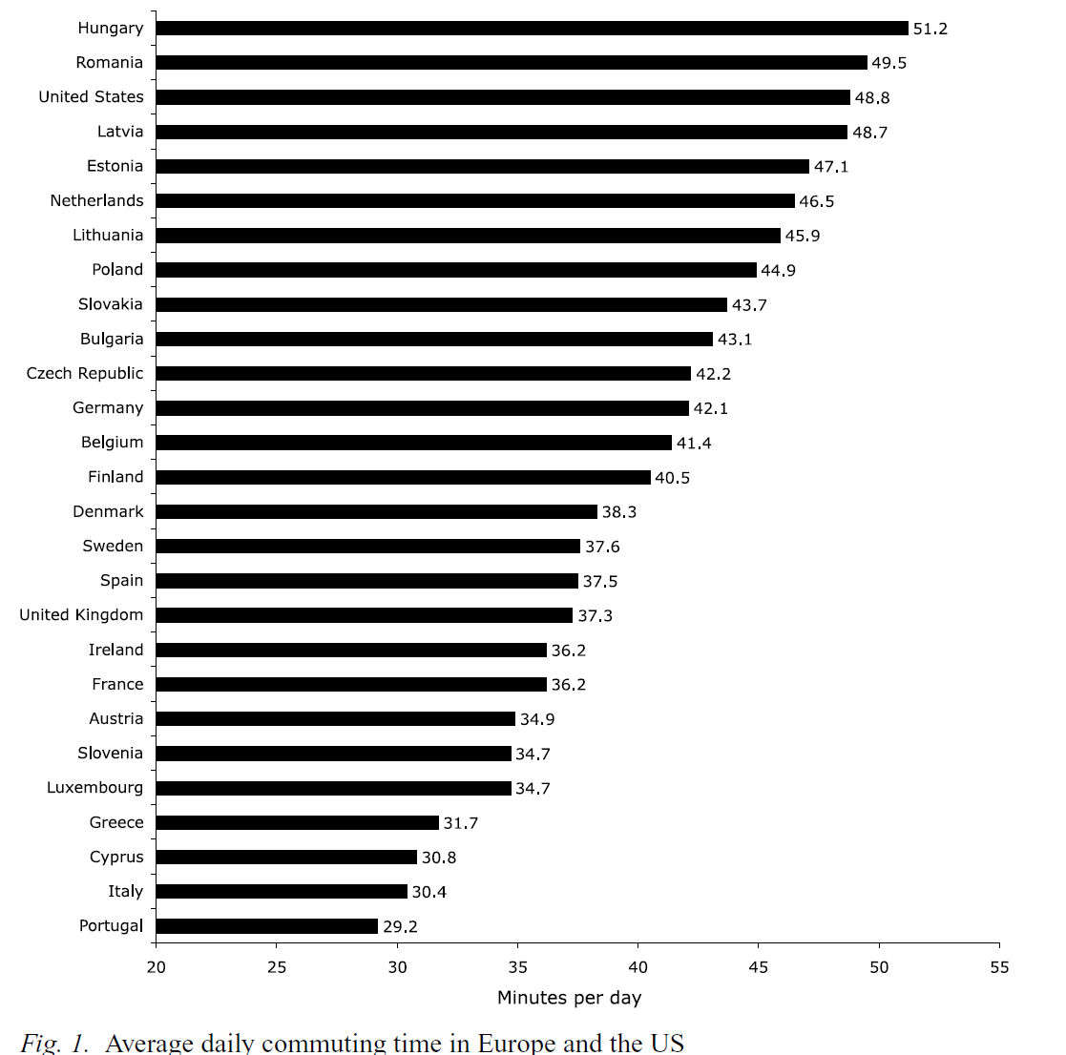
Commuting time

Slide 15
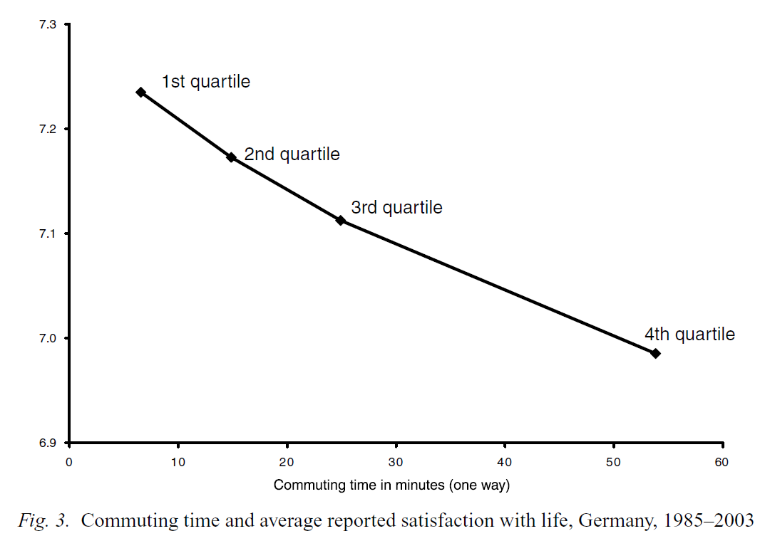
Commuting and happiness

Slide 16
PROBLEM OF PEAK
In economics it is usually assumed that demand is constant per unit of time
In transport economics this assumption cannot be made as there are peaks in demand that occur on a regular basis

Slide 17
Distribution of traffic by time of the day, UK, 2004: Cars

Slide 18
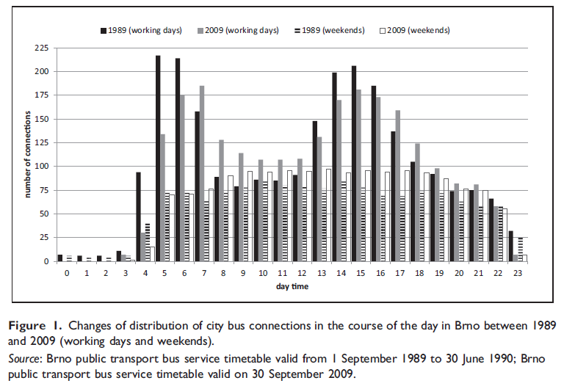
Peak and off peak periods
Mulíček – Osman – Seidenglanz (2016) constructed frequency distribution of bus services in Brno during the day in 1989 and 2009. Discuss the reasons why the distribution has changed.

Slide 19
THE NOTION OF NEED
There are some advocates of the idea that transport services, or at least some of them, should be allocated according to need rather than effective demand.
The idea is that just as everyone in a civilized society is entitled to expect a certain standard of education, medical care, security and so on, so they are also entitled to enjoy a certain minimum standard of transport provision.

Slide 20
The problem of rural demand
The provision of public transport services to satisfy demand in rural areas has always been problematic.
Such services have high costs, but low revenues due to low load factors. They are uneconomic.
However, the demand for these services is very real, as rural populations require them to get to work, to do their shopping, to access schools and medical care and for social reasons.

Slide 21
The problem of rural demand
This problem has worsened in recent times for four main reasons:
Greater car usage
Growth of urban conurbations
Public services concentrated in urban centres
Population ageing
White, P. (2015). Report on public transport provision in rural and depopulated areas in the United Kingdom.

Slide 22
EX (1): Monetary and time costs
In 1983, 87.4 % of household trips to work were by private motor vehicle, 4.6 % by public transit, and 8.0 % by other modes of travel (for example, bicycle or walk).
For private transportation, the average length of work trip (one way) was 8.5 miles, with an average commute time equal to 20 minutes. The operating cost per mile for private transportation was 8.36 cents.
For public transit, the average commute time was 46.1 minutes per one-way trip, with an average fare equal to 60 cents.
For other work-trip modes, the average one-way trip length was 5.6 miles, with an average trip time equal to 30 minutes.
For each of the three modes, what is the monetary cost per trip?
Assuming an average hourly wage rate equal to USD 10, what is the total cost pet work trip on each mode?

Slide 23
EX (2): Value of time
Most studies of modal choice find that the value of in-vehicle travel time is less than the value that travellers place upon waiting time.
Suppose that you’re an economist for a commuter railroad system. The manager of the agency is considering either of two policies: adding additional stops, with the expected result of reducing on-line speeds but also reducing the headway (that is, the average time between trains); or removing some stops, which would increase on-line speeds but also entail longer headways.
Overall, both policies are predicted to have the same effect on total travel time for the average consumer.
Discuss how you would use information on riders’ values of time in your police recommendation.

Slide 24
EX (3): Population density and public transport
One would expect that the demand for automobile ownership in metropolitan areas would be influenced by population density. Holding all else constant, the denser the area, the more public transit will be provided. Also, the denser the area, the more traffic congestion will be present.
Assuming that the public transit fare remains constant, explain why an increased supply of public transit in denser areas would reduce the opportunity cost of public transit.
Assuming no change in the per-mile monetary cost of automobile travel, explain why increased congestion will increase the opportunity cost of automobile travel.

