Slide 1
7. RAIL PRIVATIZATIONS

Slide 2
Discussion question – to heat up
What do you see as the main advantages and disadvantages of public ownership in transport markets?
What are benefits and risks of privatization?

Slide 3
Introduction
Due to many market imperfections, transport markets usually cannot be left entirely to market forces to resolve economic transport issues.
In most cases, therefore, they need some form of external intervention in order to correct for market failures

Slide 4
Government control
Government control of transport markets can be achieved through one of two measures:
Regulation - control through direct command; i.e. telling operators what to do
Ownership – the transport authority can own the assets and the means of production. The market is brought into public sector and thus it does not have to operate along market principles

Slide 5
Reasons for public ownership
Eradicate wasteful competition
Military significance
Public goods
Essential to the economy
A large employer
Key industry
High project development costs

Slide 6
Reasons for privatization
Increasing discontent with the model of public ownership
Changing macroeconomic enviroment combined with social change
The desire to introduce competition into the provision of transport services

Slide 7
Japan

Slide 8
Introduction
In rail system – passenger traffic dominant
Honsu island geography
Freight rail marginal – due to sea traffic
HSR Shinkansen – starting from 1964 on Tokyo-Osaka line
Highly successful – leading to build up of further lines with lower commercial potential
1980s – high indebtness of JNR , overemployment

Slide 9
1986 Reform
Sack of management
Horizontal separation (JR Freight)
Geographical separation (JR East, JR Central a JR West - commercialization, JR Hokkaido, JR Shikoku a JR Kyushu - subsidies)
Yardstick competition – comeptition on the edges only
Indebtness – partial bail-out, partial transfer to JR East, Central and West
Privatization of JR East, Central and West in 1990s

Slide 10
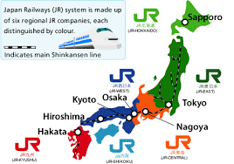
Japan rail

Slide 11
Results
Between 1987-1991: traffic + 20%; employment down from 280.000 to 160.000
Labor productivity: +68% between 1985-88 and another +25% between 1988-98
JR East, Central and West – profitable +3 bn income taxes per year (5 bn subsidies to JNR before reform)
JR Freight and JR JR Hokkaido, JR Shikoku a JR Kyushu – stable traffic, operational subsides
Better quality and responsivness to customers

Slide 12
Assesment
Successful reform/privatization
Main goals: to decrease indebtness and bigness of JNR
No competition!
More efective structure and incentives

Slide 13
New Zealand

Slide 14
General characteristics
Rail primarily oriented towards freight traffic
In passenger traffic there is important commuting to Wellington and Auckland and a few intercity connections
Until 1993 vertically and horizontally integrated structure in state ownership
Strong intermodal comeptition and worsening economic results

Slide 15
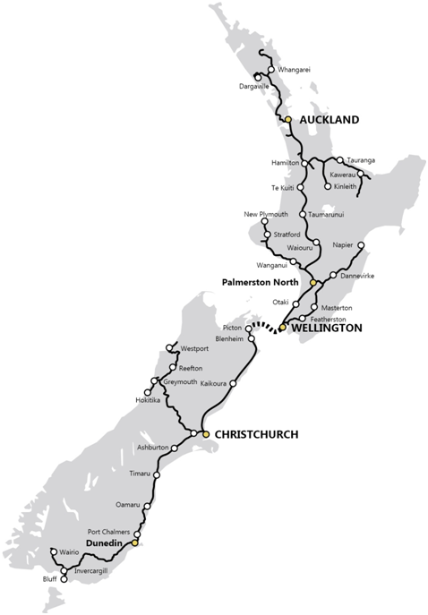
Nez Zealand rail map

Slide 16
1993 privatization
NZ government in 1993 sold it railway for 400 million USD to consortium of private investors
In the years after privatization, profits rose, however not enough to cover costs of capital
Freight traffic rose steadily

Slide 17
Problems
Private owners had increasing problems with operations of passenger rail transport and in 2002 sold commuter rail network back to government
Financial problems were increasing and in 2004, private owners sold back rail infrastructure to NZ state for 1 USD
NZ governemnt agreed to infrastructure investment, however bitter disputes over the level of infra charges emerged
This led to complete purchase of remaining rail enterprise by NZ governemnt for 690 million dollars. What was considered to be highly overpriced purchase

Slide 18
Lessons
Very problematic privatization in New Zealand (and very similar case in Tasmania) shows dangers of rail privatization involving passenger transport
Passenger rail transport in developer countries is usually not very profitable, however politically sensitive

Slide 19
Estonia
Based on Lust, A. (2017). Broken rails: the privatisation of Estonian railways. Post-Communist Economies, 29(1), 71-89.

Slide 20
Reform
In 2000–2001, Estonia sold the passenger carrier and a portion of the track to domestic businessmen posing as a British strategic investor, and the main freight carrier and most of the track to an American-led consortium.

Slide 21
Passenger and freight
The passenger carrier continued to receive government subsidies but closed several rail lines, which led to protests by passengers.
The freight carrier earned large profits from the transit of Russian oil to Europe, but invested its money in buying used American locomotives, rather than rebuilding the track.

Slide 22
Final part
Both companies laid off about half of their workforce, provoking the first private-sector strike in Estonia since the collapse of Communism.
In 2006, a new government bought back the freight services and track at more than twice the sale price, an expensive lesson in the perils of privatisation.

Slide 23
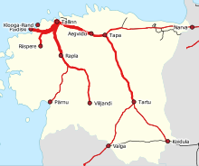
Train frequencies

Slide 25
UK

Slide 26
Introduction
British rail reform – probably the most complex and complicated one
Vertical, horizontal and geographical separation of the industry (1993-1997)
Fragmentation of former British Rail into more than 100 companies
Competition and privatization on all levels

Slide 27
Discussion question
Can you see any drawback/problem with such reform strategy?

Slide 28
Privatization
Privatization of the infrastructure manager (1996)
Privatization of freight operators (6 companies) – subsequently merged into 2
ROSCOs – rolling stock private owners – leasing to franchisee
Passenger operations - franchising

Slide 29
Franchising
25 regional franchisee
Private firms bid for the right to operate it (competition for the market)
No British Rail in these tenders!
Limited role of open access (competition on the market)
First, second and third round of franchising (1996, 2002, 2010)

Slide 30
Discussion question
Why do you think open access was not granted higher role in British rail reform?

Slide 31
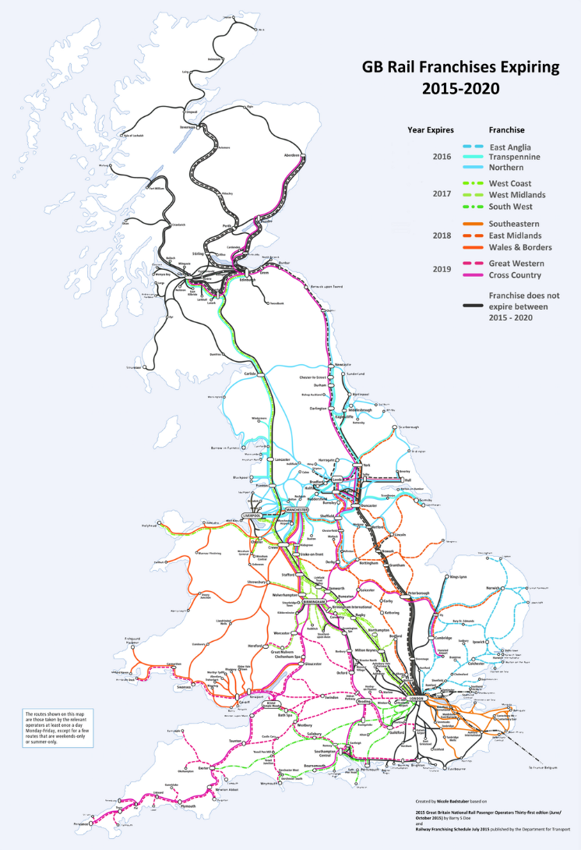
Map of franchisee

Slide 32
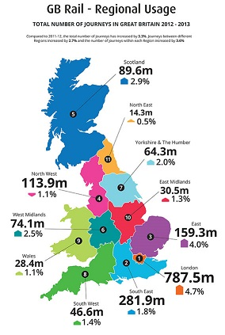
Regional Usage

Slide 33
Hatfield
Fatal accident in October 2000
Due to broken rail (bad maintanance?)
Railtracked panicked and introduced severe speed limits
Result: operational chaos, financial troubles of Railtrack and its bankruptcy in 2001
Higher involvement of governemnt (subsidies) into rail after Hatfield

Slide 34
Results
Growth of traffic (especially passenger)
Subsidies (firstly sharply down, up after Hatfield, then again down)
Costs (growth if unit costs; Why?)

Slide 35
Assesment
Mix of successes (traffic, innovations) and failures (costs, Hatfield)
Rail important in intercity and commuting transport (role of London!)
Therefore, governemnt can hardly hope that by privatization will solve the „rail problem“

Slide 36
Discussion question
Can you imagine a better way how to reform British railways?

