Slide 1
8. COMPETITION OR PRIVATIZATION?

Slide 2
Case: Canada freight railways
Caves, D. W., & Christensen, L. R. (1980). The relative efficiency of public and private firms in a competitive environment: the case of Canadian railroads. Journal of political Economy, 88(5), 958-976.
Boardman, A. E., Laurin, C., Moore, M. A., & Vining, A. R. (2013). Efficiency, profitability and welfare gains from the Canadian National Railway privatization. Research in Transportation Business & Management, 6, 19-30.

Slide 3
North American rail market
Source: Rodriguez (2008)

Slide 4
Canada rail sector
In the 20th century two big transcontinetal railroads:
Canadian National (CN) – public
Canadian Pacific (CP) - private

Slide 5
Ownership/competition
Public ownership Non-competitive enviroment | Private ownership Non-competitive enviroment
Public ownership Competitive enviroment | Private ownership Competitive enviroment

Slide 6
Canada (1980): Public ownership does or does not matter?
The efficiency of public and private firms is usually compared in industries which have heavy regulation and limited competition. In this paper we present a case study in which the effects of property rights can be isolated from the effects of regulation on noncompetitive markets. We compare the postwar (1956–1975) productivity performance of the Canadian National (public) and Canadian Pacific Railroads (private).
Caves, D. W. – Christensen, L. R. (1980): The Relative Efficiency of Public and Private Firms in a Competitive Enviroment: The Case of Canadian Railroads. Journal of Political Economy

Slide 7
Methodology
Comparison of total factor productivity (TFP) – real output per unit of input
In the paper, they estimated both the rates of growth of TFP and the relative levels of TFP for the CN and CP during the period 1956-75

Slide 8
Estimates
Table: Average annual growth rate of productivity of CN and CP
 | CN | CP | CN relative to CP
1956-63 | 1.9 | 1.7 | 0.2
1963-74 | 4.4 | 3.3 | 1.1
1956-75 | 3.1 | 2.5 | 0.7

Slide 9
Conclusions
Contrary to the predictions of the property rights literature, we find no evidence of inferior performance by the government-owned railroad. We conclude that any tendency toward inefficiency resulting from public ownership has been overcome by the benefits of competition.

Slide 10
Discussion question
Can you spot any weak point in argumetation of Caves and Christensen (1980)?

Slide 11
Privatization of CN
In 1995 was Canadian National privatized after careful three years preparation
Can we infer any interesting information out of this privatization?

Slide 12
Hypothesis
If Caves and Christensen were right than we can expect no change in performance of CN due to privatization

Slide 13
Canada (2013)
This article describes and analyzes the privatization of Canadian National Railway (CN), a large railroad privatization.
It uses data from 1990 to 2011 to compare CN's post-privatization operating performance with its pre-privatization performance.
Boardman, A. E., Laurin, C., Moore, M. A., & Vining, A. R. (2013). Efficiency, profitability and welfare gains from the Canadian National Railway privatization. Research in Transportation Business & Management, 6, 19-30.

Slide 14
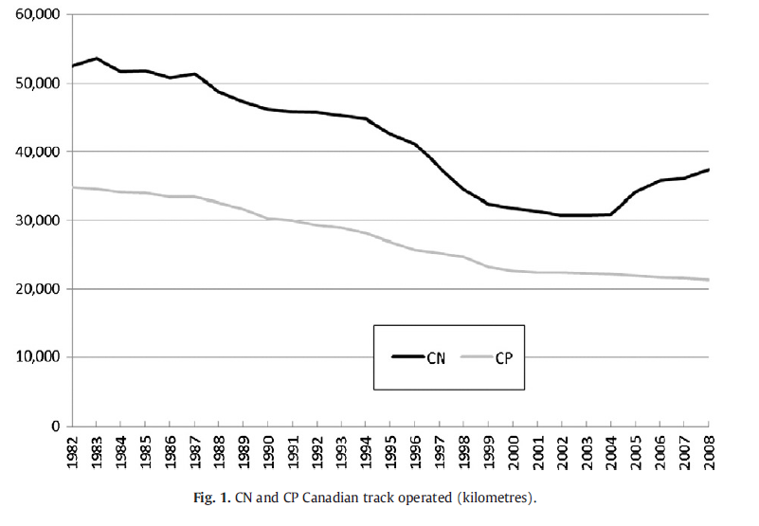
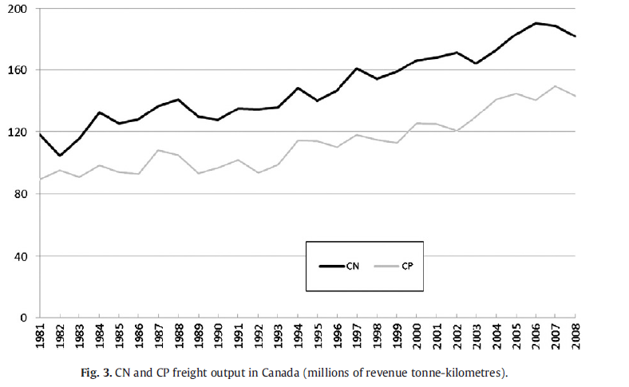
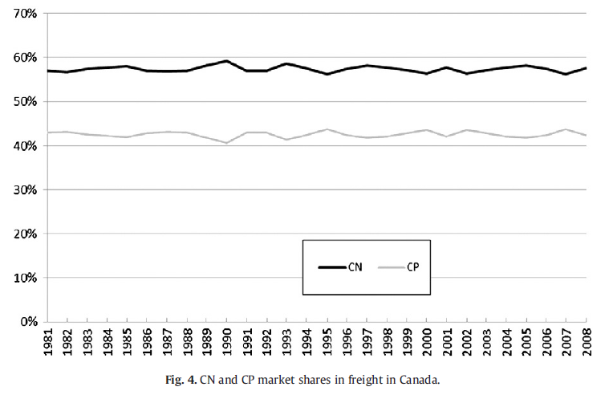
Canada: Output

Slide 15
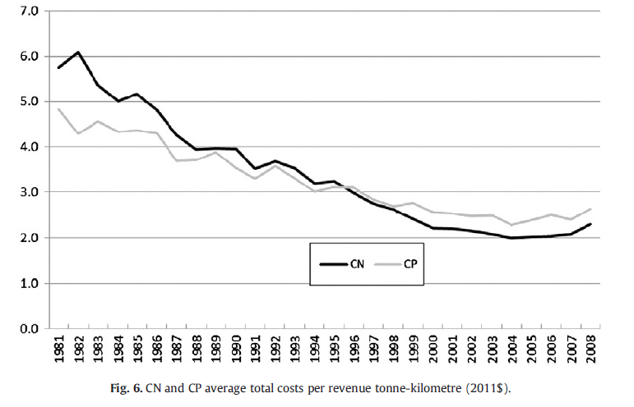
Canada: Employment and costs
Boardman, A. E., Laurin, C., Moore, M. A., & Vining, A. R. (2013). Efficiency, profitability and welfare gains from the Canadian National Railway privatization. Research in Transportation Business & Management, 6, 19-30.

Slide 16
Canada (2013): Ownership does matter?
The overall results demonstrate that CN performed substantially better following privatization, both from an operational perspective and from a broader social welfare perspective.
We find statistically significant increases over the long term (16 years following privatization) in sales, capital investment, assets, profit, profitability, productivity, dividends and corporate taxes paid.
There was little change in the capital structure of CN and a significant decrease in employment.
Using Canadian Pacific Railway as a basis for the counterfactual, we estimate that CN's privatization generated social welfare gains of approximately $25 billion in 2011 Canadian dollars.
The Canadian government received almost half of these gains, while CN's shareholders (most of whom were non-Canadian) captured the rest.
Boardman, A. E., Laurin, C., Moore, M. A., & Vining, A. R. (2013). Efficiency, profitability and welfare gains from the Canadian National Railway privatization. Research in Transportation Business & Management, 6, 19-30.

Slide 17
Discussion question
What are lessons from Canadian case study?

Slide 18
Summary (1)
Caves- Christensen (1980) we find no evidence of inferior performance by the government-owned railroad CN. They conclude that any tendency toward inefficiency resulting from public ownership has been overcome by the benefits of competition.
Boardmann et al. (2013): The overall results demonstrate that CN performed substantially better following privatization, both from an operational perspective and from a broader social welfare perspective.

Slide 19
Competition or Privatization?
Tomeš, Z. (2017). Do European reforms increase modal shares of railways?. Transport Policy, 60, 143-151.

Slide 20
Motivation
50% of road freight over 300 km should shift to rail and water and the majority of medium distance passenger transport should go by rail by 2050 (EC, 2011)
These goals underpinned by reform initiatives (vertical separation and especially competition entry)
However, there are many factors causing long term structural decline of railways (DiPietrantonio – Pelkmans, 2004) and net benefits of vertical separation are questioned by some scholars (Pittman 2003, van de Velde et al. 2012)
Do European reforms actually increase modal share of railways? Or could be privatization more effective?

Slide 21
Railway reforms in the EU
Vertical separation = a complete institutional separation of the infrastructure manager and the incumbent operator
Competition entry = actual entry of the non-incumbent operators on the freight and passenger rail market
Horizontal separation = institutional separation between passenger and freight operations of the incumbent
Freight privatization = privatization of freight operator

Slide 22
Reform options
(Gómez-Ibánez, 2006)

Slide 23
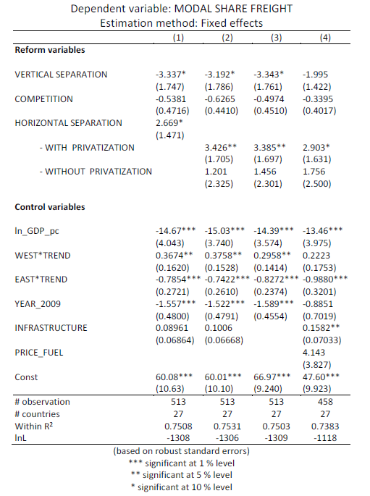
Results

Slide 24
Conclusion
There is no evidence that principal European reforms (vertical separation and competition entry) are increasing modal shares of European railways.
The more promising reform strategy seems to be horizontal separation, especially when followed by freight privatization.
There are significant differences in the long term development of railway’s modal shares between Western and Eastern Europe.

Slide 25
Competition or Privatization?
Local public transport

Slide 26
Local public transport
Boitani – Nicolini - Scarpa (2010) investigated whether competition and ownership matter in local public transport in Europe. This paper investigates how the ownership and the procedure for the selection of firm operating in the local public transport sector affect their productivity.

Slide 27
Methodology
In order to compare different institutional regimes, they carried out a comparative analysis of 72 companies operating in large European cities.
This allows them to consider firms selected either through competitive tendering or negotiated procedures.
They also control for ownership form

Slide 28
Exercise
Their results are in the table. You task is to identify whether competition or ownership has higher impact on their productivity. Based on their results, what are other important determinants of productivity?

Slide 29
Results

Slide 30
Summary
In local public transport, firms selected through competition for the market present higher levels of productivity. Also ownership matters: public firms are generally less productive than private firms, and so are mixed firms.

