Slide 1
10. SUBSIDY

Slide 2
Motivation
Close connection between pricing and subsidies
When the prices are not right – there is often a need for subsidy
Why so often the prices in transport are not right?
Two case studies

Slide 3
Modal shift from cars to HS rail
The aim of this study is to analyse whether the HSR expansion in Italy has led to a modal shift from motorway to HSR.
We empirically test
whether HSR openings adjacent to motorway sectors have reduced the total km travelled by light vehicles on these sectors during the period 2001–2017; and
whether this reduction has been persistent or even more evident after the opening of on-track competition between two HSR operators.
Borsati, M., & Albalate, D. (2020). On the modal shift from motorway to high-speed rail: evidence from Italy. Transportation Research Part A: Policy and Practice, 137, 145-164.

Slide 4
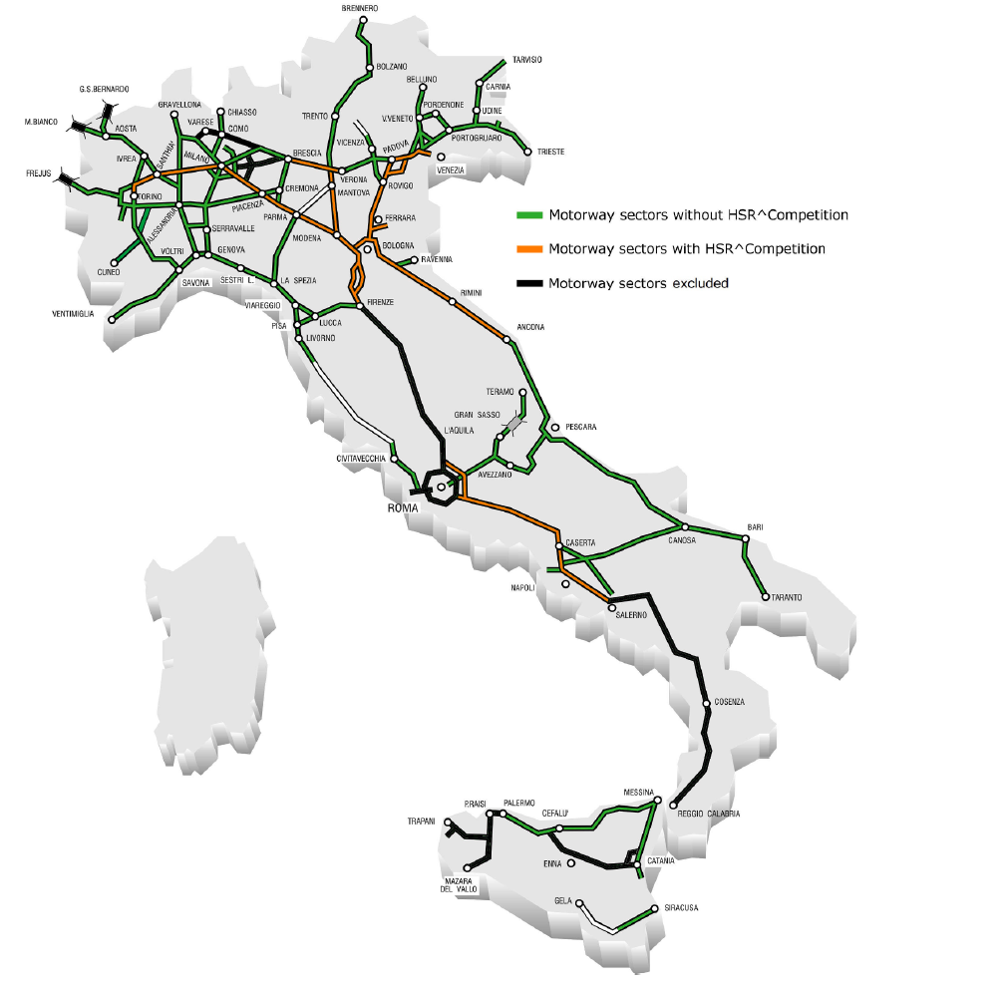
Geography

Slide 5
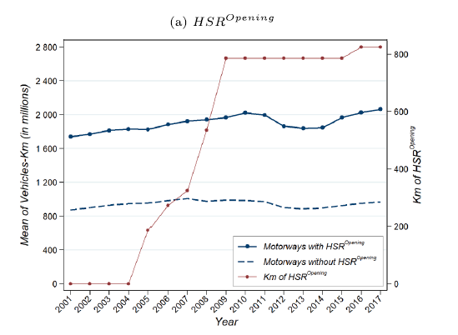
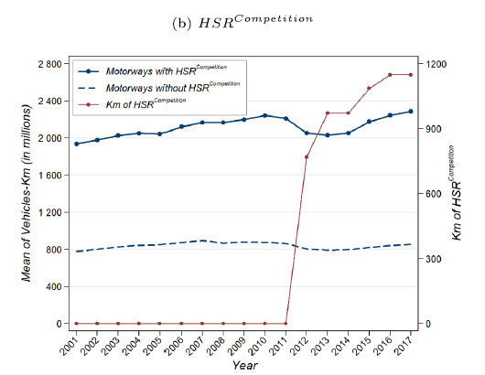
Evidence

Slide 6
Conclusions
Our findings reveal that neither HSR openings nor the opening of on-track competition led to a modal shift from motorway to HSR services, as the two transport modes are non-competing.
Conversely, HSR expansion had a slightly positive impact on motorway traffic. The extent to which HSR demand could be the result of a modal shift from motorways is a relevant issue in any cost-benefit analysis of HSR investments

Slide 7
Should we ban short distance flights?
Several countries have considered banning or even decided to ban or tax super short-haul flights, arguing that the availability of rail alternatives makes them unnecessary.
Such policies result from the need for governments to be seen as acting to mitigate climate change and scholars favouring energy (climate) efficiency perspectives
Dobruszkes, F., Mattioli, G., & Mathieu, L. (2022). Banning super short-haul flights: Environmental evidence or political turbulence?. Journal of Transport Geography, 104, 103457.

Slide 8
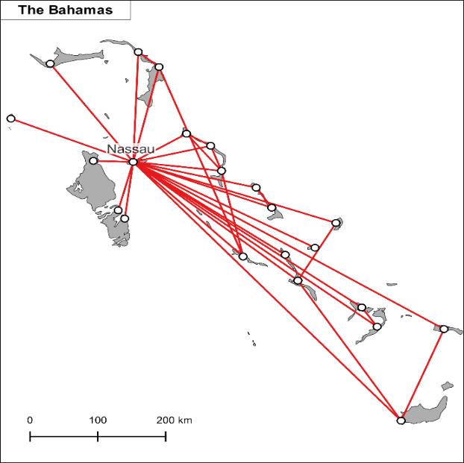
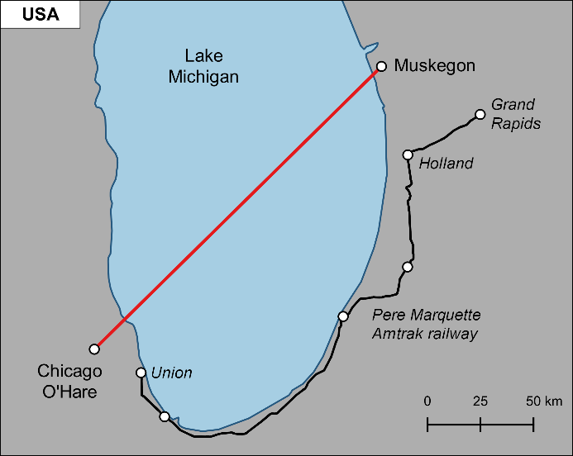
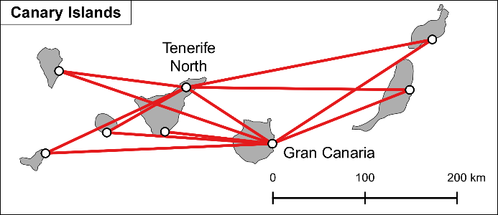
Examples of short haul flights

Slide 9
Cumulative distribution of passenger air services and fuel burnt from Europe

Slide 10
Fuel burnt by the shortest and longest flights at the country level

Slide 11
Conclusions
Our results lead to a conclusion: in nearly all the 31 European countries under investigation, banning super short-haul flights will help very little in mitigating aviation’s contribution to climate change.
While these measures might make a difference in some countries such as Norway, this would likely be to the detriment of remote, small communities, for which limited transport alternatives are available.
In other words, if the goal is to reduce the climate footprint of aviation, it is longer, not shorter flights that ought to be the primary target for action.

Slide 12
Conclusion
The current debate also tends to overlook that shifting passengers from super-short haul flights to trains may also induce unexpected effects in two ways.
First, freeing slots at constrained airports (namely, airports in which no more slots are available at relevant hours) by banning shorter flights could mean they would be replaced by longer flights, which would generate more GHG emissions.
Second, the lack of super short-haul flights may induce passengers to consider car travel instead of railways, and car travel can result in as much emissions as air travel

Slide 13
SUBSIDY

Slide 14
Introduction
Subsidy plays a vital role in the operation of transport markets
The transport markets are made up of a combination of market forces and the actions of transport planning authorities
Subsidies are playing the pivotal role in reconciling these two forces in the actual market place

Slide 15
Discussion questions
Discuss the following simple statements, which should help to build on and develop some of the issues discussed in this chapter:
Low subsidy is “good” and high subsidy is “bad”
Transport should only be subsidized on the basis of what can be afforded by the relevant authorities
Public transport is a public good, therefore should be subsidized
Road networks, because they are provided and maintained by the state, are therefore provided free of charge

Slide 16
Subsidy or payment for public service?
The payment of subsidy is closely related to aspects of regulation
With the more private sector involment, many argue that there is no longer a subsidy but rather a payment for the performance of a contract for providing a service
The issue is further complicated by the fact, that paying transport subsidies has also a very strong political dimension

Slide 17
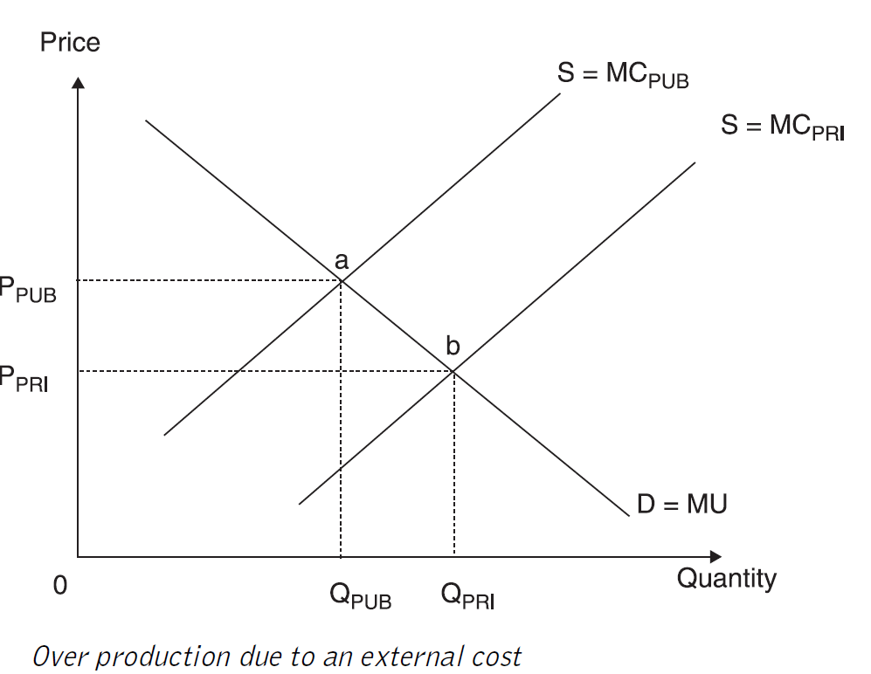
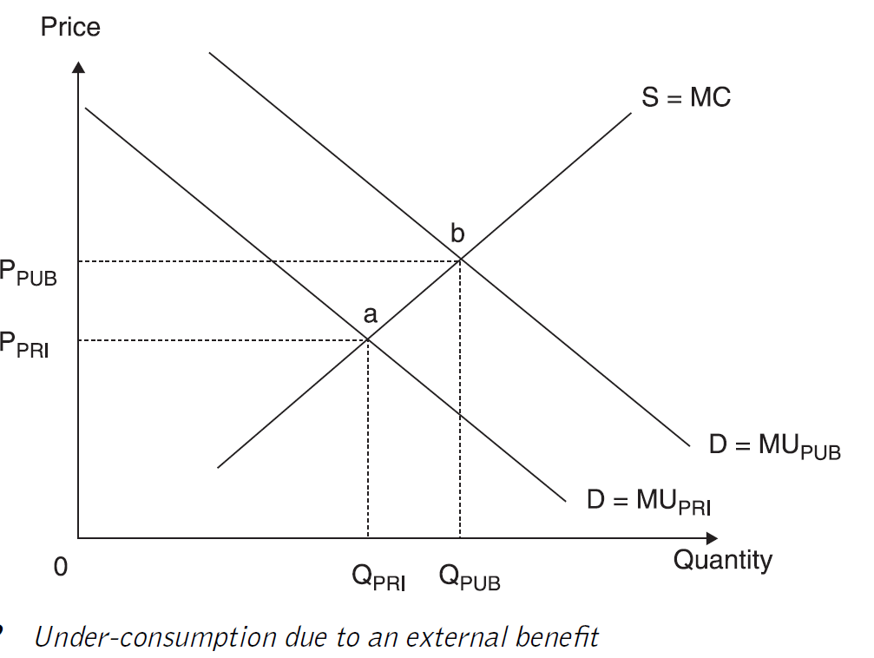
Externalities

Slide 18
The economic rationale for subsidisation
In support of land use efficient modes of transport
To lessen the impact of enviromentally unfriendly modes of transport
To support economic development or regeneration of an area
To support socially necessary services

Slide 19
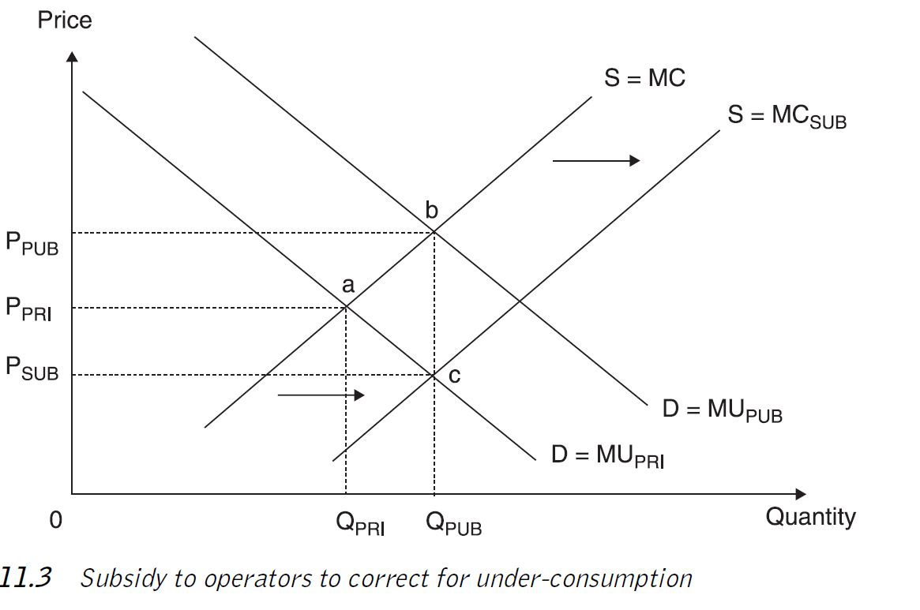
Subsidy to operators to correct for under-consumption (supply side measure)

Slide 20
Demand side measures
Far more straightforward
Used to correct for a demand side market failure
Specific groups and individuals are targeted to receive the subsidy
In effect the individual is given a concession (a reduced fare) to use a service

Slide 21
Free fares
Free fares and fare discounts are frequently used tools. They are utilized to stimulate public transport ridership, and promote transport equity and justice.
Policymakers are trying to limit car usage growth and promote public transport to battle congestion and decrease environmental damage.
The aim of fare reduction policies is to make transport cheaper, improve its affordability, and stimulate ridership. The crucial issue is the price elasticity of demand.
However, research suggested that price is not the only factor and is not the most important in determining transport ridership (service quality, time, route, and status)
Particularly problematic has been switching car user

Slide 22
Case studies
Some evidence may be derived from free-fare transport experiments.
The classic example is Studenmund – Connor (1982), who described the result of a free-fare experiment in the US, where in Trenton, New Jersey, off-peak bus fares were eliminated. The authors claimed that net ridership went up by 15% (off-peak ridership by 45%).
Widely analysed were the results of a free-fare experiment in Tallinn. Cats et al. (2017) stated that, after a year, ridership went up by 14%. The mobility of low-income residents also improved.

Slide 23
Political economy
Scheiner – Starling (1974) analysed the political economy of free-fare transport. They argued that four issues are critical:
demand elasticity and its responsiveness to the introduction of free fares
the costs of such policies and their financing
identification and evaluation of the benefits
political feasibility of the policy.

Slide 24
Assesment
Fearnley (2013) analysed the impact of free-fare policies on modal shares and other policy goals (economic, political, and environmental)
He argued that although these policies seem to be attractive, their rate of goal achievement is poor and comes at high costs
The effects on car ridership are marginal and typically offset by a few years of growth.
Successful free-fare traffic schemes are those that concentrate only on public transport ridership growth.
Other goals are best achieved with targeted measures.

Slide 25
Free Fare in Central Europe
Slovakia has introduced 100% fare discounts for children, students, and pensioners for railways from November 2014. The Czech Republic has introduced 75% discounts for children, students, and pensioners for both trains and buses from September 2018.
The policies significantly increased ridership and the modal share of railways went up significantly. The mobility of the targeted groups was significantly affected and the share of young and elderly riders increased.
However, the policies were costly and also had some undesirable side effects that could have been prevented by better policy design.
Tomeš, Z., Fitzová, H., Pařil, ….. (2022). Fare discounts and free fares in long-distance public transport in central Europe. Case Studies on Transport Policy, 10(1), 507-517.

Slide 26
Free fare – Rail Slovakia
The intention of free fare policy was:
To increase the modal share of rail
To improve social inclusiion
Coverage: Free fare in PSO rail services for children, students and pensioners.
No discounts for buses!
Čarek (2017): Learning the lesson of free rail travel. Railway Gazette International.

Slide 27
Results
Increased ridership
Higher vehicle occupancy
Occasional overcrowding
Rise in the government subsidies
Shift of demand from buses to trains

Slide 28
Policy pitfalls
How to maintain service quality? (for paying customers)
Cumbersome registration
Introduction of compulsory seat reservations
Student parties and homeless people in trains
Modal shift from buses to trains
Little effect on car ridership
Hurting commercial rail services and competition
Čarek (2017): Learning the lesson of free rail travel. Railway Gazette International.

Slide 29
Assesment
Significant market distortions and unintended consequences
The scope was too broad (possible restriction in students travel)
Once introduced – hard to cancel (political risk)
The rise in supply – better even for paying customers
Čarek (2017): Learning the lesson of free rail travel. Railway Gazette International.

Slide 30
Czech Republic – Better design?
The design of the policy was more sophisticated in the Czech Republic, where it was undoubtedly inspired by the shortcomings of the Slovak policy. The exclusion of buses in Slovakia was a significant omission.
The crucial decision in the Czech policy design was to keep some monetary costs present
However, both designs did little to differentiate between peak and off-peak travel and have no bonuses/stimulation for travel from or to disadvantaged regions
Tomeš, Z., Fitzová, H., Pařil, ….. (2022). Fare discounts and free fares in long-distance public transport in central Europe. Case Studies on Transport Policy, 10(1), 507-517.

Slide 31
Drawbacks of paying subsidy
It is always a second best solution
Can lead to inefficient operation
The winners curse syndrom
Subsidise a service that doesn't actually need a subsidy

Slide 32
Cross-subsidization
Cross-subsidization occurs where the profits of one route or service are used to pay for the losses on another route or service.
It has often been used in the past to reduce the level of total subsidy
Drawbacks:
Hides true costs of providing a particular service
Users of profitable routes are penalized
There are better instruments to ensure provision of services

Slide 33
Methods of paying subsidy
Deficit subsidy
Net cost contract
Full cost contract
Design, Built, Operate and Maintain (DBOM)

Slide 34
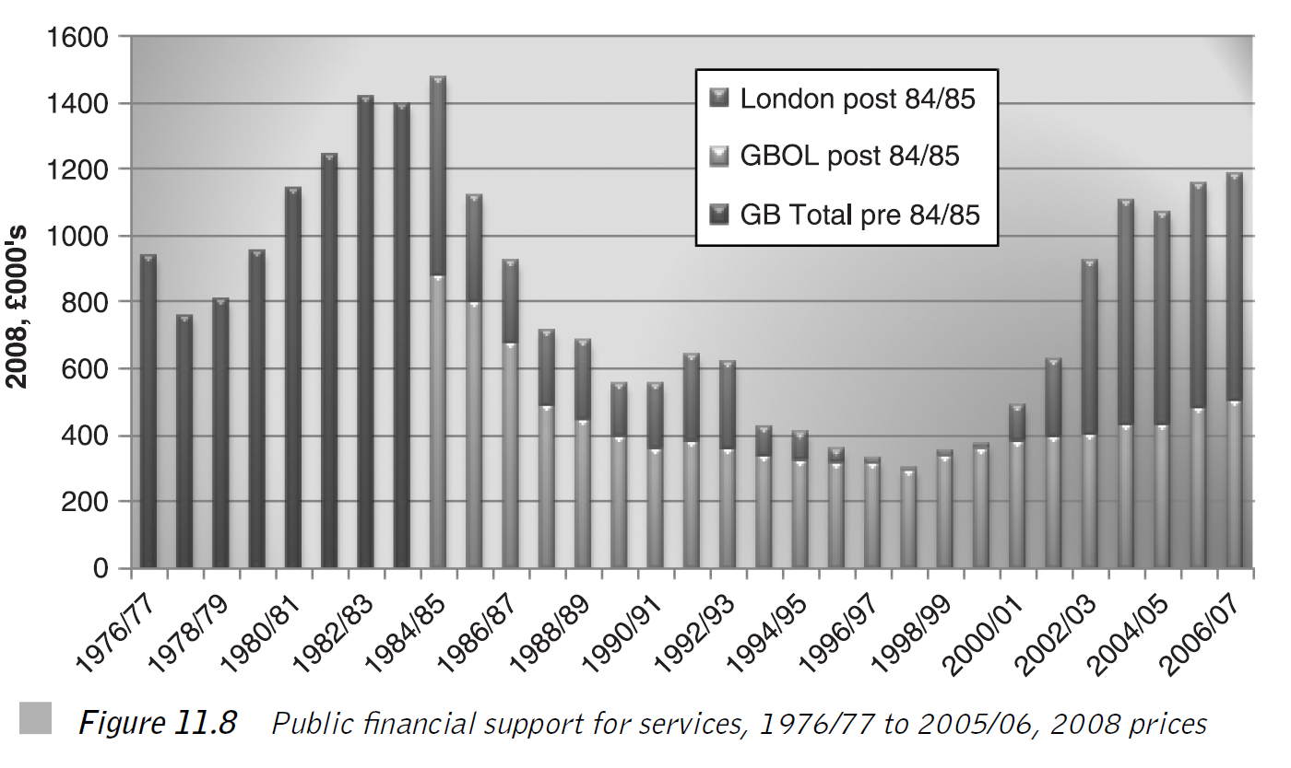
Success in the pamynet of subsidy – British buses

Slide 35
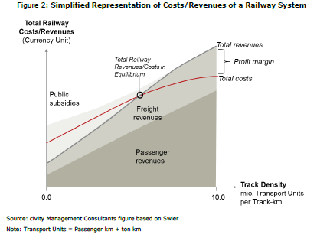
Economies of density and subsidy for railways
OECD

Slide 36
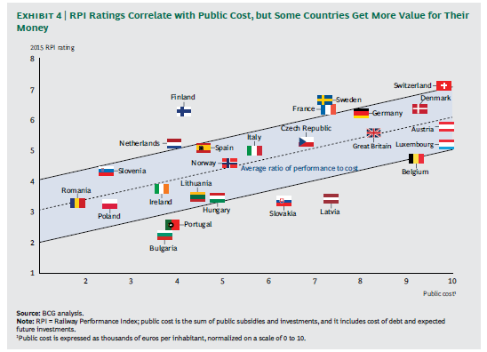
Value for public money - railways
BCG (2015)

Slide 37
Rail subsidisation in the European Union
Crossmann – Mause (2014) analysed determinants of railways subsidies in the member countries of the EU.
The principal result is that right-wing parties tend to subsidize railways more than left-wing parties. How would you explain such a surprising result?

Slide 38
Exercise
The price elasticity of transit demand has been estimated in the range of –0.2 to –0.4. Suppose that the transit authority seeks to increase demand through a 10% reduction in fares. What impact will this have on transit demand, and what impact do you think it would have on the operating subsidies?

Slide 39
Exercise: Options in payment of subsidy
A transport authority seeks to produce a modal shift from the car to public transport services in order to encourage local economic development and reduce traffic congestion.
Outline in a variety of diagrams the main options that are open to the authority to achieve this aim and come to a conclusion as to which you believe to be the `best’ approach or combinations of approaches that should be used.
Where subsidy features in your solutions, you should outline the main drawbacks that stand in the way of a successful outcome and what measures you propose to take to minimise the impact of these drawbacks.

Slide 40
Exercise: Which type of contract to use
As the recently appointed leader of your local transport authority, you are given a blank sheet of paper with which to re-organise urban public transport services in your local area.
Assume that the national legislation allows for any of the models of delivery outlined to be used, but nationalisation is out of question.
Consider for each of the following scenarios which `model’ of ownership and contract would be most suitable for the particular situation:

Slide 41
Exercise: Which type of contract to use
A pro public transport council that has a strong policy stance on encouraging more people to use public transport.
A council that is facing possible budget cuts in the medium to longer term and seeks to reduce its budget for public transport services.
A council that is expecting strong economic growth in the medium and long runs and is concerned that the current public transport provision, which is mainly bus based, will limit this economic growth.

Slide 42
Exercise: Which type of contract to use
Where public transport services have been run directly by the local authority department, however, the last ten years have seen a significant decline in patronage and low investment levels.
Public transport services are currently run by private sector companies; however, the overall perception is of poor quality services that have seen significant passenger declines in the last ten years.
A publicly owned and run urban rail metro that is badly in need of refurbishment; however, budget constraints means that the local authority do not have the funds available to undertake the investment required.

