Slide 1
Country and Political Risks
Oleg Deev
Department of Finance

Slide 2
Country Risk
the risk of investing or lending in a country, arising from possible changes in the business environment that may adversely affect operating profits or the value of assets in the country
the risk of economic agents (including government) in a particular country will not fulfill their international financial obligations
the risk that a foreign government will default on its bonds or other financial commitments
the uncertainty associated with investing in a particular country, and more specifically the degree to which that uncertainty could lead to losses for investors

Slide 3
Financial and Economic Risk Factors
Ratio of a country’s external debt to its GDP
Ratio of a country’s debt service payments to its exports
Ratio of a country’s imports to its official international reserves
A country’s terms of trade (export/import prices)
A country’s current account deficit

Slide 4
Political Risk Factors
Expropriation/nationalization – worst-case scenario
Contract repudiation (revoking) without compensation
  Default on payments, cancelation of licenses
Taxes and regulation (i.e., hiring/firing, environmental standards, repatriation of funds)
Exchange controls (e.g., Argentina in 2002)
Corruption and legal inefficiency
  Transparency International Corruption Perceptions Index (for more than 150 countries)
Ethnic violence, political unrest, and terrorism
Home-country restriction

Slide 5
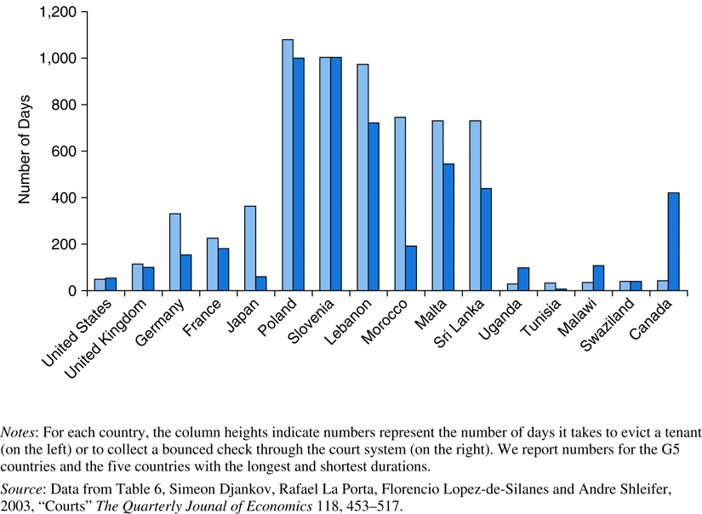
Legal System Quality

Slide 6
The Debt Crisis Origins
(late 70s, early 80s)
Origins of the debt crisis – oil prices went from $2.50 to $60.00 per barrel (in 2000 dollars)!
OPEC extra income was deposited with international banks, which in turn loaned “petrodollars” to non-OPEC developing countries at floating interest rates
Oil shock of late 1970s led to the change of macroeconomic situation in developed countries: high real interest rates, dollar appreciation
Mexico announced in 1982 they could not repay their foreign debt; by the end of the year 24 other countries followed suit

Slide 7
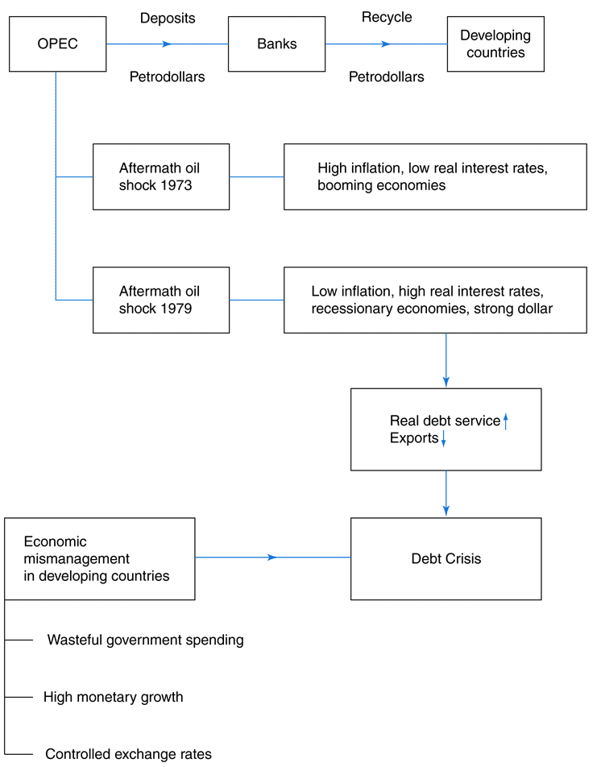
The Debt Crisis Origins
(late 70s, early 80s)

Slide 8
The Debt Crisis Resolution
(late 70s, early 80s)
First treated as a liquidity problem (IMF recommendations)
Managing the debt crisis - The Baker plan (1985)
  Implemented when IMF debt restructurings didn’t work
  Included new loans by banks/World Bank in exchange for agreeing to follow economic advice
“Debt overhang” – the country with a huge debt burden has little incentive to implement economic reforms or stimulate investment because the resulting increase in income will simply be appropriated by the country’s creditors
Debt and debt service-reducing operations
  Debt buyback (at a discount)
  Debt-equity swap – MNC buys discounted debt to invest in country. This helps country and is a cheaper way for companies to invest in developing nations

Slide 9
The Debt Crisis Resolution
(late 70s, early 80s)
The Brady Plan (1989), Options available to the banks:
  Buybacks: the debtor country was allowed to repurchase part of its debt at an agreed discount
  Discount bond exchange: the loans could be exchanged for bonds at an agreed discount, with the bonds yielding a market rate of interest
  Par bond exchange: the loans could be exchanged at their face value for bonds yielding a lower interest rate than the one on the original loans
  Conversion bonds combined with new money: loans could be exchanged for bonds at par that yield a market rate; banks had to provide new money in a fixed proportion of the amount converted
Official credit enhancements in the form of collateral provisions

Slide 10
Brady Bonds
Valued like other fixed-income securities but have special features
Principal collateral: all par and discount bonds are collateralized by U.S. Treasury zero-coupon securities
Interest collateral: the government issuing Brady bonds deposits money w/ NY Federal Reserve Bank in amounts covering 12 – 18 months of interest payments
Sovereign portion: The remaining cash flows are subject to sovereign risk

Slide 11
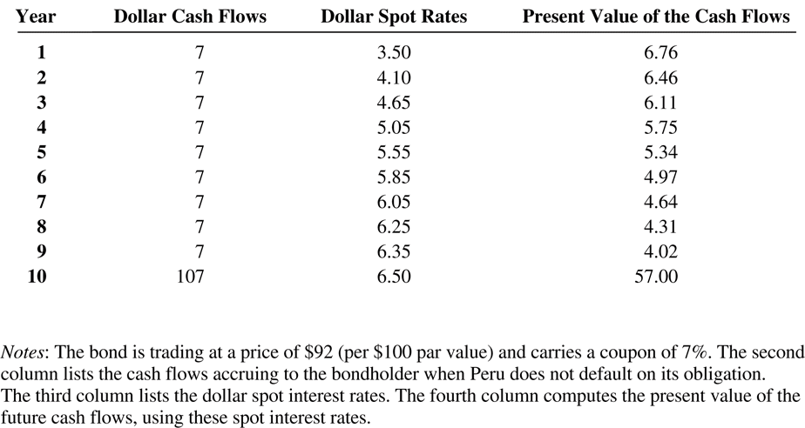
Analyzing a Brady Bond

Slide 12
Country Risk Analysis
The PRS Group’s ICRG Rating System
  Financial and economic risk factors – assessing a country’s ability to repay foreign debt; objective inputs
  The political risk components – stability based on government; subjective inputs
  Overall ratings
    1-49: Very risky
    50-59.9 High risk
    60-69.9 Moderate risk
    70-79.9 Low Risk
    80-100 Very low Risk

Slide 13
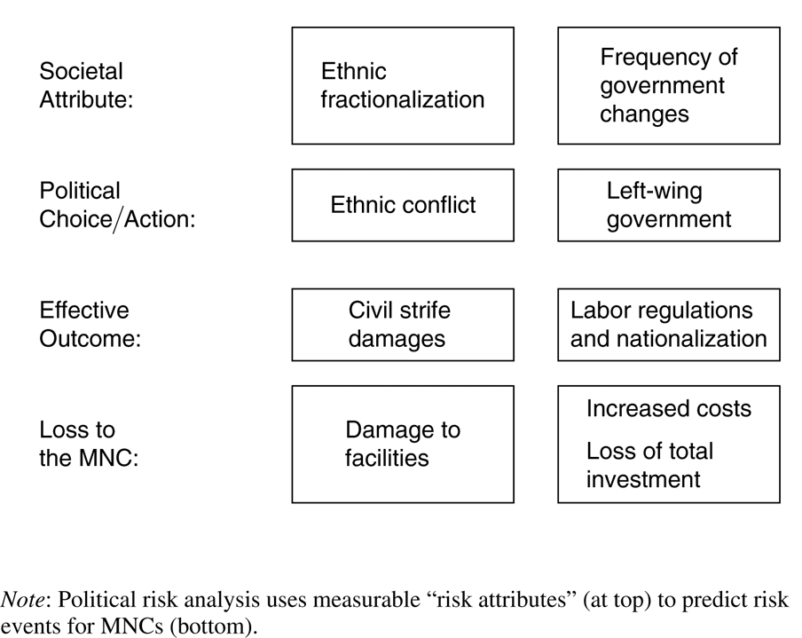
Political Risk Analysis

Slide 14
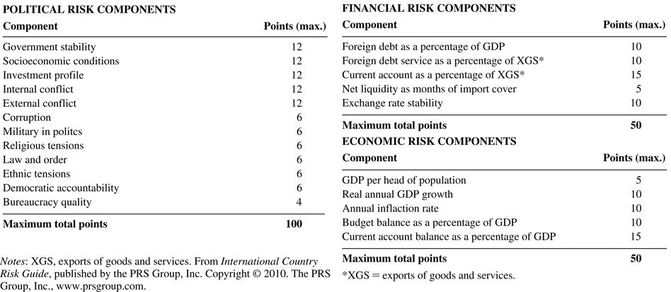
ICRG Risk Components

Slide 15
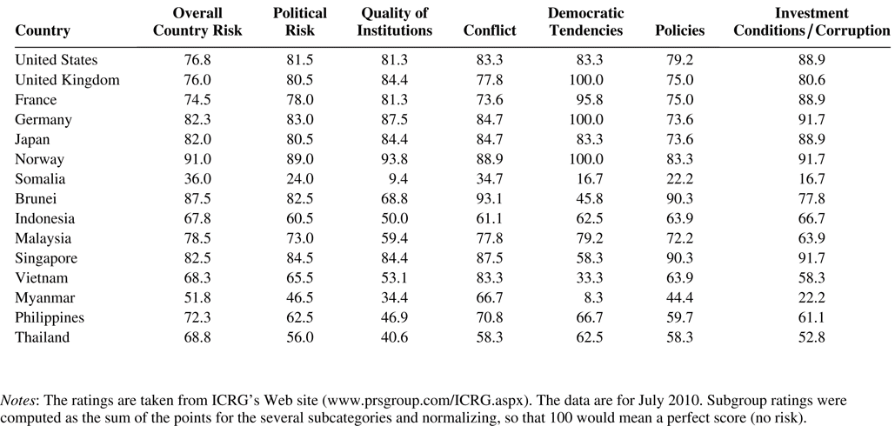
Political Risk Ratings

Slide 16
Country Credit Spreads
Institutional Investor’s Annual Rating
Sovereign credit ratings – Moody’s, S&P, Fitch
Why is sovereign credit risk different?
Can’t take a country to bankruptcy court
Still, there are consequences
  Assets may be seized
  Country won’t be able to borrow so easily going forward
  International trade could be impacted
  Default could make economic crises worse

Slide 17
Country and Political Risk Analysis (1)
Country spreads and political risk probabilities
An indication of default risk of a sovereign bond
Moody’s reported in 2008 an historical recovery rate of 35%
Default probabilities with positive recovery values
where Stripped Price is the dollar price of the bond after subtracting the value of the collateral, CF(j) is the promised dollar cash flow, i(j) is the USD interest rate for period j and p is the default probability

Slide 18
Country and Political Risk Analysis (2)
In order to adjust capital flows (preferred to adjusting discount rate) one must compute the political risk probabilities
Information
  Country spreads
    Don’t just add to discount rate
    Uncover default probabilities
  Political risk ratings
    No evidence of predictive ability
    Could be lagging (and not leading)
  Political risk insurance premiums (if available)

Slide 19
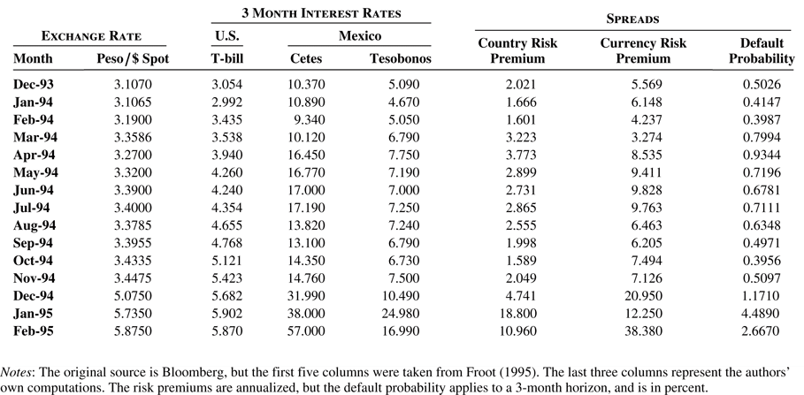
Country and Currency Premiums Around the Mexican Currency Crisis

Slide 20
Managing Political Risk (1)
What MNCs need to keep in mind when structuring an investment
  Focus on the short term
  Rely on unique supplies or technology (making government takeover more difficult)
  Use local resources
  Bargain with the government
  Hire protection (i.e., bodyguards, or even military companies)

Slide 21
Managing Political Risk (2)
Insurance
Coverage
  Currency inconvertibility and non-transferability
  Expropriation
  War and political violence Political risk insurance for U.S. Companies
  Overseas private investment corporation (OPIC)
Political risk insurance in emerging and transitioning economy
  Multilateral investment guarantee agency (MIGA)
Public versus private insurance
  Private - more important as time goes on
  Public – may deter rogue nations

Slide 22
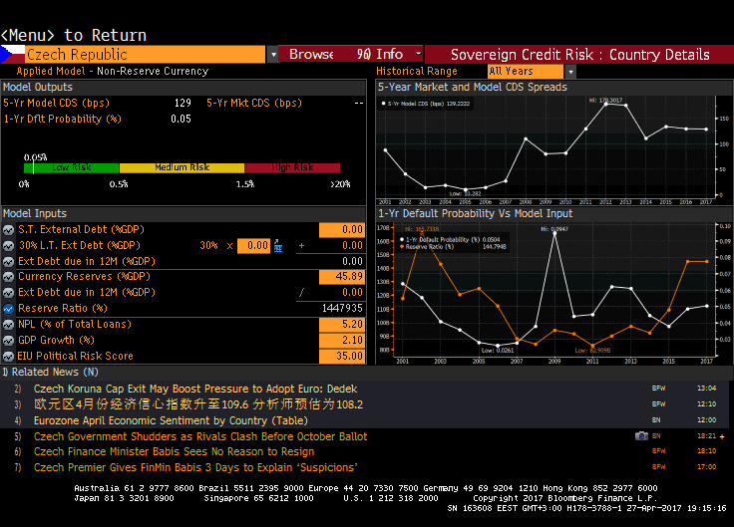
Country Risk Analysis in Bloomberg
SRSK
DDIS

